Slide 1
Distributed GLM Implementation
on H2O platform
Tomas Nykodym, 0xDATA

Slide 2
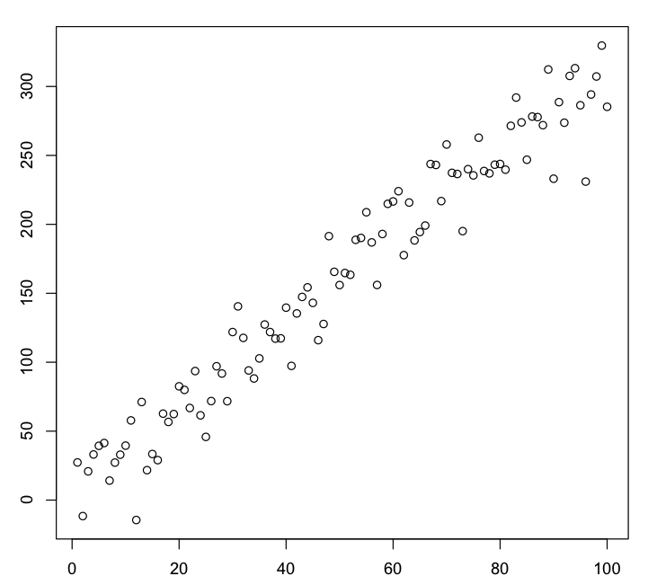
Linear Regression
Data:
x, y + noise
Goal:
predict y using x
i.e. find a,b s.t.
y = a*x + b

Slide 3
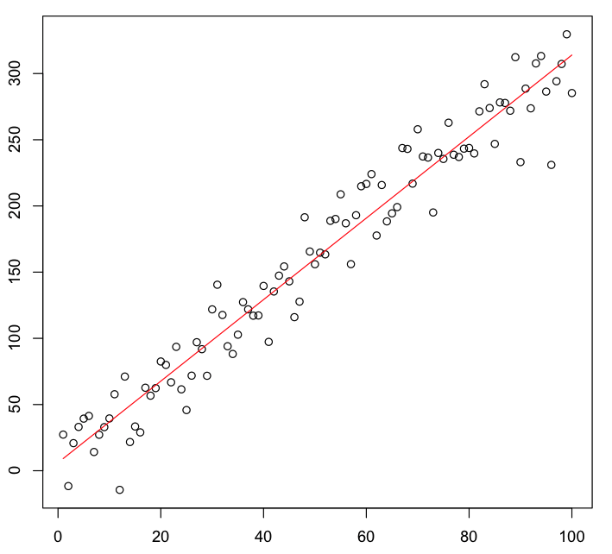
Linear Regression
Least Squares Fit
Real Relation:
y=3x+10+N(0,20)
Best Fit:
y = 3.08*x + 6

Slide 4
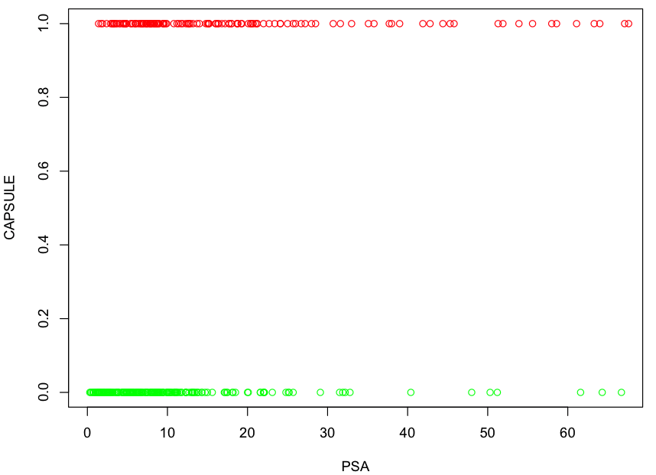
Prostate Cancer Example
Data:
x = PSA
(prostate-specific antigen)
y = CAPSULE
  0 = no tumour
  1 = tumour
Goal:
predict y using x

Slide 5
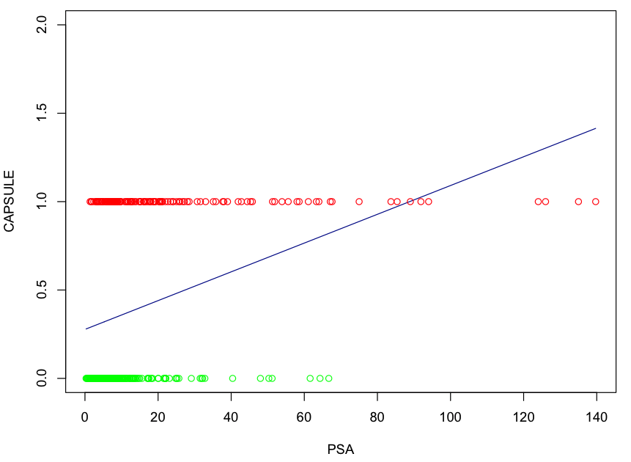
Prostate Cancer Example
Linear Regression Fit
Data:
x = PSA
(prostate-specific antigen)
y = CAPSULE
  0 = no tumour
  1 = tumour
Fit:
Least squares fit

Slide 6
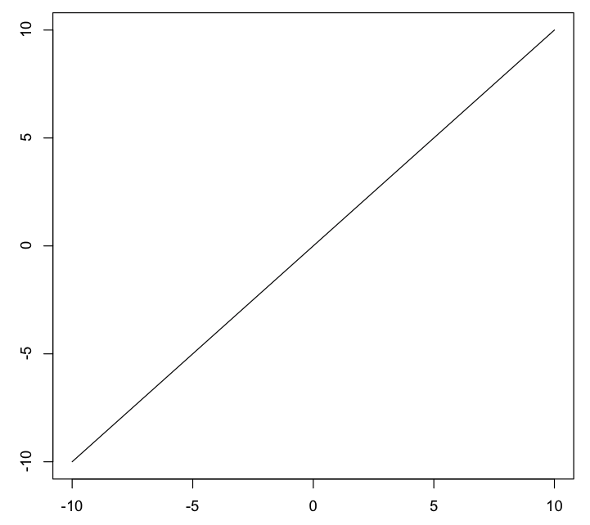
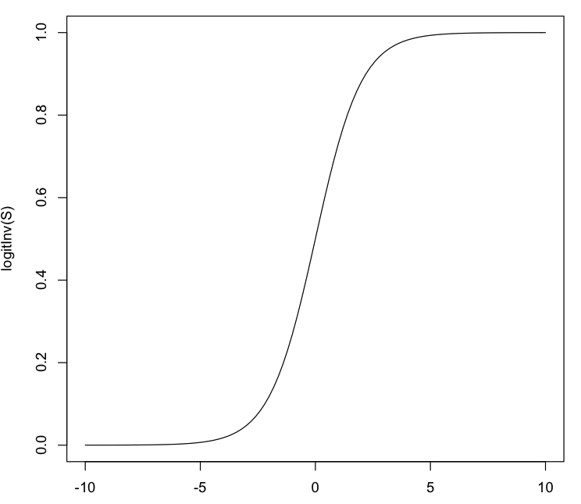
Generalized Linear Model
Generalizes linear regression by:
  adding a link function g to transform the output
    z = g(y) – new response variable
  noise (i.e.variance) does not have to be constant
  fit is maximal likelihood instead of least squares

Slide 7
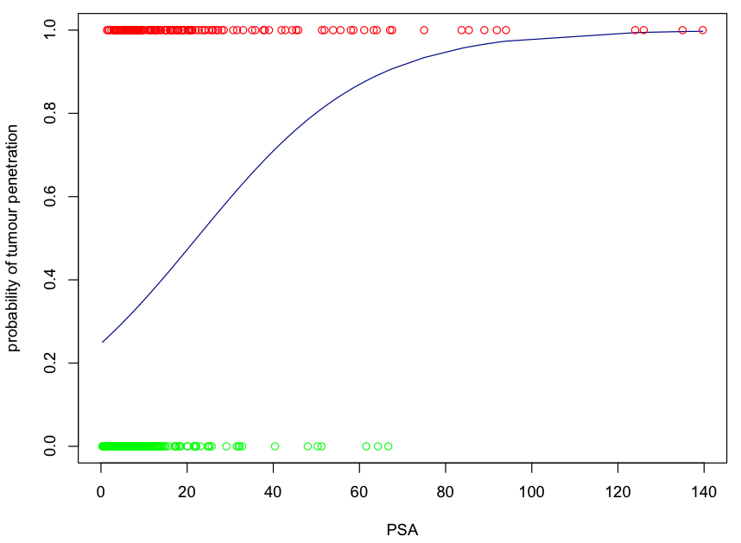
Prostate Cancer
Logistic Regression Fit
Data:
x = PSA
(prostate-specific antigen)
y = CAPSULE
0 = no tumour
1 = tumour
GLM Fit:
  Binomial family
  Logit link
  Predict probability of CAPSULE=1.

Slide 8
Implementation - Solve GLM by IRLSM
Input:
  X: data matrix N*P
  Y: response vector (N rows)
  family, link function, α,β
Output:
  β vector of coefficients, solution to max-likellihood
OUTER LOOP:
While β changes, compute:
INNER LOOP:
Solve elastic net:
ADMM(Boyd 2010, page 43):

Slide 9
H2O Implementation
Outer Loop:
(Map Reduce Task)
public class SimpleGLM extends MRTask {
@Override public void map(Chunk c) {
res = new double [p][p];
for(double [] x:c.rows()){
double eta,mu,var;
eta = computeEta(x);
mu = _link.linkInv(eta);
var = Math.max(1e-5,_family.variance(mu)); double dp = _link.linkInvDeriv(eta);
double w = dp*dp/var;
for(int i = 0; i < x.length; ++i)
for(int j = 0; j < x.length; ++j)
res[i][j] += x[i]*x[j]*w;
}
}
@Override public void reduce(SimpleGLM g) {
for(int i = 0; i < res.length; ++i)
for(int j = 0; i < res.length; ++i)
res[i][j] += g.res[i][j];
}
}
Inner Loop:
(ADMM solver)
public double [] solve(Matrix xx, Matrix xy) {
// ADMM LSM Solve
CholeskyDecomposition lu; // cache decomp!
lu = new CholeskyDecomposition(xx);
for( int i = 0; i < 1000; ++i ) {
// Solve using cached Cholesky decomposition!
xm = lu.solve(xyPrime);
// compute u and z update
for( int j = 0; j < N-1; ++j ) {
double x_hat = xm.get(j, 0);
x_norm += x_hat * x_hat;
double zold = z[j];
z[j] = shrinkage(x_hat + u[j], kappa);
u[j] += x_hat - z[j];
u_norm += u[j] * u[j];
}
}
}
double shrinkage(double x, double k) {
return Math.max(0,x-k)-Math.max(0,-x-k);
}

Slide 10
Regularization
Elastic Net (Zhou, Hastie, 2005):
Added L1 and L2 penalty to β to:
  avoid overfitting, reduce variance
  obtain sparse solution (L1 penalty)
  avoid problems with correlated covariates
No longer analytical solution.
Options: LARS, ADMM, Generalized Gradient, ...

Slide 11
Linear Regression
Least Squares Method
Find β by minimizing the sum of squared errors:
Analytical solution:
Easily parallelized if X^{T}X is reasonably small.

Slide 12
Generalized Linear Model
Generalizes linear regression by:
  adding a link function g to transform the response
    z = g(y) – new response variable
    η = Xβ – linear predictor
  μ = g⁻¹(η)
  y has a distribution in the exponential family
  variance depends on μ
    e.g var(μ) = μ*(1-μ) for Binomial family.
  fit by maximizing the likelihood of the model

