Slide 1
H2O Design and Infrastructure
R Summit and Workshop, Copenhagen
27 Jun 2015
Matt Dowle

Slide 2
Overview
1. What exactly is H2O
2. How it works

Slide 3
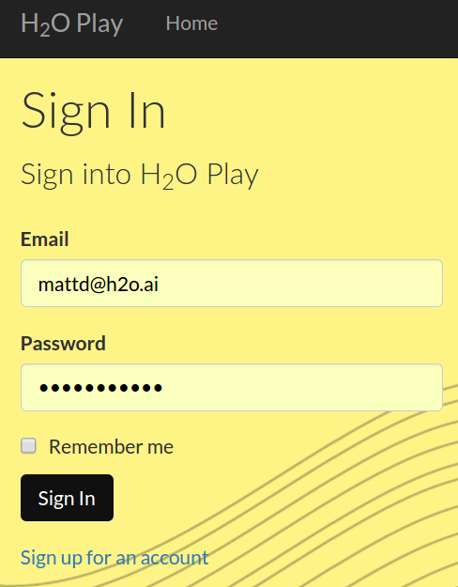
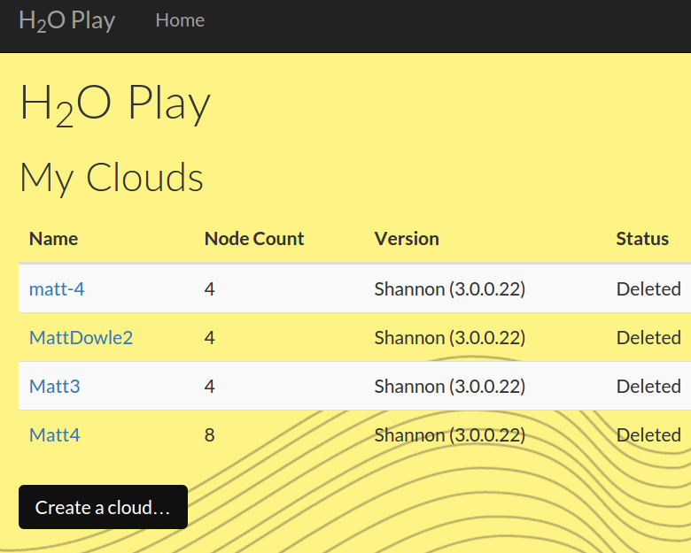
I'll start an 8 node cluster live on EC2 now
Click

Slide 4


4 mins to start up, 2 slides

Slide 5
H2O
Machine learning e.g. Deep Learning
In-memory, parallel and distributed
1. Data > 240GB needle-in-haystack; e.g. fraud
2. Data < 240GB compute intensive, parallel 100's cores
3. Data < 240GB where feature engineering > 240GB
Speed for i) production and ii) interaction
Developed in the open on GitHub
Liberal Apache license
Use from R, Python or H2O Flow … simultaneously
I now work here

Slide 6
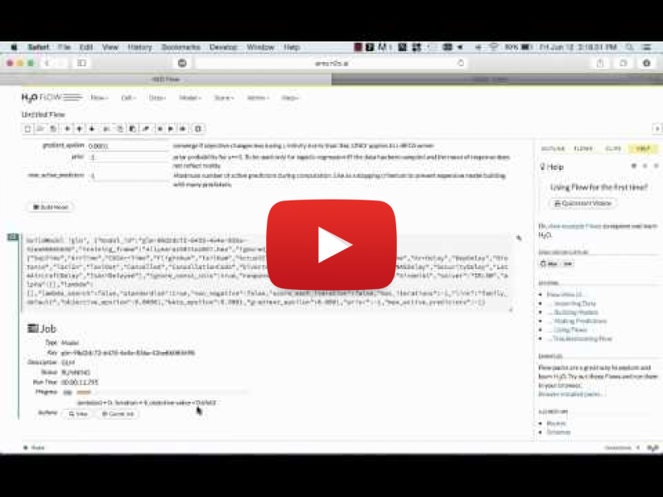
8-node cluster on EC2 is now ready
LIVE 15MIN DEMO

Slide 7
To use from R
# If java is not already installed :
$ sudo add-apt-repository -y ppa:webupd8team/java
$ sudo apt-get update
$ sudo apt-get -y install oracle-java8-installer
$ sudo apt-get -y install oracle-java8-set-default
$ java -version
$ R
> install.packages(“h2o”)
That's it.

Slide 8
Start H2O
> library(h2o)
> h2o.init()
H2O is not running yet, starting it now...
Successfully connected to http://127.0.0.1:54321
R is connected to H2O cluster:
H2O cluster uptime: 1 sec 397 ms
H2O cluster version: 2.8.4.4
H2O cluster total nodes: 1
H2O cluster total memory: 26.67 GB
H2O cluster total cores: 32

Slide 9
h2o.importFile
23GB .csv, 9 columns, 500e6 rows
> DF <- h2o.importFile("/dev/shm/test.csv")
user system elapsed
0.775 0.058 50.559
> head(DF)
id1 id2 id3 id4 id5 id6 v1 v2 v3
1 id076 id035 id0000003459 20 80 8969 4 3 43.1525
2 id062 id023 id0000002848 99 49 7520 5 2 86.9519
3 id001 id052 id0000007074 89 16 8183 1 3 19.6696

Slide 10
library(h2o)
h2o.importFile("/dev/shm/test.csv") # 50 seconds
library(data.table)
fread("/dev/shm/test.csv") # 5 minutes
library(readr)
read_csv(“/dev/shm/test.csv”) # 12 minutes
23GB .csv, 9 columns, 500e6 rows
Parallel
Single thread
Single thread

Slide 11
h2o.importFile also
compresses the data in RAM
profiles the data while reading; e.g. stores min and max per column, for later efficiency gains
included in 50 seconds
accepts a directory of multiple files

Slide 12
Standard R
hex <- h2o.importFile(conn, path)
summary(hex)
hex$Year <- as.factor(hex$Year)
myY <- "IsDepDelayed"
myX <- c("Origin", "Dest", "Year", "UniqueCarrier", "DayOfWeek", "Month", "Distance", "FlightNum")
dl <- h2o.deeplearning(y = myY, x = myX, training_frame = hex, hidden=c(20,20,20,20), epochs = 1, variable_importances = T)

Slide 13
How it works
Slides by Cliff Click
CTO and Co-Founder

Slide 14
Simple Data-Parallel Coding
Map/Reduce Per-Row: Stateless
  Example from Linear Regression, Σ y²
Auto-parallel, auto-distributed
Fortran speed, Java Ease
double sumY2 = new MRTask() {
double map( double d ) { return d*d; }
double reduce( double d1, double d2 ) {
return d1+d2;
}
}.doAll( data );

Slide 15
Simple Data-Parallel Coding
Map/Reduce Per-Row: Statefull
  Linear Regression Pass1: Σ x, Σ y, Σ y²
class LRPass1 extends MRTask {
double sumX, sumY, sumY2;// I can have State?
void map( double X, double Y ) {
sumX += X; sumY += Y; sumY2 += Y*Y;
}
void reduce( LRPass1 that ) {
sumX += that.sumX ;
sumY += that.sumY ;
sumY2 += that.sumY2;
}
}

Slide 16
Non-blocking distributed KV
Uniques
  Uses distributed hash set
Setting dnbhs in <init> makes it an input field.
Shared across all maps(). Often read-only.
This one is written, so needs a reduce.
class Uniques extends MRTask {
DNonBlockingHashSet<Long> dnbhs = new ...;
void map( long id ) { dnbhs.add(id); }
void reduce( Uniques that ) {
dnbhs.putAll(that.dnbhs);
}
};
long uniques = new Uniques().
doAll( vecVistors ).dnbhs.size();

Slide 17
Limitations
Code runs distributed...
  No I/O or Machine Resource allocation
  No new threads, no locks, no System.exit()
No global / static variables
  Instead they become node-local
  "Small" global read state: in constructor
  "Small" global writable state: use reduce()
  "Big" state: read/write distributed arrays (Vecs)
Runs one (big step) to completion, then another...

Slide 18
Strengths
Code runs distributed & parallel without effort
  Millions & billions of rows; 1000's of cores
Single-threaded coding style
  No concurrency issues
Excellent resource management
  "No knobs needed" for GC or CPUs or network
  No "data placement", no "hot blocks" or "hot locks"

Slide 19
How Does It Work?
(Code)

Slide 20
Distributed Fork / Join
T = new MRtask().doAll(data);
JVM
JVM
JVM
JVM
Task
JVM
JVM
JVM
JVM

Slide 21
Distributed Fork / Join
T = new MRtask().doAll(data);
  Log tree fan-out copy...
JVM
JVM
Task
JVM
JVM
Task
JVM
JVM
Task
JVM
JVM

Slide 22
Distributed Fork / Join
T = new MRtask().doAll(data);
  Log tree fan-out copy...
JVM
Task
JVM
Task
JVM
JVM
Task
Task
JVM
JVM
Task
Task
JVM
JVM
Task

Slide 23
Distributed Fork / Join
T = new MRtask().doAll(data);
  Log tree fan-out copy...
JVM
Task
JVM
Task
JVM
JVM
Task
Task
JVM
JVM
Task
Task
JVM
JVM
Task
Task

Slide 24
Distributed Fork / Join
Within a single node, classic Fork/Join
  Divide & Conquer
JVM
Task
data
data
data
data

Slide 25
Distributed Fork / Join
Within a single node, classic Fork/Join
  Divide & Conquer
JVM
Task
data
data
Task
data
data

Slide 26
Distributed Fork / Join
Within a single node, classic Fork/Join
  Divide & Conquer
JVM
Task
data
Task
data
Task
data
Task
data

Slide 27
Distributed Fork / Join
Within a single node, classic Fork/Join
  Divide & Conquer
JVM
Task
data
Task
data
Task
data
Task
data

Slide 28
Distributed Fork / Join
Within a single node, classic Fork/Join
  Divide & Conquer, parallel map over local data
JVM
map()
Task
data
Task.B
Task
data
Task.B
Task
data
Task.B
Task
data
Task.B

Slide 29
Distributed Fork / Join
Within a single node, classic Fork/Join
  Parallel, eager reduces
JVM
Task.B
reduce()
Task.B
Task.B
reduce()
Task.B

Slide 30
Distributed Fork / Join
Within a single node, classic Fork/Join
  Log-tree reduce
JVM
Task.B
reduce()
Task.B

Slide 31
Distributed Fork / Join
Within a single node, classic Fork/Join
  Reduce to the same top-level instance
JVM
Task.B

Slide 32
Distributed Fork / Join
Reductions back up the log-tree
JVM
Task.B
reduce()
JVM
Task.B
JVM
JVM
Task.B
Task.B
reduce()
JVM
JVM
Task.B
Task.B
JVM
reduce()
JVM
Task.B
Task.B

Slide 33
Distributed Fork / Join
Reductions back up the log-tree
JVM
JVM
Task.B
JVM
reduce()
JVM
Task.B
JVM
JVM
Task.B
JVM
JVM
Task.B

Slide 34
Distributed Fork / Join
Final reduction into the original instance
JVM
JVM
JVM
JVM
Task.B
JVM
JVM
Task.B
JVM
JVM

Slide 35
Distributed Fork / Join
Final reduction into the original instance
JVM
JVM
JVM
JVM
Task.B
JVM
JVM
JVM
JVM

Slide 36
How Does It Work?
(Data)

Slide 37
Distributed Data Taxonomy
Distributed Parallel Execution
Vec
Vec
Vec
Vec
Vec
JVM 1 Heap
All CPUs grab
Chunks in parallel
F/J load balances
Code moves to Data
Map/Reduce & F/J
handles all sync
H2O handles all
comm, data manage
JVM 2 Heap
JVM 3 Heap
JVM 4 Heap

Slide 38
Distributed Data Taxonomy
Frame – a collection of Vecs
Vec – a collection of Chunks
Chunk – a collection of 1e3 to 1e6 elems
elem – a java double
Row i – i'th elements of all the Vecs in a Frame

Slide 39
Summary

Slide 40
Distributed Coding Taxonomy
No Distribution Coding:
  Whole Algorithms, Whole Vector-Math
  REST + JSON: e.g. load data, GLM, get results
  R, Python, Web, bash/curl
Simple Data-Parallel Coding:
  Map/Reduce-style: e.g. Any dense linear algebra
  Java/Scala foreach* style
Complex Data-Parallel Coding
  K/V Store, Graph Algo's, e.g. PageRank

Slide 41
Summary: Writing (distributed) Java
Most simple Java “just works”
  Scala API is experimental, but will also "just work"
Fast: parallel distributed reads, writes, appends
  Reads same speed as plain Java array loads
  Writes, appends: slightly slower (compression)
  Typically memory bandwidth limited
    (may be CPU limited in a few cases)
Slower: conflicting writes (but follows strict JMM)
  Also supports transactional updates

Slide 42
Summary: Writing Analytics
We're writing Big Data Distributed Analytics
  Deep Learning
  Generalized Linear Modeling (ADMM, GLMNET)
    Logistic Regression, Poisson, Gamma
  Random Forest, GBM, KMeans, PCA, ...
Come write your own (distributed) algorithm!!!

Slide 43
Further articles from H2O
Efficient Low Latency Java and GCs
A K/V Store For In-Memory Analytics: Part 1
A K/V Store For In-Memory Analytics, Part 2
H2O Architecture
http://h2o.ai/about/

