Slide 1
Introduction to data.table
Bay Area R Users Group
12 May 2015
Matt Dowle

Slide 2
In one slide
DT[type=="books", sum(sales)]

Slide 3
filter and do by group
DT[type=="books", sum(sales), by=country]

Slide 4
Why inside […] ?
R's lazy evaluation enables optimizations of i, j and by together
Fast development
Flexible – do anything in j
Fast to read and maintain in production

Slide 5
PRC
id date price
SBRY 20080501 380.50
SBRY 20080502 391.50
SBRY 20080506 389.00
VOD 20080501 159.30
VOD 20080502 163.30
VOD 20080506 160.80
setkey(PRC, id, date) Result
1. PRC[.(“SBRY”)] rows 1:3
2. PRC[.(“SBRY”,20080502),price] 391.50
3. PRC[.(“SBRY”,20080505),price] NA
4. PRC[.(“SBRY”,20080505),price,roll=TRUE] 391.50
5. PRC[.(“SBRY”,20080601),price,roll=TRUE] 389.00
6. PRC[.(“SBRY”,20080601),price,roll=TRUE,rollends=FALSE] NA
7. PRC[.(“SBRY”,20080601),price,roll=20] NA
8. PRC[.(“SBRY”,20080601),price,roll=40] 389.00

Slide 6
Client server demo

Slide 7
:= by reference
DT
100GB
F1 = function(...) {
…
DT[ 2154634, done:=TRUE ]
…
}
F2 = function(...) {
…
DT[ 4238758, done:=TRUE ]
…
}
F3 = function(...) {
…
DT[, sum(done), by=group]
…
}
i.e. like a database.
We need this ability.

Slide 8
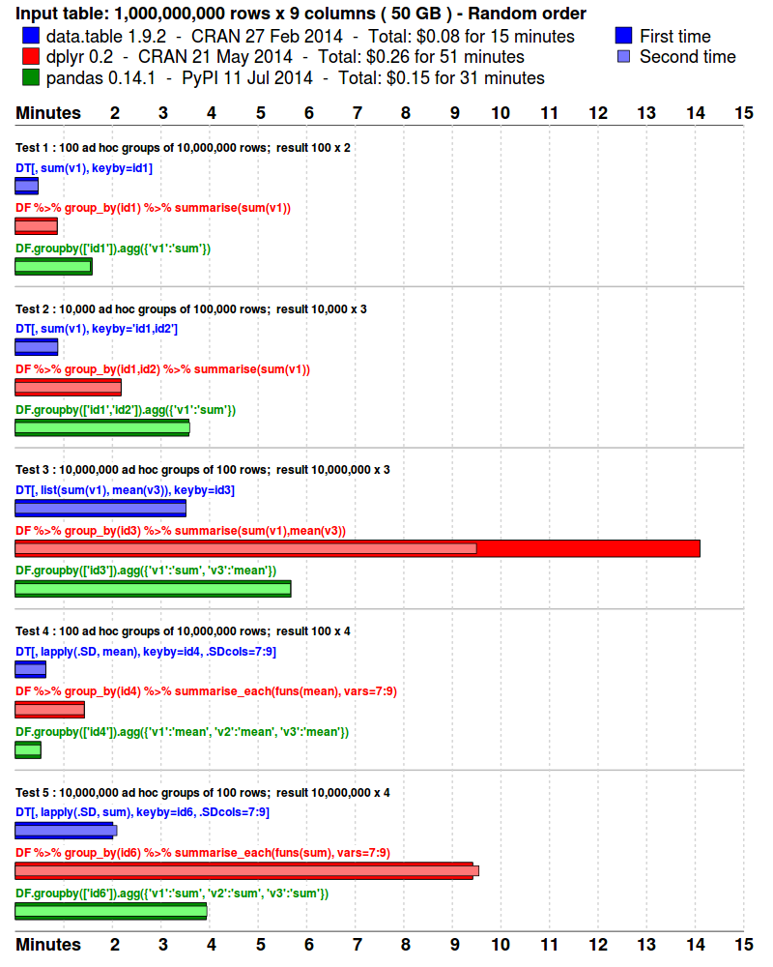
To be updated

Slide 9

To be updated

Slide 10
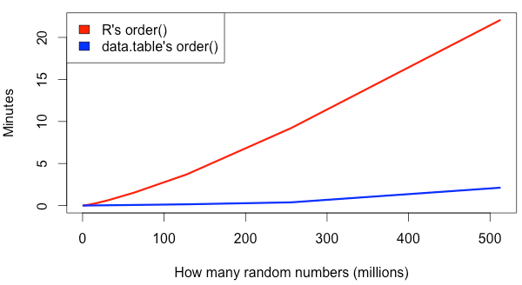
22 mins
2 mins
4GB
MacBook Pro 2.8GHz Intel Core i7 16GB
R 3.1.3 data.table 1.9.4

Slide 11
Non-speed reasons
Two S.O. questions
data.table wiki
?data.table examples

Slide 12
Thank you
https://github.com/Rdatatable/data.table/wiki
This presentation was recorded :
http://livestream.com/h2oai/events/4046257

