Slide 1
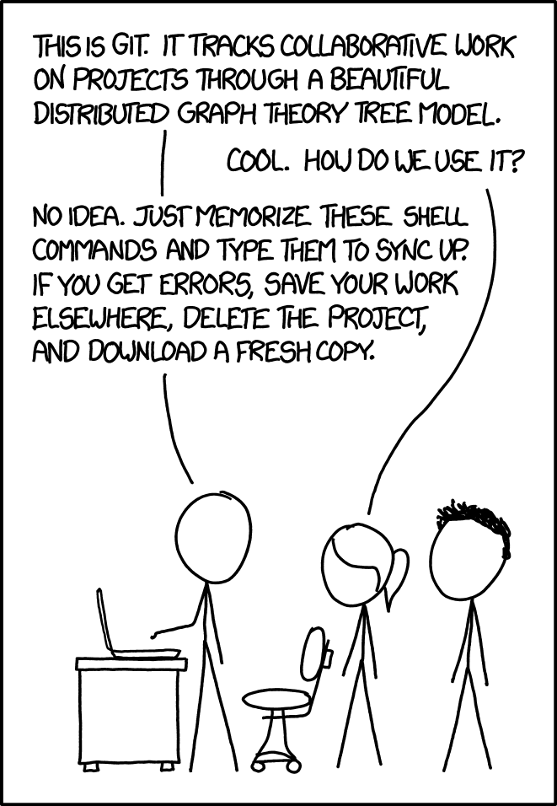
Git: Let’s f* up history, and then restore it
💩
alpha
Or: How to get rid of my_git_project_bkp (copy1-10)
A small introduction into some more advanced features of Git

Slide 2
Why use version control as a hobbyist?
Manage progress
Revert changes
Test new stuff in separate branches (Organise branches)
Project history
Understand why I changed something some years ago
Backtrack when some functionality broke

Slide 3
GIT - the stupid content tracker
According to its README
"git" can mean anything, depending on your mood.
random three-letter combination that is pronounceable, and not actually used by any common UNIX command. The fact that it is a mispronounciation of "get" may or may not be relevant.
stupid. contemptible and despicable. simple. Take your pick from the dictionary of slang.
"global information tracker": you're in a good mood, and it actually works for you. Angels sing, and a light suddenly fills the room.
"goddamn idiotic truckload of sh*t": when it breaks

Slide 4
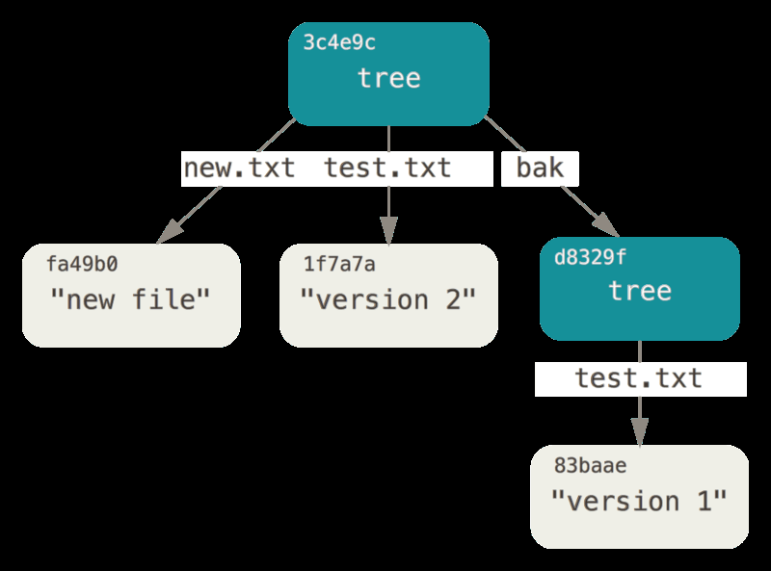
GIT – Under the hood
According to its README
This is a stupid (but extremely fast) directory content manager. It doesn't do a whole lot, but what it does do is track directory contents efficiently.
There are two object abstractions: the "object database", and the "current directory cache".
Object database
Objects

Slide 5
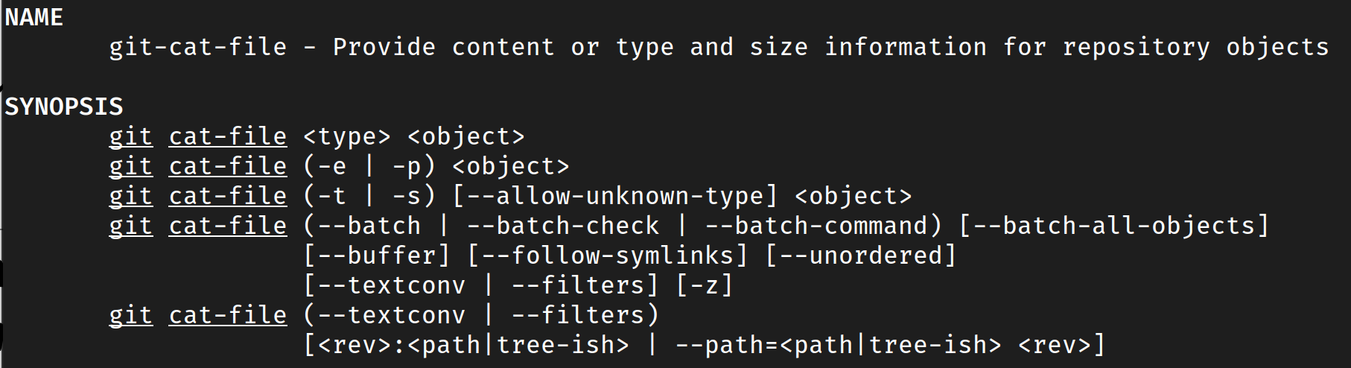
GIT command overview
There are continuously more options and commands added so best check git command –help from time to time.

Slide 6
GIT command overview
Basic commands: git ..
add Stage files for commission
commit ommit staged files
push Upload commits to a remote repository
pull Pull all commits of a remote repository into the current branch and merge according to git configuration
checkout Has multiple functions. Create new branches, switch to a branch, revert all unstaged files, etc.

Slide 7
GIT command overview
Working with the commit history: git ..
log List commit history of the currently checked out branch
cherry-pick Pull single commits into the current branch
rebase Apply all commits introduced by the current branch on top of another branch, then replace the current branch with the result
Branch
A
B
C
X
Branch
A
B
C
X
Branch A
A
B
D
Branch B
C
E
Branch B
A
B
D
C
E

Slide 8
GIT command overview
Lower level commands: git ..
reflog List local "action log" (Current directory cache)
cat-file Cat objects
fsck Inspect the object trees (eg. list dangling (unused) objects)
Garbage collecting: git ..
prune Deletes dangling object
gc (garbage collector) Simplifies cleanup in general.
And many, many more

Slide 9

A week with GIT
Goto https://github.com/h2obrain/about/blob/main/odyssey.md

Slide 10
That’s all folks – Thanks for listening
Take aways
Data can be restored, once it is committed and pushed
Do not check in sensitive data
There are dozens of commands, each having their use case
Most of the time, Google what you want to do and you will find it already implemented in one way or another
The presentation can be found here soonish..
https://github.com/h2obrain/about

