Slide 1
EasyMerge
A new tool for code clones refactoring
H. Qin, S. Pan, Y. Chen

Slide 2
Background
A code fragment (CF) is any sequence of code lines (with or without comments). A CF is identified by its file name and begin-end line numbers in the original code base.
A code fragment CF₂ is a clone of another code fragment CF₁ if they are similar by some given definition of similarity, that is, f(CF₁) = f(CF₂) where f is the similarity function.
Previous research shows that a significant fraction (between 7% and 23%) of the code in a typical software system has been cloned.
By detecting, categorizing, and removing code clones we can produce easier to understand, cleaner, and more reusable code.

Slide 3
Clone Types
Type-1: Identical code fragments except for variations in whitespace, layout and comments.
Type-2: Syntactically identical fragments except for variations in identifiers, literals, types, whitespace, layout and comments.
Type-3: Copied fragments with further modifications such as changed, added or removed statements, in addition to variations in identifiers, literals, types, whitespace and comments.
Type-4: Two or more code fragments that perform the same computation but are implemented by different syntactic variants.

Slide 4
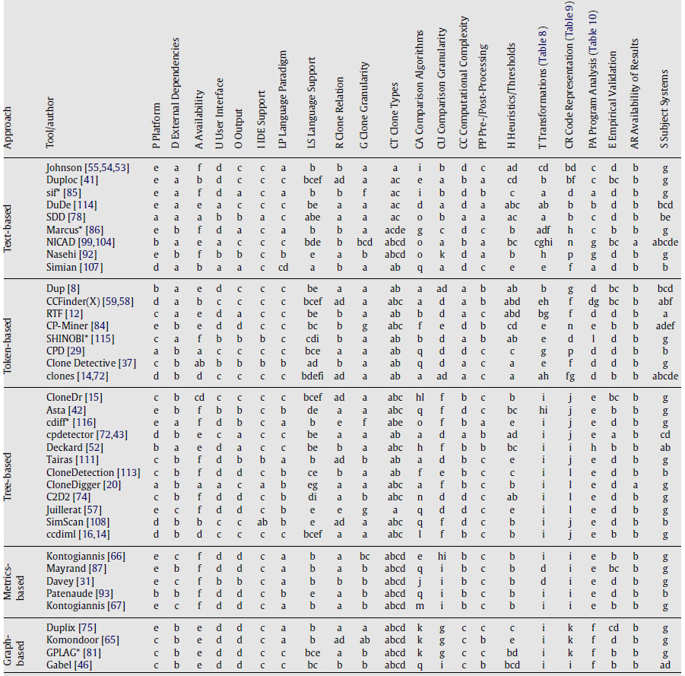
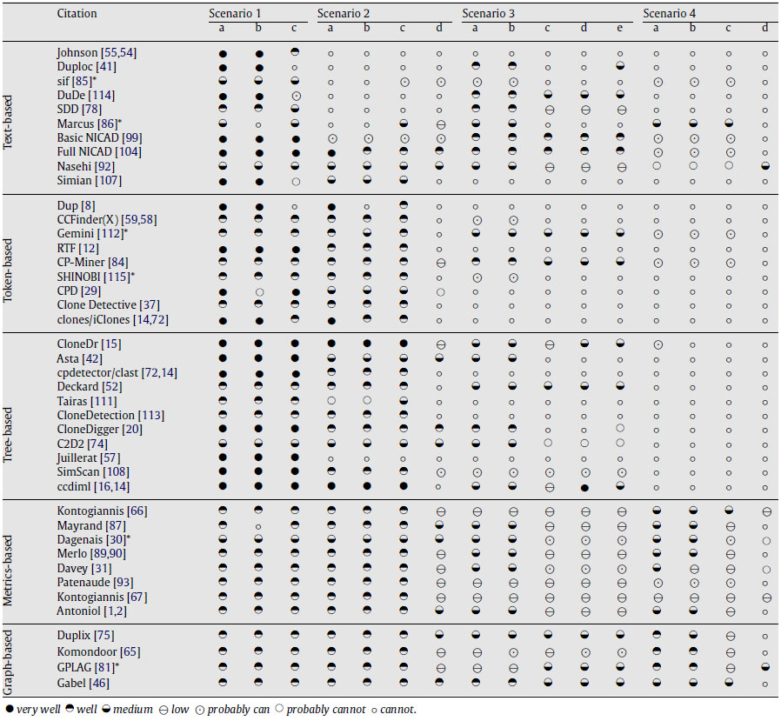
Clone Detection

Slide 5

CloneDigger – Anti-Unification
Anti-unification: let E₁ and E₂ be two terms. Term E is a generalization of E₁ and E₂ if there exist two substitutions $σ$₁ and $σ$₂ such that $σ$₁(E) = E₁ and $σ$₂(E) = E₂. The most specific generalization of E₁ and E₂ is called anti-unifier. The process of finding an anti-unifier is called anti-unification.
The anti-unifier tree of two trees T₁ and T₂ is obtained by replacing some subtrees in T₁ and T₂ by special nodes, containing term placeholders which are marked with integers.
Let U be the anti-unifier of two trees, the anti-unification distance between them is a sum of sizes of all substituting trees in their substitutions.

Slide 6
CloneDigger – Clone Detection Algorithm
Build the AST for the program.
Identify similar statements using anti-unification and partition them into clusters.
Find identical sequences of cluster IDs. These are candidates to be reported as duplicate code fragments.
Refine by examining the identified code sequences for overall similarity. In this phase, every pair of candidate sequences is checked for overall similarity at the statement level, again using anti-unification.

Slide 7
Clone Refactoring
Extract Method
Pull Up Method*
Possible implications
External references such as variables, objects and function calls
Future references
Related works: usage of refactoring guidance metrics

Slide 8
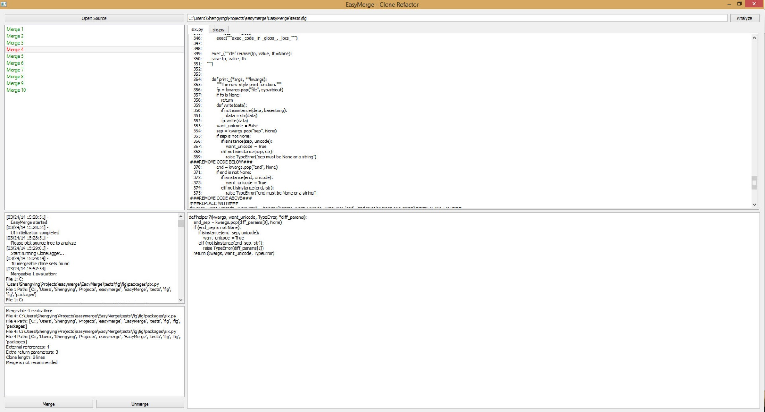
EasyMerge - UI

Slide 9
EasyMerge - Preprocessing

Slide 10
EasyMerge - Classification

Slide 11
EasyMerge - Merging

Slide 12
EasyMerge - Merging

Slide 13
EasyMerge - Merging

Slide 14
Experimental Results

Slide 15
Experimental Results

Slide 16
Experimental Results

Slide 17
Experimental Results

Slide 18
Conclusion & Future Work

