Slide 1
Internship at NAIST
Prof. Akito Monden
Okayama U. / NAIST
monden@okayama-u.ac.jp
Skype ID: monden.akito

Slide 2
Research Target --- TaskPit
TaskPit is a “desktop task measurement tool” developed at NAIST: It automatically records the time and deliverables of each task such as:
Browsing Emailing Text Editing Programming Debugging and so on.
TaskPit helps us to improve ourselves by self-measurement of our daily tasks in software development.
TaskPit also helps project managers to find any troubles or possible improvements of engineers.
http://taskpit.jpn.org/

Slide 3
TaskPit: Motivation
Lord Kelvin said “if you can not measure it, you can not improve it.”
If we could reveal details of our tasks, we may find where to improve, just like your mother eliminate unnecessary expenses at home by using household accounts book.
Task Name
Bound to applications and/or window names
Time
Time spent for each task
Notes:
Lord Kelvin said “if you can not measure it, you can not improve it.”
So we assume that if we can reveal our tasks, we can improve our own work like we eliminate unnecessary expenses at home by keeping household accounts book.

Slide 4
Example of TaskPit log data
Task name | start time | end time | left click | right click | keystroke
file operation | 20130204:095217 | 20130204:095229 | 0 | 0 | 0
browsing | 20130204:095229 | 20130204:095234 | 0 | 0 | 0
browsing | 20130204:095235 | 20130204:095235 | 0 | 0 | 0
browsing | 20130204:095235 | 20130204:095236 | 0 | 0 | 0
file operation | 20130204:095236 | 20130204:095237 | 0 | 0 | 0
browsing | 20130204:095237 | 20130204:095239 | 0 | 0 | 0
browsing | 20130204:095239 | 20130204:095240 | 0 | 0 | 0
browsing | 20130204:095240 | 20130204:095241 | 0 | 0 | 0
browsing | 20130204:095241 | 20130204:095242 | 0 | 0 | 0
email | 20130204:095243 | 20130204:095245 | 0 | 0 | 0
browsing | 20130204:095245 | 20130204:095248 | 0 | 0 | 0
browsing | 20130204:095248 | 20130204:095249 | 0 | 0 | 0
We have data recorded at some software company in Japan,
but we don’t have good analysis tools.
Goal of this internship.

Slide 5
What kind of analysis can we do from TaskPit data?
We expect TaskPit data can assist project managers to analyze how engineers are working, such as:
How busy are they?
Which tasks are they working on?
How many hours did they spent on programming (or testing).
Did they have lots of interruptions (e.g. by e-mails) during their works?
What is their productivity of programming (e.g. the number of keystrokes per hour)
What is the total effort (person-hours) for programming (or testing) in our team last week?
… and so on.

Slide 6
Goals of this internship
Develop an analysis tool (visualization tool) for TaskPit log data for the purpose of
Helping project managers to monitor their engineers for project control (e.g. progress control, finding project risks, etc.)
Helping engineers (who are using TaskPit) to improve themselves.
Write a research paper in English.
We have written two symposium (short) papers in Japanese but we have not published them in English.
We are happy if you and Pattara-sensei could reuse some part (or all part) of our papers, add your achievements of this internship, and published it in English at some Journal.

Slide 7
Research materials
TaskPit web: http://taskpit.jpn.org/ (Japanese)
TaskPit English Version
TaskPit_English_Version.zip (no one tested!)
Research papers about TaskPit (Japanese)
FOSE2008v11.doc … written in 2008
fose2013_V12.dox … written in 2013
These are long versions of our (published) short papers.
Presentation slides (Japanese)
FOSE2008V03.ppt
FOSE2013V1a.ppt
TaskPit log data (Japanese)
12_log.zip
TaskLog_Eng.csv … an example of log data in English

Slide 8
Research procedure
Download/install TaskPit and understand how it works.
Read research papers and presentation slides using Google Translate.
Translate log data into English
I will help.
Design and develop the analysis tool.
Show an example of an analysis by your tool.
Write a research paper

Slide 9
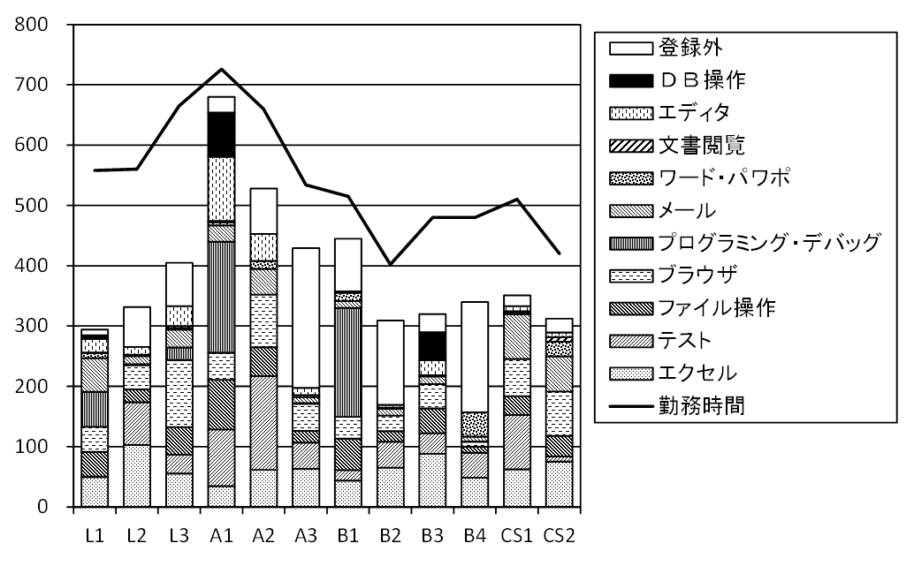
Some idea on designing the analysis tool
Visualization for analyzing
How busy are they?
Which tasks are they working on?
Cumulative bar chart of tasks to monitor all engineers’ tasks during a certain period.
Example (with Excel)
It’s just an idea.
Engineers

Slide 10
Some idea on designing the analysis tool
Think about how you can visualize data to analyze:
How many hours did they spent on programming (or testing).
Did they have lots of interruptions (e.g. by e-mails) during their works?
What is their productivity of programming (e.g. the number of keystrokes per hour)
What is the total effort (person-hours) for programming (or testing) in our team last week?
… and so on.
Any of your idea is OK!!
You can use any programming language/framework for the implementation.
Let’s try and error!

