Slide 1
Speed up the local inhibition
Rev 1.1
Hideaki Suzuki
September 22, 2013

Slide 2
Preface
In the middle of my studying HTM CLA, I’ve got some ideas to accelerate the special pooler.
This presentation explains one such experiment: accelerating the local inhibition of SP.
Update History of this material
Rev | Date | Contents
1.0 | Sep.5, 2013 | Release to Nupic ML
1.1 | Sep.22, 2013 | Wrong screens are recaptured on Page 12. Some confusing expressions are corrected.

Slide 3
The missions of the local inhibition
There are three missions IIUC.
Sparsely; activate only the fixed number of columns.
Stability; similar activations for similar input patterns.
Coverage; capture the entire input image.

Slide 4
The current local inhibition
The algorithm :-
For each column in the region;
Look at its preactive neighbors.
If its intensity is within the top k among the neighbors, activate this column
Issues
Three issues have been observed. (the next slide)
I use the term “preactive” to mean the column state that the column has gotten good enough overlap and became a candidate to become active (but it’s not decided before the inhibition process)

Slide 5
Issues
Speed; O(N * n * k + A) with unordered partial sorting.
where N is the number of columns in the region (>1K), n is the number of columns in the inhibition radius (typically 10~200), k is the desired local activity (a few), A is the number of active columns.
The local inhibition is 60-100 times slower than the global inhibition. O(p) can be achieved for the global inhibition, where p is the number of preactive columns (0 ≤ p ≤ N) before inhibition.
Coverage; active columns are biased toward the densest area of the input bits.
If the synapses of a column do not cover the entire region, a column has locality over the input pattern. The densest input area makes those columns connected to the area to get excited very much. Thus, those columns will have higher probability to survive after the local inhibition.
If a column has locality, the active columns tend to gather to the core part of the image pattern. Thus, SDR will have less coverage over the input pattern (though much better than the global inhibition).
Control; difficult (not so intuitive) to find out the proper parameters to achieve the sparsity.
The desired local activity k indirectly relates to the sparsity. Not only k but also the shape of the input pattern affect sparsity. e.g. a big input pattern, a tiny pattern, scattered pattern,…,etc.
If we use a square inhibition area, it contains 1 column in the inhibition radius 0, 9 columns in the radius 1. Then 25, 49, 81, …, and (2 * R + 1)^2 in the radius R in general, which is too rough.
For example. when we want 3% sparsity, what is the best setup for the desired local activity and the inhibition radius? 1/(2*2+1)^2 = 4%, 1/(2*3+1)^2 = 2%, or the mix of those …?

Slide 6
The improved local inhibition
The algorithm :-
Repeat the below till all active columns are selected.
Choose the column with the highest intensity from the preactive columns globally, and mark it active.
Put penalty to the intensities of the neighbor columns.
The result is…
Faster than the current local inhibition
Better coverage over the input pattern
Less pain to control sparsity

Slide 7
The control parameters
The inhibition radius
If we have P preactive columns where the target active columns is A, one active column should inhibit P/A preactive columns on average.
So, P/A+1 is a good candidate for the area size of the local inhibition; the inhibition radius = sqrt (P/A+1) / 2 – 1.
Since preactive columns are not packed and there will be some space between columns, sqrt (P/A) seems to work well.
The inhibition penalty
This parameter is analog to the current desired local activity.
If the penalty is set as W % against the maximum possible intensity I, and C is the number of active neighbors, one column will receive (W% * I * C) penalty from its active neighbors.
For example,
Assume W = 8%, the minimum overlap threshold is T = 2%
If a preactive column has the intensity 40% of I, three active columns chosen around it will make the intensity to drop down to 40%-3*8% = 16% of I.
In the same way, four surrounding active columns will make the intensity to drop to 8%.
Five active columns around it will finally make it to become 0%, which is less than T. Then, this column will not be selected, unless all of not-inhibited-yet preactive columns are exhausted and still we’re in short to achieve the target sparsity.
Note that the final intensity of a column can go negative.

Slide 8
Computational complexity
O((P + A)*(P - A + 1) + A*n + A)
P is the number of preactive columns (A<P≤N), A is the number of active columns (target sparsity), n is the number of columns within the inhibition radius.
This is still slower than global inhibition O(P + A), but not as slow as the current O(N*n*k + A).
The worst case is when P = N. Still, (P+A)*(P-A+1) < P*A = N*A, which is typically much less than N*n*k. Though A*n is the additional factor, the new algorithm is faster than the current one.
As learning in SP progresses, the number of inhibited columns tends to decrease (having leaner preactive SDR), as columns are segregated for its own input patterns. As P → A, n → 0, this local inhibition approaches toward O(3A) that is similar to the cost of global inhibition.

Slide 9
Pseudo Code
Input: List<int> preactiveColumns; int targetActiveColumnCount; Output: List<int> activeColumns;
int inhibitionRadius = (int)sqrt(preactiveColumns.Count / targetActiveColumnCount);
for (; ; )
{
chosen = findColumnWithLargestIntensity (preactiveColumns);
preactiveColumns.Remove(chosen);
activeColumns.Add(chosen);
markColumnState(chosen, Active);
if (activeColumns.Count == targetActiveColumnCount) break;
foreach (c in neighborsOf(chosen))
c.intensity -= localInhibitionPenalty;
}
The number of scan lookups:
(P+A)*(P-A+1)
The constant amount of task:
A
The number of subtraction:
A * n

Slide 10
Speed Measurement
When I don’t have so many preactive columns (<100), the local inhibition is less than 4 times slower than global inhibition.
If we have many columns to inhibit, local inhibition can get slow by ten fold. (but not 60 times or 100 times)
Elapsed Time Ratio (New local / global)
1024 columns
4% sparsity

Slide 11
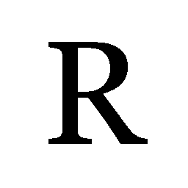
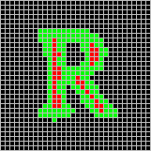
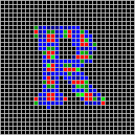
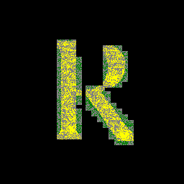
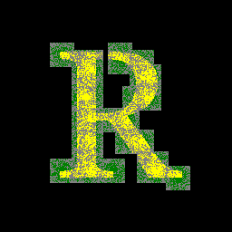
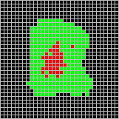
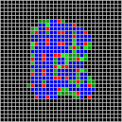
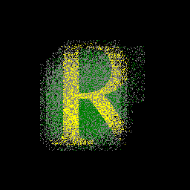
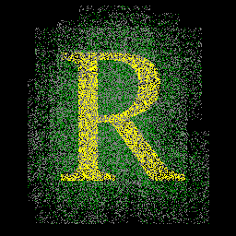
The coverage of SDR
Input Image
Image size: 256x256 pixs
Region size: 32x32 cols
Target Sparsity: 4%
Connected synapse: 512
Minimum overlap: 20
Inhibition penalty: 8%
Initial SDR
Reverse Map
Global
New Local
Global
New Local
Fanout diameter 10% over the input space (fanout radius 13)
Red: Active columns
Green: Preactive with positive intensity
Blue: Preactive with negative intensity
Gray: Disconnected synapse
Green: Inactive synapse
Yellow: Active synapse
Fanout diameter 30% over the input space
(fanout radius 38)
Active columns are more evenly distributed
Thus, it provides better coverage

Slide 12
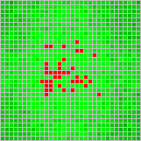
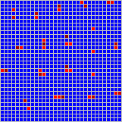
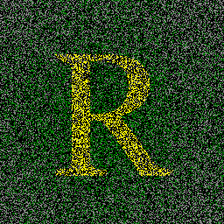
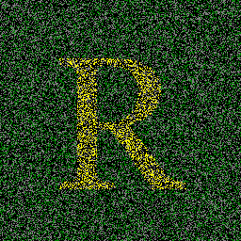
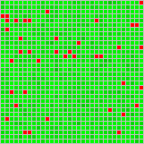
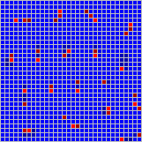
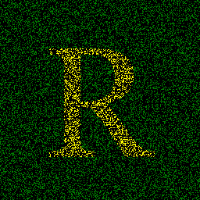
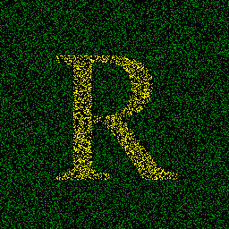
The coverage of SDR
Input Image
Image size: 256x256 pixs
Region size: 32x32 cols
Target Sparsity: 4%
Connected synapse: 512
Minimum overlap: 20
Inhibition penalty: 8%
Initial SDR
Reverse Map
Global
New Local
Global
New Local
Fanout diameter 100% over the input space
(fanout radius 128)
More active columns are near center due to the bias on synapse distribution
Fanout diameter 100% No permanence bias
(perm sinker 0)
If no bias is given to permanence, all columns are equal.

Slide 13
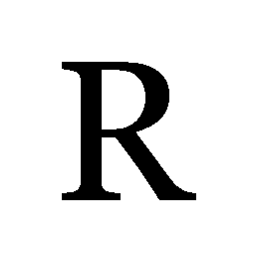
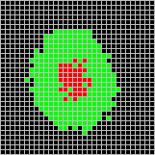
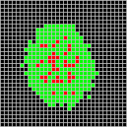
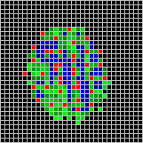
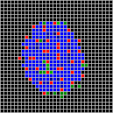
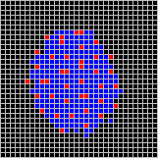
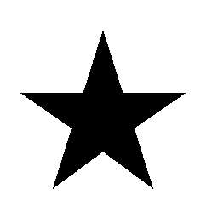
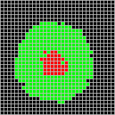
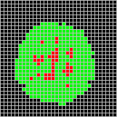
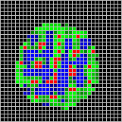
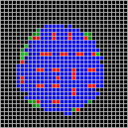
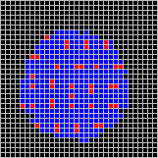
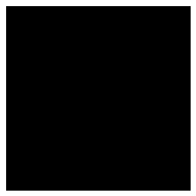
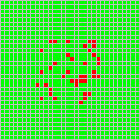
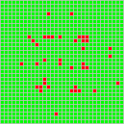
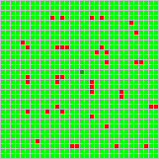
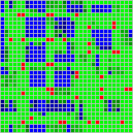
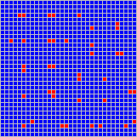
Effect of inhibition penalty
Image size: 256x256
Region size: 32x32
Potential synapse: 1024
Minimum overlap: 102
Connected synapse: 50%
Fanout diameter: 50%
Initial SDR
Input Image
Penalty 0%
Global Inhibition
Penalty 1%
Penalty 4%
Penalty 8%
Penalty 32%
Penalty 80%
The results converge to one final SDR.
Those two are identical

Slide 14
How three missions are achieved
Sparsity
It is guaranteed to produce the target sparsity, if the enough number of preactive columns is given, because the new algorithm will not stop till the target sparsity is achieved.
Stability
It is achieved because the new algorithm picks up the column of the highest intensity globally every time. Similar inputs with similar intensity distribution will end up with similar SDRs.
Coverage
With good inhibition penalty, active columns cannot gather at a single location and will be distributed, which gives better coverage over the input image.

Slide 15
Direction for further work
Implement the improvement in Nupic code and see any positive or negative impact to the result of prediction.
Further optimize the algorithm. e.g. by dividing the space to narrow the search area for the next winner column, more GPU friendly algorithm, …,etc.

