Slide 1
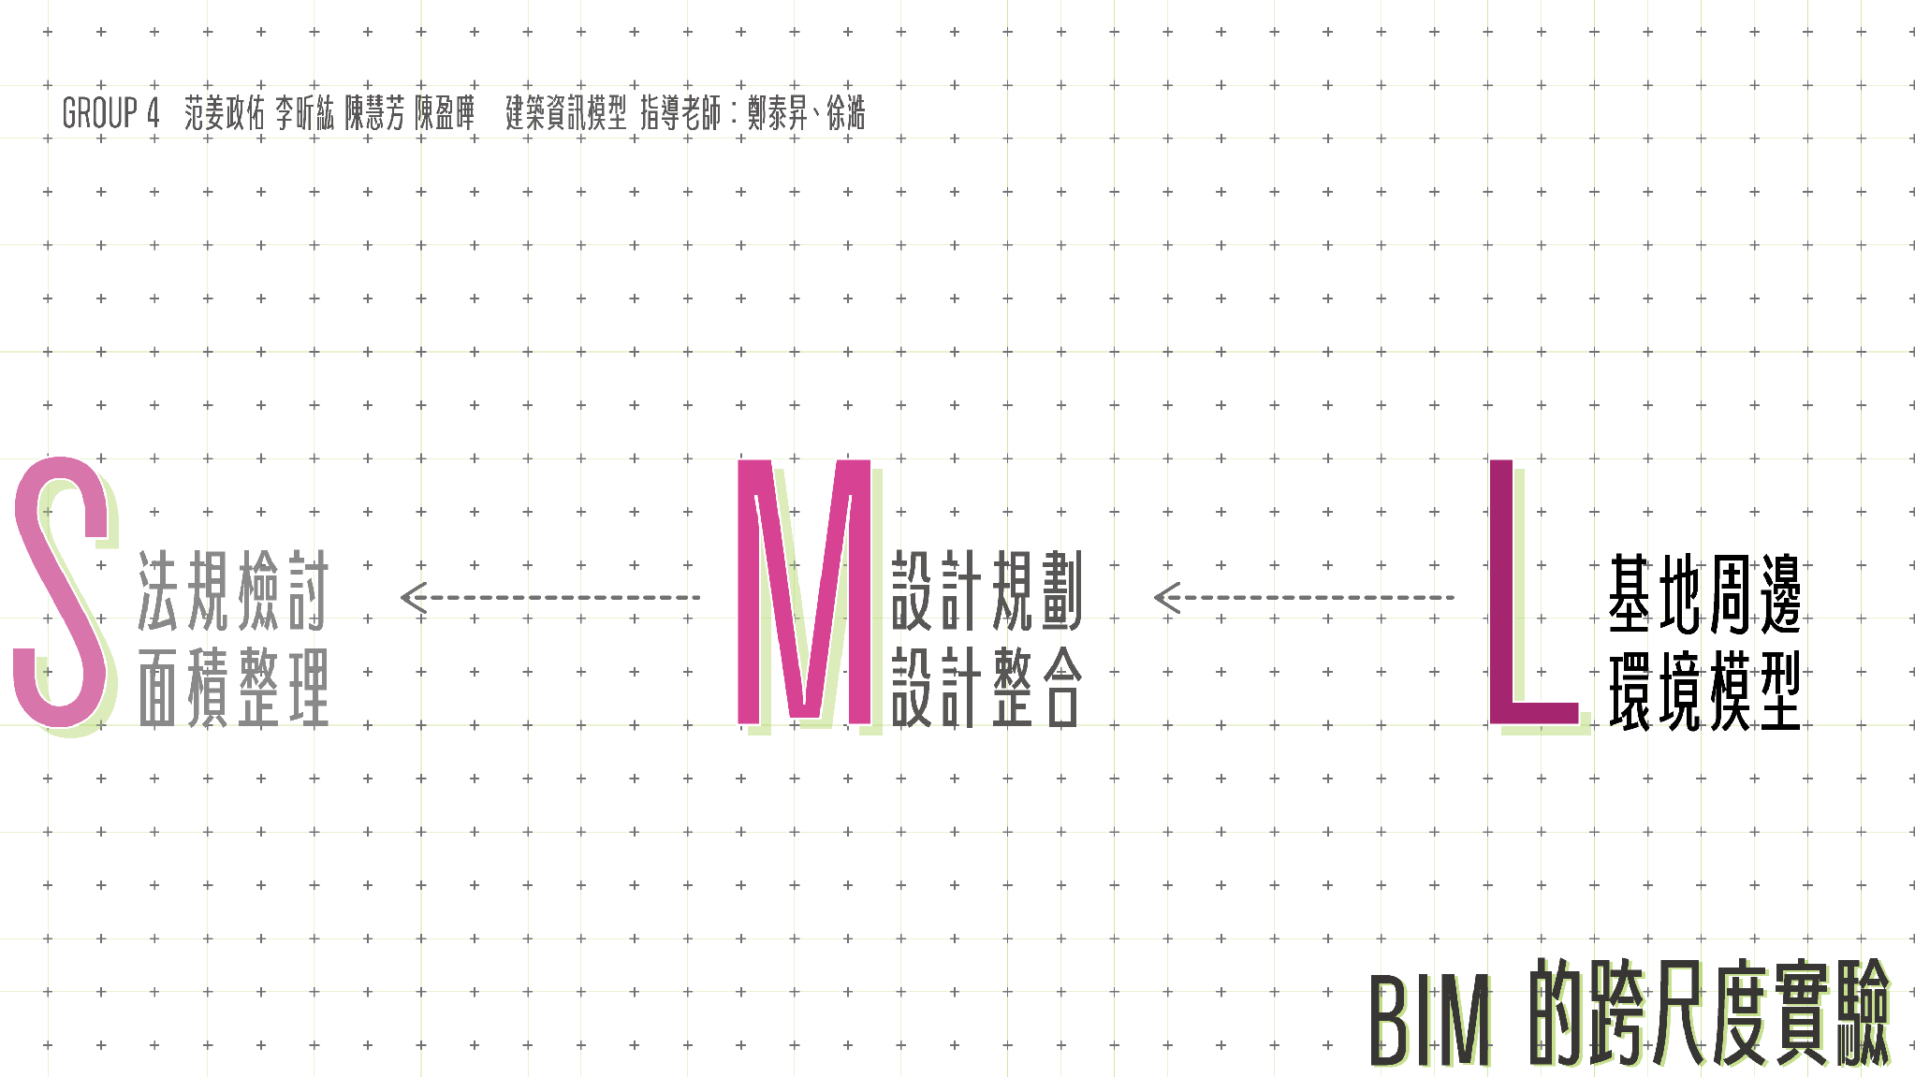
Notes:
「在 BIM 的工作中，從整個基地的建立、停車場的配置，到局部法規條件的檢查，不同尺度的任務，需要處理的資訊與操作也不同。
這次我們以『跨尺度實驗』為主題，選擇這三種任務，實際透過 MCP 進行操作。我們想了解：面對不同尺度的需求，應該如何準備資料、下達指令，以及確認操作結果？」

Slide 2
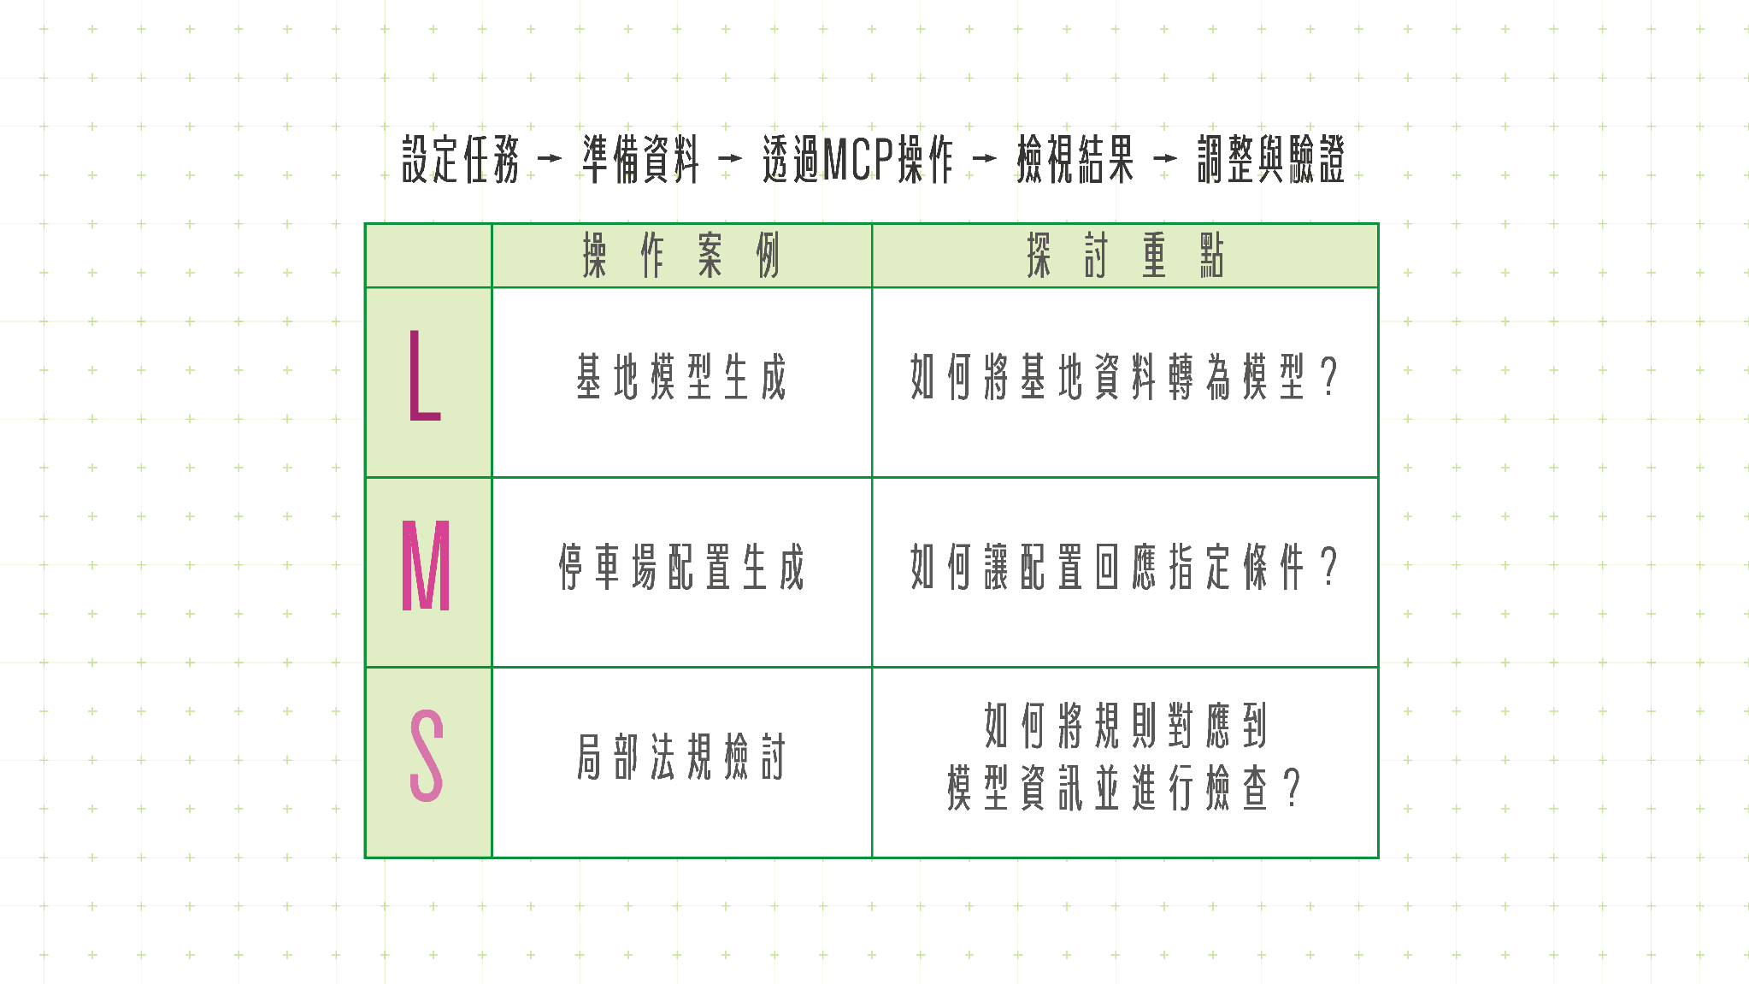
Notes:
大尺度：基地模型 → 中尺度：停車場配置 → 小尺度：局部法規檢討
「接下來，我們會由大到小，依序展示三種尺度的操作。每個案例都會說明我們提出了什麼任務、MCP 如何介入，以及最後得到什麼結果。」

Slide 3

Notes:
大尺度：基地模型 → 中尺度：停車場配置 → 小尺度：局部法規檢討
「接下來，我們會由大到小，依序展示三種尺度的操作。每個案例都會說明我們提出了什麼任務、MCP 如何介入，以及最後得到什麼結果。」

Slide 4

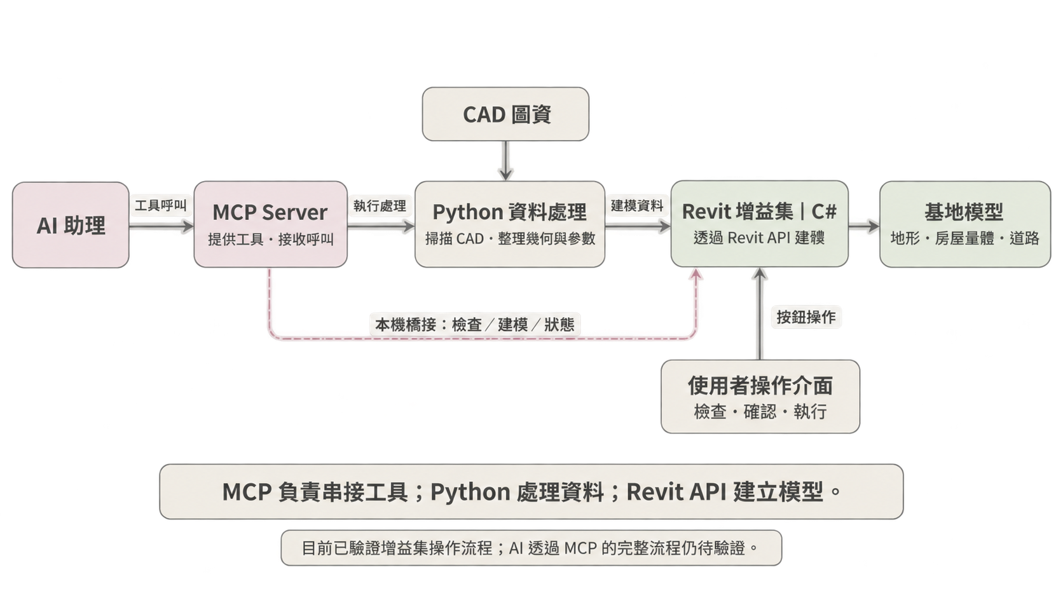
資料分別整理、模型逐項建立，修改時需反覆檢查。
傳統建模流程｜基地模型的重複工作
01
Notes:
在設計前期，我們通常需要先建立基地模型。雖然 CAD 已經提供等高線、房屋和道路，但進入 Revit 之前，還是需要確認單位、整理圖層，以及檢查高程和輪廓。
接著，地形、房屋和道路還要分別建立，最後再整合檢查。如果資料有問題或更新，就需要回頭修正。這些重複工作，就是我想透過工具改善的地方。

Slide 5
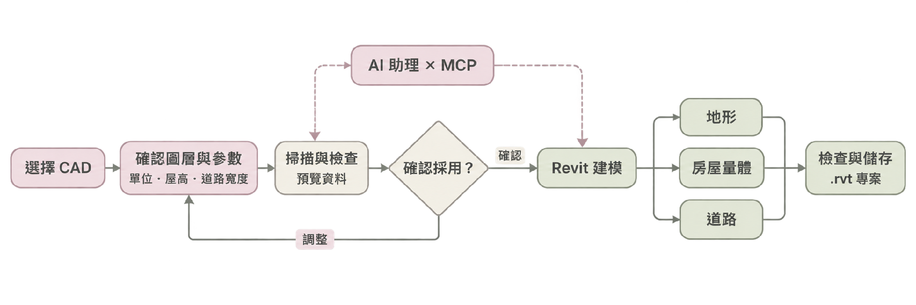
整合選檔、參數設定與資料檢查，建立地形、房屋量體及道路。
工具操作流程｜從 CAD 圖資到 Revit 模型
屋高資料不足時採用可調假設值並標示；目前已驗證增益集操作流程，AI 透過 MCP 的完整流程仍待驗證。
01
Notes:
所以，我把這些操作整理成一個連續的流程。
使用者先選擇 CAD，確認圖層與建模參數，再查看資料檢查結果。確認採用後，就能在 Revit 裡建立地形、房屋量體和道路。
中間仍保留檢查與調整的步驟，尤其是屋高資料不足時，會使用可調的假設值並標示出來。

Slide 6
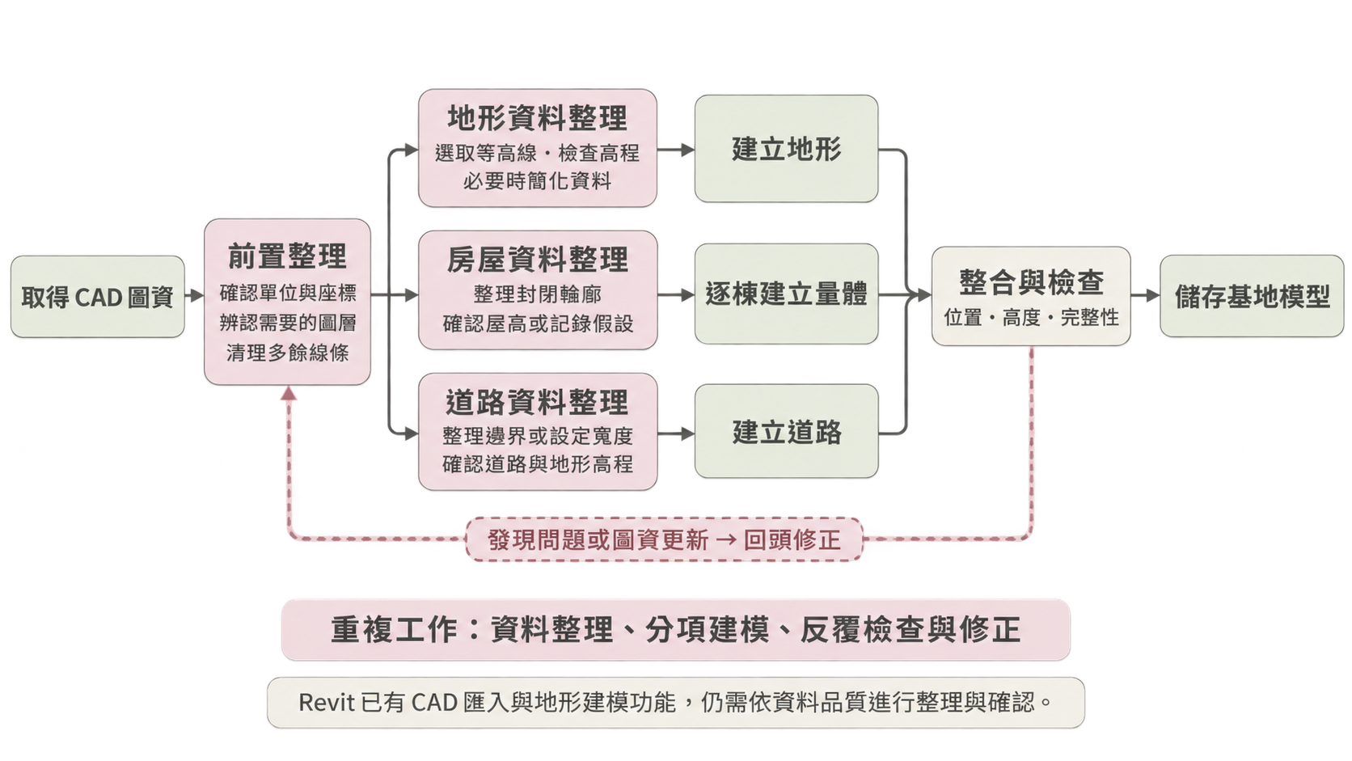
MCP 串接工具呼叫，Python 處理資料，Revit API 執行建模。
系統架構｜MCP 如何串接 AI 與建模工具
01
Notes:
技術上，這個工具分成三個部分。
Python 負責整理 CAD 資料；C# 開發的 Revit 增益集，透過 Revit API 建立模型；MCP 則提供 AI 呼叫這些工具的入口。
所以，MCP 的角色是串接操作，實際的資料處理和建模由後面的程式執行。目前已驗證的是增益集操作流程，AI 透過 MCP 的完整流程還需要進一步測試。

Slide 7
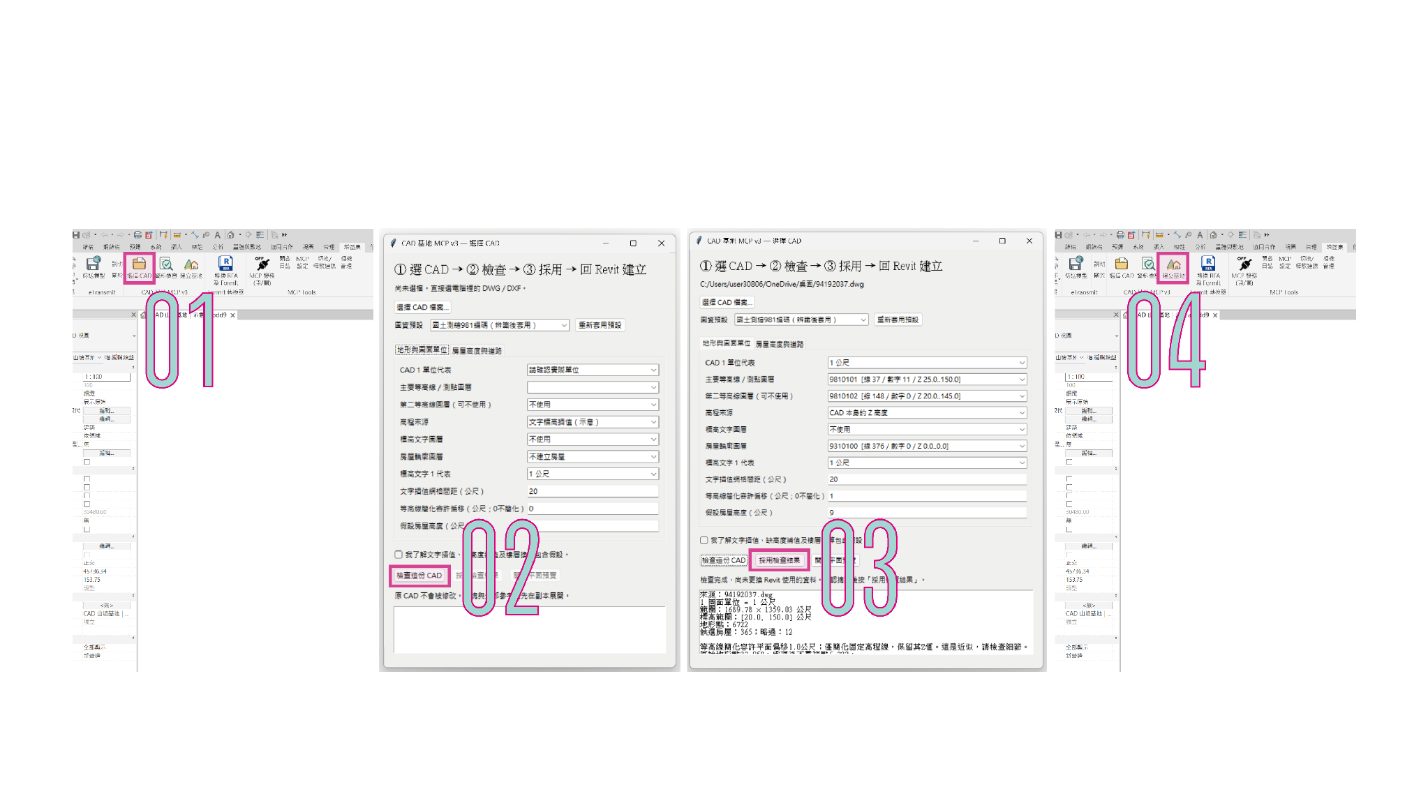
整合選檔、參數設定與資料檢查，建立地形、房屋量體及道路。
操作過程：從圖資設定到執行建模
07
Notes:
接下來是實際操作。
我先選擇這份練習 CAD，確認單位和對應圖層，再設定房屋高度與道路模式。
接著執行檢查，查看資料是否符合建模條件；如果有問題，就回到設定調整。
確認採用後，再到 Revit 執行建模。模型完成後，還需要檢查位置、高度和完整性，最後儲存專案。

Slide 8
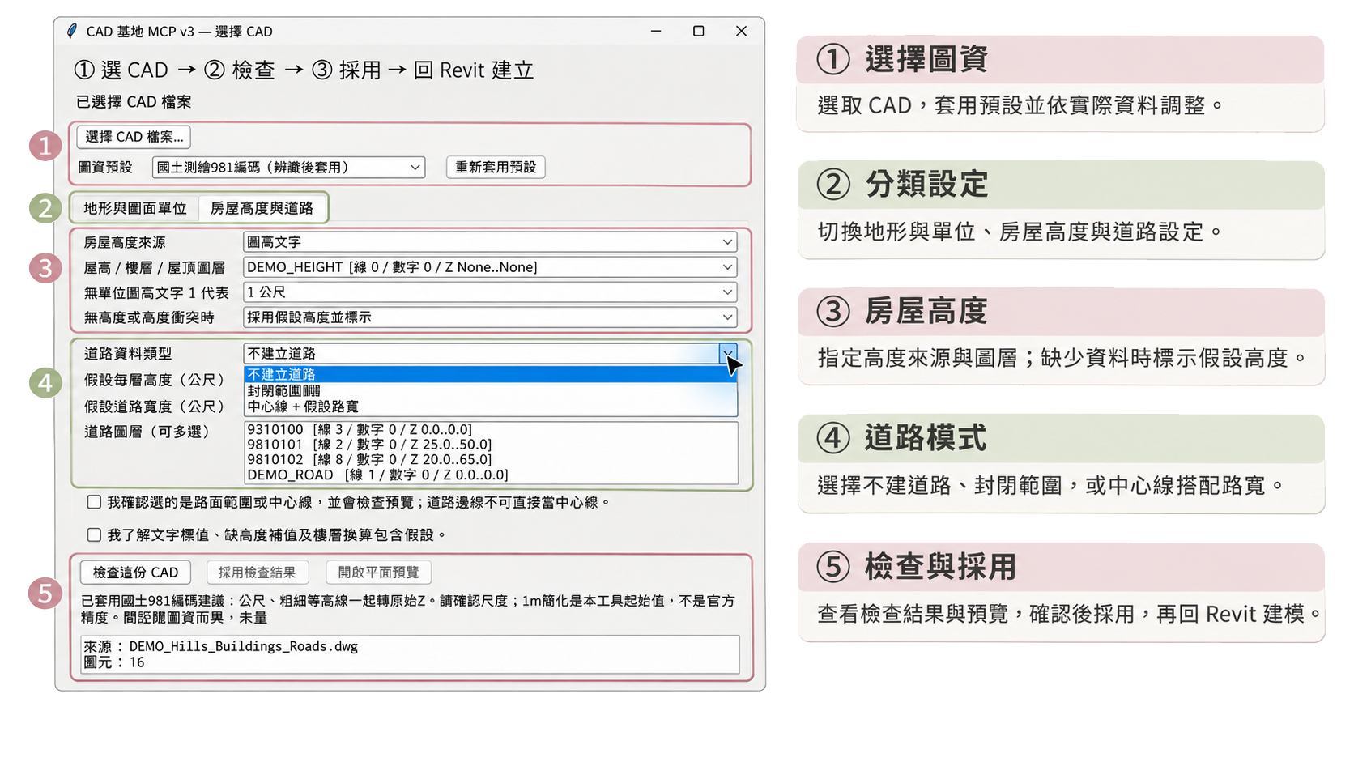
整合選檔、參數設定與資料檢查，建立地形、房屋量體及道路。
操作介面介紹｜ CAD 選擇與建模設定
07
Notes:
這是工具的主要設定介面，可以分成五個區域。
上方選擇 CAD 和圖資預設，中間透過分頁設定地形、單位、房屋高度與道路。
房屋可以指定高度來源，缺少資料時採用假設高度。道路則能選擇封閉範圍，或由中心線搭配路寬建立。
設定完成後，下方會顯示檢查結果，也可以開啟預覽。確認資料和假設設定後，再採用這份資料。

Slide 9
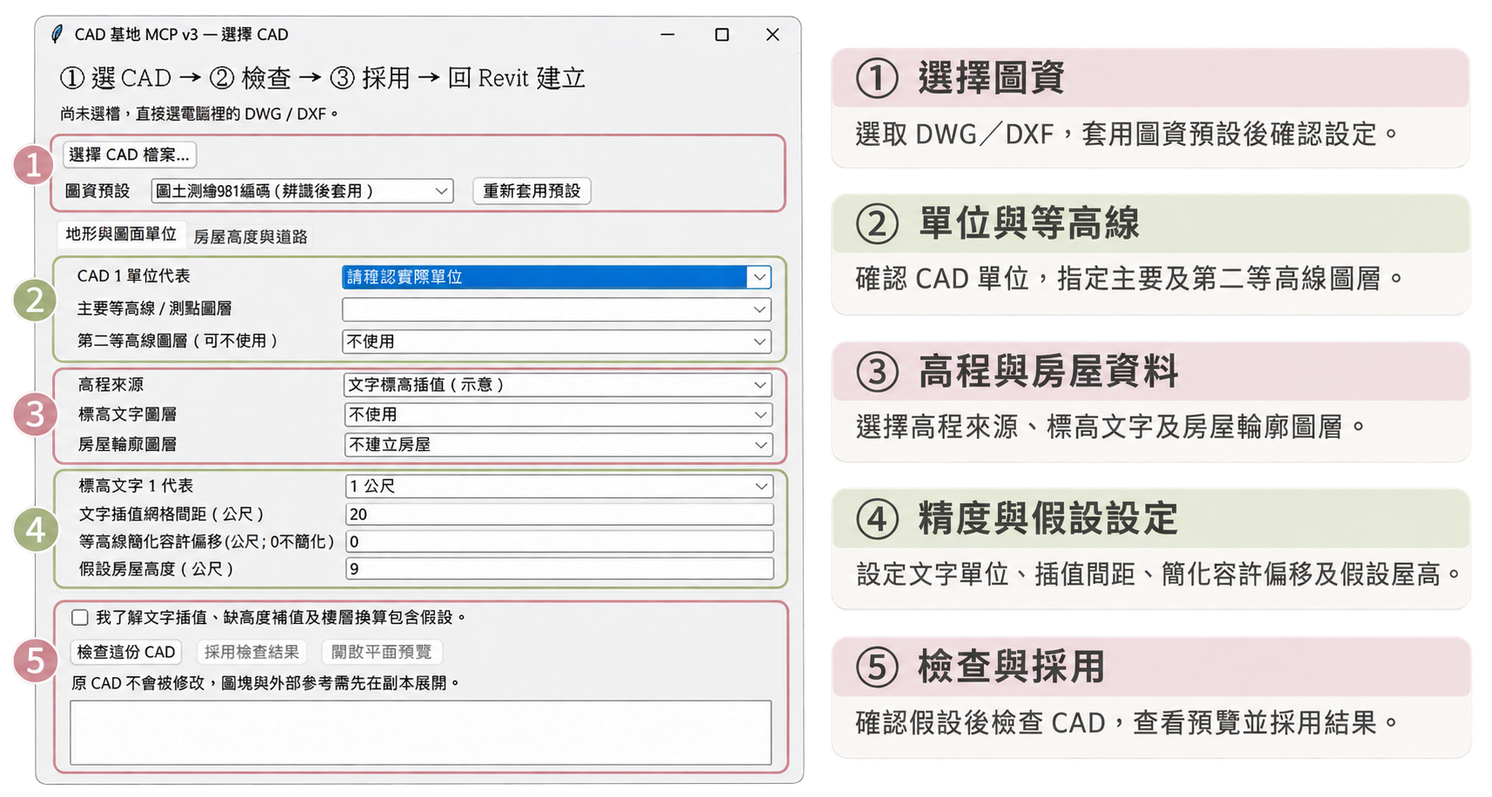
整合選檔、參數設定與資料檢查，建立地形、房屋量體及道路。
操作介面介紹｜ CAD 選擇與建模設定
07
Notes:
這是工具的主要設定介面，可以分成五個區域。
上方選擇 CAD 和圖資預設，中間透過分頁設定地形、單位、房屋高度與道路。
房屋可以指定高度來源，缺少資料時採用假設高度。道路則能選擇封閉範圍，或由中心線搭配路寬建立。
設定完成後，下方會顯示檢查結果，也可以開啟預覽。確認資料和假設設定後，再採用這份資料。

Slide 10
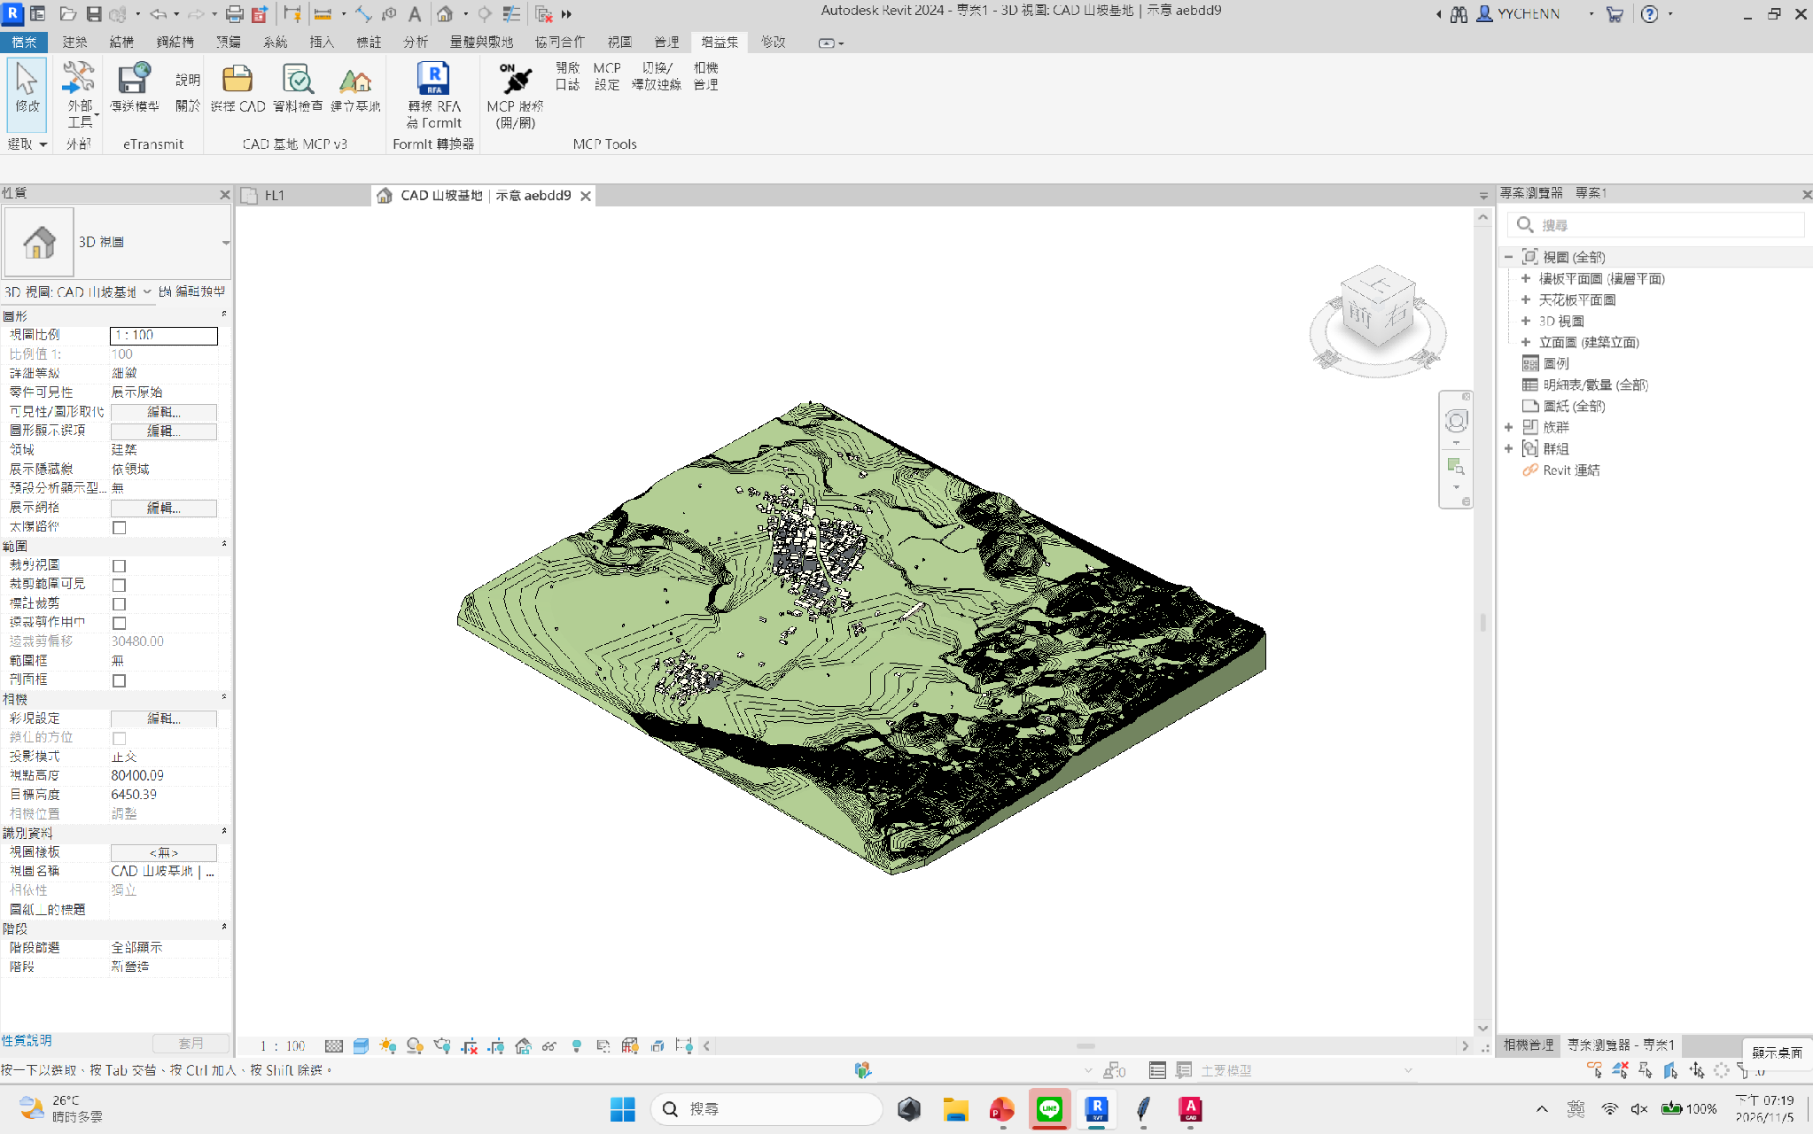

整合選檔、參數設定與資料檢查，建立地形、房屋量體及道路。
建模成果：地形、房屋量體與道路
Do Re Mi So
07
Notes:
這是目前的建模結果。在這份合成練習圖資上，成功建立了四百一十三點的地形、三棟房屋量體，以及一個道路範圍。
這次完成了從 CAD 選檔到 Revit 建模、儲存的流程，但大型圖資、道路貼合精度，以及不同資料條件仍需要持續驗證。
接下來交給中尺度

Slide 11

Notes:
大尺度：基地模型 → 中尺度：停車場配置 → 小尺度：局部法規檢討
「接下來，我們會由大到小，依序展示三種尺度的操作。每個案例都會說明我們提出了什麼任務、MCP 如何介入，以及最後得到什麼結果。」

Slide 12
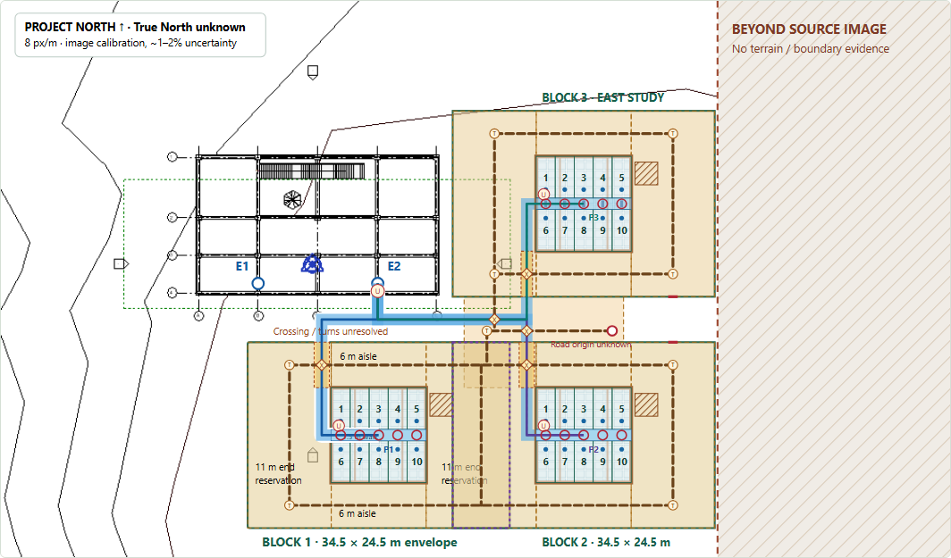
PROJECT PURPOSE / EXECUTIVE SUMMARY
EV Charging Hub
A BIM-informed concept study for modular parking, charging and a timber/PV canopy
Compare capacity, space and
access in one interactive review
10 / 20 / 30 spaces
Standard / Compact layouts; east or south/SE expansion.
Site: NCKU_9hours_intro_course.rvt
EV Charging Hub Interactive Designer can be downloaded from GitHub: https://github.com/Fanchiang0418/2026_NCKU_BIM_Course/tree/main/20261030/%E7%AC%AC4%E7%B5%84/demo
M3.2.3 | EV Charging Hub | Concept design review | M3.2.3 baseline / 2 November 2026
Notes:
Opening / 40 seconds. Objective: turn saved BIM context into traceable modular EV hub alternatives. Deliverables are concept layouts and local calculations. Site fit, surveyed coordinates, engineering design and regulatory approval remain pending. Image: actual M3.2.3 Presentation Mode step 8, Standard / east. Teacher reference: instructor-provided NCKU_9hours_intro_course.rvt, zoehchen/2026_NCKU_BIM_Course, 20260918/CAD. Referenced for site/view organization and parametric modeling; no teacher assets were transferred into the EV Hub model in this milestone.

Slide 13
ARCHITECTURE
Architecture
REVIT MODEL
REVIT MCP
SAVED EVIDENCE
BROWSER JS
HTML / SVG
Building + Site + view IDs
TS/Node → WebSocket → C#
Views, elements, PNG
Placement + calculations
Scenarios + walkthrough
→
→
→
→
Source: project handoff and historical M3 evidence; M3.2.3 not supplied

Slide 14
METHOD / MCP TOOLS & SKILLS
What worked, what failed, what remains partial
MCP tools query model data. Skills guide the inspection workflow. The browser runs the layout calculations.
TOOL / SKILL
WHAT IT DOES
RECORDED RESULT
get_active_view / get_all_views
Identify view context and available plans
Historical results saved
query_elements_with_filter*
Find elements; inspect fields and dimensions
Historical results saved
list_family_symbols / get_all_levels
List loaded types and building level datums
Historical results saved
get_project_info
Return project metadata
Recovered 28 Oct; other RVT
get_active_schema
Read active-view element schema
Failed; cause unconfirmed
measure_distance / get_element_geometry
Point distance / native geometry
Not exposed or run
element-query / parking-check / building-compliance
Discovery guidance / parking and rule screening
Applied / partial / partial
* With get_category_fields and get_element_info. capture_view_image deployment/capture unverified; PVWatts not run.
Lessons: preserve source evidence; distinguish failed calls, unavailable tools and incomplete checks.
M3.2.3 | EV Charging Hub | Concept design review | M3.2.3 baseline / 2 November 2026
Notes:
65 seconds. Saved evidence is in the preview evidence/ folder, especially 39-source-verification.json, 36-mcp-snapshot.json and 29-connection-recovery.json. get_project_info succeeded once after service startup, returning EV_Hub_M1_1f3853a9; this does not establish access to the NCKU document, return geometry or refresh the Site image. Previous schema failures remain open; do not assign one proven root cause. measure_distance and get_element_geometry were defined but not exposed/invoked in the recorded snapshot, not demonstrated failed calculations. capture_view_image source exists in a linked fork but deployment/exposure and successful image retrieval are unverified; wider Site export was not obtained. element-query workflow applied historically; parking-check and building-compliance are incomplete, not audit passes. Loaded parking types differ from proposed 2.5 x 5.5 m bays; zero placed native Parking instances was historical. Error reporting was repaired/tested; service availability recovery is distinct. PVWatts was considered but not executed; the Taiwan research paper returned HTTP 403 and was not read. No new MCP calls or model operations were performed to make this deck.

Slide 15
REGULATIONS / STATUS & NEXT STEPS
Referenced rules guide the next validation
CATEGORY
CONSIDERED / CURRENT USE
NEXT CHECK
Parking / circulation
Articles 59-1, 60, 61, 62 referenced;
2.5 × 5.5 m bays and 6 m aisles drawn
Legal access, parking counts, grades,
swept paths, clear height
Charging / accessibility
Art. 62 refers to electrical rules;
1.5 m path is a project assumption
Applicable electrical clauses, utility,
protection, accessible bays/routes
PV / energy
Taipei DOE guidance; assumed yield;
PVWatts considered, no simulation
Product data, panel packing, shading,
solar model, permits/interconnection
Canopy / site / fire
Timber/PV design intent;
site-fit and legal boundary unverified
Survey, setbacks, local rules, structural
loads, foundations and fire review
Next gate: validate the site and circulation → resolve equipment/access → complete engineering and code review.
M3.2.3 | EV Charging Hub | Concept design review | M3.2.3 baseline / 2 November 2026
Notes:
65 seconds. Reference: Taiwan Building Technical Regulations, Architectural Design and Construction chapter, Articles 59-1, 60, 61, 62. Official source re-opened 2 Nov 2026: https://law.moj.gov.tw/LawClass/LawAll.aspx?pcode=D0070115 ; displayed amendment date 23 Feb 2026. Article 59-1 addresses access and refers to Articles 136–139 for more than 30 accessory spaces; these clauses were referenced, not individually checked for this project. Bay/aisle values are adopted dimensions, not a completed applicability or clearance assessment. 1.5 m walk and 11 m end bands are project assumptions. User electrical installation rules were referred to; project-specific clauses/version and verification remain pending. Accessibility, fire, timber structural and local requirements and applicable CNS/IEC standards need review. SKILL-002 and SKILL-003 remain open. The 21 historical equipment-access conflicts are separate from newer station/pedestrian schematic overlaps; no violation count or compliance approval inferred. The official legal and DOE pages were consulted for this deck; no legal or engineering review was performed. Sources and category detail: M3.2.3 regulatory-section.html.

Slide 16
OUTPUTS / PARKING LAYOUT & LAND
Compare capacity and land reservation
STANDARD DESIGN
10 SPACES
20 SPACES
30 SPACES / EAST
10-space modules
1
2
3
Dual-output stations / points
5 / 10
10 / 20
15 / 30
Total land reservation
994 m²
1,671 m²
2,517 m²
Canopy projection total
156.25 m²
312.50 m²
468.75 m²
Compact land alternative
—
1,442 m²
2,287 m² / east
Each module: 2.5 × 5.5 m bays, two rows of five;
34.5 × 24.5 m reference envelope including circulation.
30-space south/SE: 2,359 m² Standard;
1,871 m² Compact. Off-image land unresolved.
Area savings do not establish turning feasibility, legal access or usable land.
M3.2.3 | EV Charging Hub | Concept design review | M3.2.3 baseline / 2 November 2026
Notes:
55 seconds. Source: assets/capture-evidence.json, captured from the actual M3.2.3 runtime. Exact unions: 993.9375, 1671.375, 2516.625 m² Standard; 1442 and 2287.25 m² Compact 20/east30. South/SE: 2358.75 and 1870.75 m². Areas rounded to nearest square metre. Canopy projection is arithmetic: 156.25 m² per module. Module envelope 845.25 m² differs from the total land union with access links. Bounds are not union areas. No surveyed legal parcel or paving quantities. Compact reassigns internal vehicle reservations; it requires new maneuver validation.

Slide 17
OUTPUTS / EQUIPMENT, PV & STRUCTURE
What the concept specifies
CHARGING
PV / ENERGY
TIMBER CANOPY
5 stations / 10 points per module
Two simultaneous outputs assumed
7.4 kW per point → 74 kW / module
3 × 3 m equipment allowance
50 × 450 W = 22.5 kWp
1,300 kWh/kWp/year assumed
29,250 kWh/year estimated
≈ 3.6 daily 20 kWh top-up equivalents
12.5 × 12.5 m per module
Glulam beams + CLT / timber deck
Timber or timber/steel columns
Waterproofing + rails + foundations
Still required: utility capacity and protection; charger bodies and cable management; panel packing, True North and
shading; member sizes, connections, foundations, drainage and fire design.
PV calculator: one 50-panel input set; it does not automatically multiply PV capacity for 20/30 spaces.
M3.2.3 | EV Charging Hub | Concept design review | M3.2.3 baseline / 2 November 2026
Notes:
55 seconds. Charging connected-load arithmetic at 7.4 kW/point gives 74/148/222 kW for 10/20/30 points, before load management or diversity. Actual concurrent power not validated. No manufacturer selected. PV annual result: 50*450/1000*1300 = 29250 kWh. Daily delivered energy = annual/365*0.90 = 72.12 kWh, divided by 20 = 3.606 top-up equivalents. This is an annual-average energy equivalent, not daily charging throughput or peak-power adequacy. 60 kWh battery and 90% charging efficiency are assumptions. PV tilt 18 degrees is a mounting assumption, separate from roof slope. 50 modules are not verified to fit on the canopy. Taipei DOE FAQ was checked as general guidance, not a project simulation: https://english.doed.gov.taipei/News_Content.aspx?n=58BBD573B69EE5E8&s=0E181BD055DDAD32&sms=5B794C46F3CDE718 . Structural intent from M3.2.3 timber section; no new native Revit construction model.

Slide 18
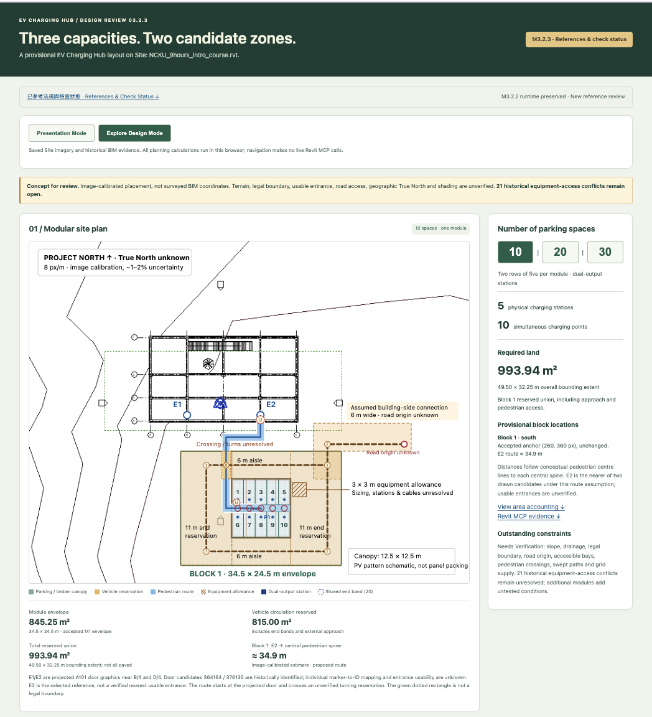
Demo

Slide 19

DEMO FALLBACK / STEP 1 OF 8
Start
Captured from M3.2.3 Presentation Mode · Standard layout · east-side study at 30 spaces
Begin with an empty
canvas.
Start resets the visible layers.
No live model query occurs.
Offline concept preview. Site fit, legal access, terrain, shading, turning and clearances require validation.
M3.2.3 | EV Charging Hub | Concept design review | M3.2.3 baseline / 2 November 2026
Notes:
Backup demo step 1: STEP 1 / 8
Start
Empty canvas. Begin the saved-evidence demonstration. No Site, building, entrances or proposed parking is visible.
Saved Site: NCKU_9hours_intro_course.rvt. No live Revit MCP call.
View this stepâ€™s evidence â†“
MCP tools Â· saved evidence
get_active_view
get_project_info
Skills Â· historical / partial
element-query
parking-check
building-compliance
Not run / failed diagnostic
get_active_schema
Saved workflow evidence; presentation steps make no live MCP calls.
Source: actual browser capture assets/step-1.png; on-slide image is the site-frame capture from the same state. See assets/capture-evidence.json for exact geometry, inputs and source hash. Screenshot timestamp: 2026-11-02T10:59:35.276Z. No model operations performed. The Start screenshot is intentionally blank. No regulation check is implied by a graphical layer appearing.

Slide 20
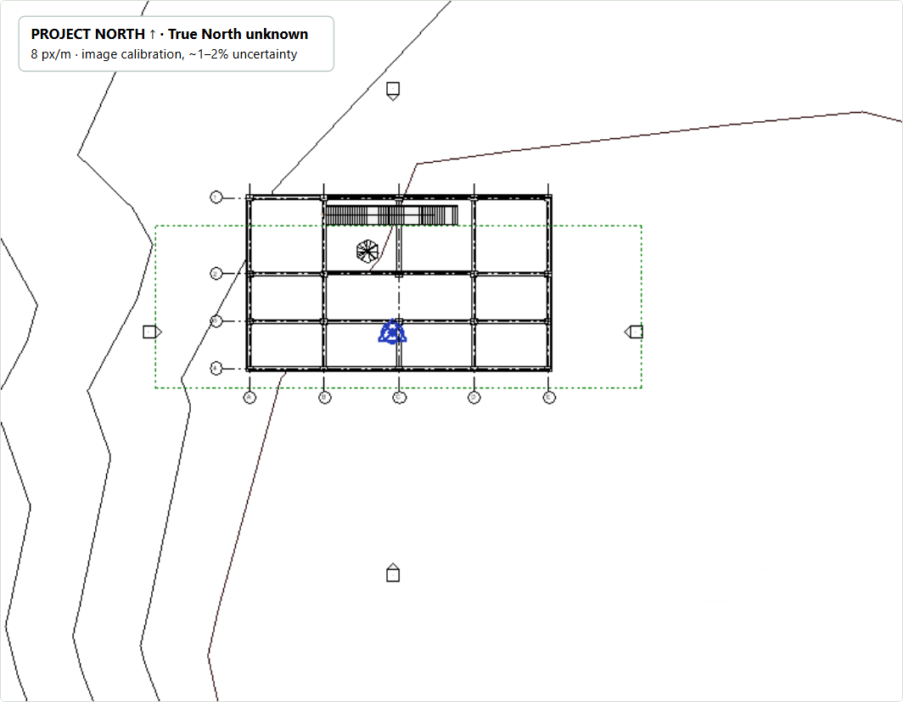
DEMO FALLBACK / STEP 2 OF 8
Load Site
Captured from M3.2.3 Presentation Mode · Standard layout · east-side study at 30 spaces
Load the saved Site
image.
NCKU course model / 755 × 587
px.
Terrain pixels do not establish grades
or legal boundaries.
Offline concept preview. Site fit, legal access, terrain, shading, turning and clearances require validation.
M3.2.3 | EV Charging Hub | Concept design review | M3.2.3 baseline / 2 November 2026
Notes:
Backup demo step 2: STEP 2 / 8
Load Site
Load the saved Site image for NCKU_9hours_intro_course.rvt. The existing building and terrain are pixels in the image, not live Revit geometry.
Saved Site: NCKU_9hours_intro_course.rvt. No live Revit MCP call.
View this stepâ€™s evidence â†“
MCP tools Â· saved evidence
get_active_view
get_all_views
get_project_info
Skills Â· historical / partial
element-query
Saved workflow evidence; presentation steps make no live MCP calls.
Source: actual browser capture assets/step-2.png; on-slide image is the site-frame capture from the same state. See assets/capture-evidence.json for exact geometry, inputs and source hash. Screenshot timestamp: 2026-11-02T10:59:35.276Z. No model operations performed. The Start screenshot is intentionally blank. No regulation check is implied by a graphical layer appearing.

Slide 21
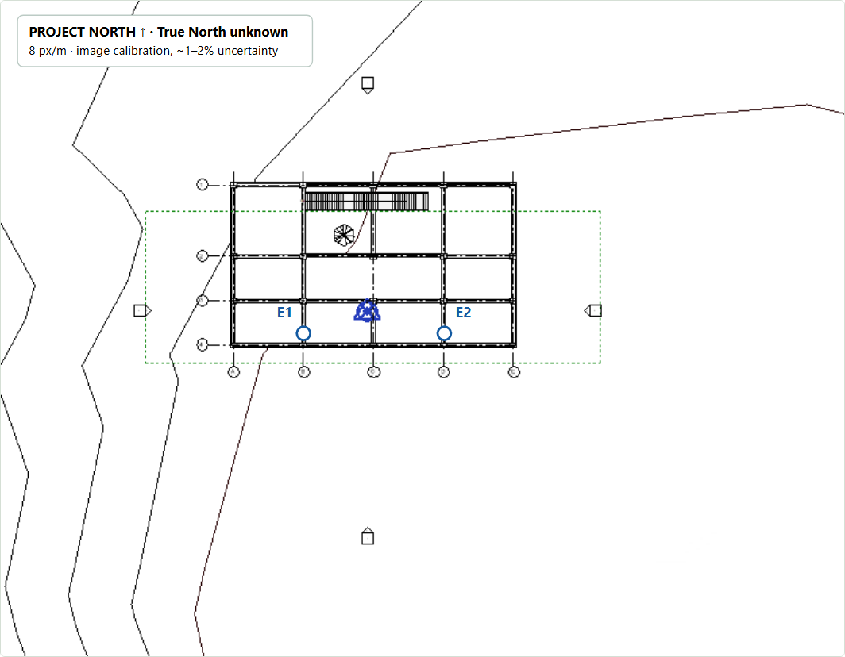
DEMO FALLBACK / STEP 3 OF 8
Identify Entrances
Captured from M3.2.3 Presentation Mode · Standard layout · east-side study at 30 spaces
Mark two entrance
candidates.
E1 / E2 projected from saved
plan evidence.
8 px/m calibration; usable access
remains unverified.
Offline concept preview. Site fit, legal access, terrain, shading, turning and clearances require validation.
M3.2.3 | EV Charging Hub | Concept design review | M3.2.3 baseline / 2 November 2026
Notes:
Backup demo step 3: STEP 3 / 8
Identify Entrances
Identify E1 near B/4 and E2 near D/4 from registered A101 door graphics. Native dimensions support the image calibration; individual door-ID mapping and usable access remain unknown.
Saved Site: NCKU_9hours_intro_course.rvt. No live Revit MCP call.
View this stepâ€™s evidence â†“
MCP tools Â· saved evidence
get_active_view
get_all_views
get_category_fields
query_elements_with_filter
get_element_info
get_project_info
Skills Â· historical / partial
element-query
Saved workflow evidence; presentation steps make no live MCP calls.
Source: actual browser capture assets/step-3.png; on-slide image is the site-frame capture from the same state. See assets/capture-evidence.json for exact geometry, inputs and source hash. Screenshot timestamp: 2026-11-02T10:59:35.276Z. No model operations performed. The Start screenshot is intentionally blank. No regulation check is implied by a graphical layer appearing.

Slide 22
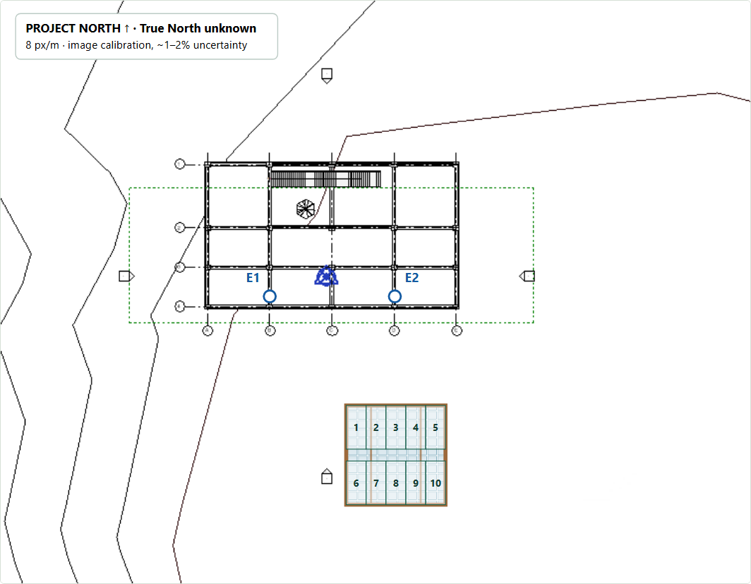
DEMO FALLBACK / STEP 4 OF 8
Generate Block 1
Captured from M3.2.3 Presentation Mode · Standard layout · east-side study at 30 spaces
Create one 10-space
module.
Two rows of five / 2.5 × 5.5 m
bays.
12.5 × 12.5 m canopy; browser
geometry only.
Offline concept preview. Site fit, legal access, terrain, shading, turning and clearances require validation.
M3.2.3 | EV Charging Hub | Concept design review | M3.2.3 baseline / 2 November 2026
Notes:
Backup demo step 4: STEP 4 / 8
Generate Block 1
Generate Block 1 at its accepted south anchor. Ten 2.5 Ã— 5.5 m stalls form two adjacent rows of five under a proposed 12.5 Ã— 12.5 m timber/PV canopy. No native roof is created.
10 spaces Â· 1 module(s), each 5 + 5
Proposed timber/PV canopy: 12.5 Ã— 12.5 m per module
Saved Site: NCKU_9hours_intro_course.rvt. No live Revit MCP call. Unverified: site fit, access, terrain, shading, turning and clearances.
View this stepâ€™s evidence â†“
MCP tools Â· saved evidence
get_active_view
get_all_views
get_category_fields
query_elements_with_filter
get_element_info
list_family_symbols
get_project_info
Skills Â· historical / partial
element-query
parking-check
building-compliance
Saved workflow evidence; presentation steps make no live MCP calls.
Source: actual browser capture assets/step-4.png; on-slide image is the site-frame capture from the same state. See assets/capture-evidence.json for exact geometry, inputs and source hash. Screenshot timestamp: 2026-11-02T10:59:35.276Z. No model operations performed. The Start screenshot is intentionally blank. No regulation check is implied by a graphical layer appearing.

Slide 23
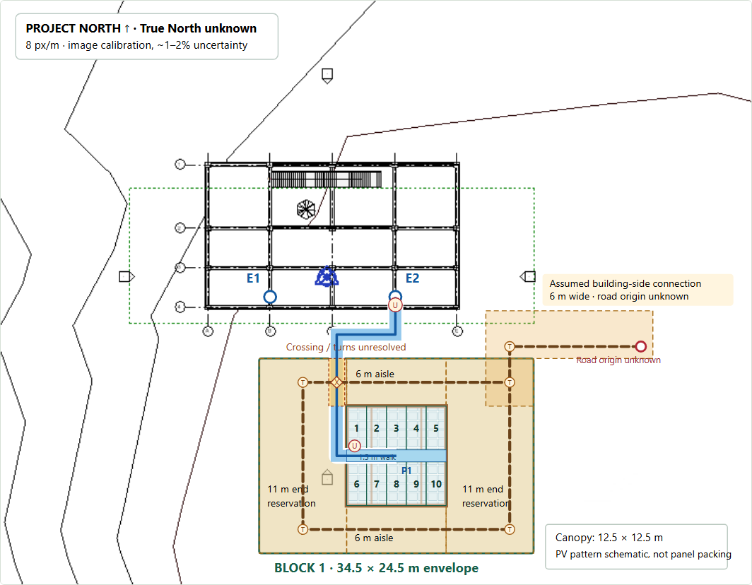
DEMO FALLBACK / STEP 5 OF 8
Add Circulation
Captured from M3.2.3 Presentation Mode · Standard layout · east-side study at 30 spaces
Add circulation
reservations.
6 m aisles / 11 m ends / 1.5 m
spine.
E2 route ≈ 34.9 m; turning and
crossings unresolved.
Offline concept preview. Site fit, legal access, terrain, shading, turning and clearances require validation.
M3.2.3 | EV Charging Hub | Concept design review | M3.2.3 baseline / 2 November 2026
Notes:
Backup demo step 5: STEP 5 / 8
Add Circulation
Add conceptual 6 m vehicle aisles, 11 m end reservations and a 1.5 m pedestrian spine. E2-to-spine distance is approximately 34.9 m. Crossings, turning and terrain remain unresolved.
10 spaces Â· 1 module(s), each 5 + 5
Proposed timber/PV canopy: 12.5 Ã— 12.5 m per module
Reserved union: 993.94 mÂ² (equipment not yet included)
E2 conceptual routes: B1: â‰ˆ 34.9 m
Saved Site: NCKU_9hours_intro_course.rvt. No live Revit MCP call. Unverified: site fit, access, terrain, shading, turning and clearances.
View this stepâ€™s evidence â†“
MCP tools Â· saved evidence
get_active_view
get_all_views
get_category_fields
query_elements_with_filter
get_element_info
list_family_symbols
get_project_info
Skills Â· historical / partial
element-query
parking-check
building-compliance
Not run / failed diagnostic
measure_distance
Saved workflow evidence; presentation steps make no live MCP calls.
Source: actual browser capture assets/step-5.png; on-slide image is the site-frame capture from the same state. See assets/capture-evidence.json for exact geometry, inputs and source hash. Screenshot timestamp: 2026-11-02T10:59:35.276Z. No model operations performed. The Start screenshot is intentionally blank. No regulation check is implied by a graphical layer appearing.

Slide 24
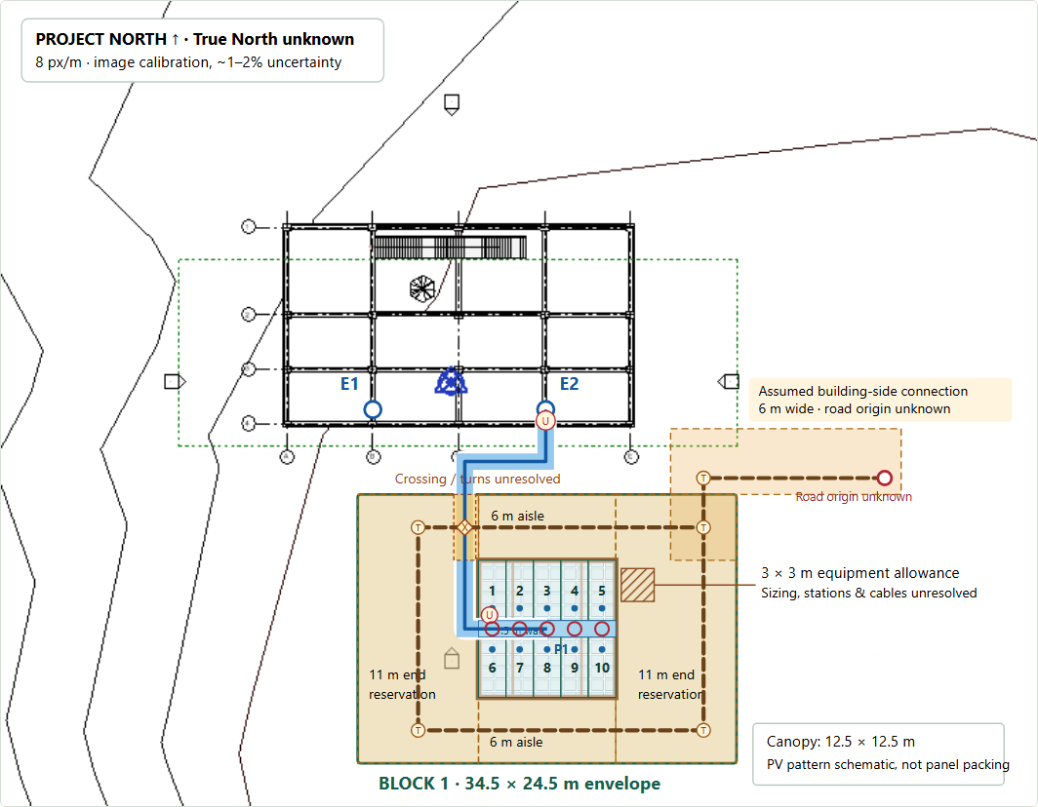
DEMO FALLBACK / STEP 6 OF 8
Add Charging Stations
Captured from M3.2.3 Presentation Mode · Standard layout · east-side study at 30 spaces
Add five dual-output
stations.
10 simultaneous points
assumed.
994 m² land union; 3 × 3 m equipment
allowance.
Offline concept preview. Site fit, legal access, terrain, shading, turning and clearances require validation.
M3.2.3 | EV Charging Hub | Concept design review | M3.2.3 baseline / 2 November 2026
Notes:
Backup demo step 6: STEP 6 / 8
Add Charging Stations
Add five physical dual-output charging stations, serving ten simultaneous charging points, and the retained 3 Ã— 3 m equipment allowance. Bodies, cable reach, supply and clear passage remain unverified.
10 spaces Â· 1 module(s), each 5 + 5
Proposed timber/PV canopy: 12.5 Ã— 12.5 m per module
Reserved union: 993.94 mÂ²
E2 conceptual routes: B1: â‰ˆ 34.9 m
5 physical stations Â· 10 simultaneous charging points
3 Ã— 3 m equipment allowance per module
Saved Site: NCKU_9hours_intro_course.rvt. No live Revit MCP call. Unverified: site fit, access, terrain, shading, turning and clearances.
View this stepâ€™s evidence â†“
MCP tools Â· saved evidence
get_active_view
get_all_views
get_category_fields
query_elements_with_filter
get_element_info
list_family_symbols
get_project_info
Skills Â· historical / partial
element-query
parking-check
building-compliance
Not run / failed diagnostic
measure_distance
Saved workflow evidence; presentation steps make no live MCP calls.
Source: actual browser capture assets/step-6.png; on-slide image is the site-frame capture from the same state. See assets/capture-evidence.json for exact geometry, inputs and source hash. Screenshot timestamp: 2026-11-02T10:59:35.276Z. No model operations performed. The Start screenshot is intentionally blank. No regulation check is implied by a graphical layer appearing.

Slide 25
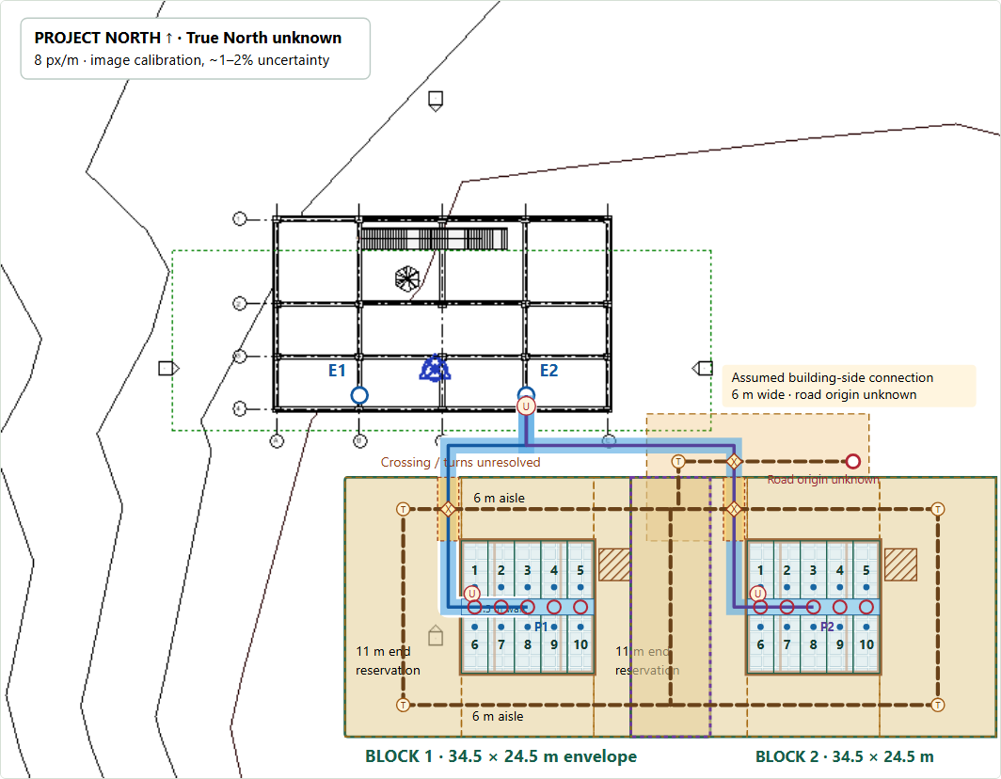
DEMO FALLBACK / STEP 7 OF 8
Expand to 20 Spaces
Captured from M3.2.3 Presentation Mode · Standard layout · east-side study at 30 spaces
Add a second module.
20 spaces / 10 stations / 20
points.
Standard 1,671 m²; Compact 1,442
m².
Offline concept preview. Site fit, legal access, terrain, shading, turning and clearances require validation.
M3.2.3 | EV Charging Hub | Concept design review | M3.2.3 baseline / 2 November 2026
Notes:
Backup demo step 7: STEP 7 / 8
Expand to 20 Spaces
Add Block 2 in its accepted M2.1 Standard or Compact location. Compact changes internal vehicle allocation and tests a 1.5 m pedestrian passage; area saving does not establish safe maneuvers.
20 spaces Â· 2 module(s), each 5 + 5
Proposed timber/PV canopy: 12.5 Ã— 12.5 m per module
Reserved union: 1,671.38 mÂ²
E2 conceptual routes: B1: â‰ˆ 34.9 m Â· B2: â‰ˆ 47.1 m
10 physical stations Â· 20 simultaneous charging points
3 Ã— 3 m equipment allowance per module
Option A â€” Standard Design Â· 61.50 Ã— 32.25 m overall bounds
Saved Site: NCKU_9hours_intro_course.rvt. No live Revit MCP call. Unverified: site fit, access, terrain, shading, turning and clearances.
View this stepâ€™s evidence â†“
MCP tools Â· saved evidence
get_active_view
get_all_views
get_category_fields
query_elements_with_filter
get_element_info
list_family_symbols
get_project_info
Skills Â· historical / partial
element-query
parking-check
building-compliance
Not run / failed diagnostic
measure_distance
Saved workflow evidence; presentation steps make no live MCP calls.
Source: actual browser capture assets/step-7.png; on-slide image is the site-frame capture from the same state. See assets/capture-evidence.json for exact geometry, inputs and source hash. Screenshot timestamp: 2026-11-02T10:59:35.276Z. No model operations performed. The Start screenshot is intentionally blank. No regulation check is implied by a graphical layer appearing.

Slide 26
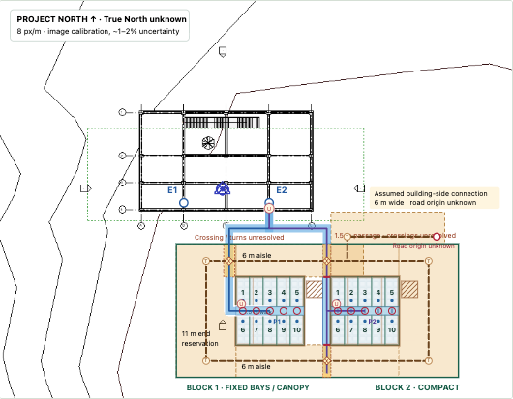
DEMO FALLBACK / STEP 7 OF 8
Expand to 20 Spaces (Compact)
Captured from M3.2.3 Presentation Mode · Standard layout · east-side study at 30 spaces
Add a second module.
20 spaces / 10 stations / 20
points.
Standard 1,671 m²; Compact 1,442
m².
Offline concept preview. Site fit, legal access, terrain, shading, turning and clearances require validation.
M3.2.3 | EV Charging Hub | Concept design review | M3.2.3 baseline / 2 November 2026
Notes:
Backup demo step 7: STEP 7 / 8
Expand to 20 Spaces
Add Block 2 in its accepted M2.1 Standard or Compact location. Compact changes internal vehicle allocation and tests a 1.5 m pedestrian passage; area saving does not establish safe maneuvers.
20 spaces Â· 2 module(s), each 5 + 5
Proposed timber/PV canopy: 12.5 Ã— 12.5 m per module
Reserved union: 1,671.38 mÂ²
E2 conceptual routes: B1: â‰ˆ 34.9 m Â· B2: â‰ˆ 47.1 m
10 physical stations Â· 20 simultaneous charging points
3 Ã— 3 m equipment allowance per module
Option A â€” Standard Design Â· 61.50 Ã— 32.25 m overall bounds
Saved Site: NCKU_9hours_intro_course.rvt. No live Revit MCP call. Unverified: site fit, access, terrain, shading, turning and clearances.
View this stepâ€™s evidence â†“
MCP tools Â· saved evidence
get_active_view
get_all_views
get_category_fields
query_elements_with_filter
get_element_info
list_family_symbols
get_project_info
Skills Â· historical / partial
element-query
parking-check
building-compliance
Not run / failed diagnostic
measure_distance
Saved workflow evidence; presentation steps make no live MCP calls.
Source: actual browser capture assets/step-7.png; on-slide image is the site-frame capture from the same state. See assets/capture-evidence.json for exact geometry, inputs and source hash. Screenshot timestamp: 2026-11-02T10:59:35.276Z. No model operations performed. The Start screenshot is intentionally blank. No regulation check is implied by a graphical layer appearing.

Slide 27
DEMO FALLBACK / STEP 8 OF 8
Expand to 30 Spaces
Captured from M3.2.3 Presentation Mode · Standard layout · east-side study at 30 spaces
Add the east-side third
module.
30 spaces / 15 stations / 30
points.
Standard 2,517 m²; Compact east
2,287 m².
Offline concept preview. Site fit, legal access, terrain, shading, turning and clearances require validation.
M3.2.3 | EV Charging Hub | Concept design review | M3.2.3 baseline / 2 November 2026
Notes:
Backup demo step 8: STEP 8 / 8
Expand to 30 Spaces
Add Block 3 and compare south/southeast continuation with the east-side candidate. Image coverage, route length and reservation area support comparison; neither candidate has a verified site fit.
30 spaces Â· 3 module(s), each 5 + 5
Proposed timber/PV canopy: 12.5 Ã— 12.5 m per module
Reserved union: 2,516.63 mÂ²
E2 conceptual routes: B1: â‰ˆ 34.9 m Â· B2: â‰ˆ 47.1 m Â· B3: â‰ˆ 47.1 m
15 physical stations Â· 30 simultaneous charging points
3 Ã— 3 m equipment allowance per module
Option A â€” Standard Design Â· 61.50 Ã— 55.00 m overall bounds
East-side study Â· +845.25 mÂ² for Block 3 Â· 0.00 mÂ² beyond image
View south-versus-east comparison
Saved Site: NCKU_9hours_intro_course.rvt. No live Revit MCP call. Unverified: site fit, access, terrain, shading, turning and clearances.
View this stepâ€™s evidence â†“
MCP tools Â· saved evidence
get_active_view
get_all_views
get_category_fields
query_elements_with_filter
get_element_info
list_family_symbols
get_all_levels
get_project_info
Skills Â· historical / partial
element-query
parking-check
building-compliance
Not run / failed diagnostic
measure_distance
get_element_geometry
Saved workflow evidence; presentation steps make no live MCP calls.
Source: actual browser capture assets/step-8.png; on-slide image is the site-frame capture from the same state. See assets/capture-evidence.json for exact geometry, inputs and source hash. Screenshot timestamp: 2026-11-02T10:59:35.276Z. No model operations performed. The Start screenshot is intentionally blank. No regulation check is implied by a graphical layer appearing.

Slide 28
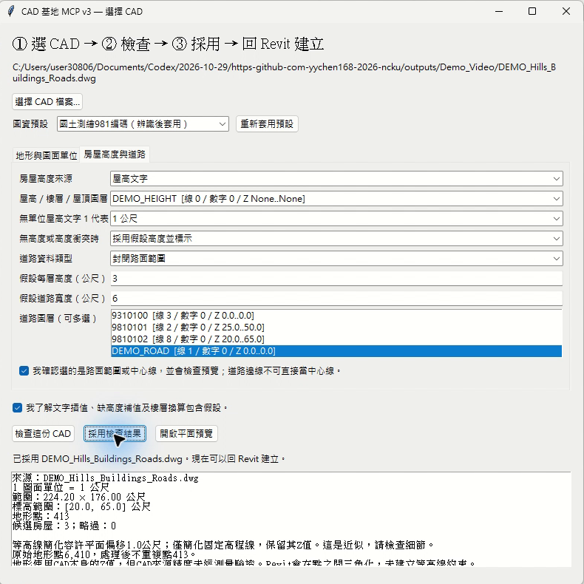
選檔、檢查與採用
先確認資料
再建立模型
選擇 CAD
檢查設定
採用結果
回 Revit 建立
04
Notes:
操作說明：先選擇 CAD，確認圖面單位及圖層，按檢查，再採用結果，最後回到 Revit 建立。檢查不會直接寫入模型，採用步驟可以避免把未確認資料送進 Revit。圖中是本次真實操作錄影畫面。

Slide 29

Notes:
大尺度：基地模型 → 中尺度：停車場配置 → 小尺度：局部法規檢討
「接下來，我們會由大到小，依序展示三種尺度的操作。每個案例都會說明我們提出了什麼任務、MCP 如何介入，以及最後得到什麼結果。」

Slide 30
目的
Revit MCP 自然排煙開口檢核助手
從模型資料查詢、法規檢核，延伸至排煙窗方案規劃、套用與復原。
已完成：
Revit
Model
MCP / AI
讀取與分析
網頁
檢核與預覽
為什麼做？
傳統檢核需要人工逐一確認房間、窗戶、開啟方式與有效面積，當模型規模增加，判讀與反覆修改容易耗時。
檢核 → 改善 → 回寫 → 再驗證
希望做到：
形成可反覆操作的 BIM 檢核系統
01
自動讀取 BIM 空間與窗戶資料
目前檢核邏輯：
02
自動計算有效排煙面積並判定 PASS / FAIL
需求排煙面積＝房間面積 × 2%
有效排煙面積＝有效排煙帶內窗面積 × 窗戶開啟比例
有效面積 ≥ 需求面積 → PASS
03
針對 FAIL 房間提出可執行的改善方案

Slide 31
系統流程
從「自動檢核」做到「協助改善」
系統將 Revit 資料、檢核公式、3D 預覽與模型回寫串成一套流程。
01
02
03
04
05
讀取
檢核
改善
預覽
回寫
Room / Window / Level
Effective Area
Plan / Retrofit
3D Dashboard
Apply / Undo
取得房間面積、天花高度、窗戶位置與窗型。
計算有效排煙帶內面積與開啟比例，自動判定 PASS / FAIL。
針對 FAIL 的房間評估既有窗調整和新增開口的方案。
以簡化 3D 房間呈現既有窗、有效排煙帶與改善預覽。
將方案套用至 Revit，再次檢核，失敗可以復原 。
已完成：
Room→Window 對應
有效排煙帶計算
開啟比例估算
3D 房間檢核視圖
改善方案預覽
Apply / Undo 安全機制

Slide 32
案例與實作
系統架構
系統提供 Codex AI Client 與網頁介面兩種操作入口，由 Node MCP Server 統一處理請求，透過 localhost:8964 的 WebSocket 與 Revit MCP Add-in 溝通，再由 C# 呼叫 Revit API 執行模型查詢、檢核與修改。
Codex / AI Client
自然語言操作
Node MCP Server
WebSocket
Revit MCP Add-in
Revit
統一處理 AI 指令與網頁請求
localhost:8964
C# / Revit 2026
API
網頁介面
HTTP 127.0.0.1:10002

Slide 33
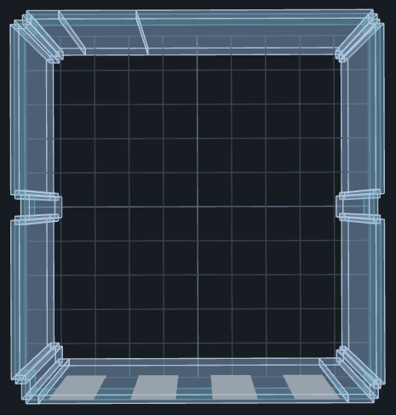
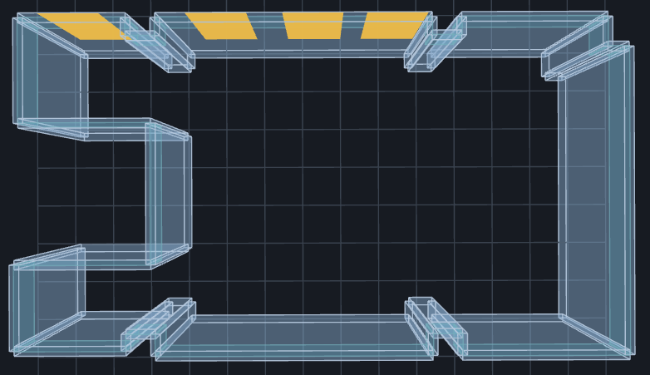
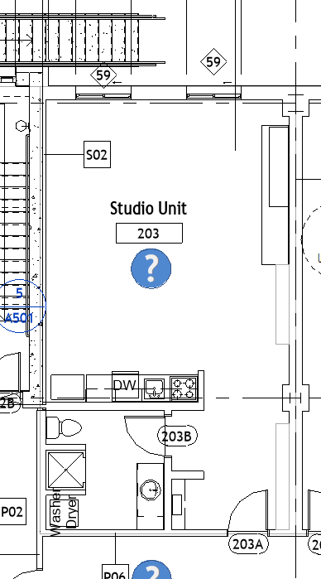
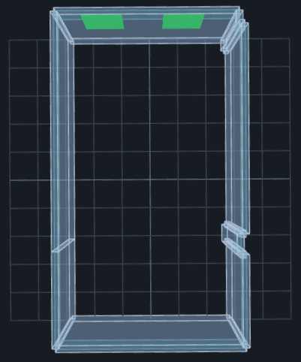
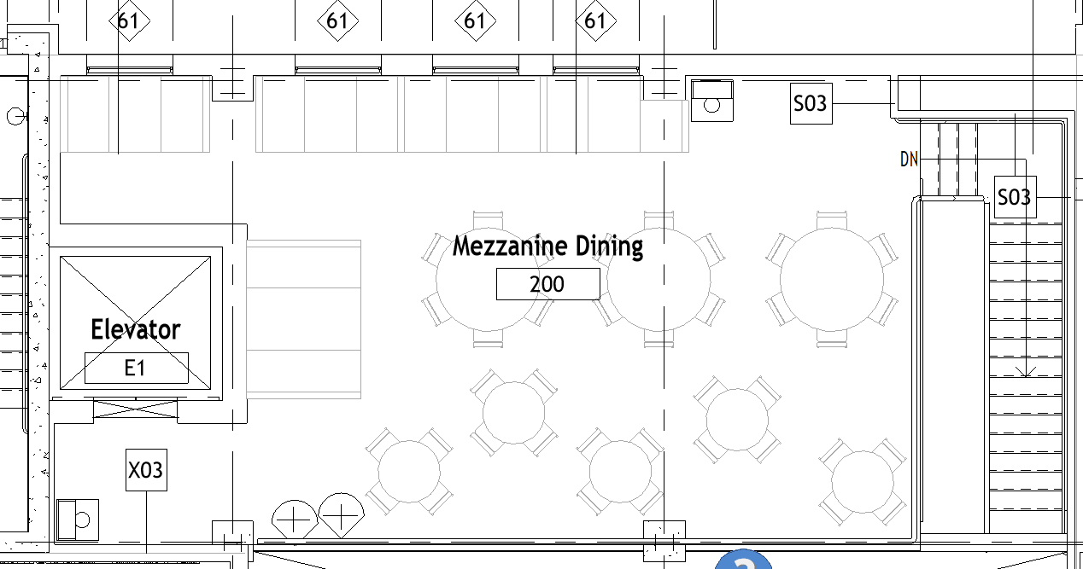
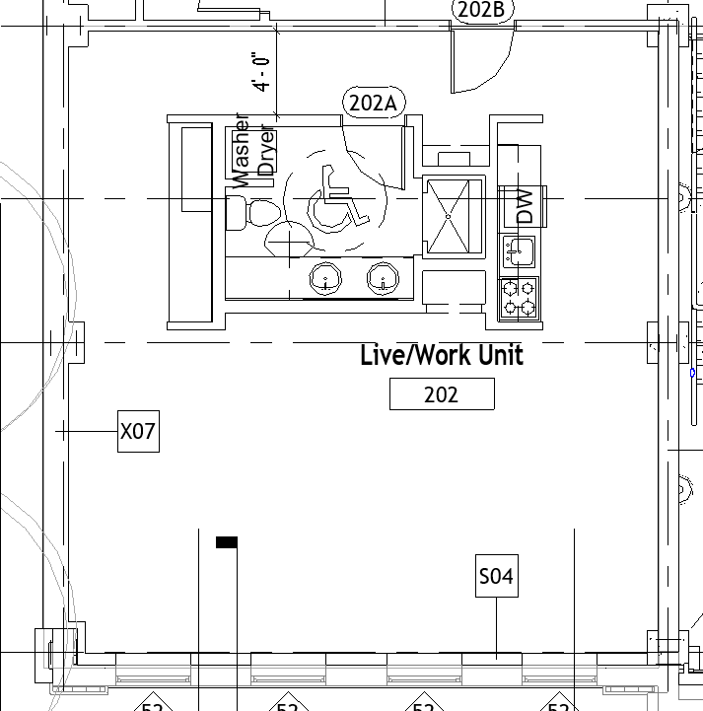
案例與實作
空間 3D 即時預覽
Snowdon Towers Sample Architectural
Mezzanine Dining / 夾層餐廳
Room 200
Live/Work Unit / 住辦單元
Room 202
Studio Unit / 套房單元
Room 203

Slide 34
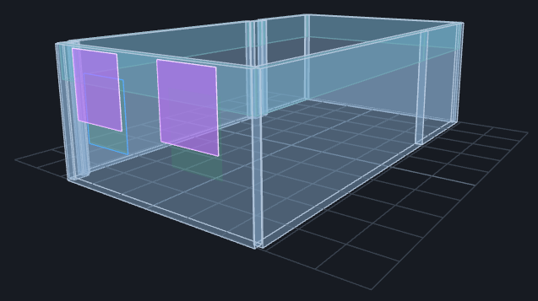
案例與實作
從 FAIL 到可執行的改善方案
影片連結
以 Room 203 示範：檢核 → 3D 預覽 → 套用 Revit → 再檢核。
Studio Unit｜Room 203
改善前：
FAIL
Room Area
Required
Effective
55.08 m²
1.1016 m²
0.3224 m²
既有 2 扇 Sliding Window，只有上方部分落入有效排煙帶。
改善策略：
紫色＝改善預覽
保留原 Host 與位置，調整既有 2 扇窗的尺寸與 Sill，使更多開口進入有效排煙帶。
Window-Sliding-Double 56" × 60"
Sill ≈ 1590 mm
改善後：
Effective 1.1234 m² > Required 1.1016 m²
PASS

Slide 35
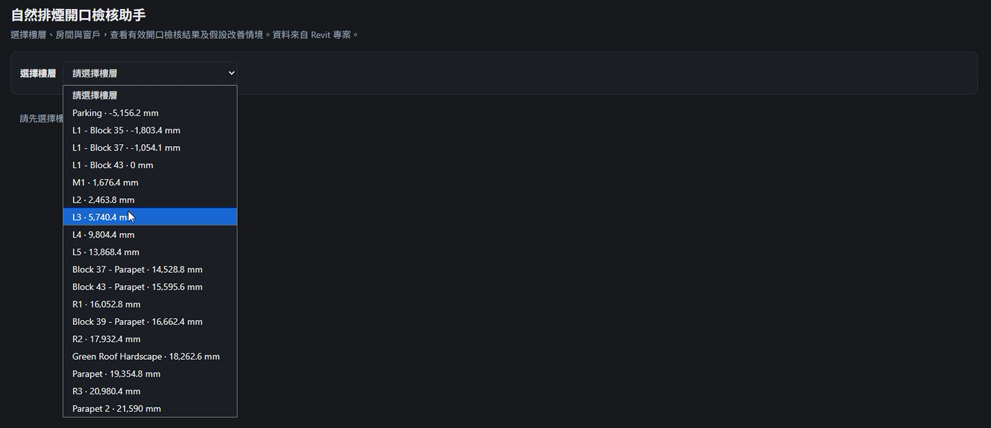
案例與實作

Slide 36
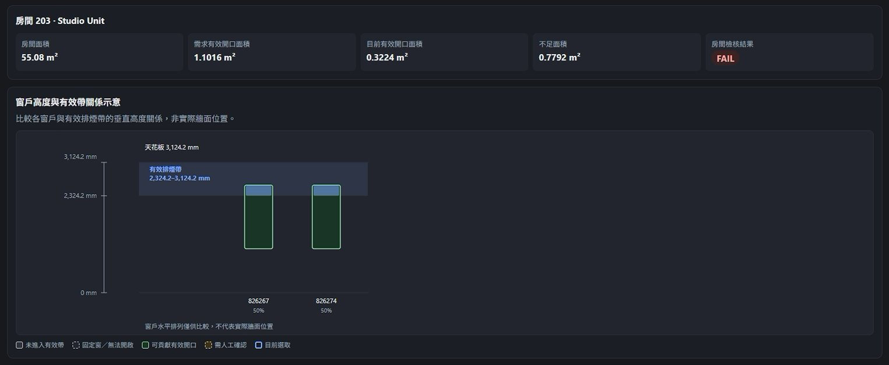
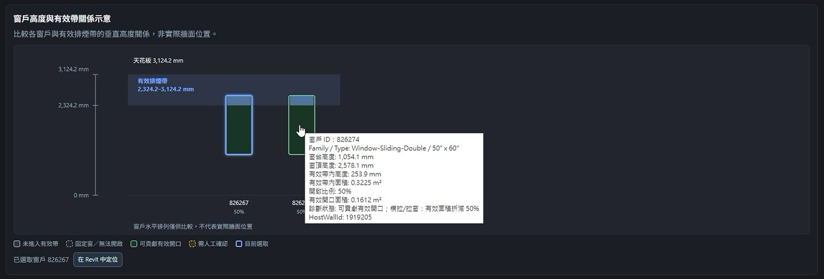
案例與實作

Slide 37
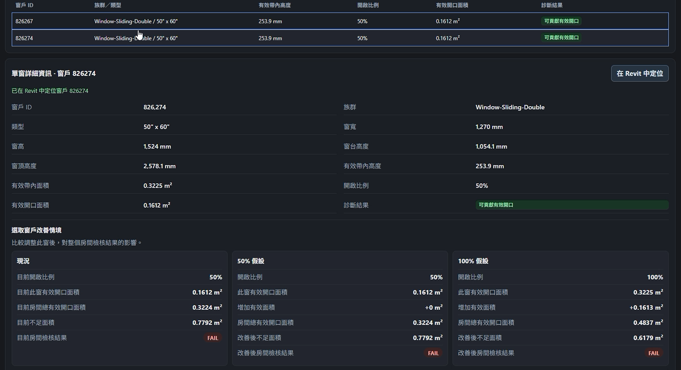
案例與實作

Slide 38
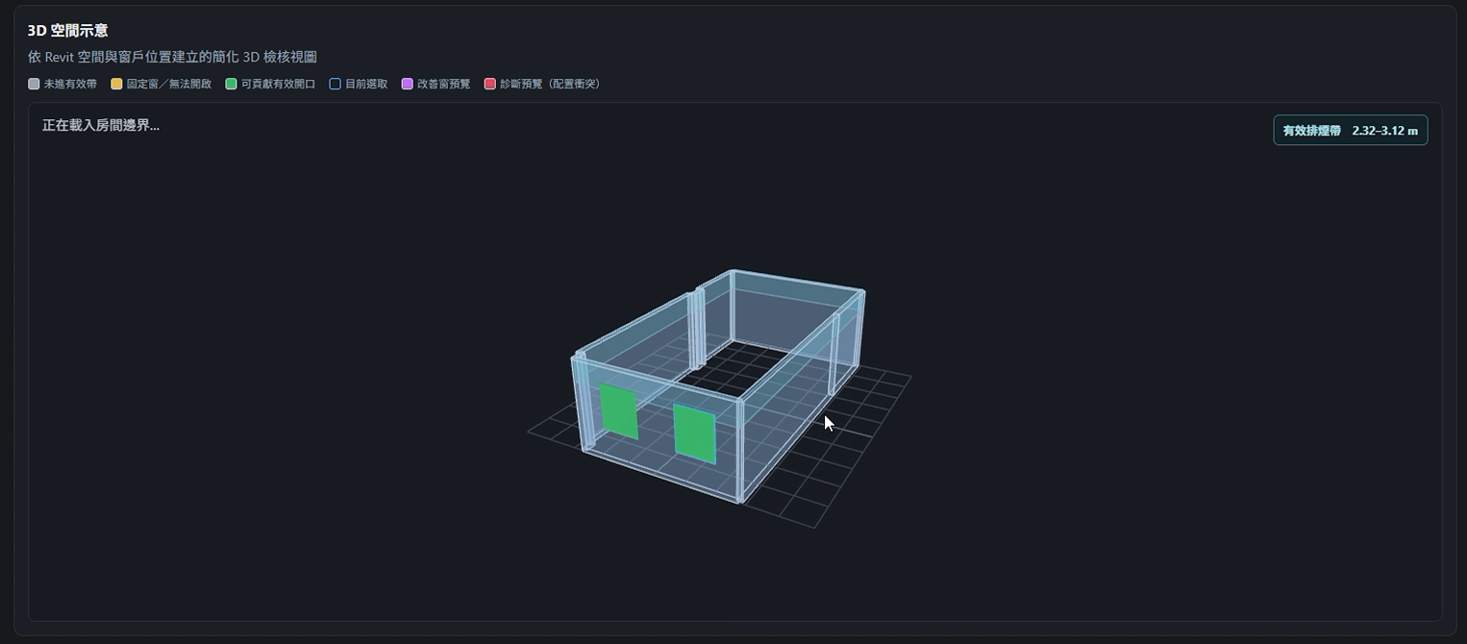
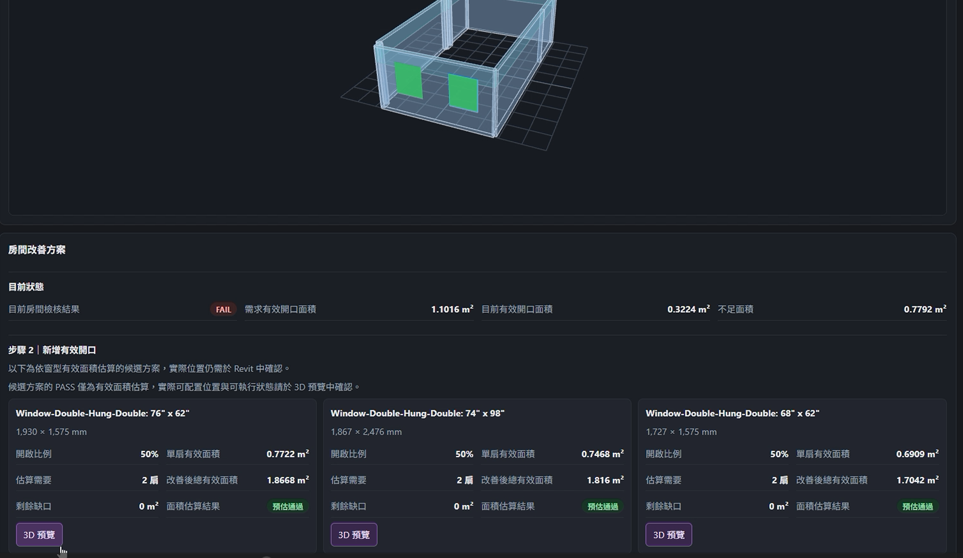
案例與實作

Slide 39
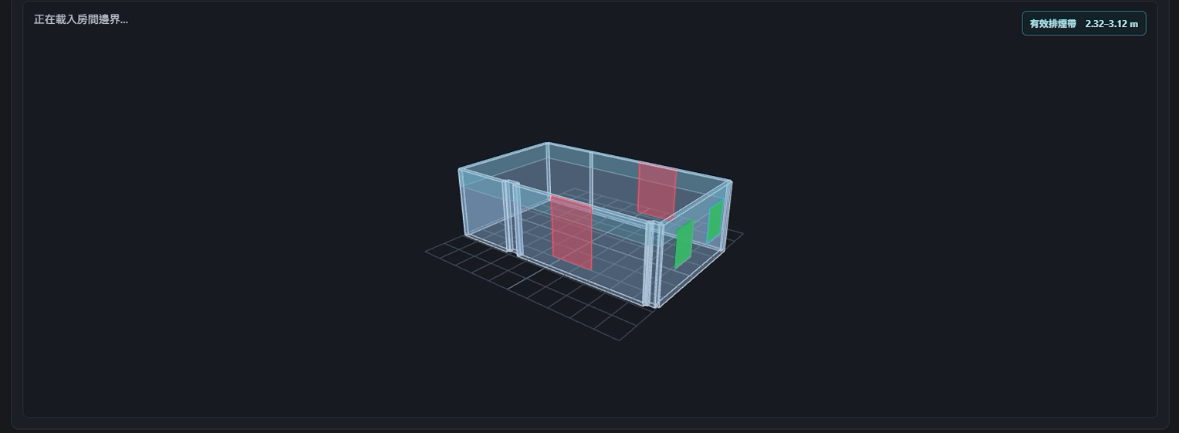
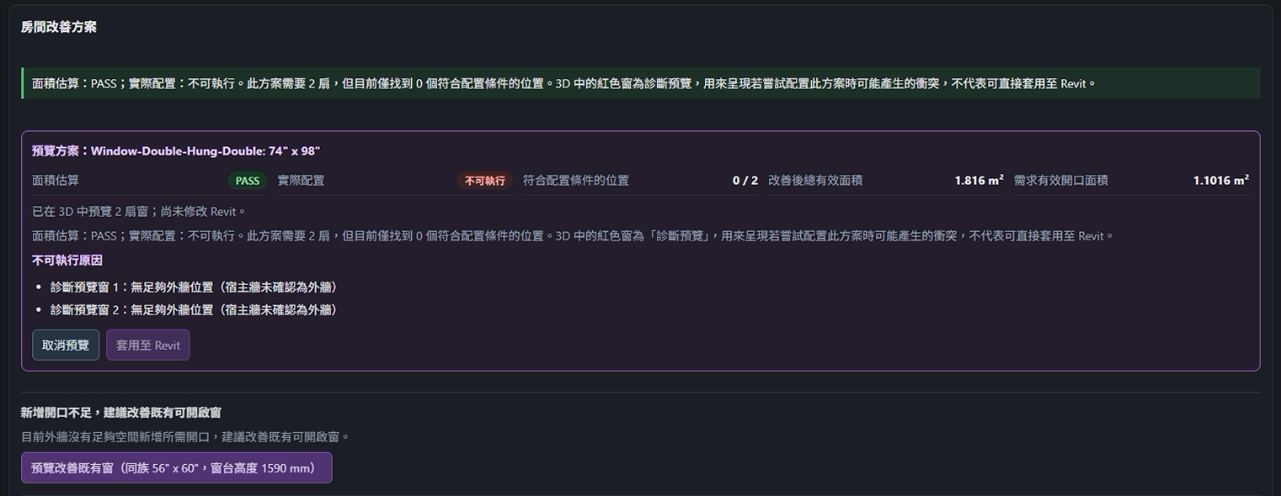
案例與實作

Slide 40
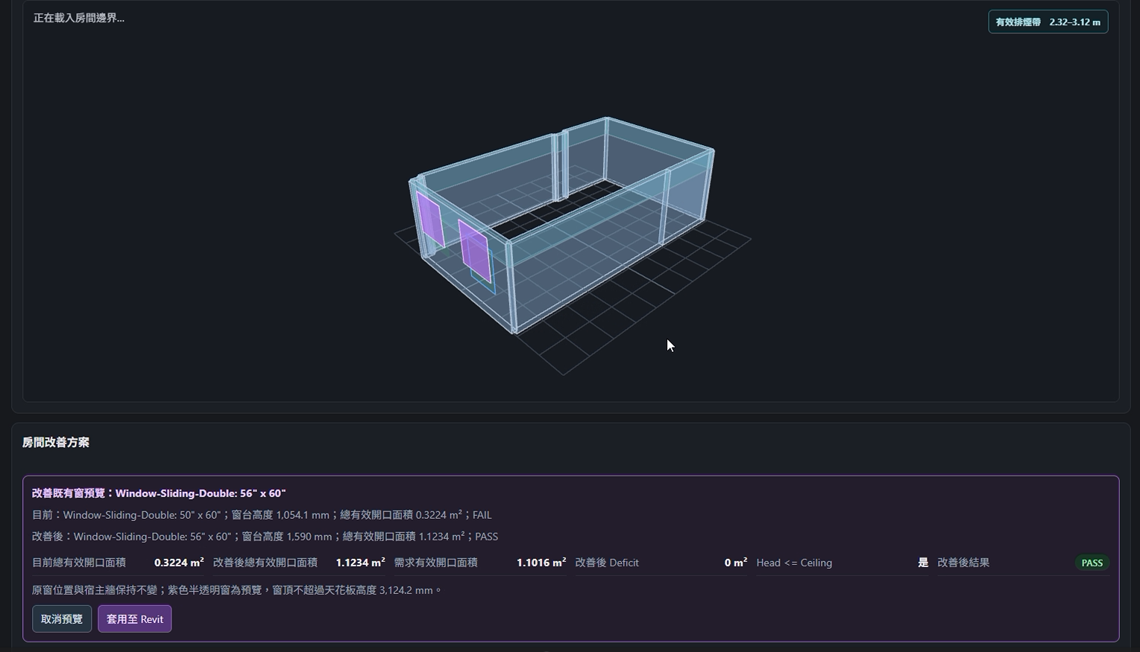
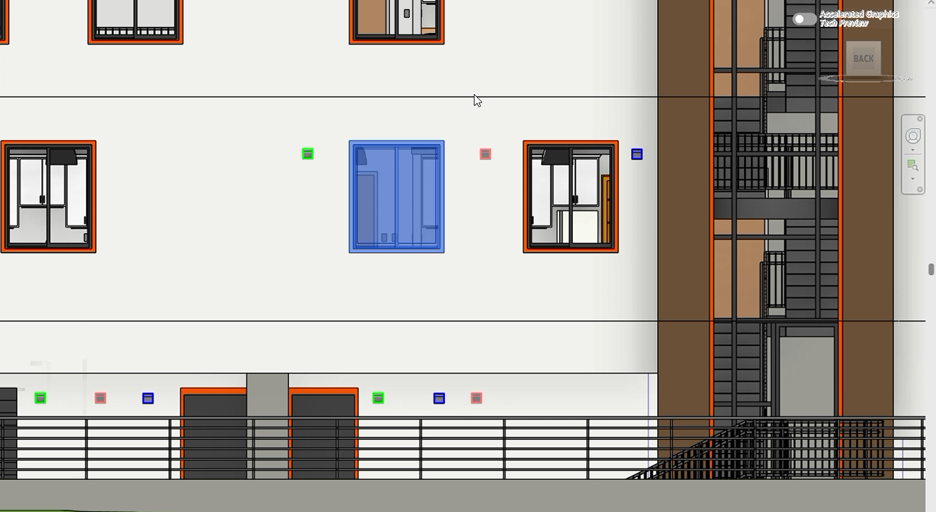
案例與實作

Slide 41
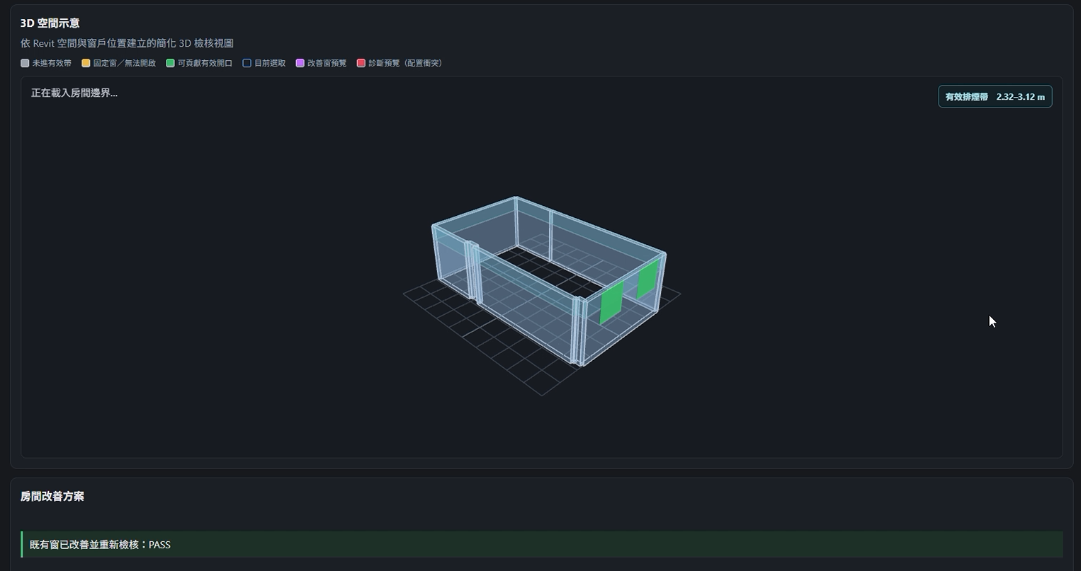
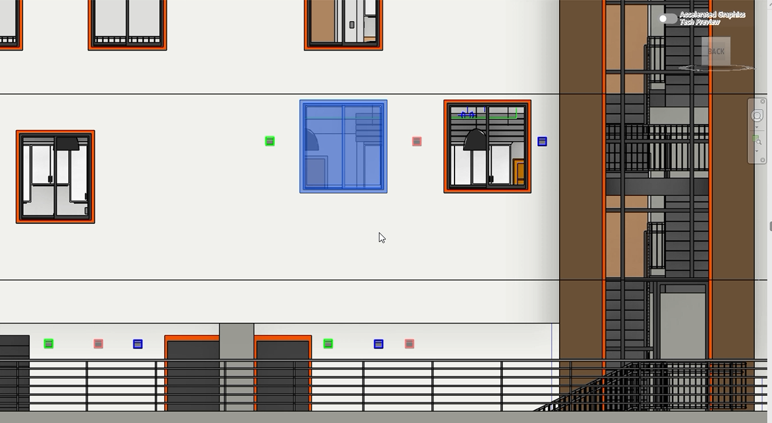
案例與實作

Slide 42
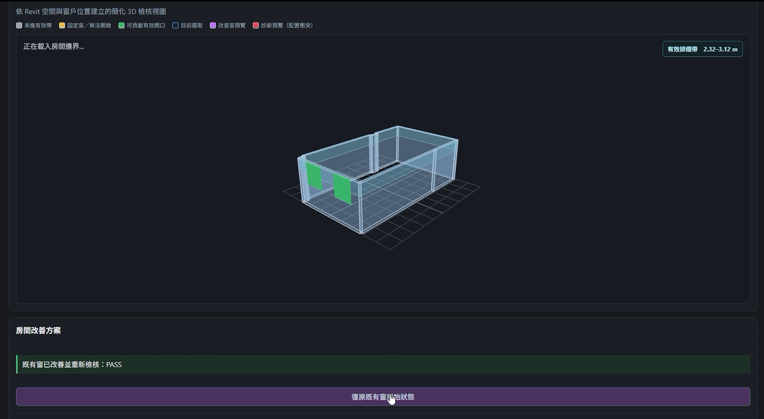
案例與實作

Slide 43
Revit MCP 工具
Revit MCP 工具盤點與擴充
既有 MCP 工具
新增 MCP 工具
。基礎與查詢
  。get_all_levels (取得樓層與標高)
  。query_elements (搜尋 Room、Window 等模型元素)
  。get_element_info (讀取窗戶 Type、Sill、Head、Host Wall 等資訊)
  。zoom_to_element (從網頁定位回 Revit 元素)
。建模與構件
  。get_wall_info (讀取牆體厚度、長度、高度等資訊)
。房間與空間
  。get_rooms_by_level (取得樓層內房間)
  。get_room_info (取得房間詳細資訊)
  。get_room_window_counts (計算每個房間的窗戶數量)
  。get_room_daylight_info (取得房間採光相關資訊)
。MEP 與碰撞
  。get_element_geometry (取得元素幾何與 Bounding Box，輔助判斷窗戶位置與空間關係)
。法規檢核
  。check_smoke_exhaust_windows (排煙窗有效開口檢核)
。新增排煙窗方案
  。plan_smoke_exhaust_window_plan (規劃新增窗戶位置與數量)
  。apply_smoke_exhaust_window_plan (將新增窗戶方案套用至 Revit)
  。undo_smoke_exhaust_window_plan (復原本次新增窗戶操作)
。既有可開啟窗改善
  。plan_smoke_exhaust_window_retrofit (規劃既有窗尺寸與窗台高度改善)
  。apply_smoke_exhaust_window_retrofit (將既有窗改善方案套用至 Revit)
  。undo_smoke_exhaust_window_retrofit (復原既有窗改善操作)
。固定窗轉換為可開啟窗
  。plan_smoke_exhaust_window_replacement (規劃固定窗轉為可開啟窗方案)
  。apply_smoke_exhaust_window_replacement (將固定窗替換方案套用至 Revit)
  。undo_smoke_exhaust_window_replacement (復原固定窗替換操作)

Slide 44
未來改善
未來改善方向
。窗戶開啟比例可調整
  。目前依窗型設定固定開啟比例，未來可依實際窗型、開啟方式或專案條件調整有效開口比例
。模型幾何判斷更精準
  。強化 Room、窗戶與 Host Wall 的對應關係，降低抓錯牆、抓錯窗或樓層判斷錯誤，讓 3D 預覽與改善方案更可靠
。Revit 回寫安全性提升
  。自動替換或調整窗戶時，保留原有位置與重要參數，若操作失敗，可自動復原，避免破壞模型
。批次改善與報告整合
  。將目前單一 Room 的改善流程擴展至整層，自動彙整 FAIL 房間、改善方案與改善後結果

Slide 45
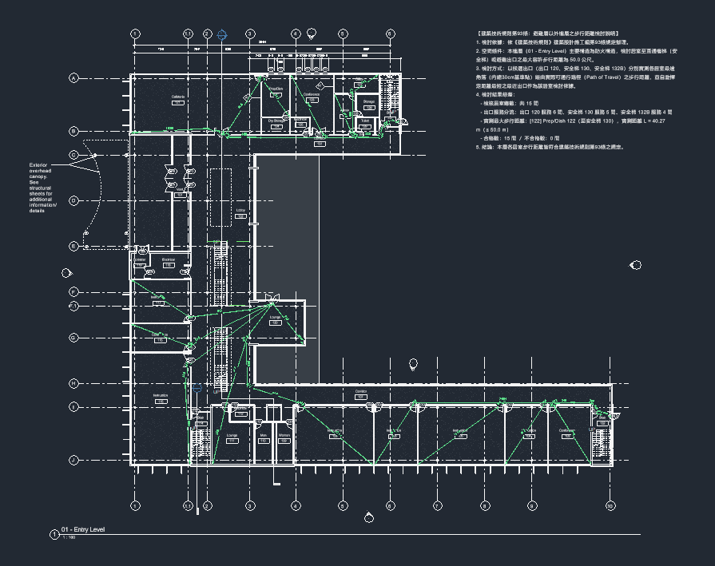
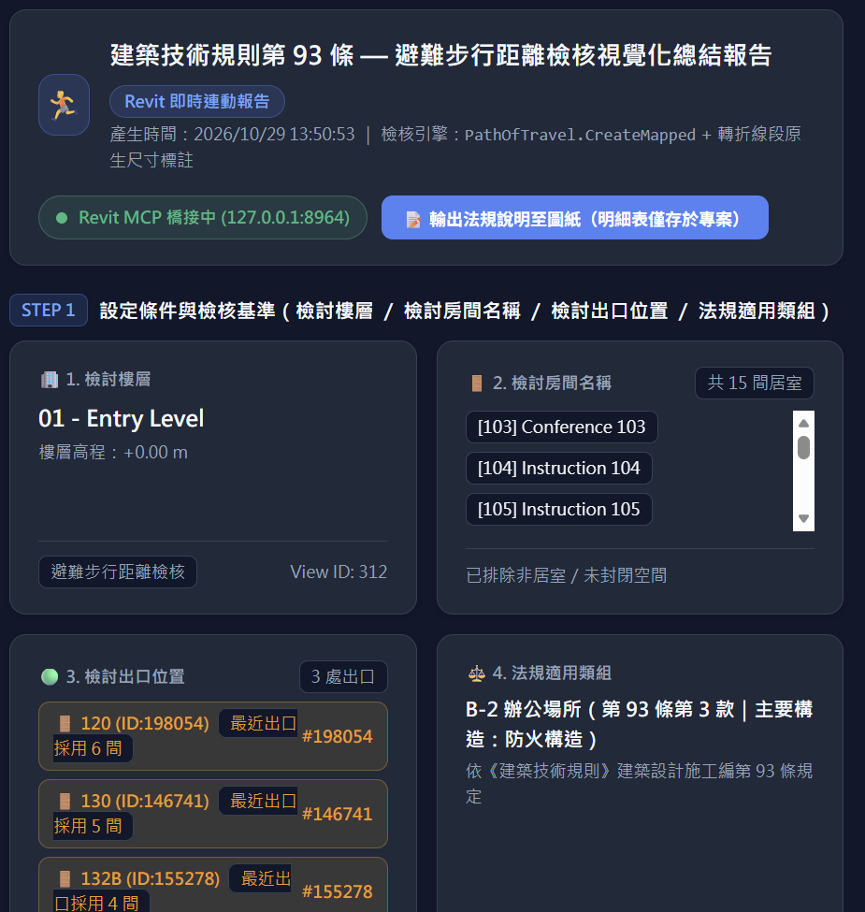
PROJECT PURPOSE / EXECUTIVE SUMMARY
法規-逃生避難距離自動檢討與製圖工具_Walking-Egress-Review
Notes:
我針對小尺度做的skill是有關建築避難的步行距離法規檢討工具
Walking egress review

Slide 46
ARCHITECTURE
架構說明與轉換-現有法規
建築技術規則施工編93條:
直通樓梯之設置應依左列規定：
一、任何建築物自避難層以外之各樓層均應設置一座以上之直通樓梯（包括坡道）通達避難層或地面，樓梯位置應設於明顯處所。
二、自樓面居室之任一點至樓梯口之步行距離（即隔間後之可行距離非直線距離）依左列規定：
（一）建築物用途類組為Ａ類、Ｂ－１、Ｂ－２、Ｂ－３及Ｄ－１組者，不得超過三十公尺。建築物用途類組為Ｃ類者，除有現場觀眾之電視攝影場不得超過三十公尺外，不得超過七十公尺。
（二）前目規定以外用途之建築物不得超過五十公尺。
（三）建築物第十五層以上之樓層依其使用應將前二目規定為三十公尺者減為二十公尺，五十公尺者減為四十公尺。
（四）集合住宅採取複層式構造者，其自無出入口之樓層居室任一點至直通樓梯之步行距離不得超過四十公尺。
（五）非防火構造或非使用不燃材料所建造之建築物，不論任何用途，應將本款所規定之步行距離減為三十公尺以下。
前項第二款至樓梯口之步行距離，應計算至直通樓梯之第一階。但直通樓梯為安全梯者，得計算至進入樓梯間之防火門。
「從每間居室中最遠的角落，到最近的逃生出口，不能超過規定距離」
Notes:
以上簡單說明有關該法規的內容，基本上依照建築寄書規則施工篇第93條內文，
不過簡單概括就是:「從每間居室中最遠的角落，到最近的逃生出口，不能超過法律規定的一定距離」

Slide 47
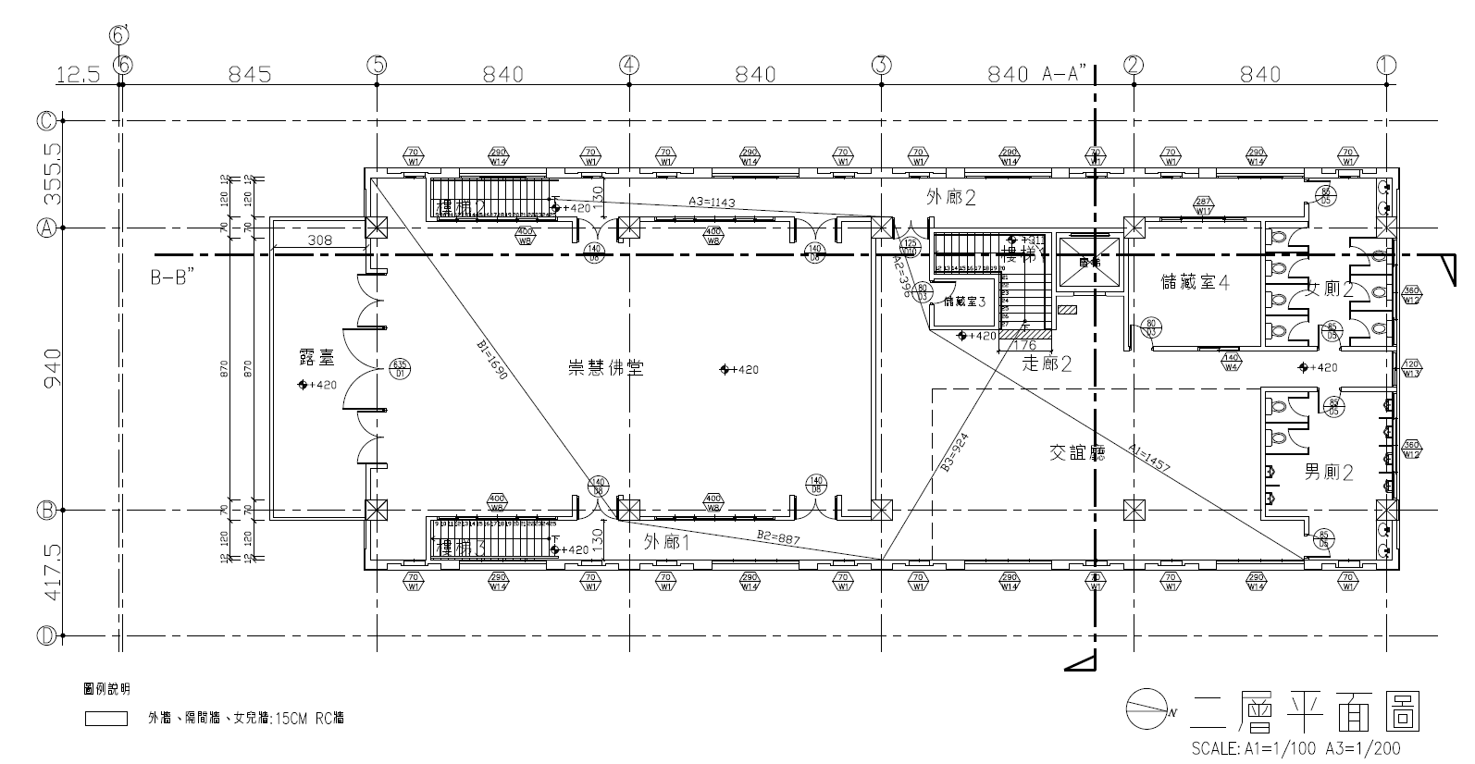
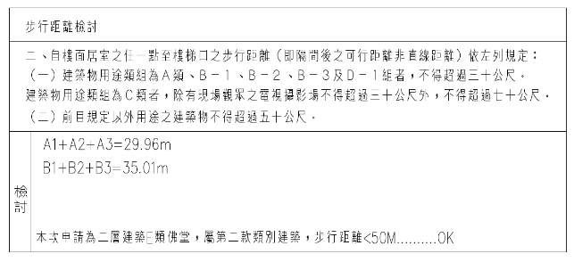
ARCHITECTURE
架構說明與轉換-一般建照檢討方式
Notes:
而以往事務所透過cad等平面軟體的處理方式不外乎就是
每個空間手動拉長度、判斷最短出口、以及手動標註長度加總寫成檢討表格放置於建照平面圖紙內
若整棟檢討完可能要花上兩三個小時乃至一個下午不等的時長

Slide 48
ARCHITECTURE
架構說明與轉換-自動化架構
需要檢討樓層，逃生出口位置提供(請AI Agent自動判定)
自動化檢討
設計修正
建築物用途確認
平面空間居室判定
居室與逃生出口
最長距離判定
選擇最近逃生出口
作為檢討對象並繪製平面檢討圖說
檢討結果可視化
>Revit Skill建立檢討結果
明細表
>Revit Skill輸出檢討文字
自動排版至圖紙
>C#外掛生成可視化檢討
報告。
>Revit skill輸出房間名稱
>AI Agent 判定
>Revit skill輸出房間名稱
>AI Agent 判定
>Revit skil輸出居室點、
阻擋牆面、逃生出口位
置。
>C#外掛計算最長距離
>C#外掛計算判定
>Revit skill 繪製檢討線與
標註
Walking-Egress-Review
Notes:
而我將檢討法規需要的
建築用途確認、平面居室判定、最長距離計算、選擇最近逃生出口以及檢討與繪製建照圖說等流程皆整合進這個skill中
讓建築師只需要對ai agent說要檢討的樓層
經過幾分鐘即可完成撿討並提供可試化的分析結果與完整的建照圖說
大幅縮短繁瑣的檢討流程

Slide 49
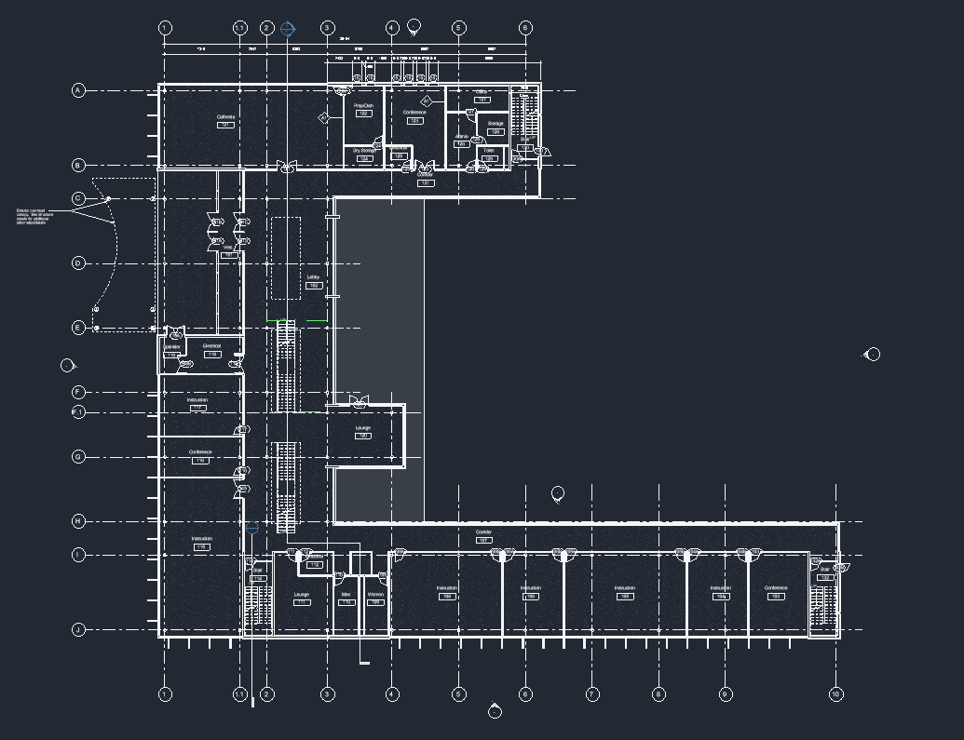
Demo
Notes:
這邊以測試時的截圖進行demo
這是revit模型中的原始樓層平面

Slide 50
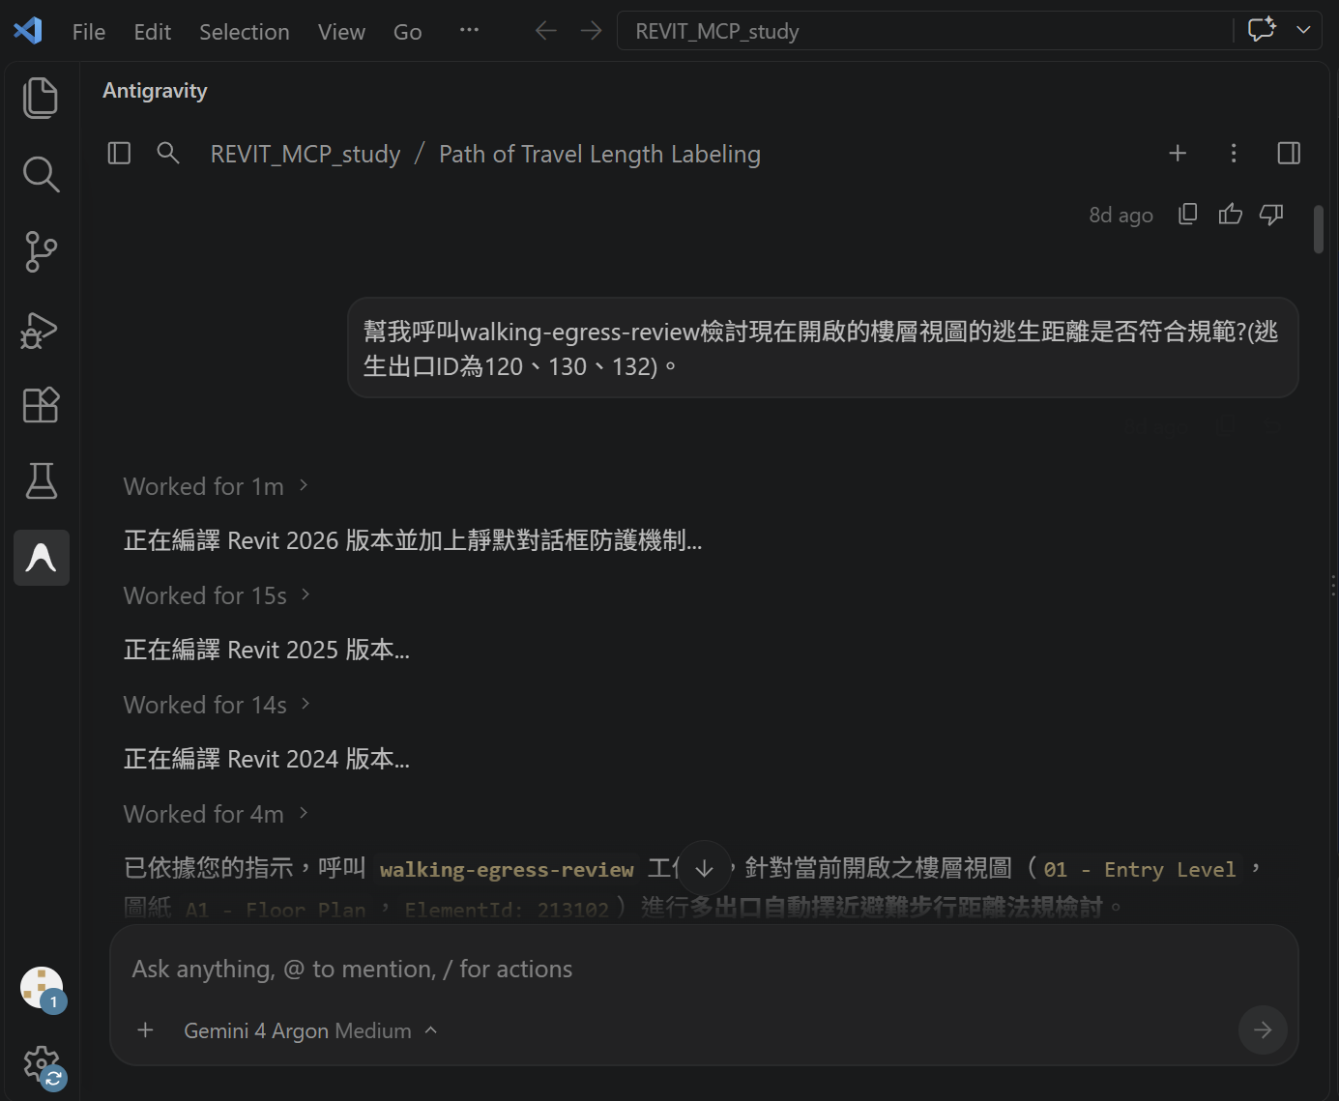
Demo
Notes:
透過呼叫skill指定檢討樓層與簡單述明幾個逃生出口位置即可開始運作

Slide 51
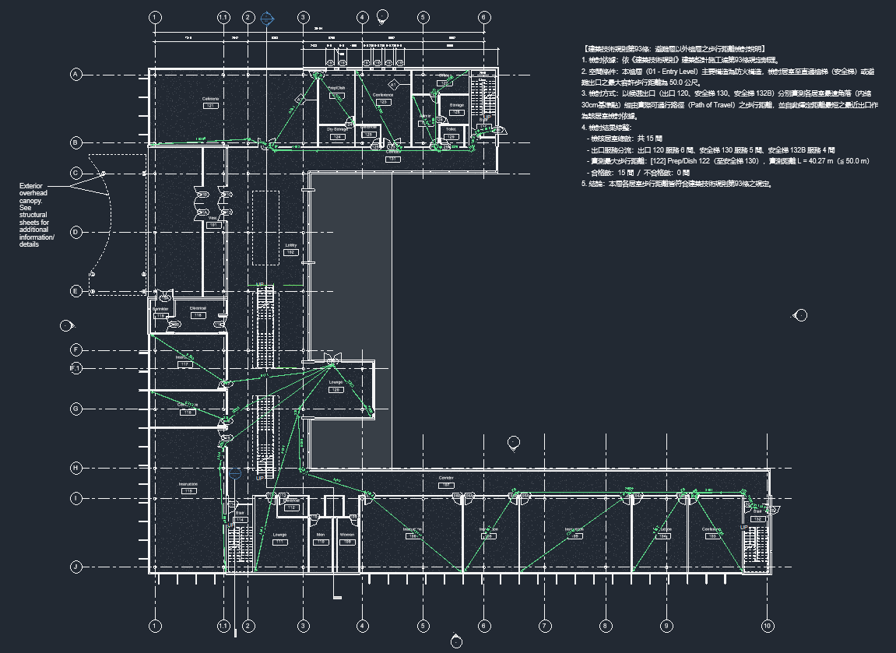
Demo
Notes:
系統會自動計算各個空間距離的最近出口
並計算該出口的最近距離
最後繪製檢討動線並標註尺寸

Slide 52
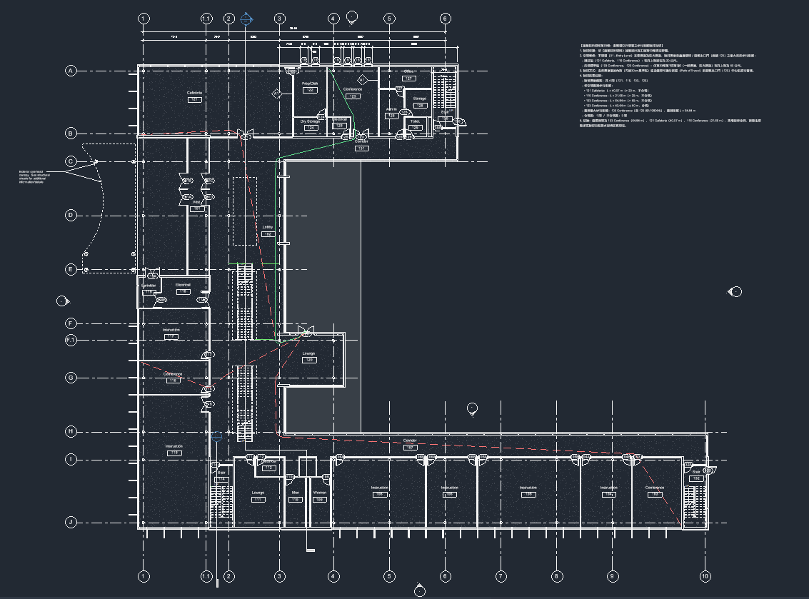
Demo
Notes:
補充說明
亦有設定若過長的距離會顯示紅線表示距離超過
而有在規範內的會顯示綠線

Slide 53
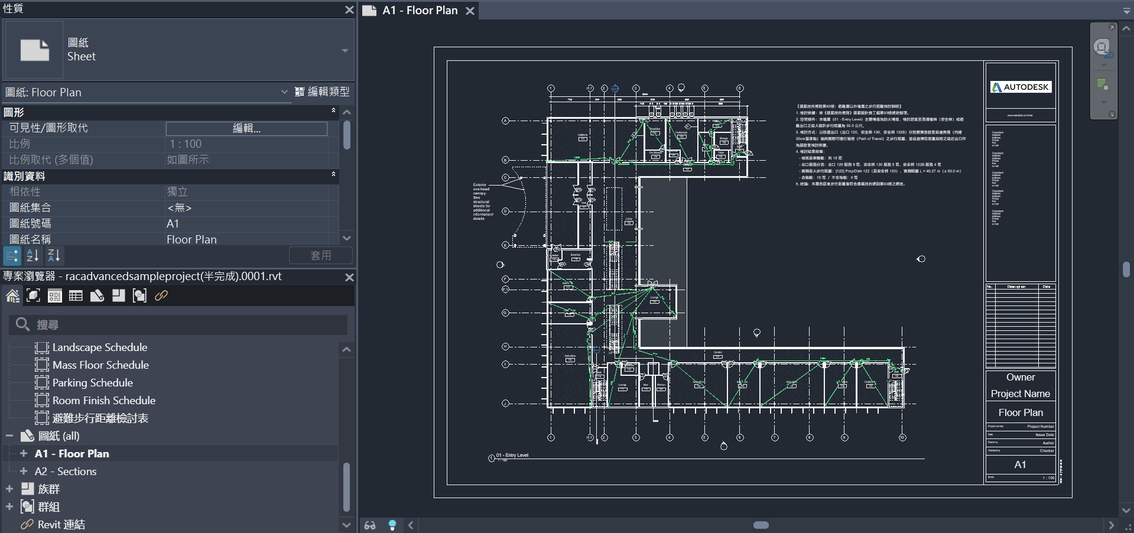
Demo
Notes:
而檢討結果會直接繪製在圖紙上，並解會自動放上法規檢討文字
可直接輸出

Slide 54
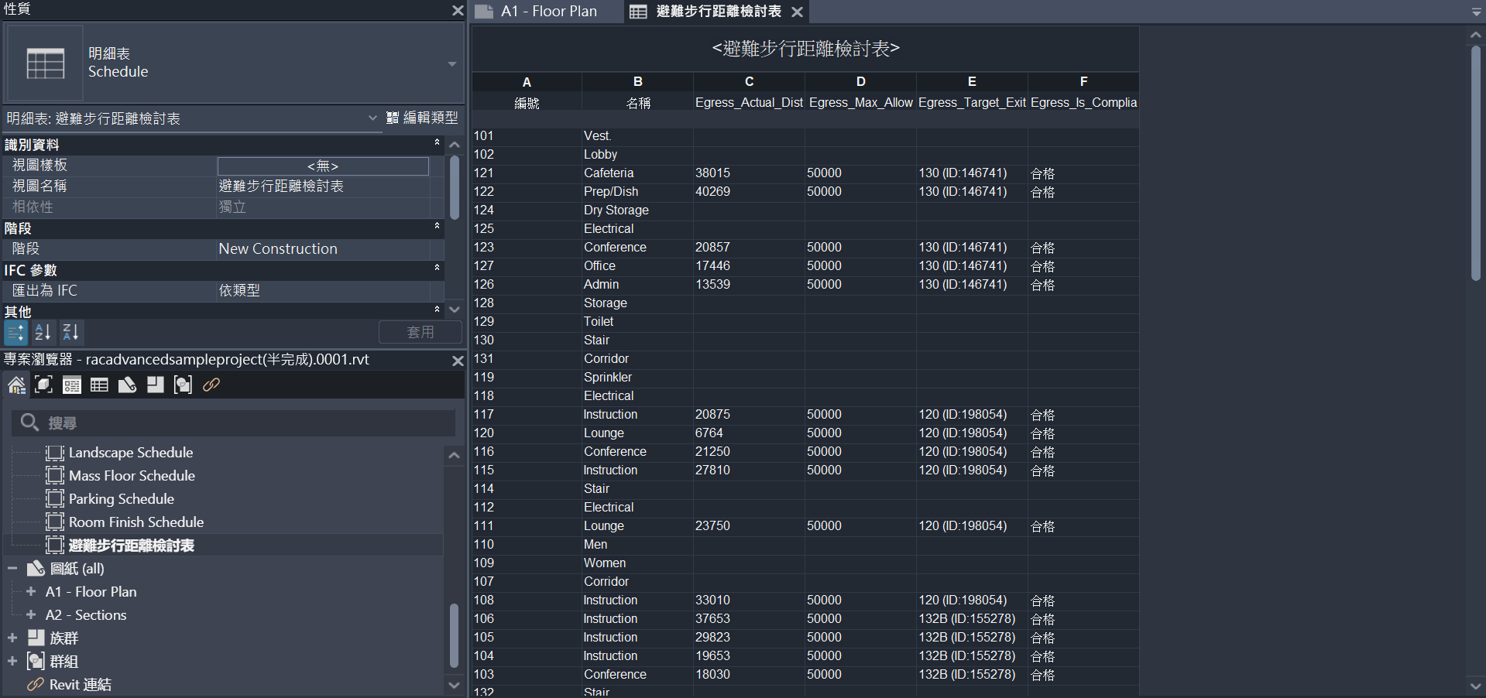
Demo
Notes:
於revit端亦有輸出整理完整檢討資料表格
供需要進一步做法規檢討總表使用

Slide 55
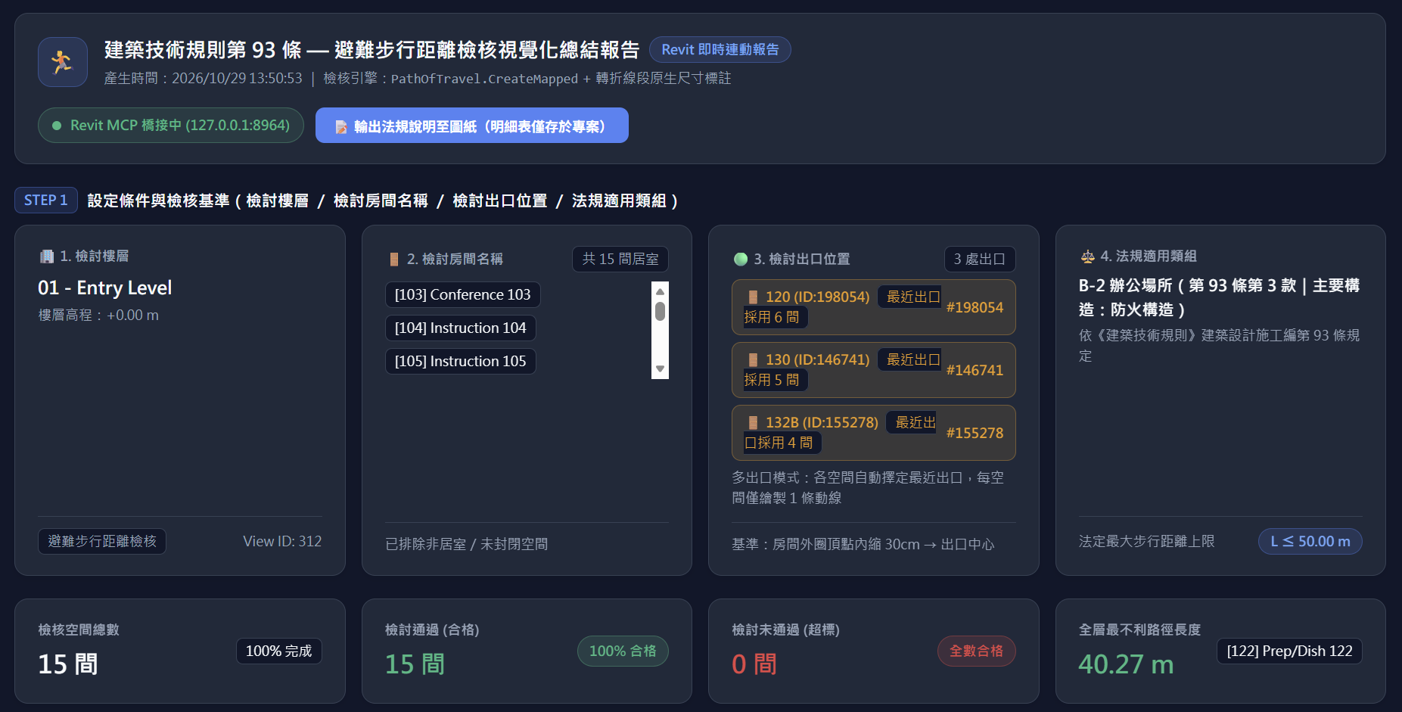
Demo
Notes:
而分析完成後也會同步生成完整易讀的外部業面
供設計師後端完整檢核與修改設計

Slide 56
Summary
未來改善方向
• 多樓層同時檢討導出
• 法規檢討放置時圖紙自動識別空白處並提供多種放置選項
• 分析結果提供進一步修改建議
Notes:
然後有關改善方向這邊大致列出幾點改善方向

Slide 57


Notes:
總結來說，我們組透過城市、建築基地配置與建築法規三尺度的skill開發，我們從不同尺度觀察 MCP 如何參與 BIM 操作。 並希望發展完善後能放入之後建築生產流程的各個部位中。最後，請大家票投第四組，謝謝!

