Slide 1
Fast Fourier Transforms
Henry Wang
2B Candidate for B.A.Sc. in Computer Engineering May 30th 2017

Slide 2
Objective
Analyze and compare the runtime performances of specific algorithm implementations of the discrete Fourier transform.

Slide 3
Outline
Discrete Fourier Transform (DFT)
Iterative Implementation
Twiddle Factors
Fast Fourier Transform (FFT)
Conclusion

Slide 4
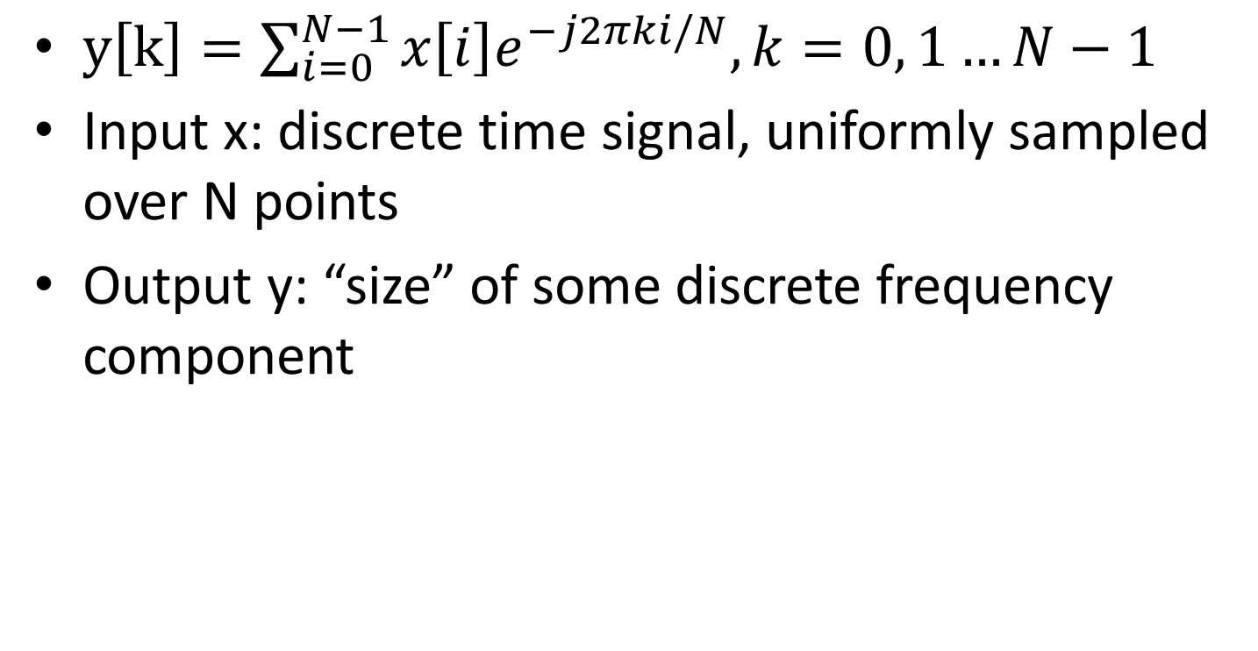
Discrete Fourier Transform (DFT)
$y\left[k\right]=\sum_{i=0}^{N−1}{x\left[i\right]e^{−j2πki/N}, k=0, 1…N−1}$
Input x: discrete time signal, uniformly sampled over N points
Output y: “size” of some discrete frequency component

Slide 5
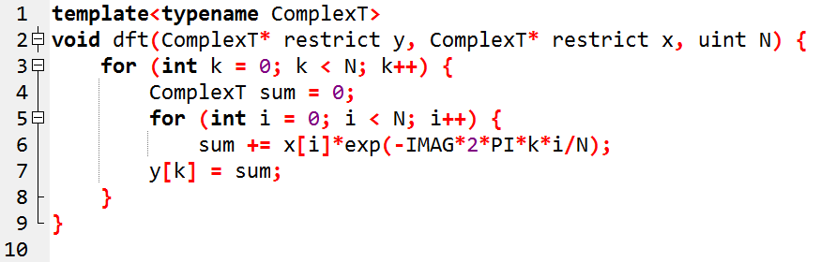
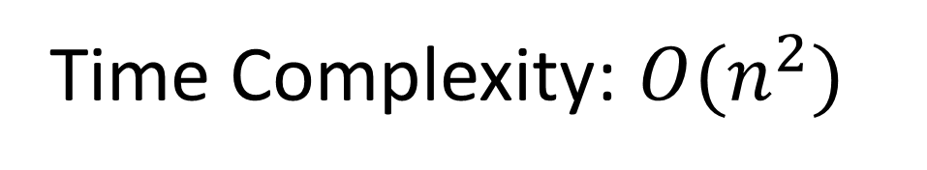
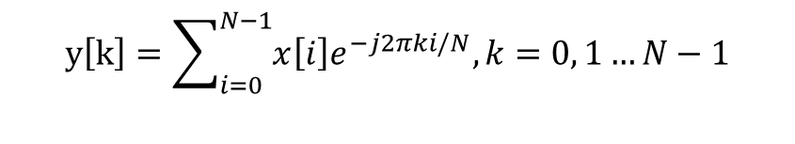
DFT Implementation
Number of Complex Additions: N x (N – 1) = N² - N
Number of Complex Multiplications: N x N = N²
T(n) = O(n²)
$$y\left[k\right]=\sum_{i=0}^{N−1}{x\left[i\right]e^{−j2πki/N}, k=0, 1…N−1}$$
Time Complexity: $O(n^{2})$

Slide 6
Twiddle Factors
Complex factors in the DFT equation
Phasors on the unit circle
Corresponds to N-th roots of unity, for some N-point DFT

Slide 7
Twiddle Factors
Source: http://www.suitcaseofdreams.net/Images/TF/RootUnity.gif

Slide 8
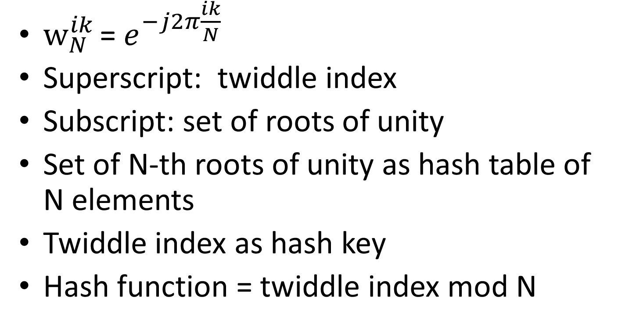
Notation Change
${­w}_{N}^{ik}$ = $e^{−j2π\frac{ik}{N}}$
Superscript: twiddle index
Subscript: set of roots of unity
Set of N-th roots of unity as hash table of N elements
Twiddle index as hash key
Hash function = twiddle index mod N

Slide 9
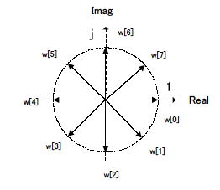
Periodicity of Twiddle Factors
http://digitalfilter.com/devken/fftmemo/image3.jpg

Slide 10
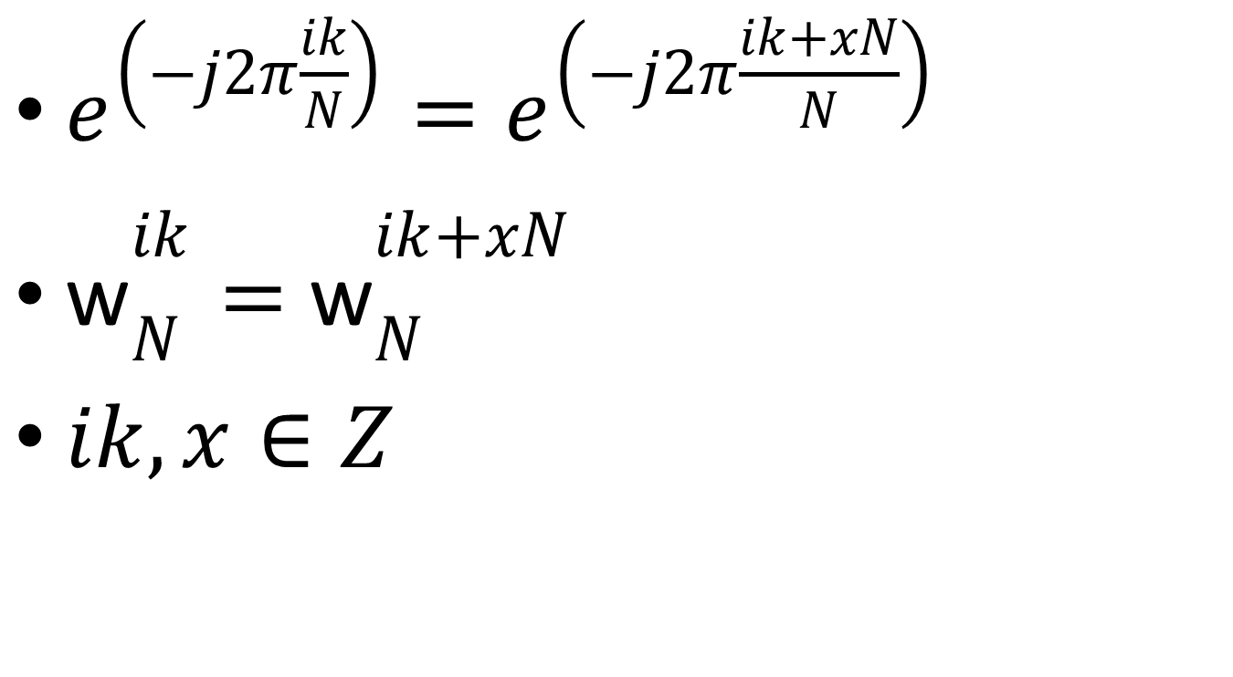
Periodicity of Twiddle Factors
$e^{\left(−j2π\frac{ik}{N}\right)}=e^{\left(−j2π\frac{ik+xN}{N}\right)}$
$\text{w}­_{N}^{ik}=$ $\text{w}­_{N}^{ik+xN}$
$ik, x∈Z$

Slide 11
Symmetry of Twiddle Factors
http://digitalfilter.com/devken/fftmemo/image3.jpg

Slide 12
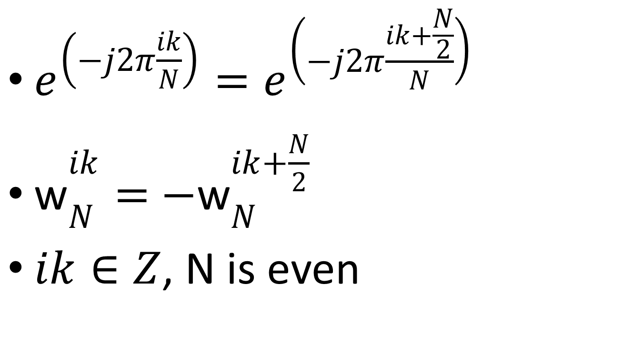
Symmetry of Twiddle Factors
$e^{\left(−j2π\frac{ik}{N}\right)}=e^{\left(−j2π\frac{ik+\frac{N}{2}}{N}\right)}$
$\text{w}­_{N}^{ik}=$ $−\text{w}­_{N}^{ik+\frac{N}{2}}$
$ik∈Z$, N is even

Slide 13
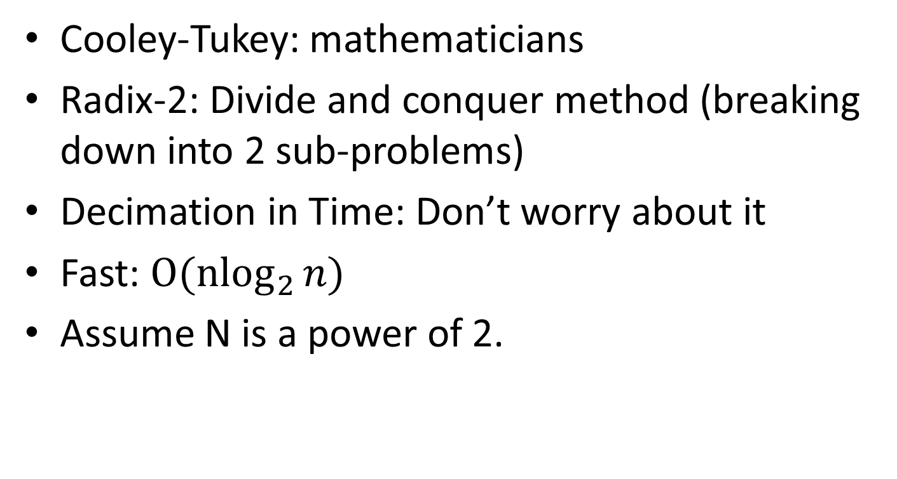
Cooley-Tukey’s Radix-2 (Decimation in Time) Fast Fourier Transform
Cooley-Tukey: mathematicians
Radix-2: Divide and conquer method (breaking down into 2 sub-problems)
Decimation in Time: Don’t worry about it
Fast: ${O(nlog}_{2}{n})$
Assume N is a power of 2.

Slide 14
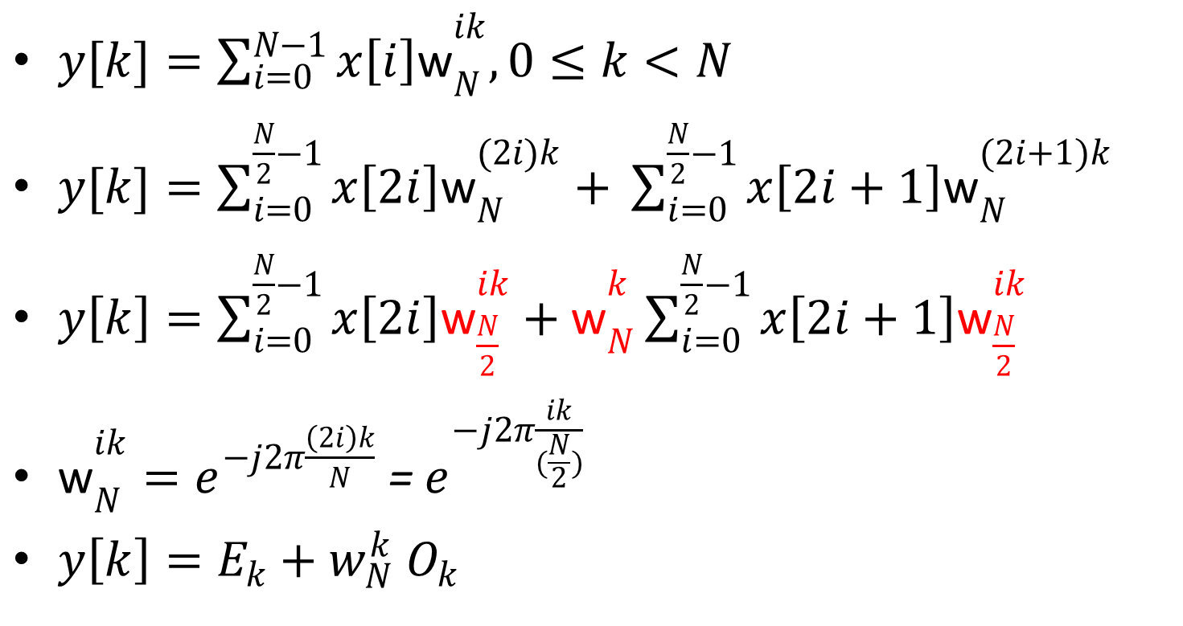
FFT Derivation
$y[k]=\sum_{i=0}^{N−1}{x\left[i\right]\text{w}­_{N}^{ik},0≤k<N }$
$y[k]=\sum_{i=0}^{\frac{N}{2}−1}{x\left[2i\right]\text{w}­_{N}^{(2i)k}+ }\sum_{i=0}^{\frac{N}{2}−1}{x\left[2i+1\right]\text{w}­_{N}^{(2i+1)k}}$
$y\left[k\right]=\sum_{i=0}^{\frac{N}{2}−1}{x\left[2i\right]\text{w}­_{\frac{N}{2}}^{ik}+\text{w}­_{N}^{k}}\sum_{i=0}^{\frac{N}{2}−1}{x\left[2i+1\right]\text{w}­_{\frac{N}{2}}^{ik}}$
$\text{w}­_{N}^{ik}=e^{−j2π\frac{\left(2i\right)k}{N}}$ = $e^{−j2π\frac{ik}{(\frac{N}{2})}}$
${y\left[k\right]=E}_{k}+w_{N}^{k}{ O}_{k}$

Slide 15

Apply Periodicity
$E_{k}=\sum_{i=0}^{\frac{N}{2}−1}{x\left[2i\right]}$ $w_{\frac{N}{2}}^{ki}=\sum_{i=0}^{\frac{N}{2}−1}{x\left[2i\right]} w_{\frac{N}{2}}^{(k+ \frac{N}{2})i}$
Therefore:
$E_{k}= E_{k+\frac{N}{2}}$
$O_{k}$ = $O_{k+\frac{N}{2}}$

Slide 16
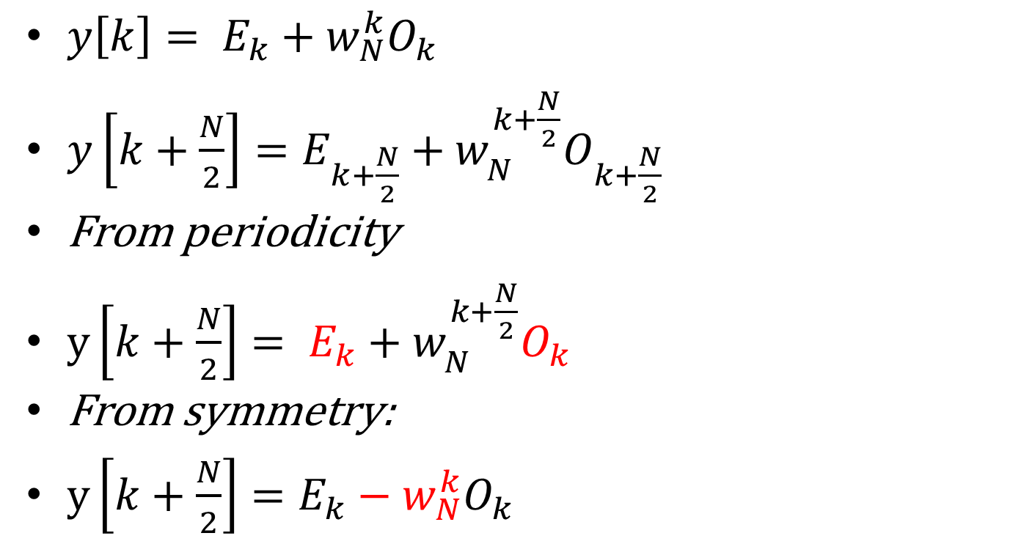
Magical Step
$y\left[k\right]= E_{k}+w_{N}^{k}O_{k}$
$y\left[k+\frac{N}{2}\right]=E_{k+\frac{N}{2}}+w_{N}^{k+\frac{N}{2}}O_{k+\frac{N}{2}}$
From periodicity
$y\left[k+\frac{N}{2}\right]= E_{k}+w_{N}^{k+\frac{N}{2}}O_{k}$
From symmetry:
$y\left[k+\frac{N}{2}\right]=E_{k}−w_{N}^{k}O_{k}$

Slide 17
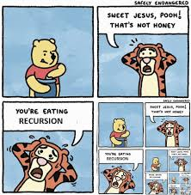
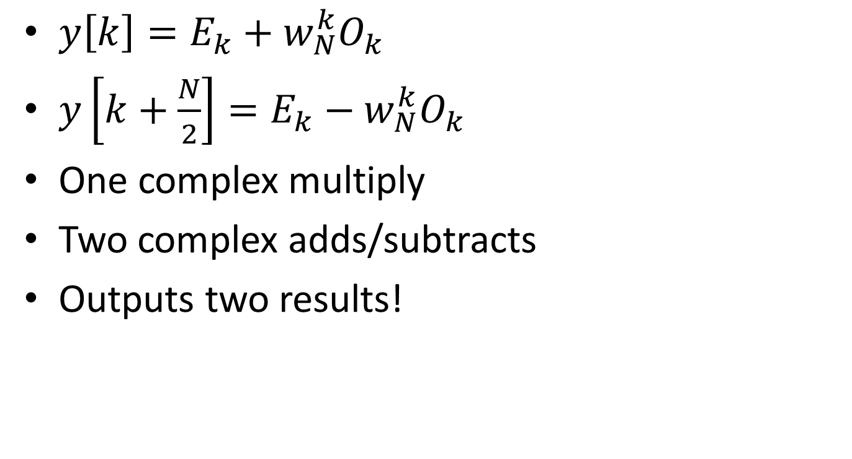
2-point Butterfly (DIT)
$y\left[k\right]=E_{k}+w_{N}^{k}O_{k}$
$y\left[k+\frac{N}{2}\right]=E_{k}−w_{N}^{k}O_{k}$
One complex multiply
Two complex adds/subtracts
Outputs two results!
https://thumbs.gfycat.com/ResponsibleRespectfulEquestrian-size_restricted.gif

Slide 18
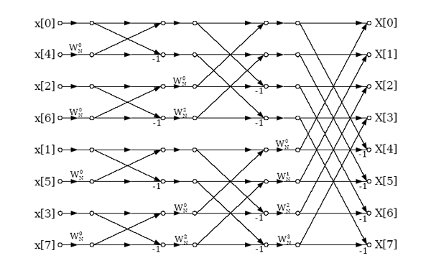
8-point (DIT) FFT Signal Flow Chart
https://qph.ec.quoracdn.net/main-qimg657717c02db3efbef5dd37729d676ba1

Slide 19
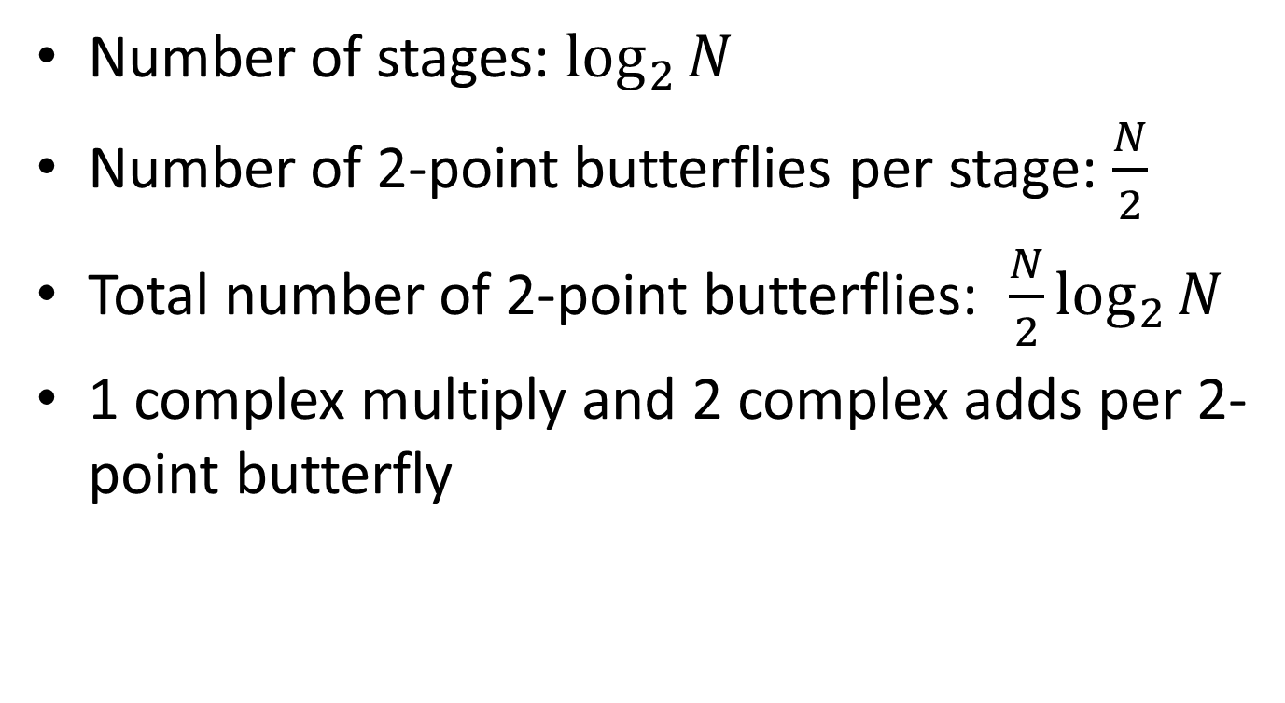
FFT Operations Summary
Number of stages: $\log_{2}{N}$
Number of 2-point butterflies per stage: $\frac{N}{2}$
Total number of 2-point butterflies: ${\frac{N}{2}log}_{2}{N}$
1 complex multiply and 2 complex adds per 2-point butterfly

Slide 20
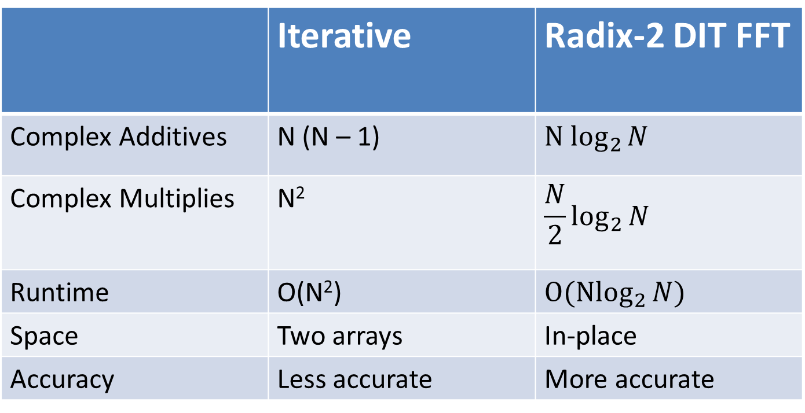
Conclusion
 | Iterative | Radix-2 DIT FFT
Complex Additives | N (N – 1) | $${N log}_{2}{N}$$
Complex Multiplies | N² | $${\frac{N}{2}log}_{2}{N}$$
Runtime | O(N²) | $${O(Nlog}_{2}{N)}$$
Space | Two arrays | In-place
Accuracy | Less accurate | More accurate

Slide 21
Thank You
Gilbert Strang, MIT – “the most important numerical algorithm of our lifetime”

