Slide 1

Microsoft Intune

Slide 2
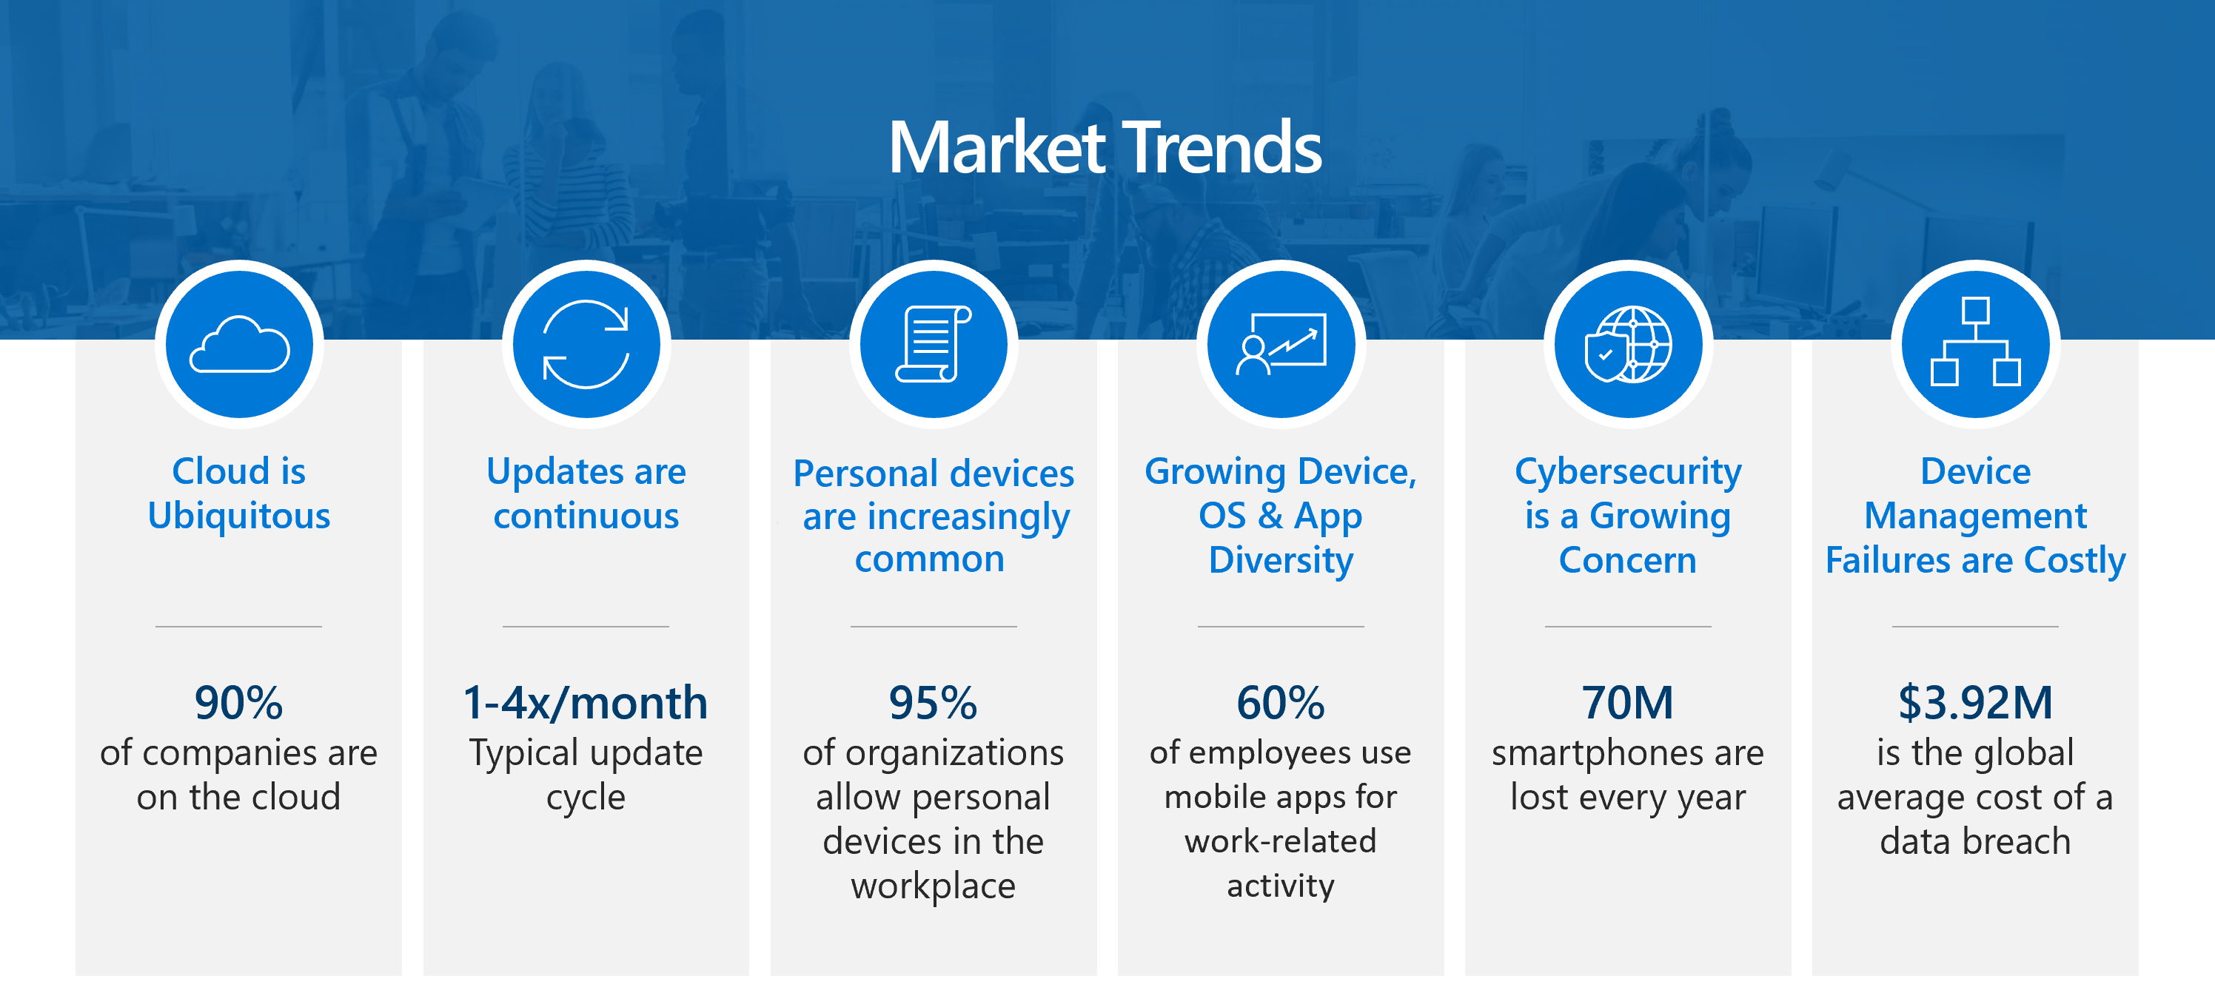
As an IT admin or business decision maker, you must find modern methods and technologies to successfully protect your organization against digital threats while maintaining productivity. You can start by implementing services and tools to protect the digital devices, apps, and data, or endpoints, that the members of your organization need to be productive.

Slide 3
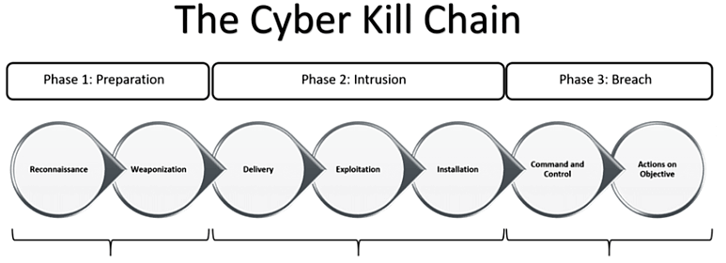
Why Endpoint/Device Protection?
Stop the attacker here in the cyber attack kill chain with endpoint/device protection

Slide 4
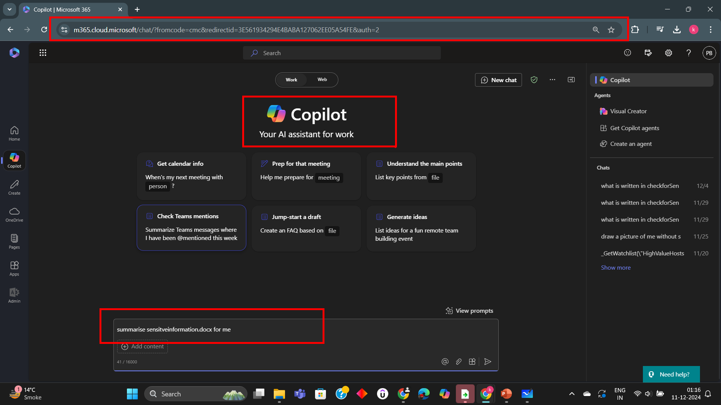
Suppose your endpoint gets compromised by a malware through a phishing mail. Now the attacker can go to copilot.microsoft.com which is available on all your corporate devices as a managed cloud app and can run a query to extract sensitive information in no time

Slide 5
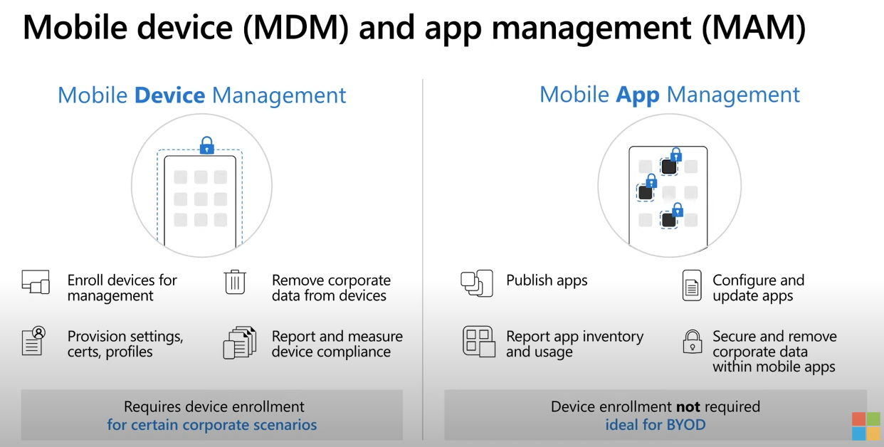
SOLUTION : MAM and MDM
enables organizations to protect and secure their resources and data based on enrolled devices.
enables organizations to manage and protect their data within applications.

Slide 6
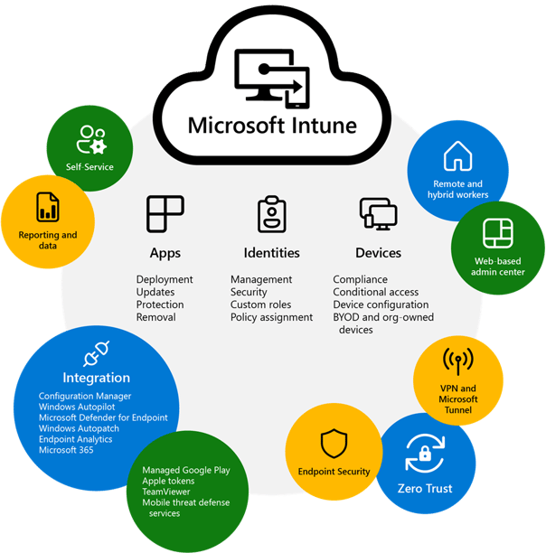
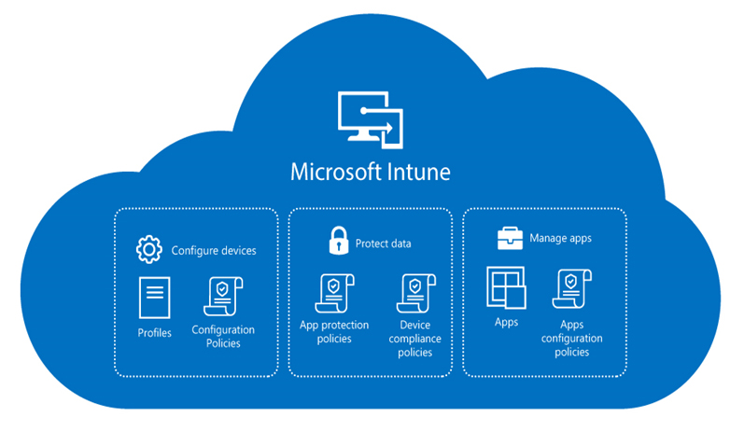
(MAM + MDM) by Microsoft = Intune
Microsoft Intune is a single, integrated management platform for managing, protecting, and monitoring all of your organization's endpoints.
Endpoints include all the apps and devices that your organization uses

Slide 7
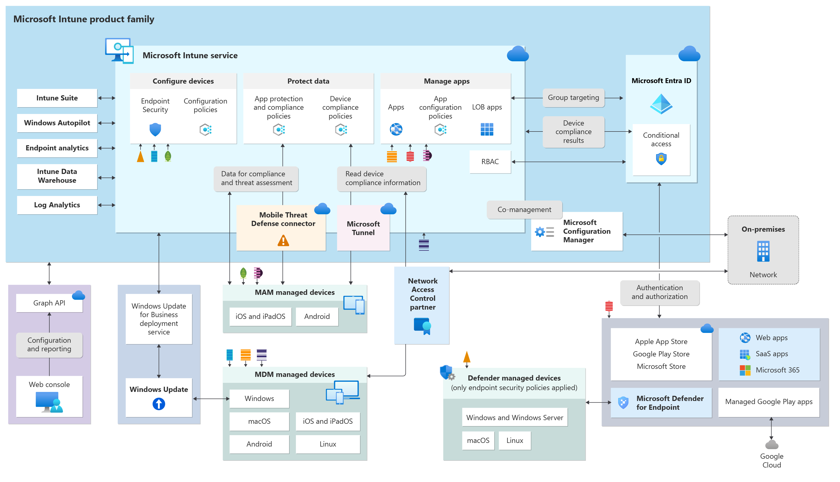

Slide 8
Key Features of Microsoft Intune

Slide 9
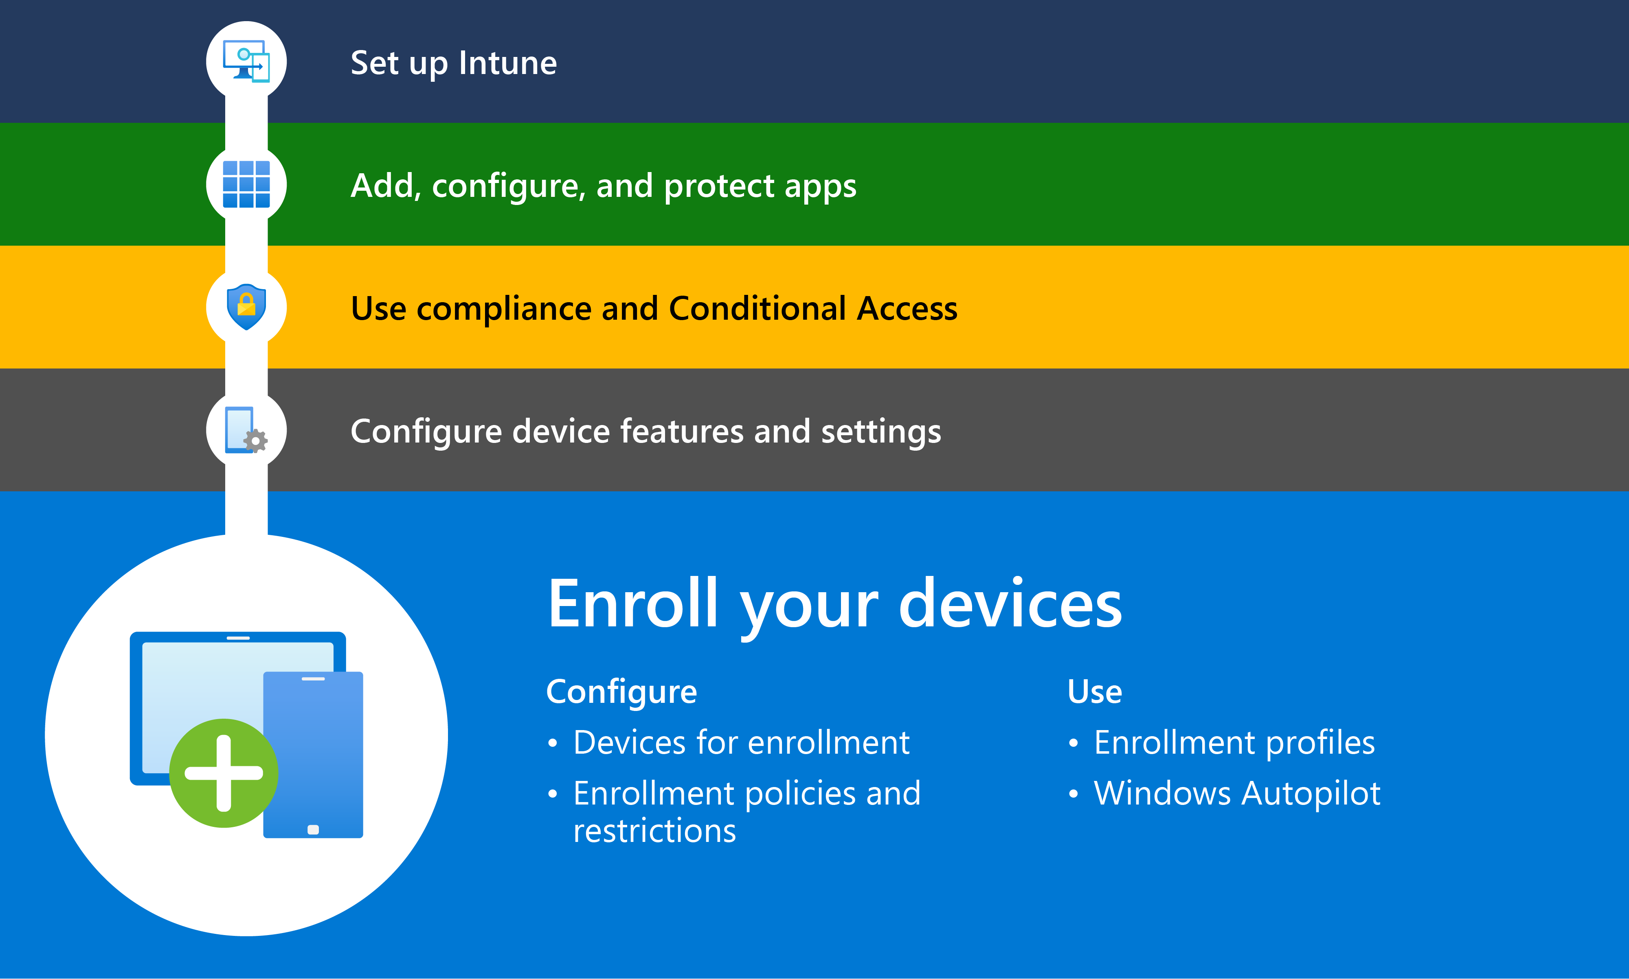
Device Enrollment
1) Windows Devices: Use Autopilot, Group Policy, or manual enrollment.
2) macOS Devices: Utilize Apple Automated Device Enrollment (ADE) via Apple Business Manager.
iOS/iPadOS Devices: Enroll through the Intune Company Portal app or Apple ADE.
3) Android Devices: Use Android Enterprise for corporate-owned or personally-owned devices.

Slide 10
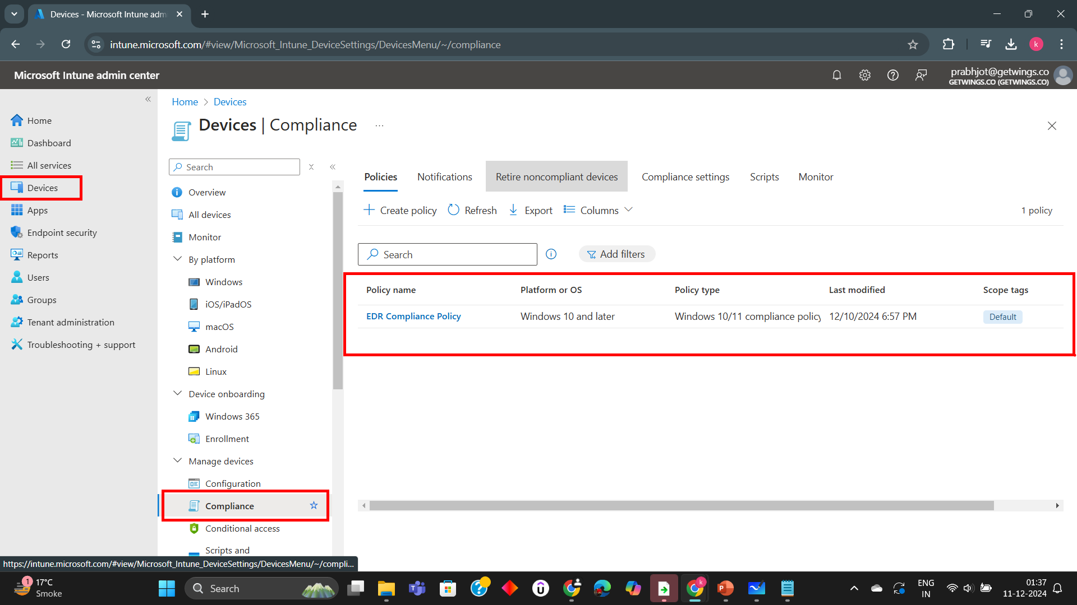
Device Compliance
Device compliance in Microsoft Intune ensures that enrolled devices meet your organization's security and operational requirements. It evaluates devices against predefined compliance policies and integrates with Conditional Access to secure resources.

Slide 11
Configuration Policies
What are Configuration Policies? Configuration policies in Microsoft Intune are predefined settings used to configure and enforce rules on managed devices. These policies help organizations ensure devices meet security and operational standards.
Key Features of Configuration Policies:
Device Settings Management: Enforce Wi-Fi, VPN, email, and device password configurations.
Security Settings: Apply BitLocker encryption, firewall rules, and antivirus settings.
Compliance Enforcement: Ensure devices adhere to organizational compliance policies.
User Experience Customization: Configure desktop settings, start menus, and device restrictions.

Slide 12
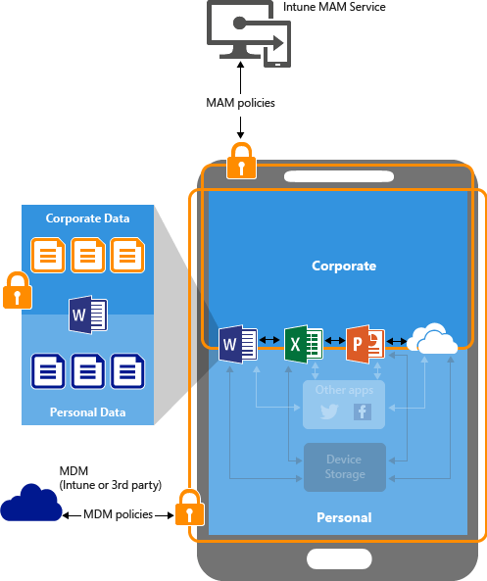
App Protection Policies
App Protection Policies (APP) in Microsoft Intune are rules that secure and manage apps on both managed and unmanaged devices. They help protect organizational data at the application level without requiring full device enrollment.
Key Features of App Protection Policies:
Data Protection:
Prevent data leakage by restricting copy-paste, save-as, or screenshot capabilities.
Encrypt app data for added security.
Access Control:
Require PIN or biometric authentication to access apps.
Set session timeouts for inactive apps.
Conditional Launch:
Restrict app access based on device health, location, or network conditions.
Block access if the device is jailbroken or rooted.
Selective Wipe:
Remove corporate data from apps without affecting personal data.

Slide 13
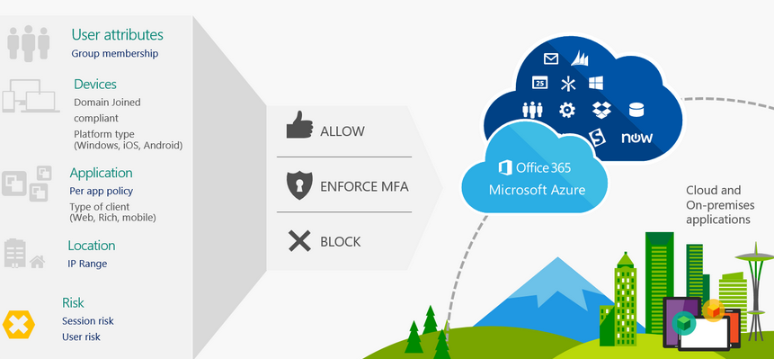

Conditional Access Policies
What are Conditional Access Policies? Conditional Access Policies in Microsoft Intune are access control mechanisms that enforce security measures before granting access to organizational resources. They use signals like user identity, device compliance, location, and app usage to determine access rights.

Slide 14
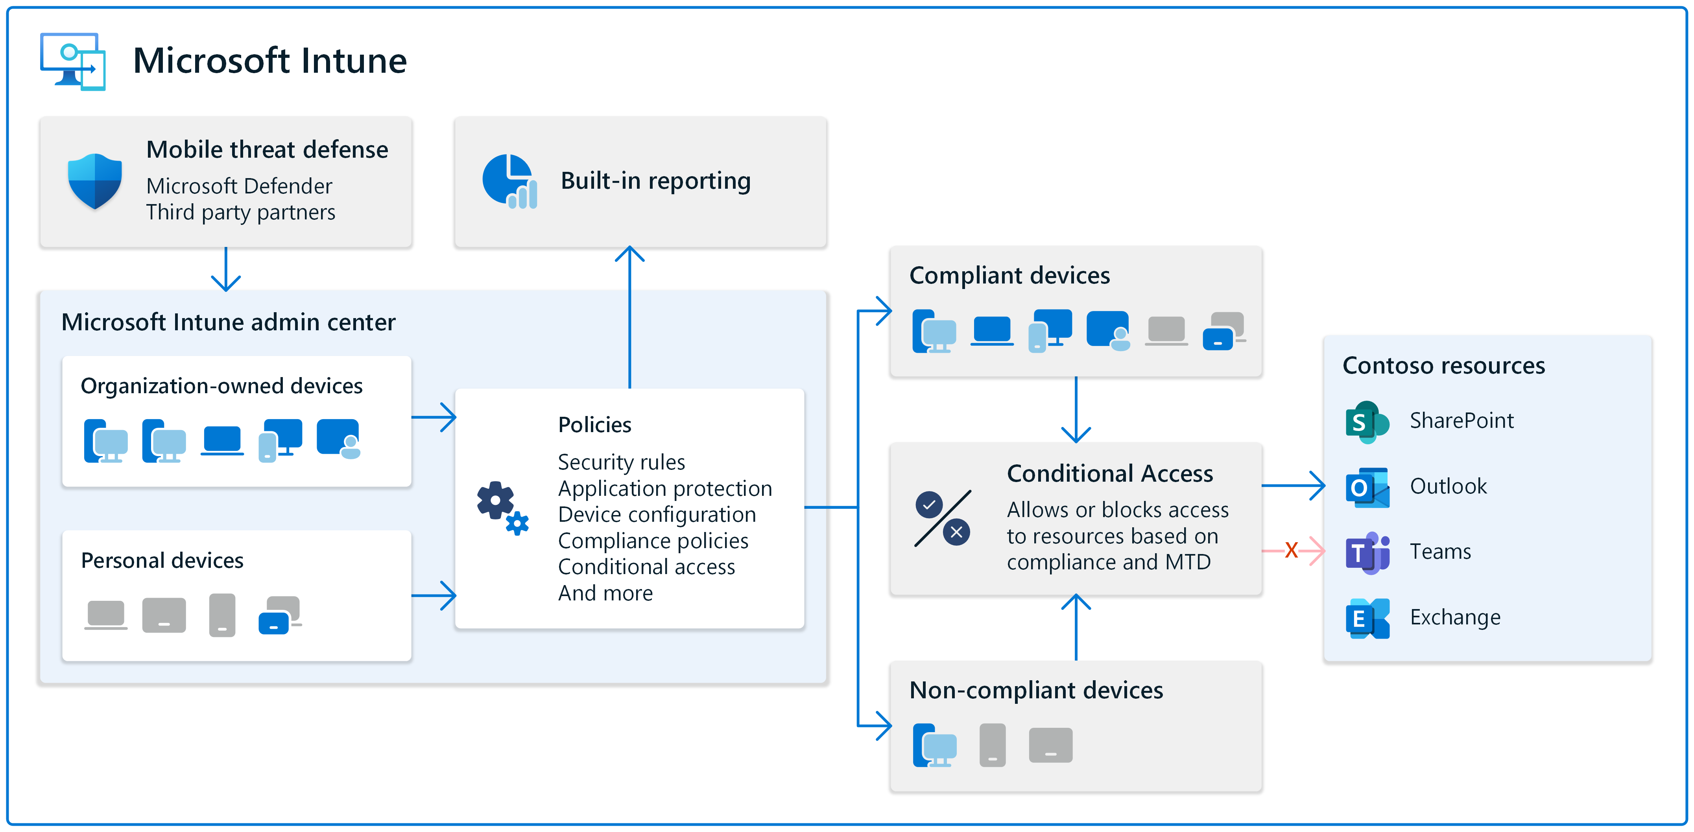

Slide 15
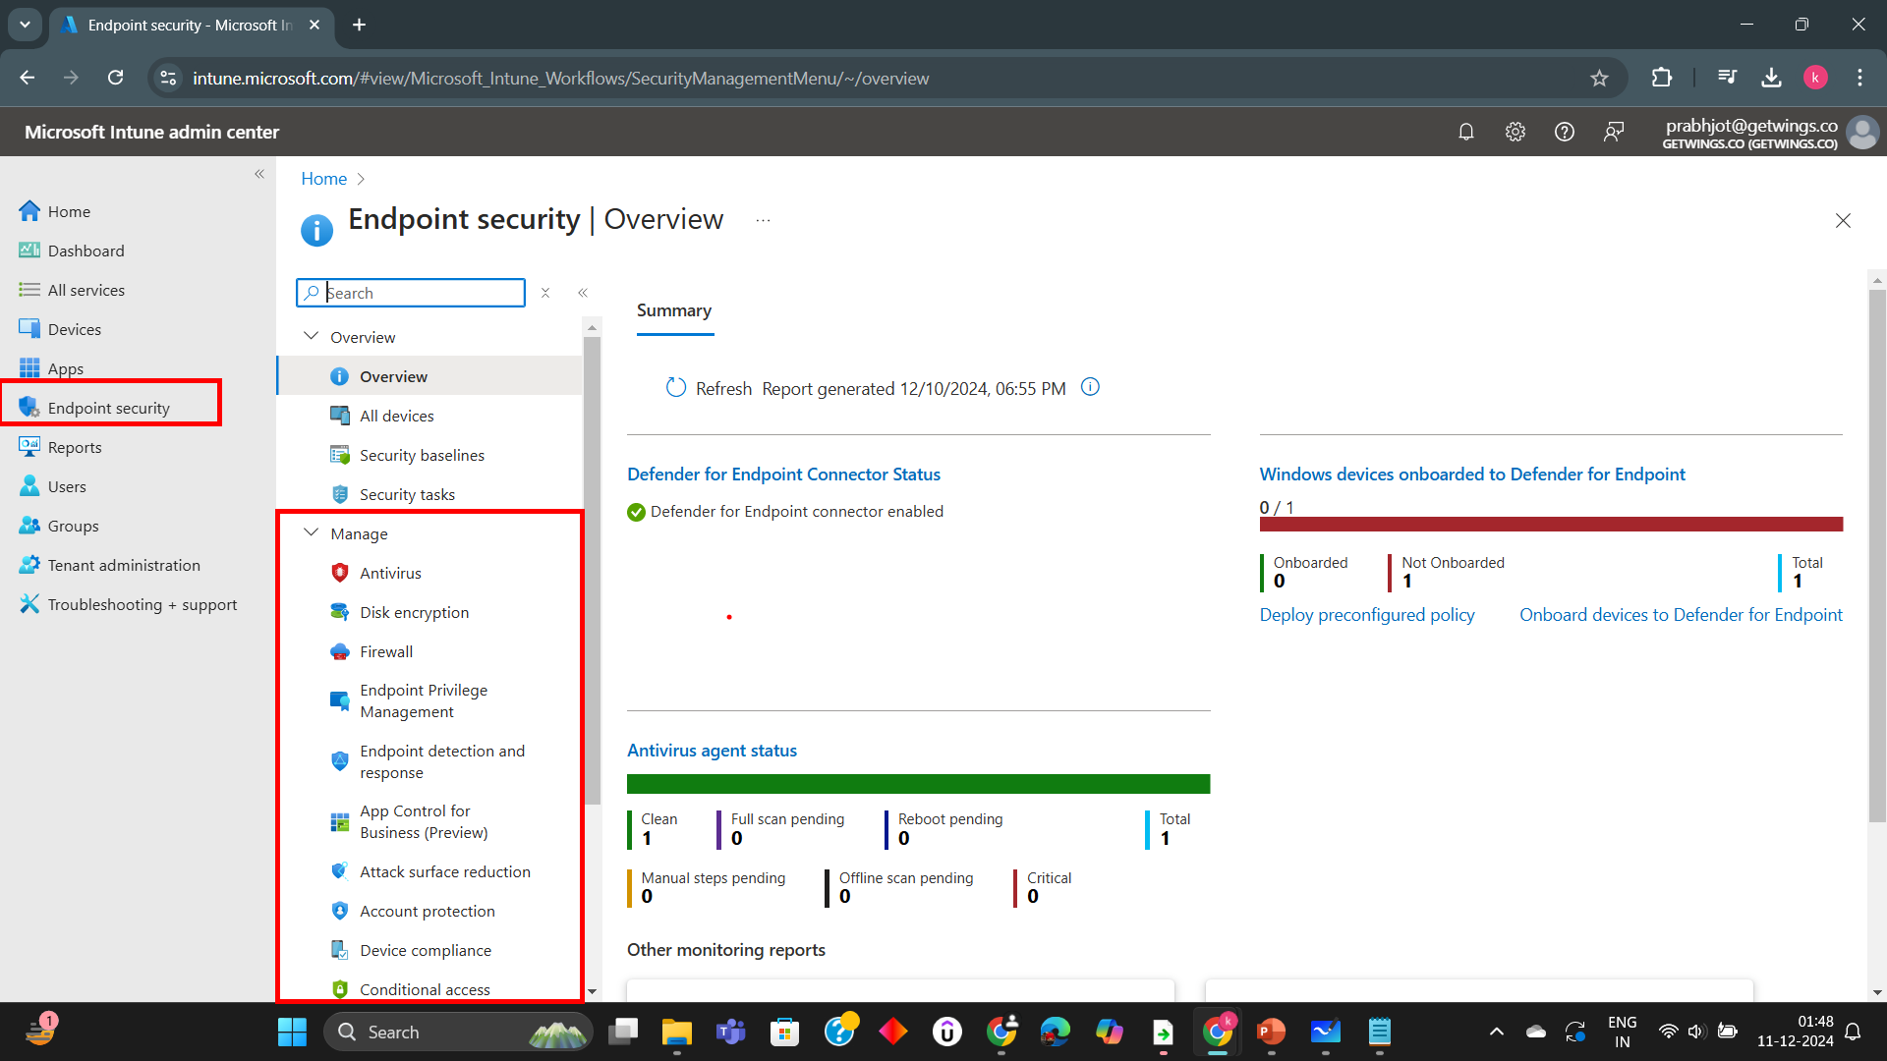
Endpoint Security with Intune
With Endpoint Security through Microsoft Intune, you can set and manage things like firewall, Disk Encryption using BitLocker, Endpoint Detection and Response, Attack Surface Reduction etc.

Slide 16

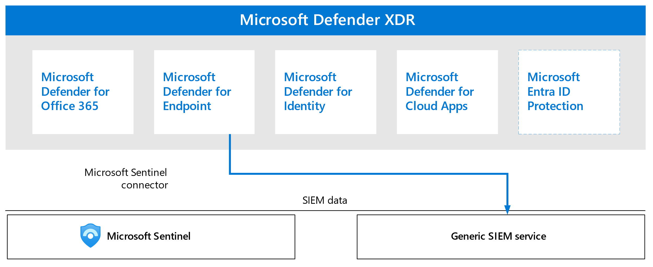
MAM and MDM Policy Enforcement
Endpoint
Microsoft Intune
Post Breach response like marking the device non-compliant and isolating it from the network
Threat Indicators

