Slide 1
Local Rule-Based Explanations of Black Box Decision Systems
Riccardo Guidotti, Anna Monreale, Salvatore Ruggieri, Dino Pedreschi,
Franco Turini, Fosca Giannotti
Presented By: Rebecca Adaimi
Ronshee chawla

Slide 2
Outline
Introduction
Problem and Explanations
Proposed Method
Experiments
Conclusion and Extensions

Slide 3
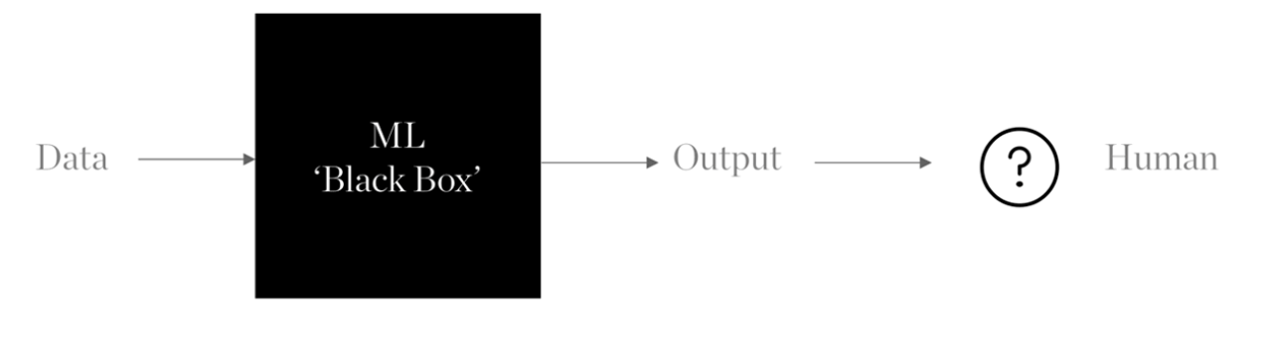
Introduction
Rise of accurate but obscure decision systems
Algorithms are opaque and their logic unexplained.
Inability to control the inference of a classification model step-by-step.
Key ethical issue, limiting the adoption of machine learning systems in socially sensitive and mission critical environments.
Lack of transparency in algorithms results in perpetuation of injustice.
Notes:
Algorithm itself has not been coded by a human but rather a machine by learning from data.
Huge training data and complex model generation.
Paradox between explainability and accuracy.
Example: soap dispenser not dispensing soap to dark skinned people

Slide 4
Introduction
In this paper
The problem of explaining the decision outcome taken by an obscure algorithm is addressed.
Assumptions
Interested in local explanations rather than global explanations.
User can understand elementary logic rules.
Black box decision system can be queried multiple times as necessary.
Agnostic setting: interested only in analyzing input-output behavior of the black box.
Notes:
Intent is to provide meaningful explanations of the logic involved during automated decision making.
No assumptions on the specific algorithms used in the black box.

Slide 5
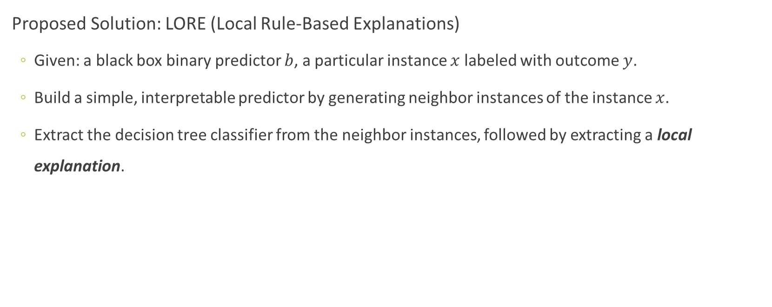
Introduction
Proposed Solution: LORE (Local Rule-Based Explanations)
Given: a black box binary predictor $b$, a particular instance $x$ labeled with outcome $y$.
Build a simple, interpretable predictor by generating neighbor instances of the instance $x$.
Extract the decision tree classifier from the neighbor instances, followed by extracting a local explanation.
Notes:
Use of genetic algorithm for creating neighbors.
Local explanation has 2 parts:
1. Decision/Logic rule: Particular path in the tree which explains why x has been labeled as y by b.
2. Counterfactual rules.
Intuition/Motivation behind the proposed method: complex decision boundary over the entire data space, whereas high chance that the decision boundaries are simple in the neighborhood.
Novelty:
1. Use of genetic algorithm to produce training data for learning local decision tree
2. High expressiveness using decision rules and counterfactuals.

Slide 6
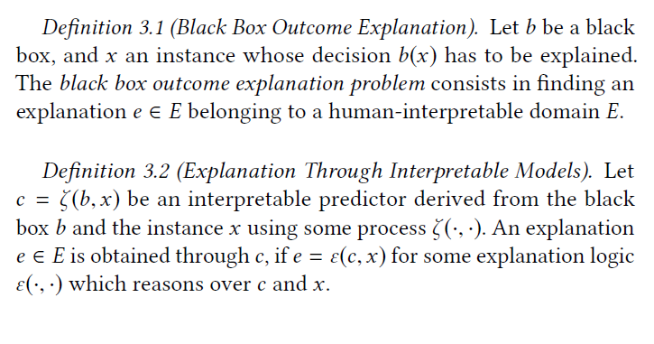
Problem and Explanations
But, what is a comprehensible domain of explanations?
Notes:
Predictor: A function $b:X^{(m)}→Y$ which maps data instances $x∈X^{m}$ to a decision $y∈Y$.
An instance $x$ consists of $m$ attribute-value pairs $\left(a_{i}, v_{i}\right)$ where $a_{i}$ is a feature and $v_{i}$ its value.
$b$ denotes the black box predictor.
$c$ denotes an interpretable predictor, whose internal processing behind the decision $c\left(x\right)=y$ can be given a symbolic interpretation understandable by humans.

Slide 7

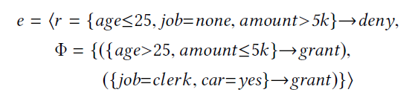
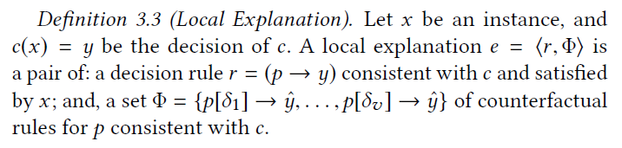
Problem Explanation
An explanation is defined as:
A logic rule corresponding to the path in the tree that explains why instance x was labeled as y by b.
A set of counterfactual rules, explaining which conditions should be changed by x so to invert the class y.
What is a Local Explanation?
logic
rule
counterfactual rule
Notes:
In a decision rule $r=p→y$, $p$ is called premise, which is a Boolean condition on feature values.
$p$ is assumed to be a conjunction of split conditions $sc$ of the form $a∈\left[v_{1}, v_{2}\right]$. Then, $x$ satisfies $r$ if $p$ evaluates to true for $x$.
$r$ is said to be consistent with $c$, if $c\left(x\right)=y$ for every $x$ that satisfies $r$.
Let $δ$ denote a set of split conditions. Define $p\left[δ\right]=δ∪\left\{a∈\left[v_{1}, v_{2}\right]∈p : ∄ \left[w_{1}, w_{2}\right], \left(a∈\left[w_{1}, w_{2}\right]\right)∈δ\right\}$.
$p\left[δ\right]$ denotes the update of $p$, i.e. $p$ with ranges for attributes overwritten as stated in $δ$.
A counterfactual rule for $p$ is of the form $p\left[δ\right]→\hat{y}$ for $\hat{y}≠y$, $δ$ is a counterfactual.
$δ$ describes what features to change and how to change them to get a different outcome.

Slide 8
Proposed Method
Input: $x$ (instance to explain), b (black box)
Input: 𝑥 (instance to explain), b (black box)
Neighborhood Generation
Local Rule-Based Classifier and Explanation Extractor
Output: Local Explanation of $x$
Output: Local Explanation of 𝑥
LORE (Local Rule-based Explanations)

Slide 9
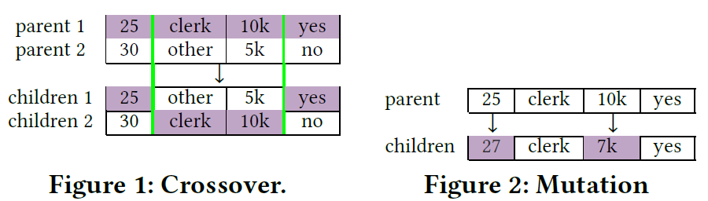
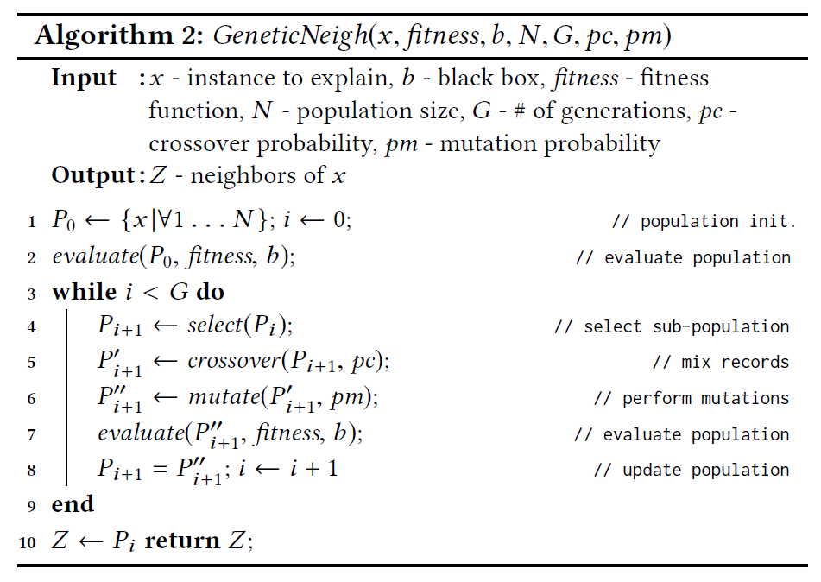


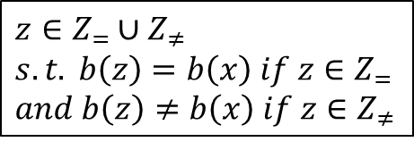
Neighborhood Generation
The genetic algorithm generates:
By maximizing the fitness functions:
where $d(x,z)$ is the distance function defined as:
$$z∈Z_{=}∪Z_{≠} \\ s.t. b\left(z\right)=b\left(x\right) if z∈Z_{=} \\ and b\left(z\right)≠b\left(x\right) if z∈Z_{≠}$$
Notes:
Instances with both decision values are generated for constructing the neighborhood. Reason: the neighborhood should be flexible enough so that predictor learns well.
An approach based on genetic algorithm is adopted which maximizes the fitness functions for each decision.
A subset of the population is selected with the highest fitness score.
Two point crossover being used on the next subset: selects two parents and two crossover features at random (pc=0.5), followed by swapping the crossover feature values of the parents.
From crossover and unaffected population a subset is chosen for mutation. Mutation involves replacing features at random according to the empirical distribution of a feature.

Slide 10
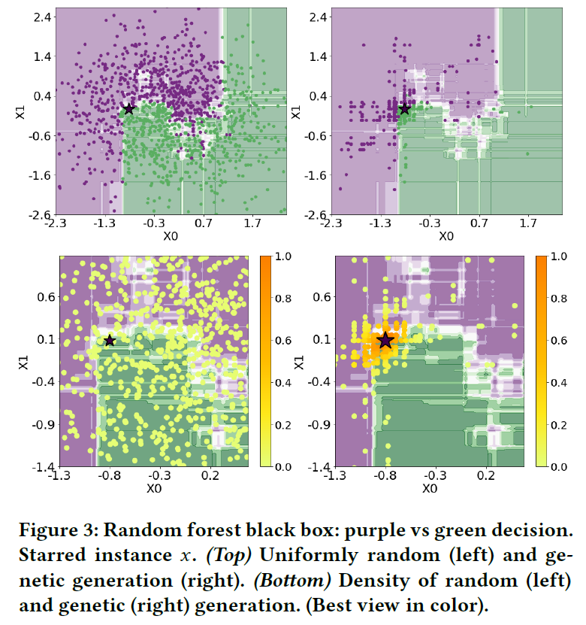
Neighborhood Generation
Using Random Forest Black Box: purple vs green decision
Starred Instance x
Uniformly random (left) and genetic generation (right)
Density of random (left) and genetic (right)

Slide 11
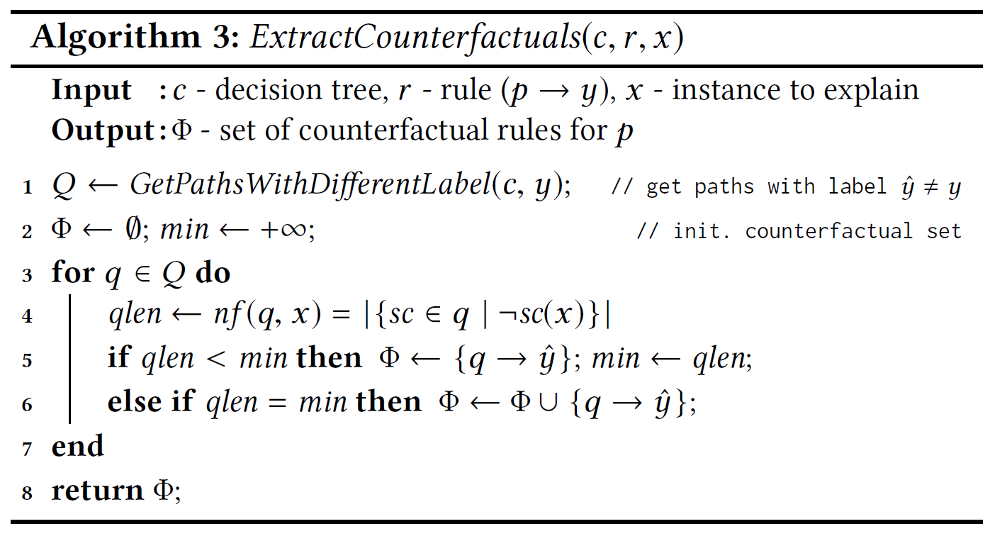
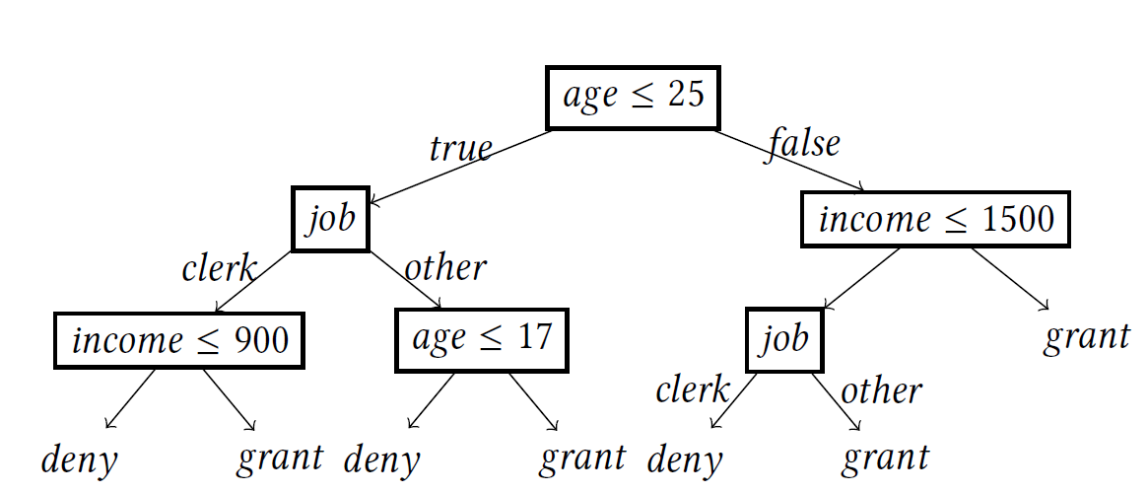
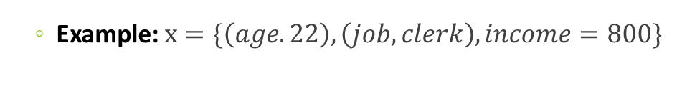
Local Rule-based Classifier and Explanation
Number of falsified split conditions
sc : split conditions
Example: $x=\{\left(age. 22\right), \left(job, clerk\right), income=800\}$
Notes:
In order to extract local explanations, LORE employs decision trees as the “interpretable” predictor because:
1- decision rules can naturally be derived from a root-leaf path in the decision tree
2- counterfactuals can be extracted as well.
So, counterfactual rules explain which conditions should be changed by x so to invert the class y.
In order to extract the counterfactual rule, they came up with the following algorithm. The algorithm first looks for all paths in the decision tree that lead to a decision different than that of instance x. Then, looking at each path, they compute the number of falsified split conditions (i.e. the conditions that are no longer satisfied by x that lead to a different decision. So, from all possible paths, only the ones with minimal split conditions not satisfied by x are considered in the counterfactual rules.
To understand better, let’s look at this example and decision tree.

Slide 12
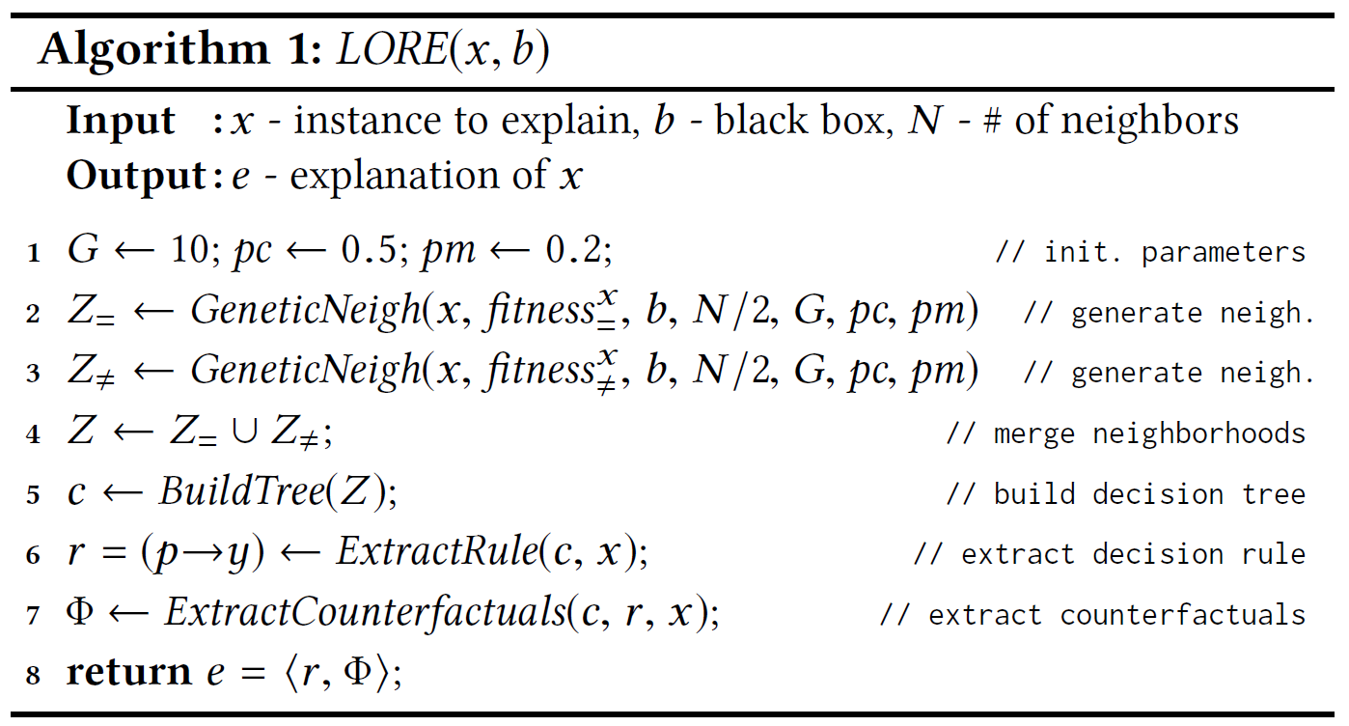
LORE Algorithm
Notes:
After extracting the neighborhood Z, the next step is to build an interpretable predictor c trained on the instances in Z labeled with the black box decision.

Slide 13
Experiments
Datasets: (split 80% training and 20% testing)
Adult Dataset (UCI Machine Learning Repository)
Compas Dataset (ProPublica)
German Dataset (UCI Machine Learning Repository)
Predictors as black boxes:
SVM with RBF kernel
Random Forests with 100 trees
Multi-layer neural networks
Notes:
They ran experiments on three real-world “tabular” datasets: adult, compas, and german.
All datasets include categorical and continuous features
They experimented three predictors and black boxes: SVM, random forest, and multi-layer neural network.
The datasets are split 80% for training the black box and 20% for which the black box decisions have to be explained.

Slide 14
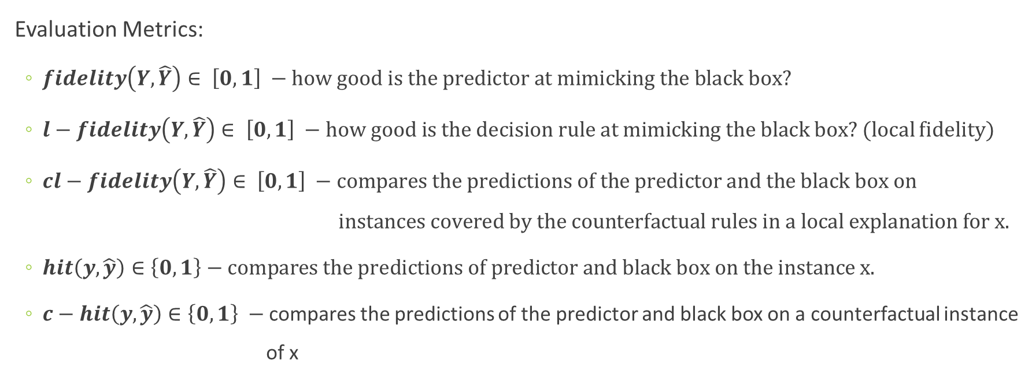
Experiments
Evaluation Metrics:
$fidelity\left(Y, \hat{Y}\right)∈ \left[0, 1\right] −$ $how good is the predictor at mimicking the black box?$
$l−fidelity\left(Y,\hat{Y}\right)∈ \left[0, 1\right] −$ $how good is the decision rule at mimicking the black box?$ (local fidelity)
$cl−fidelity\left(Y, \hat{Y}\right)∈ \left[0, 1\right] −$ $\text{compares} \text{the} \text{predictions} \text{of} \text{the} \text{predictor} \text{and} \text{the} \text{black} \text{box} \text{on}$ $\text{instances} \text{covered} \text{by} \text{the} \text{counterfactual} \text{rules} \text{in} \text{a} \text{local} \text{explanation} \text{for} \text{x}\text{.}$
$hit\left(y, \hat{y}\right)∈\left\{0,1\right\}−compares the predictions of predictor and black box on the instance x.$
$c−hit\left(y, \hat{y}\right)∈\left\{0,1\right\} −$compares the predictions of the predictor and black box on a counterfactual instance of x
Notes:
The first three are f1-measures and hit/c-hit are the average over the set of test instances
fidelity(Y,Yˆ) ∈ [0, 1]. It compares the predictions of c and of the black box b on the instances Z used to train c [11]. It answer the question: how good is c at mimicking b?
• l-fidelity(Y,Yˆ) ∈ [0, 1]. It compares the predictions of c and b on the instances Zx covered by the decision rule in a local (hence “l-”) explanation for x. It answers the question: how good is the decision rule at mimicking b?
• cl-fidelity(Y,Yˆ) ∈ [0, 1]. It compares the predictions of c and b on the instances Zx covered by the counterfactual rules in a local explanation for x.
• hit(y,yˆ) ∈ {0, 1}. It compares the predictions of c and b on the instance x under analysis. It returns 1 if y = c(x) is equal to yˆ = b(x), and 0 otherwise.
• c-hit(y,yˆ) ∈ {0, 1}. It compares the predictions of c and b on a counterfactual instance of x built from counterfactual rules in a local explanation of x.

Slide 15
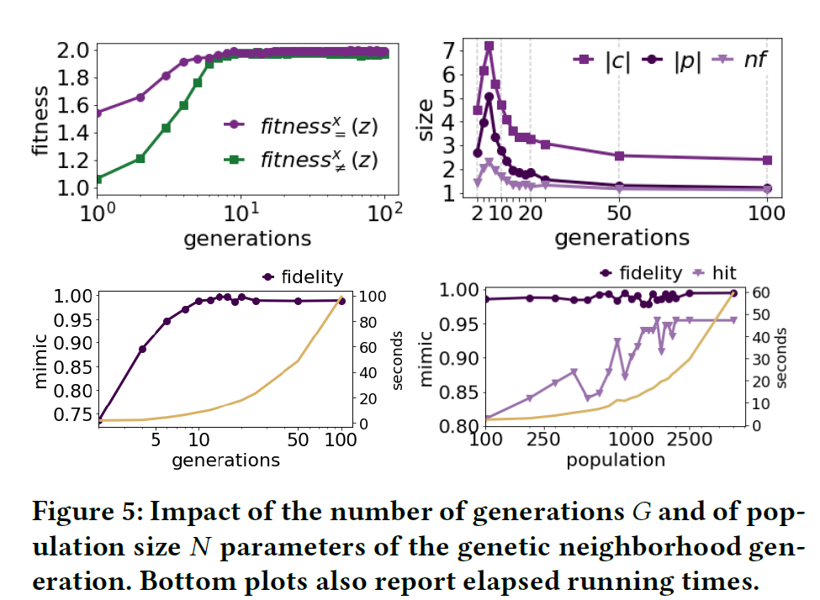
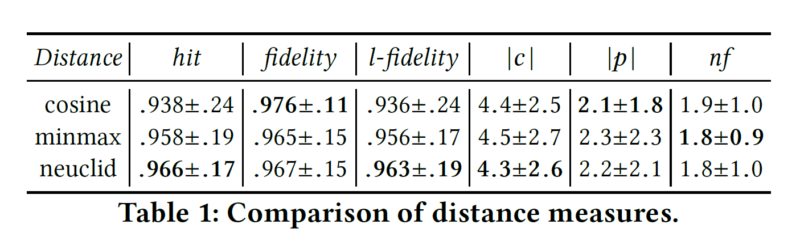
Analysis of Neighborhood Generation
Results reported are only for German dataset.
Fixed size of neighborhood - N=1000, after 10 generations, the fitness function converges around optimal value, fidelity almost maximized, and measures of sizes become stable and small.
Size N of the neighborhood instances is relevant for the hit rate but not for fidelity.
Considering running time, there is a good trade-off by setting N=1000.
Changing the distance function used by the genetic algorithm has no considerable effect on the results.
Notes:
They analyzed the impact of the number of Generations G and size of neighborhood N on the performances of instance generation and the size complexity of the LORE output.
The top plots show the value of fitness functions and measures of sizes of local classifier c (decision tree depth), of decision rule (size of p), and of counterfactual rules (number nf of falsified split conditions). For fixed size N – 1000, we can see from the top plots that after 10 generations, the fitness function converges around the optimal, fidelity is maximized, and measures of sizes become stable and decrease.
They also plot the fidelity and hit for different neighborhood size. They notice that fidelity is not affected by the size of the population, whereas hit rate is affected. By also looking at the running time, a good trade-off is obtained by setting N = 1000
Then, they compared different distance functions, cosine – minmax – and the one they used normalized Euclidean. Results had no considerable difference.

Slide 16
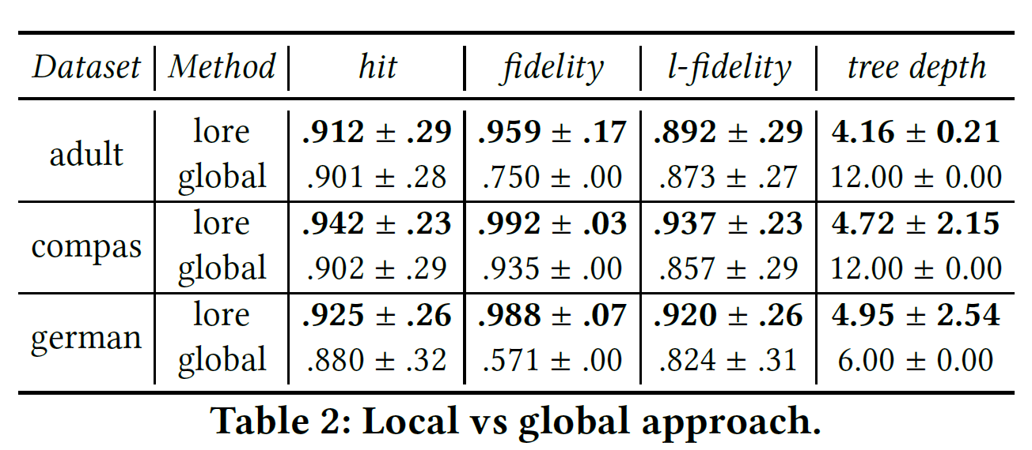
Validation of Local Explanations
Local: building a predictor from the neighborhood of an instance
Global: building a single predictor from all instances in the test set
The size and depth of the decision tree of the global approach may lead to explanations more complex to understand than those returned by the local approach LORE

Slide 17
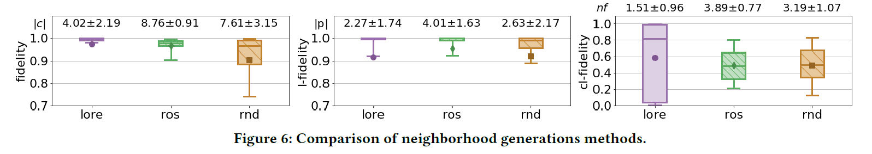
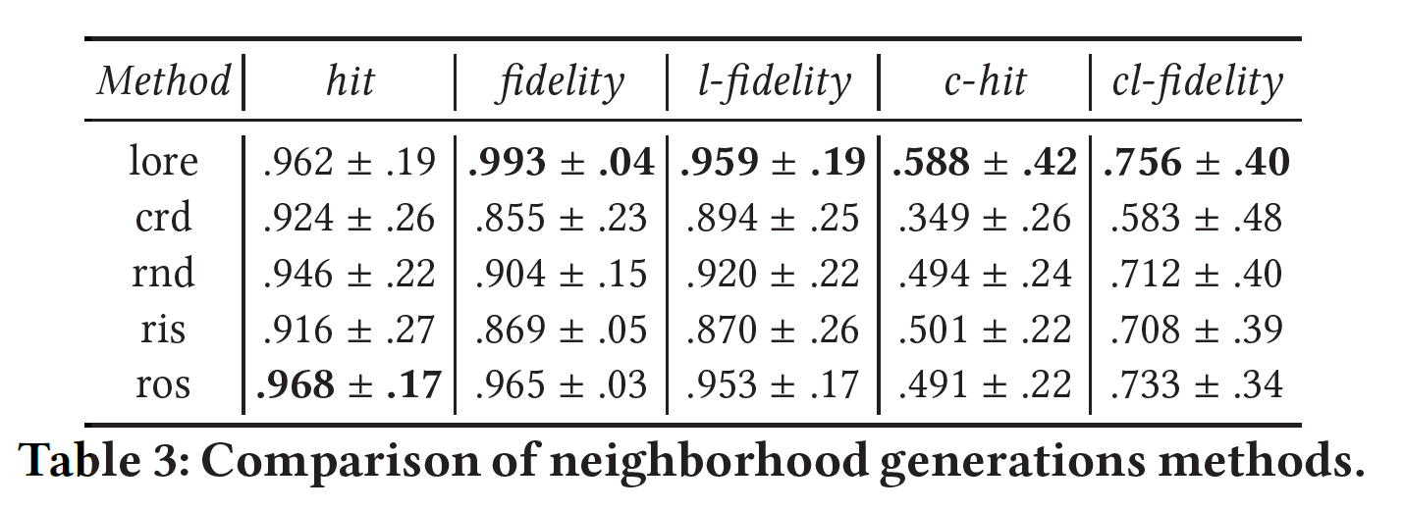
Validation of Local Explanations
Comparing the genetic programming approach to other neighborhood generations methods:
crn: returns the k = 100 instances from the test set that are closest to x
rnd: augment the output of crn with additional randomly generated instances to get a stratified set.
ris: starting from the output of rnd, performs the instance selection using condensed nearest neighbor rule (CNN)
ros: starting from the output of rnd, performs a random oversampling to balance the decision outcomes
Notes:
Table 3: LORE overtook the performance of all the other neighbors generators. Intuitively, this means that LORE’s genetic programming approach contributes more than the other methods in capturing/explaining the behavior of the black box for both direct and counterfactual decisions.
Figure 6: box plots of the distributions of fidelity, l-fidelity, cl-fidelity and size of decision trees, decision rule, and number of falsified split conditions in counterfactual rules. LORE has the highest mean and median, low variability (smallest interquartile ranges). Note for cl-fidelity, LORE has the highest variability, but a median value that is higher than the 90th percentile of the competitors.

Slide 18
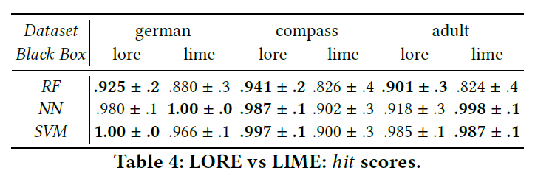
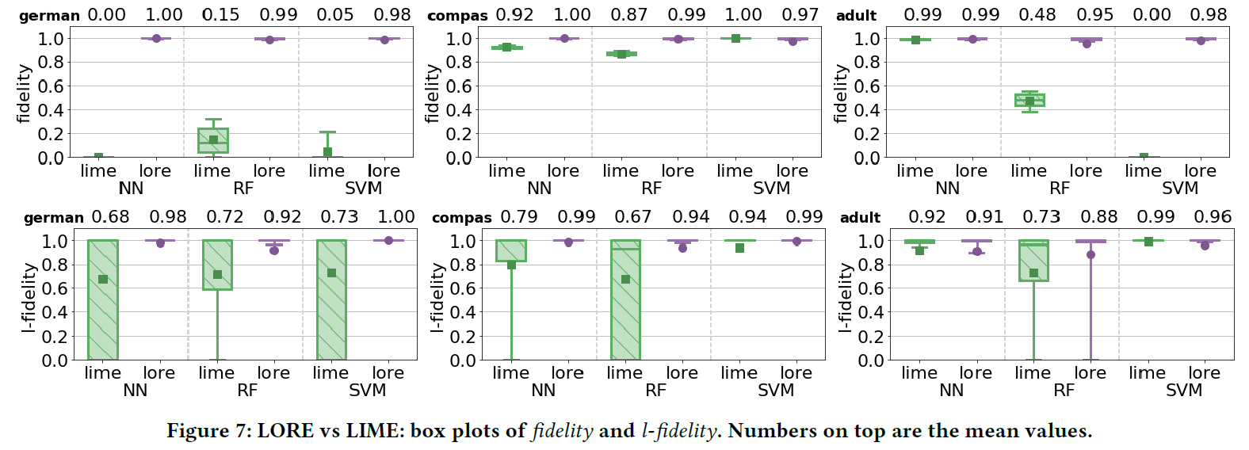
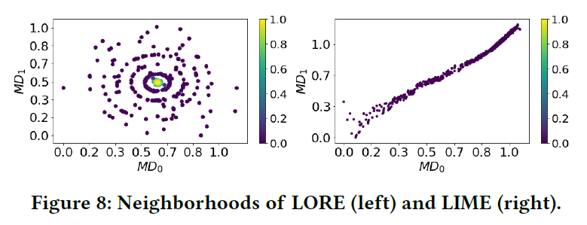
Comparison with State-of-Art
LORE vs. LIME:
In LIME, the number of features composing an explanation is an input parameter specified by the user. LORE automatically provides the user with an explanation and the features useful for justify the black box.
The explanations provided by LORE are more abstract and comprehensible than LIME.
Notes:
Now, to compare with state-of-the-art, they compare LORE vs. LIME.
A first crucial difference is that in LIME, the number of features composing an explanation is an input parameter that is specified by the user, whereas LORE automatically provides the user with an explanation including only the features useful.
Table 4: reports the mean and standard deviation of hit. We can see even when LORE is worse that LIME, it has a score close to 1.
Figure 7: LORE has better fidelity score and is more robust than LIME. We can see that for l-fidelity LIME exhibits very high variability in the neighborhood of the instance to explain.
Figure 8: reports a multidimensional scaling of the neighborhood of a sample x generated by the two approaches. LORE computes a dense and compact neighborhood. The instances generated by LIME, can be very distant from each other and always with a low density around x.

Slide 19
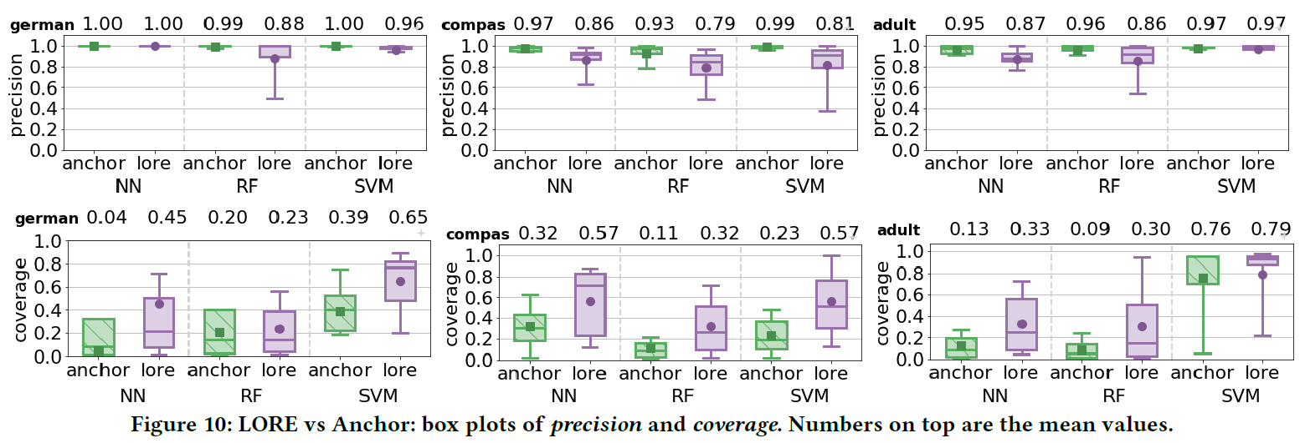
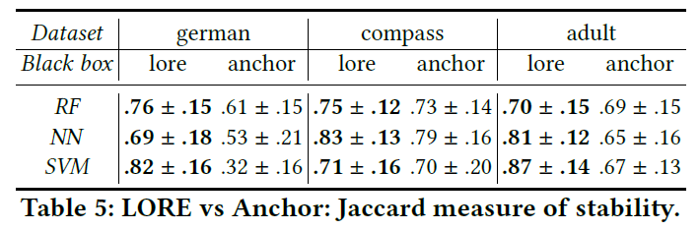
Comparison with State-of-Art
LORE vs. Anchor:
LORE has on average a high rule precision (despite not being set as parameter as in Anchor), and very similar to that of Anchor of 95% obtained by construction.
LORE shows a consistently better coverage than Anchor.
LORE has a better stability than Anchor
Notes:
Now, comparing LORE to Anchor.
Large values of coverage are preferable, since this means that the set of decision rules produced over the instances to explain can be condensed/restricted to a subset of it.
Table 5: They compare the stability of the two approached with respect to randomness introduced in the neighborhood generation. They measure stability using the Jaccard coefficient of feature sets used in the 10 decision rules computed fir a same instanced in 10 runs of the system.
The Jaccard coefficient measures similarity between finite sample sets, and is defined as the size of the intersection divided by the size of the union of the sample sets.

Slide 20
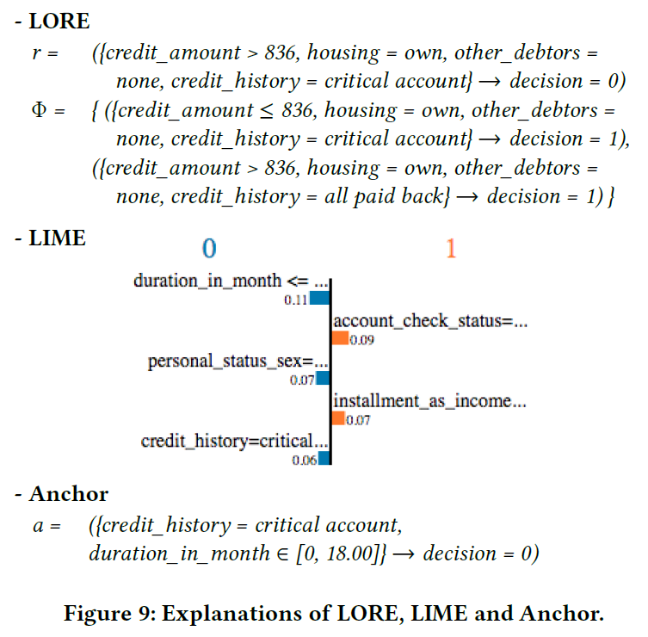
Comparison with State-of-Art
LIME provides a rough indication of where to look for a different decision
LORE provides high-level and minimal-change contexts for reversing the outcome prediction of the black box (counterfactual rules)
Anchor requires the apriori discretization of continuous features, and does not clearly extend to compute counterfactuals.
Notes:
For a qualitative comparison, we take an example of an instance x from the german dataset.
LIME: Weights are associated to the categorical values in the instance x to explain, and to continuous upper/lower bounds where the bounding values are taken from x. Each weight tells the user how much the decision would have changed for different (resp., smaller/greater) values of a specific categorical (resp., continuous) feature.
In the example, the weight 0.11 has the following meaning: if the duration in months had been higher than the value it is for x, the prediction would have been, on average, 0.11 less “0” (or 0.11 more “1”). A not very easy logic to follow when compared to a single decision rule which characterize the contextual conditions for the decision of the black box. Another major advantage of our notion of explanation consists of the set of counterfactual rules. LIME provides a rough indication of where to look for a different decision: different categorical values or lower/higher continuous values of some feature. LORE’s counterfactual rules provide high-level and minimal-change contexts for reversing the outcome prediction of the black box.
Anchor: the Anchor approach requires the apriori discretization of continuous features, while the decision rule of LORE benefits of the capabilities of decision tree to split continuous features.

Slide 21
Conclusion and Extensions
LORE:
Builds an interpretable predictor for a given black box and instance to be explained
The local interpretable predictor is a decision tree trained on a dense set of artificial instances generated by a genetic algorithm
The decision tree enables the extraction of a local explanation, consisting of a single rule for the decision and a set of counterfactual rules for the reversed decision
FUTURE WORK:
LORE now works tabular data. Future direction is to make the method work for image and text data
Deriving a global description of the black box bottom-up by composing the local explanations and minimizing the complexity of the global description
Conducting research lab experiments to evaluate the human comprehensibility of the explanations provided by LORE
LORE explanations can be used for identifying data and/or algorithmic biases.

Slide 22
Thank you!
Any Questions?

