Slide 1
Critique Anchors: High-Precision Model-Agnostic Explanations Marco Tulio Ribiero Sameer Singh Carlos Guestrin
-Jie Hua and Shubham Sharma

Slide 2
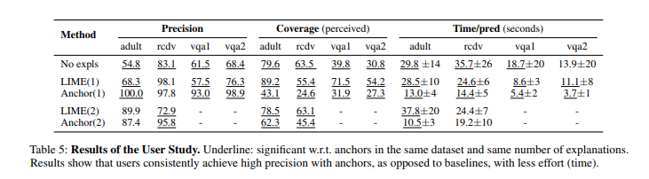
Is Anchors really better than LIME: Precision vs Coverage
Coverage is defined as the fraction of instances where users made a prediction other than I don’t know.
Precision is better for Anchor but coverage is better for LIME!
While Anchors might be better for extrapolating explanations to new data instances, users are more confident after seeing LIME explanations

Slide 3
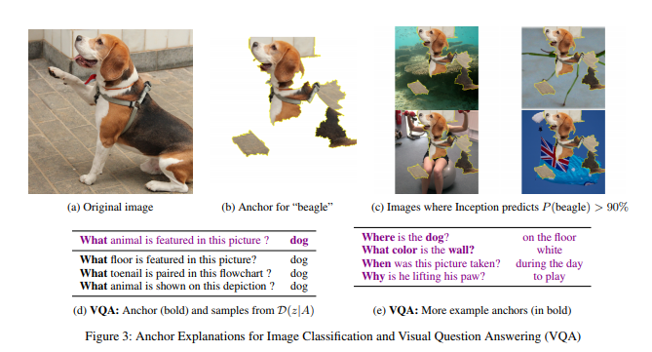
Anchors for Image Data
Taken one example case without details on precision or coverage or advantage over LIME
Github doesn’t include the code or experiments for image data or VQA

Slide 4
Hyperparameters and Sensitivity Analysis: Is the approach really model agnostic?
Anchors depends heavily on the hyperparameters that are needed to get good precision and coverage.
The choice of these parameters would vary for different models otherwise the anchors could be complex, conflicting or none.
Hence, analyzing various models sensitivity to these is crucial (left for future work in the paper)
The user is having to choose these at present and it is important to either learn them or do a grid search approach, which might then make anchors slower than LIME.

Slide 5
Other problems
Users have reported getting empty anchors for high precision in some cases. The threshold value then needs to be tuned to ensure some sub-optimal explanation
Data instances near the decision boundary give very narrow Anchors and LIME might work better then
Complex Output Space: Having a large number of labels will cause issues to the user with anchors.
The Simulated User study section is very unclear on how precision and coverage have been computed and how this classifies as a ‘simulated user’.

