Slide 1
On Formalizing Fairness in Prediction with Machine Learning
Pratik Gajane and Mykola Pechenizkiy
Critiqued by: Rebecca Adaimi
Ronshee Chawla

Slide 2
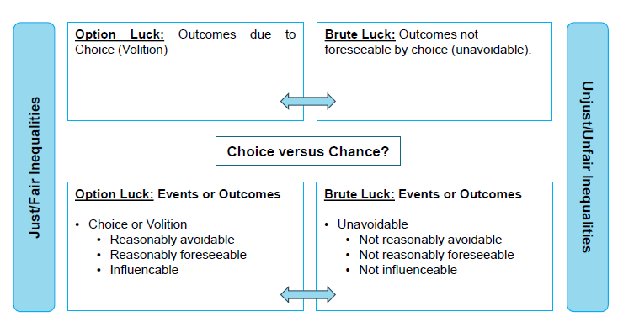
Equality of Resources
Dworkin claims that: “individuals are treated equally (with regard to the distribution of resources) only if that distribution is “sensitive towards ‘ambition’ or ‘option luck’, i.e. the traits and choices for which individuals should be held responsible, but where the distribution is insensitive to endowments and brute luck, i.e. those things for which the individual should not be held responsible”
Notes:
For instance, one could argue that algorithmic inequalities would be due to brute luck when they are based on a) information or data, whether provided directly or indirectly, concerning the affected individual or b) resulted from his or her actions but for which, for the individual affected, no clear link exists between a, b, and the algorithmic outcome - even though the algorithm did find such a link to be present. If one remains true to the strict definition of ‘option’ luck, as being determined by choice or volition, one could also argue that, where an individual has freely given informed consent to the processing of his or her personal data for the purposes of automated decision-making, algorithmic inequalities that follow are justified.
With regard to group level inequalities, it seems more difficult to judge their fair nature on the basis of brute and option luck. How can one determine whether or not unfair outcomes for a group, such as a stereotype, are the result of brute or option luck? How and when can one ascribe volition or responsibility to random groups? In addition, what to do with inequalities that are unfair for the group, but nonetheless have produced beneficial outcomes for certain individual members within the group (or vice versa)? Should there follow some sort of redistribution or compensation in favor of the group? Finally, the difficulty to demarcate brute from option luck likely limits the possibility that these notions will one day be formalized in an effective, airtight manner.

Slide 3
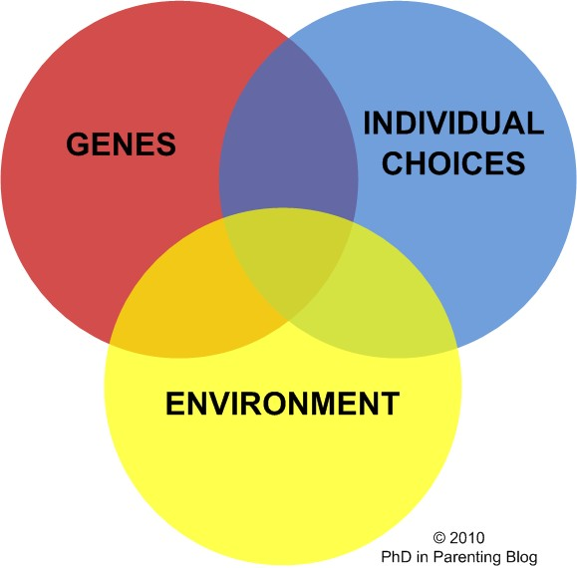
Equality of Resources
Ambition-sensitive and endowment-insensitive attributes may not be independent. (e.g.: having a job where you have no say in the environment but you have a say in how you make the most out of it)
Personality is affected by:
genes (nature)
individual choices
environment (nurture)
Notes:
Introvert vs. extrovert personality

Slide 4
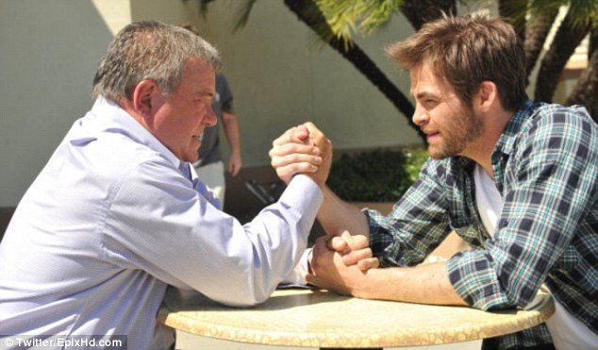
Equality of Capability of Functioning
Capabilities of functionings are dependent on protected attributes (ex: age) – how do we define the compensation?

Slide 5
Prospective Notions of Fairness
They attempt to cast algorithmic notions of fairness as instances of existing theories of justice. But, their prospective notions of fairness only deal with individual fairness.
What about Group Fairness?
Notes:
With regard to group level inequalities, it seems more difficult to judge their fair nature on the basis of brute and option luck. How can one determine whether or not unfair outcomes for a group, such as a stereotype, are the result of brute or option luck? How and when can one ascribe volition or responsibility to random groups? In addition, what to do with inequalities that are unfair for the group, but nonetheless have produced beneficial outcomes for certain individual members within the group (or vice versa)? Should there follow some sort of redistribution or compensation in favor of the group? Finally, the difficulty to demarcate brute from option luck likely limits the possibility that these notions will one day be formalized in an effective, airtight manner.

