Slide 1
Explanations based on the Missing: Towards Contrastive Explanations with Pertinent Negatives
Amit Dhurandhar, Pin-Yu Chen, Ronny Luss , Chun-Chen Tu, Paishun Ting , Karthikeyan Shanmugam and Payel Das

Slide 2
Motivation: Contrastive Explanations?
“Steve is the tall guy with long hair who does not wear glasses.”
Why is it an effective explanation?
Highlight what is minimally sufficient
Identify contrastive features that should be minimally and critically absent
Contrastive facts can be essential for accurate explaination:
Maybe we have a Bob who’s tall with long hair but wear glasses.
So we fix our eyes not on what is seen, but on what is unseen. For what is seen is temporary, but what is unseen is eternal.
-- 2 Corinthians 4:18
Notes:
So reading the title, the first question is, what is contrastive explanations? Let’s first consider a common human explanation.
Two reasons argued by the authors…. So in the context of this paper, the contrastive explanation means to not only exploit what is seen as evidence of judgement, but also what is absent that makes the explained object as A rather than B, which is often ignored in previous explanary techniques
The authors believe those contrastive facts can give you more informative and inspirational explanations. For example,...

Slide 3
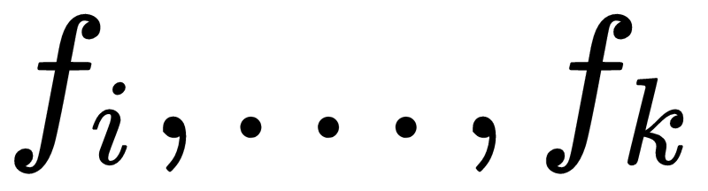
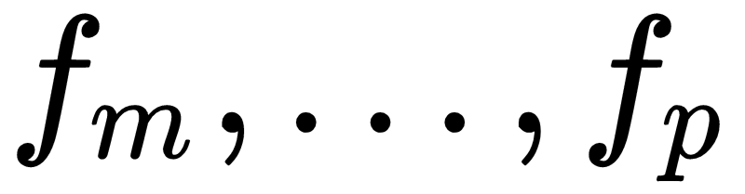
Contrastive Explanation Methods (CEM)
Under a classifier C, an example x is classified as some label t,
CEM generates an explanation as follows:
“An input x is classified in class t because features are present and because features are absent.”
Pertinent Positive (PP): Factor whose presence is minimally sufficient in justifying the final classification.
Pertinent Negative (PN): Factor whose absence is necessary in asserting the final classification
Notes:
They call their explanation framework CEM.

Slide 4
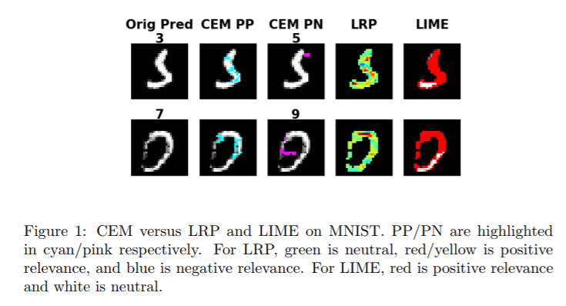
Comparisons vs Current Approaches
Previous Works: LRP, LIME
Both highlight positively or negatively relevant features
Pertinent Negatives vs Negatively Relevant Features: “direct evidence supporting the hypothesis” vs “information that devalues the hypothesis”
“An input x is classified in class t because existent features a,b,c are positively relevant in spite of other existent features e,f,g which is negatively relevant.”
Notes:
In the paper they mainly compare their work with two current techniques: LRP and LIME. LRP and LIME both … Their explanation is something like this: An input x is classified in class t because existent features are positively relevant in spite of other existent features e,f,g which is negatively relevant.
But PN is totally different from NRF. PN are absent features you don’t see of an example but will help its classification; NRF are existent features you have that actually harm your current prediction. The authors believe PN is more close to a human understanding. Because they’re ...
Here’s a quick example. Now we have an image which is classfied as 3. For CEM, we can give PP, the blue pixels here, which means the presence of these pixels are mostly driving the classifier to do the judgement; and also PN, the purple pixels, which means the absence of these pixels help distinguish the image from 3 to 5. In contrary, the LRP gives another type of explanation: it doesn’t have any explanation on absence, instead, it basically tells you what present pixels are helping you classifying the image as 3; and also the LRP tells you what are keeping you away from 3. We’ll give a full introduction of the test results in the later sections.

Slide 5


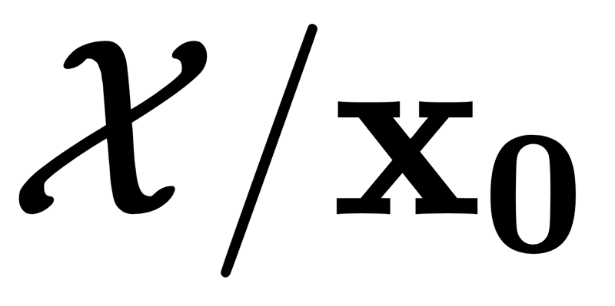


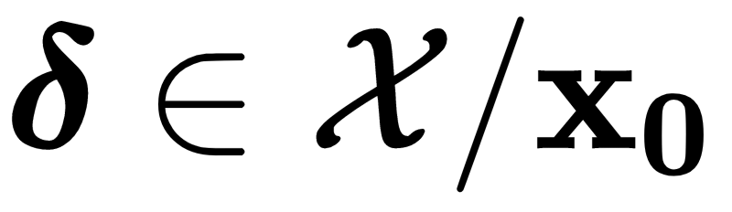
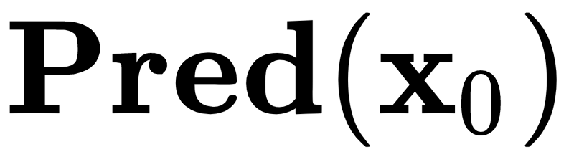

Algorithm (Finding Pertinent Negatives)
Given an input and its label
Denote as the space of missing parts with respect to
: prediction scores (logits) of all classes given the classifier
Aim: Find “the most critical” perturbation such that and give significantly different predictions.
Mathematically, solve the following optimization:
Notes:
Ok. So let’s take a look at how they’ve achieved their goal. We’ll highlight their method for PN and PP is just simlar.
… So we call it the missing space. Like in the digit recognition example, the missing space contains all the black pixels of an image. For different database, the missing space should be carefully specified and you need to define it in a proper mathematical way. …
Aim of finding PN is to locate ..

Slide 6
Algorithm (Finding Pertinent Negatives)
Optimization Objective:
Main Loss Function:
Notes:
In the optimization, we want to find an optimal delta in the missing space to minimize this whole thing. The first part is the main loss function. first let’s focus on first part, this term is the prediction score of the perturbed example for the original class t, and this term is the prediction score of the perturbed example for a new class which has the largest probability. So if we choose the delta well, the perturbed example should be classified as a new label, so this subtraction will give us a negative number and as low as possible. That’s why we want to min this thing. The max just gives a lower bound for the first part for computational stability so nothing fancy here.

Slide 7
Algorithm (Finding Pertinent Negatives)
Optimization Objective:
Regularizer: Feature Selection (“Minimally Critical Features”)

Slide 8
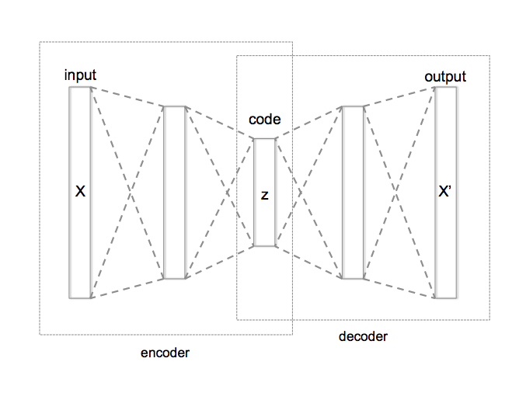
Algorithm (Finding Pertinent Negatives)
Optimization Objective:
Reconstruction Error Evaluated by Auto-Encoder (AE)
Auto-Encoder Error:
To ensure the perturbed input is still close to the original data manifold.
Notes:
The last part is a little bit tricky. it’s called … It is to ensure…Remind that
A well-trained autoencoder can compress data of a certain type from into a short code, and then uncompress that code into something that closely matches the original data. If the dataset is digit images then the reconstruction error of a new digit image should be small because AE can learn the data manifold properly.
Suppose for the given dataset, we have a well-trained AE for the example data.

Slide 9
Algorithm (Finding Pertinent Positives)
Optimization Objective:
Main Loss Function:

Slide 10
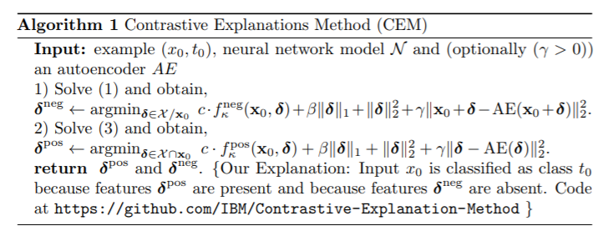
Algorithm
Optimization Solver: FISTA

Slide 11
Experiment

Slide 12
3 Databases
Handwritten Digits: MNIST
Procurement Fraud: a real procurement dataset for risk evaluation
Brain Functional Imaging: Autism Brain Imaging Data Exchange (ABIDE)

Slide 13
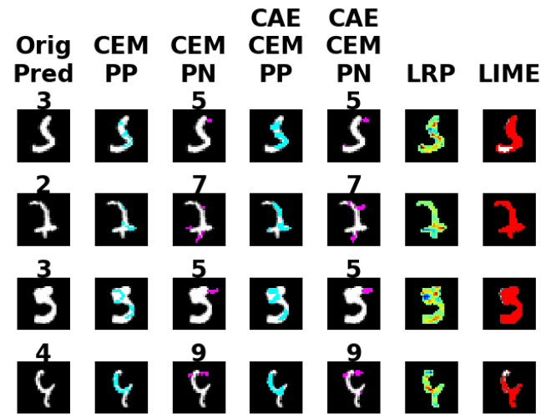
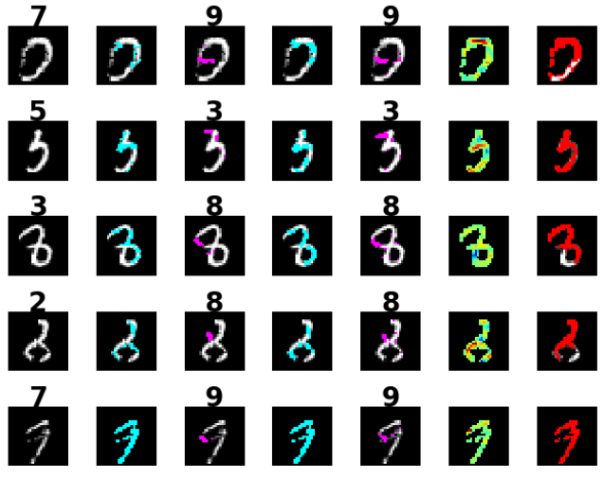
MNIST
PP/PN: cyan/pink

Slide 14
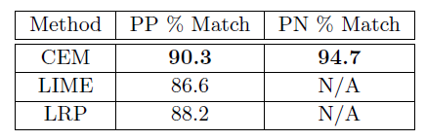
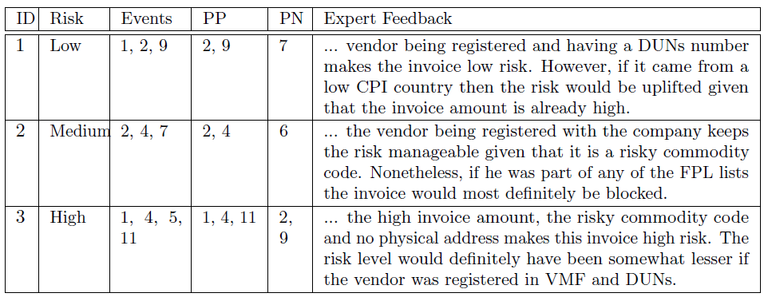
Procurement Fraud
Label | Feature

Slide 15
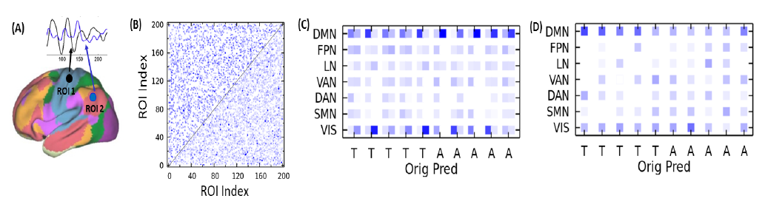
Brain Functional Imaging
B: Upper-left is PP, Down-right is PN.
C: Left is PP, Right is PN.
Feature
CEM
LRP
T: five health subjects
A: five autistic (patient) subjects
Feature index
Features are different connections between different parts of the brain.

Slide 16
Quantitative Evaluation
Action: Add PPs or PNs into the original input to test whether the predicted results are maintained or switched.
Accuracy: 100% effective

Slide 17
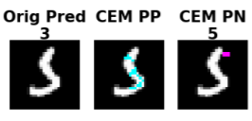
A few questions not clear in paper...
Non-convex? (Local/global min)
How to be sure there is one and only one solution?
General?

Slide 18
Conclusion
An input x is classified in class t because of:
PPs are present,
PNs are absent.
Compare with Negatively Relevant Features, PNs give better explanations
CEM: Obtain PPs and PNs by solving optimization problem

Slide 19
Thank you!!!

