Slide 1
A unified approach to interpreting model predictions
Author: Scott M. Lundberg, Su-In Lee
Presenter:
Xing Han
Dept. of Electrical and Computer Engineering
Yihao Feng
Dept. of Computer Science

Slide 2
interpretation methods
Interpretation by data points: influence functions, MMD critic, etc.
Interpretation by features: LIME, SHAP, DeepLIFT, etc.
Model specific explanation: linear SHAP, low-order SHAP, Max SHAP, etc.
Model agnostic explanation: Anchors, LIME, SHAP, etc.

Slide 3
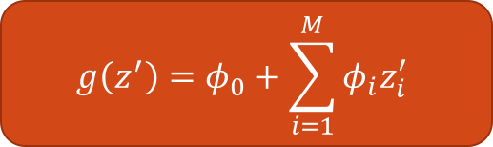
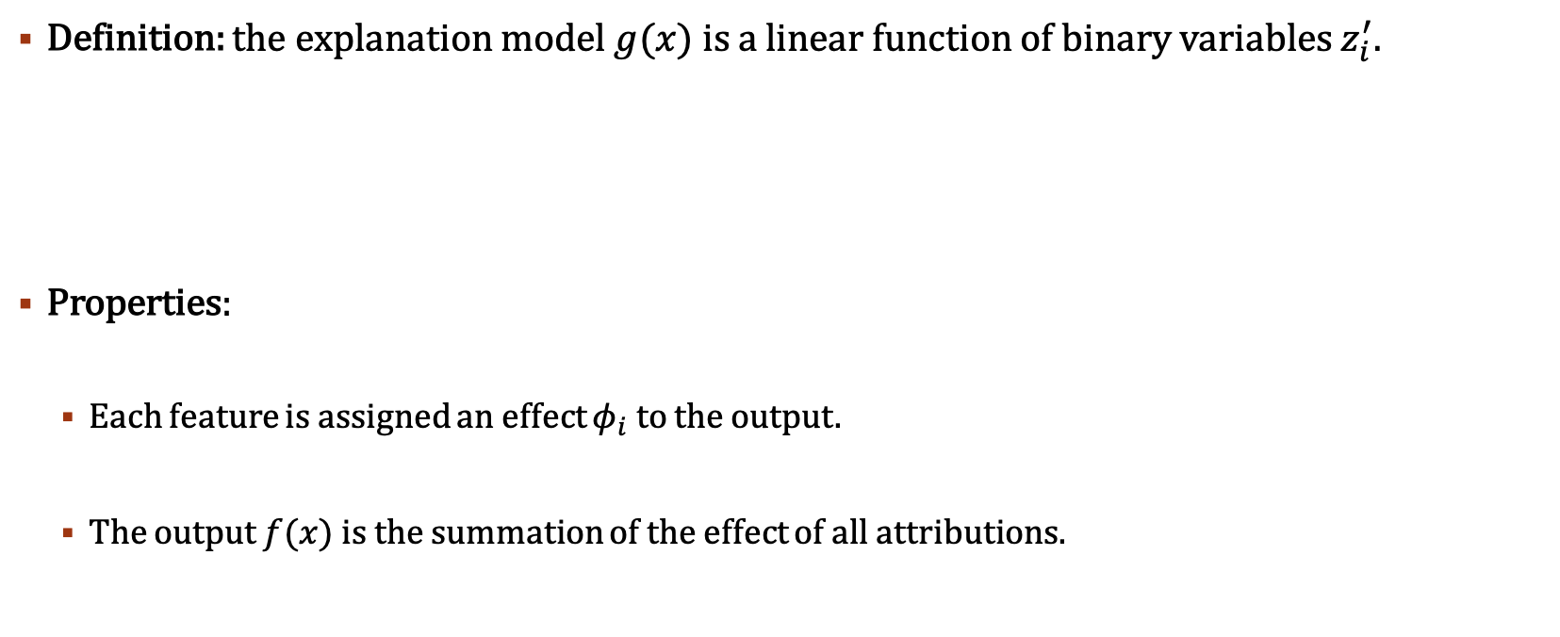
Additive feature attribution
Definition: the explanation model $g(x)$ is a linear function of binary variables $z_{i}^{′}$.
Properties:
Each feature is assigned an effect $φ_{i}$ to the output.
The output $f(x)$ is the summation of the effect of all attributions.
$$g\left(z^{′}\right)=φ_{0}+\sum_{i=1}^{M}{φ_{i}z_{i}^{′}}$$

Slide 4
Additive feature attribution
Additive Feature Attribution
DeepLIFT:
$\sum_{i=1}^{n}{C_{∆x_{i}∆o}=∆o}$,
Summation-to-delta: every input perturbation add up to the output value
DeepLIFT:
∑24_(𝑖=1)^𝑛▒〖𝐶_(∆𝑥_𝑖 ∆𝑜)=∆𝑜〗,
Summation-to-delta: every input perturbation add up to the output value
Shapley Value:
$$φ_{i}=\sum_{S⊆F\backslash \{i\}}{\frac{\left|S\right|!\left(\left|F\right|−\left|S\right|−1\right)!}{\left|F\right|!}[f_{S∪\left\{i\right\}}\left(x_{S∪\left\{i\right\}}\right)−f_{S}\left(x_{S}\right)]}$$
Feature attribution of all subset combinations.
Shapley Value:
𝜙_𝑖=∑10_(𝑆⊆𝐹\\{𝑖})▒〖|𝑆|!(|𝐹|−|𝑆|−1)!/|𝐹|![𝑓_(𝑆∪{𝑖} ) (𝑥_(𝑆∪{𝑖} ) )−𝑓_𝑆 (𝑥_𝑆 )]〗
Feature attribution of all subset combinations.
LIME:
$$ξ=\arg_{g∈𝒢}\min{L\left(f, g, π_{x}\right)+ Ω(g)}$$
Weighted combination of squared sample loss (linear regression with $l2$ loss)
LIME:
𝜉=〖𝑎𝑟𝑔〗_(𝑔∈𝒢) min⁡〖𝐿(𝑓, 𝑔, 𝜋_𝑥 )+ Ω(𝑔)〗
Weighted combination of squared sample loss (linear regression with 𝑙2 loss)

Slide 5
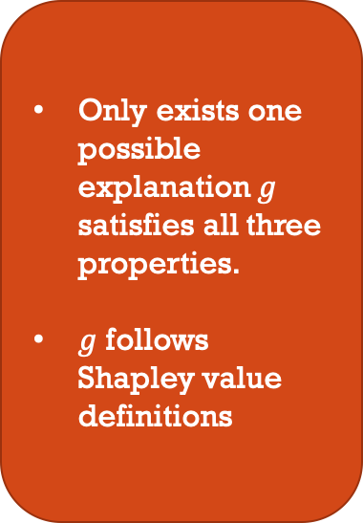
Properties
Local accuracy: $f\left(x\right)=g(x^{′})$ in every point of interpretation.
Local accuracy: 𝑓(𝑥)=𝑔(𝑥^′) in every point of interpretation.
Missingness: missing features have no attribution effect.
Consistency: higher attribution results in higher output perturbation.
Only exists one possible explanation $g$ satisfies all three properties.
$g$ follows Shapley value definitions

Slide 6
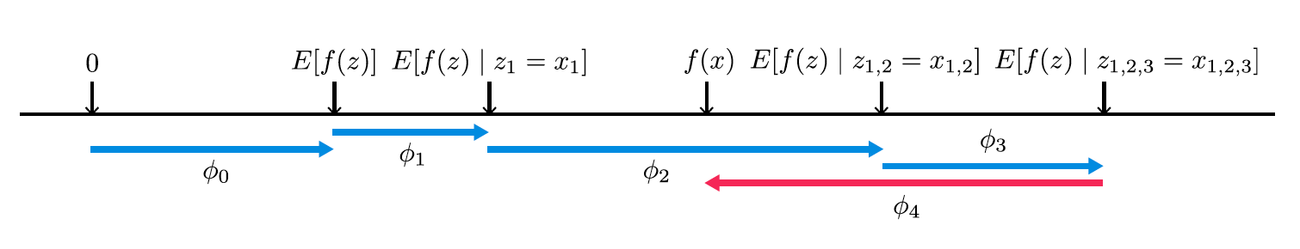
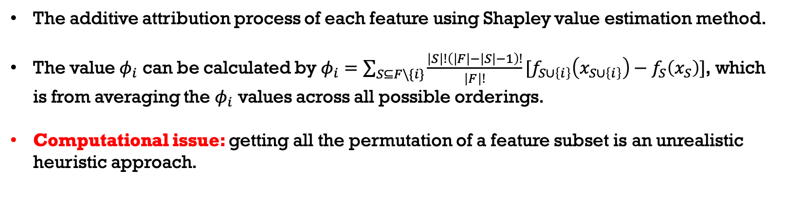
SHAP Values
The additive attribution process of each feature using Shapley value estimation method.
The value $φ_{i}$ can be calculated by $φ_{i}=\sum_{S⊆F\backslash \{i\}}{\frac{\left|S\right|!\left(\left|F\right|−\left|S\right|−1\right)!}{\left|F\right|!}[f_{S∪\left\{i\right\}}\left(x_{S∪\left\{i\right\}}\right)−f_{S}\left(x_{S}\right)]}$, which is from averaging the $φ_{i}$ values across all possible orderings.
Computational issue: getting all the permutation of a feature subset is an unrealistic heuristic approach.

Slide 7
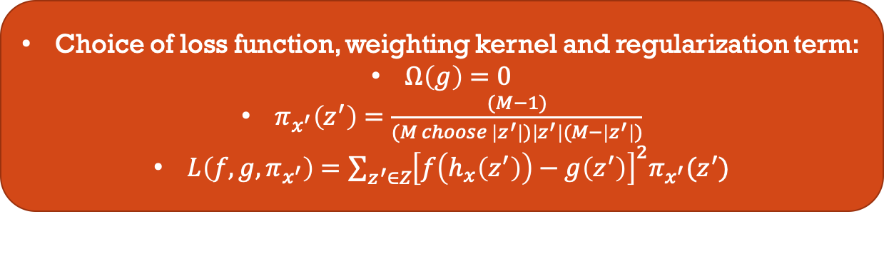
Compute shap values
Model-Agnostic Approximations:
Old methods: Shapley sampling values, Quantitative Input Influence
Kernel SHAP: combine Linear LIME and Shapley values
faster approximation
satisfy local accuracy and consistency
Weighted regression based, model agnostic approximation of Shapley values
Choice of loss function, weighting kernel and regularization term:
$Ω\left(g\right)=0$
$π_{x^{′}}\left(z^{′}\right)=\frac{(M−1)}{(M choose \left|z^{′}\right|)\left|z^{′}\right|(M−\left|z^{′}\right|)}$
$L\left(f, g, π_{x^{′}}\right)=\sum_{z^{′}∈Z}{{\left[f\left(h_{x}\left(z^{′}\right)\right)−g\left(z^{′}\right)\right]}^{2}π_{x^{′}}(z^{′})}$

Slide 8
Compute shap values
Model Specific Approximations
Linear SHAP
Low-Order SHAP
Max SHAP
Deep SHAP
Linear Model Assumption
Quadratic Model Assumption
Max Function Assumption
Deep Networks Assumption

Slide 9
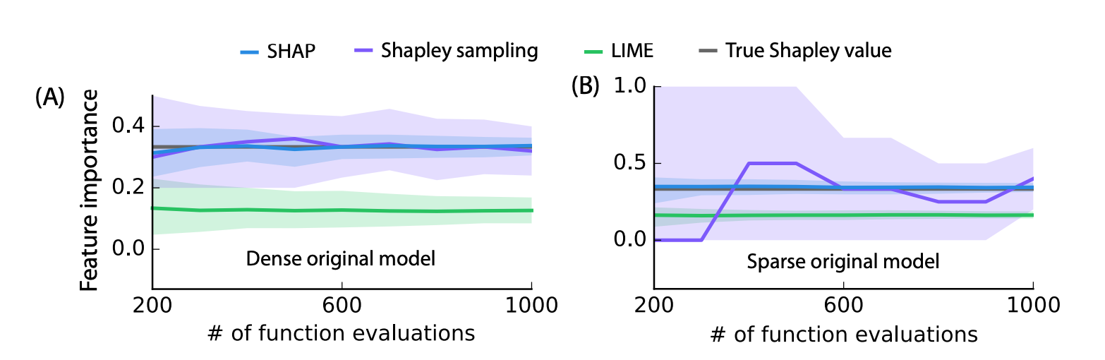
Computational efficiency
Kernel SHAP demonstrates significant advantages:
Faster approximation speed than Shapley sampling and true Shapley value
Better local accuracy and consistency than LIME

Slide 10
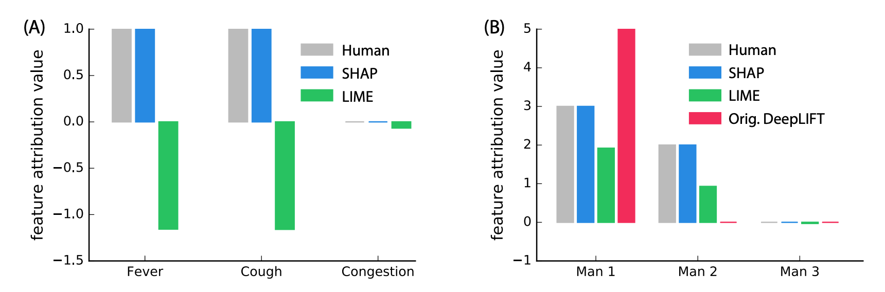
User study
Comparison of model explanation quality: SHAP outperforms all other models.

Slide 11
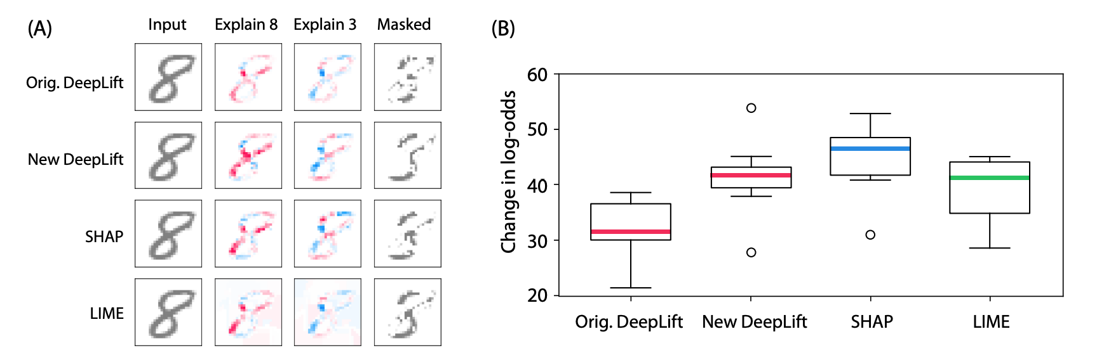
Model improvement
Neural network interpretation task
Modified DeepLIFT outperforms original DeepLIFT
Kernel SHAP model get the best performance

Slide 12
Summary of contribution
Unified few existing models with additive feature attribution methods
Defined 3 properties that can serve as the metric of all explainable models
Developed efficient computation methodology of Shapley values
Proposed an improvement to original LIME and DeepLIFT models
Consider attributions of feature combinations instead of individually

