Slide 1
Discussion on : Learning Qualitatively Diverse and Interpretable Rules for Classification (Andrew Slavin Ross, Weiwei Pan, Finale Doshi-Velez)
By Yan Han, Gautam Krishna

Slide 2

Problem statement
Data Set
Classifier 1
Classifier 2
Classifier 3
Comparable accuracy
Comparable accuracy
Comparable accuracy
Classification - Cross entropy or negative log likelihood

Slide 3
Continued
Traditional ML
Classifier 1
Classifier 2
Classifier 3
Authors show
More complex model
Simpler and more interpretable
Classifier is better

Slide 4
Major contributions
Propose a formal definition of maximal diverse classifier set
Propose a new method to train group of maximal diverse classifiers

Slide 5
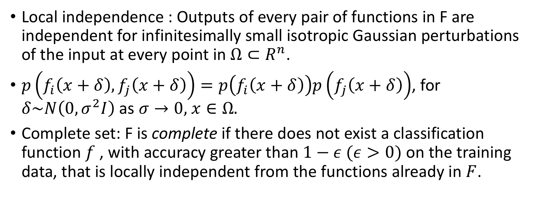

Maximal Diverse Classifier Set $F=\{f_{1},…,f_{n}\}$
Local independence : Outputs of every pair of functions in F are independent for infinitesimally small isotropic Gaussian perturbations of the input at every point in $Ω⊂R^{n}$.
$p\left(f_{i}\left(x+δ\right),f_{j}\left(x+δ\right)\right)=p\left(f_{i}\left(x+δ\right)\right)p\left(f_{j}\left(x+δ\right)\right)$, for $δ\sim N\left(0, σ^{2}I\right)$ as $σ→0,$ $x∈Ω.$
Complete set: F is complete if there does not exist a classification function $f$ , with accuracy greater than $1−ε (ε>0)$ on the training data, that is locally independent from the functions already in $F$.

Slide 6
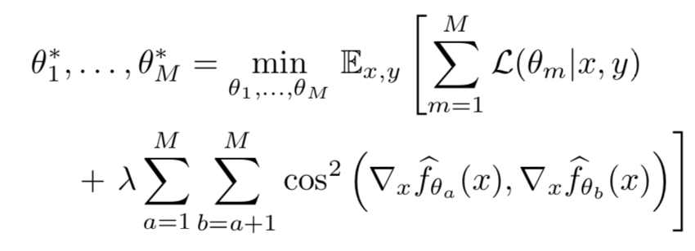
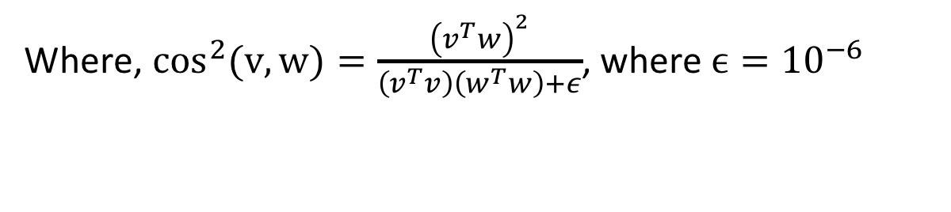
Local Independence Training
Where, $\cos^{2}(v,w)=\frac{{\left(v^{T}w\right)}^{2}}{\left(v^{T}v\right)\left(w^{T}w\right)+ε}$, where $ϵ={10}^{−6}$

Slide 7
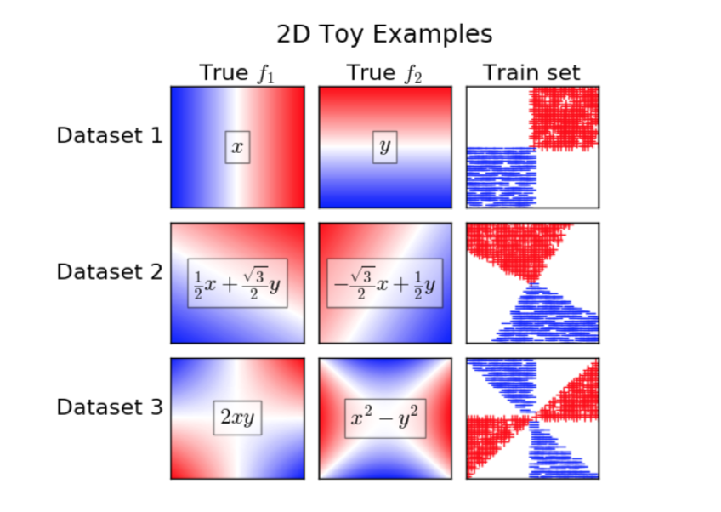
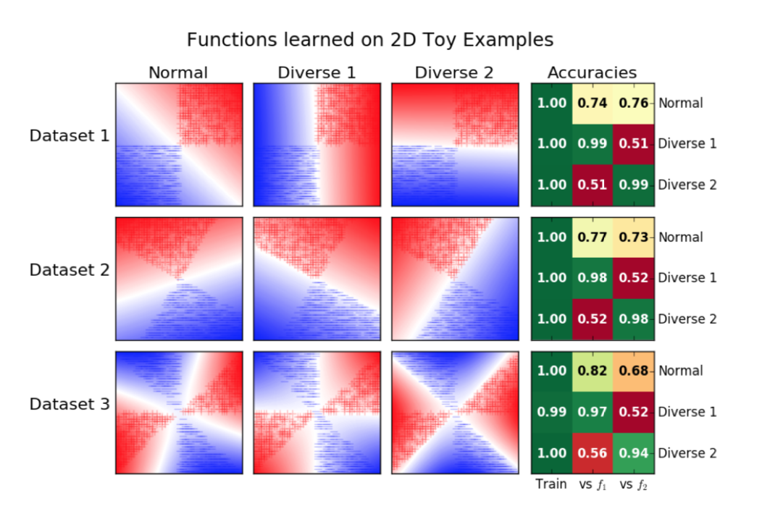
Experimental Results

Slide 8
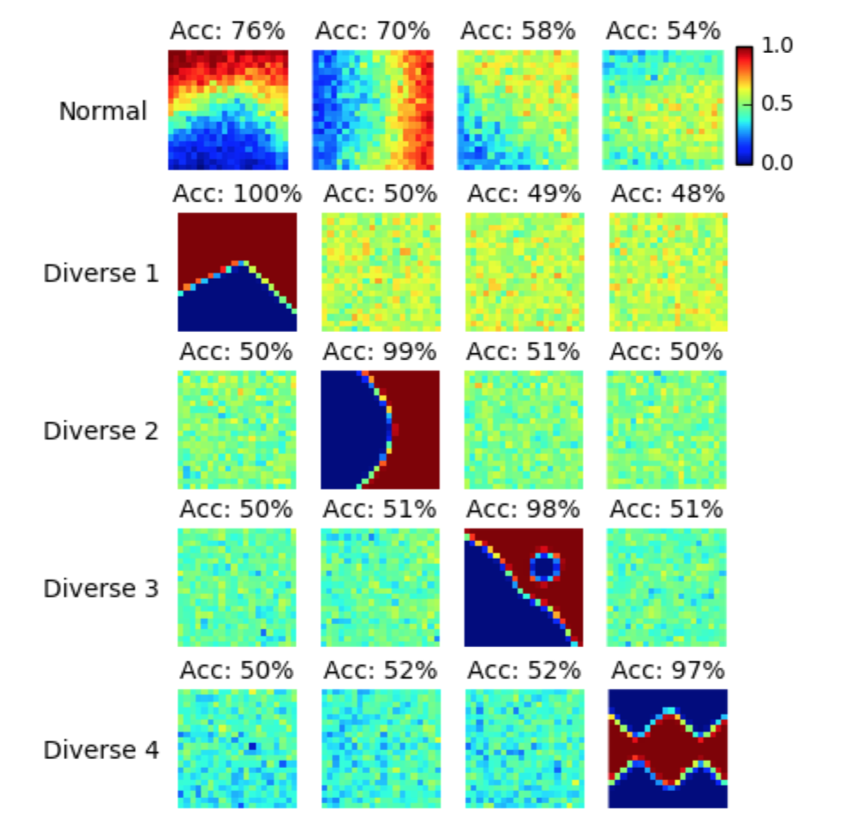
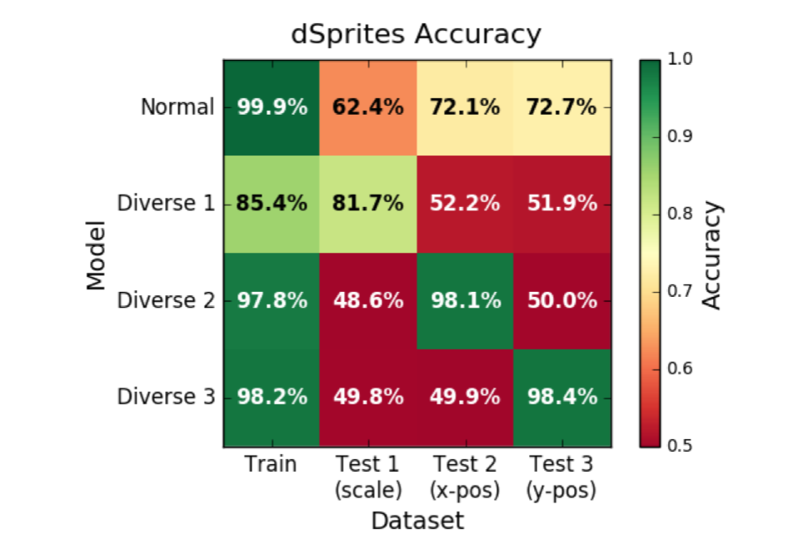
Continued

Slide 9
Conclusion
Faced with a data set that supports multiple decision rules.
Standard ML learn complex combinations of those decision rules.
Proposed a heuristic way to separate them out via locally independent training.
The experiments results show that the proposed training technique can recover these locally independent functions with ‘simple’ functional forms.

Slide 10
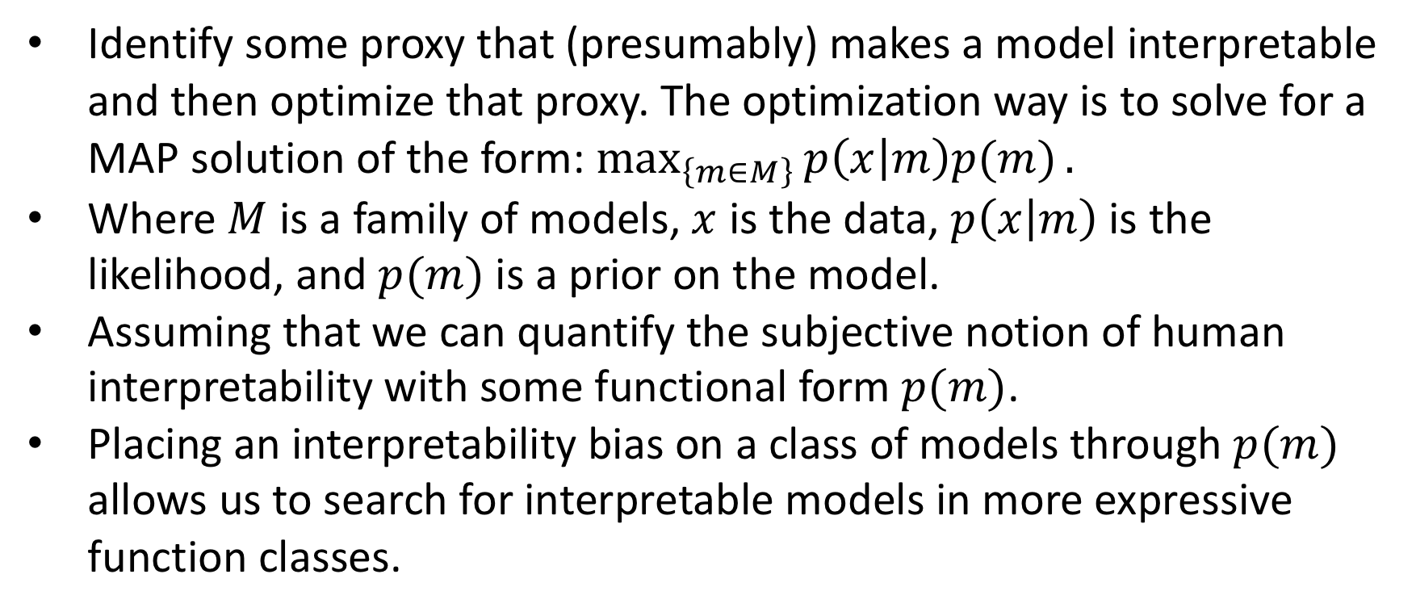
Human-in-the-Loop Interpretability Prior
Identify some proxy that (presumably) makes a model interpretable and then optimize that proxy. The optimization way is to solve for a MAP solution of the form: $\max_{\left\{m∈M\right\}}{p\left(x | m\right)p(m)}.$
Where $M$ is a family of models, $x$ is the data, $p\left(x | m\right)$ is the likelihood, and $p(m)$ is a prior on the model.
Assuming that we can quantify the subjective notion of human interpretability with some functional form $p(m)$.
Placing an interpretability bias on a class of models through $p(m)$ allows us to search for interpretable models in more expressive function classes.

