Slide 1

Actionable Recourse in Linear Classification Berk Usten, Alexander Spangher, Yang Liu
Presented by: Shubham Sharma, Jie Hua

Slide 2

GOAL
Recourse: the ability of a person to obtain a desired outcome from a fixed prediction model
Answer questions such as: Does a model provide recourse to all individuals who are subject to its predictions? Are there systematic disparities in recourse across subgroups of individuals in the target population? What changes can a person make to attain a desired prediction from the model? How much easier would these changes be if a person could change immutable attributes, such as race or gender?

Slide 3
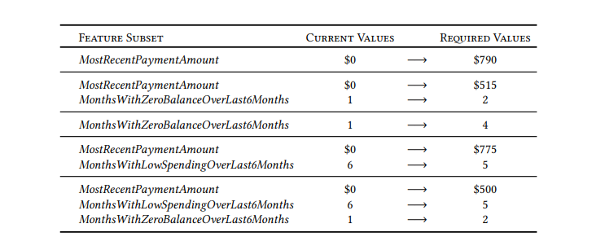
Example
Similar to the generation of counterfactuals, with specific guarantees

Slide 4
Tools developed
A procedure to measure the feasibility and cost of recourse of a classifier for individuals in a target population
When the optimization problem is infeasible, this means that there is no actionable change for a person to attain the desired outcome
A method to generate a list of actionable changes that an individual can make to flip the prediction of the classifier. The list is called a flipset
The method can be used to analyze the fairness of the model towards certain groups

Slide 5
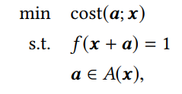
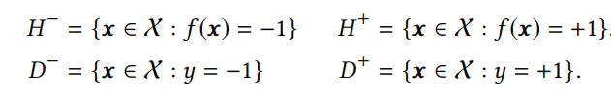
Problem formulation
Given an individual whose predicted outcome is f(x) = −1, the aim is to determine if there exists an action a such that f(x + a) = 1
A(x) is a set of feasible actions that can be constrained to so that x+a is feasible (if a feature is immutable, A_{j}(x) = 0)
Notations:

Slide 6
Feasibility guarantees
A linear classifier provides recourse to all individuals with features x∈H⁻ if it only uses actionable features, and does not trivially predict a single class
If the feature values belong to a bounded space, then a linear classifier with at least one actionable feature provides recourse to all individuals in any target population
If the feature values belong to a bounded space, then a linear classifier with at least one immutable feature may not provide recourse to some individuals in a target population.

Slide 7
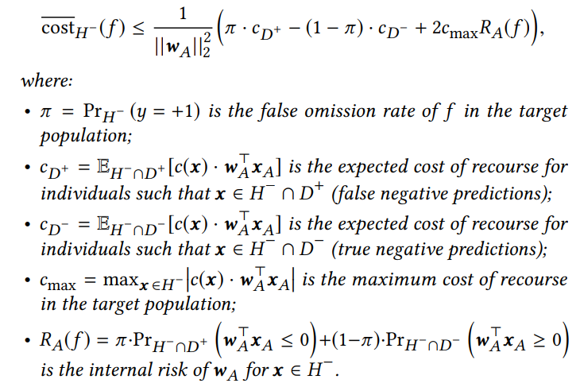
Cost Guarantees
The expected cost of recourse of a linear classifier over a target population obeys:
Notes:
we can reduce the expected cost of recourse by reducing cmax (the maximum cost for recourse) or RA(f ) (the internal risk of the classifier)
one can (maliciously) reduce the bound on the expected cost of recourse by increasing the false omission rate π

Slide 8
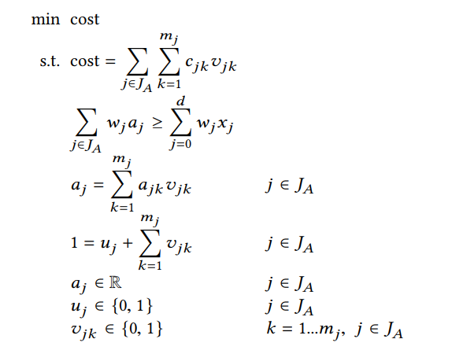

IP formulation and auditing recourse
Cost of a feasible action
Flip the prediction of the linear clasifier
Restrict features to lie in a bounded space
J_{A} is the set of changeable features
Cost function to audit recourse: maximum percentile shift
Notes:
Customization. Users can easily customize the set of feasible actions by adding logical constraints to (2). Many constraints can be expressed using the uj indicators (i.e., without the need to introduce new variables). To limit actions to change ≤ r features, we can add the constraint Íd j=1 (1 −uj ) ≤ r. To ensure actions change only one feature in a subset of features S ⊆ J, we can add the constraint Íd j ∈S (1−uj ) ≤ 1.
Discretization
The benefit of the cost function is that it produces a meaningful optimal cost. If the optimal cost is 0.25, for example, then any feasible action must change a feature by at least 25 percentiles. That is, no action can flip the prediction without changing a feature by less than 25 percentiles.

Slide 9
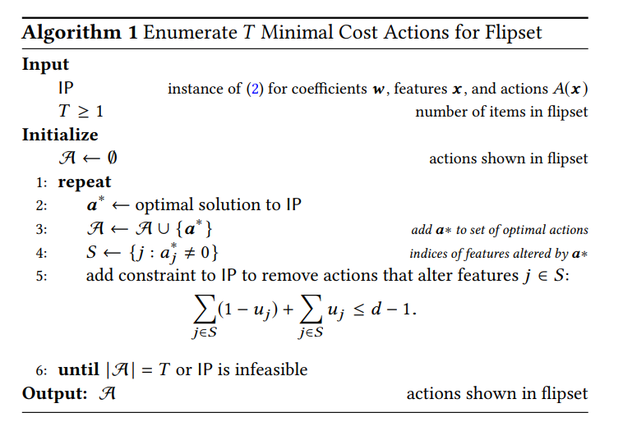
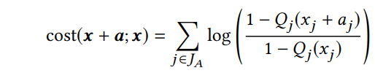
Building flipsets
Cost function: Total log-percentile shift
Produces flipsets where items reflect “easy" changes with respect to the target population
Example: changing income from percentiles 90 → 95 is harder than 50 → 55
Notes:
T≥ 1 minimal-cost actions with distinct combinations of features. Each iteration solves the IP to obtain the optimal action a ∗ , then adds a constraint to the IP to eliminate actions that use the same subset of features as a ∗ . The procedure repeats these steps until it has recovered T actions, or it has certified that the IP is infeasible
Cost function: In particular, it ensures that cost of aj increases exponentially as Qj (xj ) → 1. This aims to capture the notion that changes become harder when starting off from a higher percentile value

Slide 10
Evaluation
Default of credit card (UCI)
Will parameter tuning affect recourse?
Financial distress data (Kaggle)
Will out-of-sample affect recourse?
German credit data (UCI)
Are there disparities in the cost of recourse?
Notes:
This is paper use 3 datasets and their tool to answer these three questions. The first one is...

Slide 11
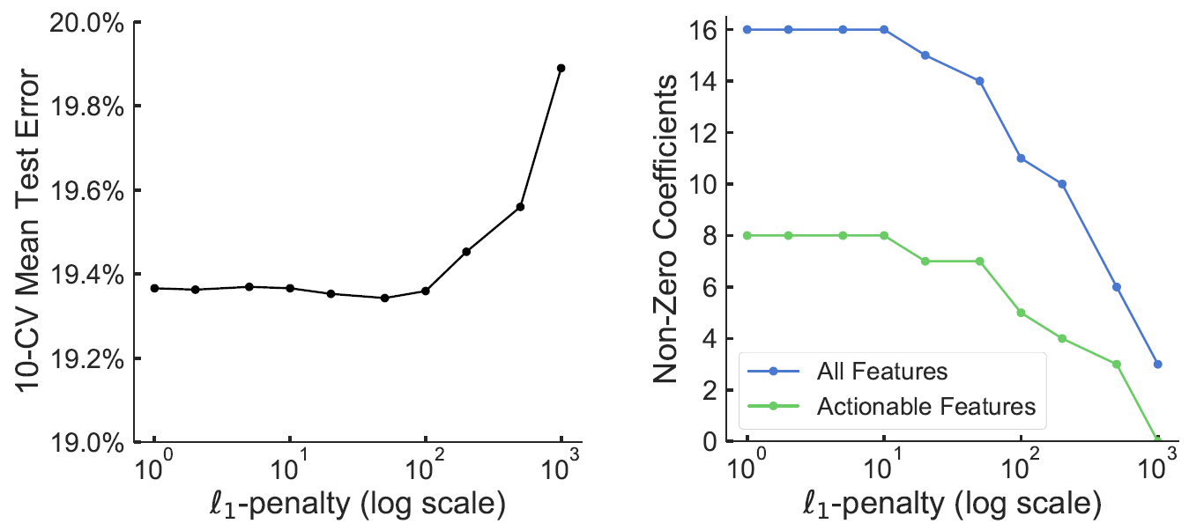
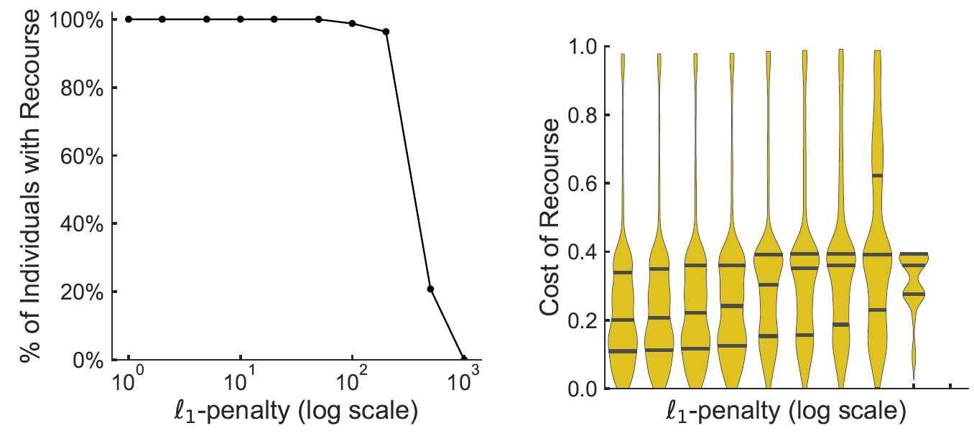
Default of Credit Card
Model:
Logistic Regression
L1 penalty value tuning.
Result:
Help parameter tuning
Help practitioner to choose features
Notes:
The first model they built is a Logistic Regression model with l1 penalty. It is trained on a credit dataset from UCI and the l1 value is tuned. In this experiment, they mainly focuses on the effect of l1 tuning on the cost and coverage of recourse. The auditing result is shown in these four figures as you can see. On the top left is the mean test error and on the bottom left is the coverage. Notice the scale of y-axis,
On the bottom right is the cost of course, maybe is not very clear, but the median cost doubled from 0.2 to 0.39 as the l1 value increases.
There may be classifiers that attain similar performance but provide easier recourse.

Slide 12
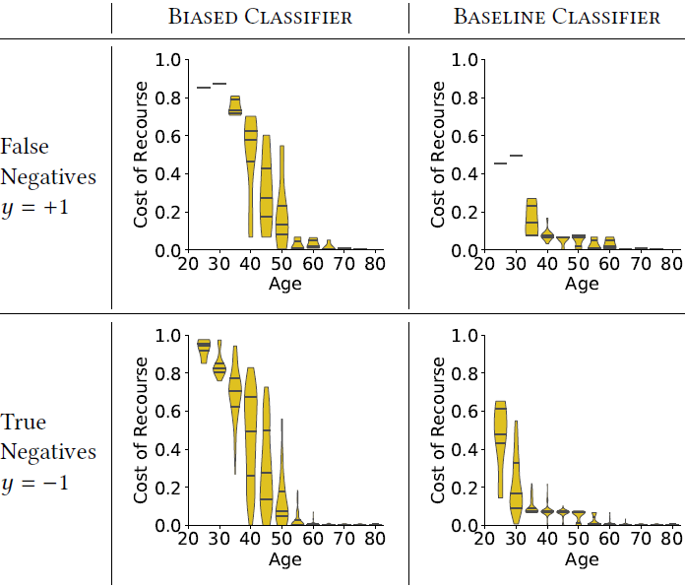
Financial Distress
Model:
L2-penalized LR
Biased training data
Results:
0.11 vs 0.79
Biased deployment affects recourse cost.
Notes:
The second model they discussed in the paper is a l2-penalized Logistic Regression trained on a personal financial dataset from Kaggle. In this experiment, they trained the model on biased training data to compare with the baseline classifier. They undersampled the individuals with Age < 35 by 90%. As a result the median cost of recourse for young adults in baseline classifier is 0.11 while its 0.79 in the biased classifier.
The purpose of this experiment is not to suggest that out-of-sample will increase the cost. Insteading it’s just showing that it can greatly affect the cost of recourse. Since there is no theoretical guarantees on how recourse can change due to distributional difference in training data. The effect can only then be measured using an audit tool like this one.

Slide 13
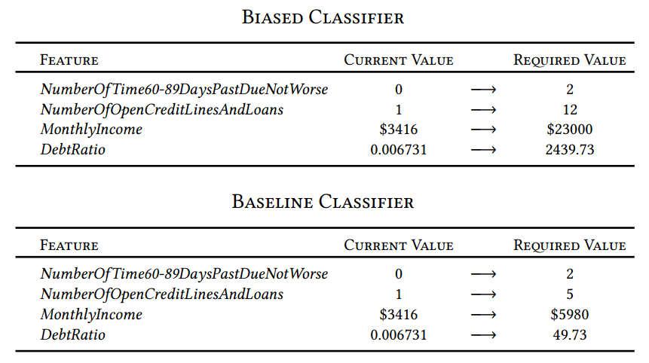
Financial Distress
Notes:
This is one example, as you can the changes are significant.

Slide 14
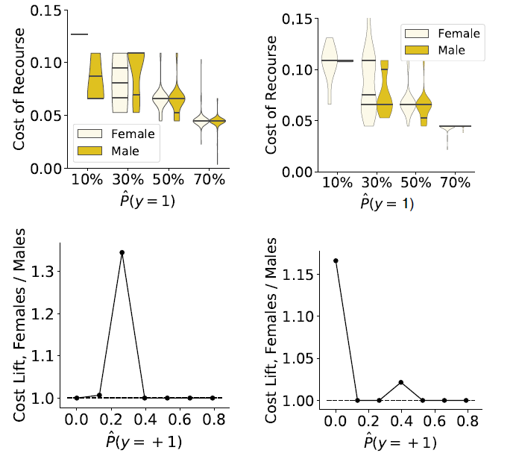
German Credit Dataset
Model:
L2-penalized LR
Approval threshold 80%
Results:
Disparities between males and females.
Notes:
The third model is also a l2-penalized Logistic Regression trained on a german credit dataset from UCI. The result shows that there could be disparities in cost of course in target population. In this case, the cost of course for female is relatively higher then the cost of male.

Slide 15
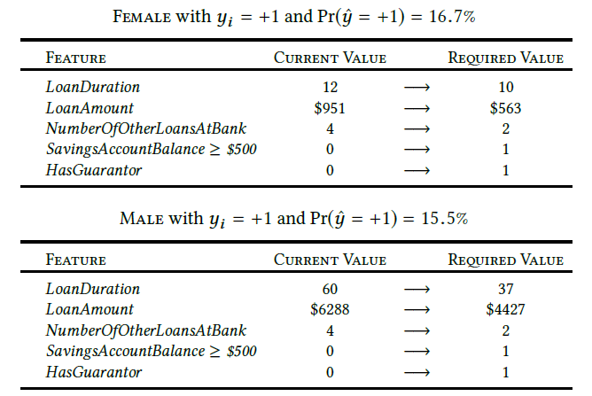
German Credit Dataset

Slide 16
Conclusion and Future work
Research Contribution:
Novel tool on measuring the feasibility and cost of recourse for linear classifiers.
Extensions:
Non-Linear Classifiers
Preventing potential manipulation of ancillary features
Measuring Flexibility
Potential in guiding model training.
Notes:
There are some extensions for this paper. First and the most obvious one is that how can it be applied to non-linear classifier. The second one is that this tool can be used to audit models to make the cost of recourse of ancillary features higher to prevent such manipulation. The third one is that this tool can be used to audit each individual in the target sample in order to measure the flexibility. And the last one is that it can be used to guide future model training.

