Slide 1
Aspect-oriented programming
with AspectJ
David Aeschlimann, Emanuel Knecht
_{Prof. Dr Jürgen Eckerle}
₂₀₁₅

Slide 2
Structure
      History of AOP
      Flaws of Object oriented programming
      Aspect oriented approach
      Demo
      Pros and cons
      Questions

Slide 3
History of AOP with AspectJ
1995 Concept invented in Xerox PARC
1998 First implementation released
2002 AspectJ 1.0 released
…
9.9.2015 Latest Version (1.8.7) released

Slide 4
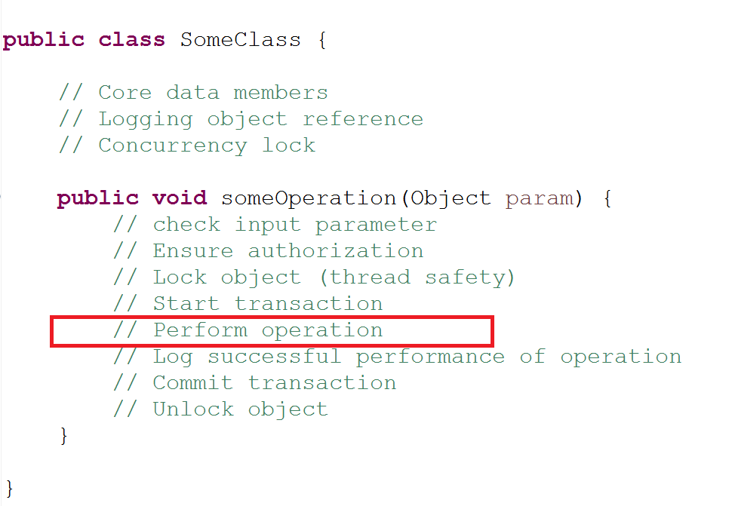
Object oriented

Slide 5
Object oriented
SINGLE RESPONSIBILITY PRINCIPLE

Slide 6
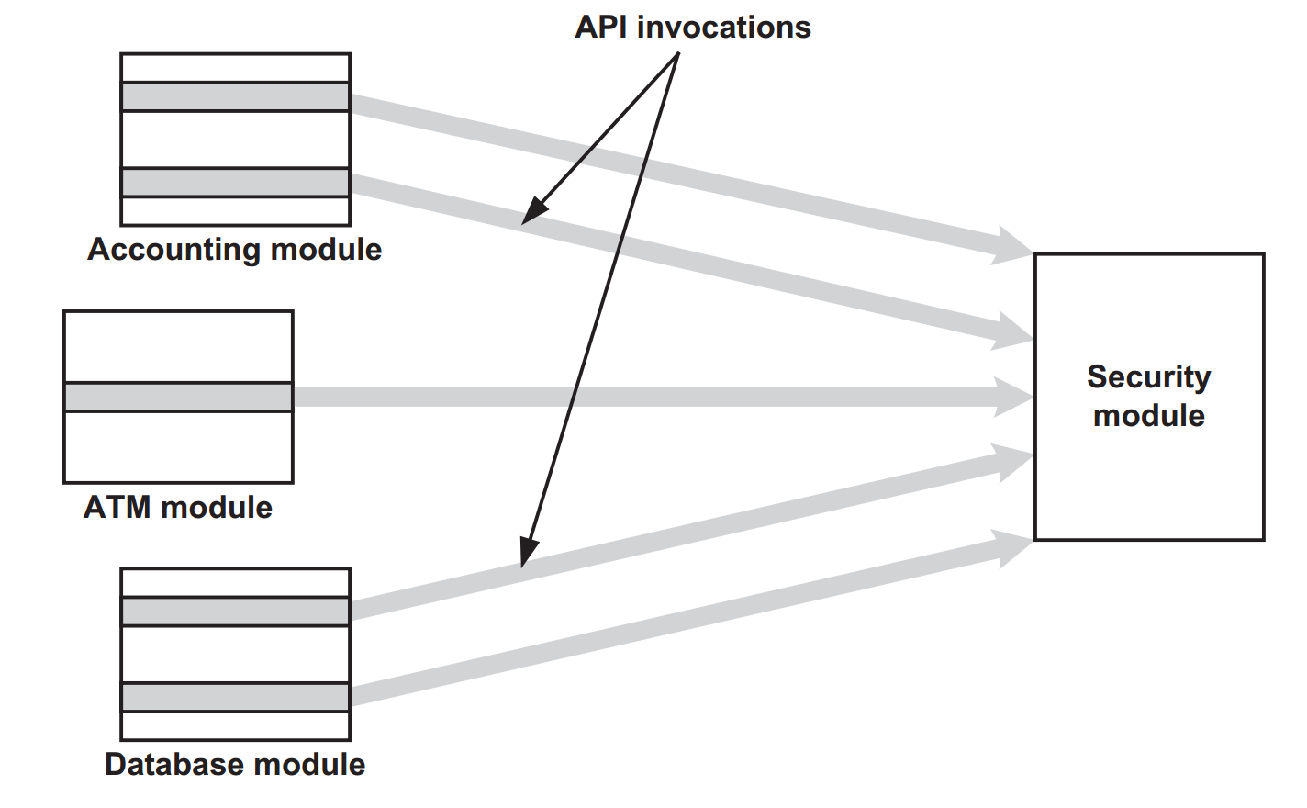
Object oriented

Slide 7
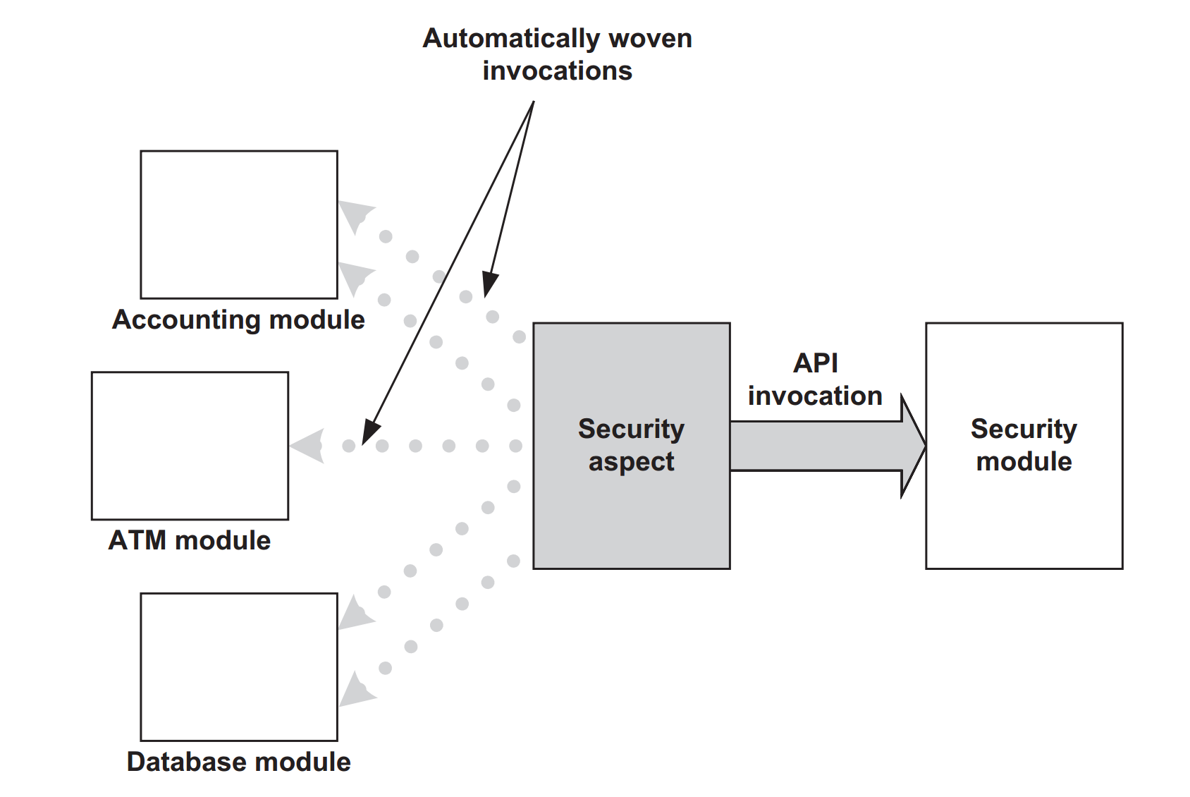
Aspect oriented

Slide 8
Aspect oriented
Join Point
Pointcut
Advice
Dynamic crosscutting
Static crosscutting
Aspect

Slide 9
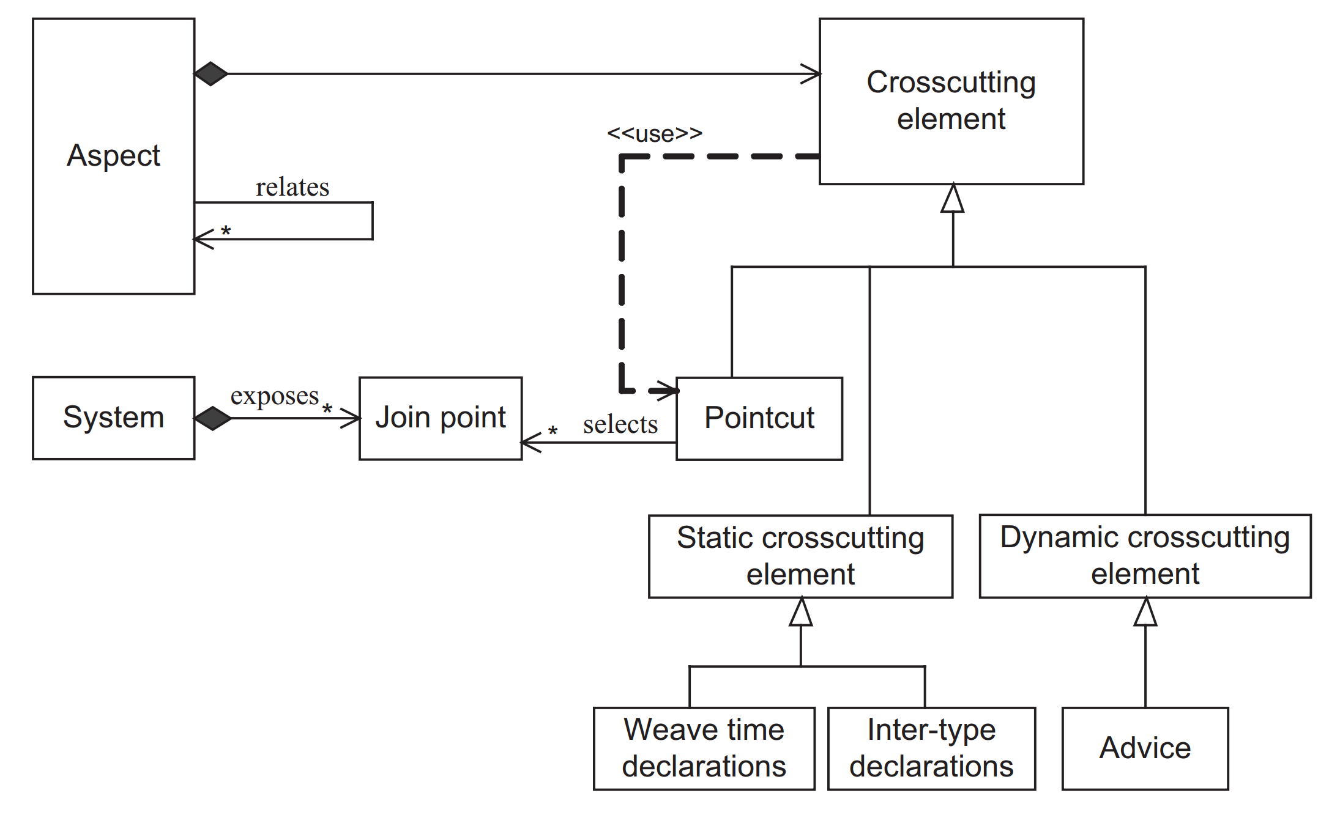
Aspect oriented

Slide 10
Aspect oriented
SINGLE RESPONSIBILITY PRINCIPLE

Slide 11
Languages
Java
  AspectJ
  Spring AOP
C/C++
  AspectC++
C#
  PostSharp
  AspectSharp
  Afterthought (Open Source)
Nemerle

Slide 12
Demo

Slide 13
Pros and Cons
Easy design
Clean code
Reusability
Extendability
Experience needed
Changes in build and deployment
Obscure program flow

Slide 14

Questions?

