Slide 1

SMART INDIA HACKATHON 2026
TITLE PAGE
Problem Statement ID - SIH26070
Problem Statement Title - AI/ML-based Tropical Cyclone Identification, Classification and Prediction using Multi-Source Satellite Data
Theme-Disaster Management
PS Category- Software
Team ID- NA
Team Name - Omnitrix

Slide 2
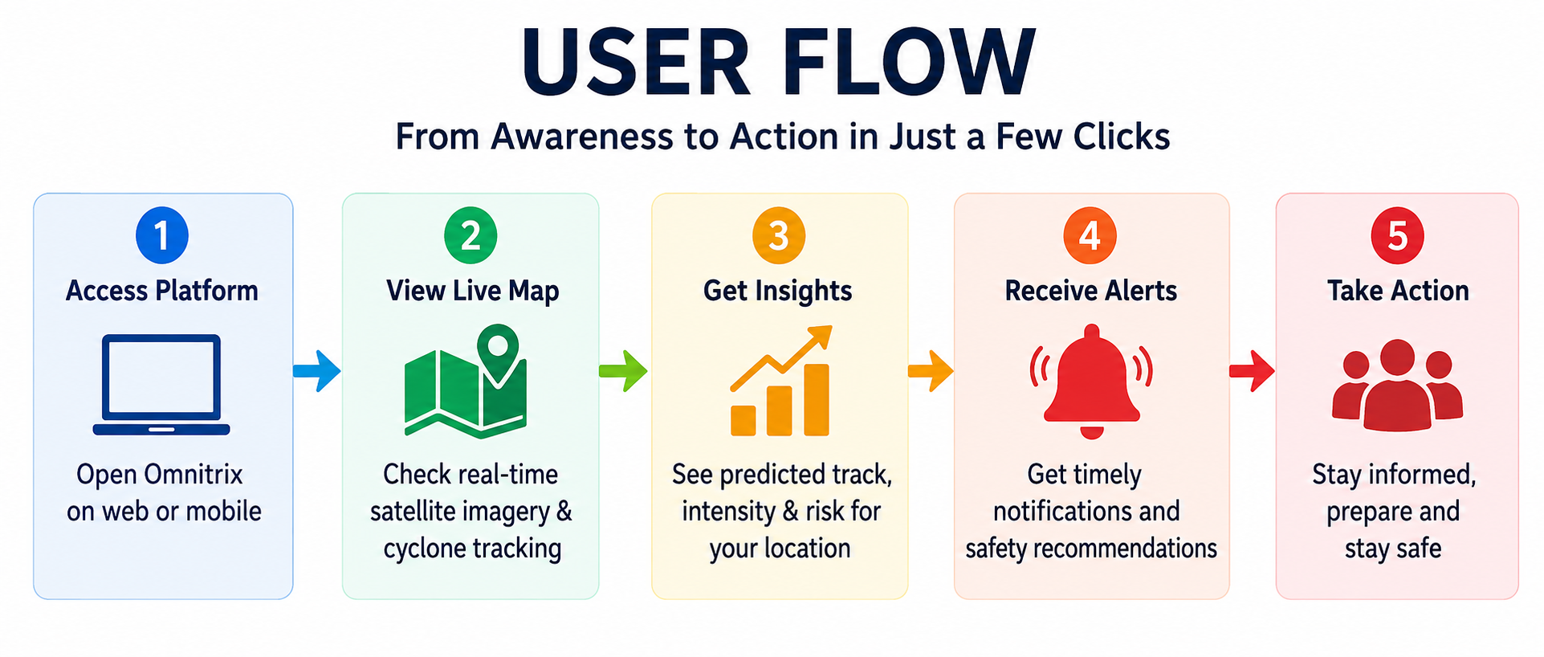
IDEA TITLE
Omnitrix
Proposed Solution
One platform converts complex satellite and weather observations into understandable predictions, risks and alerts.
1
2
3
4
5
MULTI-SOURCE
DATA
PROCESSING
& FUSION
AI/ML
MODEL
RISK
ASSESSMENT
USER
OUTPUTS
Satellite • Weather • Ocean
Clean • Extract • Fuse
Detect • Classify • Forecast
Location • Impact • Severity
Map • Alerts • AI Assistant
How It Addresses the Problem
COMPLEX DATA → SIMPLE INSIGHTS
LOCATION-SPECIFIC
UNIQUE ADVANTAGE
Turns satellite/weather observations into clear cyclone status, forecasts and risk information.
Assesses risk for a user's location and provides focused warnings.
Prediction + observation + risk + smart alerts + AI assistant in one platform.
DETECT → PREDICT → ASSESS → WARN → PREPARE

Slide 3
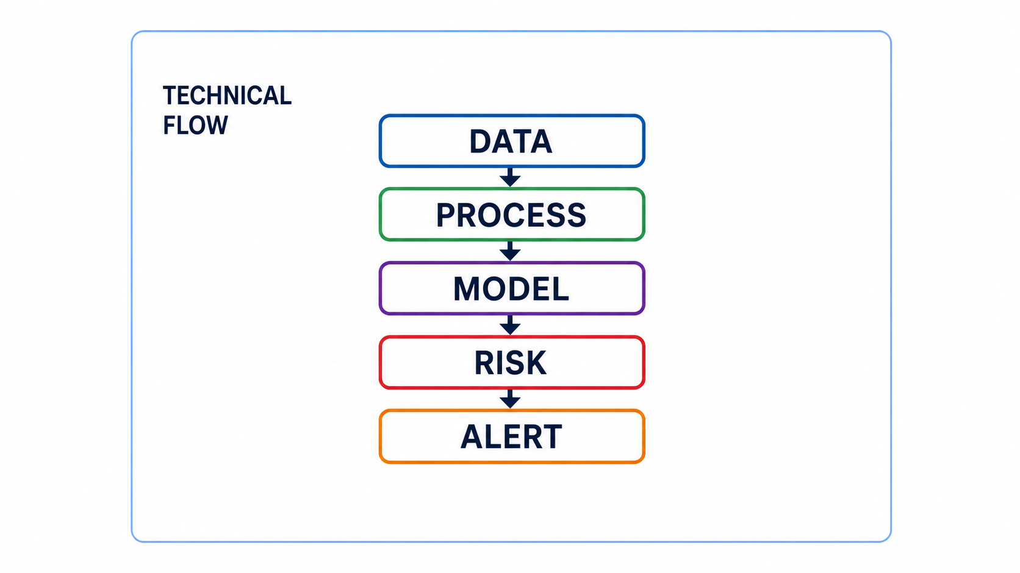
TECHNICAL APPROACH
Omnitrix
Methodology & Process
Python • ML / Deep Learning • Computer Vision • React / Next.js • FastAPI • PostgreSQL • Maps & Satellite APIs
INPUT DATA
AI/ML PIPELINE
OUTPUT LAYER
SATELLITE
PREPROCESS
LOCATION RISK
INSAT-3D / 3DR • NOAA observations
Clean + normalize
Impact radius • storm surge • heavy rain • wind
FEATURE EXTRACTION
WEATHER
Image + numerical features
INTERACTIVE MAP
Wind • Pressure • Temperature • Humidity
DATA FUSION
Satellite observation + predicted track
Combine sources
OCEAN + HISTORY
SMART ALERTS
SST • Ocean data • IMD / IBTrACS
DETECTION
Timely location-based warnings
Cyclone present?
CLASSIFICATION
AI ASSISTANT
Category / intensity
Explains forecast and alerts simply
TRACK + INTENSITY
Future path + strength
NEW DATA → UPDATE → REASSESS

Slide 4
FEASIBILITY AND VIABILITY
Omnitrix
Feasibility
Viability
DATA AVAILABILITY
SEQUENTIAL DEPLOYMENT
Uses available satellite, meteorological and historical cyclone datasets for training/testing.
Test prediction, map and alert sections separately before integration.
TECHNICAL FEASIBILITY
VALIDATION
Web architecture supports access across devices and modular development.
Compare predictions with past cyclone observations.
KEY CHALLENGES
SCALABILITY
Large/varied data • reliable track & intensity • timely location-based alerts.
Modular pipeline can incorporate additional data sources later.
IMPLEMENTATION FLOW
DATA
PROCESS
MODEL
DEPLOY
Collect
Clean + Fuse
Train + Test
Map + Alerts

Slide 5
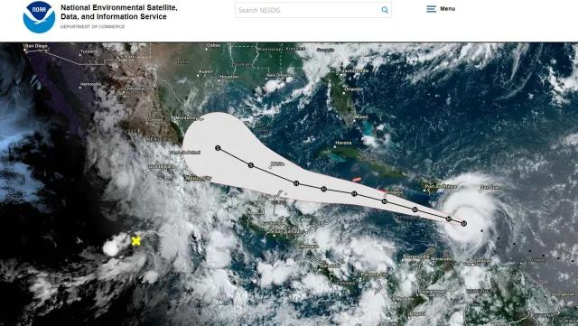
IMPACT AND BENEFITS
Omnitrix
Target Beneficiaries
Impact Chain
PEOPLE IN CYCLONE-PRONE AREAS
AI PREDICTION
Clear forecasts, risk views and timely warnings.
Detect + classify + forecast
DISASTER-RESPONSE TEAMS
RISK ASSESSMENT
Better situational awareness for preparedness and response.
Estimate local impact
LOCAL AUTHORITIES
EARLY WARNING
Location-specific information to support decisions.
Send timely alerts
COMMUNITIES & BUSINESSES
PREPARED RESPONSE
Support readiness and action
Accessible information for vulnerable areas.
EXPECTED OUTCOME
Better awareness • Easier understanding
Localized alerts • Better preparedness

Slide 6
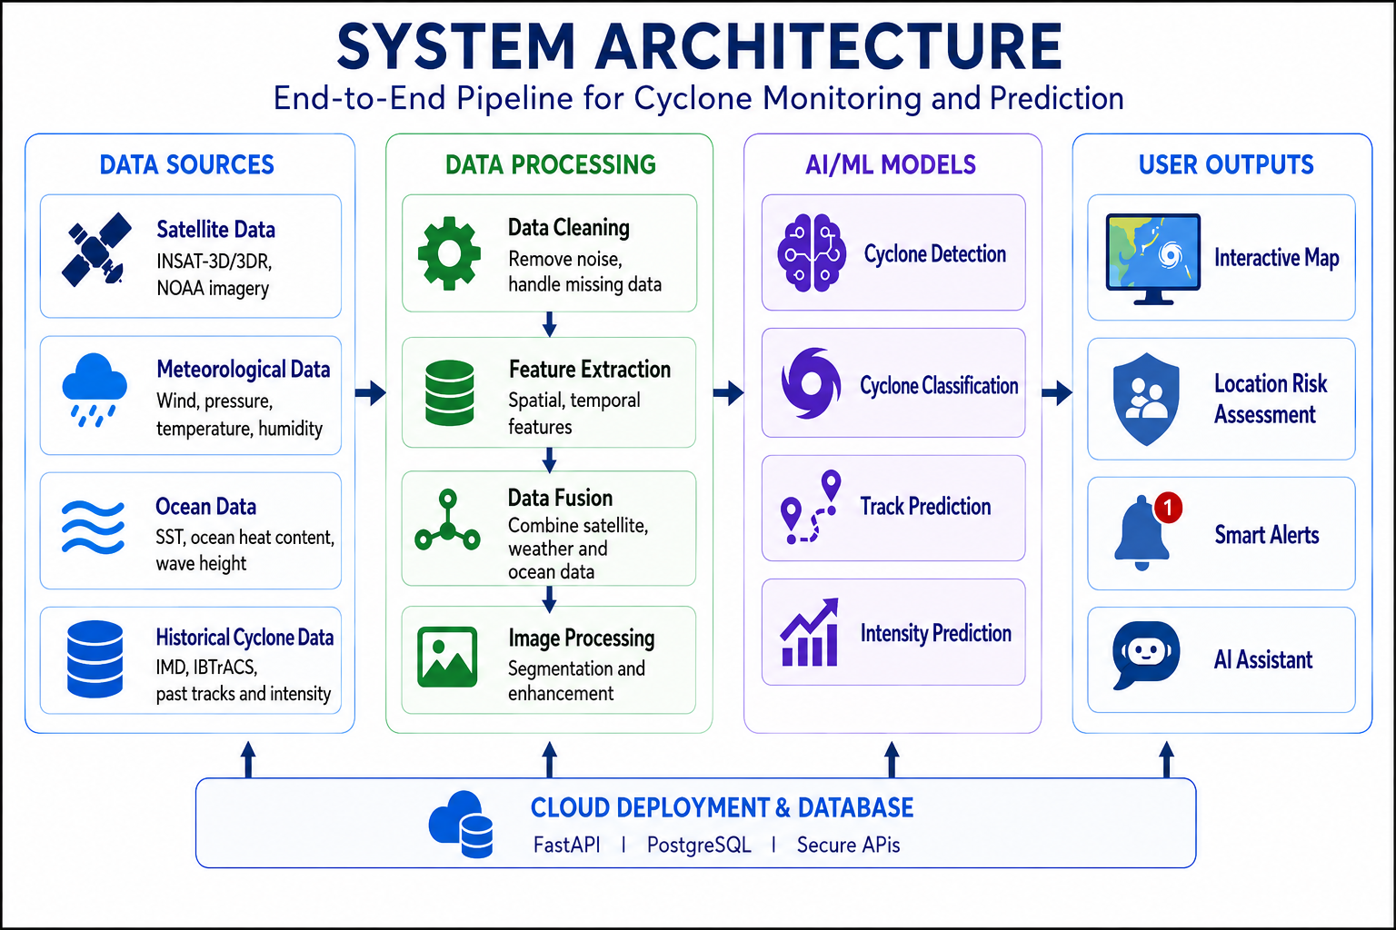
RESEARCH AND REFERENCES
Omnitrix
Datasets
Research References
INSAT-3D / INSAT-3DR
2025 — CONVLSTM RESEARCH
Satellite observations for cyclone monitoring.
MOSDAC / ISRO data source.
Cyclone intensity estimation and classification using satellite imagery over the North Indian Ocean.
IMD CYCLONE DATA
2024 — EXPLAINABLE DEEP LEARNING
Historical cyclone tracks, intensity and advisories.
Cyclone intensity forecasting integrating satellite observations and numerical model outputs.
NOAA IBTrACS
Global historical tropical cyclone tracks and intensity data.
TECHNOLOGY STACK
Python • ML / Deep Learning • Computer Vision • React / Next.js • FastAPI • PostgreSQL • Maps & Satellite APIs.
FROM DATA TO ACTION → A SAFER TOMORROW

