Slide 1
Case Study – Jain Global
By Shiri Alouf-Heffetz

Slide 2
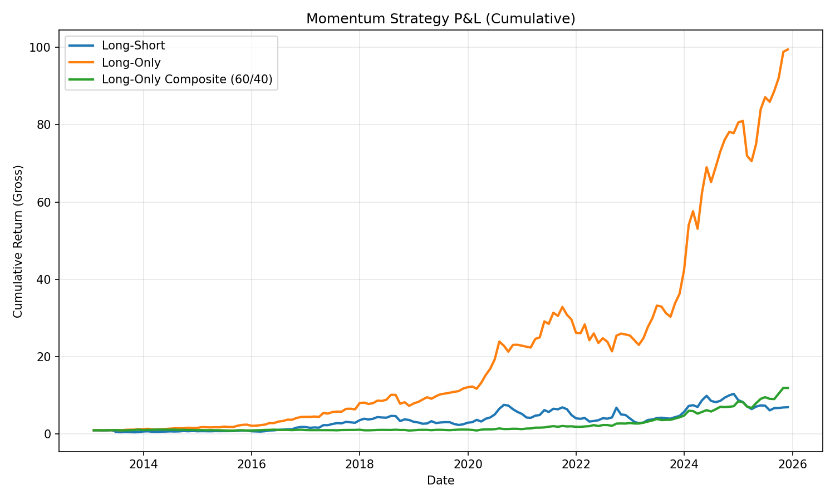
Question_I
Momentum aspects.
Here we consider classic momentum signals, selected the 12-to-1 signal adjusted for volatilty.
Our data was collected using the yfinance package, the results for the pure momentum with selection of top 20% cutoff :
Long-Only Top 20%: CAGR 42.77%, Vol 27.02%, Sharpe 1.47, MaxDD -34.92%, Hit 65.81%.
The results for the composite with (momentum60%, sector40%)
Long-Only Composite (60% stock, 40% sector): CAGR 21.16%, Vol 25.02%, Sharpe 0.89, MaxDD -23.99%, Hit 57.42%
We can see the long only performs consistently better then long short and has a better sharp ratio.

Slide 3
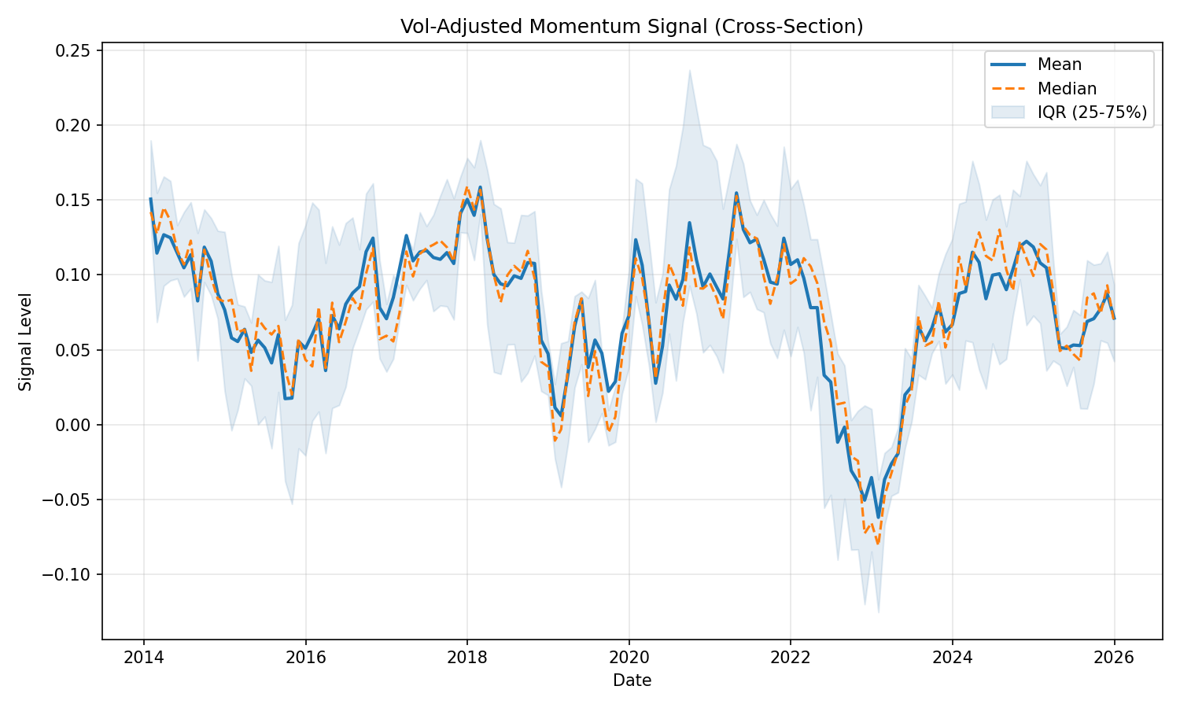
The 12m-to-1 signal, vol adjusted.

Slide 4
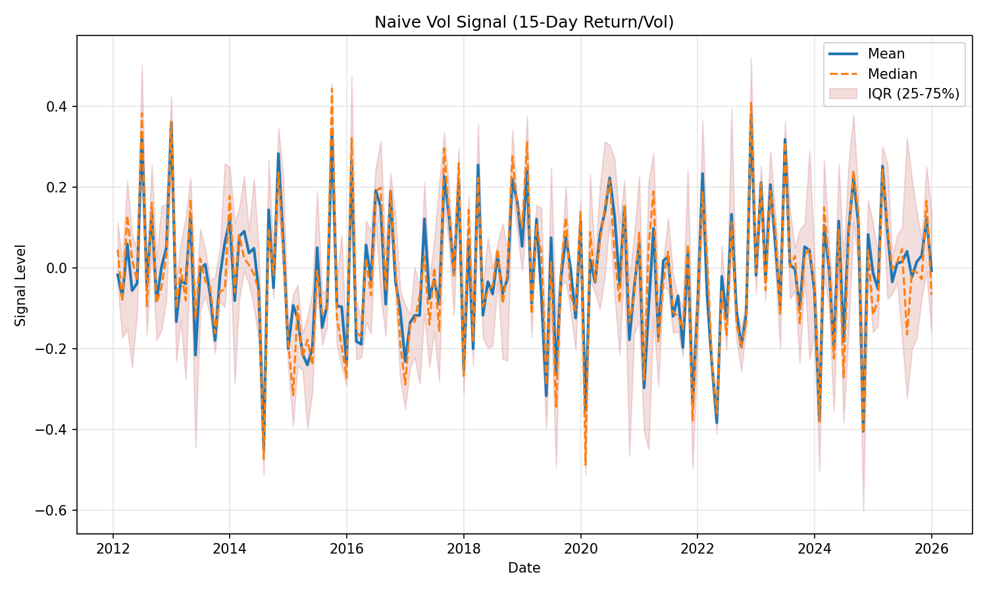
Naïve 15 days, vol adjusted signal.

Slide 5
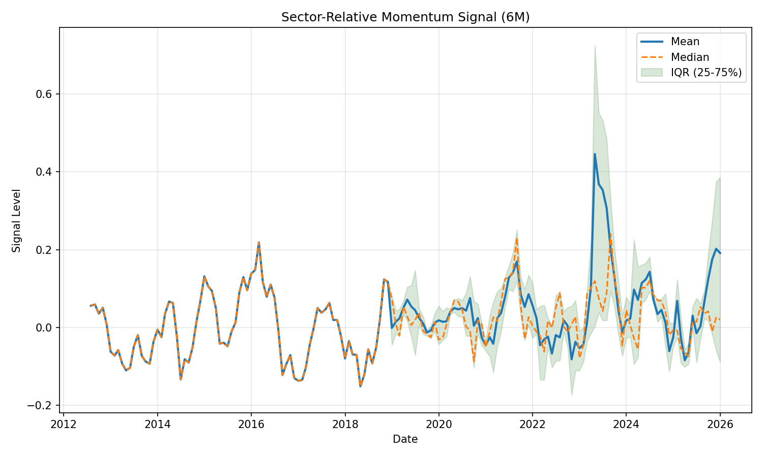
Sector Signal
Momentum 6m

Slide 6
Question_II
Crowding
One of our investors is concerned that holding securities that are also owned by other long/short equity hedge funds can be dangerous.
-- Discuss why you agree or disagree
Discuss which datasets and methodologies might you use to test this theory?
Holding crowded securities can be dangerous due to liquidity constraints, forced unwinds, and in rare cases short squeezes. Historical examples include the quant meltdown or the recent GameStop saga. However, the overlap itself is not inherently dangerous; it can improve market efficiency and may indicate strong fundamentals.
To test this theory, we can examine 13F, Bloomberg or Barclays hedge index; evaluate performance, drawdowns, and Sharpe ratios. One approach is to construct a basket of stocks that have historically been heavily owned by many funds and analyze how that basket has performed over time.

Slide 7
Question_III
Groups
Our investors believe that the standard sector classifications are inaccurate and would like to generate their own that more tightly track securities that are like one another.
Develop a method that generates these custom groups.
Discuss the results and merits of your approach.
Notes:
Email input : "For Task #3 please answer by discussing the methods you would use to accomplish the task and any other thoughts you may have. "

Slide 8
Question_III
Feature selection
First, we need to determine which features to use for constructing the new index:
A) Market/Price Features
– Historical returns (1m/3m/6m/12m)
– Volatility
– Liquidity measures such as bid-ask spread
– Momentum factor
– Size
C) Textual/NLP-Based Features
– Company descriptions
– Filing statements and news sources
We would embed these texts and look for similarities.
B) Fundamental/Business Features
– Revenue
- Cash Flow
– Earnings
– Debt
– R&D expenditure as a percentage of budget

Slide 9
Question_III
Clsutering and Evaluation
We can take all of these features (or select a subset), apply PCA or other dimensionality-reduction methods, and then run clustering algorithms such as K-means or spectral clustering.
Finally, we would evaluate whether the resulting clusters make economic sense and whether they provide better risk-adjusted performance over time compared to standard sector indices.

Slide 10
Question_IV
Earnings KPI Drivers
Earnings KPI Drivers. We spend significant effort understanding the companies in which we invest.
Select two US securities from different industries. Compare and contrast their business models, earnings drivers, and earnings results. Spend part of the analysis addressing KPIs that might be useful for predicting future under/over performance.
Track any materials that you used during your research.

Slide 11
Question_IV
Business Model Comparison
Qualcomm operates a fabless semiconductor and intellectual property licensing model, generating revenue through its chipset business (QCT) and high-margin wireless patent licensing (QTL). Earnings depend heavily on global smartphone demand, OEM design wins, and adoption of new wireless and edge-AI technologies, with diversification emerging from automotive and IoT segments.
Axon, by contrast, leverages a hardware-enabled SaaS platform model centered on TASER devices, body and in-car cameras, cloud evidence management software, and real-time public-safety tools. Its growth strategy emphasizes recurring subscription revenue, multi-year government contracts, and continued expansion across the public-safety ecosystem.

Slide 12
Question_IV
Primary Earnings Drivers
Qualcomm’s earnings are shaped by smartphone unit volumes, premium chip adoption, royalty collections, and gross-margin mix across handset, automotive, and IoT markets. As mobile markets mature, long-cycle automotive design wins, increasing on-device AI capabilities, and stable licensing revenue are becoming more influential predictors of growth and margin expansion.
Axon’s earnings are driven by device deployments (TASERs, cameras, sensors), software subscription growth, contracted backlog, and expanding recurring revenue mix. Its high revenue visibility and scalable operating model have enabled sustained >30% annual growth, supported by strong adoption from law-enforcement and public-safety agencies.
Sources we primarly SEC reports including 10-K, news coverage, public market and annual reports.

Slide 13
Question_IV
KPIs for Predicting Future Performance
For Qualcomm, the most predictive KPIs include:
QCT segment mix (Handset vs. Automotive/IoT)
Licensing revenue stability and royalty rates (QTL)
Premium device share and AI-enabled chipset adoption
Automotive design wins and revenue backlog
Gross margin trajectory and R&D intensity
For Axon, the most predictive KPIs include:
ARR growth and software/service revenue as a share of total
Subscription renewal rates and net revenue retention
Device deployments (TASER, cameras, drones) and attach rates to cloud modules
Backlog growth and multi-year contract momentum
Adjusted EBITDA margin expansion

Slide 14
Question_V
Portfolio Analytics
A portfolio manager approaches you with the following questions, describe how you would approach each one. The portfolio is $1B in GMV, includes 50 software securities, has 80% idio variance when measured by a multi-factor risk model with 50 factors, historically trades about $100M per month, and has performed at a 2 Sharpe and 1.5 IR over the last 2 years. Limit each response to a maximum of 3 sentences.

Slide 15
Question_V
Part i
My momentum exposure is higher than two weeks ago, what could be driving that?
The factor exposure may have changed because recent price moves increased the realized momentum signal of the holdings, even if you no trades were made. Recent trades may have unintentionally tilted the portfolio toward names with strong short-term or intermediate momentum. Lastly, the risk model’s factor returns or loadings may have shifted unintentionally increasing the measured exposure.

Slide 16
Question_V
Part ii
The risk model says that I have no Beta exposure, but it feels like I do, can you check?
We can consider measuring the beta against several time frames, compared that against the model predicted beta. It could also be that we have several non-linear relationship in our factors. Lastly, it could be that the distribution we use to model our returns is different then what we have empirically.

Slide 17
Question_V
Part iii
The risk model says that my portfolio has $2M of daily idio vol, but it feels more volatile than that, what could be going on?
Since the multi-factor model updates slowly, factor loadings and volatilities may not reflect recent market conditions, leading to understated idio vol. The model also ignores intraday moves or event-driven risks, which can make realized volatility feel higher. Finally, if the factor set is incomplete, the model misattributes some systematic risk as idiosyncratic and underestimates its magnitude.

Slide 18
Question_V
Part iv
I’m not sure how well I’m timing my trades, will you help me quantify my timing skill?
We should measure timing skill by comparing our actual trade prices to benchmarks like VWAP or arrival price across different time horizons. By analyzing the slippage and PnL relative to these benchmarks, we can see whether our trades systematically add value. We can also regress post-trade returns against trade direction to see whether we tend to buy before price decreases or sell before increases.

Slide 19
Question_V
Part v
I have 50 positions in my portfolio, some larger than others, how should I think about measuring the concentration of position sizes?
We can compute metrics like Herfindahl-Hirschman Index (HHI), effective number of positions (1/HHI), and top-k weight shares to capture size concentration. We can also evaluate factor concentration by examining how much risk comes from your top exposures rather than just notional weight.

Slide 20
Question_V
Part vi
My Sharpe is higher than my IR, how can I find the drivers of those differences?
Sharpe includes both factor and idiosyncratic returns, while IR isolates only idiosyncratic alpha, so the gap reflects the contribution of rewarded factor exposures. We can run a factor-based return attribution using the risk model to separate factor PnL from alpha PnL and identify which specific factors are driving the higher Sharpe..

Slide 21
Question_V
Part vii
I’ve been losing money on FOMC and CPI days, will you help me understand why and quantify it for the future?
We can isolate returns on past FOMC and CPI dates and run an event-study to quantify average and distributional performance on those days. Then, decompose those event-day returns into factor and idiosyncratic components to identify whether the losses come from macro exposures such as rates sensitivity, growth/defensive tilts, or crowded factors. Finally, we use the historical event-day return distribution to estimate expected PnL and tail risk on future macro-event days.

