Slide 1
Automatic Classification of
Digital Audio Signals
Based on Chord Movement
Progress Report by Dan Church, Project Leader
Project Name: Audicon

Slide 2
Preamble
What humans perceive as sound is actually a series of tiny fluctuations in air pressure, perceived by the inner ear as changes in motion in fluid surrounding cilia attached to nerves.
Sound, as produced by machines, is presented as a series of electric pulses to a speaker. The speaker then translates these pulses to changes in air pressure by moving its magnetic speaker face in and out in accordance with the magnitude of the electric pulses.
Hz (Hertz) is a measurement of cycles per second.
Regular (uncompressed) digital audio uses a technique called sampling to approximate a given waveform.

Slide 3
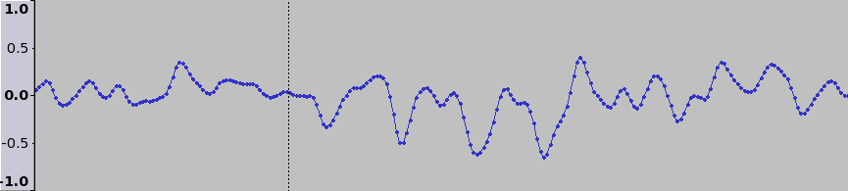
Data Types & Storage
Digital audio data is composed of samples.
Samples are floating-point values from -1 to +1.
Standard audio CD samples are composed of 16 bits
and are played at 14,400 Hz (samples per second).
Time →
Plot of samples in Ogg-compressed song “Rock the 40 Oz.” by Leftöver Crack (2004)
positioned from 0:01.948420 to 0:01.953955

Slide 4
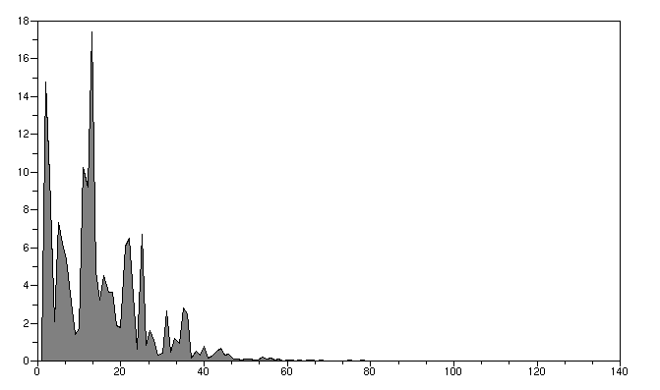
Data Types & Storage
Fast Fourier Transform (FFT)
Analyzes a signal by determining what frequencies compose a signal and in what strength (amplitude).
Can be used to draw more meaningful information out of audio and signal streams.
Used by SETI@Home to find patterns in radio telemetry data.
Amplitude (Relative) →
Frequency (Hz) →
An FFT plot of the sample data in the previous slide

Slide 5
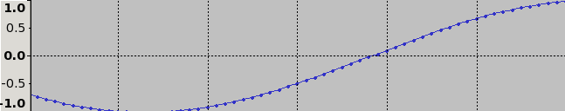
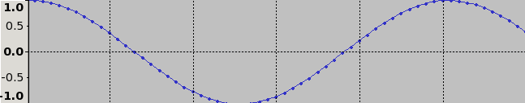
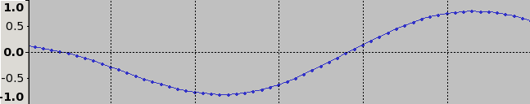
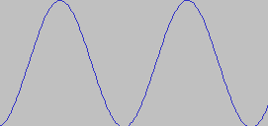
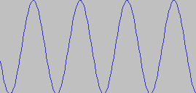
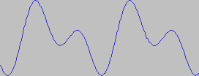
Data Types & Storage
Fast Fourier Transform (FFT)
Named for Joseph Fourier, a French physicist who discovered in 1822 that complex waveforms are formed by composing (averaging the amplitudes of) smaller, less complex waves.
He also discovered that the inverse of a wave, when added to another wave would effectively “subtract” that wave from the other.
Thus, it is possible to decompose complex waves into simple, single-frequency waves.
+
(
+
=
)

Slide 6
Data Types & Storage
To simplify the analysis process, I have decided to do the following to the incoming waveform:
Down-mix (average) all audio channels into one.
  When listening to sound, as humans, our minds can only really pay attention to one channel at a time.
  This would help because many popular artists like to record different things on each channel.
Normalize the combined audio signal with respect to sample amplitude.
  Since many of the formulas I will use are based on both frequency and amplitude, a quieter signal would evaluate differently.

Slide 7
Flowchart of Operations

Slide 8
Chord Detection
Piano Scales
Middle C (4) →
261.626 Hz →
277.183 Hz →
293.665 Hz →
311.127 Hz →
329.628 Hz →
349.228 Hz →
369.994 Hz →
391.995 Hz →
415.305 Hz →
440.000 Hz →
466.164 Hz →
493.883 Hz →
C
C#
The Piano is the standard instrument for tunings.
Since the piano scale is a logarithmic (base 2) scale, frequencies for other octaves can be found by found by multiplying or dividing by two for each octave away.
For instance, the note after B on the diagram on the right would be 2*261.626 = 523.252
D
D#
E
F
F#
G
G#
A
A#
B
Source: http://en.wikipedia.com/Piano_key_frequencies (30 Oct 2006)

Slide 9
Chord Detection
Chords are when three or four harmonious notes are played simultaneously
C#
D#
F#
G#
A#
C
D
E
F
G
A
B
Example of a chord:
C Major

Slide 10
Formulas & Applications
Centroid Frequency
Measure of spectral brightness with respect to frequency.
Autocorrelation (AR)
Computed using the FFT for efficiency
Spectral Flux
Routine for tracking the average frequency of a sound
Zerocrossings
Routine for finding the number of times the waveform changes sign.
Indication of the amount of noise in the stream

Slide 11
Data Set
I will be training my software with the following song set:
Jazz: Duke Ellington, Charlie Mingus, Max Roach – Money Jungle [1962]
Classical: Beethoven, Ludwig Van – Missa Solemnis [1818]
Calypso: Steel Band Music of the Caribbean [traditional]
Blues & Acid Rock: Carlos Santana – A Profile of [1960-1978]
Big Band: Michael Davis – Absolute Trombone [1997]
Big Band: Michael Davis – Brass Nation [2000]
Blues: B. B. King – How Blue Can You Get [1994]
Blues: B. B. King – Swing Low Sweet Chariot [1994]
Metal: Kittie – Spit [2000]
Industrial: Nine Inch Nails – The Downward Spiral [1994]
Swing: Kings of Swing – Benny Goodman. Count Basie, Glenn Miller Orchestra
Punk: The Ramones – Mania
Electronic: Massive Attack – 100th Window [2003]
Synth-Pop: Depeche Mode – Some Great Reward [1989]
Punk & Ska: Operation Ivy – Energy [1990]
Hard Rock: The Midnight Evils – Straight Til Morning [2002]
Metal: Fear Factory – Obsolete [1999]
Techno & Pop: Lamb – Self-titled [1996]
Rock & Pop: Marcy Playground – Self-titled [1997]
Pop: Motion City Soundtrack – I Am the Movie [2002]
Plus anything I can think of later.

Slide 12
Project Timeline
Research musical theories (and the math behind them)
Research other projects / formulas under same scope as this one
Code and test formulas
  Report: List of formulas
Design database
Design statistics analysis and comparison engine
Select song / sample set
  Presentation: Formulas & explanations; data [song] set
Start training engine & database
Normalize statistics information
  Report: Analysis of statistics mapping
Design input & normalization filters for general use
Build some sort of front-end
  Presentation: Front-end + demonstration

