Slide 1
Automatic Classification of
Digital Audio Signals
Based on Chord Movement
Progress Report by Dan Church, Project Leader
Project Name: Audicon

Slide 2
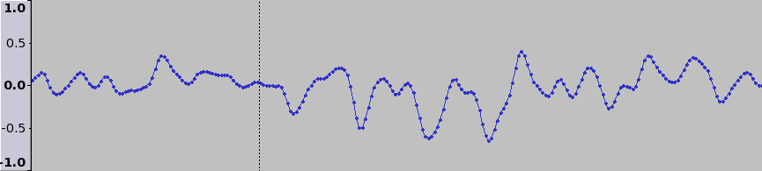
Review: Digital Audio Storage
Digital audio data is composed of samples.
Samples are floating-point values from -1 to +1.
Standard audio CD samples are composed of 16 bits
and are played at 14,400 Hz (samples per second).
Time →
Plot of samples in Ogg-compressed song “Rock the 40 Oz.” by Leftöver Crack (2004)
positioned from 0:01.948420 to 0:01.953955

Slide 3
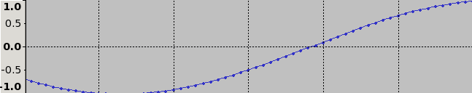
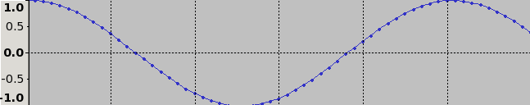
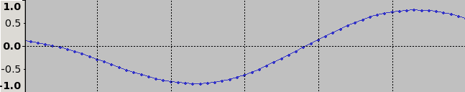
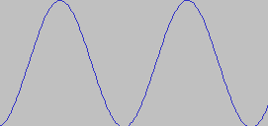
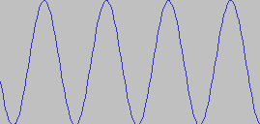
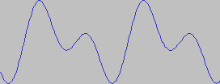
Review: The Fast
Fourier Transform (FFT)
Named for Joseph Fourier, a French physicist who discovered in 1822 that complex waveforms are formed by composing (averaging the amplitudes of) smaller, less complex waves.
He also discovered that the inverse of a wave, when added to another wave would effectively “subtract” that wave from the other.
Thus, it is possible to decompose complex waves into simple, single-frequency waves.
+
(
+
=
)

Slide 4
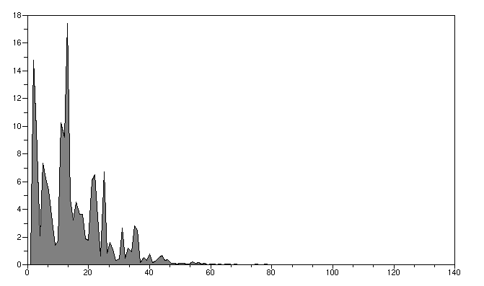
Review: The Fast
Fourier Transform (FFT)
$\text{fft}\left(k\right)=F\left[f\left(x\right)\right]\left(k\right)=\int_{−∞}^{∞}{f}\left(x\right)⋅e^{−2πikx}dx$
Analyzes a signal by determining what frequencies compose a signal and in what strength (amplitude).
Can be used to draw more meaningful information out of audio and signal streams.
Used by SETI@Home to find patterns in radio telemetry data.
Amplitude (Relative) →
Frequency (Hz) →
An FFT plot of the sample data in the previous slide

Slide 5
Inherent Problems with
the Fast Fourier Transform
Let A be a vector of values of size 1xs such that:
$A\left[n\right]=c∗sin\left(\frac{n}{s}∗2π∗60\right)+c∗sin\left(\frac{n}{s}∗2π∗150\right)$
That is, if one thinks of A as a vector of wave sample values played at s samples per second, then A can be thought of as a combination of a 60-Hz wave and a 150-Hz wave, each at amplitude c.
The FFT-decomposition of A would then yield the following:

Slide 6
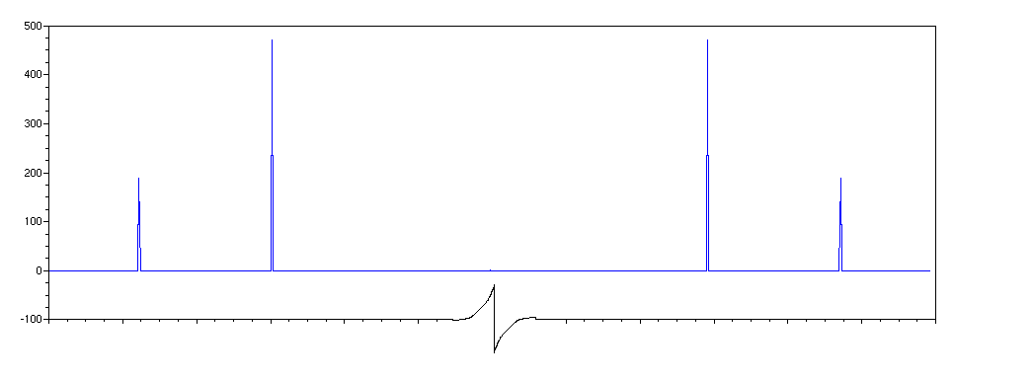
Inherent Problems with
the Fast Fourier Transform
Plotted values of abs(real(fft(A)))
$\begin{aligned}\text{Peak at 151:} \\ value=150π\end{aligned}$
$\begin{aligned}\text{Peak at }\text{s}\text{ - 149:} \\ value=150π\end{aligned}$
$\begin{aligned}\text{Peak at 61:} \\ value=60π\end{aligned}$
← symmetric →
$\begin{aligned}\text{Peak at }\text{s}\text{ - 59:} \\ value=60π\end{aligned}$
50
100
150
200
250
S - 250
S - 200
S - 150
S – 100
S - 50
S
Even though the two component waves were of the same amplitude, they were given different amplitude values when passed through fft(). I wrote a function that would give an accurate representation of the amplitudes of component waves.

Slide 7
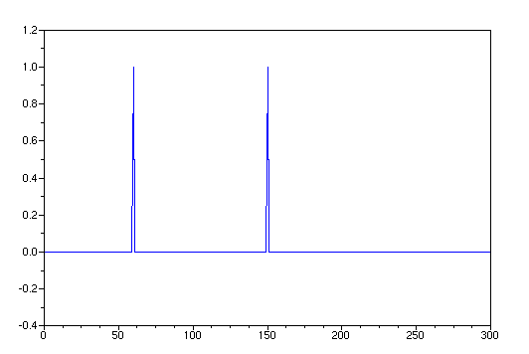
Inherent Problems with
the Fast Fourier Transform
Plot of (freqs, amps) where [amps freqs] = fft_unweighted(A)
Peak at (60, 1)
Peak at (150, 1)
This plot shows the output of my unweighted FFT function.

Slide 8
Note Extraction
Piano Scales
Middle C (4) →
261.626 Hz →
277.183 Hz →
293.665 Hz →
311.127 Hz →
329.628 Hz →
349.228 Hz →
369.994 Hz →
391.995 Hz →
415.305 Hz →
440.000 Hz →
466.164 Hz →
493.883 Hz →
C
C#
The Piano is the standard instrument for tunings.
Since the piano scale is a logarithmic (base 2) scale, frequencies for other octaves can be found by found by multiplying or dividing by two for each octave away.
For instance, the note after B on the diagram on the right would be 2*261.626 = 523.252
D
D#
E
F
F#
G
G#
A
A#
B
Source: http://en.wikipedia.com/Piano_key_frequencies (30 Oct 2006)

Slide 9
Note Extraction
Function amps_by_key
Relies on function fft_unweighted to deliver amplitude and
frequency values for the given set of sound data.
Takes into account frequencies defined as corresponding to
musical notes in an arbitrary octave
  Default frequencies for piano-based middle-C octave
  are pre-defined.
Takes into account an octave span in which to detect notes
  Frequency values for an octave one higher than the current
  has frequencies multiplied by 2
  Inversely, one octave lower is ½ the frequency of the current
Makes use of a note span, which is taken to be where to set
the upper and lower frequency limits, as a fraction of the
distance between the note and the halfway-point between
adjacent notes, affecting the “width” of the “bins” to which the
amplitudes are tallied.

Slide 10
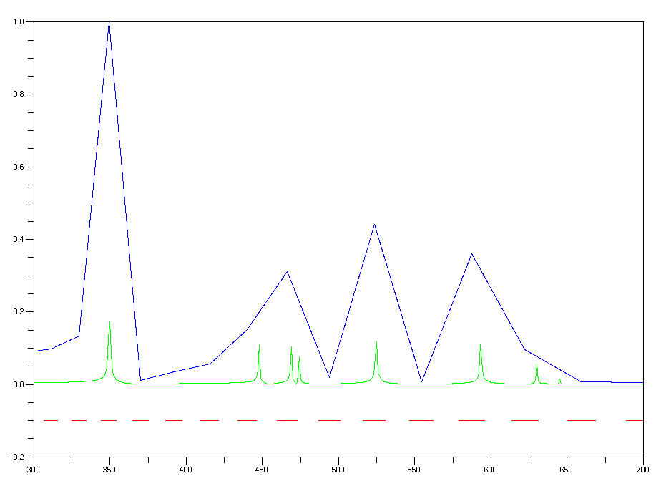
Note Extraction
– Normalized, unweighted FFT
– Extracted note values
– Note limits
Normalized amplitude →
Frequency (Hz) →
Plotted test of note extraction from a 1-second wave plot with 300 sine waves of random frequency 1-1000

Slide 11
Review: Chord Detection
Chords are when three or four harmonious notes are played simultaneously
C#
D#
F#
G#
A#
C
D
E
F
G
A
B
Example of a chord:
C Major

Slide 12
Chord Extraction
Bypassing the need for chord detection
If one were to use the amplitude value of each of the notes detected as part of the input pattern to the network, it would then be plausible to assume that the network would have enough information to be able to (in theory) train itself to recognize any chords in its hidden layer. For example:

Slide 13
Chord Extraction
Assume that this network has 4 inputs, each the amplitude of a note. Notes are color-coded: blue and green notes are part of the same chord, as are yellow and green notes.
I'm not saying that the network will definitely arrange its weights to detect chords in its hidden layer. It may take more than 1 hidden node to report a detected chord to the output layer, or it may not detect chords at all. It all depends on how effective the practice is at minimizing errors.
Note inputs
(part of)
Hidden layer
To output layer →

Slide 14
Statistical Audio Features
Almost every paper I read used four of the same audio features for generating useful audio characteristics:
Centroid Frequency
  100% implemented, 80% tested
  A measure of where in the spectrum the signal is brightest
  Computed from weighted FFT (frequency * amplitude)
Spectral Rolloff
  50% implemented, 0% tested
  A measure of where the spectrum contains 85% of its total brightness
  Also computed from weighted FFT
Spectral Flux
  100% implemented, 50% tested
  A measure of the total spectral change from previous audio frame
  Computed from unweighted FFT
Zerocrossings Per Second
  100% implemented, 100% tested
  A measure of the amount of noise in the signal
  Computed from raw audio sample data.
$c=\frac{\sum_{1}^{N}{f}M\left[f\right]}{\sum_{1}^{N}{M}\left[f\right]}$
$\sum_{n=1}^{r}{M\left[n\right]}=0.85∗\sum_{n=1}^{N}{M\left[n\right]}$
$f=\sum_{n=1}^{N}{{\left(N_{t}\left[n\right]−N_{t−1}\left[n\right]\right)}^{2}}$
$z=\frac{1}{2}\sum_{n=1}^{N}{\left|sign\left(x\left[n\right]\right)−sign\left(x\left[n−1\right]\right]\right|}$

Slide 15
Network Design
Input vector will be made up of both detected note amplitudes and the four statistical audio features.
Default octave span is 3 octaves below middle c to 4 octaves above it & default note span is 0.5 (half the space between notes is covered).
There are 12 default notes defined as belonging to the middle octave, so, coincidentally enough the number of input vectors is
12 * (3 + 1 + 4) + 4 = 100
Output vector size varies directly to how many genres are defined. Each value in the target matrix (0 or 1) corresponds to whether its corresponding input song fit that genre.

Slide 16
Current State of Project
Ideas for expansion:
Usage of multicomputing API to train network
Server-client architecture-based training data collection

Slide 17
Code Statistics
(for Your Amusement)
Arnold's Laws of Documentation:
(1) If it should exist, it doesn't.
(2) If it does exist, it's out of date.
(3) Only documentation for useless programs transcends the
first two laws.

