Slide 1

BABU BANARASI DAS UNIVERSITY · SCHOOL OF ENGINEERING, LUCKNOW
AI Plant Disease Detection System
Disease diagnosis, severity grading and yield-loss estimation for six Indian field crops
Presented by
Presented to
Anshu Mishra (1230432155)
Anshul Yadav (1230432157)
Anshuman Mishra (1230432158)
Anu Kushwaha (1230432160)
Mr. Gaurav Kumar Srivastava
Notes:
Title slide. Project: AI Plant Disease Detection System — CNN-based disease classification with per-image severity estimation and literature-backed yield-loss lookup, covering six Indian field crops.

Slide 2
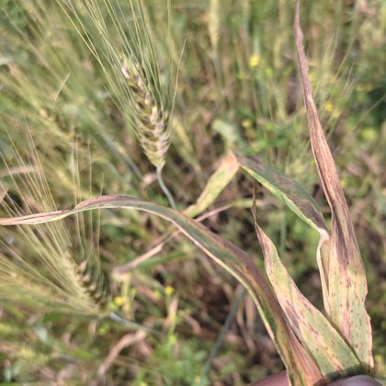
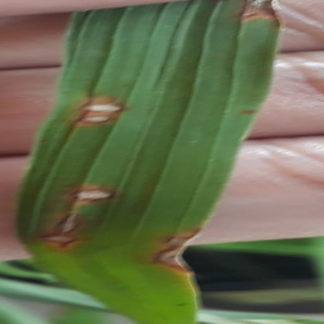
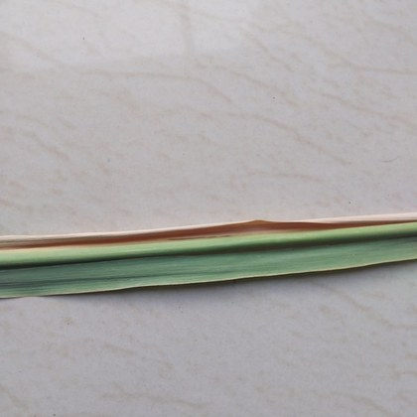
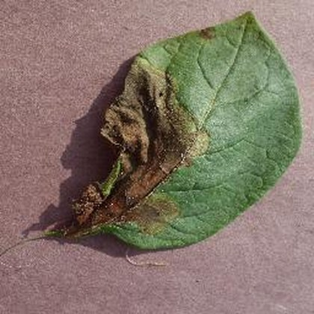
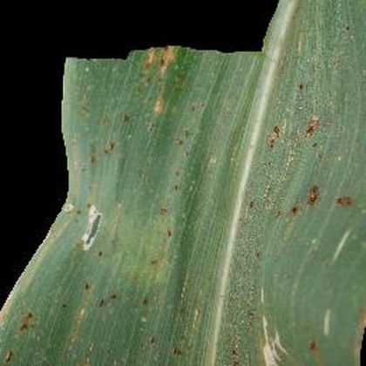
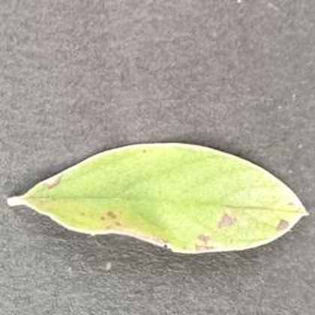
01 — INTRODUCTION
From Leaf to Loss
6
CROPS COVERED
AI Plant Disease Detection System
32
DISEASE CLASSES
A farmer selects the crop, uploads one leaf photograph, and gets back a disease diagnosis, a severity grade, treatment advice and an estimated yield loss — the number that actually drives a decision in the field.
36,848
TRAINING IMAGES
Six Indian field crops · 32 disease classes · built, trained and deployed
4
OUTPUTS PER SCAN
WHEAT
RICE
SUGARCANE
POTATO
MAIZE
PIGEONPEA
Notes:
Opening frame. Six crops, 32 disease classes, 36,848 training images. The point to land: this does not stop at a class label — it ends at a yield-loss percentage.

Slide 3
02 — AIMS & OBJECTIVES
From a class label to a cost estimate
Aim — most leaf-disease demos stop at naming the disease. The five objectives below are the pipeline in order: each stage exists because the next one needs its output.
01
Diagnose the disease
Classify a leaf photo into the correct disease for the user-selected crop, across 3 to 11 classes depending on the crop.
02
Grade the severity
Estimate affected leaf area per image and bin it as early, moderate or severe — computed live from the photo, not looked up.
03
Show the model's reasoning
Return a Grad-CAM heatmap with every prediction, so a confidence score is never the only evidence the user has.
04
Translate into treatment and cost
Map crop + disease to advisory text, and crop + disease + severity to a yield-loss percentage from published agronomy literature.
05
Stay extensible and honest
Add a seventh crop by training one head, not the whole model — and tag every estimate with the confidence its source data supports.
Notes:
Emphasise the ordering: severity is meaningless without a diagnosis, and the yield figure is meaningless without severity. That dependency chain is why the deck is structured this way.

Slide 4
03 — TECHNICAL APPROACH
One frozen backbone, one head per crop
STEP 03a · PARALLEL
Classify
EfficientNetB0, frozen
per-crop Dense head
STEP 01
Capture
React 19 + Vite
crop dropdown + photo
STEP 02
Gateway
Express 5 · JWT
auth, upload, routing
STEP 04
Explain
Grad-CAM overlay
which pixels decided it
STEP 05
Quantify
treatment + yield loss
keyed by severity
STEP 06
Deliver
one JSON response
saved to user history
STEP 03b · PARALLEL
Grade
ExG + Otsu leaf mask
Lab median / MAD
STEP | TECHNOLOGY | PURPOSE
Crop selection & upload | React 19 · Vite 8 · Tailwind 4 | Farmer names the crop, so the model never has to guess it
Request handling | Express 5 · Multer · JWT · Cloudinary | Auth, multipart intake, image hosting, orchestration
Feature extraction | EfficientNetB0 (ImageNet, frozen) | One shared 1280-dim embedding reused by all six crops
Disease classification | Dense(128) → Dropout(0.3) → Softmax | A small head per crop; only the selected crop's head runs
Severity grading | ExG + Otsu · Lab median / MAD (v4) | Percent affected leaf area → early / moderate / severe
Explainability | Grad-CAM · TensorFlow · matplotlib | Heatmap proving the call used lesions, not backgrounds
Advisory & impact | treatmentMap.js · yieldLoss.js | Disease → treatment text; plus severity → yield-loss percent
Storage & deploy | MongoDB Atlas · Cloud Run · Vercel | Per-user history; ML and API scale independently
Notes:
The fork is the design point: the same image goes down two independent paths. Classification says what the disease is; severity says how far along it is. Neither one depends on the other's output.

Slide 5
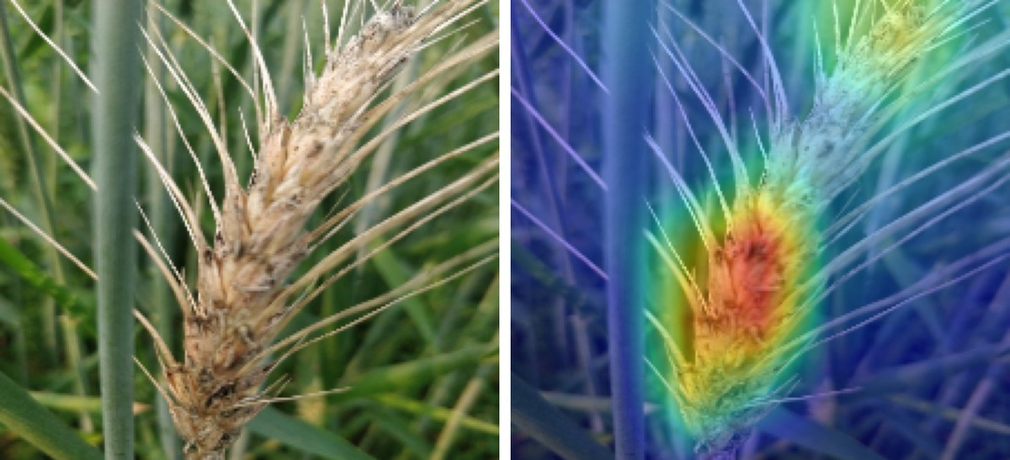
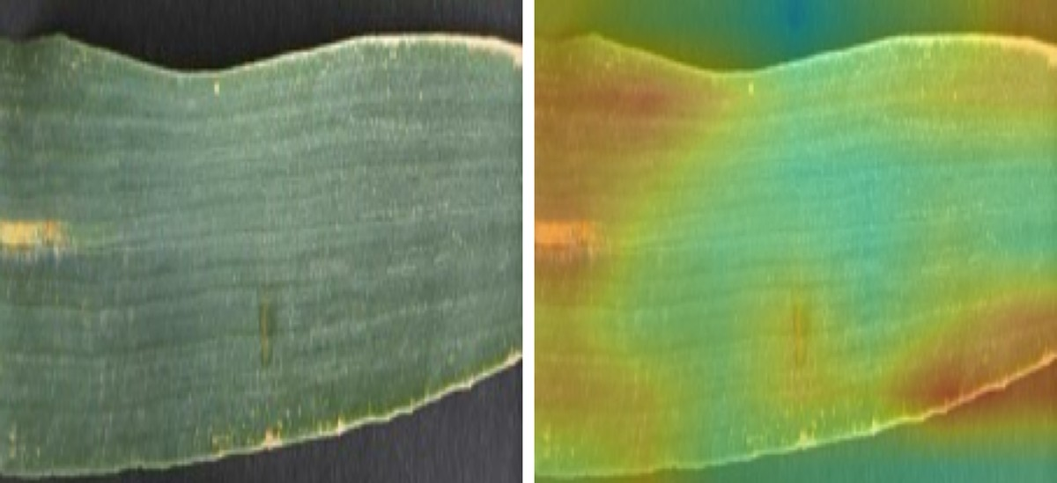
04 — POTENTIAL CHALLENGES & RISKS
High accuracy alone does not prove the model is correct
CORRECT BEHAVIOUR
The model’s attention settles on the diseased wheat ear, which is the evidence a plant pathologist would use.
SHORTCUT LEARNING
Attention spreads over the whole leaf and its dark studio background, rather than the rust lesions themselves.
Learning the wrong feature
Unequal dataset sizes
A wheat class scored 100% by recognising its dataset’s photography, not the disease. Grad-CAM found it before deployment.
Pigeonpea has 973 images against wheat’s 16,000, and its accuracy is correspondingly lower at 79%.
Limited validation in the field
Yield loss is literature-based
Training images were captured under controlled conditions. Accuracy on real field photographs has not yet been measured.
Estimates come from published agronomy studies, not a trained model, so they exclude local soil, weather and variety.
Severity grading is approximate
The automated grade agrees with expert assessment 44% of the time. It shows direction, not a clinical measurement.
Notes:
The Yellow_Rust finding is the strongest methodological result in the project: a 100% class that Grad-CAM proved was recognising photography style rather than rust. Catching it is the reason Grad-CAM runs on every crop, not just as a visualisation.

Slide 6
05 — FEASIBILITY & VIABILITY
Already deployed, and inexpensive to extend
1
Training is inexpensive
Each image is processed by the shared network once and its features are stored. Every crop’s classifier then trains in seconds rather than hours.
2
Adding a crop is straightforward
A seventh crop requires training only one additional classifier. None of the existing six needs to be retrained.
3
The system is already running
The inference service and the web API run as containers on Google Cloud Run, with the user interface hosted on Vercel.
4
It is practical for real use
The user selects the crop, so the system never has to guess it, and every yield estimate carries a stated confidence rating.
Held-out test sets · pigeonpea marked as the known weak point
Deployed on Google Cloud Run (Mumbai region) · Vercel · MongoDB Atlas · Cloudinary — the three services scale independently of one another.
Notes:
The accuracy spread is not random: it tracks dataset size and class count. Pigeonpea is coloured differently on purpose — flagging the weak point is more credible than averaging it away.

Slide 7
06 — RESEARCH & REFERENCES
Every number traces to a dataset or a paper
1
Datasets
2
Methods
3
Agronomy & yield loss
Mendeley Wheat Leaf Disease
original un-augmented folder · 1,603 images
Yellow-Rust-19
expert grades 0/R/MR/MRMS/MS/S · severity validation only
Sethy et al., Rice Leaf Disease (Mendeley)
plus RiceLeafBD healthy class · 6,184 images
Mendeley Sugarcane Leaf Disease
11-class, Maharashtra · 6,748 images
PlantVillage — Hughes & Salathé, 2015
potato subset · 2,152 images
Corn/Maize Leaf Disease — Kaggle
smaranjitghose · 4,188 images
Mendeley Pigeonpea Leaf Disease
973 images · smallest set
Tan & Le (2019)
EfficientNet: Rethinking Model Scaling for CNNs, ICML
Selvaraju et al. (2017)
Grad-CAM: Visual Explanations from Deep Networks, ICCV
Otsu (1979)
A Threshold Selection Method from Gray-Level Histograms, IEEE Trans. SMC
Woebbecke et al. (1995)
Color Indices for Weed Identification, Transactions of the ASAE
Deng et al. (2009)
ImageNet: A Large-Scale Hierarchical Image Database, CVPR
ICAR institute publications
crop-specific loss figures, Indian conditions · tagged HIGH
IRRI
rice loss data — blast, bacterial blight, brown spot, tungro · tagged HIGH
State Agricultural University bulletins
severity-resolved loss ranges · tagged HIGH
Peer-reviewed plant pathology studies
used where no India-specific figure exists · tagged MED
Documented proxies
SCMV for sugarcane Viral_Disease; Alternaria for pigeonpea Leaf_Spot · tagged LOW
Rejected on the record Master Plant Disease Dataset (overlaps existing sources) · two sugarcane sets (taxonomy conflict, suspected pre-augmentation) · pre-augmented and pre-split folders (train–test leakage) · the mustard set that carried Indonesian fruit-ripeness labels.
Notes:
Worth saying out loud: rejecting datasets was as much work as using them. The mustard set and the Master aggregation would both have inflated the numbers.

Slide 8
07 — THANK YOU
Thank you
Disease diagnosis, severity grading and yield-loss estimation for six Indian field crops
Questions are welcome.
Project team Anshu Mishra · Anshul Yadav · Anshuman Mishra · Anu Kushwaha Guided by Mr. Gaurav Kumar Srivastava

