Slide 1

Open Everything
James Michael DuPont
h4ck3rm1k3

Slide 2
Copying
Copying is the basic operation of life
Mutations occur and good ones flourish
Speed of copying is increasing over time

Slide 3
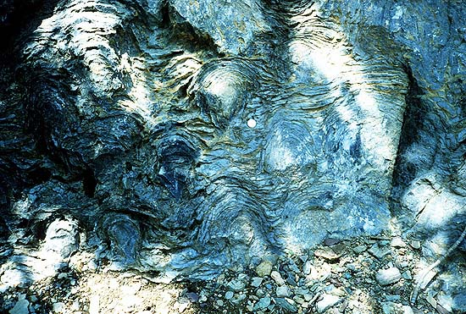
Abiogenesis 4.1 billion years

Slide 4
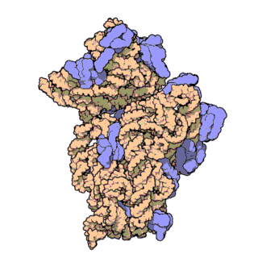
Self replicating RNA

Slide 5
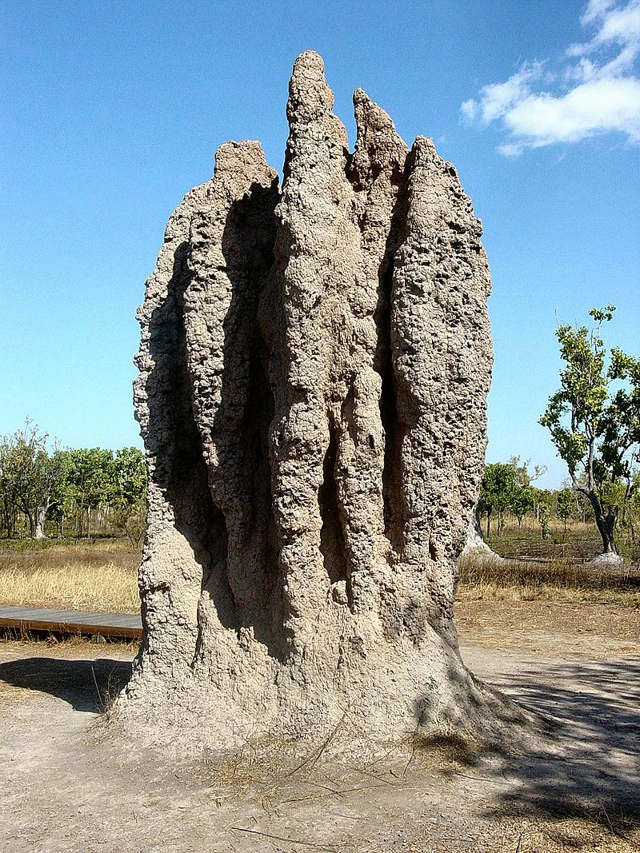
Colony

Slide 6
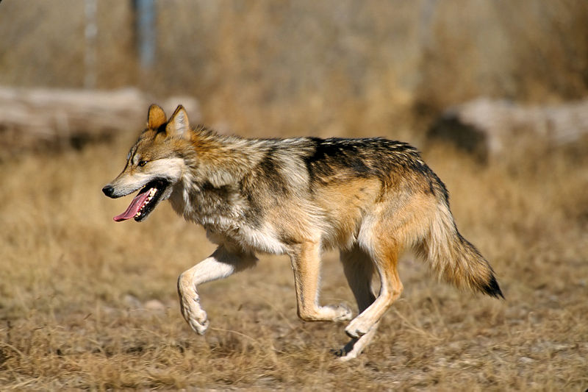
Individual

Slide 7
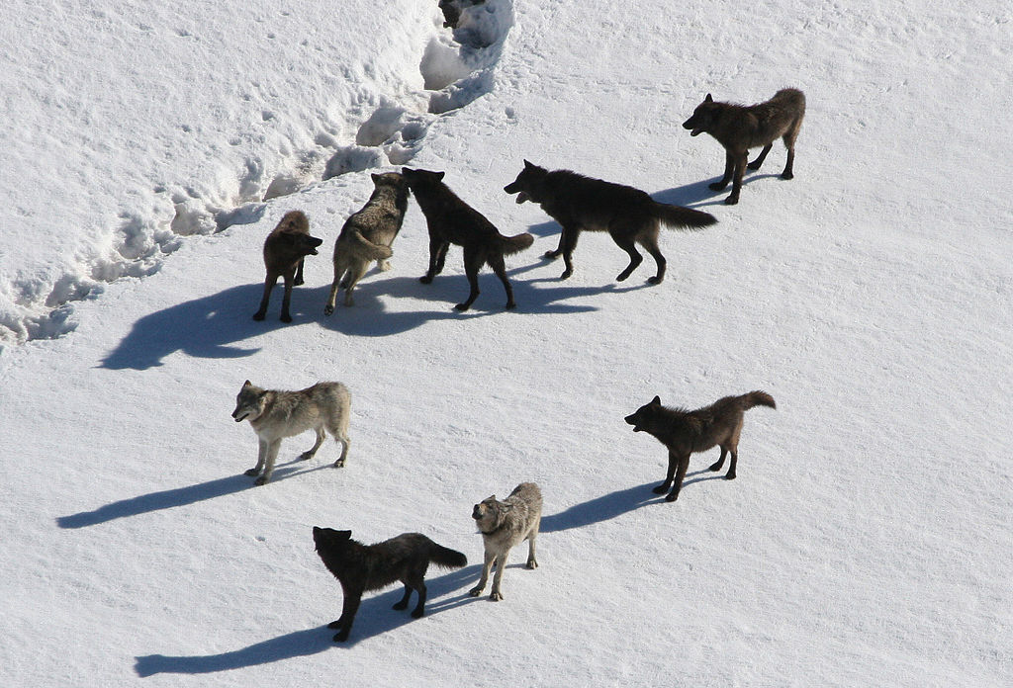
Pack

Slide 8
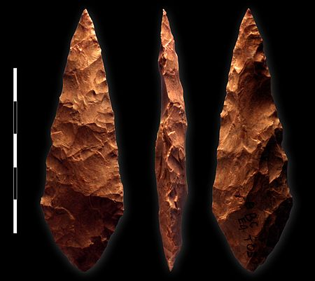
Stone tools 3.3 million year

Slide 9
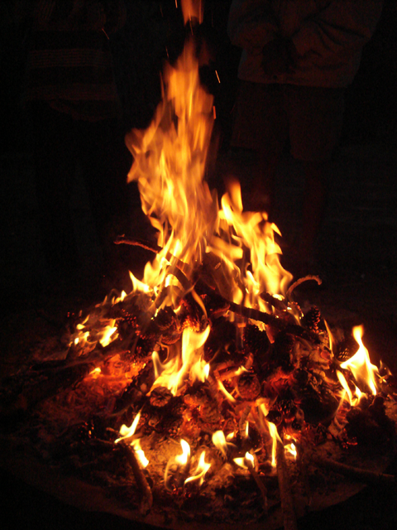
Fire 400,000 BC

Slide 10
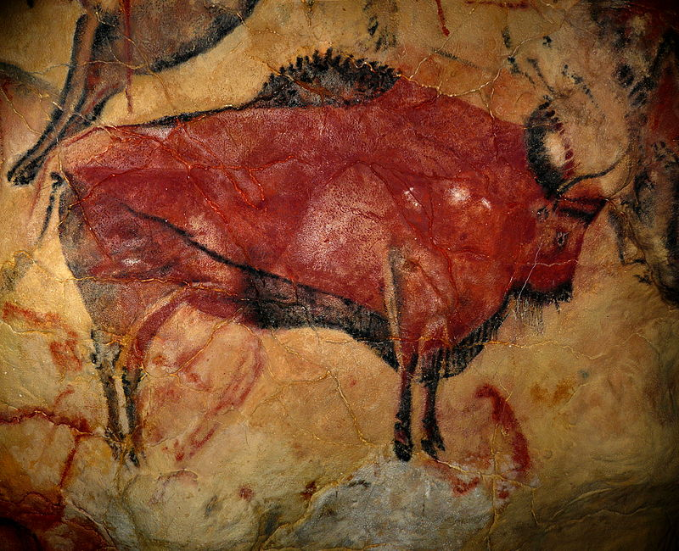
Art (35,600 -20,000 years old)
Notes:
Cave of Altamira

Slide 11
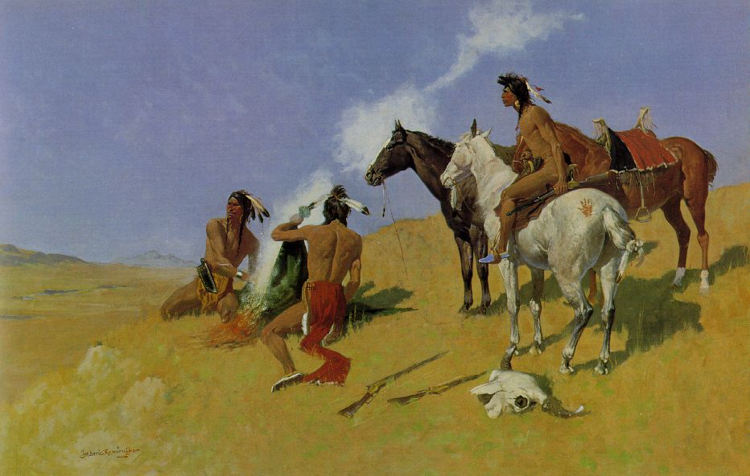
Smoke Signals

Slide 12
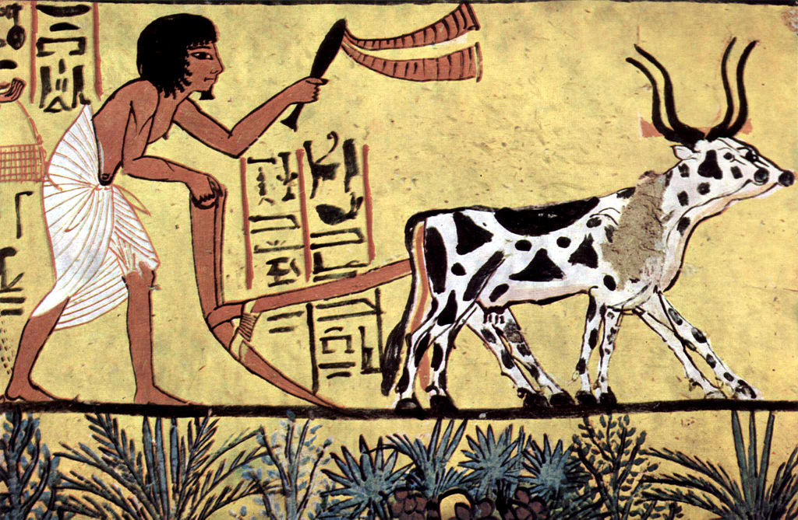
Agriculture 9000 BC

Slide 13
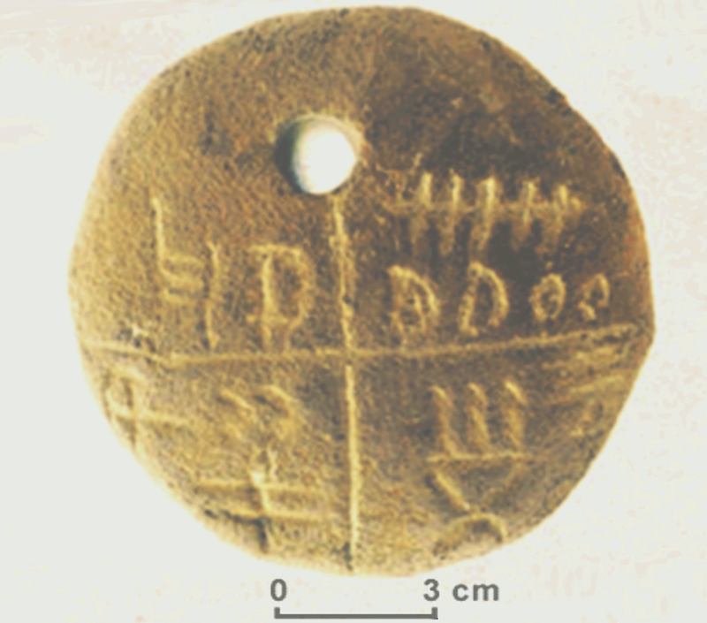
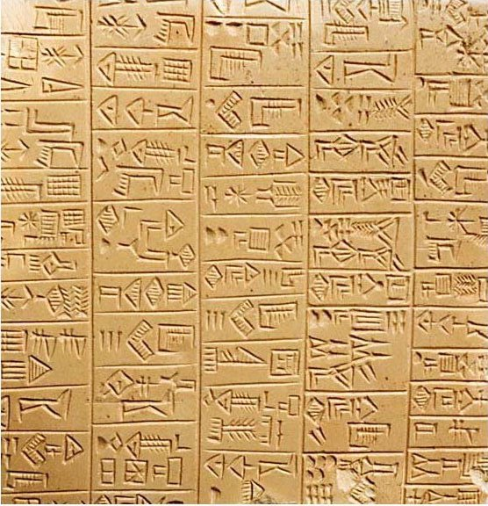
Writing 5500 BC
Tărtăria tablets 5500 BC
Sumerian Writing 2900 BCE

Slide 14
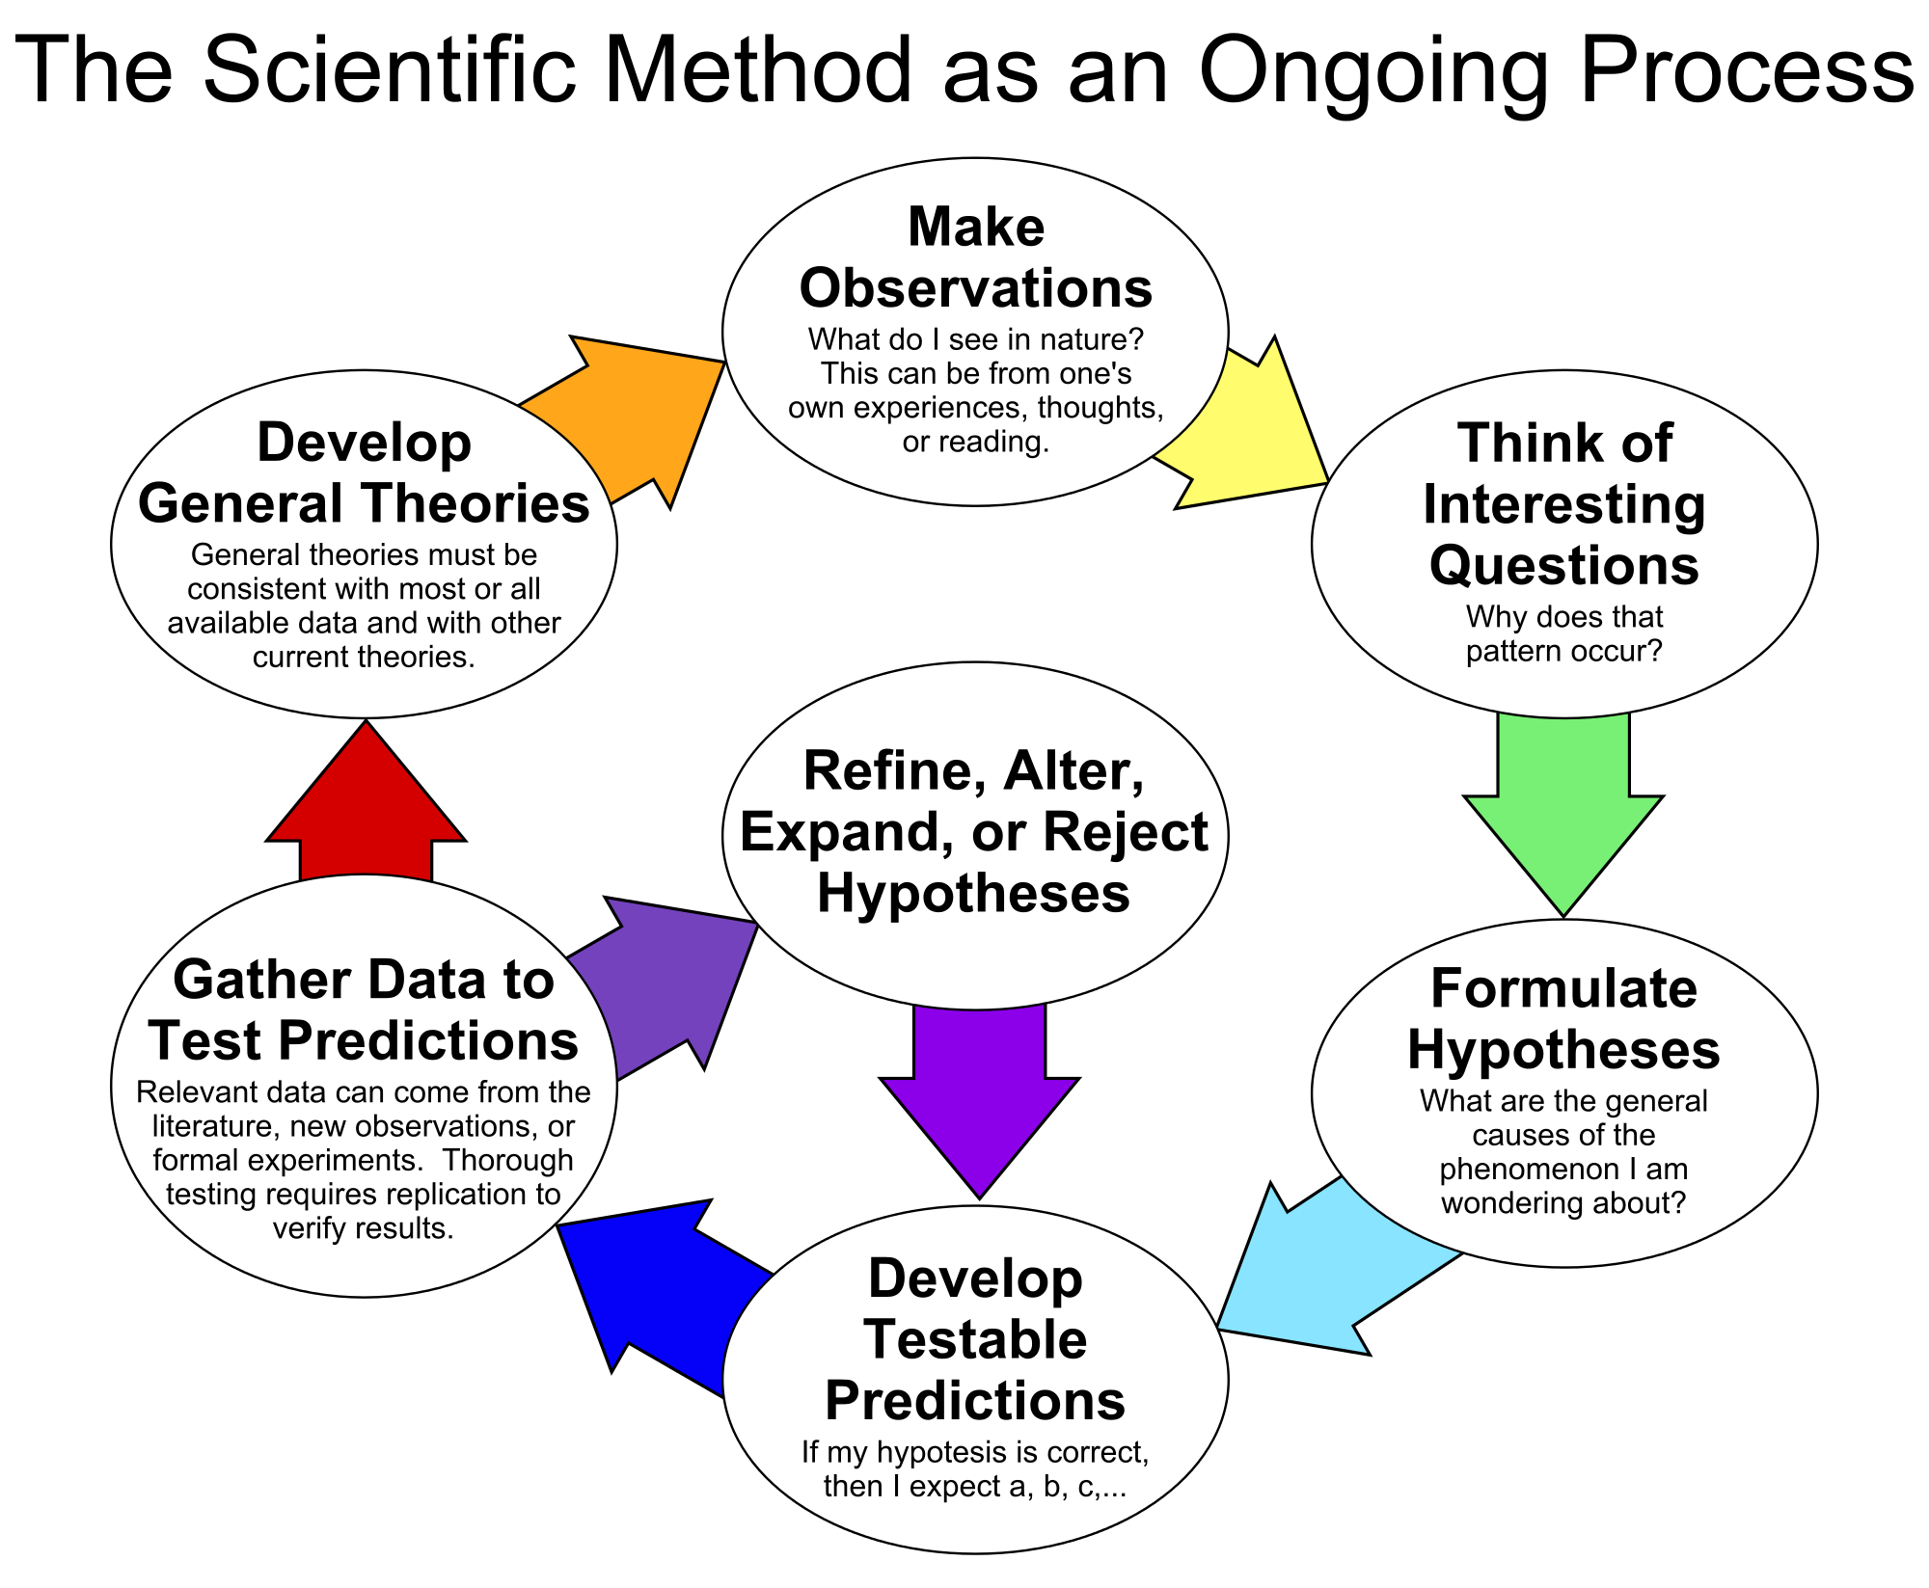
The Scientific Method as an Ongoing Process 2000bc

Slide 15
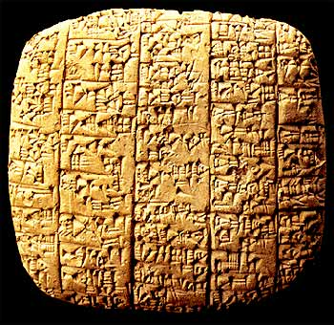
Transactions 2400 BC

Slide 16
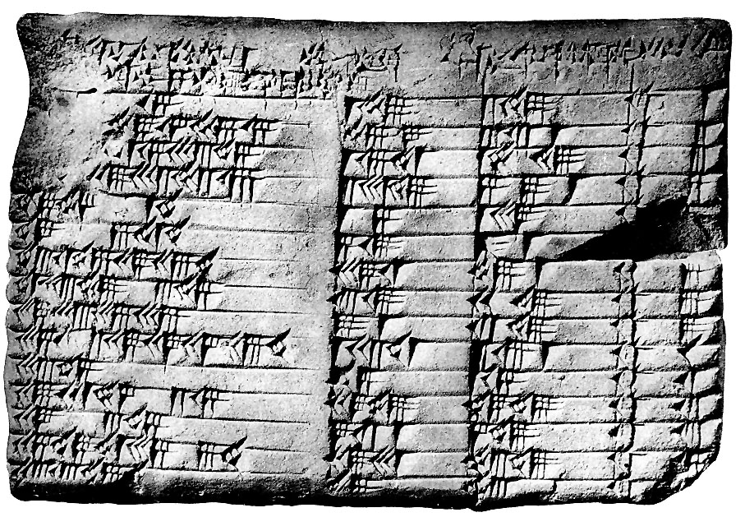
Mathematics 1800 BC

Slide 17
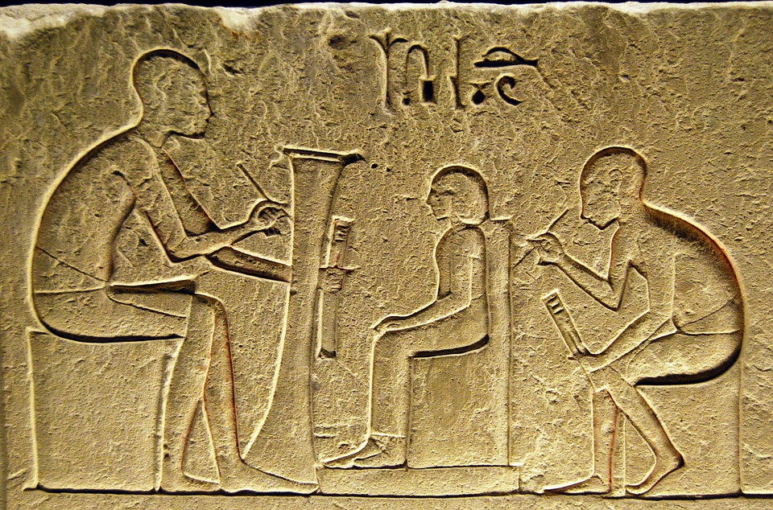
Physical Copy

Slide 18
Open science 300 BC
“...make scientific research, data and dissemination accessible to all levels of an inquiring society, amateur or professional”
  Open Research
  Open Access
Open notebook Science
  http://jupyter.org/ An integrated pad for calculation and publishing
  https://zenodo.org/

Slide 19
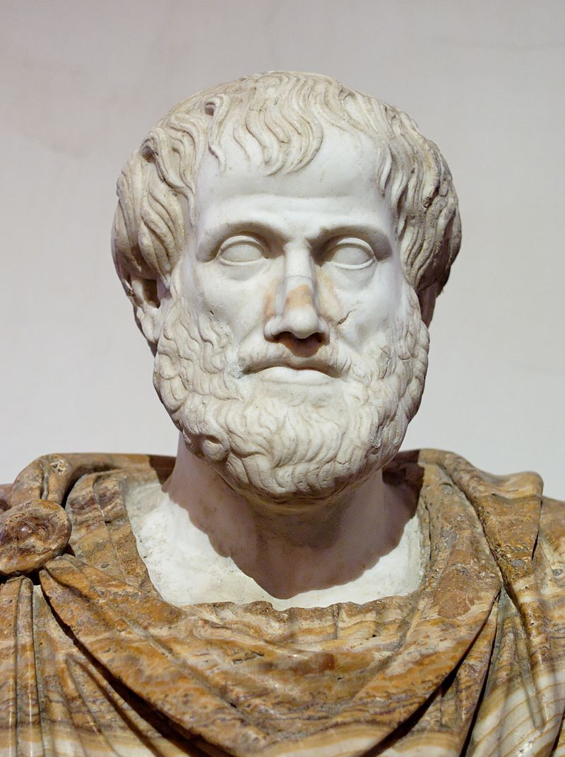
Aristotle 300 BC

Slide 20
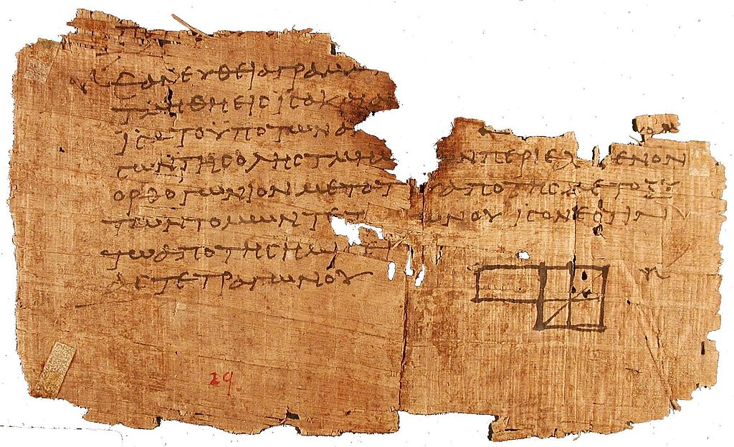
Euclid 300 BCE

Slide 21
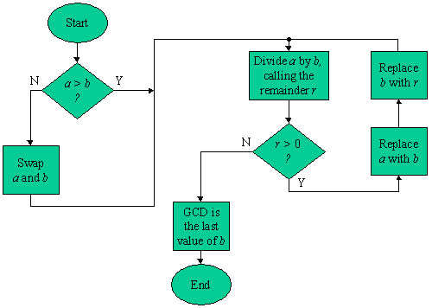
Euclid Flow

Slide 22
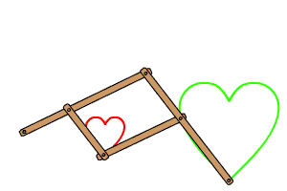
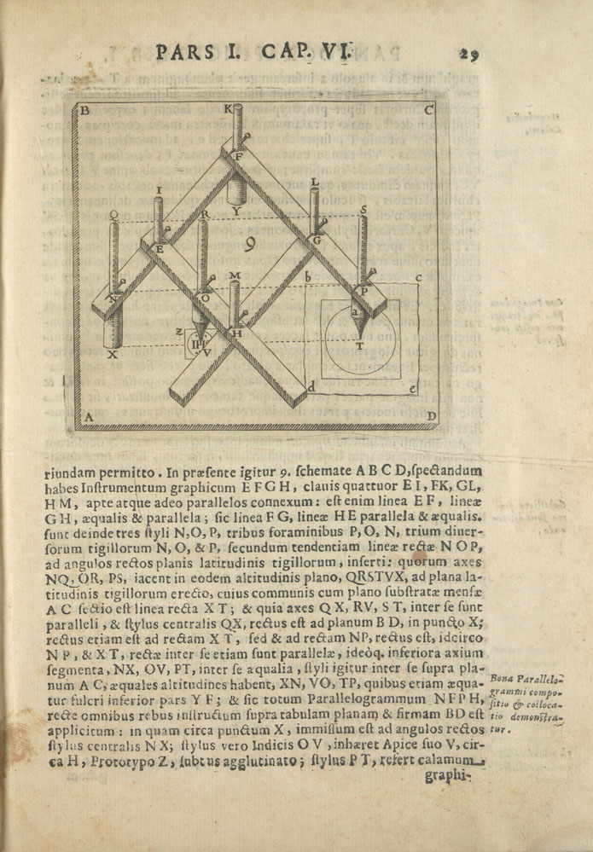
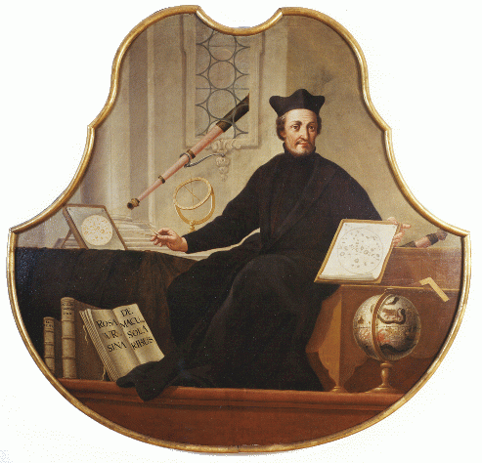
Pantograph 1603

Slide 23
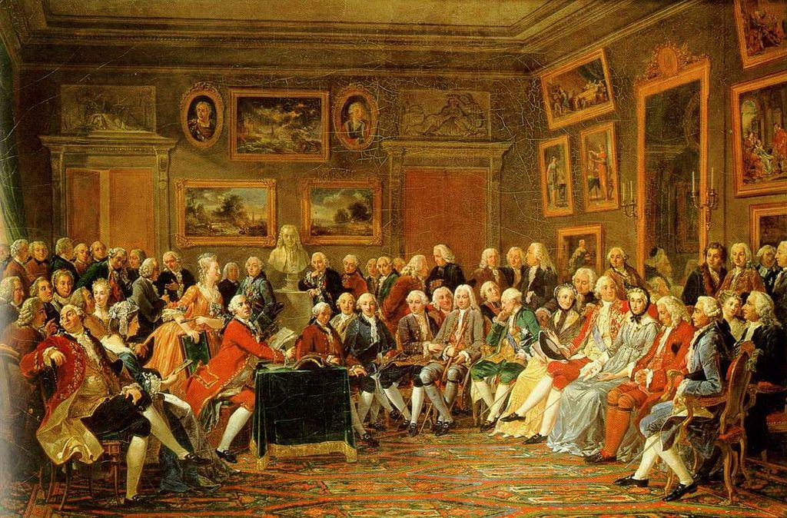
Open government 1715
Notes:
the governing doctrine which holds that citizens have the right to access the documents and proceedings of the government to allow for effective public oversight. In its broadest construction it opposes reason of state and other considerations, which have tended to legitimize extensive state secrecy.
https://en.wikipedia.org/wiki/Age_of_Enlightenment#/media/File:Salon_de_Madame_Geoffrin.jpg

Slide 24
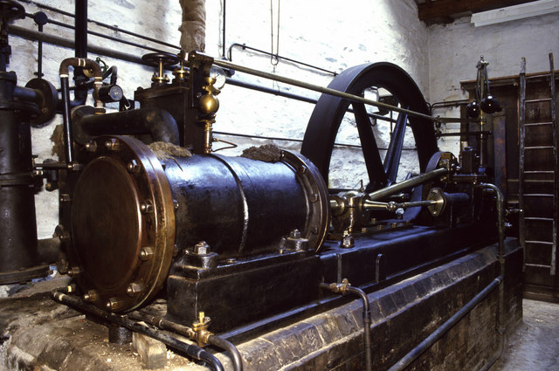
Steam Engine 1781

Slide 25
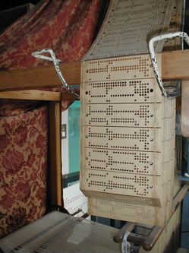
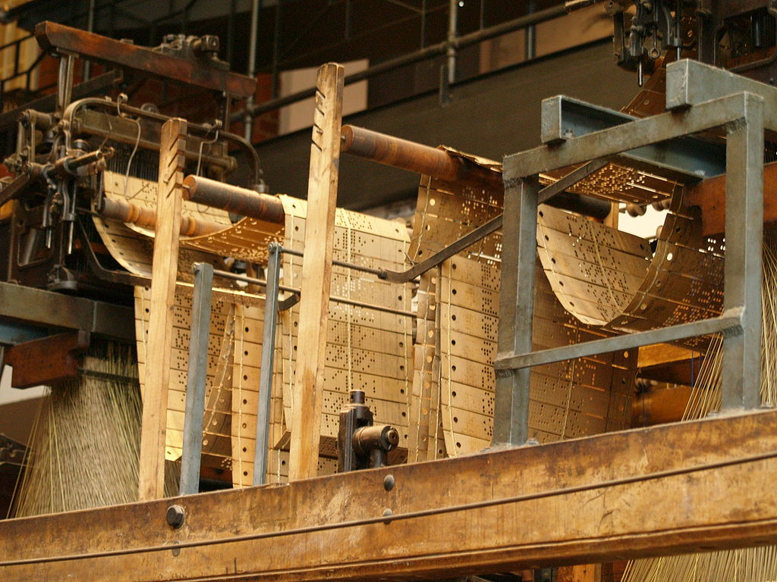
Jaquard Loom 1801

Slide 26
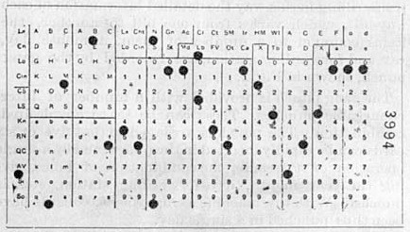
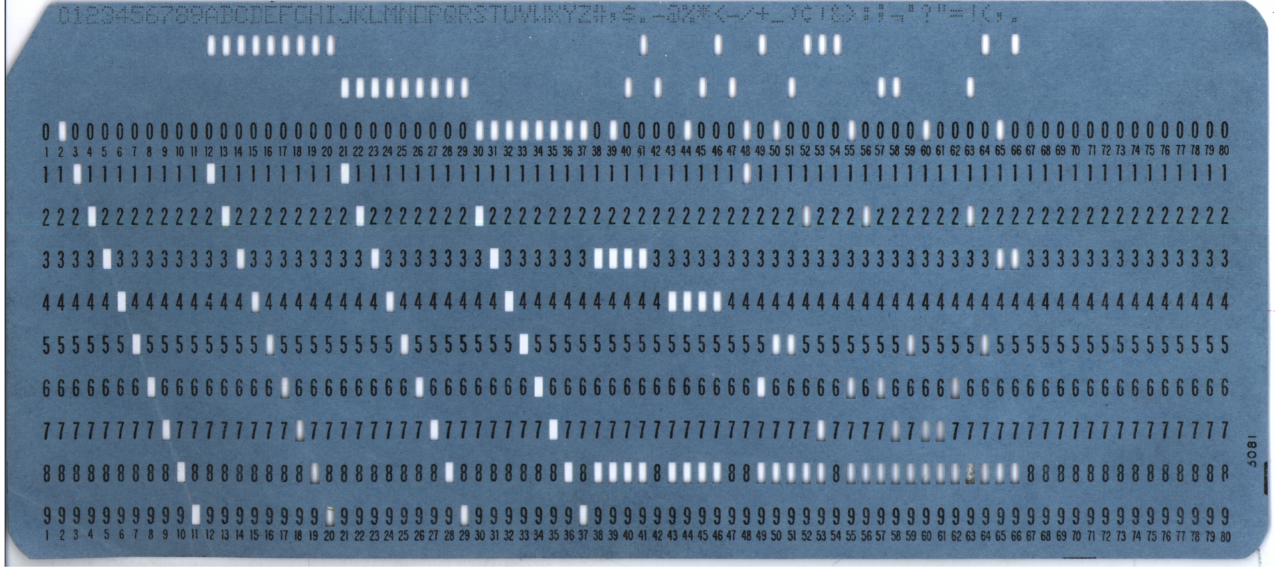
Punch Card 1889

Slide 27
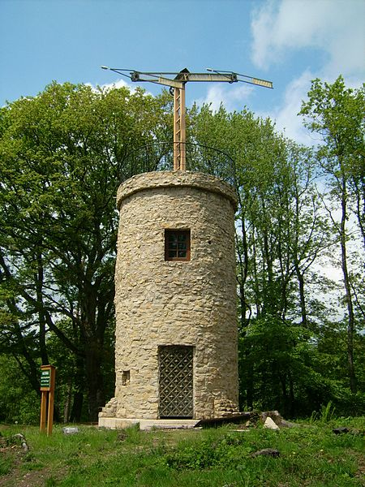
Semaphore line (1792)

Slide 28
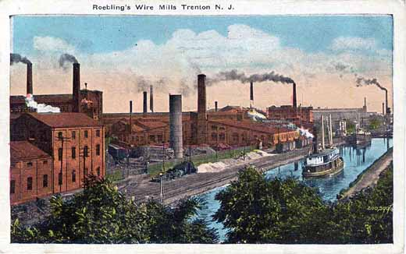
Industry 1760

Slide 29
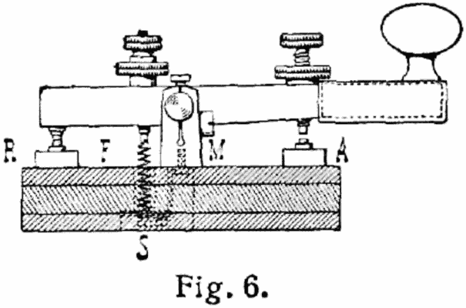
Telegraph (1823,1837)

Slide 30
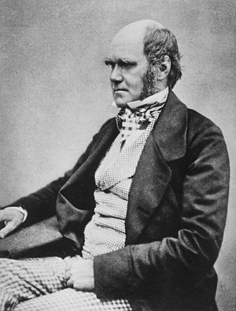
On the Origin of Species 1959

Slide 31
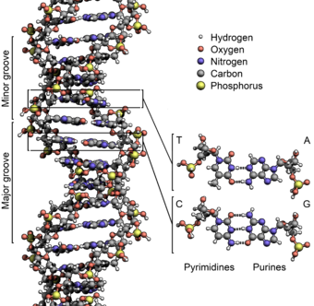
DNA 1869

Slide 32
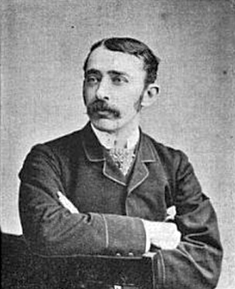
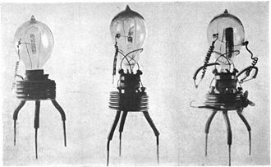
Fleming valve(Vacum Tube) 1904
Sir John Ambrose Fleming

Slide 33
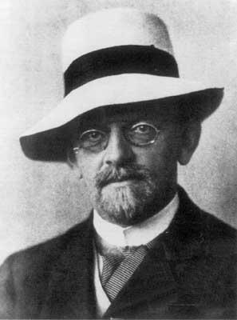
Hilbert's Program 1920
1. all of mathematics follows from a correctly chosen finite system of axioms; and
2. that some such axiom system is provably consistent through some means such as the epsilon calculus.

Slide 34
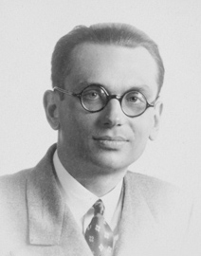
Gödel 1931
"G is not provable in the system T."
Entscheidungsproblem
Gödel showed that any consistent system with a computable set of axioms which is capable of expressing arithmetic can never be complete: it is possible to construct a statement that can be shown to be true, but that cannot be derived from the formal rules of the system

Slide 35
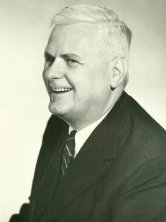
Λ-calculus 1936
Alonzo Church

Slide 36
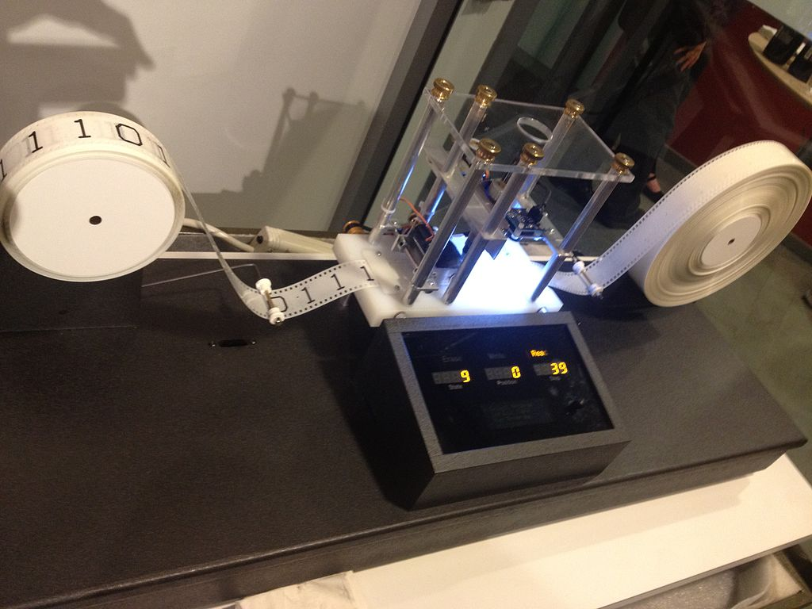
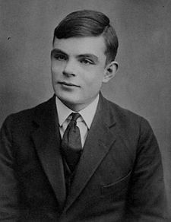
Turing Machine 1936

Slide 37
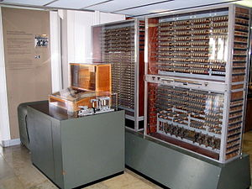
Z3 1941

Slide 38
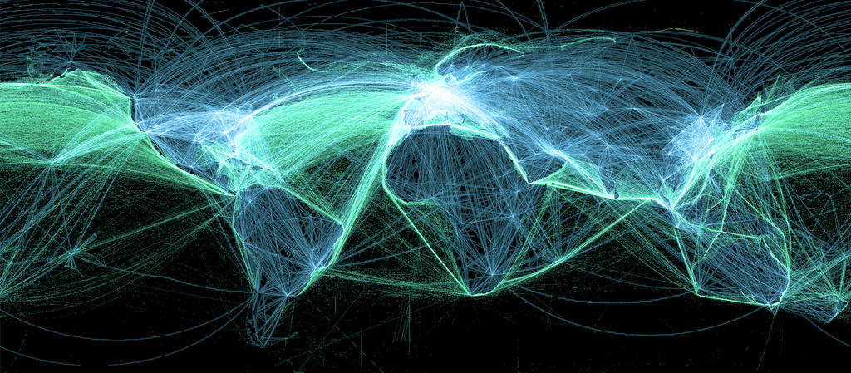
Globalism 1940s

Slide 39
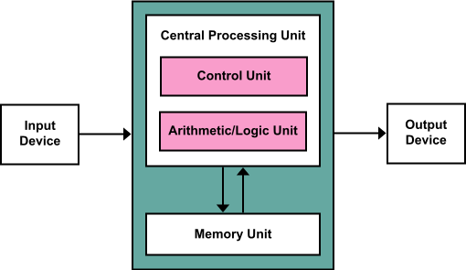
Von Neumann architecture 1945

Slide 40
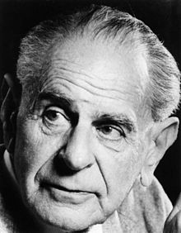
Popper : Open Society (1945)
Popper :standing on a historical continuum reaching from the organic, tribal, or closed society, through the open society marked by a critical attitude to tradition ….
Notes:
government is expected to be responsive and tolerant, and political mechanisms are said to be transparent and flexible. Advocates claim that it is opposed to authoritarianism.

Slide 41
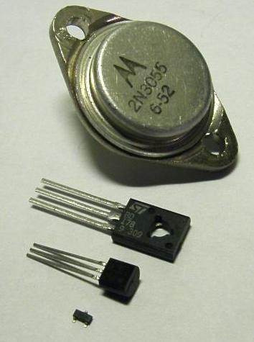
Transistor 1947

Slide 42
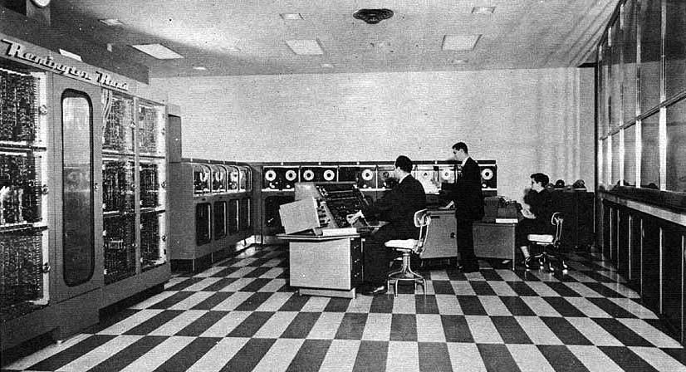
UNIVAC I 1951

Slide 43
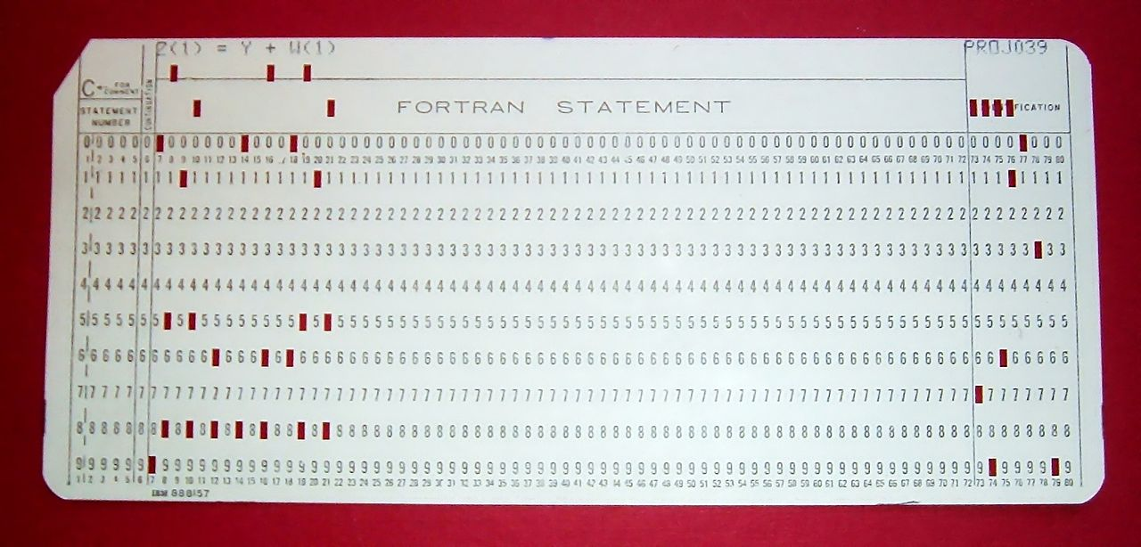
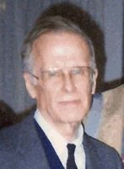
Fortran 1953
* euclid.f (FORTRAN 77)
* Find greatest common divisor using the Euclidean algorithm
PROGRAM EUCLID
PRINT *, 'A?'
READ *, NA
IF (NA.LE.0) THEN
PRINT *, 'A must be a positive integer.'
STOP
END IF
PRINT *, 'B?'
READ *, NB
IF (NB.LE.0) THEN
PRINT *, 'B must be a positive integer.'
STOP
END IF
PRINT *, 'The GCD of', NA, ' and', NB, ' is', NGCD(NA, NB), '.'
STOP
END
FUNCTION NGCD(NA, NB)
IA = NA
IB = NB
1 IF (IB.NE.0) THEN
ITEMP = IA
IA = IB
IB = MOD(ITEMP, IB)
GOTO 1
END IF
NGCD = IA
RETURN
END
John Warner Backus

Slide 44
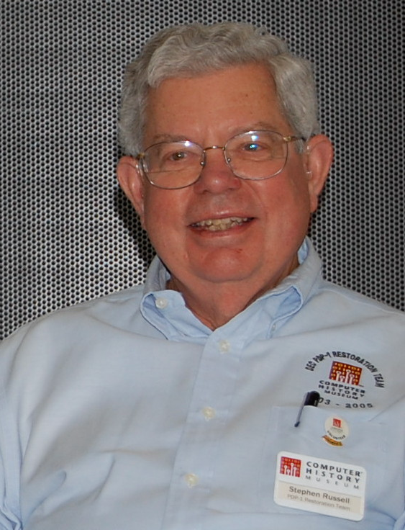
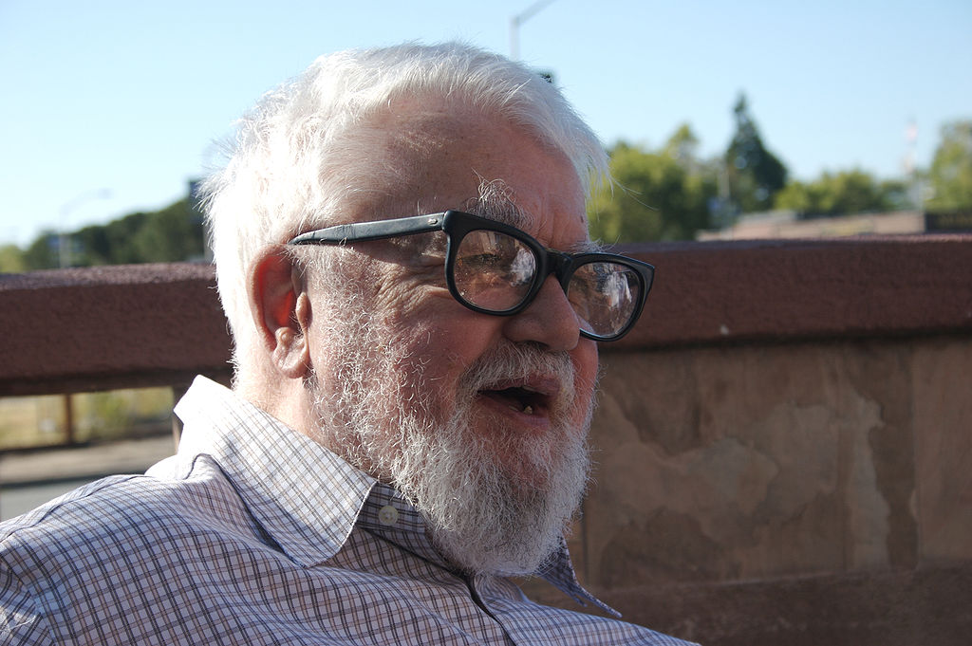
Lisp 1958
(defun greatest-common-divisor (a b)
(if (zerop b)
a
(greatest-common-divisor b (mod a b))))

Slide 45

Computer Memory Hierarchy

Slide 46

Science Model Extended

Slide 47

Arpanet 1960-1990

Slide 48

IBM Unbundling 1969

Slide 49


Project Gutenberg 1971
Notes:
Project Gutenberg
http://www.gutenberg.org/
Project Gutenberg offers over 46,000 free ebooks: choose among free epub books, free kindle books, download them or read them online.

Slide 50

Unix (1972)

Slide 51

History of Unix

Slide 52

Open Letter to Hobbyists 1976
Why is this? As the majority of hobbyists must be aware, most of you steal your software. Hardware must be paid for, but software is something to share. Who cares if the people who worked on it get paid?

Slide 53

Meme 1976
v

Slide 54

BSD (1977)
Notes:
https://en.wikipedia.org/wiki/Berkeley_Software_Distribution
1974

Slide 55

UUCP (1978)

Slide 56

BBS (1978)
__
/ \
/|oo \
(_| /_)
_`@/_ \ _
| | \ \\
| (*) | \ ))
______ |__U__| / \//
/ FIDO \ _//|| _\ /
(________) (_/(_|(____/
(c) John Madil
FidoNet

Slide 57

Usenet (1979)

Slide 58

UNIX System V (1983)

Slide 59

GNU (1983)

Slide 60


Copyleft GPL (1985)
Notes:
Based on the GPL.
the practice of offering people the right to freely distribute copies and modified versions of a work with the stipulation that the same rights be preserved in derivative works down the line.

Slide 61


EMACS 1985

Slide 62

Private Internet 1989

Slide 63

World Wide Web (1989)

Slide 64

Mosaic Browser (1993)

Slide 65


Linux (1991)
Notes:
2001,2003
https://en.wikipedia.org/wiki/Linux

Slide 66

Archive.org 1996
Notes:
15 petabytes
$10 million budget
From Alpha:
~~ ( 0.16 ~~ 1/6 ) × estimated data content of the deep web (as of 2001) (~~ 91000 TB )
http://www.learnthenet.com/how-to/search-the-deep-web/index.php
~~ 2.9 × digitized material content of the Library of Congress (as of 2015) (~~ 5.1 PB )

Slide 67


Open City Planning 1999
Notes:
CivilHub
Shareabouts, OpenTripPlanner, OneBusAway
Open Core (coactivate)
Spacehive (uk)
Ushahidi crisis maps
Fix my street
Open311

Slide 68

Egranery 2000
Notes:
eGranary Digital Library
The eGranary Digital Library contains an off-line collection of approximately 30 million educational resources from more than 2,500 Web sites and hundreds of CD-ROMs and fits on a 4TB hard drive.[1] The collection includes more than 60,000 books in their entirety, hundreds of full-text journals, and dozens of software applications.
Source: https://www.widernet.org/egranary/

Slide 69

Creative commons (2001)
Notes:
Founded 2001 by Lawrence Lessig
1.1 Billion licensed documents
One of several public copyright licenses that enable the free distribution of an otherwise copyrighted work.
P2PU peer to peer university
http://schoolofopen.p2pu.org/

Slide 70

Sharing Model

Slide 71

Wikipedia 2001

Slide 72

Semantic Web (2001)

Slide 73

Wordpress 2003

Slide 74

Open Source voting 2003
Notes:
Green party asks for “publicly-owned, open source voting equipment”
Open Voting Coalition (files from 2003-2004)
http://www.notablesoftware.com/PENN2008/VotingLinuxWorld.html
Decision making software
Loomio
Notes

Slide 75

Open source ecology 2003
By User Chris F - http://opensourceecology.org/wiki/File:GVCS.jpg, CC BY-SA 3.0, https://commons.wikimedia.org/w/index.php?curid=17093641

Slide 76
Open-source governance 2004
“aka “open politics” is a political philosophy which advocates the application of the philosophies of the open-source and open-content movements to democratic principles to enable any interested citizen to add to the creation of policy, as with a wiki document”

Slide 77

Openstreetmap 2004

Slide 78

Librivox 2005
Notes:
https://librivox.org/
free public domain audiobooks
LibriVox
Source: (http://www.disc-shelf.com/?artist=35)

Slide 79

OODO / openerp 2005

Slide 80


One laptop per child 2005
Notes:
Mission Statement: To create educational opportunities for the world's poorest children by providing each child with a rugged, low-cost, low-power, connected laptop with content and software designed for collaborative, joyful, self-empowered learning. When children have access to this type of tool they get engaged in their own education. They learn, share, create, and collaborate. They become connected to each other, to the world and to a brighter future.
Source : http://laptop.org/en/

Slide 81

Hackerspaces

Slide 82

Make Magazine 2005

Slide 83

Open Source 3d printer 2007

Slide 84

Platform : Data.gov 2009
Notes:
450k datasets
Visualization
http://vocab.data.gov/
https://github.com/GSA/data.gov
CKAN + wordpress
https://github.com/GSA/ckanext-geodatagov GEO

Slide 85

Code for America 2009
Code for NYC
Code for Newark
Code for Philadelphia
Code for Trenton!

Slide 86
CKAN 2009
https://datahub.io/
CKAN is the world's leading open-source data portal platform. It is a complete out-of-the-box software solution that makes data accessible -- by providing tools to streamline publishing, sharing, finding and using data. CKAN is aimed at data publishers (national and regional governments, companies and organizations) wanting to make their data open and available
See also DKAN

Slide 87

Open Source Currency 2009
Notes:
Bitcoin and derived
Namecoin
First Fork
Decentral DNS
Devcoin
Support FLOSS
Blockchain

Slide 88




Open source social network 2010
Diaspora
  decentralized
Gnu Social
Pump.io

Slide 89


Humantiarian OSM 2010

Slide 90


Open Source Things
Open source manufacturing
Thingverse
openstructures

Slide 91

Open Source Architecture
Notes:
Wikihouse

Slide 92

Open Education resources

Slide 93

Open Source Hardware

Slide 94


Domain : Health 1975
VistA
Liability and Regulation
  FDA open data
Privacy
  Big Data
  Insurance
Software health Providers
Hardware for devices
  EEG
  Mobile Sensors
Things :
  3d Printing stethoscopes
Scientific Research
Genetics
  BioBrick
Domain : Food and Farming
Notes:
Software :
Openqrs
VA VistA
http://www.openhealth.org/
https://sourceforge.net/directory/business-enterprise/enterprise/medhealth/os:linux/
https://en.wikipedia.org/wiki/List_of_open-source_health_software
http://p2pfoundation.net/Product_Hacking#Health
Devices
https://www.cooking-hacks.com/documentation/tutorials/ehealth-biometric-sensor-platform-arduino-raspberry-pi-medical
https://github.com/GliaX/Stethoscope
https://github.com/AngelSensor/angel-sdk
https://www.youtube.com/watch?v=nPpV_J2yvNU
Big Data Insurance
http://www.computerworld.com/article/2911594/insurance-company-now-offers-discounts-if-you-let-it-track-your-fitbit.html
http://nursingassistantguides.com/2009/50-successful-open-source-projects-that-are-changing-medicine/
https://open.fda.gov/

Slide 95
World Model 1
Legal Entities
Cooperation
Writing
Law
State
Companies
Transparency
Music
County
Democracy
Art
Games
Municipality
Police
Education
Security
Tribe
Architecture
Building
Family
Communication
Mathematics
Computation
Entertainment
Manufacture
Hardware
Informal
Health
Agriculture
Food
Pack / Gang
Medicine
Personal
Biology
Proteins
Chemistry
Compounds
Physics
Atoms

Slide 96
Resources
Scarce
Plenty
Time
Physical
Copy
Digital Copy
Energy
Land
Air
Opinions!
Usable Digital
Resources
Drinking Water
Digital
Information
Producers of
Creative Work
Food
Consumers of
Creative Works

Slide 97
Cultural Model
Analog
Digital
Film
Web pages
Writing
Culture
Society
“Apps”
Internet
Wetware
Software
Speech
Video
Games
Games
Music
Touch
Keyboard
Person
Sound
Mouse
Computer
Sight
Audio
Taste
Smell
Video

Slide 98
Foundation : Enabling Openness
Free and Interconnected Internet
Funding of Fast Hosting
Strong Legal Framework
Security
Usable working code
Open Standards and formats
Large sources of Open Data
Strong Community with common goal

Slide 99
Matrix of power
 | Physical Connection | Computation | Cognition Knowledge
Cooperation | Open Source hardware | Free/Libre open source software | Wikipedia | Power is positive
Co-Option | Proprietary | Proprietary | Intellectual Property | Power is balanced
Coercion | Bombs | Malware | Threats Propaganda | Power is negative
 | Hardware | Software | Wetware

Slide 100
Stack of openness
Decentralized
Open Java script
Identity
Open Content
Metadata
Open Access
Reputation
Privacy
Open Formats
Server Software
Accessibility
Encrypted
Client Software
F/LOSS
Operating System
Accessible
F/LOSS
Operating System
HOSTING
Transferable
Client
Licensing
IETF/W3C/ICAN

Slide 101
Aspects
Transferable
  Shareable
  Copyable
  Open Formats
Changeable
  Able to share modifications
  Able to share procedures to modify
Computing
  Decentralized
Social
  Community
  Identity
  Reputation
  Accessible
  Open Access
  Spontaneous Participation (No permissions)
  Peer Networks
  Transparency of contributions
  Expectation of Openness

Slide 102
Aspects 2
Security
  Anti spam
  Encrypted
Legal
Economic
Aesthetics
Utility
Relevance
Quality
Best Practices
Competition

Slide 103
Infrastructures of openness
infrastructures in which enablers of openness are embedded :
Open platforms, both virtual and physical, to produce in a open way
collaborative technical platforms
open places where to connect local production with global open design communities
open media and communication infrastructures
open and free software, knowledge and scientific data

Slide 104
Practices of openness
Open Source Software
Open Design
Open Manufacturing
Open Commerce
Open educational practices
Open sharing of professional practices
Leadership, Governance, and Culture Change Practices
Transparency Practices
Participation and Collaboration Practices
Security Practices
Open Best Practices

Slide 105
Hosting of data
Social Media...
Cloud
p2p
Archive.org
Dynamic
websites
Static
websites
Wikimedia
Decentralized
Project
Hosting
Freenet

Slide 106
Storage lifetime/volatility
Constants
Database
Values
Short Lived -Lifetime- Long Lived
Static Code
Static Data
Countries
Borders
Dynamic/
Evolutionary
Code
Documents
Variables
Transactions
Businesses
Opening Times
JIT Code
Registers
Change Often
Don’t Change
Volatility

Slide 107
Cost of hosting data
Simple Scenario (100gb data, 10gb transfer, 1 cpu) : 25$/m
  Elastic IP $4 / month
  Transfer costs : 5-23ct per GB transfer
  Storage costs : 2ct per gb per month
  100gb disk on aws $5 per month
  AWS micro instance $0.02/h $15/month
S3 for 100gb is less ($10/m)

Slide 108
Problems with proprietary sites
No access to the data (look don’t touch)
Unclear licensing (talk to your lawyer)
Limited and proprietary APIS (lock in)
Terms of service limiting usage (tosdr)
Loss of data, site going offline

Slide 109
OS Decision tools
CivilHub (collaboration in local civic communities)
Loomio (make decisions together)
Democracyos propose, debate, vote
Airesis : problems, solutions, alternatives, decision
Liquid feedback, PirateFeedback

Slide 110


