Slide 1
🎓
GradeGuardian
An Offline-First Academic Companion for Improving Student Performance
End of Term Project Defense
Richard Yawlui — 4211231018 · Addo Foster Keteku — 4211231161
Department of Computer Science · July 2026

Slide 2
THE PROBLEM
Students lose marks they could have kept
📉
Grade blindness
⏱
Unmeasured study
GPA is discovered when results are published — too late to react to a failing course.
Studying happens in unplanned bursts; neglected courses stay invisible until the exam.
📖
Passive revision
📅
Missed deadlines
Re-reading notes feels productive but is one of the least effective techniques known.
Assignments live on notice boards and group chats; overdue work is found by accident.
Existing tools solve fragments of this — and almost all need internet, accounts or subscriptions.

Slide 3
CHAPTER 1
Aim & Objectives
Course manager with automatic GPA on the 4.0 scale
Pomodoro study tracker with automatic logging & streaks
Active-recall flashcards with mastery tracking
Private on-device vault for notes & past questions
Deadline-aware tasks with notifications
Zero internet, zero accounts — full backup & restore
AIM
Design and build a free, fully offline, browser-based academic companion that helps students monitor and improve their performance.

Slide 4
FOUNDATIONS
Built on how learning actually works
🧠
📆
🍅
Active recall
Distributed practice
Time-boxing
Testing yourself beats re-reading for long-term retention.
Study spaced across days beats cramming the night before.
Fixed focus intervals with short breaks sustain attention.
Roediger & Karpicke (2006)
Cepeda et al. (2006)
Cirillo (2006)
→ Flashcards make you answer before you flip
→ Streaks & 7-day charts reward consistency
→ Built-in Pomodoro timer logs real focus time

Slide 5
ARCHITECTURE
100% local — the browser is the whole platform
Presentation
8 pages · hash router · CSS-variable theme system (light/dark) · Chart.js visualisations
No build step.
No framework.
No server.
No account.
Logic
Feature modules: courses · grades · timer · flashcards · vault · tasks · search · settings
HTML5 · CSS3 · vanilla JavaScript. Fonts, icons and Chart.js are bundled — it runs with Wi-Fi off.
Persistence
localStorage (structured data) + IndexedDB (image & PDF blobs) · JSON export / import
Open index.html → it just works.

Slide 6
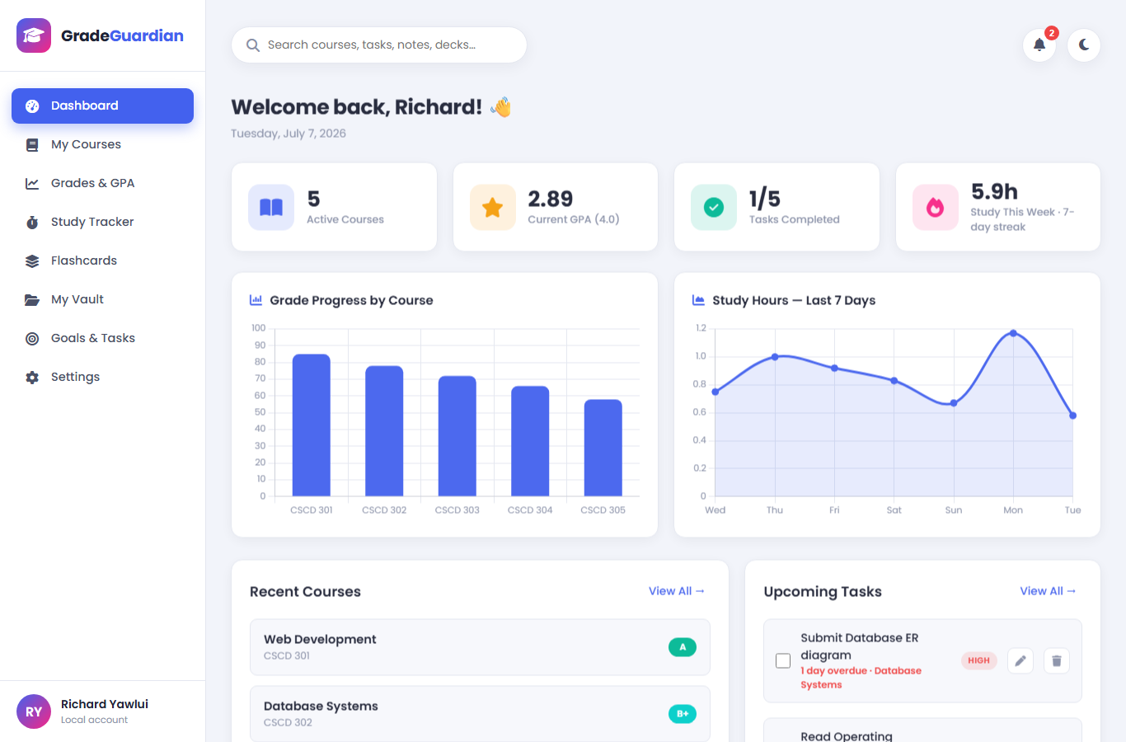
DASHBOARD
One glance — the whole academic picture
⭐
Live GPA on the 4.0 scale, recomputed on every change
🔥
Study hours this week + day streak for motivation
🔔
Overdue & due-today tasks surface automatically

Slide 7
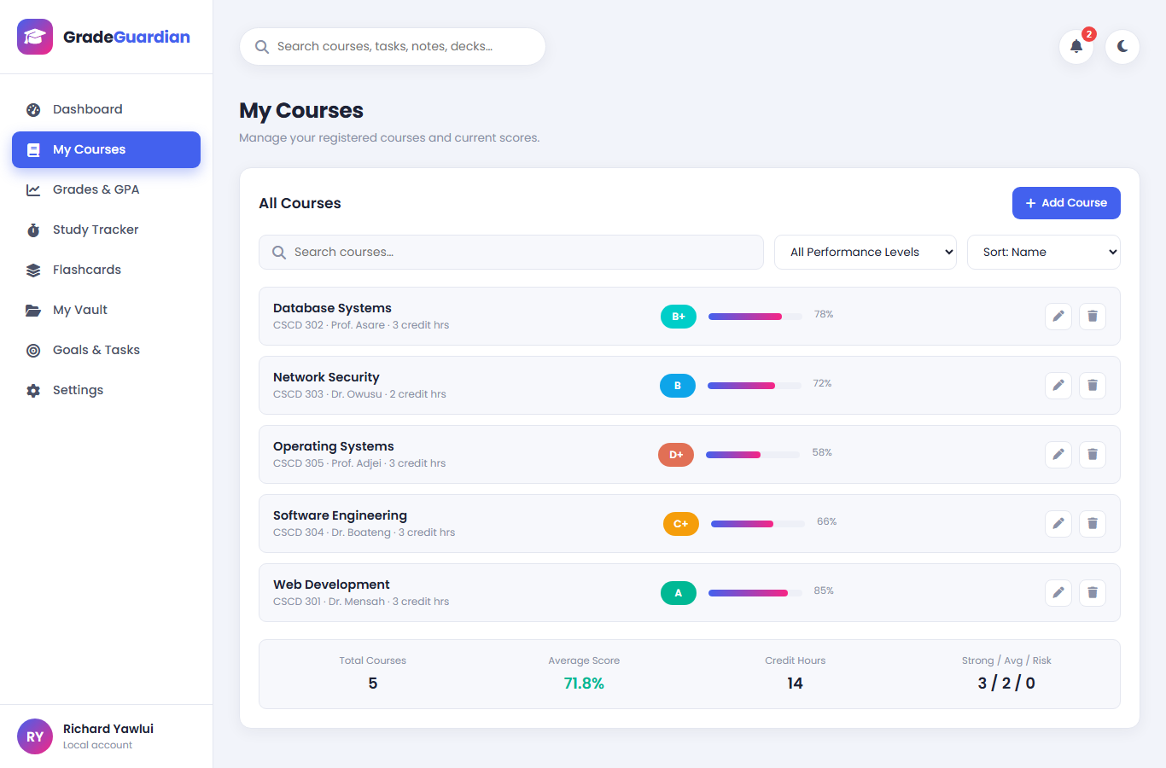
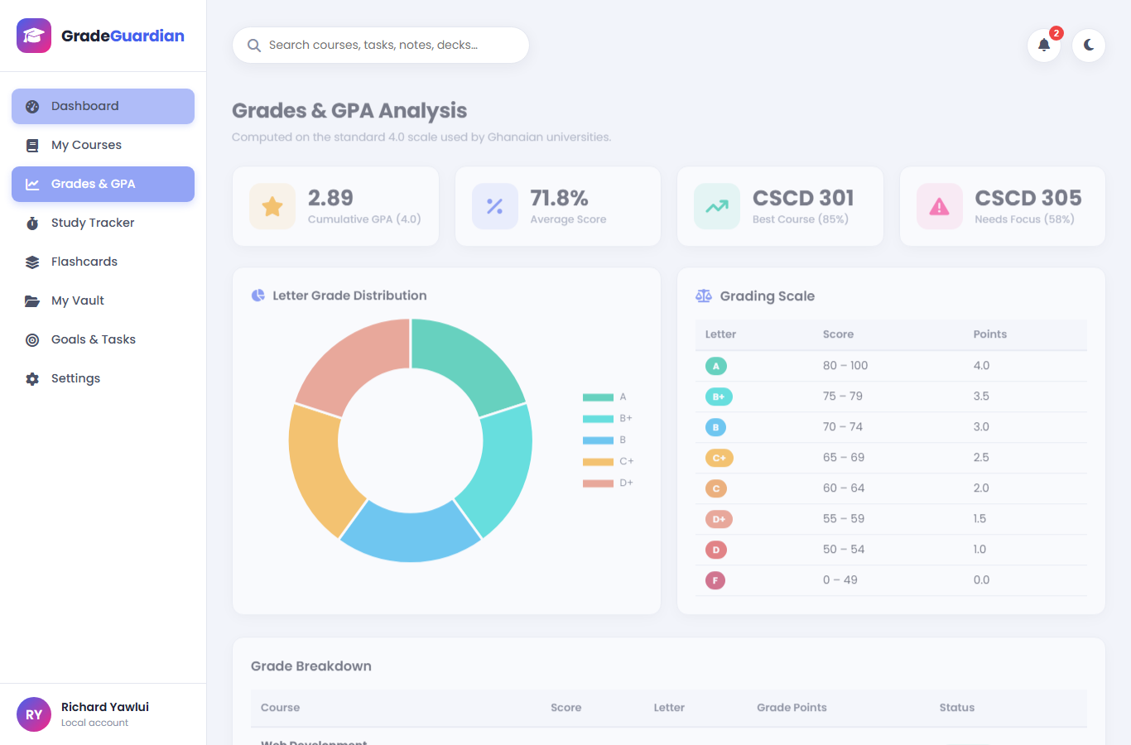
CORE MODULE
Courses & grade intelligence
Search, filter & sort with live letter-grade preview
Ghanaian 4.0 scale: one table drives letters, points & GPA
GPA = Σ(grade points × credit hours) ÷ Σ(credit hours)

Slide 8
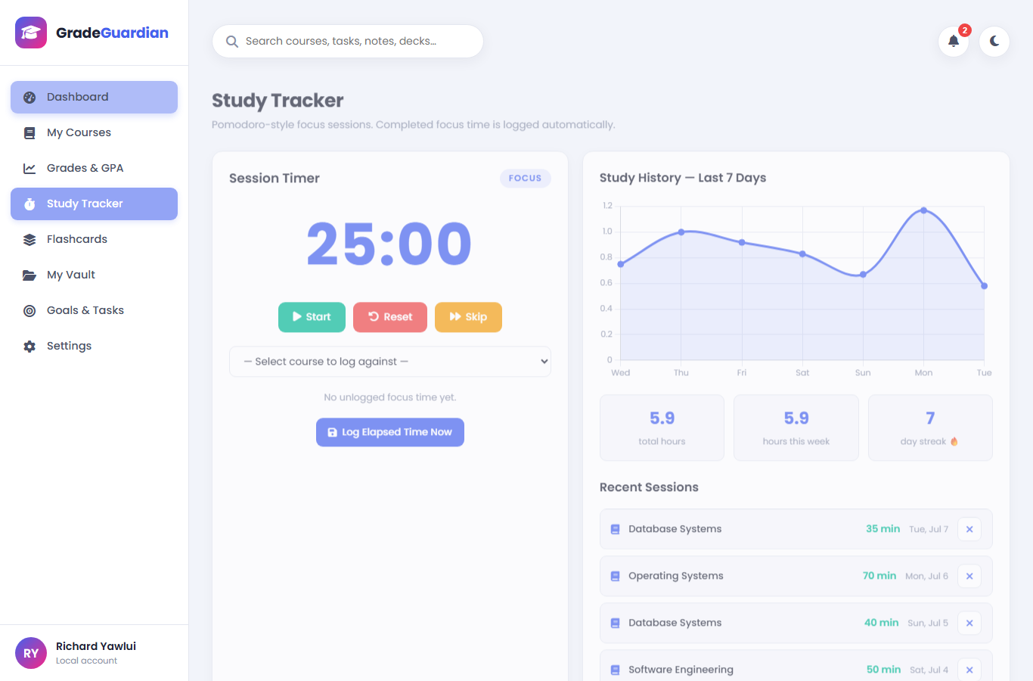
STUDY TRACKER
Study time you can trust
⏱
Drift-free timer
Uses real timestamps, so background-tab throttling can't corrupt it
✍
Honest logging
Only genuinely elapsed focus minutes can be logged — no phantom hours
🔥
Consistency
7-day chart, weekly totals and streaks make neglect visible

Slide 9
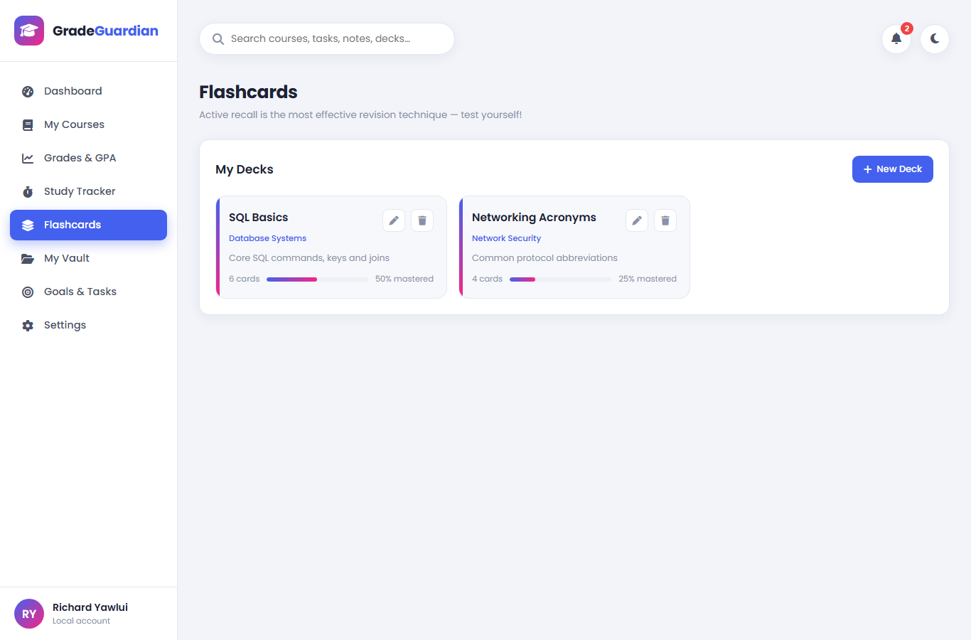
FLASHCARDS
Revision that actually works
Active recall, built in
Decks per course · 3-D flip cards · shuffled with unmastered cards first.
Mastery tracking
Answer honestly — “I knew it” twice in a row marks a card mastered; a miss resets it. Deck tiles show mastery %, giving a concrete revision target.

Slide 10
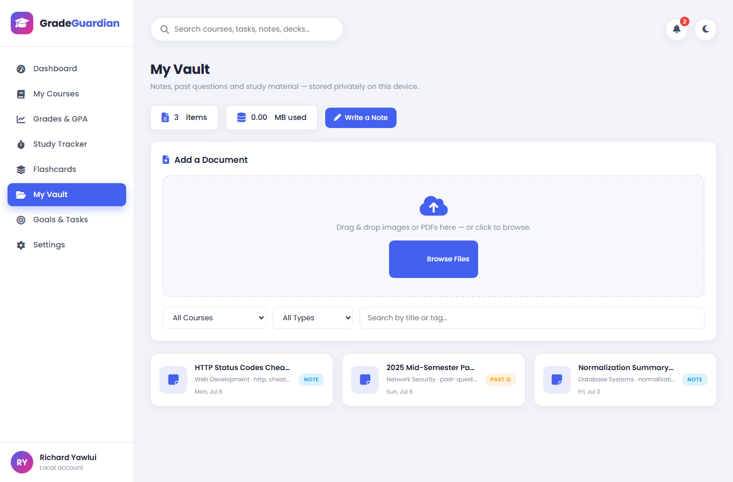
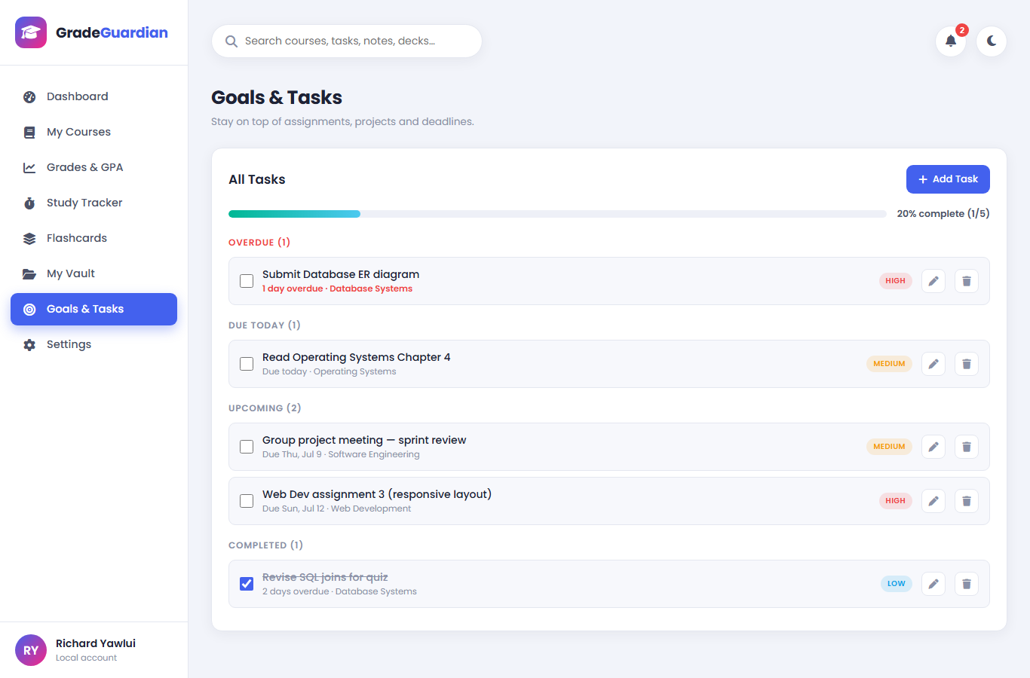
VAULT · TASKS
Everything else a semester needs
Vault — notes, images & PDF past questions stored privately in IndexedDB
Tasks — auto-grouped: Overdue · Due Today · Upcoming, with priorities

Slide 11
ENGINEERING
From prototype to product: 12 defects repaired
Version 1 (before) | Version 2 (after)
✗ Uploads required Firebase + internet | ✓ IndexedDB file store — works fully offline
✗ Logged 25 phantom minutes for 0 studied | ✓ Only real elapsed focus time can be logged
✗ B+/C+ grades rendered unstyled | ✓ Full 8-letter colour scale, valid CSS classes
✗ GPA scale contradicted letter scale | ✓ One authoritative Ghanaian 4.0 grading table
✗ Profile “Save” button did nothing | ✓ Profile saves & updates UI instantly
✗ Search & notifications were decorative | ✓ Real global search + live deadline alerts
+ hardened HTML escaping (XSS), drift-free timer, deduplicated CSS, offline avatar, dynamic semesters…

Slide 12
TESTING & RESULTS
Tested like a user, not like a demo
20 / 20
0
100%
functional test cases passed
console errors & warnings
features work with Wi-Fi off
Real user journeys exercised end-to-end: add/edit/delete courses, complete focus blocks, study decks, upload files, group tasks, export → reset → import round-trip
Edge cases covered: zero-minute logging rejected, unsupported file types rejected, invalid backups rejected
Verified responsive from 360 px to desktop; light & dark themes persist without flashes

Slide 13
FUTURE WORK
Honest limits, clear roadmap
Current limitations
Planned next
Data lives in one browser profile — clearing site data without a backup loses it
JSON backups exclude uploaded binary files
Mastery streaks, not full spaced-repetition scheduling
One aggregate score per course (no itemised assessments)
Assessment-level grades with final-grade projection
SM-2 spaced repetition with daily review queues
PWA packaging — installable, service-worker cached
Optional end-to-end-encrypted sync to the student's own drive
ZIP backups that include vault files · deadline reminders

Slide 14
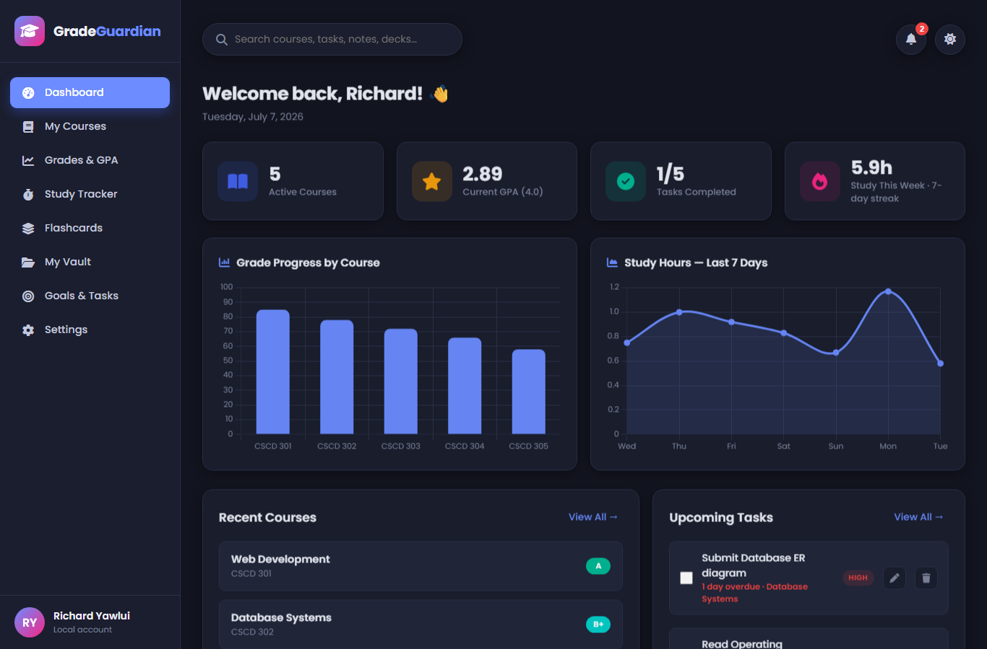
Conclusion
The browser alone is a complete application platform.
GradeGuardian pairs learning science with careful front-end engineering to give every student — regardless of connectivity or budget — one private place to see the truth about their grades, their time and their revision…
…and to act on it before it's too late.
Thank you — questions welcome
Live demo available — it even works with the Wi-Fi off.

