Slide 1
Enhanced Bioinspired Backstepping Control for a Mobile Robot With Unscented Kalman Filter
By : ZHE XU, SIMON X. YANG, AND S. ANDREW GADSDEN
A presentation by Navdeep Singh (120098024) and Hamza Shah Khan
(119483152)

Slide 2
Research gap addressed
This paper is aimed at addressing the research gap of being able to do real time tracking control of robotic systems. The required changes in position are to be tracked and performed accurately and the effect of measurement and system noise to be minimized.
The paper employs Kalman Filtering and Unscented Kalman Filtering to track the velocities outputted by the dynamic equations of the robot and the pose of the robot respectively employing a very high accuracy in state estimation.
In addition to this, it also employs a novel bio-inspired backstepping controller in addressing velocity jumps among other tracking control techniques. The control block implemented in the paper overall becomes highly robust because of these advanced techniques.

Slide 3
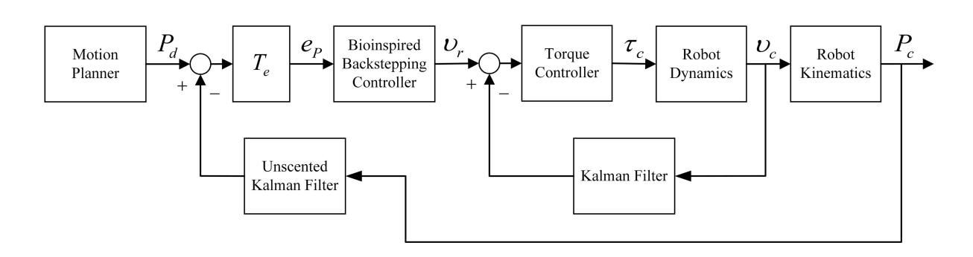
Control block

Slide 4
Continued...
Consider the control block on the previous page. It describes the proposed structure for the implementation of the proposed strategy. It is a highly robust strategy as there is a controller governing the reference velocities as well as the torque values.
There is state estimation happening at different parts of the block one for velocity values and the other for position values. The motion planner comes with the desired trajectory for the robot and the UKF block outputs the corrected value of the pose of the robot. Error between the two is computed which is converted into error in the inertial frame and the required inputs are fed into the bioinspired backstepping controller.
This is how the loop closes and the tracking completes.

Slide 5
Explanation of the Kalman Filter
The Kalman filter is a highly effective state estimation technique named after its inventor Rudolf Emil Kalman. It considers both the predicted state and the measured value and computes the corrected state by iteratively going through a set of equations to quickly narrow down to the right value.
It takes into account the amount of uncertainty around the measured value and the predicted state and creates a tradeoff between the two to calculate the Kalman gain value and to further estimate a very accurate state based on the Kalman gain value.
The Kalman gain narrows down to the right very quickly only after a small amount of iterations

Slide 6
Explanation of the Unscented Kalman Filter
The Unscented Kalman Filter is an extension of the Extended Kalman Filter and is highly effective working very accurately even for non-linear states.
The idea in this approach is to come up with sigma points around the mean of the state that represent the variance of the mean. The state transition function is applied to all of these points to get an idea of the mean and the variance of the transformed state.
The measured state also has sigma points which are transformed as well. These give an idea of the mean and the variance of the output state. This approach is highly effective for non-linear states.

Slide 7
Explanation of Bioinspired Backstepping Controller
Based on the error values in the inertial frame for the non-holonomic robot being tracked the proposed bioinspired back-stepping controller comes up with the reference linear and angular velocities to drive the robot on the right path.
Consider the conventional backstepping control law for a non-holonomic robot
υr = C1eD + υd cos eθ
ωr = ωd + C2υd eL + C3υd sin eθ
Here C1, C2 and C3 are constants and eD, eθ and eL are error values in the inertial frame.
After the application of the proposed control law the equations transform to the following :

Slide 8
Continued...
υr = υs + υd cos eθ
ωr = ωd + C2υd eL + C3υd sin eθ
where υs is from a neural dynamics equation with respect to the error in the driving direction as
dυs / dt = −A1υs + (B1 − υs)f (eD) − (D1 + υs)g(eD)
where f (eD) = max{eD, 0} is the linear above threshold function and g(eD) = max{−eD, 0} is a nonlinear function. Parameter A1 is the passive decay rate, and B1 and D1 are upper and lower bound of the velocity, respectively.
This scheme is highly effective when it comes to dealing with velocity jumps which is highly prominent in other control schemes.

Slide 9
Thoughts on the effectiveness of the proposed control block
A deep impact of the paper is because of the fact that it applies advanced control techniques and estimation techniques at the right areas of the control block. The velocity values coming out of the robot dynamics are not very non-linear so just a Kalman Filter will work and not create computational load.
The application of the Unscented Kalman Filter for estimating the pose of the robot is another good engineering choice as the pose can exhibit non-linearity. The right engineering choices make the difference.
The bioinspired controller further adds to the effectiveness of the already available torque controller overall creating a robust structure.

Slide 10
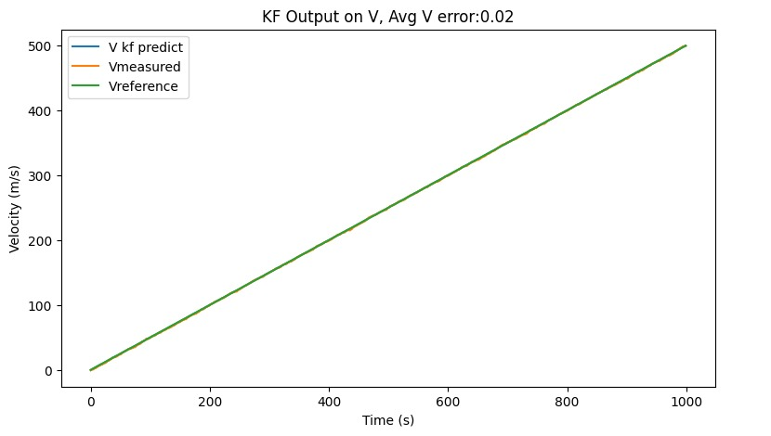
Image based results...
The following slides consist of some images describing the results of the our implementation. We implemented the whole control block in python and therefore received discrepancies in the results but overall errors were minimized.

Slide 11
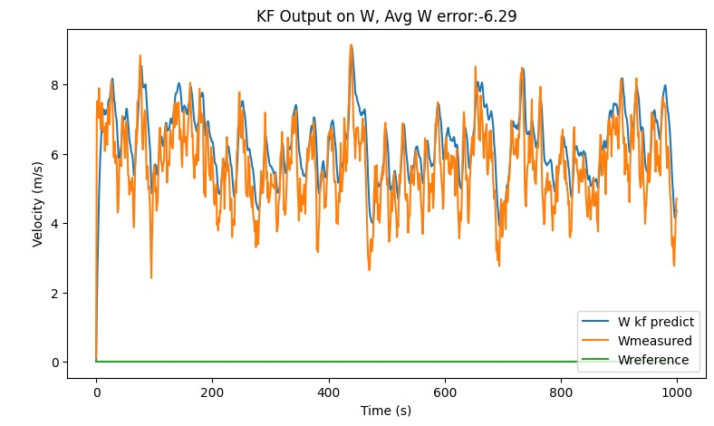
Continued...
The previous image describes the trend in velocity. The V kf predict is not distinctive as it tracks Vreference quiet closely showing good performance.

Slide 12
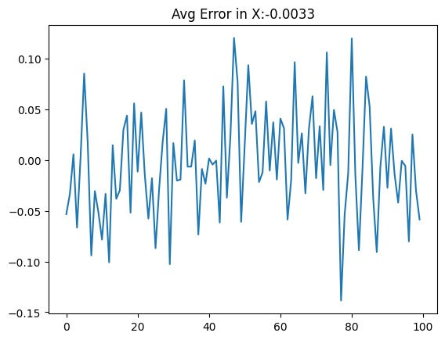
Continued...
The W kf predict in the previous slide is slightly away from Wreference and oscillates but the average error is quiet low.
Consider another image.

Slide 13
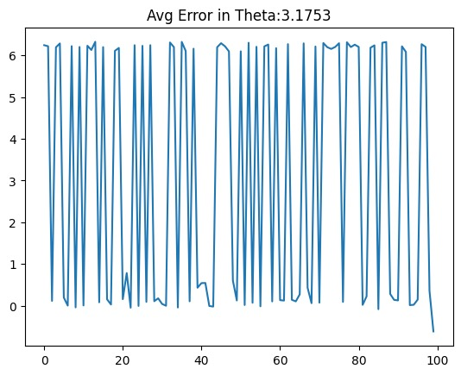
Continued...
The last image consisted of the average in the computed x values and their difference from the original x values of the pose.

Slide 14
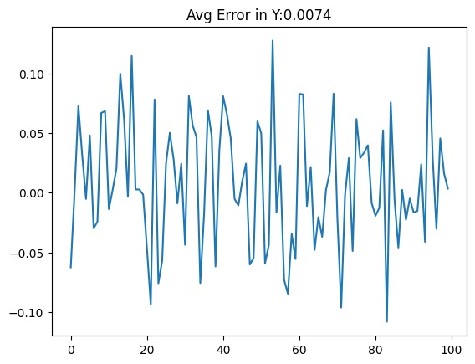
Continued...

Slide 15
Continued...
The last two images describe average in the computed theta values and their difference from the original theta values of the pose and the computed y values and the original y values of the pose respectively.

Slide 16
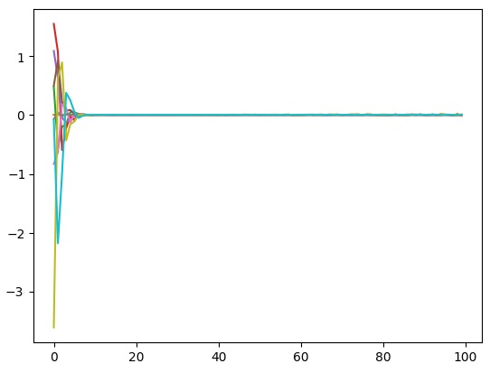
Continued...

Slide 17
Continued...
The last image describes the how in our implementation the bioinspired backstepping control, the UKF and KF worked together to minimize the error.
Link to video: https://drive.google.com/file/d/1rMpKJzSQ8kK3MNlybyrhZYb2BKH5-y3o/view?usp=sharing
End

