Slide 1
IMPLEMENTING A SPELLCHECKER
Rea Ballkoci & Jan Hric

Slide 2
Contents
Problem formulation
Levenshtein distance
PAM algorithm
Implementation
Conclusions

Slide 3
Problem formulation
A spellchecker has two main functionalities:
Check if a given word is misspelled
Suggest possible candidates to replace it
If we naively implement an algorithm to go through all the words in a dictionary, it would be very much time consuming.
How can we lower the computational complexity?
PAM algorithm

Slide 4
Levenshtein distance
It is a distance metric:
Non-negativity: d(x,y) ≥ 0
Identity: d(x,y) = 0 → x = y
Symmetry: d(x,y) = d(y,x)
Triangle inequality: d(x,y) ≤ d(x,z) + d(z,y)
Serves as a measure of similarity between two strings.
Shows the cost of the least expensive set of operations to transform a string into another:
Deletions
Insertions
Substitutions

Slide 5
Simple example
Let us have a source string s ”ARBEN” which we want to transform into target string t ”ROBIN”
A R B E N
R O B I N
Deletion

Slide 6
Simple example
Let us have a source string s ”ARBEN” which we want to transform into target string t ”ROBIN”
R O B E N
R O B I N
Insertion

Slide 7
Simple example
Let us have a source string s ”ARBEN” which we want to transform into target string t ”ROBIN”
R O B I N
R O B I N
Substitution

Slide 8
Simple example
Let us have a source string s ”ARBEN” which we want to transform into target string t ”ROBIN”
Levenshtein distance is 3 (The cost of the transformation is 3)
Could there be any other way to transform it?
ARBEN → ROBEN → ROBIEN → ROBIEN → ROBIN (cost = 4)

Slide 9
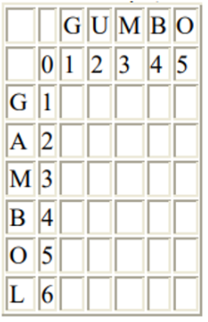
Levenshtein distance algorithm
Step 1: Initialization
Set n to be the length of s, set m to be the length of t
Construct a matrix containing 0..m rows and 0..n columns
Initialize the first row to 0..m
Initialize the first column to 0..n

Slide 10
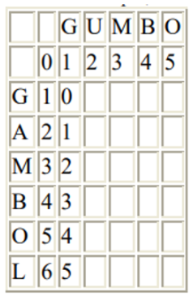
Levenshtein distance algorithm
Step 2: Processing
Examine s (i from 1 to n).
Examine t (j from 1 to m).
If s[i] equals t[j], the cost is 0.
If s[i] doesn’t equal t[j], the cost is 1.
Set cell d[i,j] of the matrix equal to the minimum of:
The cell immediately above plus 1: d[i-1,j]+ 1.
The cell immediately to the left plus 1: d[i,j-1]+ 1.
The cell diagonally above and to the left plus the cost: d[i-1,j-1]+ cost

Slide 11
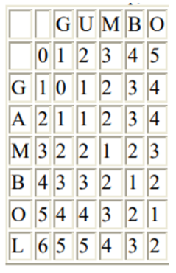
Levenshtein distance algorithm
Step 3: Result
Step two is repeated till the d[n,m] value is found.

Slide 12
Partition around medoids (PAM)
Implementation of k medoids.
Groups the dataset into k clusters with the medoid as representative.
The medoid is the value which has the closest distance with all the other members in the cluster.
It is less senstive to outliers compared to k means.

Slide 13
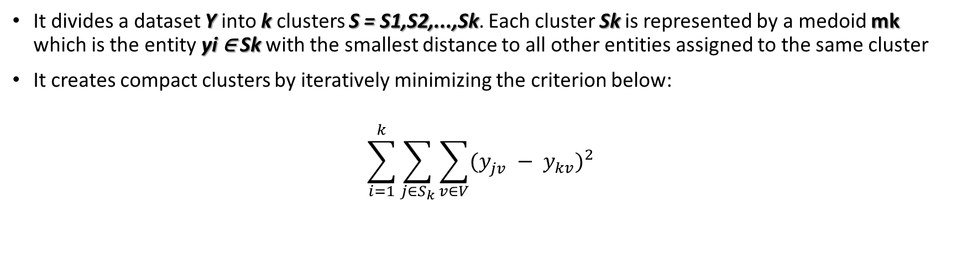
Partition around medoids (PAM)
It divides a dataset Y into k clusters S = S1,S2,...,Sk. Each cluster Sk is represented by a medoid mk which is the entity yi ∈ Sk with the smallest distance to all other entities assigned to the same cluster
It creates compact clusters by iteratively minimizing the criterion below:
$$\sum_{i=1}^{k}{\sum_{j∈S_{k}}{\sum_{v∈V}{{(y_{jv}^{} − y_{kv}^{})}^{2}}}}$$

Slide 14
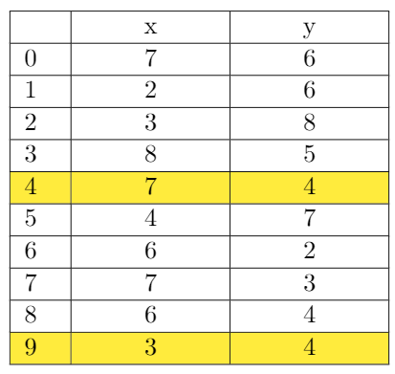
PAM algorithm
BUILD:
Select k objects to become the medoids
Calculate the dissimilarity matrix
Assign every object to its closest medoid
C2
C1

Slide 15
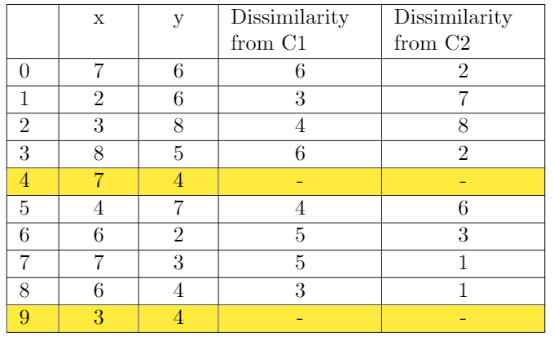
PAM algorithm
Manhattan distance
The points 1, 2, 5 go to cluster C1.
The points 0, 3, 6, 7, 8 go to cluster C2.
C= (3 + 4 + 4) + (2 + 2 + 3 + 1 + 1) =20
C2
C1

Slide 16
PAM algorithm
SWAP:
For each cluster search if any of the object of the cluster decreases the average dissimilarity coefficient. If it does, select the entity that decreases this coefficient the most as the medoid for this cluster
If at least one medoid has changed go to (3), else end the algorithm

Slide 17
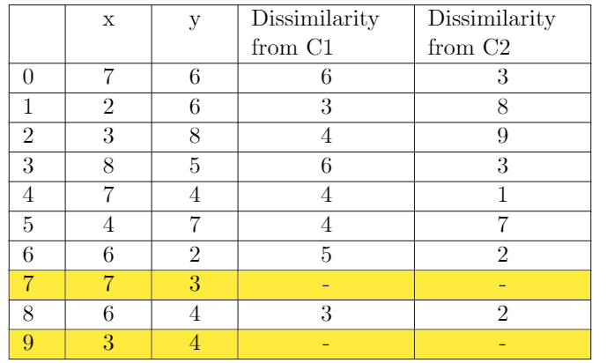
PAM algorithm
The points 1, 2, 5 go to cluster C1
The points 0, 3, 6, 7, 8 go to cluster C2
C= (3 + 4 + 4) + (2 + 2 + 1 + 3 + 3) = 22
Since the cost is bigger, the first set of medoids was a better choice.
C2
C1

Slide 18
Implementation
Algorithm:
Create clusters of words using k-means clustering algorithm
Take clusters with the shortest levenstein distance to the input word
Find all the words in the subset of clusters with the levenstein distance to the input word equal to 0 or 1
Add the most frequently used words with levenstein distance equal to 2

Slide 19
Implementation
The k-means clustering was performed on only 10,00 most frequently used words out of a total of 32,198 to reduce computational complexity
Distance matrix has to be calculated first, complexity O(n²); our distance matrix had 10⁸ elemets
The spellchecker was implemented in Python, Levenstein distance and k-means clusters were computed using python libraries

Slide 20
Conclusions
Levenshtein distance is a distance metric used to compare string. It is mostly used in spellcheckers for its sensitivity.
PAM algorithms is a k medoids method that divides the dataset into k clusters and is less sensitive to outliers than other methods.
Clustering the words into groups lowers the computational complexity as you have to calculate the distance with fewer representatives strings.

Slide 21
Questions?

