Slide 1
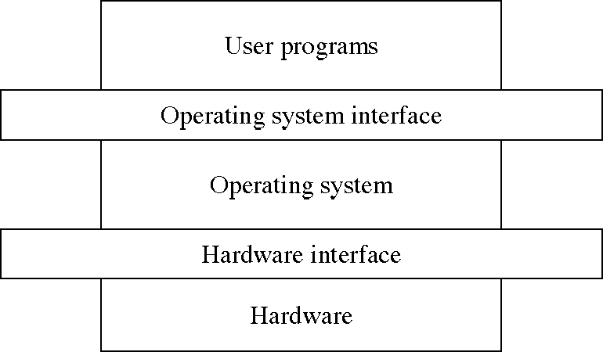
(To be studied)

Slide 2
Process Scheduling
Basic Concepts
Scheduling Criteria
Scheduling Algorithms
Real-Time Scheduling
Algorithm Evaluation
Process Scheduling Models

Slide 3

Scheduling

Slide 4
Basic Concepts
CPU scheduling is the basis of multi-programmed OS.
In the uni-processor system only one process runs at a time. Other processes must wait until CPU is free and can be rescheduled.
Idea: the process is executed until it must wait for completion of I/O request.
When one process has to wait, OS takes CPU away from that process and gives the CPU to another process.
All the computer resources are schedules before use.
Maximum CPU utilization obtained with multiprogramming
CPU–I/O Burst Cycle – Process execution consists of a cycle of CPU execution and I/O wait.
CPU burst distribution

Slide 5

Observed property
Process execution consists of a cycle of execution and I/O wait.
CPU–I/O Burst Cycle – Process execution consists of a cycle of CPU execution and I/O wait.
Process execution starts with CPU-burst. That is followed by I/O burst.
The execution ends with CPU burst.
CPU burst distribution

Slide 6

Histogram of CPU-burst Times
Many short CPU bursts and a few long CPU bursts.

Slide 7
CPU and I/O bound processes
An I/O bound program would have many short CPU bursts.
A CPU bound program would have long CPU bursts.

Slide 8
CPU Scheduler
Selects from among the processes in memory that are ready to execute, and allocates the CPU to one of them.
Short-term scheduler
CPU scheduling decisions may take place when a process:
  1. Switches from running to waiting state (due to I/O).
  Switches from running to ready state (due to interrupt)
  3. Switches from waiting to ready. (Completion of I/O)
  4. Terminates.
Scheduling under 1 and 4 is non-preemptive.
  Once a CPU has been allocated to a process, the process keeps the CPU until it releases the CPU either by terminating or by switching to the waiting state.
    WINDOWS 3.1 and MAC
All other scheduling is preemptive.
  The process can be preempted and another process can be run.
    UNIX
    Difficult to implement.
    (Refer the book for the issues)

Slide 9
Designing Preemptive Scheduling based OS is difficult
It incurs cost to access shared data
Affects the design of OS
  Interrupts occcur at arbitrary time, changing of data modified by kernel
Section of code modified by interrupts should be guarded
But, all modern OSs are preemptive scheduling due to performance advantages as compared to non- preemtive scheduling

Slide 10
Dispatcher
Dispatcher module gives control of the CPU to the process selected by the short-term scheduler; this involves:
  switching context
  switching to user mode
  jumping to the proper location in the user program to restart that program
Dispatch latency – time it takes for the dispatcher to stop one process and start another running.

Slide 11
Scheduling Criteria
Scheduling algorithm favors one process to another.
User oriented criteria
  Turnaround time – amount of time to execute a particular process
    The interval from the time of submission of a process to the time of completion.
    The sum of periods spent in waiting to get into memory, waiting in the ready queue, executing on CPU and doing I/O
  Response time – amount of time it takes from when a request was submitted until the first response is produced, not FINAL/LAST OUTPUT (for time-sharing environment)
  Deadlines: When the process completion deadlines can be specified, the scheduling discipline should subordinate their goals to that of maximizing the percentage of deadlines met.

Slide 12
Scheduling Criteria
System oriented
  Throughput – # of processes that complete their execution per time unit
  CPU utilization – keep the CPU as busy as possible; percentage of time the processor is busy.
    It may range from 0 to 100 percent.
    In a real system, it should range from 40 percent (lightly loaded) to 90 percent (heavily loaded)
  Waiting time: It is the sum of the periods spent waiting in the ready queue.
System oriented: other
  Fairness: In the absence of guidance from user or other system supplied guidance, processes should be treated the same, and no process should suffer starvation.
  Enforcing priorities: When processes are assigned priorities, the scheduling policy should favor higher priority processes.
  Balancing resources: The scheduling policy should keep the resources of the system busy. Processes that underutilize the stressed resources should be favored which involves long term scheduling.

Slide 13
Optimization Criteria
Maximize
  CPU utilization
  Throughput
Minimize
  turnaround time
  waiting time
  response time
    (Some suggest variance of response time)
  Power consumption (Mobile)

Slide 14
Scheduling Algorithms
FIFO
SJF
Priority
Round Robin
Multilevel
Multilevel feedback

Slide 15
First-Come, First-Served (FCFS) Scheduling
The process that requests CPU first is allocated the CPU first.
Process Burst Time
P₁ 24
P₂ 3
P₃ 3
Suppose that the processes arrive in the order: P₁ , P₂ , P₃
The Gantt Chart for the schedule is:
Waiting time for P₁ = 0; P₂ = 24; P₃ = 27
Average waiting time: (0 + 24 + 27)/3 = 17
P₁
P₂
P₃
0
24
27
30

Slide 16
FCFS Scheduling (Cont.)
Suppose that the processes arrive in the order
P₂ , P₃ , P₁ .
The Gantt chart for the schedule is:
Waiting time for P₁ = 6; P₂ = 0; P₃ = 3
Average waiting time: (6 + 0 + 3)/3 = 3
Much better than previous case.
Dynamic environment
  Convoy effect: short process behind long process
P₂
P₃
P₁
0
3
6
30

Slide 17
FCFS Scheduling (Cont.)
Scenarios
  One CPU bound process and many I/O bound process
  CPU bund process will hold the CPU for a long time
  All I/O processes are in ready queue
    The I/O devices are idle
  This is a convoy effect
    Several processes wait for one big process.
FCFS algorithm is non-preemptive
Positive Points
  code is simple to write and understand
Negative points
  It is not good for timesharing systems
  Average waiting time may be too long.
  Convoy effect results in lower CPU and device utilization.
  Penalizes short processes; penalizes I/O bound processes
  Response time may be high, especially there is a large variance in process execution times.

Slide 18
Shortest-Job-First (SJF) Scheduling
When CPU is available it is assigned to the process that has the smallest next CPU burst.
If the bursts are equal, FCFS is used to break the tie.
Associate with each process the length of its next CPU burst. Use these lengths to schedule the process with the shortest time.
Two schemes:
  Non-preemptive – once CPU is given to the process it cannot be preempted until it completes its CPU burst.
  Preemptive – if a new process arrives with CPU burst length less than remaining time of current executing process, preempt. This scheme is know as Shortest-Remaining-Time-First (SRTF).
SJF is optimal – gives minimum average waiting time for a given set of processes.

Slide 19
Example of Non-Preemptive SJF
Process Arrival Time Burst Time
P₁ 0.0 7
P₂ 2.0 4
P₃ 4.0 1
P₄ 5.0 4
SJF (non-preemptive)
Average waiting time = (0 + 6 + 3 + 7)/4 = 4
P₁
P₃
P₂
P₄
0
3
7
8
12
16

Slide 20
Example of Preemptive SJF
Process Arrival Time Burst Time
P₁ 0.0 7
P₂ 2.0 4
P₃ 4.0 1
P₄ 5.0 4
SJF (preemptive)
Average waiting time = (9 + 1 + 0 +2)/4 = 3
P₁
P₂
P₃
P₂
P₄
P₁
0
2
4
5
7
11
16

Slide 21
Determining Length of Next CPU Burst
Difficulty: Knowing the next CPU burst of each process.
Solution: approximation.
Simplest approximation: running average of each “burst” for each process.
  τ_{n+1}=1/n ∑t_{i} (i=1 to n)
  Where, t_{i} processor execution time for the i’th instance of this process (processor execution time for batch job, processor burst time for interactive job)
  τ_{i}; predicted value for the ith instance
  τ1;predicted value for the first instance (not calculated)
To avoid recalculating the entire summation each time we can rewrite τ_{n+1} =1/n t_{n} + (n-1)/n τ_{n}
The above formula gives equal weight to each instance
Normally most recent references likely reflect future behavior
Common technique is exponential averaging.

Slide 22
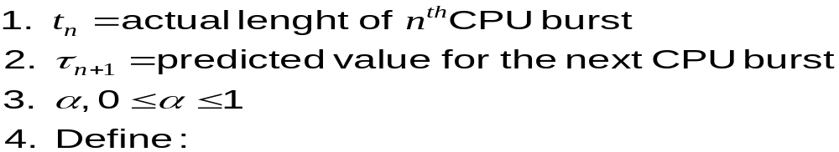
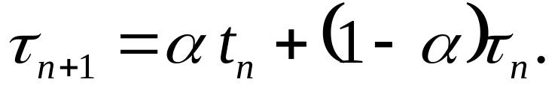
Exponential averaging

Slide 23

Prediction of the Length of the Next CPU Burst

Slide 24
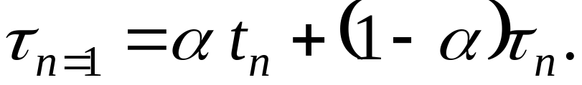
Examples of Exponential Averaging
α =0
  τ_{n+1} = τ_{n} ; Recent history does not count.
  If α → 0; greater weight is given to past values.
  If α → 1; greater weight is given to recent values.
α =1
  τ_{n+1} = t_{n}
  Only the actual last CPU burst counts.
If we expand the formula, we get:
    τ_{n+1} = α t_{n}+(1 - α) α t_{n} ₋₁ + …
    +(1 - α )^{j} α t_{n} _{-i} + …
    +(1 - α )^{n+1} τ₀
Since both α and (1 - α) are less than or equal to 1, each successive term has less weight than its predecessor.
If α =0.8, then τ_{n+1} = 0.8 t_{n}+0.16 t_{n} ₋₁ + 0.032 t_{n} ₋₂ + …

Slide 25
Priority Scheduling
A priority number (integer) is associated with each process
The CPU is allocated to the process with the highest priority (smallest integer ≡ highest priority).
Equal priority process is scheduled in FCFS order.
SJF is a priority scheduling where priority is the predicted next CPU burst time.

Slide 26
Example: Priority scheduling
Process Burst time Priority
P₁ 10 3
P₂ 1 1
P₃ 2 3
P₄ 1 4
P₅ 5 2
Priority
Average waiting time = 8.2 msec
P2
P5
P1
P3
P4
0
1
6
16
18
19

Slide 27
Priority scheduling…
Priority scheduling can be either preemptive or non-preemptive.
A preemptive priority scheduling algorithm will preempt the CPU if the priority of the newly arrived process is higher than the priority of the currently running process.
A non-preemptive priority scheduling algorithm will simply put the new process at the head of the ready queue.

Slide 28
Priority scheduling: Problem
Problem ≡ Starvation – low priority processes may never execute.
In an heavily loaded system, a stream of high priority processes can prevent low priority process from ever getting the CPU.
Solution ≡ Aging – as time progresses increase the priority of the process.
  Ex: if priorities range from 0 (low)-127 (high), every 15 minutes we can increment the priority of the waiting process.

Slide 29
Round Robin (RR)
Each process gets a small unit of CPU time (time quantum), usually 10-100 milliseconds. After this time has elapsed, the process is preempted and added to the end of the ready queue.
The ready queue is treated as a circular queue.
  If the CPU burst is less than 1 time quantum, the process leaves the system.
  If the CPU burst is greater than the time quantum, interrupt occurs and context switch will be executed.
If there are n processes in the ready queue and the time quantum is q, then each process gets 1/n of the CPU time in chunks of at most q time units at once. No process waits more than (n-1)q time units.

Slide 30
Example of RR with Time Quantum = 20
Process Burst Time
P₁ 53
P₂ 17
P₃ 68
P₄ 24
The Gantt chart is:
Typically, higher average turnaround than SJF, but better response.
P₁
P₂
P₃
P₄
P₁
P₃
P₄
P₁
P₃
P₃
0
20
37
57
77
97
117
121
134
154
162

Slide 31

Round Robin Performance
Performance depends on the size of the time quantum.
If the time quantum is large, RR policy is the same as the FCFS policy.
If the time quantum is too small, there will be more number of context switches.

Slide 32

RR performance..
If the context switch time is 10 % of time quantum, then 10 % of CPU time will be spent on the context switch.
However, if we increase the time quantum the average turnaround time may not be improved.
In general the average turnaround time will be improved if process finishes next CPU burst within single time quantum.
Performance Summary:
  q large ⇒ FIFO
  q small ⇒ more number of context switches.
  q must be large with respect to context switch, otherwise overhead is too high.
Rule of thumb: 80 % of the CPU bursts should be shorter than the time quantum.

Slide 33
Multilevel Queue
Ready queue is partitioned into several separate queues:
Example: foreground (interactive); background (batch)
  Foreground processes may have priority over background processes.
Each queue has its own scheduling algorithm,
foreground – RR
background – FCFS
Scheduling must be done between the queues.
  Fixed priority scheduling; (i.e., serve all from foreground then from background). Possibility of starvation.
  Time slice – each queue gets a certain amount of CPU time which it can schedule amongst its processes; i.e., 80% to foreground in RR
  20% to background in FCFS

Slide 34

Multilevel Queue Scheduling

Slide 35
Multilevel Queue
Each queue has absolute priority over lower-priority queues.
  No process in the batch queue can run unless the above queues are empty.
  If the interactive process enters while the batch process is running, the batch process would be preempted.
  Solaris 2 uses a form of this algorithm.
Another policy is time slice:
  Each queue gets certain portion of CPU time.
    The foreground queue may receive 80% of CPU time, and background queue receives 20% of CPU time.
Aging: A process can move between the various queues; aging can be implemented this way.

Slide 36
Multilevel Feedback Queue Scheduling
Process moving is allowed
The basic idea is to separate processes with different CPU-burst characteristics.
  If a process uses too much CPU time, it will be demoted to lower priority queue.
  If a process waits too long, it will be promoted to higher priority queue.
    Aging prevents starvation

Slide 37

Example of Multilevel Feedback Queue
Three queues:
  Q₀ – time quantum 8 milliseconds
  Q₁ – time quantum 16 milliseconds
  Q₂ – FCFS
Scheduling
  A new job enters queue Q₀ which is served FCFS. When it gains CPU, job receives 8 milliseconds. If it does not finish in 8 milliseconds, job is moved to queue Q₁.
  At Q₁ job is again served FCFS and receives 16 additional milliseconds. If it still does not complete, it is preempted and moved to queue Q₂.
The process that arrives in Q₀ will preempt a process in Q_{2.}
Highest priority is given to the process of having 8 msec CPU burst.

Slide 38
Multilevel Feedback Queue Scheduling
Multilevel-feedback-queue scheduler defined by the following parameters:
  number of queues
  scheduling algorithms for each queue
  method used to determine when to upgrade a process
  method used to determine when to demote a process
  method used to determine which queue a process will enter when that process needs service
Multi-level is a general scheduling algorithm
It can be configured to match a specific system under design.
  It requires some means of selecting the values for all the parameters.

Slide 39
Thread Scheduling
Distinction between user-level and kernel-level threads
When threads supported, threads scheduled, not processes
Many-to-one and many-to-many models, thread library schedules user-level threads to run on LWP
  Known as process-contention scope (PCS) since scheduling competition is within the process
  Typically done via priority set by programmer
Kernel thread scheduled onto available CPU is system-contention scope (SCS) – competition among all threads in system

Slide 40
Pthread Scheduling
API allows specifying either PCS or SCS during thread creation
  PTHREAD_SCOPE_PROCESS schedules threads using PCS scheduling
  PTHREAD_SCOPE_SYSTEM schedules threads using SCS scheduling
Can be limited by OS – Linux and Mac OS X only allow PTHREAD_SCOPE_SYSTEM

Slide 41
Multiple-Processor Scheduling
CPU scheduling more complex when multiple CPUs are available
Homogeneous processors within a multiprocessor
  The processors are identical
Asymmetric multiprocessing – only one processor accesses the system data structures, alleviating the need for data sharing
    Master server,
    simple to implement
Symmetric multiprocessing (SMP) – each processor is self-scheduling, all processes in common ready queue, or each has its own private queue of ready processes
  Currently, most common

Slide 42
Multiple-Processor Scheduling: Issues
Processor affinity – process has affinity for processor on which it is currently running
  soft affinity: Efforts will be made to run the process on the same CPU, but not guaranteed.
  hard affinity: Process do not migrate among the processors.
  Variations including processor sets
    Processor set is assigned to a process. It can run on any processor.

Slide 43
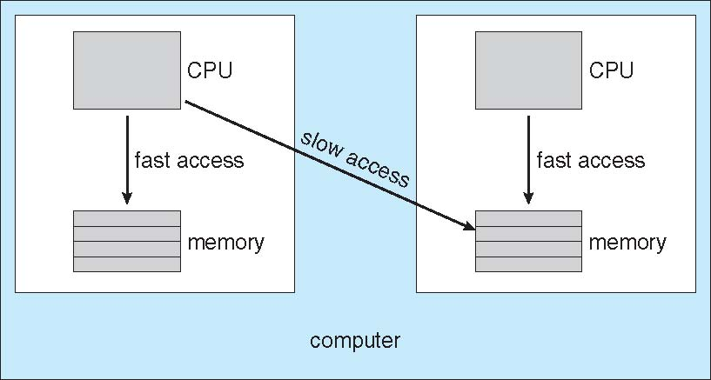
NUMA and CPU Scheduling
NUMA: Non-Uniform Memory Access : CPU has faster access to some parts of main memory than to other parts. It occurs in the systems with combined CPU and memory boards.
Note that memory-placement algorithms can also consider affinity

Slide 44
Multiprocessor Scheduling: Load Balancing
Load balancing attempts to keep the workload evenly distributed across all the processors in an SMP system.
Push migration and pull migration
  Push migration
    A specific process periodically checks the load on each processor and evenly distributes the processes.
  Pull migration
    Idle processor pulls a waiting task from a busy processor.

Slide 45
Multiprocessor Scheduling: Load Balancing
Load balancing attempts to keep the workload evenly distributed across all the processors in an SMP system.
Push migration and pull migration
  Push migration
    A specific process periodically checks the load on each processor and evenly distributes the processes.
  Pull migration
    Idle processor pulls a waiting task from a busy processor.

Slide 46
Multiprocessor Scheduling: Load Balancing
Load balancing attempts to keep the workload evenly distributed across all the processors in an SMP system.
Push migration and pull migration
  Push migration
    A specific process periodically checks the load on each processor and evenly distributes the processes.
  Pull migration
    Idle processor pulls a waiting task from a busy processor.

Slide 47
Multicore Processors
Recent trend is to place multiple processor cores on same physical chip
Faster and consumes less power
Multiple threads per core also growing
  Memory stall: When a processor accesses main memory, it spends significant amount of time in waiting.
  Takes advantage of memory stall to make progress on another thread while memory retrieve happens

Slide 48


Multithreaded Multicore System
Two threads are associated with one core
One core may have many logical processors
A dual core may have four logical processors

Slide 49
Out-of-order execution
out-of-order execution (or more formally dynamic execution) is a paradigm used in most high-performance central processing units to make use of instruction cycles that would otherwise be wasted.
In this paradigm, a processor executes instructions in an order governed by the availability of input data and execution units, rather than by their original order in a program.
In doing so, the processor can avoid being idle while waiting for the preceding instruction to complete and can, in the meantime, process the next instructions that are able to run immediately and independently.
Reference: https://en.wikipedia.org/wiki/Out-of-order_execution

Slide 50
Virtualization and Scheduling
Virtualization software schedules multiple guests onto CPU(s)
Each guest doing its own scheduling
  Not knowing it doesn’t own the CPUs
  Can result in poor response time
  Can effect time-of-day clocks in guests
Can undo good scheduling algorithm efforts of guests

Slide 51
Algorithm Evaluation
How to select CPU scheduling algorithm ?
First problem is selection off criteria
  CPU utilization, response time, or throughput
To select an algorithm we have to select relative importance of these measures.
  Maximize CPU utilization under the constraint that maximum response time is one second.
  Maximize throughput such that turnaround time is linearly proportional to total execution time.
After selecting the criteria various algorithms have to be evaluated.
The following methods are followed for evaluation
  Analytical modeling
    Deterministic modeling
    Queuing models
  Simulation
  Implementation

Slide 52
Analytical modeling
Analytic evaluation uses the given algorithm and the system workload to produce a formula or number that evaluates the performance of the algorithm for that workload.
One type of analytic evaluation is deterministic modeling.
  It takes a predetermined workload and defines the performance of each algorithm for that workload.
  + point: Fast
  - point: specific to the load
Queuing models (Reference: https://en.wikipedia.org/wiki/Queueing_theory)
  No predetermined workload which is very difficult to get.
  However, distributions of CPU and I/O busts can be approximated.
  Result is a probability of next CPU burst.
  Variation of every variable is approximated to one distribution.
  This area of study is called queuing network analysis.
  Little’s law: n=λ*W, where n= number of processes in the queue, λ is arrival rate, and w is average waiting time. (When a system is in steady state).
+ve points: no cost; pencil and paper
-ve points: too complex equations; only approximation to real system

Slide 53
Simulation
For accurate evaluation, simulation can be used.
Involve programming model of the computer system.
Software data structures represent the major data structures of the system.
There is a simulation clock which is a variable.
Whenever clock is changes, system state is modified
  Activities of the devices, the processes, and the scheduler.
Random number generator can be used to generate data sets by following appropriate distributions.
  Processes
  CPU-burst times
  Arrivals
  Departures
Trace can be used which is created by monitoring the real system.
This area of study is called simulation.

Slide 54

Evaluation of CPU Schedulers by Simulation

Slide 55
Implementation
Simulation is also of limited accuracy.
Correct way is code the algorithm and run in an OS.
(-ve) Cost of this approach
(-ve) reaction of users due to constant change
In reality all the three methods are used.
  Analytical
  Simulation
  Implementation

Slide 56
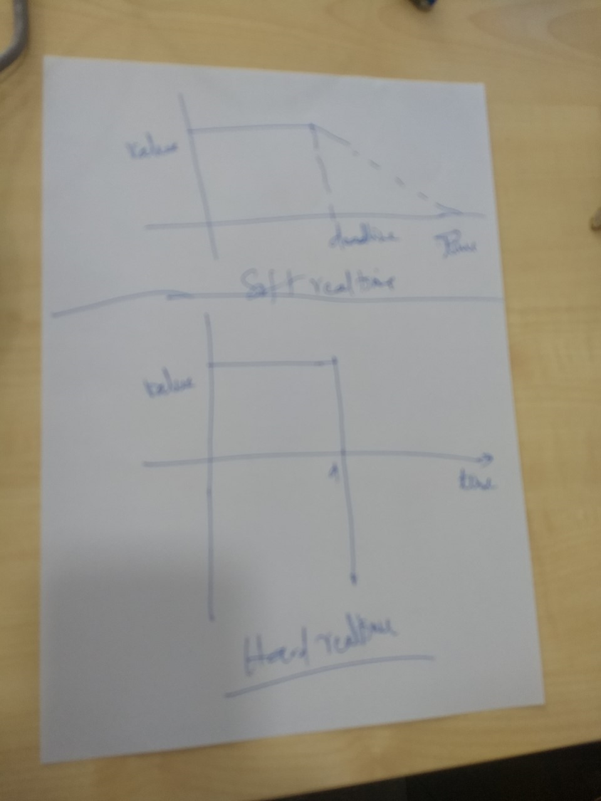

Slide 57
Real-Time Scheduling
Hard real-time systems – required to complete a critical task within a guaranteed amount of time.
Soft real-time computing – requires that critical processes receive priority over less fortunate ones.

Slide 58
Hard real-time systems
Process is submitted along with a statement of amount of time in which it needs to complete or I/O.
The scheduler may admit the process or reject the process as impossible.
The main concept is resource reservation.
  The scheduler must know exactly how long each OS function takes to perform.
It is difficult to realize this guarantee on general purpose OSs.
Therefore , hard real-time systems are composed of special purpose software running on hardware dedicated to their critical process.

Slide 59
Soft real-time systems
Computing is less restrictive.
Requires that critical process should receive priority over lesser priority processes.
Adding soft real-time functionality may cause problems
  Unfair allocation of resources may result in longer delays or even starvation for some processes.
A soft real-time system is nothing but a general purpose OS that can also support multimedia, high-speed interactive graphics and so on.
  Multimedia and high-speed interactive graphics would not work acceptably in an environment that does not support soft real-time computing.

Slide 60
Soft real-time systems…
Implementation requires careful design of the scheduler and other related aspects.
System must have priority scheduling.
Real time processes must receive highest priority and priority should not degrade over time.
  Aging is disallowed
Dispatch latency must be small.
  Which is very difficult as some system calls are complex.
  For example, many OSs are forced to wait for a system call to complete to execute context switch.
  So to keep dispatch latency low, insertion of preemption points in system call code is one solution.
  At preemption point, the process checks whether any high priority process is waiting.
  Another method is to make entire kernel pre-emptable.

Slide 61
Soft real-time systems…
If higher priority process needs to read or modify kernel data which is currently accessed by lower priority process, then higher priority process would be waiting for a lower priority process to finish.
This problem can be solved with priority-inheritance protocol
  All the process which are sharing a resource with high priority processes inherit the high priority until they are done with that resource.
  After finishing, priority reverts to original value.
So the conflict phase of dispatch latency has two components
  Preemption of any process running in the kernel
  Release by low-priority process resources needed by high-priority resources.
    In Solaris dispatch latency with preemption is 2 msec and without preemption is 100 msec.

Slide 62
Implementing Real-Time Operating Systems
In general, real-time operating systems must provide:
(1) Preemptive, priority-based scheduling
(2) Preemptive kernels
(3) Latency must be minimized

Slide 63
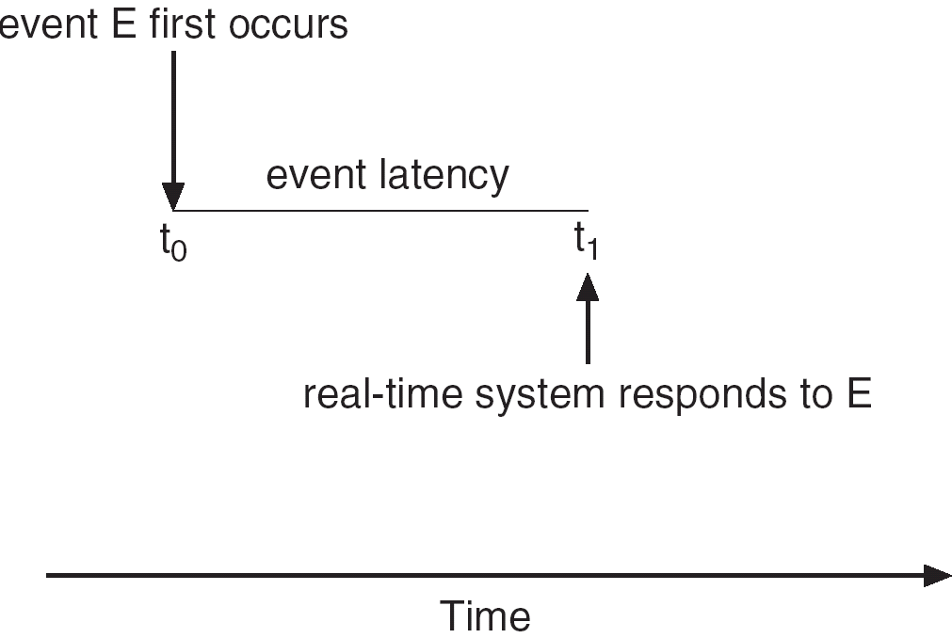
Minimizing Latency
Event latency is the amount of time from when an event occurs to when it is serviced.

Slide 64
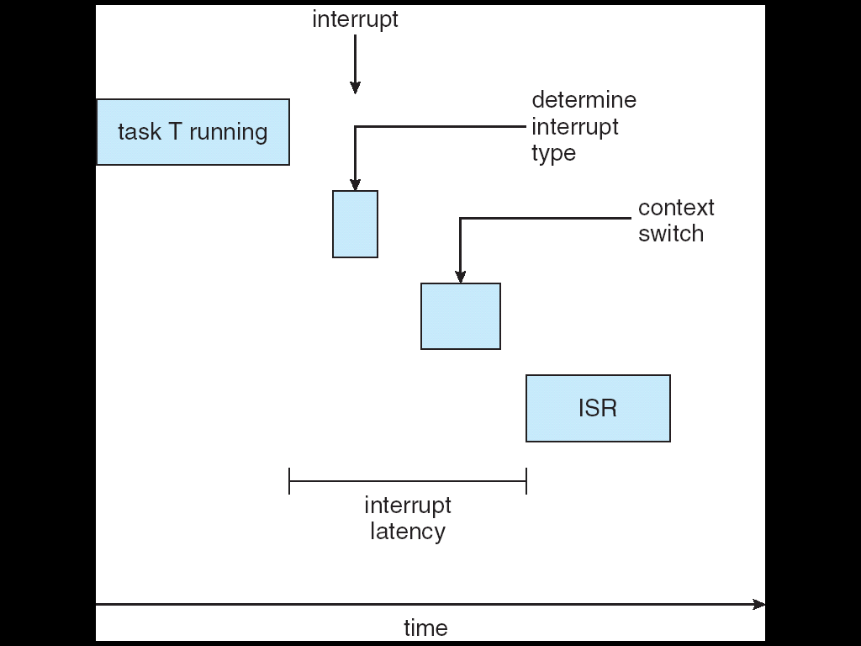
Interrupt Latency
Interrupt latency is the period of time from when an interrupt arrives at the CPU to when it is serviced.

Slide 65
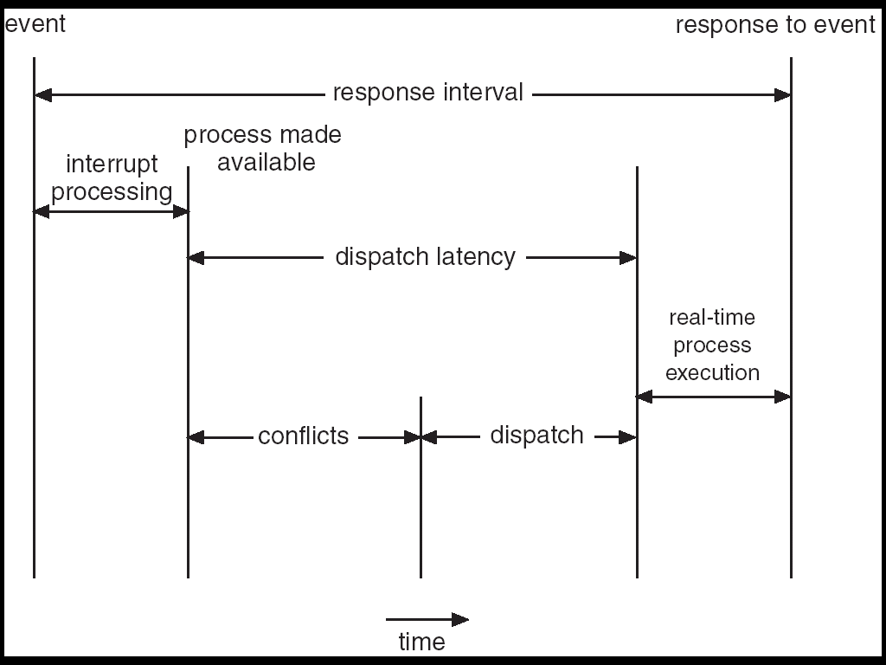
Dispatch Latency
Dispatch latency is the amount of time required for the scheduler to stop one process and start another.

Slide 66
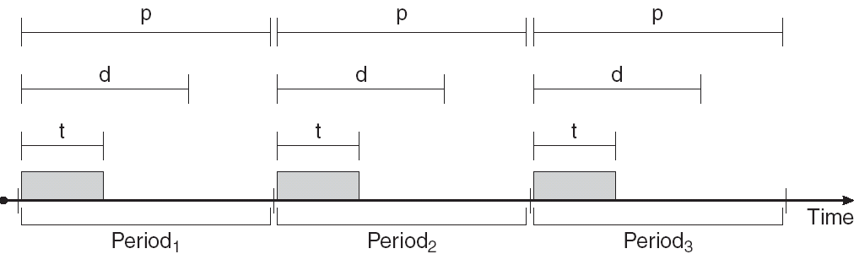
Real-Time CPU Scheduling
Periodic processes require the CPU at specified intervals (periods)
p is the duration of the period
d is the deadline by when the process must be serviced
t is the processing time

Slide 67
Rate Montonic Scheduling
A priority is assigned based on the inverse of its period
Shorter periods = higher priority;
Longer periods = lower priority
P₁ is assigned a higher priority than P₂.

Slide 68
Earliest Deadline First Scheduling
Priorities are assigned according to deadlines:
the earlier the deadline, the higher the priority;
the later the deadline, the lower the priority.

Slide 69
Proportional Share Scheduling
T shares are allocated among all processes in the system.
An application receives N shares where N < T.
This ensures each application will receive N / T of the total processor time.

Slide 70
Pthread Scheduling
The Pthread API provides functions for managing real-time threads.
Pthreads defines two scheduling classes for real-time threads:
(1) SCHED_FIFO - threads are scheduled using a FCFS strategy with a FIFO queue. There is no time-slicing for threads of equal priority.
(2) SCHED_RR - similar to SCHED_FIFO except time-slicing occurs for threads of equal priority.

Slide 71
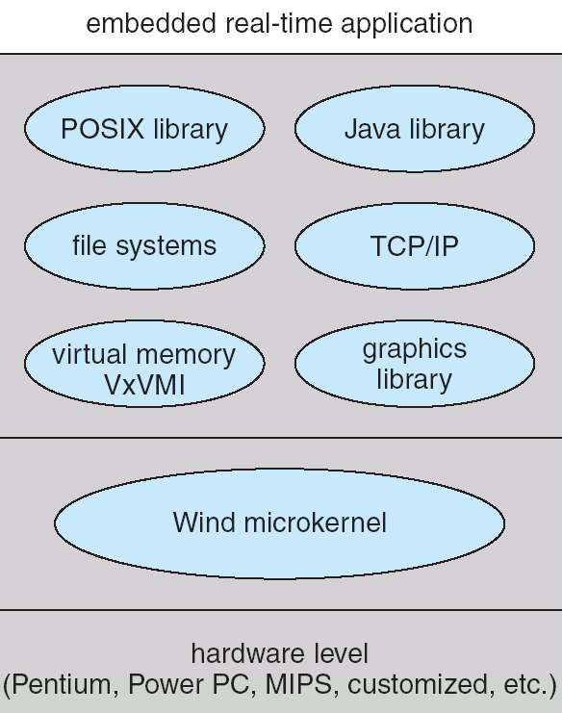
VxWorks 5.0

Slide 72
Wind Microkernel https://en.wikipedia.org/wiki/VxWorks
VxWorks is a real-time operating system (RTOS) developed as proprietary software by Wind River Systems, a wholly owned subsidiary of TPG Capital, US.
First released in 1987, VxWorks is designed for use in embedded systems requiring real-time, deterministic performance and, in many cases,
  safety and security certification, for industries, such as aerospace and defense, medical devices, industrial equipment, robotics, energy, transportation, network infrastructure, automotive, and consumer electronics.
The Wind microkernel provides support for the following:
(1) Processes and threads;
(2) preemptive and non-preemptive round-robin scheduling;
(3) manages interrupts (with bounded interrupt and dispatch latency times);
(4) shared memory and message passing interprocess communication facilities.

Slide 73
Solaris 2 scheduling
Priority based process scheduling
Four classes of scheduling: Real time, System, Time sharing and Interactive
Each class includes different priorities and scheduling algorithms.
A process starts with one LWP and is able to create new LWPs as needed.
Each LWP inherits the scheduling class and priority of the parent process.
Default scheduling class is time sharing.
The scheduling policy for time sharing dynamically alters priorities and assigns time slices of different lengths using a multilevel feedback queue.
Inverse relationship between priorities and time slices.
Interactive process receives high priority
CPU bound process receives low priority.

Slide 74
Solaris 2 scheduling
Solaris 2 uses system class to run kernel processes: scheduler and paging daemon.
The priority of a system process does not change.
The scheduling class for system class is not time slice.
  It runs until it blocks or preempted by a higher priority thread.
Threads in realtime class are given the highest priority to run among all classes.
  Allows a guaranteed response time
  In general few processes belong to real time class.
The selected thread runs until one of the following occurs.
  It blocks
  It uses its time slice (if it is not a system thread)
  It is preempted by a higher-priority thread.
If multiple threads have same priority, the scheduler uses round-robin queue

Slide 75
Dispatch Table
Fields of dispatch table
  Priority
    Higher number indicates a higher priority
  Time quantum
    Time quantum of associated priority
  Time quantum expired
    New priority if it consumes entire time quantum (lowered)
  Return from Sleep
    Priority of thread returning from sleep

Slide 76
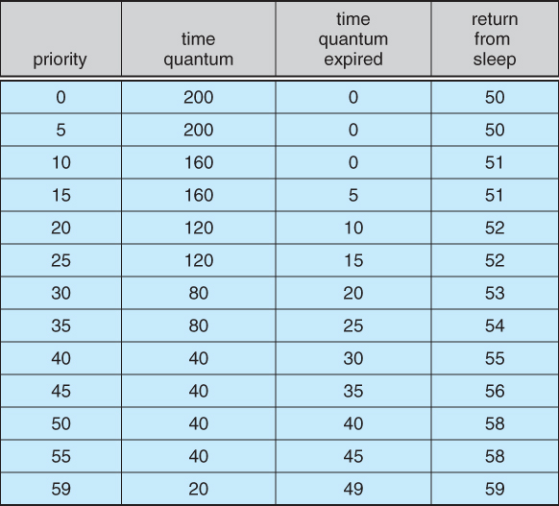

Slide 77
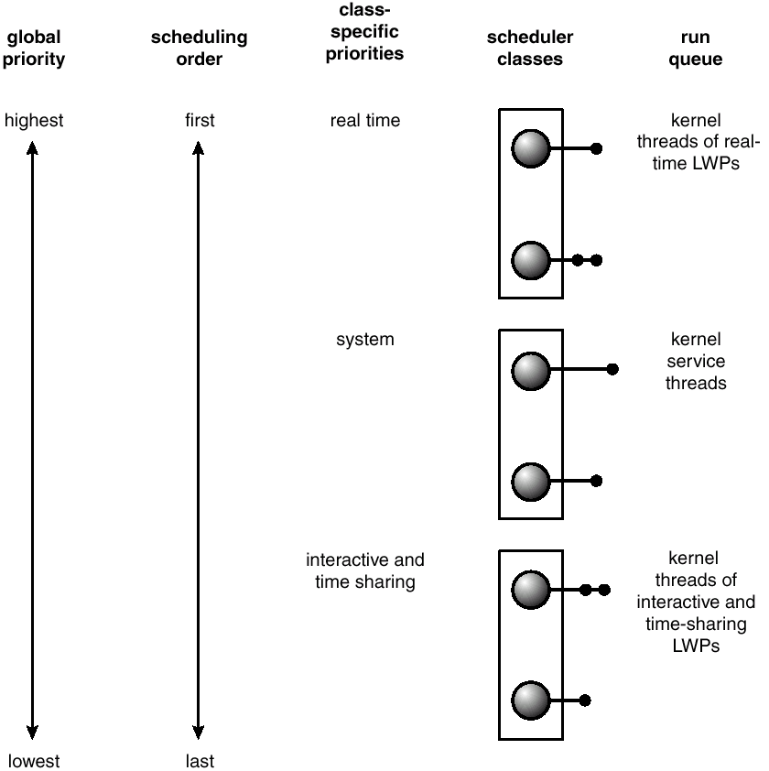
Solaris 2 Scheduling

Slide 78
WINDOWS 2000/XP scheduling
WINDOWS 2000 schedules threads using a priority-based, preemptive scheduling algorithm.
Scheduler ensures that highest priority thread always run.
Scheduler is called dispatcher.
A thread will run until
  Preempted by high priority thread
  Until it terminates
  Until its time quantum ends
  Until it calls a blocking system call.
The dispatcher uses 32-level priority scheme.
Priorities are divided into two classes
  Variable class (1 to 15)
  Real-time class (16-31)
Priority 0 is used for memory management.
The dispatcher uses a queue for each scheduling priority and traverses from highest to lowest.
If no ready thread is found, the dispatcher executes a special thread called idle thread.

Slide 79
WINDOWS 2000 scheduling
WINDOWS 2000 identifies several priority classes. These include:
  REALTIME_PRIORITY_CLASS
  HIGH_PRIORITY_CLASS
  ABOVE_NORMAL_PRIORITY_CLASS
  NORMAL_PRIORITY_CLASS
  BELOW_NORMAL_PRIORITY_CLASS
  IDLE_PRIORITY_CLASS
Except REALTIME_PRIORITY_CLASS all other are variable class priorities; the priority the thread belong to this class may change.
Within each priority class there is a relative priority
  TIME_CRITICAL
  HIGHEST
  ABOVE_NORMAL
  NORMAL
  BELOW_NORMAL
  LOWEST
  IDLE
The priority of each thread is based upon the priority class it belongs to and the relative priority within the class.
In addition each thread has a base priority which is equal to normal priority.
The initial priority is typically the base priority of the class

Slide 80
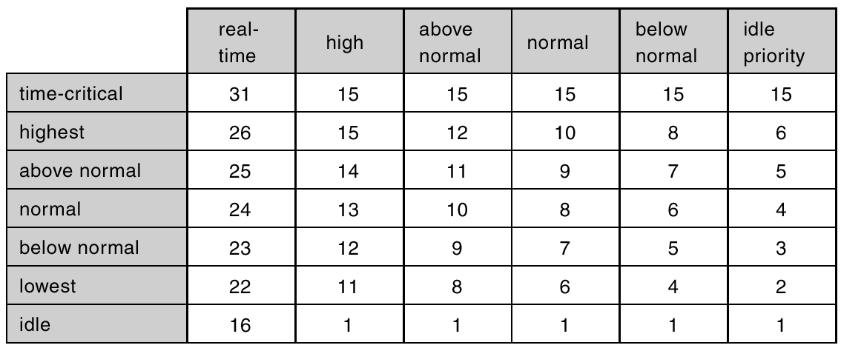
Windows 2000 Priorities

Slide 81
WINDOWS 2000 scheduling
When a thread quantum runs out, the thread is interrupted; if the thread is in variable-priority class its priority is lowered.
When the variable priority thread is released from wait operation, the dispatcher boosts its priority.
  Good response time to interactive threads.
  Keeps I/O devices busy.
  CPU bound processes use CPU cycles background.
When a process moves to foreground, the time quantum is increased by some factor---typically by three.

Slide 82
LINUX
Two separate process scheduling algorithms
  Time sharing algorithm for fair preemptive scheduling among multiple processes.
  Other is designed for real-time tasks
LINUX allows only user processes to preempt
A process can not be preempted in kernel mode, even real-time process is available to run.
Every process is assigned with scheduling class, that defines which of the algorithms to apply to the process.
First class is for time—sharing processes
  LINUX uses prioritized credit based algorithm
  Each process posses a certain number of scheduling credits.
  While choosing, the process with most credits is selected.
  Every time the interrupt occurs the process loses one credit
  When its credits reaches zero it is suspended and another process is chosen.

Slide 83
LINUX ( earlier than 2.5)
If no runnable process have any credits, LINUX performs re-crediting operation. It adds credits to every process
  Credits=(Credits/2)+priority
This algorithm uses two factors: process history and priority.
Suspended process will accumulate more credits.
It also gives high priority to interactive processes
Linux implements two real-time scheduling classes
  FCFS and round robin.
In the FCFS class the process runs until it blocks.
LINUX real-time scheduling is soft—rather than hard.
The scheduler guarantees priorities, but kernel never gives guarantees
  Kernel process can not preempted

