Slide 1
AML
郭中昊

Slide 2
1 Characteristics of AML scRNA-seq data

Slide 3
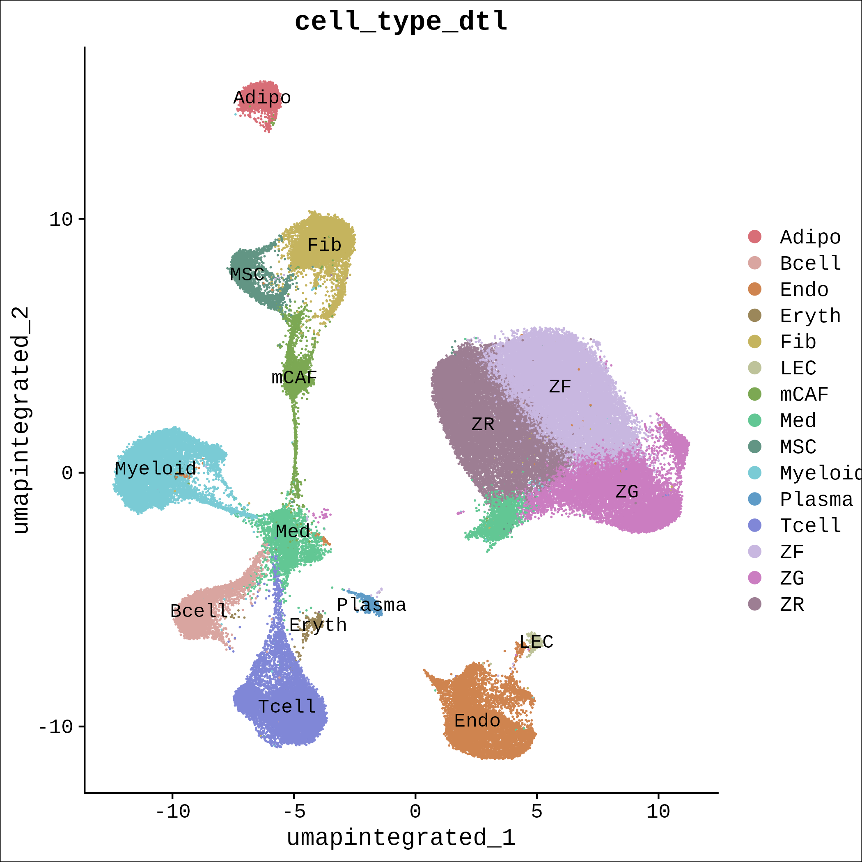
1.1 Annotation
Adipo: Adipocyte
B cell: B cell
Endo: Endothelial cell
Eryth: Erythrocyte
Fib: Fibroblast
LEC: Lymphatic Endothelial Cell
Mac/Granul: Macrophage/Granulocyte
mCAF: Matrix Cancer-Associated Fibroblast
Med: Medullary cell of adrenal gland
MSC: Mesenchymal Stem Cell
Plasma: Plasma cell
T cell: T cell
ZF: Zona Fasciculata cell
ZG: Zona Glomerulosa cell
ZR: Zona Reticularis cell

Slide 4
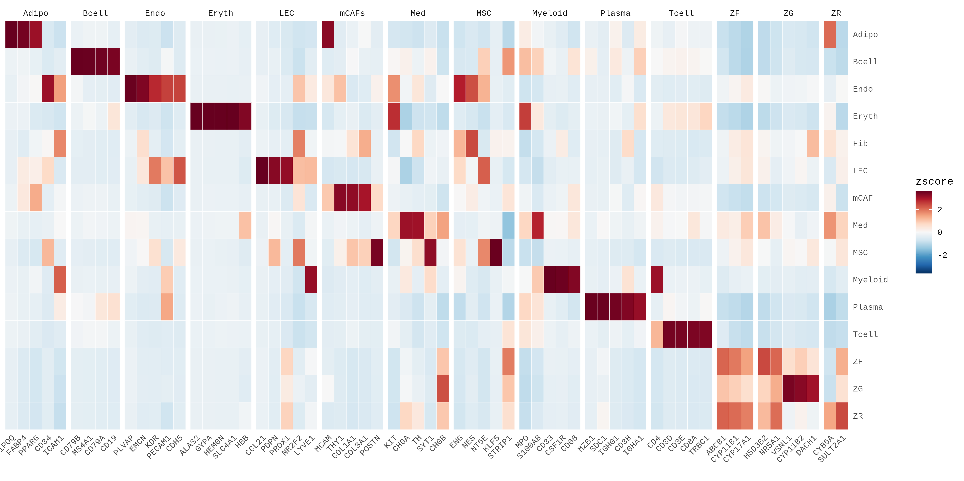
1.2 Marker genes expression
1.2.1 Top 5 marker genes of each cluster

Slide 5
### 1.2.2 Full marker genes of each cluster

Slide 6
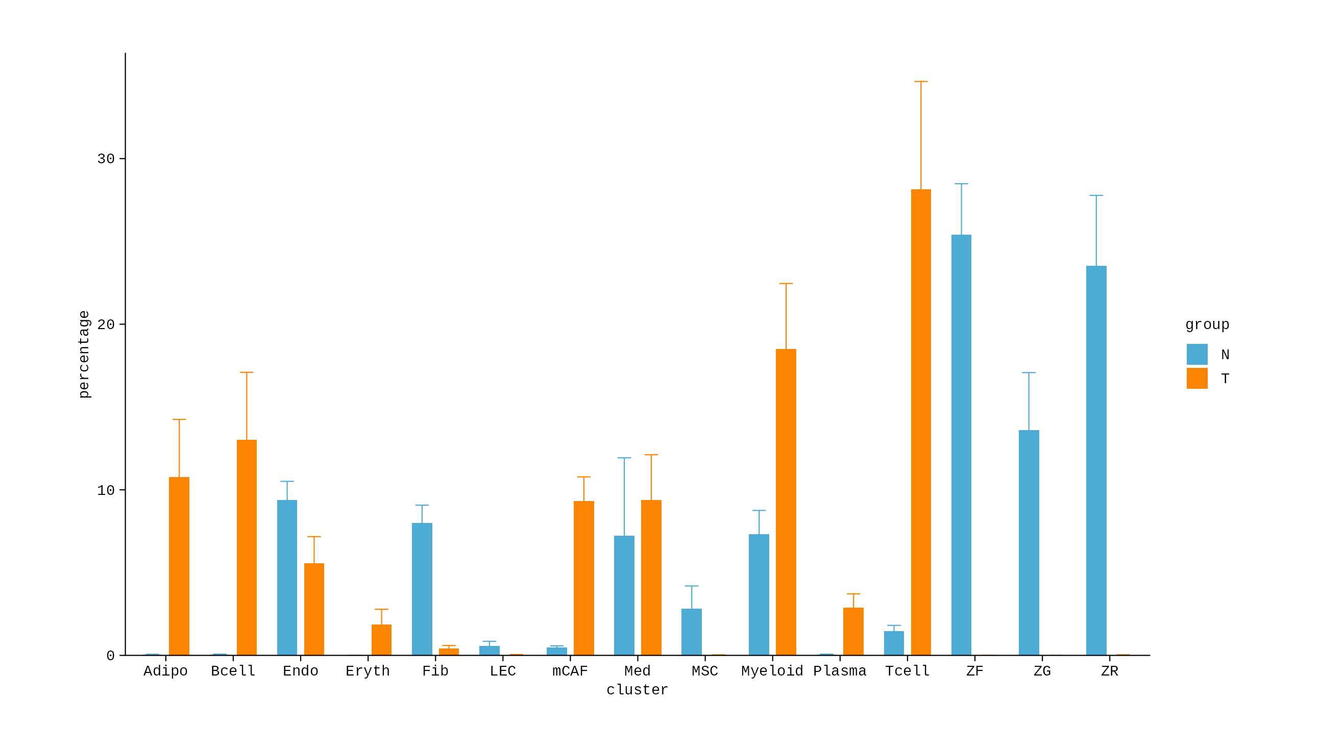
1.3 Cell type proportion

Slide 7
Adipo (Adipocytes): Tumor > Normal
Bcell (B cells): Tumor > Normal
Endo (Endothelial cells): Tumor < Normal
Eryth (Erythrocytes): Tumor > Normal
Fib (Fibroblasts): Tumor > Normal
LEC (Lymphatic Endothelial Cells): Tumor < Normal
Myeloid: Tumor > Normal
mCAF (Myofibroblasts Cancer-Associated Fibroblasts): Tumor > Normal
Med (Medullary cells): Tumor < Normal
MSC (Mesenchymal Stem Cells): Tumor < Normal
Plasma (Plasma cells): Tumor > Normal
Tcell (T cells): Tumor < Normal

Slide 8
2 Myeloid cells

Slide 9
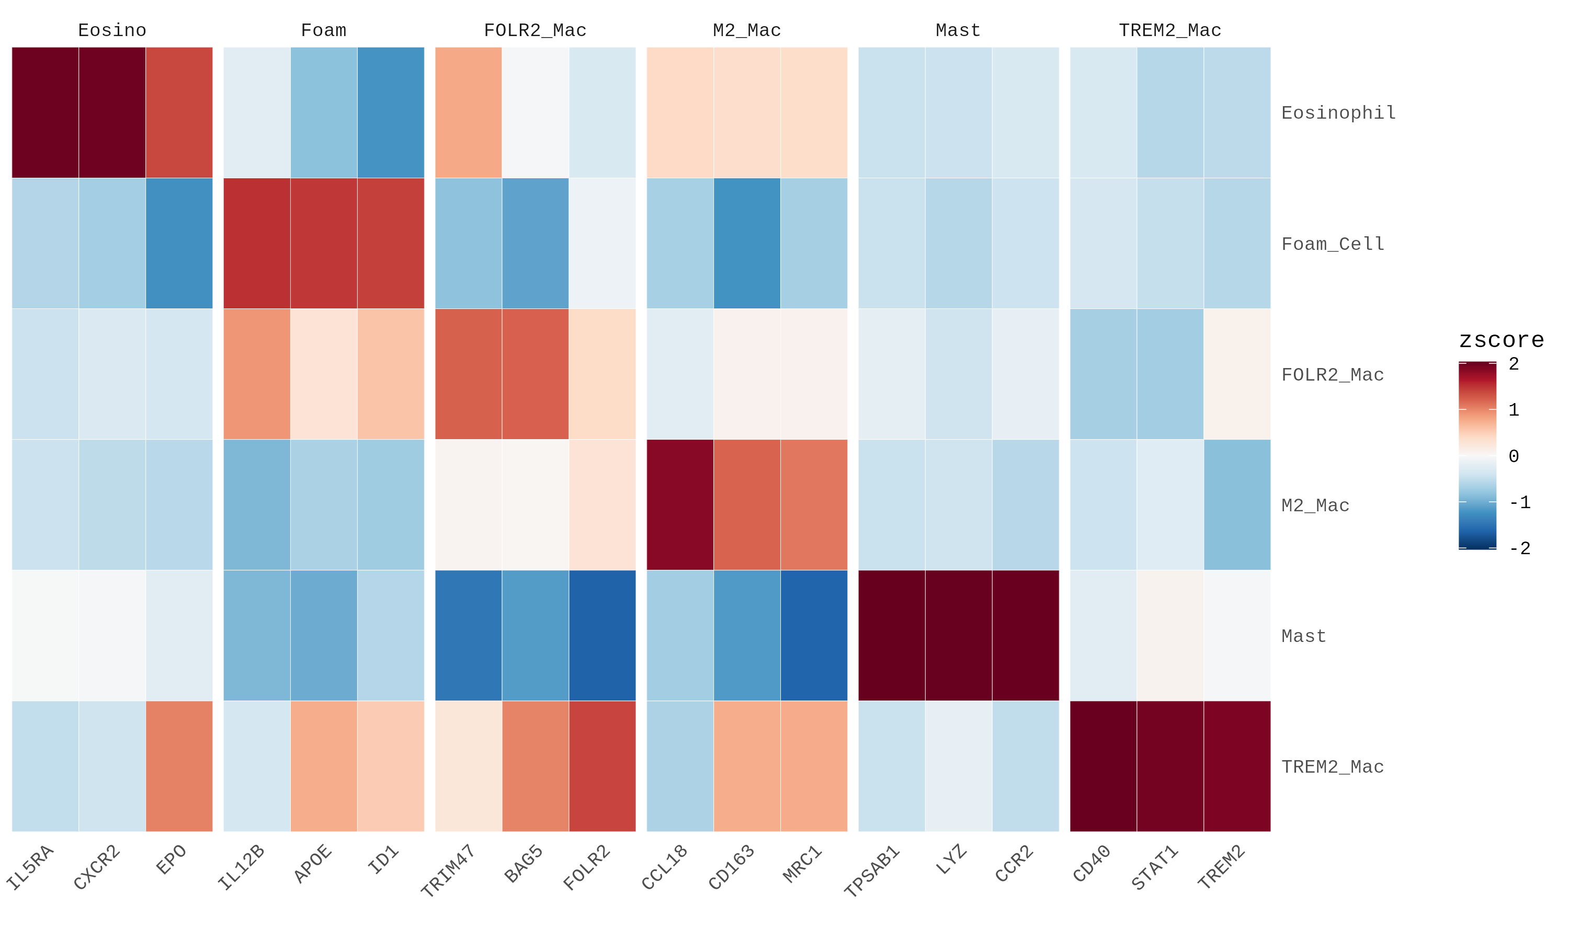
2.1 Myeloid subclusters

Slide 10
Identification of FOLR2+ Macrophages is ambiguous ## 2.2 Myeloid cell type proportion

Slide 11
Key findings
Decreased proportion of Foam Cells and TREM2+ Macrophages, suggesting defective lipid scavenging

Slide 12
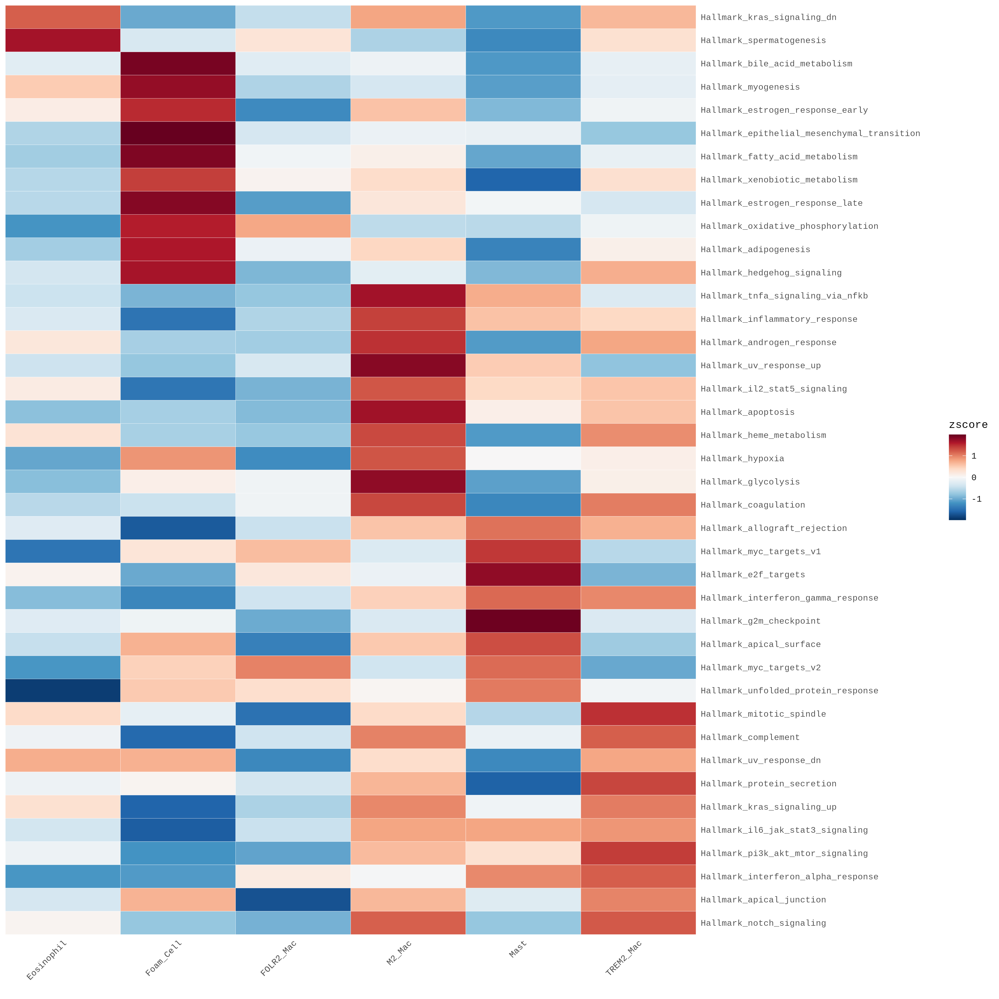
2.3 GSEA of myeloid subclusters
2.3.1 Hallmark 50 pathways

Slide 13
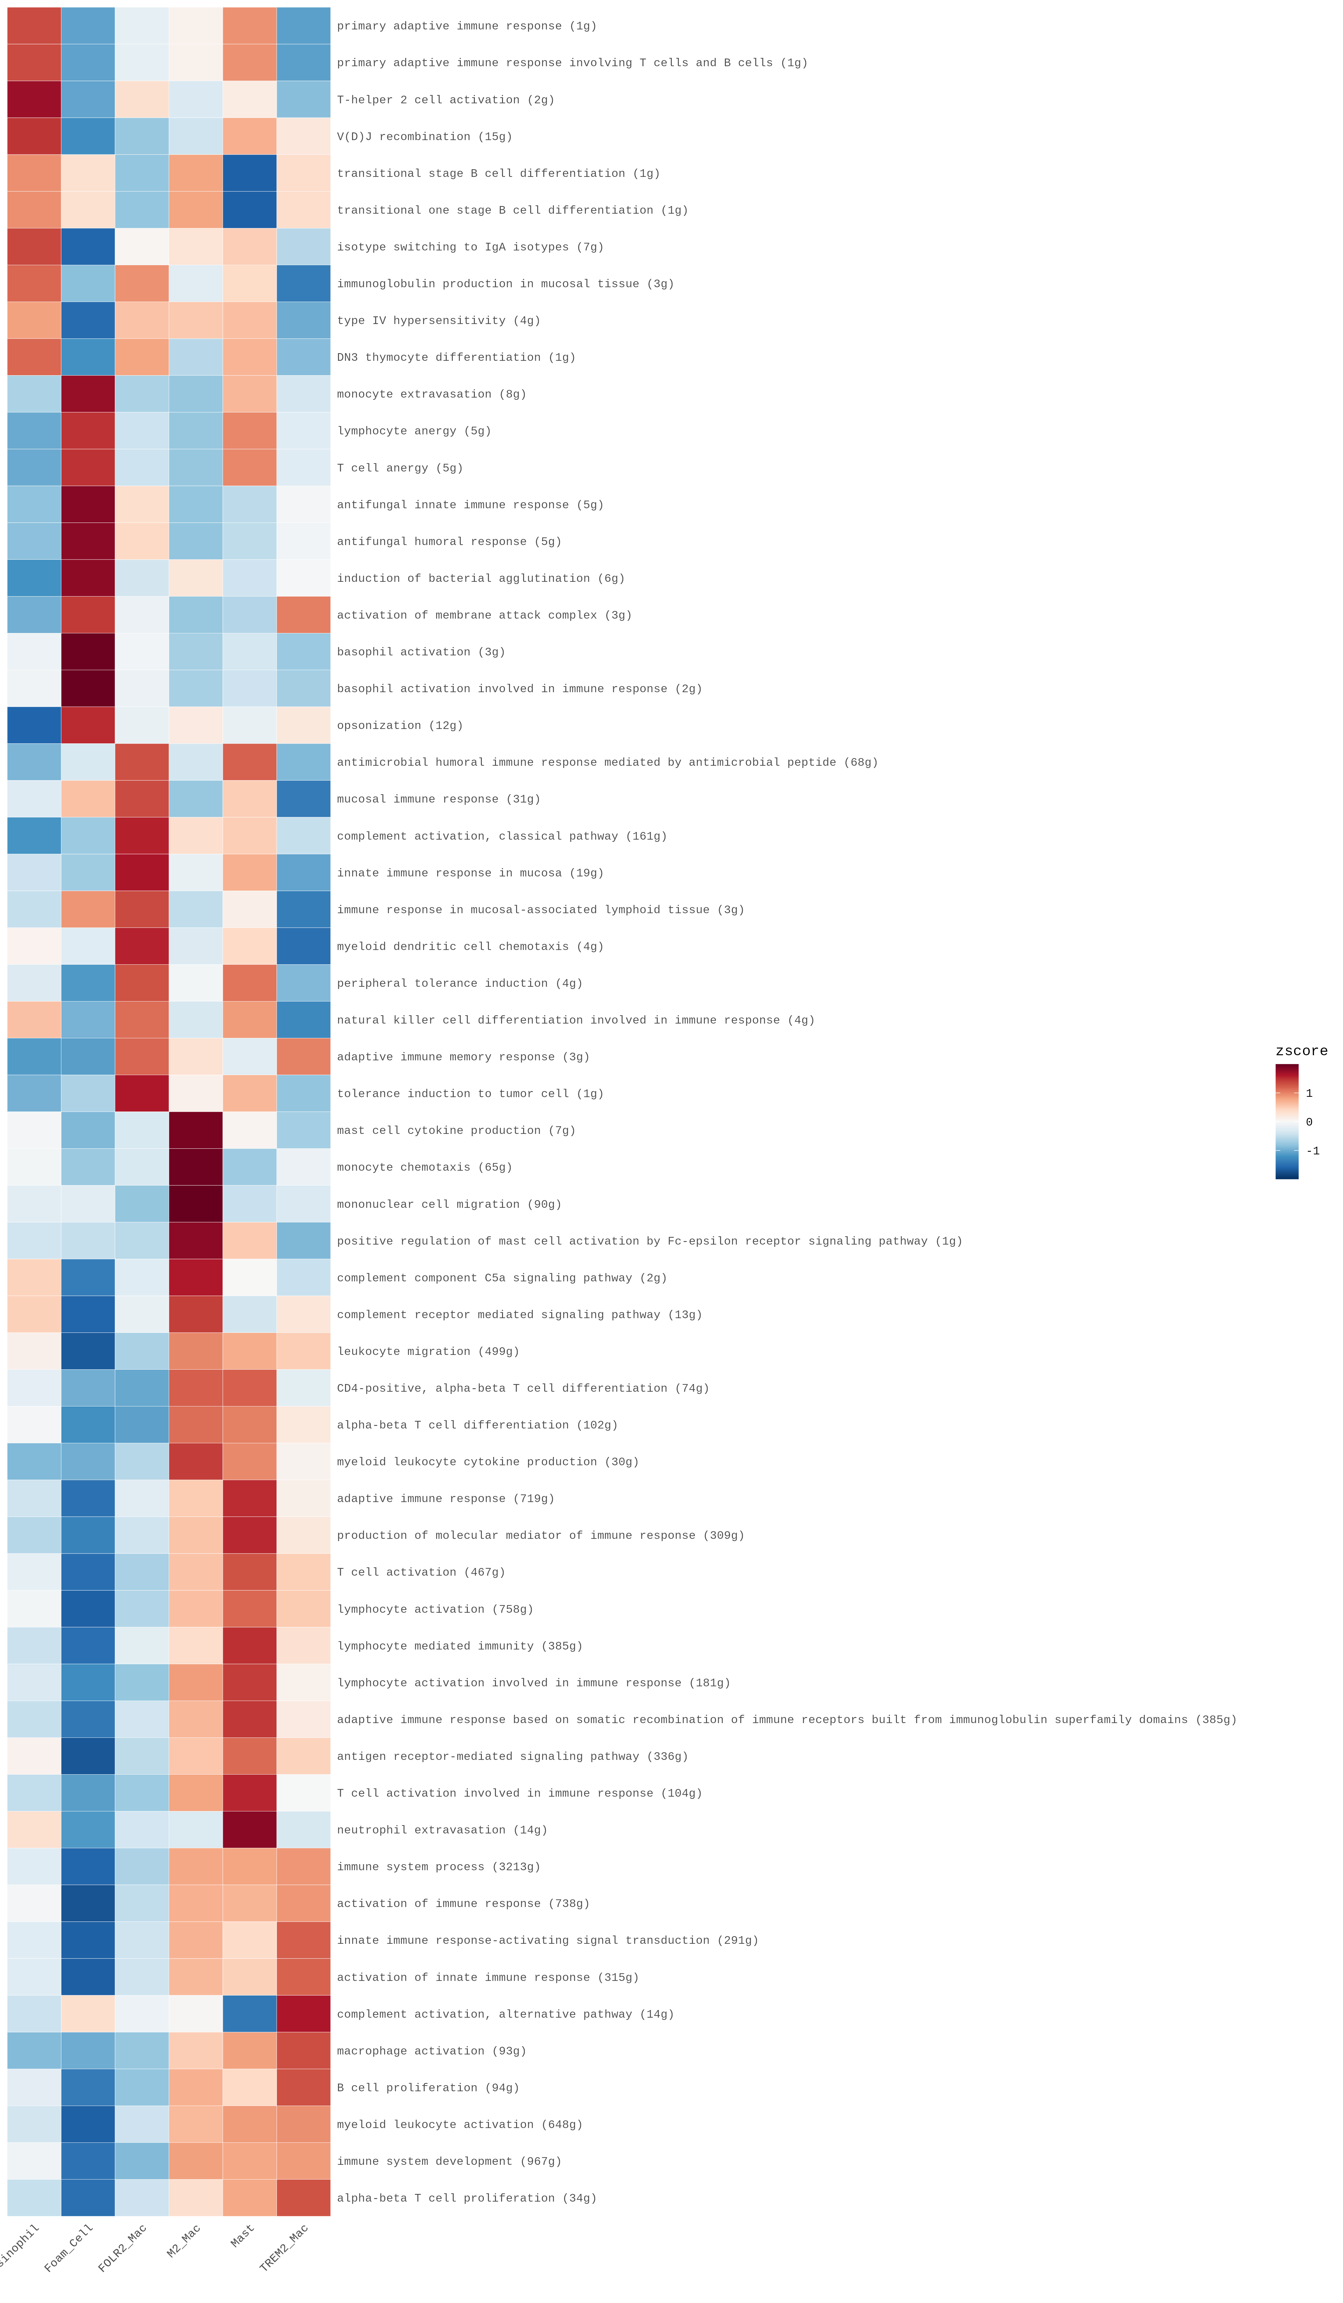
2.3.2 Immune system process

Slide 14
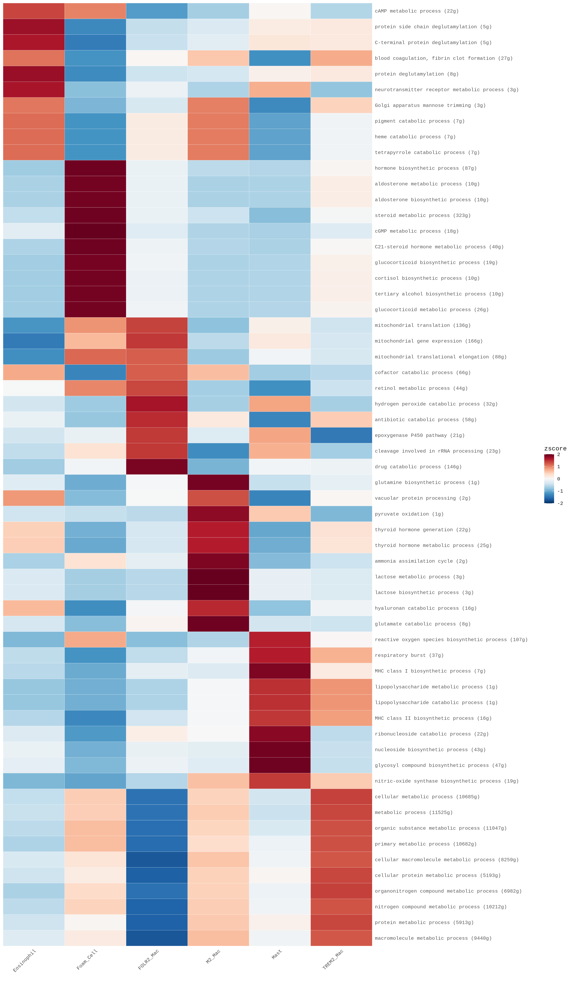
2.3.3 Metabolic process

Slide 15
2.3.4 Summary

Slide 16
1. Eosinophil:
Summary: Eosinophils in the adrenal gland appear to be involved in regulating neutrophil activity, leukotriene metabolism, and potentially IL-13 production, suggesting roles in inflammation and immune modulation. Their molecular functions involve oxidase and lysozyme activities, consistent with their effector roles. The presence of ion channel and transporter complexes, along with the unexpected “postsynaptic membrane” term, suggests potential interactions with nerves or shared molecular components with neuronal structures, and regulation by sodium channels.
Key Pathways (Proposed):
BP: Negative Regulation of Neutrophil Chemotaxis/Migration, Leukotriene D4 Metabolic/Biosynthetic Process.
MF: Primary Amine Oxidase Activity, Lysozyme Activity.
CC: Ion Channel Complex, Transmembrane Transporter Complex, Sodium Channel Complex.

Slide 17
2. Foam Cell:
Summary: These cells exhibit a complex profile. BPs suggest roles in cell cycle regulation, ceramide transport, microvillus organization, hypoxia response, and potentially tissue regeneration. MFs highlight lipid metabolism (oxysterol binding, acyl-CoA desaturase activity) and membrane lipid transport (ceramide/phosphatidylethanolamine flippase activity). The most intriguing findings are the CC terms related to neuronal structures (presynaptic cytoskeleton, astrocyte projection, dendritic spine neck). This suggests unexpected molecular similarities or potential interactions with neuronal elements, requiring further investigation. The presence of cytoskeletal components (actin filament bundles) is consistent with lipid uptake and trafficking.
Key Pathways (Proposed):
BP: Ceramide Translocation, Positive Regulation of Cellular Response to Hypoxia, Coenzyme Transport.
MF: Oxysterol Binding, Acyl-CoA Desaturase Activity, Ceramide Floppase Activity.
CC: Presynaptic Cytoskeleton, Astrocyte Projection, Contractile Actin Filament Bundle. (The neuronal terms are prioritized due to their unexpected nature and potential for novel discoveries).

Slide 18
3. FOLR2_Mac:
Summary: These macrophages show a profile suggesting roles in glucosamine/formaldehyde metabolism, gonadotropin secretion, and zinc ion response. MFs point to diverse enzymatic activities, including glutamylcyclotransferase, glutathione hydrolase, and sphingolipid/ceramide transfer. The CC terms strongly support a role in protein processing and degradation (chaperone complex, elongin complex, proteasome regulatory particle), consistent with macrophage function. ABC transporter complex highlights their role in transporting various molecules.
Key Pathways (Proposed):
BP: Glucosamine Metabolic/Catabolic Process, Response to Zinc Ion Starvation / Cellular Response.
MF: Sphingolipid Transfer Activity, Ceramide Transfer Activity, Glutathione Hydrolase Activity.
CC: Proteasome Regulatory Particle (Lid Subcomplex), Chaperone Complex, Atp-Binding Cassette (Abc) Transporter Complex.

Slide 19
4. M2_Mac:
Summary: These macrophages are likely involved in epithelial cell proliferation, monocyte chemotaxis, and glutamine/glutamate metabolism, consistent with their role in tissue repair and remodeling. MFs include ATPase regulation and ligase activities related to glutamate and cysteine. CC terms indicate roles in ion homeostasis (sodium:potassium-exchanging ATPase) and gene expression regulation (transcription elongation factor complex). The presence of B cell receptor complex is unexpected.
Key Pathways (Proposed):
BP: Monocyte Chemotaxis / Mononuclear Cell Migration, Glutamine Biosynthetic/Metabolic Process.
MF: Acid-Ammonia (Or Amide) Ligase Activity, Glutamate-Cysteine Ligase Activity.
CC: Sodium:Potassium-Exchanging ATPase Complex, Transcription Elongation Factor Complex.

Slide 20
5. Mast Cell:
Summary: Adrenal mast cells show potential involvement in smooth muscle contraction, B cell differentiation, vitamin D regulation, cell migration, and pattern recognition receptor signaling. MFs highlight receptor activities (stem cell factor, prolactin, Fc-gamma receptors) and phospholipase C activity. CC terms indicate surface localization (extrinsic component of plasma membrane) and potential, though limited, motility (trailing edge, uropod, invadopodium membrane). Spindle pole points to cell division.
Key Pathways (Proposed):
BP: Cell Surface Pattern Recognition Receptor Signaling Pathway, Pro-B Cell Differentiation.
MF: Stem Cell Factor Receptor Activity, Fc-Gamma Receptor I Complex Binding.
CC: Extrinsic Component Of External Side Of Plasma Membrane, Cell Trailing Edge, Spindle Pole.

Slide 21
6. TREM2_Mac:
Summary: These macrophages are strongly implicated in amyloid-beta clearance, TNF signaling regulation, and integrin activation, consistent with their known roles in phagocytosis and immune modulation. MFs highlight ligand-gated ion channel activity, carbohydrate binding, and receptor activities (macrophage colony-stimulating factor, purinergic nucleotide receptors). The most compelling CC terms are autophagosome, phagolysosome, and secondary lysosome, providing strong evidence for their phagocytic and degradative functions. Golgi stack highlights protein processing.
Key Pathways (Proposed):
BP: Positive Regulation of Amyloid-Beta Clearance, Regulation of Tumor Necrosis Factor-Mediated Signaling.
MF: Macrophage Colony-Stimulating Factor Receptor Activity, G Protein-Coupled Purinergic Nucleotide Receptor Activity.
CC: Autophagosome, Phagolysosome, Golgi Stack.

