Slide 1
AML
郭中昊

Slide 2
1 Characteristics of AML scRNA-seq data

Slide 3
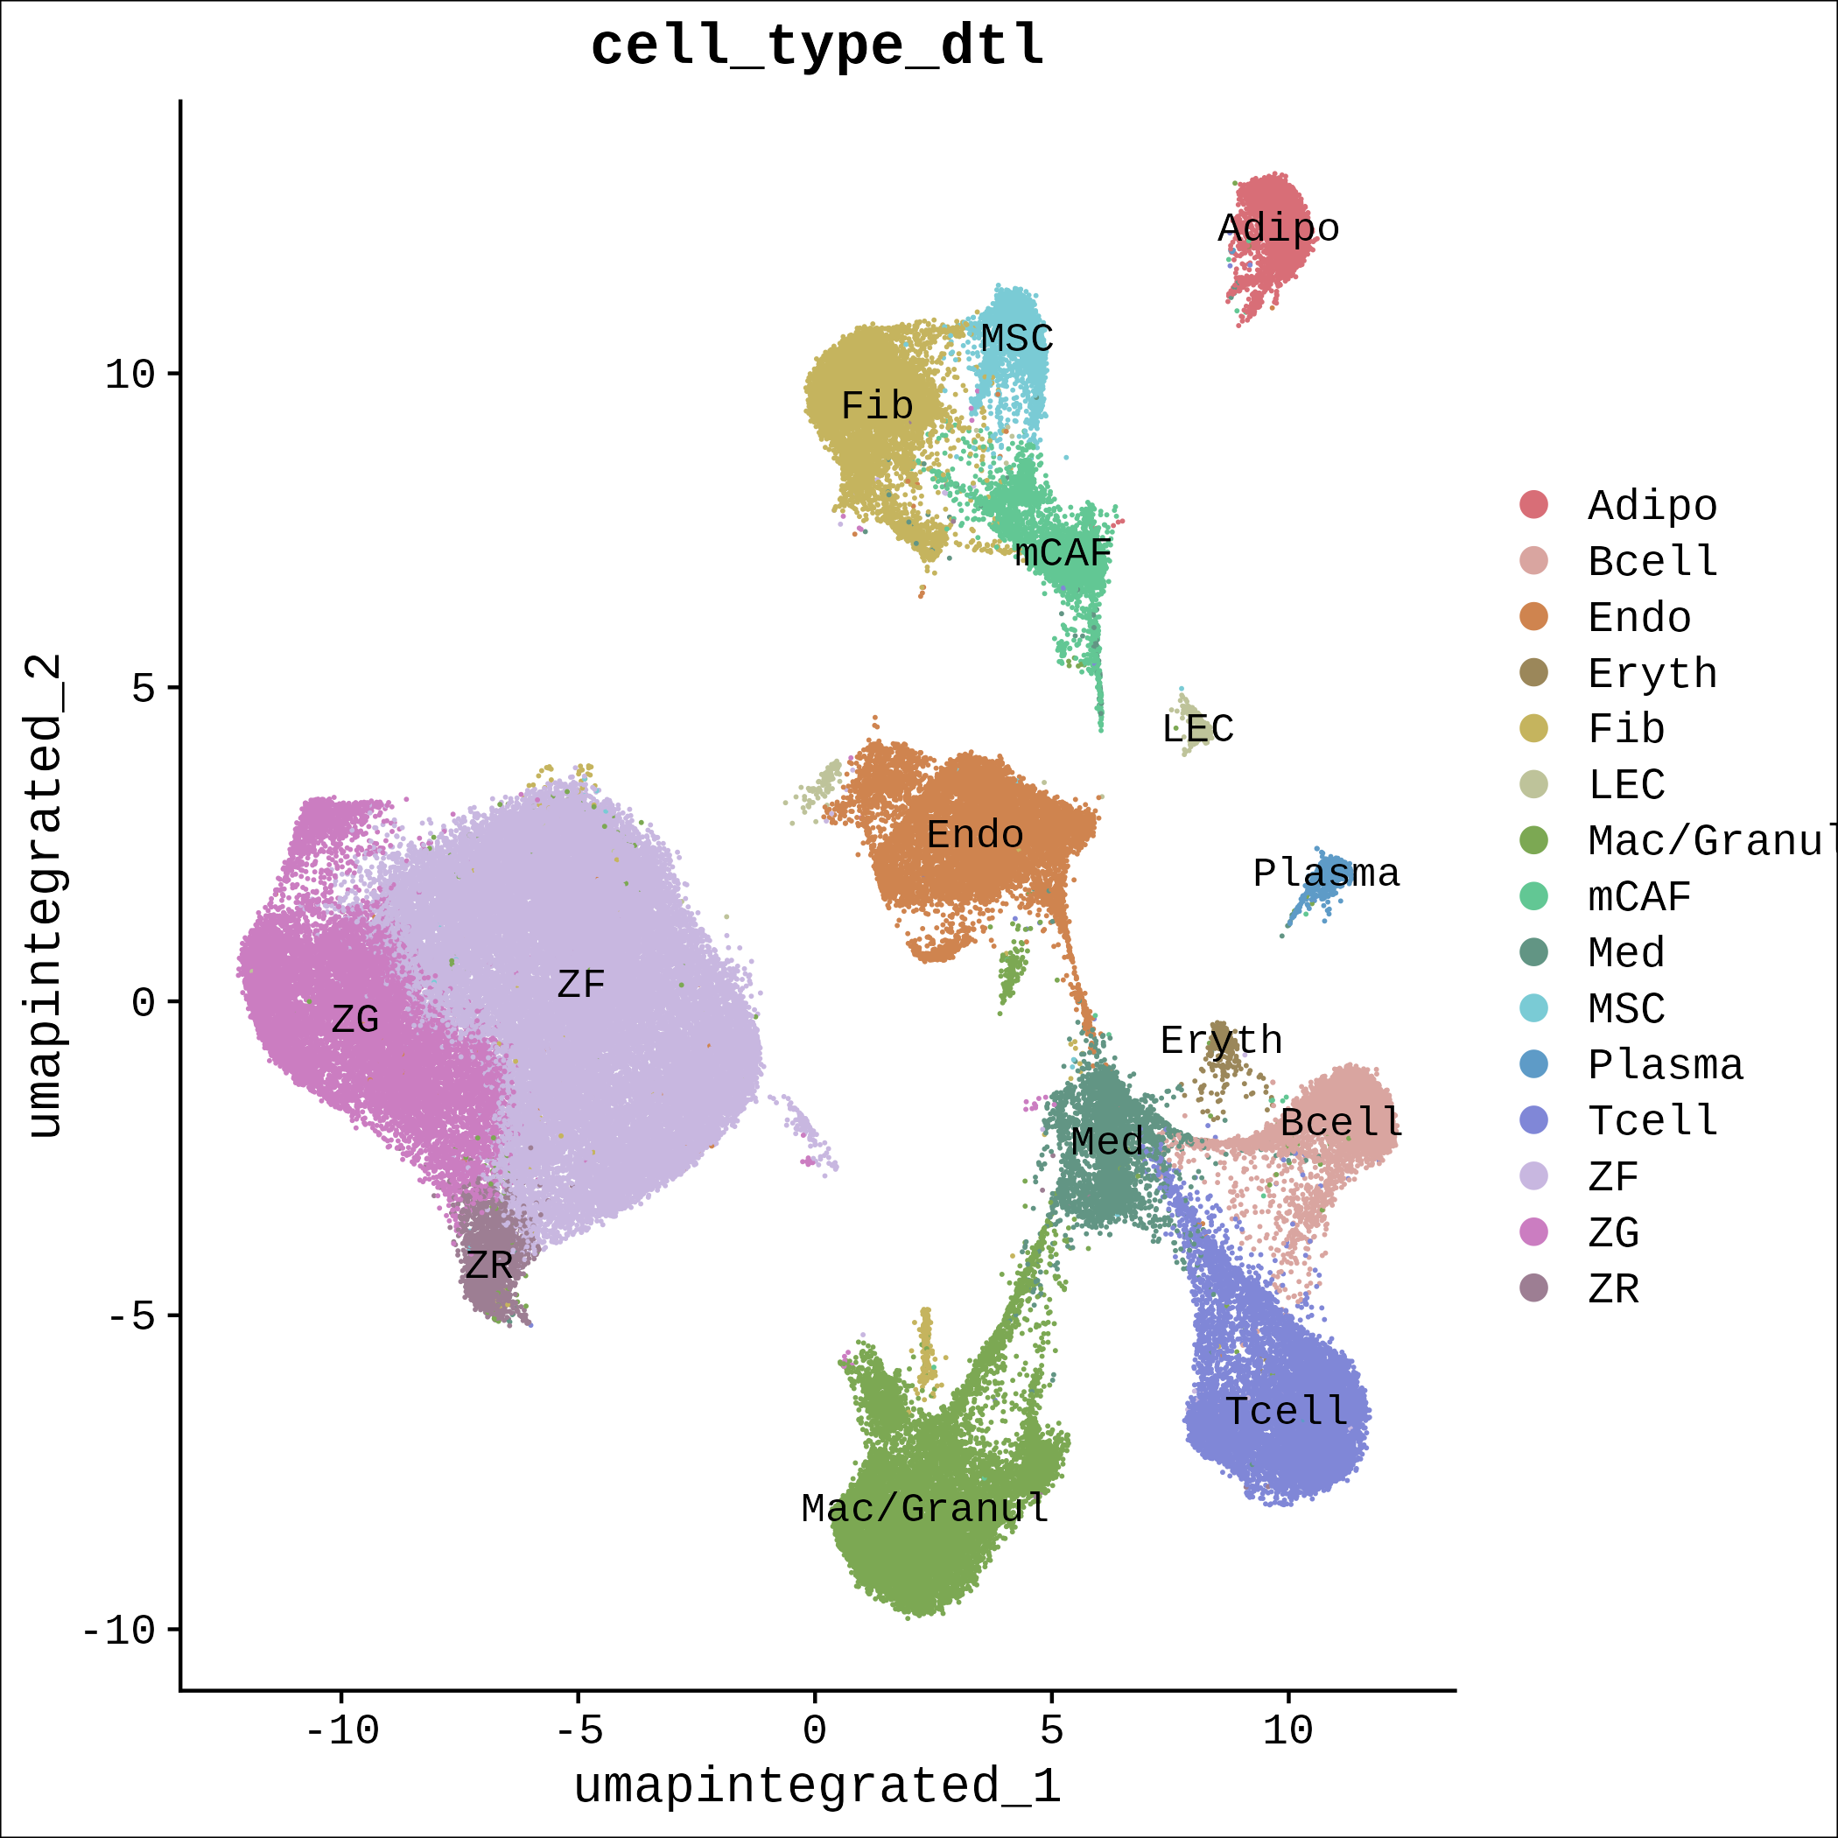
1.1 Annotation
Adipo: Adipocyte
B cell: B cell
Endo: Endothelial cell
Eryth: Erythrocyte
Fib: Fibroblast
LEC: Lymphatic Endothelial Cell
Mac/Granul: Macrophage/Granulocyte
mCAF: Matrix Cancer-Associated Fibroblast
Med: Medullary cell of adrenal gland
MSC: Mesenchymal Stem Cell
Plasma: Plasma cell
T cell: T cell
ZF: Zona Fasciculata cell
ZG: Zona Glomerulosa cell
ZR: Zona Reticularis cell

