Slide 1
Monochromator simulations

Slide 2
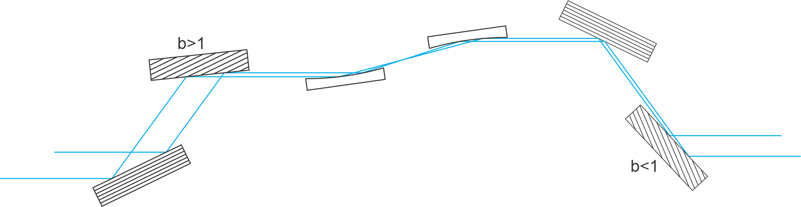
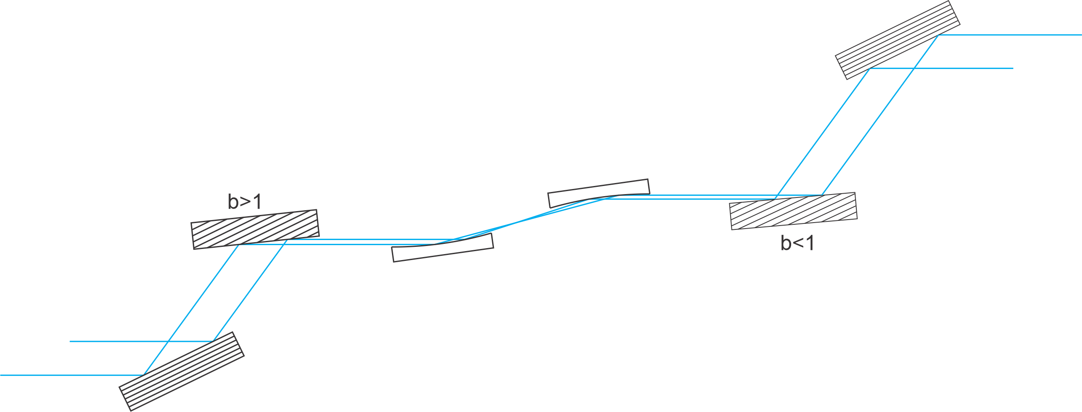
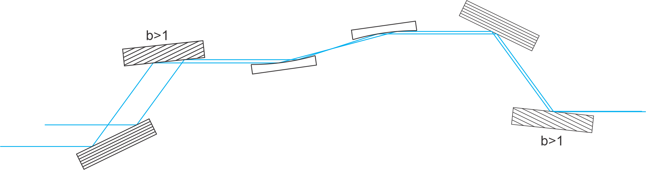
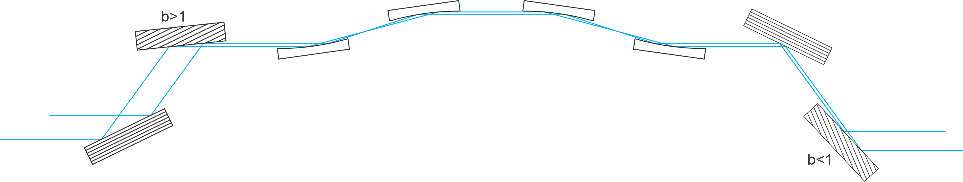
Designs
Note:
Designs 2.X are with the last two crystals going up, and with the miscut crystal first:
1.0
1.1
1.2

Slide 3
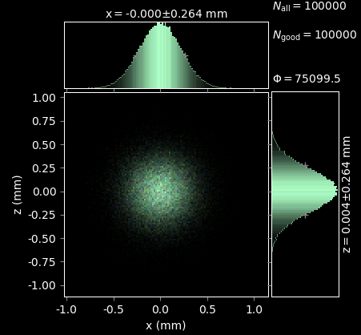
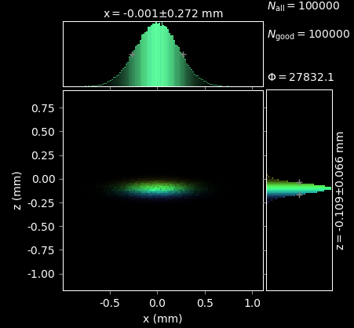
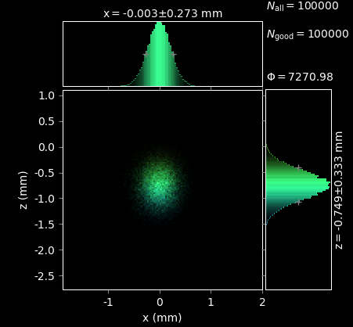
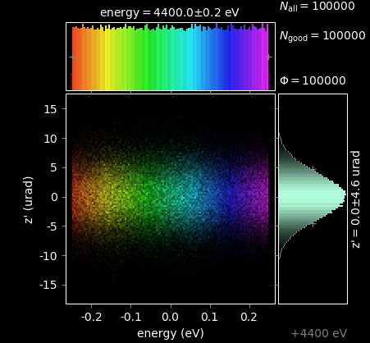
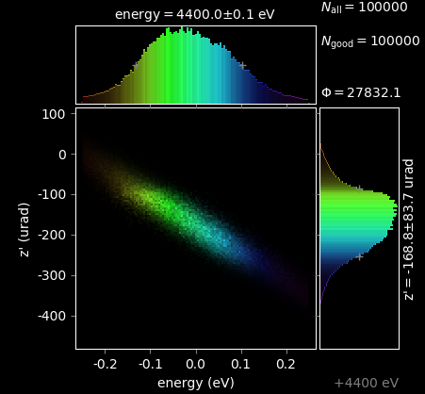
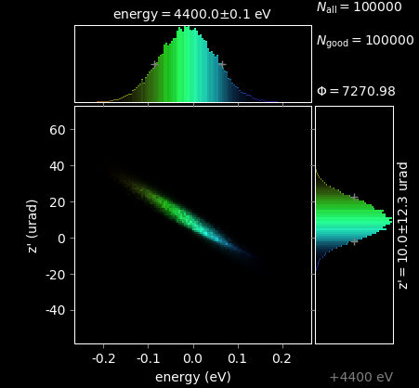
Design 1.X: crystals only
Source
After first miscut
Detector
The second miscut crystal does correct for the beam shape, but only partially for the z’ chirp.

Slide 4
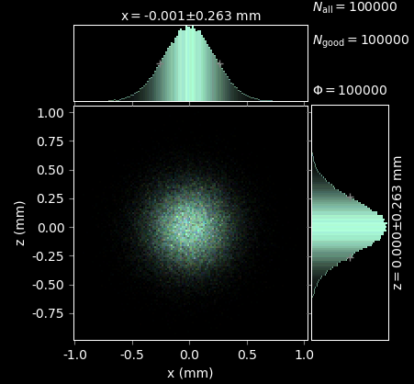
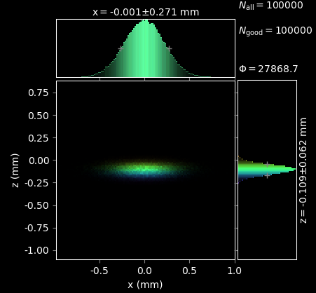
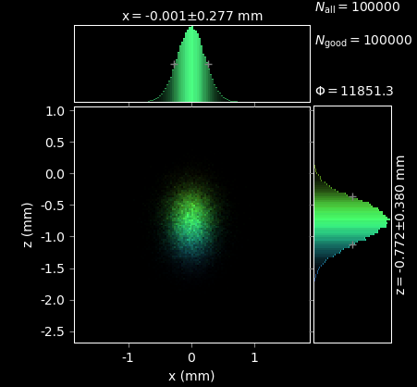
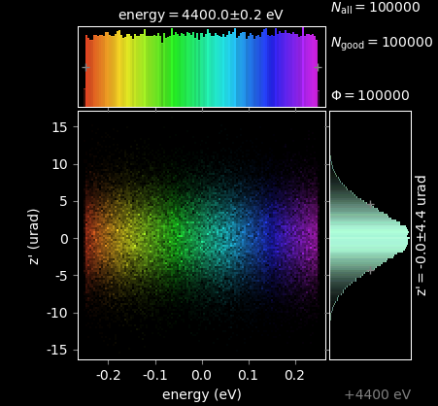
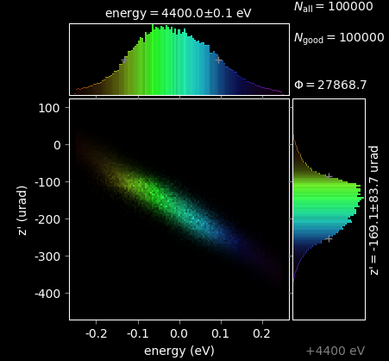
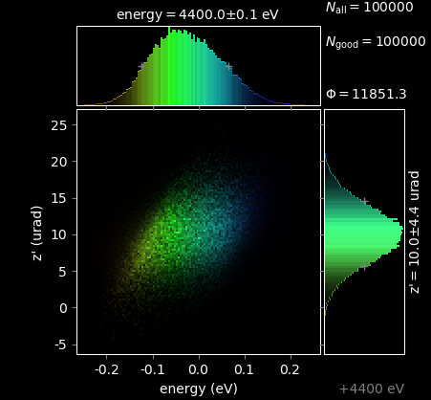
Design 2.X: crystals only
Source
After first miscut
Detector
The chirp is better corrected with this second design.

Slide 5
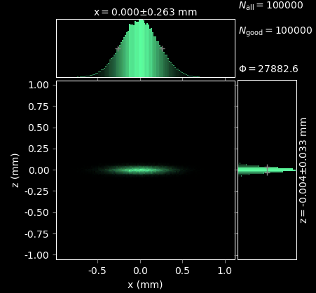
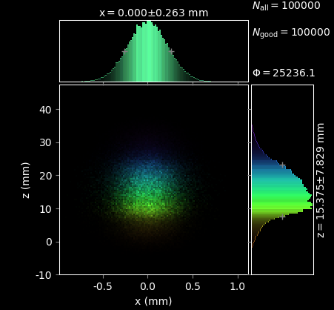
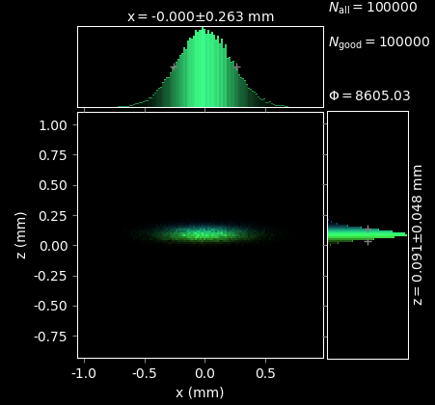
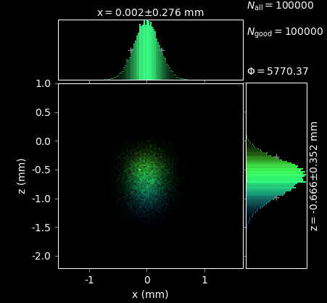

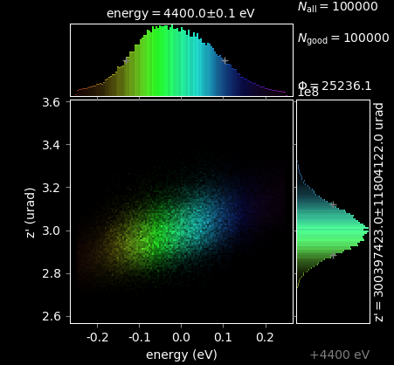
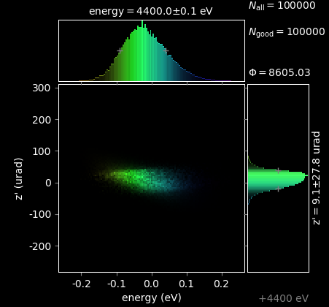
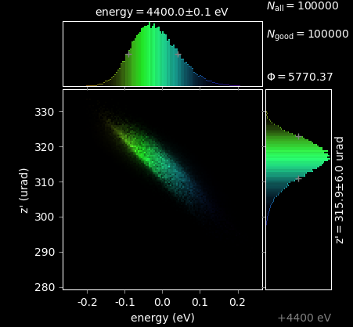
Design 1.0
After first miscut
On focus (tilted)
Before last miscut
Detector

Slide 6
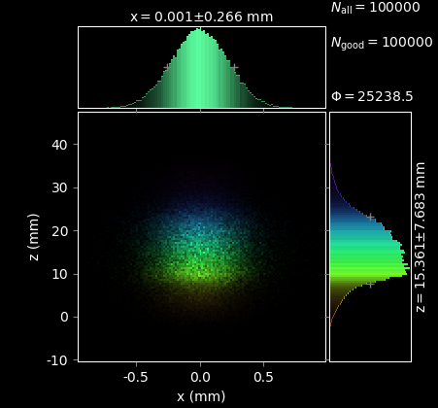
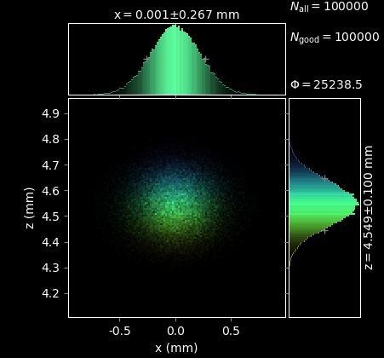
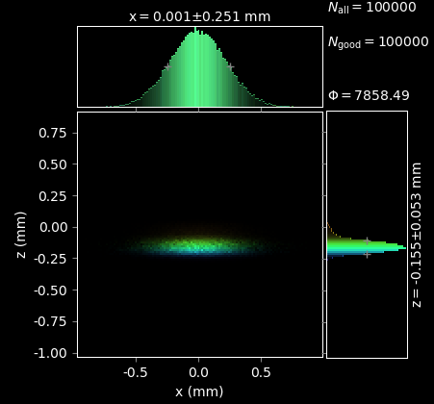
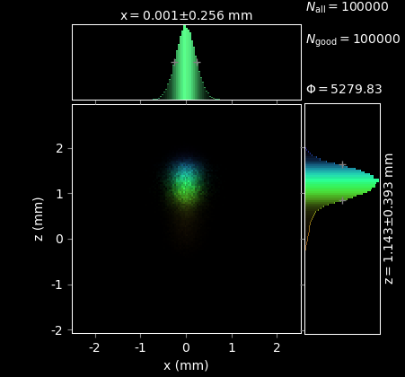
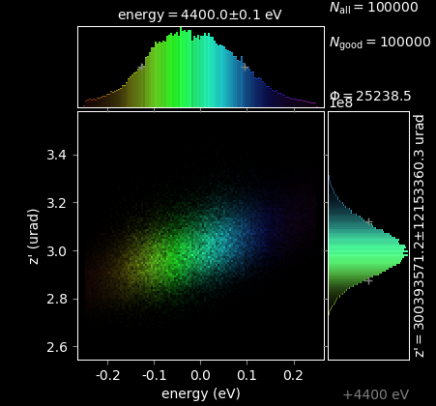
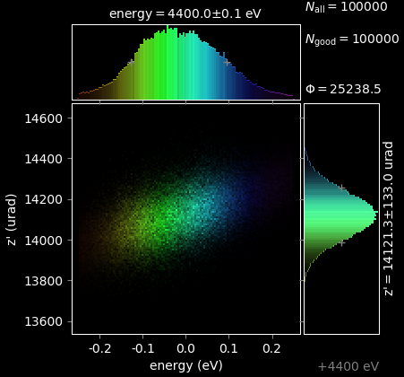
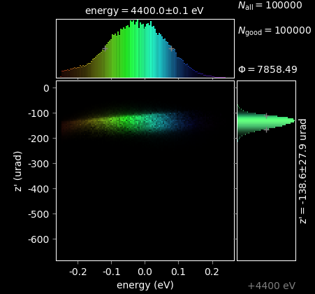
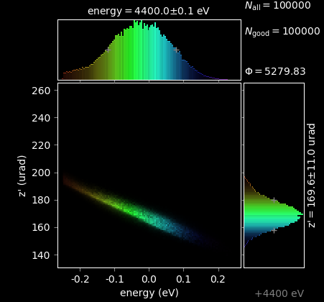
Design 1.2
On focus (tilted)
On 2nd focus
Before last miscut
Detector

Slide 7
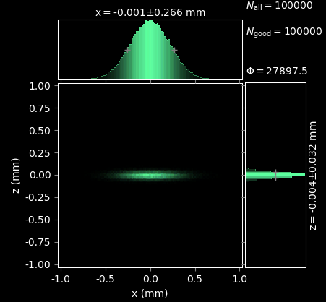
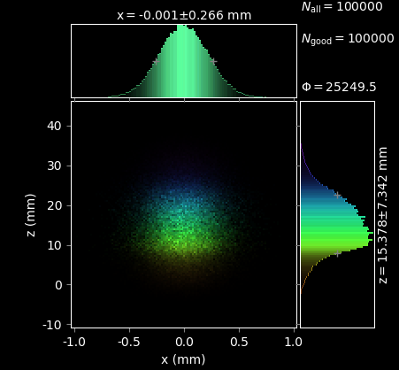
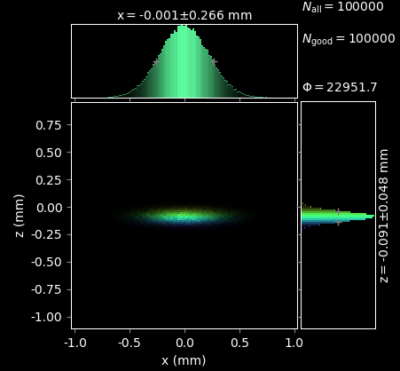
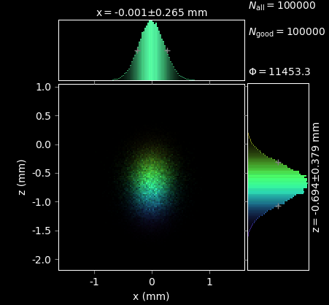

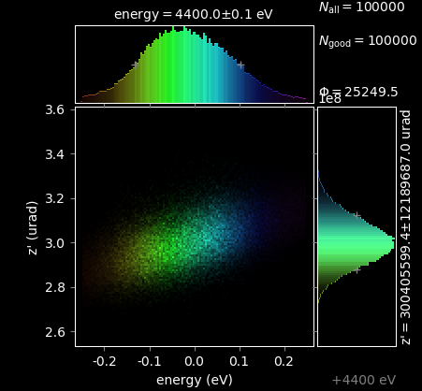
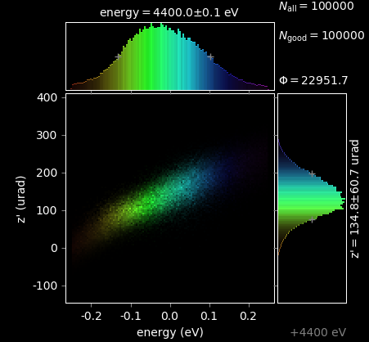
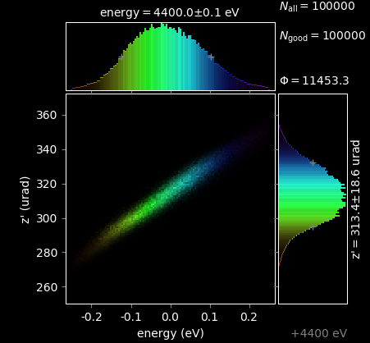
Design 2.0
After first miscut
On focus (tilted)
Before last miscut
Detector

Slide 8

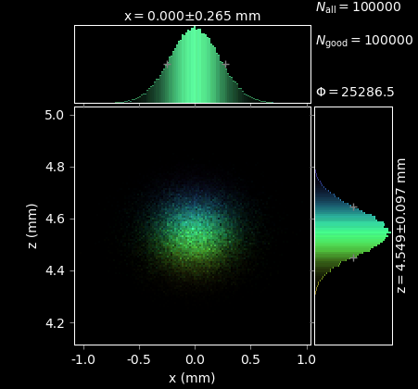
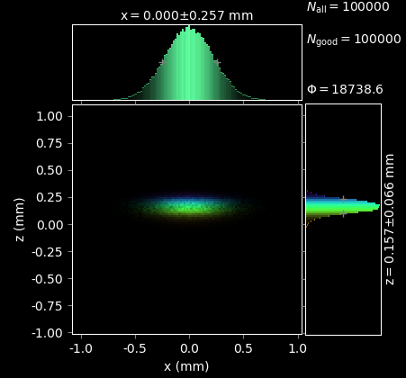
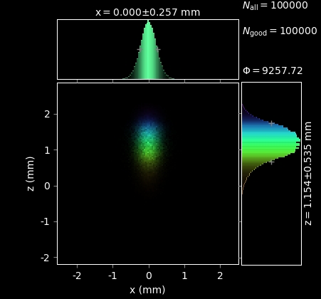

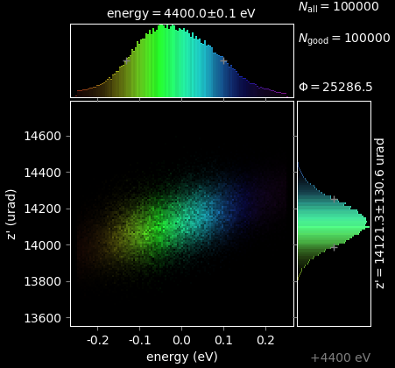
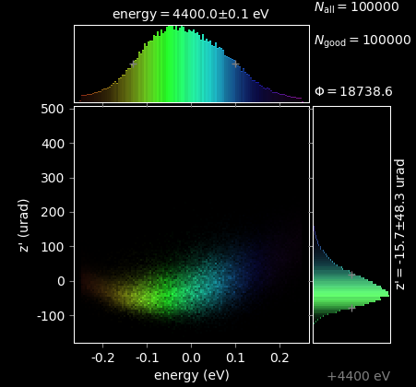
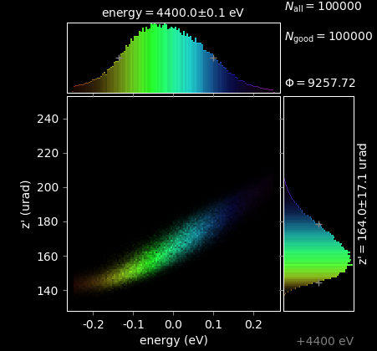
Design 2.2
On focus (tilted)
On 2nd focus
Before last miscut
Detector

Slide 9
Discussion on those first results
The main challenge lies in the rectification of the z’ chirp induced by the first miscut crystal.
Design 1:
Without the mirrors, the chirp is not fully corrected by the second miscut crystal. With the first mirror set, the correction is better and the overall z’ spread at the detector is close to the source value.
Design 2:
Without the mirrors, the chirp can nicely corrected in the design 2. But when adding the first set of mirrors, the beam is flipped at the focal point and the correction is no longer effective.
The z’ versus energy histogram before the second miscut crystal does not have a clear dispersion relation, as compared to just after the first miscut. The set of mirror seems introduce additional modification of divergence of the beam.

Slide 10
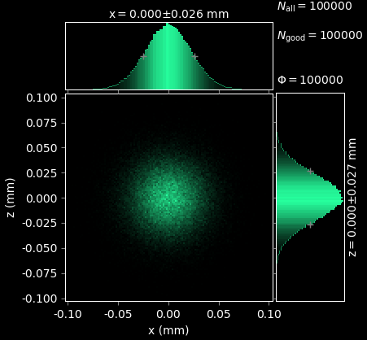
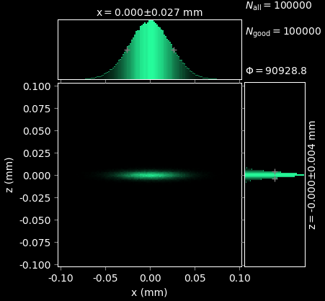
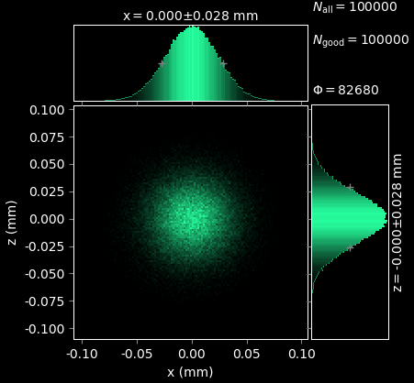
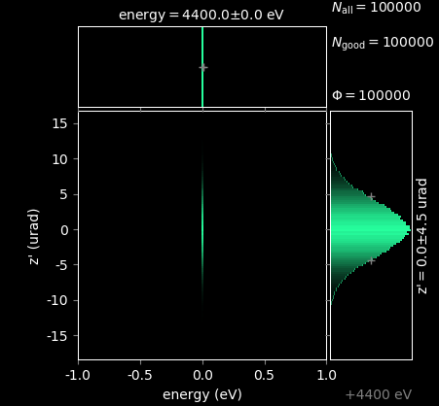
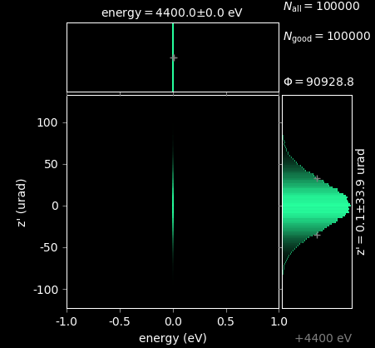
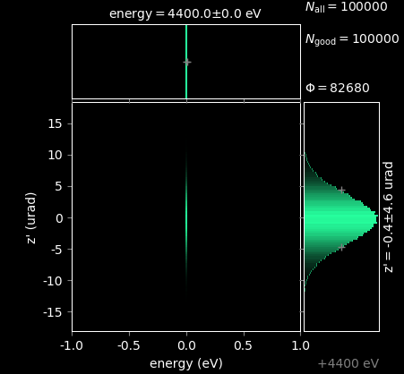
Two mirror tests: parabolic mirrors
Close to the source (2.5m):
Behaves as expected. The beam recovers all its initial properties after the second mirror.

Slide 11






Two mirror tests: parabolic mirrors
At TXI (140 m):
The beam no longer recovers its initial properties. The divergence is particularly affected and will lead to major beam shape change as it propagates.
Why is it so different when the setup is far from the source? Note that the because of the propagation over a long distance, the beam is much larger. Does the beam size on the mirror matters so much?

Slide 12

Mirrors: analytical calculations
$$\left(\begin{matrix}1 & 0 \\ −\frac{1}{f} & 1\end{matrix}\right)\left(\begin{matrix}1 & d \\ 0 & 1\end{matrix}\right)\left(\begin{matrix}1 & 0 \\ −\frac{1}{f} & 1\end{matrix}\right)\left(\begin{matrix}1 & D \\ 0 & 1\end{matrix}\right)\left(\begin{matrix}x \\ θ\end{matrix}\right)=\left(\begin{matrix}−\frac{θ\left(D\left(d−f\right)−df\right)+x\left(d−f\right)}{f} \\ \frac{−θ\left(D\left(−d+2f\right)+df−f^{2}\right)+x\left(d−2f\right)}{f^{2}}\end{matrix}\right)$$
$$\underset{⇒}{d=2f} \left(\begin{matrix}−θ\left(D−2f\right)−x \\ −θ\end{matrix}\right)$$
For d=2f we recover the initial divergence (albeit the beam flip at the focus, hence the minus sign)

Slide 13




Two mirrors: solution
The limitation of the mirror length along the beam direction helps the bracketing and enables the correct usage of the parameter p for the upstream mirror.
There is still some strange behavior when using a non-divergent source. I.e. the divergence after the upstream mirror is very dependent on the mirror size.
→ this is actually artefacts of the order 10⁻⁹ urad, such as floating point errors.

Slide 14

z vs E at the tilted detector (all designs equivalent)

Slide 15
2Θ correction (crystals only, no mirror)
No correction
XRT correction
XRT + manual correction

Slide 16
To do
I need to understand better how bend mirrors interact with beam size and divergence. It is unexpectedly hard to get the same output beam as the input. Perhaps elliptical mirrors can help.

