Slide 1
PROJECT PRESENTATION
Ransomware Sentinel
Local behavioural ransomware detection and incident response for Windows
Detect · Explain · Investigate · Respond · Audit · Recover where possible
Python 3.13 · PySide6 · watchdog · psutil · SQLite — runs entirely on the user's machine
Notes:
Good morning, everyone. This is Ransomware Sentinel: a desktop application for Windows that watches the folders where people keep their own files, recognises the behaviour typical of ransomware, explains why it raised an alert, and gives the user tools to investigate, respond and keep an audit trail. Everything runs locally on the machine, with no cloud service and no account. In the next ten minutes I will cover the problem, the architecture, how protection starts, how detection and scoring work, the investigation and response workflow, how we tested it, and then I will show a safe live demonstration, before finishing with its limitations.

Slide 2
PROBLEM AND MOTIVATION
Ransomware is a behaviour before it is a signature
▸ Fast and destructive. Files are modified and renamed in bursts within seconds.
▸ New variants appear constantly. A signature only exists after a sample is known.
▸ Users get little explanation. A bare verdict does not say what happened or what to do.
▸ Coverage is often overstated. A green tick rarely says which folders are actually watched.
SENTINEL'S APPROACH
▸ Watch the behaviour, not the file contents
▸ Explain every point of the risk score
▸ Group alerts into one incident per attack
▸ Record every response in a tamper-evident log
▸ Say plainly what is not covered
Ransomware Sentinel · local behavioural ransomware detection and response for Windows
2
Notes:
The problem we set out to address is that ransomware is, first of all, a behaviour. It modifies and renames many files very quickly, often adding an encrypted-looking extension. Signature-based tools can only recognise samples they already know, and when something is flagged, users are often given a verdict without an explanation of what happened or what to do next. Many tools also overstate their coverage. So Sentinel takes a different approach: it watches file-system behaviour in the user's own folders, explains every point of its risk score, groups related alerts into a single incident, records every response action in a tamper-evident log, and is explicit about what it does not cover.

Slide 3
SYSTEM ARCHITECTURE
One local process, clear boundaries
PySide6 GUI
Dashboard · Protected Locations · Activity · Alerts · Incidents · Quarantine · Recovery · Diagnostics · Demo Center
ApplicationController
lifecycle orchestration · joins coordinators · publishes state to the GUI by Qt signals
Monitoring
file + process monitors
Protection
locations, health
Protection flow
scan → monitor
Detection
rules, risk, alerts
Incidents
lifecycle, response
Security state
audit chain, trust
Demo
safe workspace
watchdog + psutil
user-mode filesystem events, process snapshots
SQLite (WAL, schema v4)
events, alerts, incidents, actions, trust
HMAC-chained audit log
DPAPI-protected key, verified at startup
Rules enforced by tests: the GUI makes no security decisions and contains no SQL; coordinators never import each other.
Ransomware Sentinel · local behavioural ransomware detection and response for Windows
3
Notes:
Architecturally, Sentinel is one local desktop process. At the top is the PySide6 interface. It renders what it is told and sends requests; it never makes a security decision and contains no database code. In the middle, the ApplicationController orchestrates the application lifecycle and joins the domain coordinators: monitoring, protected locations, the protection start-up flow, detection, incidents, the security state with the audit chain and trust records, and the demo. The coordinators never import each other. Underneath, watchdog provides user-mode file-system events and psutil provides process snapshots, SQLite stores events, alerts, incidents and response actions, and security-relevant records are written to an HMAC-chained audit log. Several of these rules are not just conventions: architecture tests in the suite fail if, for example, a GUI module imports the database.

Slide 4
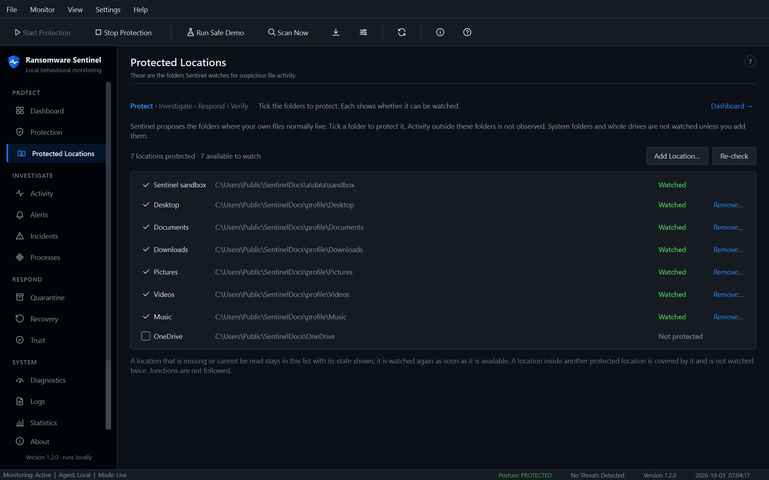
AUTOMATIC PROTECTION
From first launch to continuous monitoring
Setup
choose folders
INITIALIZING
check locations
INITIAL SCAN
names only
MONITORING ACTIVE
continuous
▸ Proposed locations: Desktop, Documents, Downloads, Pictures, Videos, Music via the Windows Known Folder API.
▸ OneDrive is detected but off by default; system folders and drives are never proposed.
▸ Scan first, then monitor: listing files can never be scored as activity.
▸ Safeguards: junctions not followed, nested folders watched once, Sentinel's own files excluded.
Protected Locations: each folder shows whether it can be watched
Ransomware Sentinel · local behavioural ransomware detection and response for Windows
4
Notes:
For a new user, protection starts with a short setup. Sentinel proposes the folders where personal files normally live: Desktop, Documents, Downloads, Pictures, Videos and Music, resolved through the Windows Known Folder API so that a redirected Documents folder is found where it really is. OneDrive is detected but switched off by default, because its sync client produces bursts of activity. System folders and whole drives are never proposed. When the user presses Start Protection, Sentinel checks every location, runs an initial scan that only lists files and checks their names, and only then starts continuous monitoring, so the scan itself can never be mistaken for ransomware activity. Junctions are not followed, a folder inside another protected folder is watched once, and Sentinel's own database and log files are excluded, so its own writes cannot feed back into detection. Locations that are missing or unreadable stay in the list with their state shown, as you can see on the right.

Slide 5
BEHAVIOURAL DETECTION AND RISK SCORING
Five deterministic rules, one explained score
File events
watchdog
Intake
backpressure
Rules
30 s window
Risk 0–100
explained
Alert
cooldown
Incident
correlated
Rule | Default trigger | Points
RAPID_FILE_MODIFICATION | 50 modifications / 30 s | 25
MASS_FILE_RENAME | 20 renames / 30 s | 25
SUSPICIOUS_EXTENSION | ≥ 1 rename to e.g. .locked | 20
MASS_FILE_CREATION | 50 creations / 30 s | 15
HIGH_EVENT_CONCENTRATION | 75 events / 30 s | 15
SEVERITY BANDS
0
NONE
1–29
LOW
30–59
MEDIUM
60–79
HIGH
80–100
CRITICAL
Thresholds are configurable. The risk engine is the only place a score becomes a severity; every alert lists the rules and points behind it.
Ransomware Sentinel · local behavioural ransomware detection and response for Windows
5
Notes:
Detection is deliberately deterministic and explainable; there is no machine learning in it. File events from the monitored folders pass through an intake stage that protects the pipeline under extreme load, and five rules are evaluated over a thirty-second sliding window: rapid modification, mass renaming, renames to suspicious extensions such as dot-locked, mass file creation, and high overall event concentration. Each rule that fires adds a stated number of points, up to one hundred, and the risk engine is the only component that turns the score into a severity band. At sixty points an alert is raised, and related alerts are correlated into one incident per attack. Because the score is a sum of named rules, the interface can always show exactly why it is what it is.

Slide 6
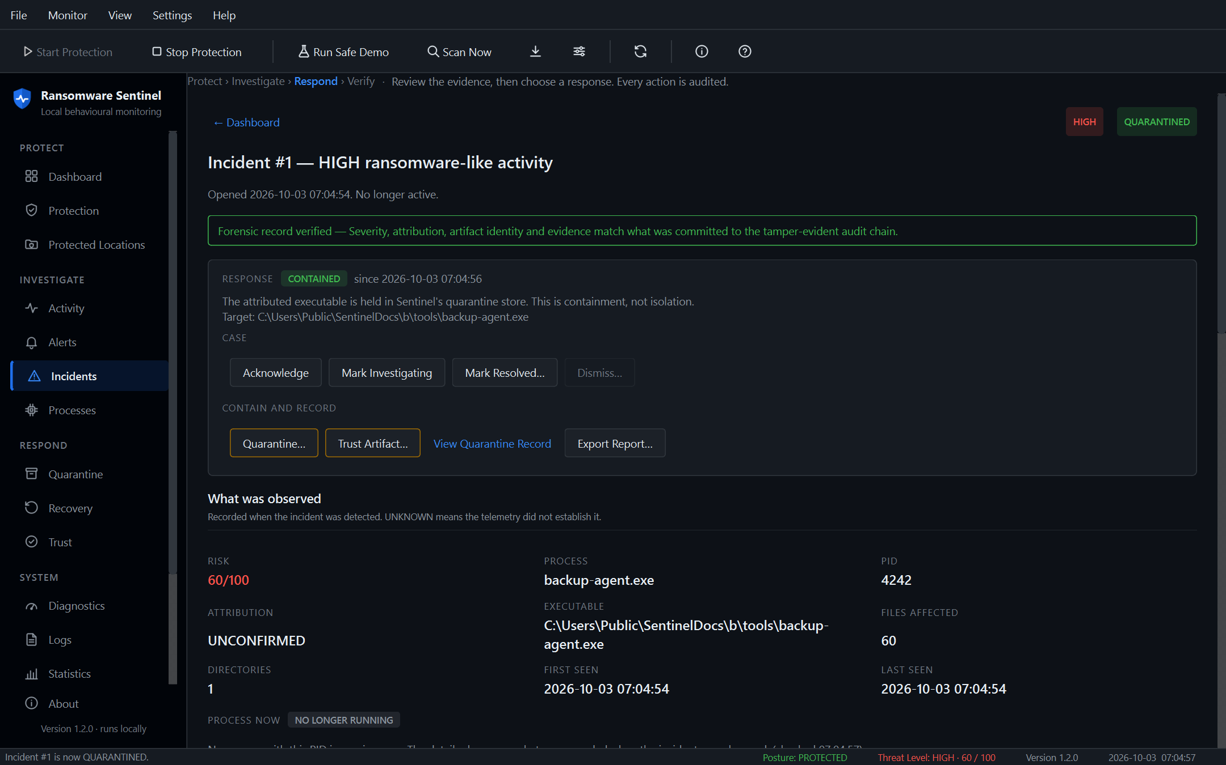
INVESTIGATION, RESPONSE AND AUDIT
One incident per attack, every action recorded
OPEN
INVESTIGATING
CONTAINED / QUARANTINED
RESOLVED
DISMISSED
▸ Evidence: rule contributions, per-file history across renames, linked alerts.
▸ Response: acknowledge, investigate, quarantine, restore, trust, resolve, dismiss.
▸ Quarantine is containment, not isolation; restore verifies the SHA-256 first.
▸ Trust is bound to an executable's hash, with a reason, expiry and revocation.
▸ Audit: HMAC-SHA256 chain with an anchor; verified at startup and on demand.
Incident detail after quarantine (documentation data)
Ransomware Sentinel · local behavioural ransomware detection and response for Windows
6
Notes:
Once an incident exists, Sentinel supports the whole investigation. The incident page shows the rule contributions behind the score, the history of each affected file, following renames as one file, the linked alerts, and a conservative process attribution that says UNKNOWN rather than guessing. The status follows a validated lifecycle from open to investigating, contained or quarantined, and resolved, or dismissed. Every response is chosen by the user and confirmed: quarantine moves the attributed file into Sentinel's store, which is containment, not isolation, and restore checks the file's hash first. Trust decisions are bound to an executable's SHA-256 with a mandatory reason and can be revoked. Each action is recorded with its real outcome, and security-relevant records go into an HMAC-chained audit log that is verified at start-up, so later modification is detected. The screenshot uses documentation data with a harmless file standing in for an attributed executable.

Slide 7
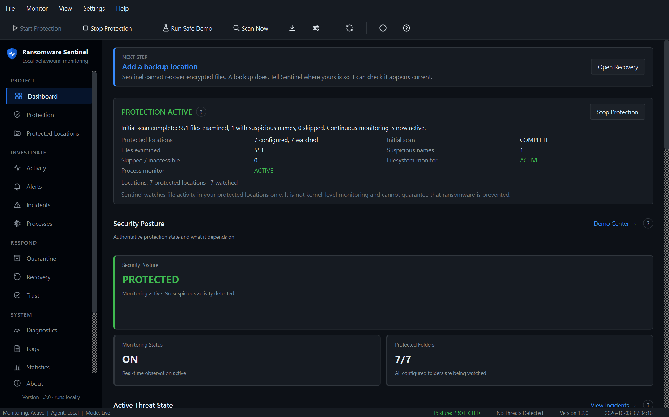
PRODUCT EXPERIENCE
Always clear: the state, the problem, the next step
▸ First-run setup: welcome, locations, initial scan, protection active.
▸ Guided tour: eleven steps that highlight the real controls and say what to do.
▸ Next step banner: one recommended action, decided from the real state.
▸ Workflow navigation: Protect › Investigate › Respond › Verify, plus Learn.
▸ Contextual help: short explanations of risk score, incident, quarantine…
Dashboard: next step, protection status, posture, threats
Ransomware Sentinel · local behavioural ransomware detection and response for Windows
7
Notes:
A large part of this project was turning correct functionality into something a new user can actually follow. On first launch a four-step setup explains what Sentinel does and does not do, lets the user choose folders, runs the initial scan and confirms that protection is active. A guided tour then highlights the real controls on each page and says what to do there. The Dashboard always shows one recommended next step, decided by the backend from the real state: set up protection, start it, open an incident, fix a location, add a backup location, or try the demo. Navigation follows the workflow: protect, investigate, respond and verify. And small help buttons explain terms such as risk score, incident and quarantine where they appear, without promising more than the product does.

Slide 8
TESTING AND VALIDATION
Automated, randomised, and run in the real app
▸ Unit: rules, risk engine, attribution, trust, quarantine, scope model.
▸ Integration: real controller, database and file monitor end to end.
▸ Architecture: GUI never imports SQL, engines or coordinators.
▸ Hostile input: control and bidirectional characters neutralised.
▸ Failure injection: database errors reported, never shown as success.
▸ Demo and protection: real end-to-end runs; scan never scored as activity.
FULL SUITE (RANDOMISED ORDER)
1389 passed, 2 skipped, 0 failed
1391 tests collected · pytest-randomly · 150 s per-test timeout · 2 skips need admin rights (symlink tests)
Plus scripted checks of the launched application: setup, tour, second instance refused, clean shutdown, no orphan processes.
Ransomware Sentinel · local behavioural ransomware detection and response for Windows
8
Notes:
Testing was central to the project. The full automated suite runs in random order with a per-test timeout so that hangs and order dependence show up. The final run gave 1389 passed, 2 skipped, 0 failed, out of 1391 collected tests; the two skipped tests create symbolic links, which Windows only allows with administrator rights or developer mode. The suite covers the rules and risk engine, attribution, trust and quarantine, real end-to-end runs through the controller and database, hostile file names, injected database failures, and architecture rules that fail the build if the interface ever touches the database. Beyond the automated tests, we drove the launched application itself: first-run setup, the guided tour, refusing a second instance, and shutting down cleanly with no orphan processes.

Slide 9
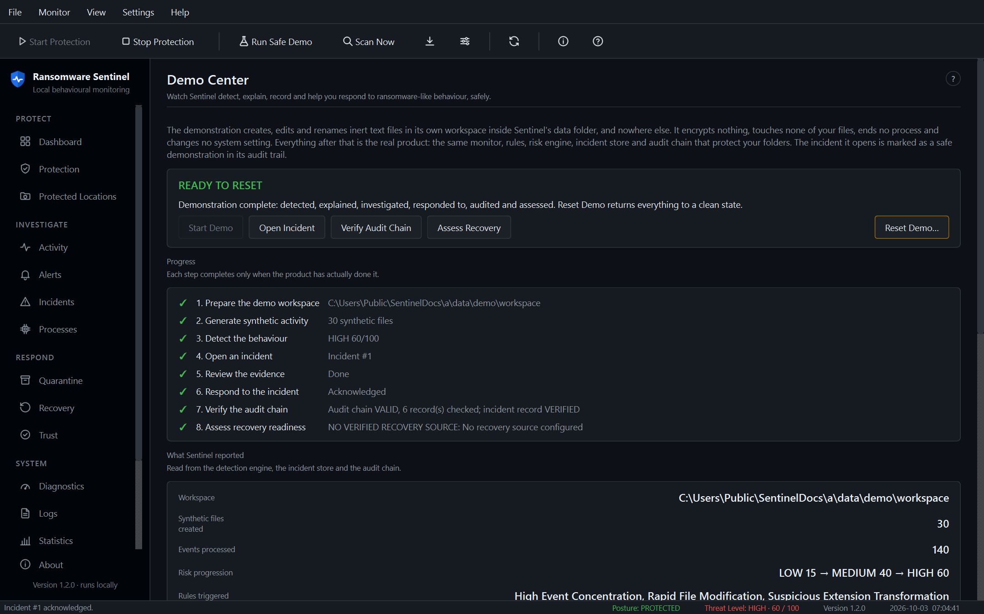
SAFE LIVE DEMONSTRATION
Synthetic files, real pipeline
1
Explain the demo
7
Open the incident and evidence
2
Prepare a clean workspace
8
Respond (acknowledge)
3
Start the demonstration
9
Verify the audit chain
4
Show synthetic activity
10
Assess recovery readiness
5
Show detection (risk rising)
11
Reset: files removed, records kept
6
Show the alert
Demo Center: every step completed by real events
Never: encryption, real user files, process termination, persistence or network activity.
Ransomware Sentinel · local behavioural ransomware detection and response for Windows
9
Notes:
Now the live demonstration, which is completely safe. The Demo Center creates, edits and renames inert text files in its own isolated workspace inside Sentinel's data folder, and nowhere else. It encrypts nothing, touches none of my files, ends no process and changes no system setting. Everything after that is the real product. I press Start Demo; you can see the synthetic activity on the Activity page, the risk score rising as rules fire, and an alert being raised. The alert has opened an incident through the normal routing, marked as a safe demonstration. I open it to show the per-file evidence, acknowledge it as my response, verify the audit chain, and assess recovery readiness. Finally, Reset Demo removes only the files the demo created and dismisses the incident through the normal audited transition, so the records remain but the system is clean.

Slide 10
LIMITATIONS AND FUTURE WORK
Stated plainly, in the product and here
▸ User-mode only: no kernel driver, ETW consumer or minifilter.
▸ Protected locations only: activity elsewhere is not observed.
▸ Attribution is usually UNKNOWN: file events do not name a process.
▸ No prevention guarantee: no process termination or write blocking.
▸ No decryption or file recovery: readiness only checks for a backup.
▸ Tampering is detected, not prevented.
FUTURE WORK
▸ Kernel or ETW telemetry for causal attribution
▸ Process suspension as a confirmed response
▸ Volume Shadow Copy inspection for recovery
▸ Signed installer (MSI/MSIX)
▸ Authenticated telemetry checkpoints
Ransomware Sentinel · local behavioural ransomware detection and response for Windows
10
Notes:
It is important to be clear about the limits. Sentinel is a user-mode application: there is no kernel driver, no ETW consumer and no file-system minifilter, so it only sees the folders it protects and it usually cannot say which process changed a file; it reports UNKNOWN rather than guessing. It does not terminate processes or block writes, so it detects and records but cannot guarantee prevention. It cannot decrypt files or recover them; recovery readiness only checks that a backup appears to exist. And the audit log detects tampering after the fact; it cannot prevent it. Future work would add kernel or ETW telemetry for real causal attribution, a confirmed process-suspension response, Volume Shadow Copy inspection, a signed installer, and authenticated telemetry checkpoints.

Slide 11
CONCLUSION
Ransomware Sentinel
▸ Detects ransomware-like behaviour in the user's own folders with five explainable rules.
▸ Guides a new user from setup to protection, investigation and response.
▸ Records every security action in a tamper-evident audit log.
▸ Demonstrates the full workflow safely, on synthetic files, with a clean reset.
▸ Is honest about coverage: user-mode, protected locations only, no prevention guarantee.
Thank you — questions welcome.
Ransomware Sentinel · local behavioural ransomware detection and response for Windows
11
Notes:
To conclude: Ransomware Sentinel detects ransomware-like behaviour in the folders people care about, using five rules whose every point is explained. It guides a new user from first launch through protection, investigation and response, and it records every security action in a tamper-evident log. The Demo Center lets anyone see the full workflow safely, and it leaves the system clean afterwards. Throughout, it is honest about what it covers and what it cannot do. Thank you for listening; I am happy to take questions.

