Slide 1

INTERNSHIP REPORT
HTML & CSS RESPONSIVE LANDING PAGE
IILM UNIVERSITY
Internship Presentation
GREATER NOIDA
Presented by
AMAN KHAN
B.Tech – Computer Science & Engineering
IILM University, Greater Noida, U.P.
21st August 2026 – 03rd September 2026
Internship Organization: JUST INTERNSHIP
2026–27

Slide 2
ABOUT THE STUDENT
Candidate Profile
Roll Number
[25SCS1003005490]
Aman Khan
B.Tech – Computer Science & Engineering Internship Domain Front-End Web Development Project HTML & CSS Responsive Landing Page
Institute
IILM University, Greater Noida, U.P.
Programme
B.Tech CSE
Internship Duration
21st Aug – 03rd Sep 2026
Organization
Just Internship
HTML & CSS Responsive Landing Page • Aman Khan

Slide 3
ABOUT THE INTERNSHIP
Project-based Front-End Web Development
Internship Focus
Core Technologies
Development Approach
A practical, task-based learning experience focused on building a responsive static landing page using browser-native front-end technologies.
HTML5 CSS3 Flexbox CSS Grid Media Queries Vanilla JavaScript
Progressive implementation from semantic structure to styling, responsive design, interactive navigation, and static deployment readiness.
HTML & CSS Responsive Landing Page • Aman Khan

Slide 4
PROBLEM STATEMENT
Bridging HTML/CSS fundamentals with practical responsive development
Building a landing page that is clear, maintainable and usable across screen sizes requires more than writing static markup.
STRUCTURE
STYLE
RESPOND
INTERACT
Poorly structured HTML can make a page difficult to maintain.
Desktop-only layouts can become difficult to use on tablets and mobile devices.
Inconsistent CSS can reduce visual hierarchy and make future changes harder.
Interactive mobile navigation requires basic DOM and event-handling knowledge.
The project addressed these gaps through a step-by-step implementation using HTML, CSS and Vanilla JavaScript.
Semantic HTML
CSS Theme
Flexbox / Grid
JavaScript
HTML & CSS Responsive Landing Page • Aman Khan

Slide 5
PROJECT OBJECTIVES
What the internship set out to achieve
01
02
03
Semantic HTML
CSS Styling
Responsive Layout
Create a meaningful page structure using HTML5 elements and internal navigation.
Apply typography, colours, spacing, borders and reusable theme variables.
Use Flexbox, Grid and media queries for desktop, tablet and mobile.
04
05
06
JavaScript
Maintainability
Deployment Readiness
Implement a responsive hamburger menu using DOM events and class toggling.
Keep HTML, CSS and JavaScript responsibilities clearly separated.
Prepare the framework-free static project for possible hosting.
HTML & CSS Responsive Landing Page • Aman Khan

Slide 6
TECHNOLOGIES & TOOLS
The toolkit behind the internship
HTML5
CSS3
Flexbox
Semantic structure and page content
Styling, theme, spacing and visual hierarchy
One-dimensional alignment and flexible layouts
CSS Grid
Media Queries
Vanilla JavaScript
Two-dimensional card and content layouts
Responsive behaviour across viewport sizes
DOM interaction and mobile navigation
Static Hosting
Readiness for Netlify, Vercel or GitHub Pages
HTML & CSS Responsive Landing Page • Aman Khan

Slide 7
SYSTEM ARCHITECTURE
From structured page to responsive interactive website
HTML LAYER
Semantic document structure
HTML5
↓
STYLE LAYER
Theme, typography, spacing and visual design
CSS3
↓
LAYOUT LAYER
Flexbox, Grid and media queries
Responsive CSS
↓
INTERACTION LAYER
DOM events and class toggling
Vanilla JavaScript
↓
APPLICATION OUTPUT
Rendered static landing page
Browser
HTML & CSS Responsive Landing Page • Aman Khan

Slide 8
METHODOLOGY
The 4-task development journey
1
2
3
4
Project Setup & Semantic HTML
CSS Theme & Styling
Flexbox / Grid Responsiveness
Navigation & Deployment
Created the project foundation, semantic elements, page sections, footer and internal anchor navigation.
Added the dedicated stylesheet, theme variables, typography, colours, spacing, borders and layout rules.
Introduced responsive grids, wrapping, media queries and layout adjustments for smaller screens.
Added the hamburger menu with Vanilla JavaScript, cleaned the CSS and prepared the static project for hosting.
HTML & CSS Responsive Landing Page • Aman Khan

Slide 9
EXPECTED OUTCOMES
Skills and capabilities developed
Explain the role of semantic HTML in structuring a landing page.
Apply CSS variables, typography, spacing and layout techniques in a maintainable stylesheet.
Use Flexbox and CSS Grid to create flexible page layouts.
Use media queries to adapt content for desktop, tablet and mobile viewports.
Implement basic DOM interaction through JavaScript event listeners.
Build a responsive hamburger navigation without a front-end framework.
Understand the structure and deployment requirements of a static website.
Document a front-end project from requirements through completion.
HTML & CSS Responsive Landing Page • Aman Khan

Slide 10
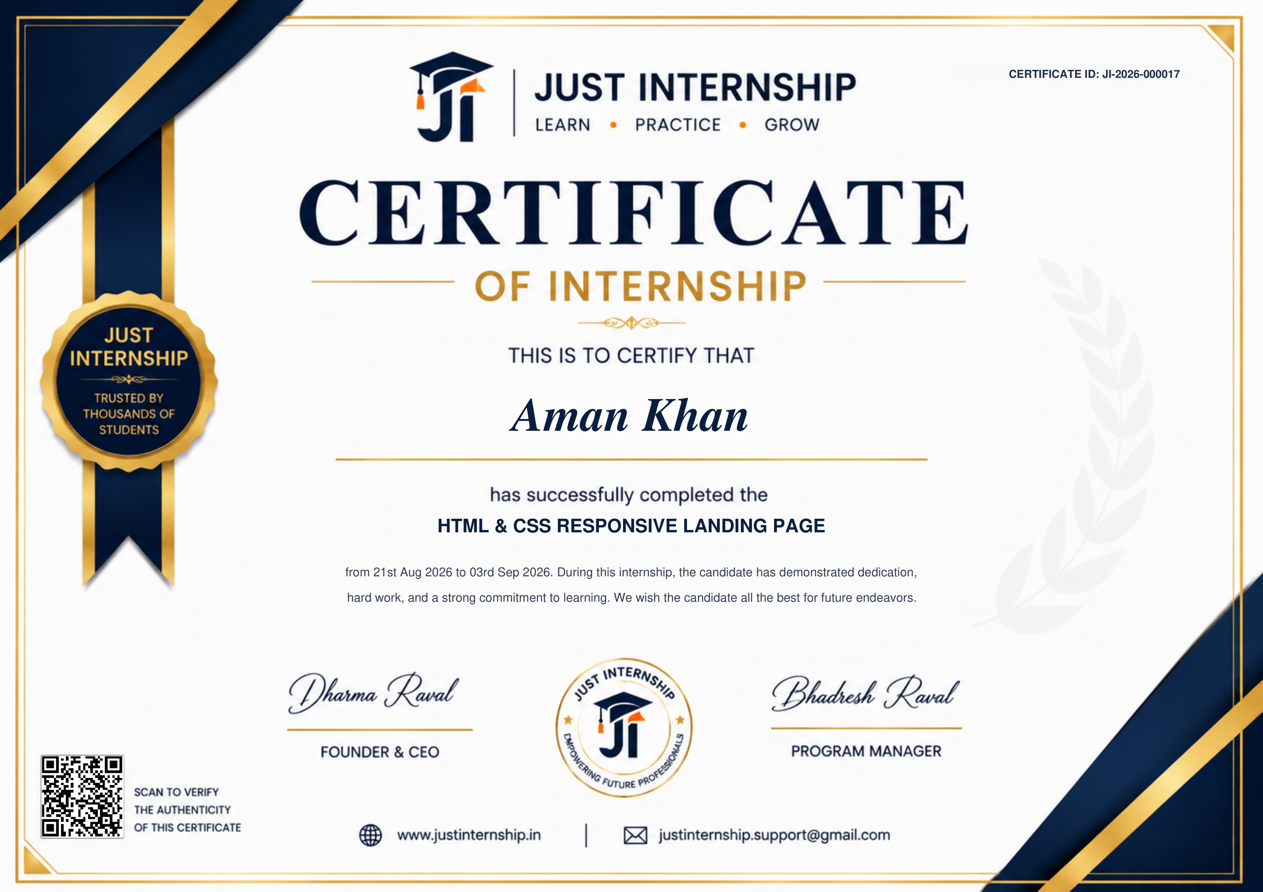
CERTIFICATION
Internship completion evidence
Certificate ID: JI-2026-000017 • Internship: HTML & CSS RESPONSIVE LANDING PAGE • 21st Aug – 03rd Sep 2026
HTML & CSS Responsive Landing Page • Aman Khan

Slide 11
THANK YOU
HTML & CSS Responsive Landing Page
Internship Presentation • Aman Khan
STRUCTURE
DESIGN
INTERACTION
Semantic HTML5
CSS3 + Responsive Layout
Vanilla JavaScript
IILM University, Greater Noida • B.Tech CSE • 2026–27

