Slide 1
LDPC Encoder
For generic LDPC code, Low density characteristic only exist in parity check matrix.
Generator Matrix can have high density of ones and result in high complexity.
Systematic LDPC code with special structure on parity matrix in parity check matrix result in low complexity encoder.
Low Triangular
Generic
Diagonal Structure
IRA-Code
WIFI-Structure
Hybrid

Slide 2
LDPC Encoder Lower Triangular
Generic lower triangular
Parity Bit Nodes
Info bits
parity bits
Information Bit Nodes

Slide 3
LDPC Encoder Lower Triangular
Diagonal Structure in parity matrix
It is very like raptor-code. (raptor-like)
Info bits
parity bits

Slide 4
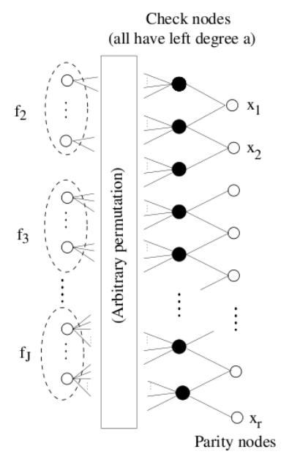
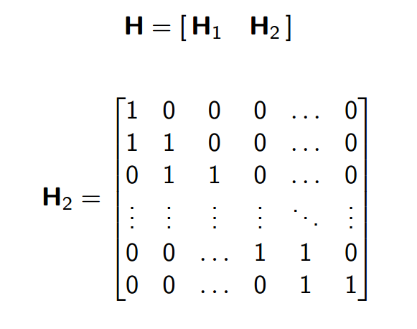
LDPC Encoder Lower Triangular
Irregular Repeat Accumulator Code Structure
It is special case of lower triangular
Encoder is easy by an accumulator.
x1
x2
xr

Slide 5
LDPC Encoder WIFI Structure
802.11n LDPC Code book wit CR=2/3
Accumulator structure
Shift Coefficient Matrix
Three weight column
Dual Diagonal
Apple/Broadcom are sued by Caltech for allegedly infringing Wi-Fi patents

Slide 6
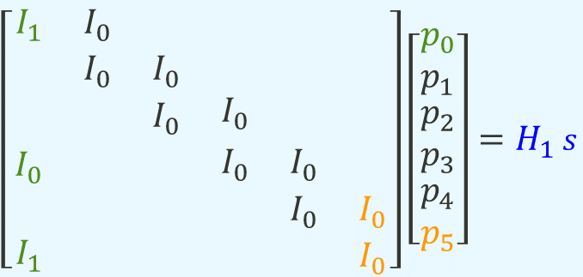


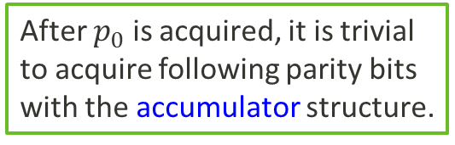
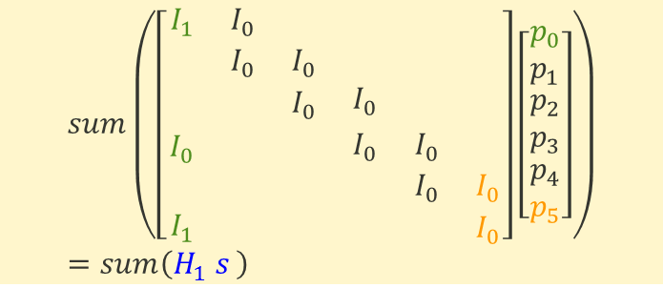
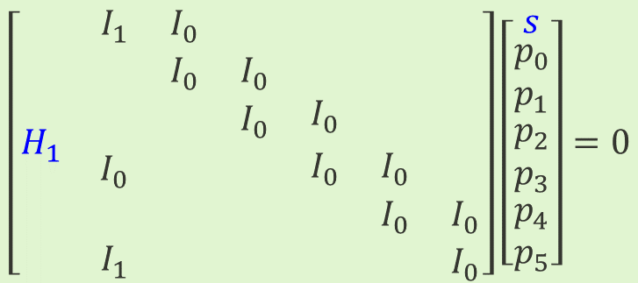
LDPC Encoder WIFI Structure
After $p_{0}$ is acquired, it is trivial to acquire following parity bits with the accumulator structure.
$$\left[\begin{matrix}H_{1} & \begin{matrix}\begin{matrix}I_{1} & I_{0} & \\ & I_{0} & I_{0} \\ & & I_{0}\end{matrix} & \begin{matrix} & & \\ & & \\ I_{0} & & \end{matrix} \\ \begin{matrix}I_{0} & & \\ & & \\ I_{1} & & \end{matrix} & \begin{matrix}I_{0} & I_{0} & \\ & I_{0} & I_{0} \\ & & I_{0}\end{matrix}\end{matrix}\end{matrix}\right]\left[\begin{matrix}s \\ \begin{matrix}p_{0} \\ p_{1} \\ \begin{matrix}p_{2} \\ p_{3} \\ \begin{matrix}p_{4} \\ p_{5}\end{matrix}\end{matrix}\end{matrix}\end{matrix}\right]=0$$
$$p_{0}=sum\left(H_{1} s \right){ \left(I_{0}\right)}^{−1}$$
$$p_{0}I_{0}=sum\left(H_{1} s \right)$$
$\left[\begin{matrix}\begin{matrix}I_{1} & I_{0} & \\ & I_{0} & I_{0} \\ & & I_{0}\end{matrix} & \begin{matrix} & & \\ & & \\ I_{0} & & \end{matrix} \\ \begin{matrix}I_{0} & & \\ & & \\ I_{1} & & \end{matrix} & \begin{matrix}I_{0} & I_{0} & \\ & I_{0} & I_{0} \\ & & I_{0}\end{matrix}\end{matrix}\right]\left[\begin{matrix}p_{0} \\ p_{1} \\ \begin{matrix}p_{2} \\ p_{3} \\ \begin{matrix}p_{4} \\ p_{5}\end{matrix}\end{matrix}\end{matrix}\right]=H_{1}$ $s$
$$p_{0}\left(I_{1}+I_{0}+I_{1}\right)+\left(p_{1}+⋯+p_{5}\right)\left(I_{0}+I_{0}\right)=sum\left(H_{1} s \right)$$
$$sum\left(\left[\begin{matrix}\begin{matrix}I_{1} & I_{0} & \\ & I_{0} & I_{0} \\ & & I_{0}\end{matrix} & \begin{matrix} & & \\ & & \\ I_{0} & & \end{matrix} \\ \begin{matrix}I_{0} & & \\ & & \\ I_{1} & & \end{matrix} & \begin{matrix}I_{0} & I_{0} & \\ & I_{0} & I_{0} \\ & & I_{0}\end{matrix}\end{matrix}\right]\left[\begin{matrix}p_{0} \\ p_{1} \\ \begin{matrix}p_{2} \\ p_{3} \\ \begin{matrix}p_{4} \\ p_{5}\end{matrix}\end{matrix}\end{matrix}\right]\right)=sum\left(H_{1} s \right)$$

Slide 7
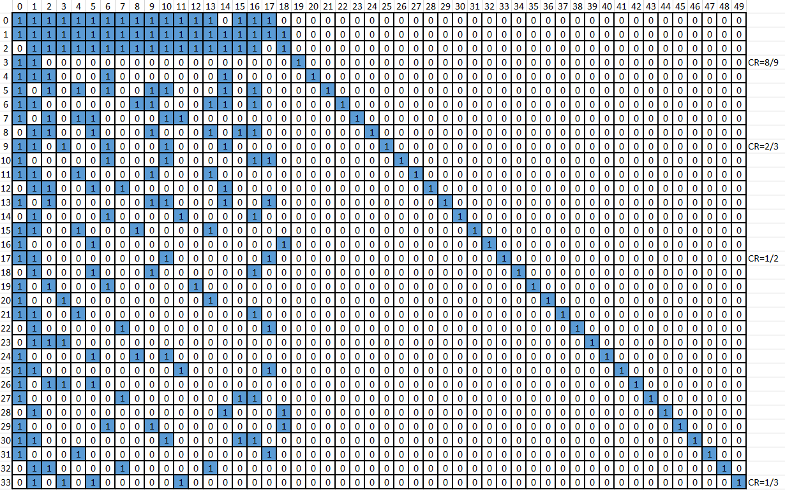
LDPC Encoder Hybrid Structure
Agreed NR eMBB LDPC Code example
WIFI structure
Diagonal structure

