Slide 1
Yorkville business
New opening

Slide 2
Introduction/Business Problem section
Toronto is a big city where the market is opened to new ideas.
A group of investments are ready to open a new business in Toronto.
They plan to open something new in Yorkville neighbourhood.
But the question is what kind of business they should open.
We can help this group of investments by finding out what kind of business they should open in Yorkville.

Slide 3
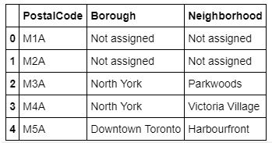
Data section
We can start by taking neighbourhoods Toronto data.
The list of Toronto postal code can be found in this Wikipedia page: https://en.wikipedia.org/wiki/List_of_postal_codes_of_Canada:_M
The table contains poste code, borough and neighbourhood.
We start by parsing the Wikipedia page into html to access the table rows.
We can extract each rows and create a dataframe with 3 columns for postal code, borough and neighbourhood.

Slide 4
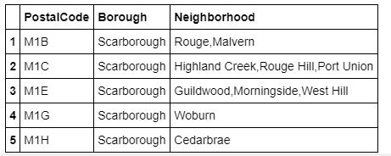
Data section part 2
First, we drop row where borough is not assigned.

Slide 5
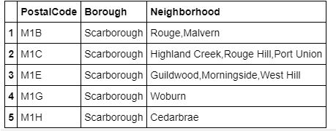
Data section part 3
Second, we combine rows neighbourhood separate by ',' where the postal codes are similar.

Slide 6
Data section part 4
Third, each row that has a borough but not assigned neighbourhood like
should has the same borough value instead of the not assigned neighbourhood like

Slide 7
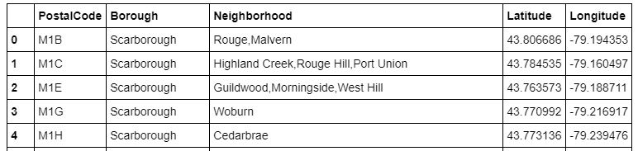
Data section part 4
Then, we can use cvs file of the neighbourhood latitude and longitude location to add them to our dataframe. First, we can extract the location information from the cvs file into a new dataframe. Second, we can add those location informations into the previous dataframe to gather all the neighbourhood information in one single dataframe.
This final dataframe version is parse and transform to be in the correct format for further investigation.

Slide 8
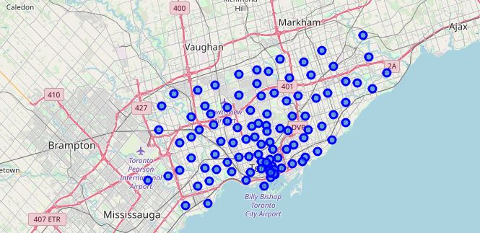
Methodology section
From the final dataframe version, we can display toronto map with the neighbourhoods.

Slide 9
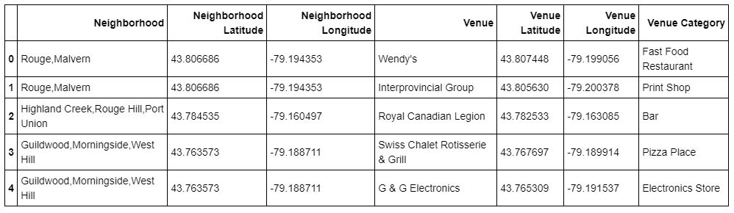
Methodology section part 2
Then, we can use foursquare API to explore each neighbourhoods to get the nearby venues.

Slide 10
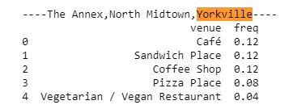
Methodology section part 3
We discover that there are 279 uniques venues categories to consider.
Now, we can analyze each neighbourhood by grouping the rows by neighbourhood, by taking the mean of the frequency of occurrence of each category and by getting the top 5 venues for each neighbourhoods.
We can see that Yorkville neighbourhood is combine with The Annex and North Midtown neighbourhood and we can see the top 5 venues.

Slide 11
Methodology section part 4
We can continue by sorting the venues in descending order, create a new dataframe and get the top 10 venues for each neighbourhoods.The following row is for Yorkville top 8.

Slide 12
Methodology section part 5
We can use the k-means clustering algorithm for unsupervised machine learning like clustering. It covers practice of partitioning on data set into groups that have similar characteristics.
K-means tries to minimize the intra-cluster distances; distance of data points from the centroid. K-means tries to maximize the inter-cluster distances; distance from other cluster centroid. K-means uses dissimilarity measures to find the k value meaning the number of clusters.
The k value depend on the neighbourhood and the fact that we are trying to find the kind of business to open. So for our case, we run k-means to cluster the neighbourhood into 5 clusters.
We can create a new dataframe with cluster and top 10 venues for each neighbourhood and then visualize the clusters.

Slide 13
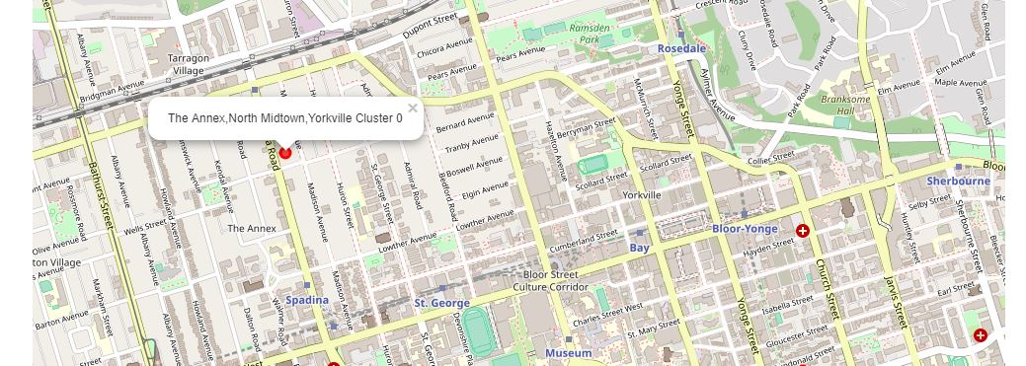
Methodology section part 6
Here we can see the cluster for yorkville neighbourhood:

Slide 14
Results section
From previous picture, the top 8 venues are coffee shop, sandwich place, cafe, pizza place, pharmacy, liquor store, burger joint and flower shop.
From previous picture, the top 5 venues and their frequency, are cafe for 12%, sandwich place for 12%, coffee shop for 12%, pizza place for 8% and vegetarian/vegan restaurant for 4%.
After the use of k-means algorithm for machine learning unsupervised data, we found that
the cluster for yorkville neighbourhood is The Annex, North Midtown, Yorkville cluster 0.

Slide 15
Discussion section
Based on our results, we can recommend different types of business to the group of investments.
We can recommend to open a cafe, sandwich place, coffee shop, pizza place and vegetarian/vegan restaurant in Yorkville neighbourhood.

Slide 16
Conclusion
Like we know Toronto has multiple neighbourhoods where you can find different types of business.
A group of investment is interested in opening a new business in Yorkville neighbourhood, and they asking for our help to know what kind of business they can open.
After our analyze, we conclude that based on our results they should open cafe, sandwich place, coffee shop, pizza place and vegetarian/vegan restaurant.

