Slide 1
Making Makefiles
He “Lonnie” Liu
https://github.com/liulonnie/making-makefiles

Slide 2
Quick Survey
a.o : a.c gcc a.c –c a.o
%.o : %.c | obj $(CC) $(CFLAGS) $^ -o $@
OBJS+=$(patsubst %.c,%.o,$(CFILES)) CFILES=a.c
make_bin = \ $(eval $(call bin_rules,$(1),$(strip $(2))))

Slide 3
Compiling a Project is Complicate
A large project has many files
Compiling a project executes over a graph
Often creates intermediate files
Time consuming to recompile everything
Idea: only recompile the updated parts

Slide 4
Describe the Compilation Graph
(draw a compilation graph)
Version control tracks source changes
Idea: A node is updated if the content changes
make updates the other nodes
Idea: a node needs update if its sources were modified after the time it was modified last time.

Slide 5
What is Makefile?
A makefile describes the compilation graph
Written in “makefile language”
make executes the graph of a makefile
Highly relies on the existing file system and the command line shell

Slide 6
Example 1: hello

Slide 7
The Language of GNUMake
Is quite different from common languages
Graphs are described like functional languages
Graphs are executed like procedural languages
Basic “statements” are shell commands
Uses bash-like “variables”
Sensitive to whitespaces
Might consider other scripting languages
Uses makefile only as the entrance

Slide 8
Before We Make Makefiles
Here is note from StackOverflow:
For a beginner, you are doing some exotic stuff. You should start simple and only use code in your Makefile that you 100% understand and trust. Even on a large project with hundreds of files you will not spend much time maintaining the Makefile.
which can be translated to:
The makefile design often lets you waste too much time on non-critical stuff. You should NOT use it for compiling your large projects.

Slide 9
GNUMake Documentation here:
http://www.gnu.org/software/make/manual/

Slide 10
Basics
Rule
Target: the output
Prerequisites: the ingredients
Recipe: command(s) that create the target
Variable
“Flavors”: Variable-like & Macro-like
Can also be used as functions

Slide 11
Rules
Target: Prerequisites "\t"Recipe
Target: Prerequisites \"\n” more prerequisites "\t"Recipe
Target: Prerequisites; Recipe
Special targets: .PHONY

Slide 12
Variables
Macro-like define: CFLAGS = -O3 –Wall
#ifndef #define: CFLAGS ?= -O3 -Wall
Variable-like define: CFLAGS := -O3 -Wall
Reference: g++ $(CFLAGS) …
Multiline:
define CFILES := -O3 –Wall endef

Slide 13
Make Usage
make
make a.o
make -B
make CFLAGS='-O2 -Wall'
Will override CFLAGS= or CFLAGS:=
CFLAGS="-O2 -Wall" make
Will only override CFLAGS?=
make -f alter.mk

Slide 14
Example 2: basic

Slide 15
Recap
Rules, recipes, variables
Problems:
Hard-coded filenames
Not very reusable

Slide 16
Making Reusable Parts
Pattern Rules
Automatic Variables
Order-only Prerequisites
Functions
Includes
Recursive make

Slide 17
Pattern Rules
%.o: %.cpp
obj/%.o: src/%.cpp g++ $^ -c -o $@

Slide 18
Automatic Variables
$@ = target
$^ = prerequisites
$< = the first prerequisite
$? = prerequisites newer than the target

Slide 19
Order Only Prerequisites
obj: @mkdir -p obj
obj/%.o : src/%.c | obj

Slide 20
Functions
$(wildcard *.cpp,src)
$(patsubst src/%.cpp,obj/%.obj,$(SRCS))
$(addprefix bin/,$(PROGRAMS))
$(filter src/%.h,$(FILES))
$(notdir $(SRCS)) # return filenames
$(shell echo src/*.cpp)

Slide 21
Includes
include Makefile.in
-include deps.mk

Slide 22
Recursive Make
all: make -C src make -C doc make -C tests -f test.mk # tests/test.mk

Slide 23
Example 3: template

Slide 24
Recap
Reusable parts: auto lists, template rules
Problem:
Either, need to manage multiple makefiles
Or, need to write rules for each dir/module
Pattern rules are the only dynamics
No recursive functions
Very project specific, still not universal

Slide 25
Making Dynamic Parts
$(error text) $(warning text) $(info text)
$(call function, parameters, …)
$(eval rules)
$(if condition,then-part,else-part)
$(foreach var,list,text)

Slide 26
Example 4: project
One makefile to rule them all

Slide 27
Example 5: autodep

Slide 28
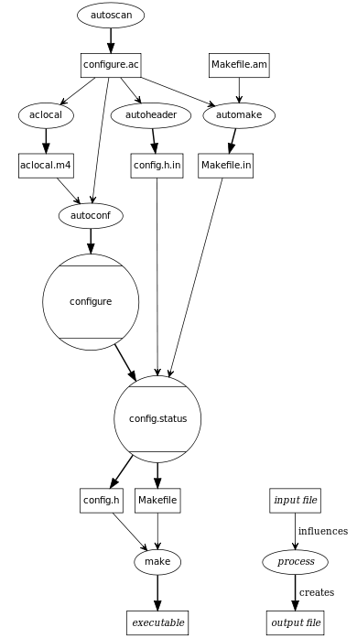
Epilogue
I love makefiles, is there more?
Windows: nmake
automake: generate Makefile.in
cmake: makefile that generates makefiles

Slide 29
And Epilogue for Haters
I hate makefiles. Do I have other choices?
Use Python. Your friends are :
os.system()
os.path.exists() os.path.isfile() os.path.getmtime()
os.makedirs() os.listdir()
Use C. Your friends are:
system() fstat() readdir()

Slide 30
Conculsion
Makefile tells make how to compile projects
It is nice to write simple wrappers
People expect typing make to build
It is non-trivial to write highly reusable ones
Might consider other scripting languages

