Slide 1
Lecture 2: DFA (FSM)
Let’s begin: Finite Automata
Practical Automata:
Automatic Supermarket Doors
Elevators
Vending Machines: Track
Traffic Lights
Lexical Analyzers (Compilers):
Email Input Verifiers

Slide 2





Lecture 2: DFA (FSM)
Let’s begin: Finite Automata
0
1
$$M1$$
0,1
1
$$q3$$
$$q1$$
$$q2$$
0
Input: finite string
Output: Accept or Reject
Computation process: Begin at start state,
read input symbols, follow corresponding transitions,
Accept if end with accept state, Reject if not.
Examples: 01101 → Accept
00101 → Reject
$M1$ accepts exactly those strings in $A$ where
$A = \{w| w$contains substring $11\}.$
1
Say that $A$ is the language of $M1$ and that $M1$ recognizes $A$ and that $A = L(M1)$.
So, Language of a Machine is the set of strings it accepts
Credits: Prof. Michael Sipser, MIT

Slide 3











Finite Automata – Formal Definition
Defn: A finite automaton $M$ is a 5-tuple $(Q, Σ, δ, q0, F)$
$Q$ finite set of states
$Σ$ finite set of alphabet symbols
$δ$ transition function $δ: Q×Σ → Q$
$q0$ start state
$F$ set of accept states
Example:
$δ (q, a) = r$ means
$$q$$
a
$$r$$
0
$$M1$$
1
0,1
$$q1$$
$$q2$$
1
$$q3$$
0
$M1 = (Q, Σ, δ, q1, F)$
$Q = \{q1, q2, q3\}$
$Σ = \{0, 1\}$
$F = \{q3\}$
$$δ=$$
 | 0 | 1
$$q1$$ | $$q1$$ | $$q2$$
$$q2$$ | $$q1$$ | $$q3$$
$$q3$$ | $$q3$$ | $$q3$$
Notes:
Goal- Precise mathematical description

Slide 4
More DFAs…
Design DFAs… Hint: come up with candidate strings
Even # of 0’s
Strings starting with 2 0’s
Write Formal Descriptions of these DFAs…

Slide 5

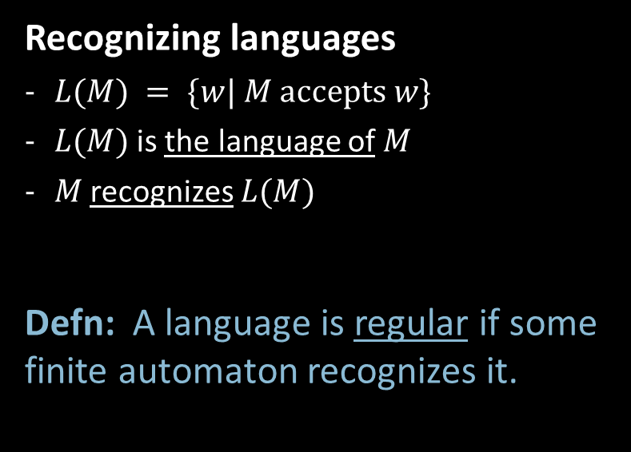
Finite Automata – Computation
Strings and languages
A string is a finite sequence of symbols in $Σ$
A language is a set of strings (finite or infinite)
The empty string ε is the string of length 0
The empty language $ø$ is the set with no strings
Defn: $M$ accepts string $w = w1w2 … wn$each $wi ε Σ$
if there is a sequence of states $r0, r1, r2, ,…, rn ε Q$
where:
- $r0 = q0$
- $ri = δ(r_{i−1}, wi)$ for $1≤i≤n$
- $rn ε F$
Recognizing languages
$L(M) = \{w| M accepts w\}$
$L(M)$is the language of $M$
$M$ recognizes $L(M)$
Defn: A language is regular if some
finite automaton recognizes it.

Slide 6





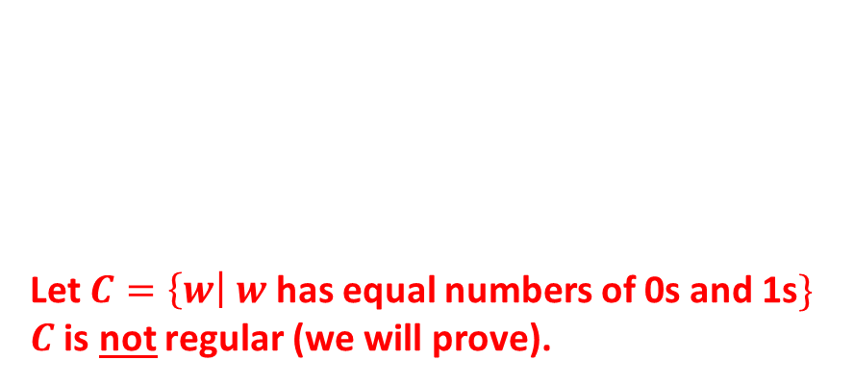
Regular Languages – Examples
$$M1$$
0
1
0,1
1
$$q3$$
$$q1$$
$$q2$$
0
More examples:
Let $B=\left\{w\right| w$has an even number of 1s$\}$
$B$ is regular (make automaton for practice).
Let $C=\left\{w\right| w$has equal numbers of 0s and 1s$\}$
$C$ is not regular (we will prove).
$L\left(M_{1}\right)= \{w| w contains substring 11\}=A$
Therefore $A$ is regular
Goal: Understand the regular languages

Slide 7




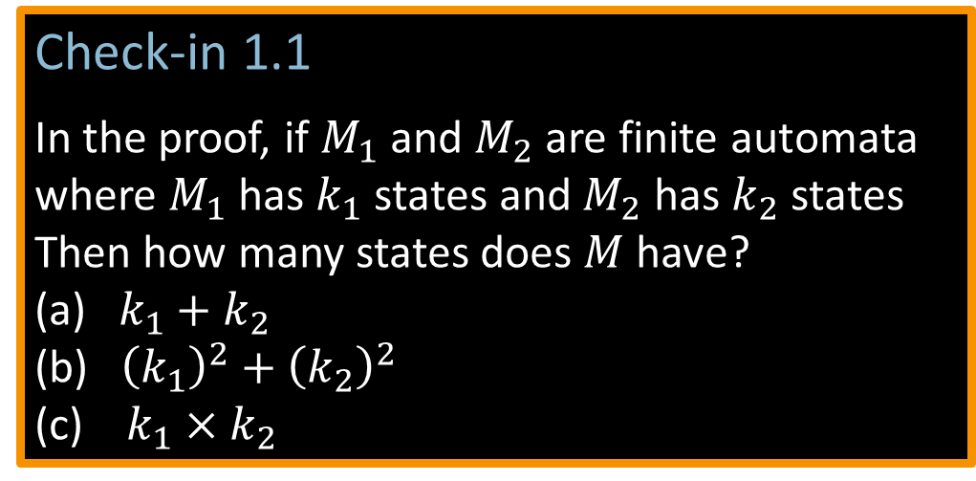




Closure Properties for Regular Languages
Theorem: If ${ A}_{1}, A_{2}$are regular languages, so is $A_{1}∪A_{2}$ (closure under $∪$)
Proof: Let $M_{1}=(Q_{1}, Σ, { δ}_{1}, { q}_{1}, { F}_{1})$ recognize $A_{1}$
$M_{2}=(Q_{2}, Σ, { δ}_{2}, { q}_{2}, { F}_{2})$ recognize $A_{2}$
Construct $M = (Q, Σ, δ, q0, F)$ recognizing ${A_{1}∪A}_{2}$
$M$ should accept input $w$ if either $M_{1}$ or $M_{2}$ accept $w$.
Example…
M1) substring 00
M2) ending in 01
Design M = M1 U M2
Check-in 1.1
In the proof, if $M_{1}$ and $M_{2}$ are finite automata
where $M_{1}$ has $k_{1}$ states and $M_{2}$ has$k_{2}$ states
Then how many states does $M$have?
(a) $k_{1}+k_{2}$
(b) ${\left(k_{1}\right)}^{2}+{\left(k_{2}\right)}^{2}$
(c) $k_{1}×k_{2}$
Components of $M$:
$Q=Q_{1}×Q_{2}$
$=\left\{\left(q_{1},q_{2}\right)\right|q_{1}∈Q_{1}$ and $q_{2}∈Q_{2}\}$
$q_{0}=(q_{1}, q_{2})$
$δ\left(\left(q,r\right),a\right)=\left(δ_{1}\left(q,a\right),δ_{2}\left(r,a\right)\right)$
$F=F_{1}×F_{2}$
$F=\left(F_{1}×Q_{2}\right)∪\left(Q_{1}×F_{2}\right)$
$$M_{1}$$
$$q$$
$$M$$
?
$$q,r$$
$$M_{2}$$
NO! [gives intersection]
$$r$$
Check-in 1.1

Slide 8
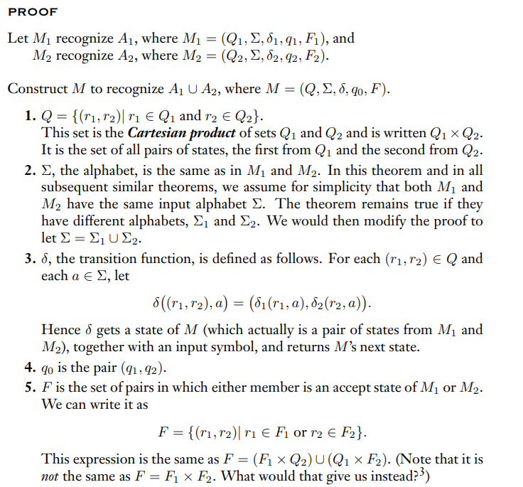
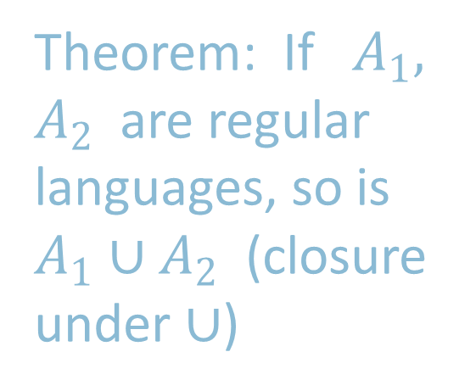
Theorem: If ${ A}_{1}, A_{2}$are regular languages, so is $A_{1}∪A_{2}$ (closure under $∪$)
Do
Worksheet…

Slide 9










Closure Properties continued
Theorem: If ${ A}_{1}, A_{2}$are regular languages, so is $A_{1}A_{2}$ (closure under $∘$)
Proof: Let $M_{1}=(Q_{1}, Σ, { δ}_{1}, { q}_{1}, { F}_{1})$ recognize $A_{1}$
$M_{2}=(Q_{2}, Σ, { δ}_{2}, { q}_{2}, { F}_{2})$ recognize $A_{2}$
Construct $M = (Q, Σ, δ, q0, F)$ recognizing ${A_{1}A}_{2}$
$$M_{1}$$
$$M_{2}$$
$M$ should accept input $w$
if $w=xy$ where
$M_{1}$ accepts $x$ and $M_{2}$ accepts $y$.
$$M$$
$$w$$
$$x$$
$$y$$
Doesn’t work: Where to split $w$?

Slide 10

Quick review of today
Introduction, outline, mechanics, expectations
Finite Automata, formal definition, regular languages
Regular Operations and Regular Expressions
Proved: Class of regular languages is closed under $∪$
Started: Closure under $∘$ , to be continued…

