Slide 1
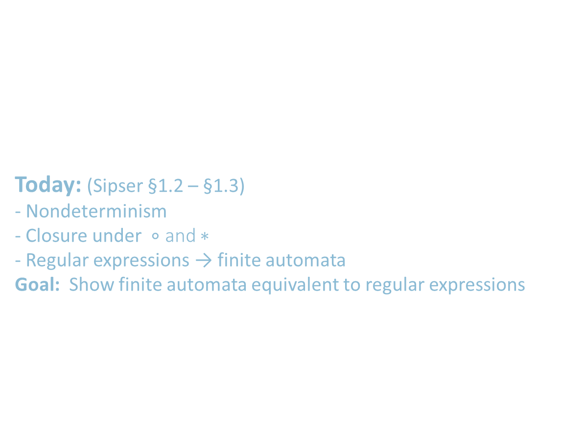
Lecture 3 and 4
Last time: (Sipser §1.1)
- Finite automata, regular languages
- Regular operations $∪, ∘, ∗$
- Regular expressions
- Closure under $∪$
Today: (Sipser §1.2 – §1.3)
- Nondeterminism
- Closure under $∘$ and $∗$
- Regular expressions → finite automata
Goal: Show finite automata equivalent to regular expressions
Credits: Prof. Michael Sipser, MIT

Slide 2










Closure Properties for Regular Languages
Theorem: If ${ A}_{1}, A_{2}$are regular languages, so is $A_{1}A_{2}$ (closure under $∘$)
Recall proof attempt: Let $M_{1}=(Q_{1}, Σ, { δ}_{1}, { q}_{1}, { F}_{1})$ recognize $A_{1}$
$M_{2}=(Q_{2}, Σ, { δ}_{2}, { q}_{2}, { F}_{2})$ recognize $A_{2}$
Construct $M = (Q, Σ, δ, q0, F)$ recognizing ${A_{1}A}_{2}$
M, to figure out, how to
split w! Know the futue?
$$M_{1}$$
$$M_{2}$$
$M$ should accept input $w$
if $w=xy$ where
$M_{1}$ accepts $x$ and $M_{2}$ accepts $y$.
$$M$$
$$w$$
$$x$$
$$y$$
Doesn’t work: Where to split $w$?
Hold off. Need new concept.

Slide 3
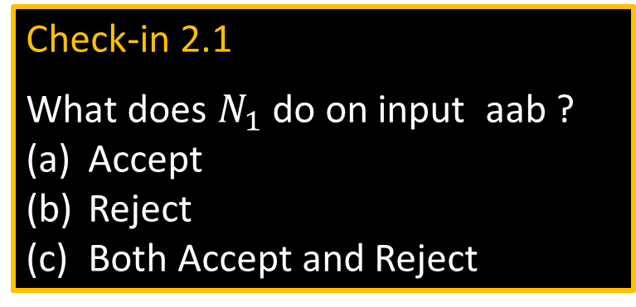





Nondeterministic Finite Automata
$$N1$$
a
a
b
a,ε
$$q4$$
$$q1$$
$$q2$$
$$q3$$
b
New features of nondeterminism:
- multiple paths possible (0, 1 or many at each step)
- ε-transition is a “free” move without reading input
- Accept input if some path leads to accept
Example inputs:
- ab accept
- aa reject
- aba accept
- abb reject
Check-in 2.1
What does $N_{1}$ do on input aab ?
Accept
Reject
Both Accept and Reject
Nondeterminism doesn’t correspond to a physical machine we can build. However, it is useful mathematically.
Check-in 2.1

Slide 4


NFA – Formal Definition
$$N1$$
a
a
b
a,ε
$$q4$$
$$q1$$
$$q2$$
$$q3$$
b
Defn: A nondeterministic finite automaton (NFA) $N$ is a 5-tuple $(Q, Σ, δ, q0, F)$
- all same as before except $δ$
- $δ:Q×Σ_{\text{ε}}→𝓟\left(Q\right)=\left\{R\right|R⊆Q\}$
- In the $N_{1}$ example: $δ\left(q_{1},\text{a} \right)=\{q_{1},q_{2}\}$
$δ\left(q_{1},\text{b} \right)= ∅$
states
alphabet
start state
Ways to think about nondeterminism:
Computational: Fork new parallel thread and accept if any thread leads to an accept state.
Mathematical: Tree with branches.
Accept if any branch leads to an accept state.
Magical: Guess at each nondeterministic step which way to go. Machine always makes the right guess that leads to accepting, if possible.
accept states
transition function
power set(subset of Q)
$$Σ∪\{\text{ε}\}$$

Slide 5
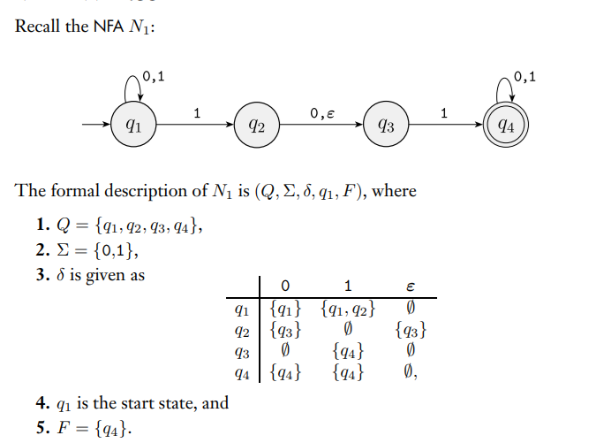
Formal Desc of NFA
Conversions next…

Slide 6
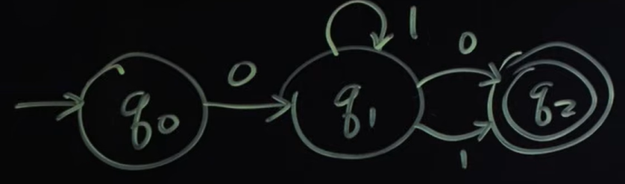
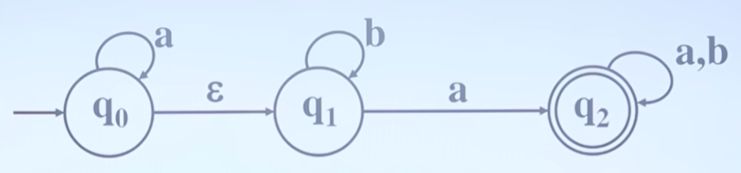
Converting NFAs to DFAs… Convert these…
Ex:1
00, 010
0110, 01110
01, 011, 0111, 01111
Ex:2
a, aab, aaa

Slide 7
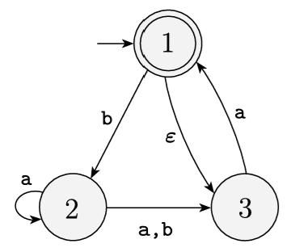
More Converting NFAs to DFAs…
Do as Worksheet

Slide 8




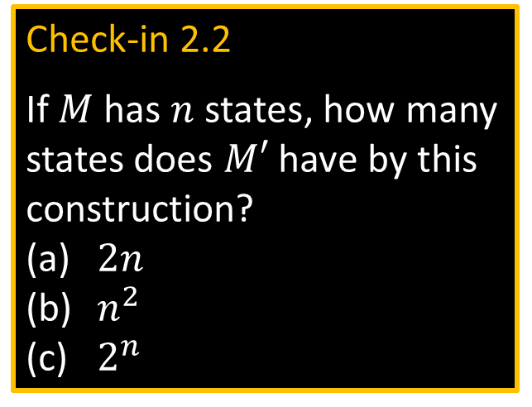




Converting NFAs to DFAs
Theorem: If an NFA recognizes $A$ then $A$ is regular
Proof: Let NFA $M=(Q, Σ,δ, { q}_{0}, F)$ recognize $A$
Construct DFA $M′=(Q′, Σ,δ′, { q}_{0}^{′}, F′)$ recognizing $A$
(Ignore the ε-transitions, can easily modify to handle them)
IDEA: DFA $M′$ keeps track of the subset of possible states in NFA $M$.
Check-in 2.2
If $M$ has $n$ states, how many states does $M′$ have by this construction?
$2n$
$n^{2}$
$2^{n}$
$$M′$$
Construction of $M′$:
$Q′=𝓟\left(Q\right)$
$δ^{′}\left(R,a\right)=\left\{q\right| q∈δ(r,a)$ for some $r∈R\}$
$q_{0}^{′}=\{q_{0}\}$
$F′=\left\{R∈Q^{′}\right| R$ intersects $F\}$
$$M$$
$${ q}_{3}$$
${ \{q}_{3}$,$q_{7}\}$
$R∈Q′$
$${ q}_{7}$$
NFA
DFA
Check-in 2.2

Slide 9
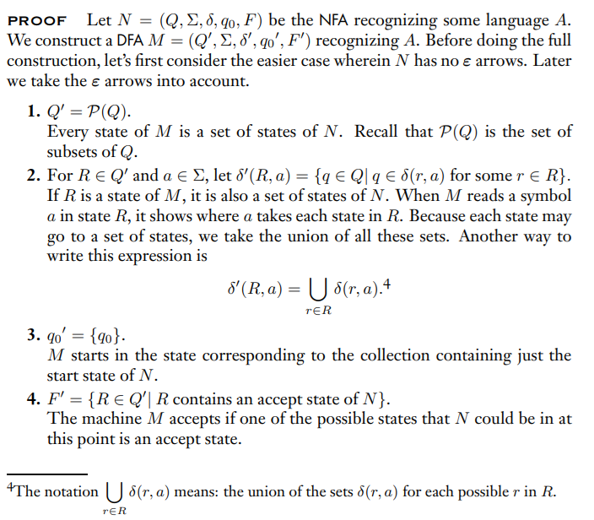
Converting NFAs to DFAs
Formal Proof
Why Nondeterminism? coming up…

Slide 10


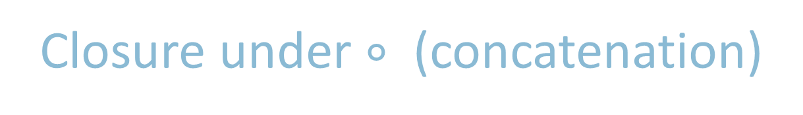






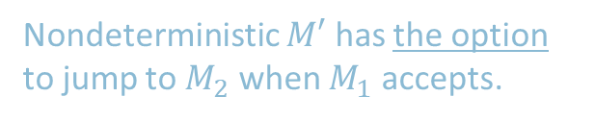
Closure under $∘$ (concatenation)
1) Why Non determinism?
Example for motivation followed by 2) Formal Proof than
3) NFM to FSM conversion
Theorem: If $A_{1}, A_{2}$are regular languages, so is $A_{1}A_{2}$
Proof sketch: Given DFAs $M_{1}$ and $M_{1}$ recognizing $A_{1}$ and$A_{2}$
Construct NFA $M$ recognizing $A_{1}A_{2}$
$$M$$
$$M_{1}$$
$$M_{2}$$
ε
$M$ should accept input $w$
if $w=xy$ where
$M_{1}$ accepts $x$ and $M_{2}$ accepts $y$.
ε
$$w=$$
$$x$$
$$y$$
Nondeterministic $M′$ has the option to jump to $M_{2}$ when $M_{1}$ accepts.

Slide 11
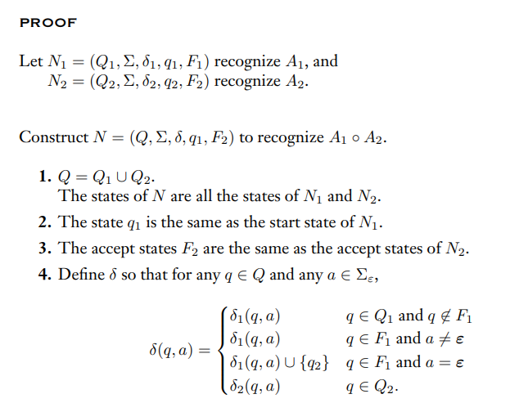

Closure under $∘$ (concatenation) – Formal Proof
Can Concatenation be done without Non Determinism?

Slide 12




More Closure Properties
Recall Theorem: If $A_{1}, A_{2}$are regular languages, so is $A_{1}∪A_{2}$
(The class of regular languages is closed under union)
New Proof (sketch): Given DFAs $M_{1}$ and $M_{2}$ recognizing $A_{1}$ and$A_{2}$
Construct NFA $M$ recognizing $A_{1}∪A_{2}$
Example and Proof
$$M$$
$$M_{1}$$
Nondeterminism
parallelism
vs
guessing
Can be understood both ways!
ε
$$M_{2}$$
ε

Slide 13
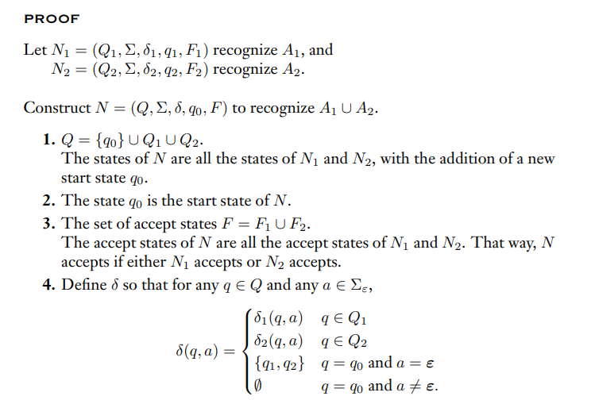

Closure under $U$ (union) – Formal Proof
Can Union be done without Non Determinism?

Slide 14

Quick review of today
Nondeterministic finite automata (NFA)
Proved: NFA and DFA are equivalent in power
Proved: Class of regular languages is closed under $∘$

