Slide 1
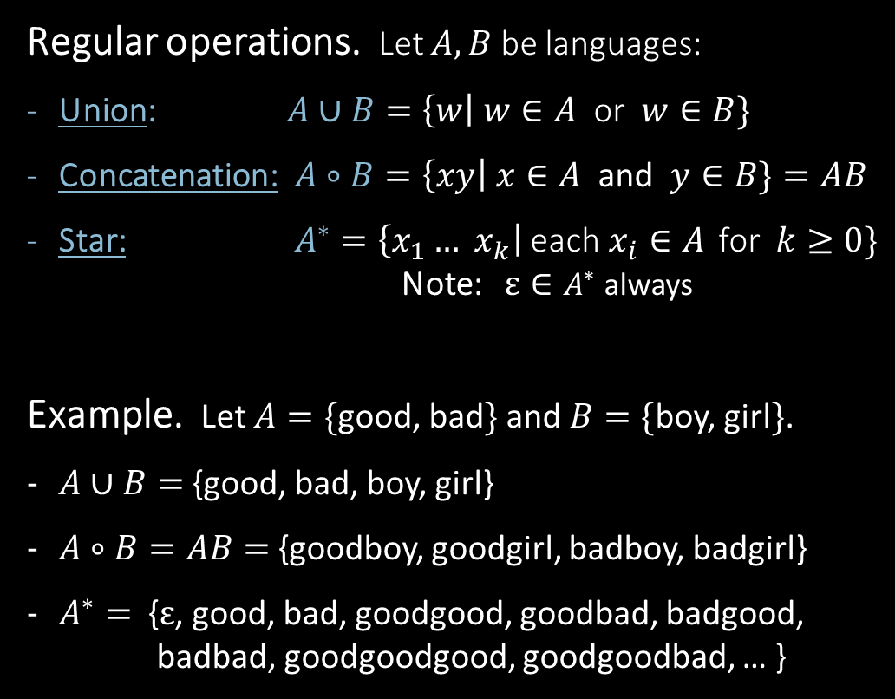

Regular Expressions
Regular operations. Let $A,B$ be languages:
Union: $A∪B=\left\{w\right| w∈A$ or $w∈B\}$
Concatenation: $A∘B=\left\{xy\right| x∈A$ and $y∈B\}=AB$
Star: $A^{∗}=\left\{x_{1}… x_{k}\right|$each$x_{i}∈A$ for $k≥0\}$
Note: $ε∈A^{∗}$ always
Example. Let $A=\{$good, bad$\}$ and $B=\{$boy, girl$\}$.
$A∪B=${good, bad, boy, girl}
$A∘B=AB=$ {goodboy, goodgirl, badboy, badgirl}
$A^{∗}=$ {$ε$, good, bad, goodgood, goodbad, badgood,
badbad, goodgoodgood, goodgoodbad, … }
Regular expressions
Built from $Σ$, members $Σ, ∅,ε$ [Atomic]
By using $∪, ∘, ∗$ [Composite]
Examples:
${\left(0∪1\right)}^{∗}=Σ^{∗}$ gives all strings over $Σ$
$Σ^{∗}1$ gives all strings that end with 1
$Σ^{∗}11Σ^{∗}=$all strings that contain 11 $=L\left(M_{1}\right)$
Goal: Show finite automata equivalent to regular expressions

Slide 2
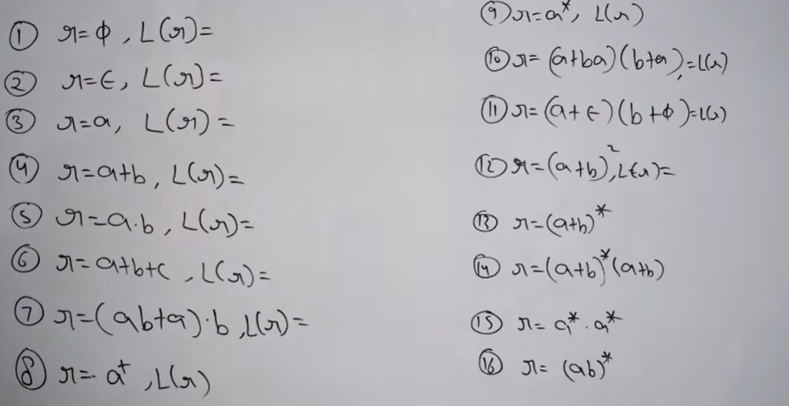
Regular Expressions….

Slide 3
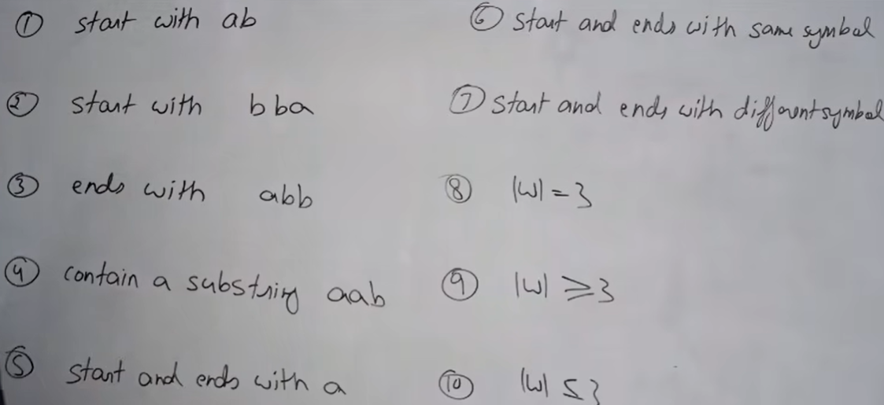
Regular Expressions for Regular Languages

Slide 4
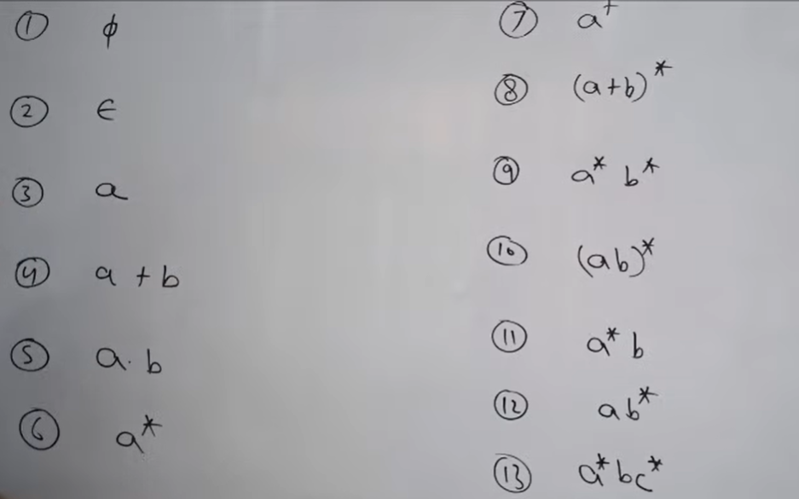
Regular Expressions to NFA Conversion

Slide 5
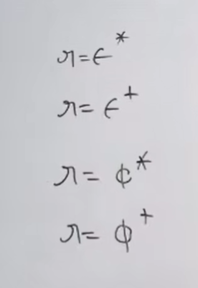
Regular Expressions….

Slide 6

Quick review of today
Introduction, outline, mechanics, expectations
Finite Automata, formal definition, regular languages
Regular Operations and Regular Expressions
Proved: Class of regular languages is closed under $∪$
Started: Closure under $∘$ , to be continued…

