Slide 1
Lecture 9,10
Last time:
- Finite automata → regular expressions
- Proving languages aren’t regular
- Context free grammars
Today: (Sipser §2.1)
- Context free grammars (CFGs) – definition
- Context free languages (CFLs)
Credits: Prof. Michael Sipser, MIT

Slide 2
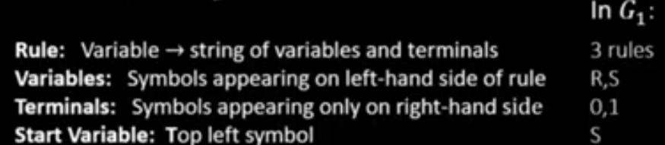








Context Free Grammars (CFGs)
$$G_{1}$$
S $→$ 0S1
S $→$ R
R $→$ $ε$
Shorthand:
S $→$ 0S1 | R
R $→$ $ε$
Recall that a CFG has terminals, variables, and rules.
Grammars generate strings
Write down start variable
Replace any variable according to a rule
Repeat until only terminals remain
Result is the generated string
$L(G)$ is the language of all generated strings
We call $L(G)$ a Context Free Language.
Example of $G_{1}$ generating a string
Tree of
substitutions
“parse tree”
S
0S1
0S1
R
$$ε$$
S
0S1
00S11
00R11
0011
Resulting
string
$$∈L\left(G_{1}\right)$$
Another Example G2…
$$L\left(G_{1}\right)=\left\{0^{k}1^{k}\right| k≥0\}$$

Slide 3



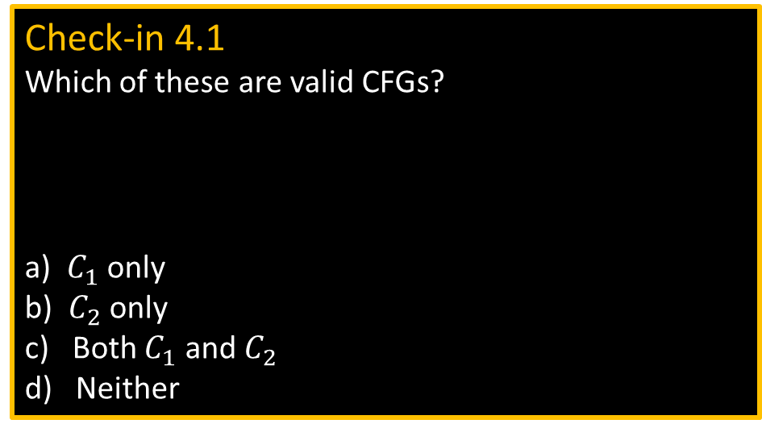




CFG – Formal Definition
Defn: A Context Free Grammar (CFG) $G$ is a 4-tuple $(V,Σ, R,S)$
$V$ finite set of variables
$Σ$ finite set of terminal symbols
$R$ finite set of rules (rule form: $V→{\left(V∪Σ\right)}^{∗}$ )
$S$ start variable
For $u,v∈{\left(V∪Σ\right)}^{∗}$ write
1) $u⇒v$ if can go from $u$ to $v$ with one substitution step in $G$
2) $u⇒v$ if can go from $u$ to $v$ with some number of substitution steps in $G$
$u⇒u_{1}⇒u_{2}⇒⋯⇒u_{k}=v$ is called a derivation of $v$ from $u$.
If $u=S$ then it is a derivation of $v$.
$L\left(G\right)=\left\{w\right| w∈Σ^{∗}$ and $S⇒w\}$
Defn: $A$ is a Context Free Language (CFL) if $A=L(G)$ for some CFG $G$.
Check-in 4.1
Which of these are valid CFGs?
a) $C_{1}$ only
b) $C_{2}$ only
c) Both $C_{1}$ and $C_{2}$
d) Neither
$$∗$$
$C_{1}$:
B $→$ 0B1 | $ε$
B1 $→$ 1B
0B $→$ 0B
$C_{2}$:
S $→$ 0S | S1
R $→$ RR
$$∗$$
Check-in 4.1

Slide 4




CFG – Example
$$G_{2}$$
E $→$ E+T | T
T $→$ T×F | F
F $→$ ( E ) | a
Parse
tree
E
E+T
T T× F
F F a
a a a
E
E+T
T+T×F
F+F×a
a+a×a
Resulting
string
$V=$ {E, T, F}
$Σ=$ {+, ×, (, ), a}
$R=$ the 6 rules above
$S=$ E
$$∈L\left(G_{2}\right)$$
Check-in 4.2
How many reasonable distinct meanings does the following English sentence have?
The boy saw the girl with the mirror.
1
2
3 or more
Generates a+a×a, (a+a)×a, a, a+a+a, etc.
Observe that the parse tree contains additional information,
such as the precedence of × over + .
If a string has two different parse trees then it is derived ambiguously
and we say that the grammar is ambiguous.
Check-in 4.2

Slide 5
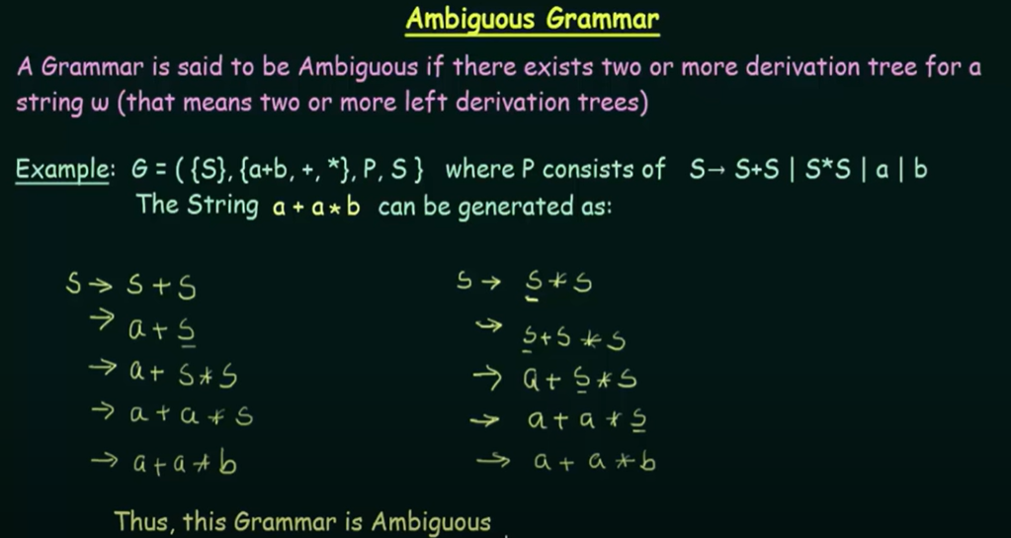
Ambiguity

Slide 6
Design Grammars / Closure Properties
Design Grammars!
CFL’s closed under:
Union
Concatenation
CFL’s NOT closed under:
Intersection
Compliment

Slide 7
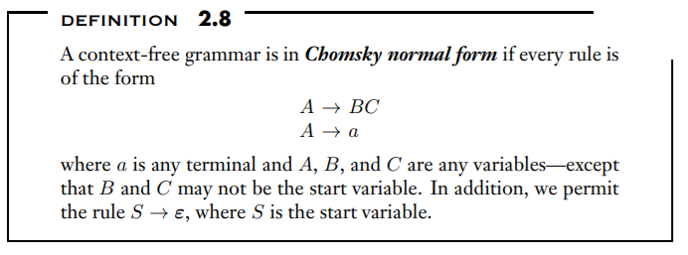
Chomsky Normal Form - CNF
Motivations for CNF!
Every string of length n is derived in 2n-1 steps
Proof for pumping lemma for CFL
Every CFG has an equivalent PDM
CFG TO CNF Conversion Steps:
Start variable not on RHS
Remove E (Epsion) productions
Remove Unit Productions
RHS should have Non Terminals or Terminals only; i.e. transform Nonterminal-Terminal Combo into NontTerminal-NonTerminal Combo.
Remove Long productions

Slide 8
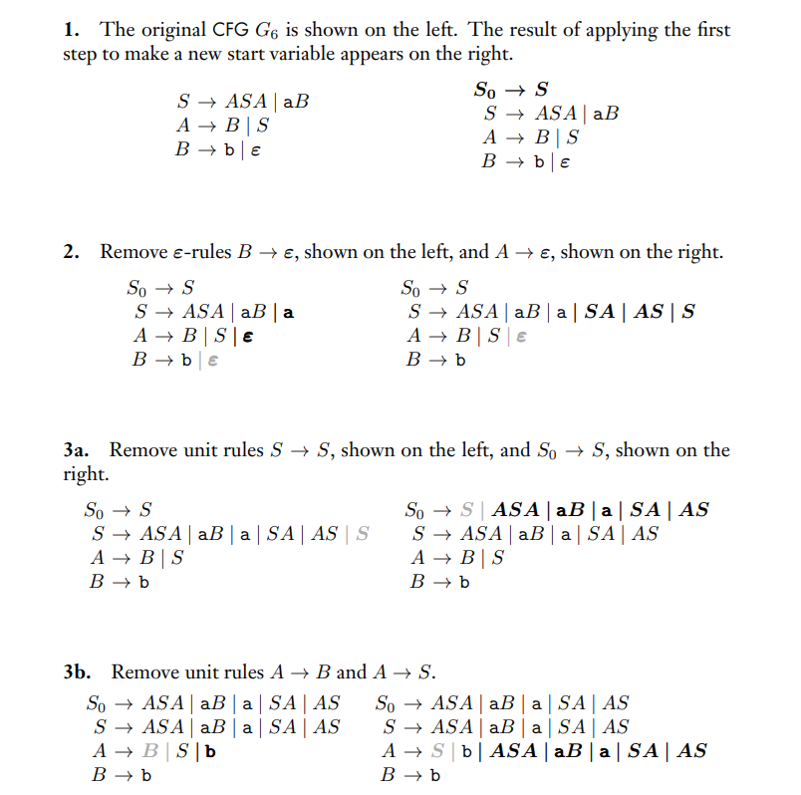
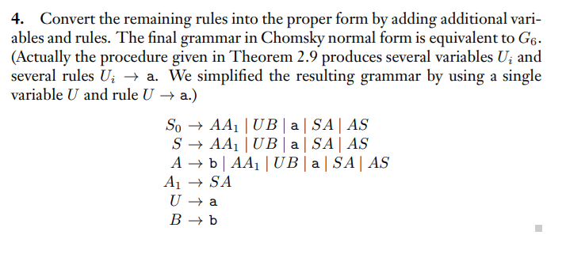
Chomsky Normal Form - Example

Slide 9
Recap
 | Recognizer | Generator
Regular language | DFA or NFA | Regular expression
Context Free language | PDA | Context Free Grammar
Context Free languages
Regular languages

Slide 10
Quick review of today
Defined Context Free Grammars (CFGs)
and Context Free Languages (CFLs)
Defined Pushdown Automata(PDAs)
Gave conversion of CFGs to PDAs.

