Slide 1
CS/PHYS-314/300: Quantum Computing
Unit 03:
Quantum Gates and Bloch Sphere
Habib University – Shaping Futures
Faisal Alvi
(For any suggested modifications please email: faisal.alvi@sse.habib.edu.pk)

Slide 2
Unit Outline
Recap – Unitary Matrices
The Pauli Matrices
Hadamard Operation and Measurement
Qubit – Amplitude and Phase
The Bloch Sphere [Nielsen and Chuang: Chapter 1]
Summary
[Reference] https://quantum.cloud.ibm.com/learning/en/courses/basics-of-quantum-information

Slide 3
Unitary Operations
Recall from the previous unit that we were introduced to unitary operations.
In this unit we build upon that content, and illustrate further operations.
We also give an overview of the Bloch Sphere – a visualization tool for a single qubit.

Slide 4


Recap – Unitary Matrices
A square matrix U with complex number entries is called a unitary matrix if it satisfies the following condition:
Here U† is the conjugate transpose of U, while 1 is the identity matrix.
The condition that U is unitary is equivalent to the condition that multiplication by U does not change the Euclidean norm of any vector.

Slide 5
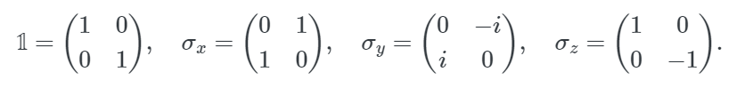
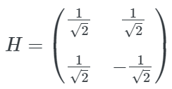

Recap – Some well known unitary matrices
Pauli Operations: The four well known Pauli matrices are:
Hadamard Operation: 3. Phase Operation:

Slide 6
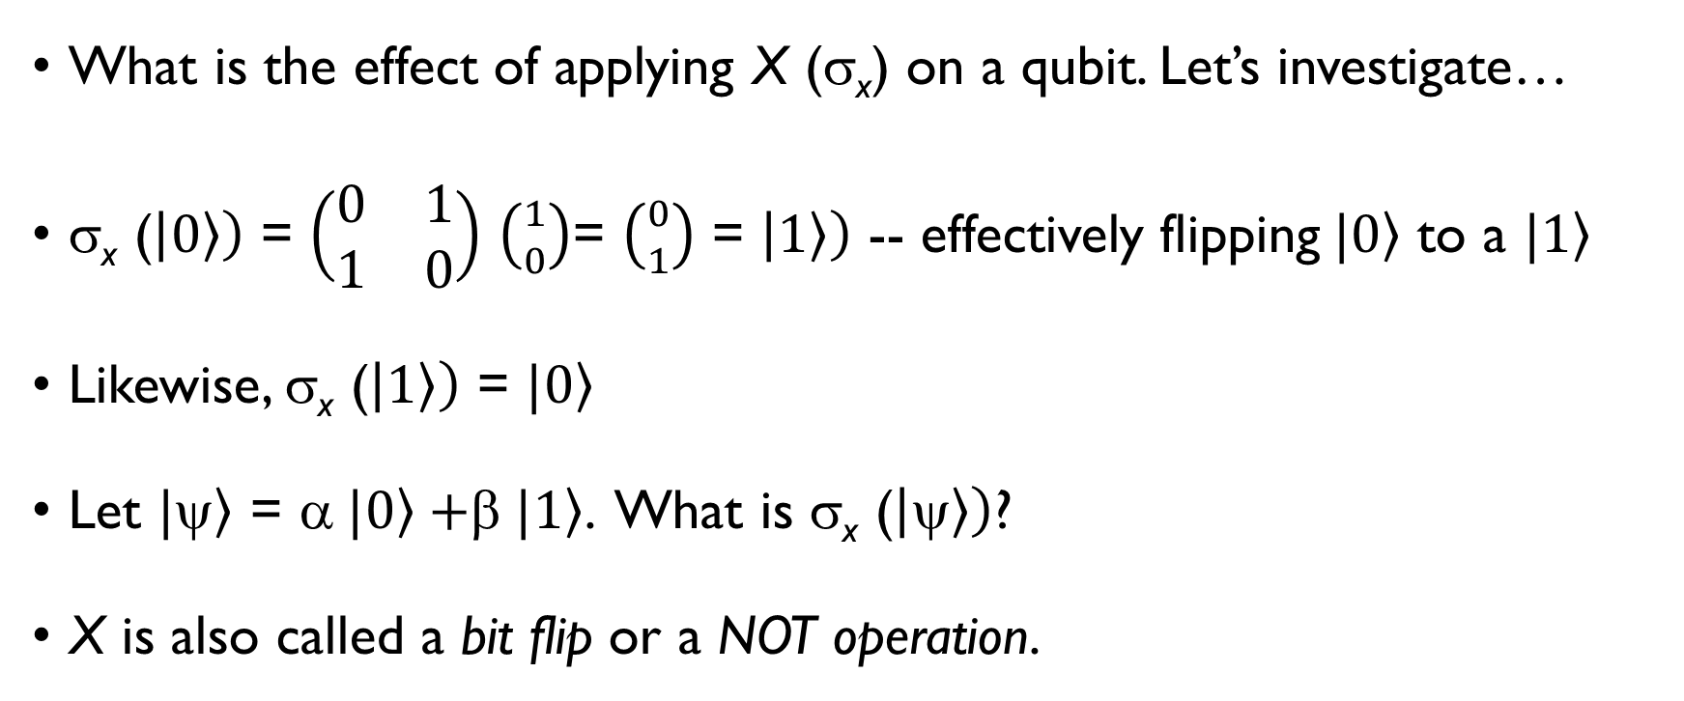
Pauli Matrices – The X matrix
What is the effect of applying X (σ_{x}) on a qubit. Let’s investigate…
σ_{x} ($\left|\left.0\right\rangle \right)$ = $\left(\begin{matrix}0 & 1 \\ 1 & 0\end{matrix}\right)$ $\left({1 \atop 0}\right)$= $\left({0 \atop 1}\right)$ = $\left|\left.1\right\rangle \right)$ -- effectively flipping$\left. |0\right\rangle$ to a $\left.|1\right\rangle$
Likewise, σ_{x} ($\left|\left.1\right\rangle \right)$ = $|\left.0\right\rangle$
Let $|\left.\right\rangle$ = α$|\left.0\right\rangle +$β$|\left.1\right\rangle$. What is σ_{x} ($\left|\left.\right\rangle \right)$?
X is also called a bit flip or a NOT operation.

Slide 7
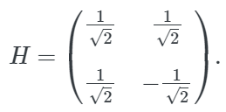
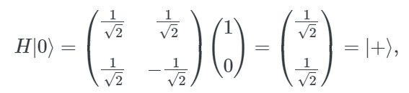
Pauli Matrices – The Hadamard Operation
The Hadamard operation is described by this matrix:
Action of Hadamard Operation on various qubit state vectors:

Slide 8
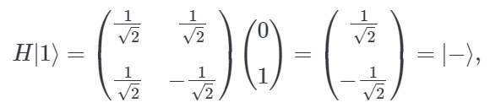
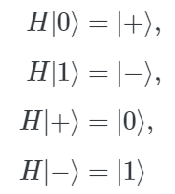
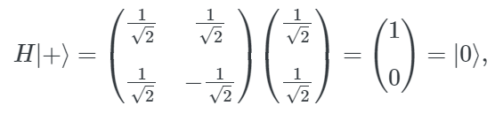
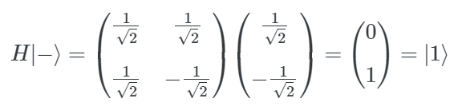
Pauli Matrices – The Hadamard Operation

Slide 9
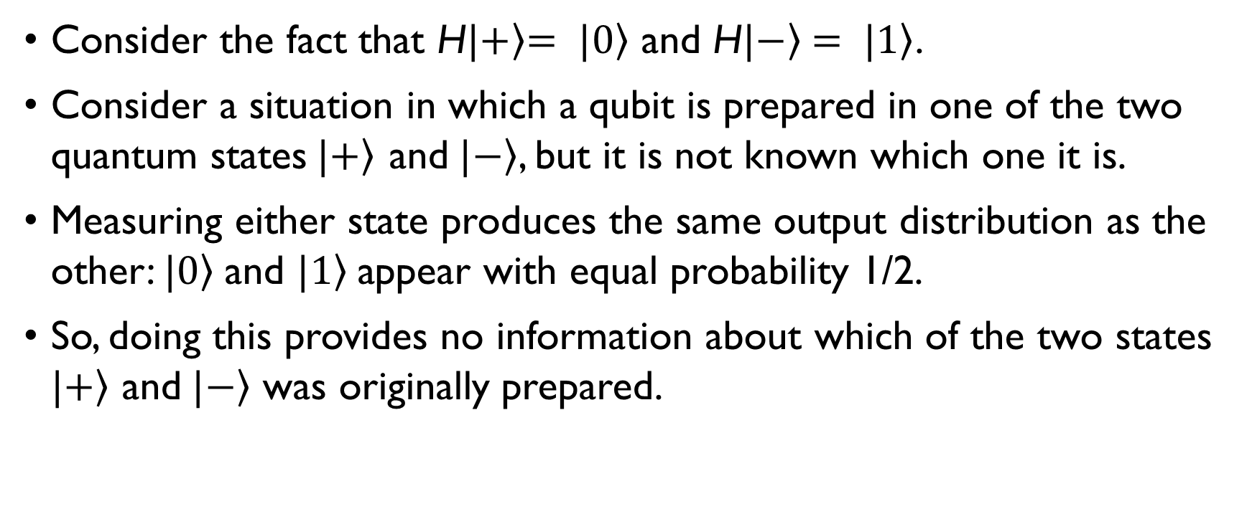
Hadamard Operation and Measurement
Consider the fact that H$|\left.+\right\rangle \left.= |0\right\rangle$ and H$|\left.−\right\rangle \left.= |1\right\rangle$.
Consider a situation in which a qubit is prepared in one of the two quantum states$|\left.+\right\rangle$ and$|\left.−\right\rangle$, but it is not known which one it is.
Measuring either state produces the same output distribution as the other: $\left.|0\right\rangle$and $\left.|1\right\rangle$appear with equal probability 1/2.
So, doing this provides no information about which of the two states $|\left.+\right\rangle$ and$|\left.−\right\rangle$ was originally prepared.

Slide 10
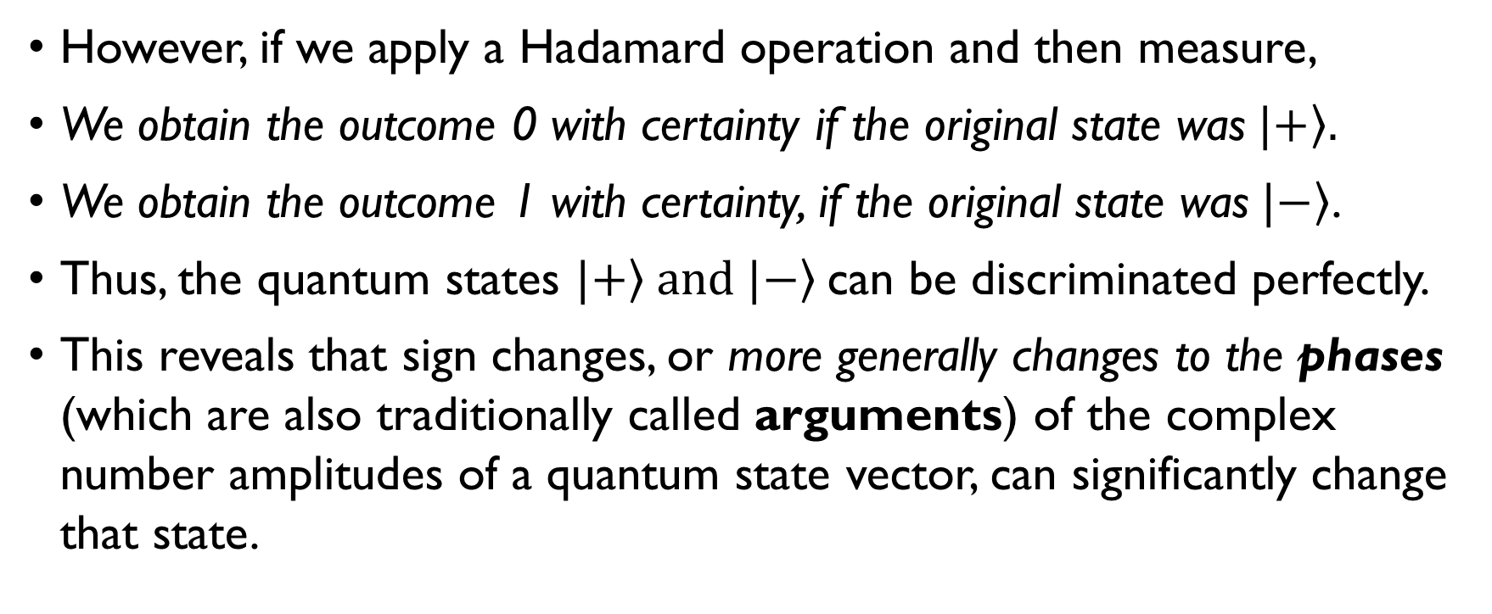
Hadamard Operations and Measurement
However, if we apply a Hadamard operation and then measure,
We obtain the outcome 0 with certainty if the original state was$|\left.+\right\rangle .$
We obtain the outcome 1 with certainty, if the original state was$|\left.−\right\rangle$.
Thus, the quantum states $|\left.+\right\rangle and |\left.−\right\rangle$can be discriminated perfectly.
This reveals that sign changes, or more generally changes to the phases (which are also traditionally called arguments) of the complex number amplitudes of a quantum state vector, can significantly change that state.

Slide 11

Pauli Matrices – The Z-operation
The Z-operation or (σ_{z}) is also called a phase flip because

Slide 12
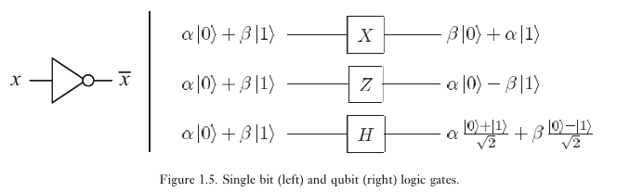
To summarize

Slide 13
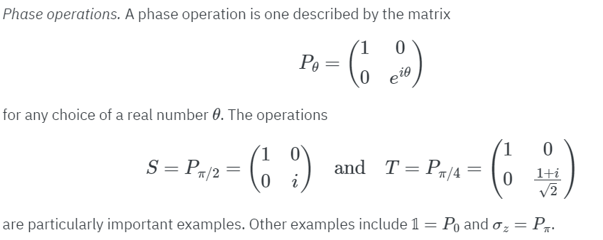
The Phase Operation

Slide 14
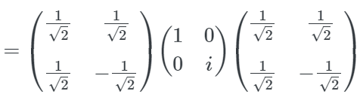
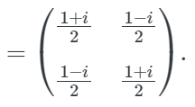
Compositions of Unitary Operations
Consider the composition R = H S H.

Slide 15
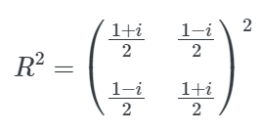
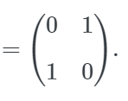
The R Operation
This unitary operation R is an interesting example.
By applying this operation twice, which is equivalent to squaring its matrix representation, we obtain a NOT operation:
That is, is a square root of NOT operation.
Such a behavior, where the same operation is applied twice to yield a NOT operation, is not possible for a classical operation on a single bit.

Slide 16
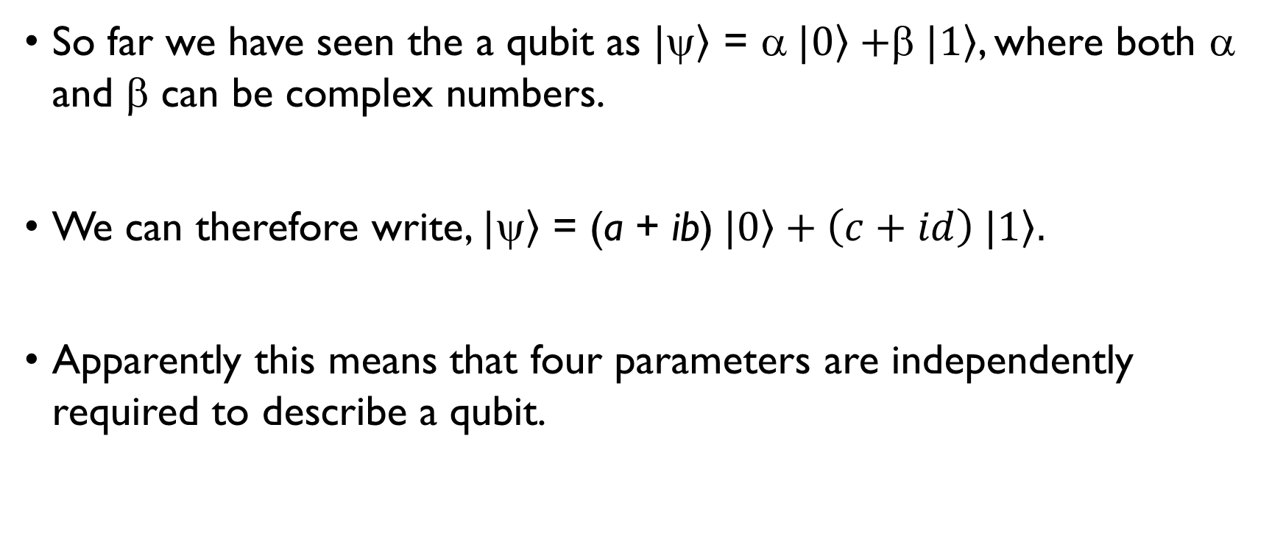
A Qubit – Phase and Amplitude
So far we have seen the a qubit as $|\left.\right\rangle$ = α$|\left.0\right\rangle +$β$|\left.1\right\rangle$, where both α and β can be complex numbers.
We can therefore write, $|\left.\right\rangle$ = (a + ib)$|\left.0\right\rangle +\left(c+id\right) |\left.1\right\rangle .$
Apparently this means that four parameters are independently required to describe a qubit.

Slide 17
Are there really 4 parameters?
No. The amplitudes cannot be chosen completely independently.
First, a quantum state must be normalized:
∣α∣²+∣β∣²=1.| α |² + 1.| β |²=1.
This imposes one constraint on the four real parameters.
Therefore, normalization reduces the number of parameters from 4 to 3.

Slide 18
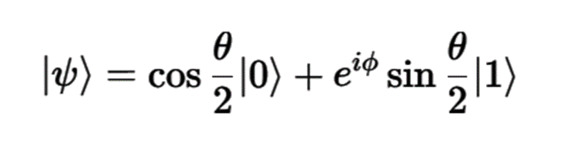
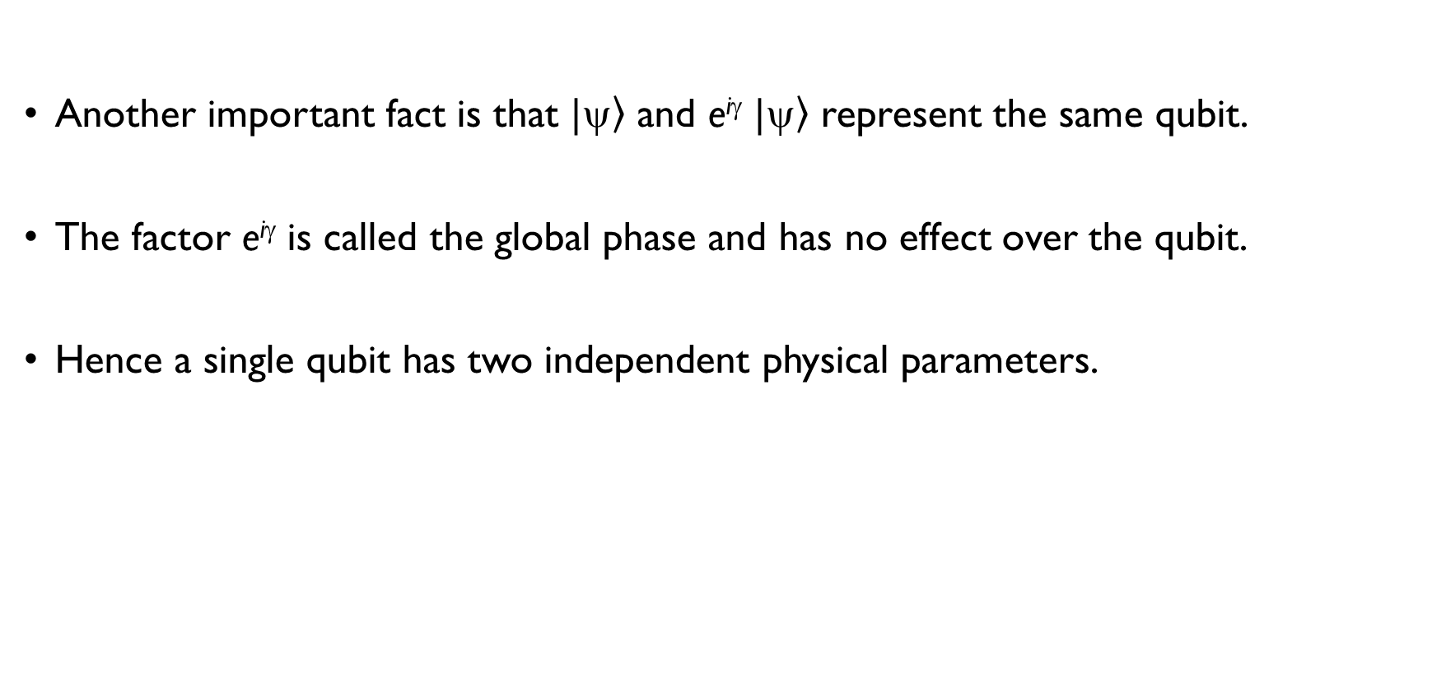
A Qubit – Phase and Amplitude
Another important fact is that $|\left.\right\rangle$ and e^{iγ} $|\left.\right\rangle$ represent the same qubit.
The factor e^{iγ} is called the global phase and has no effect over the qubit.
Hence a single qubit has two independent physical parameters.

Slide 19
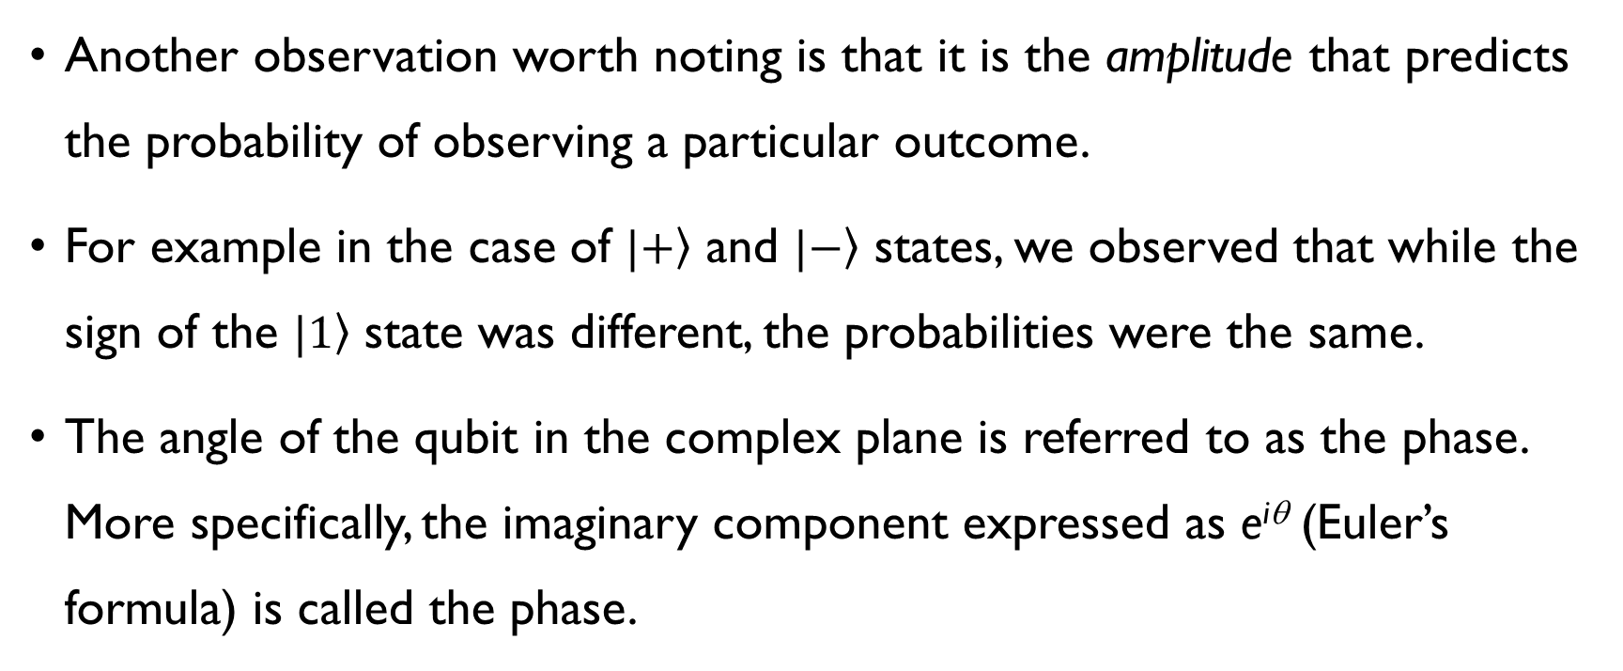
A Qubit – Phase and Amplitude
Another observation worth noting is that it is the amplitude that predicts the probability of observing a particular outcome.
For example in the case of $|\left.+\right\rangle$ and $|\left.−\right\rangle$ states, we observed that while the sign of the $|\left.1\right\rangle$ state was different, the probabilities were the same.
The angle of the qubit in the complex plane is referred to as the phase. More specifically, the imaginary component expressed as e^{iθ} (Euler’s formula) is called the phase.

Slide 20
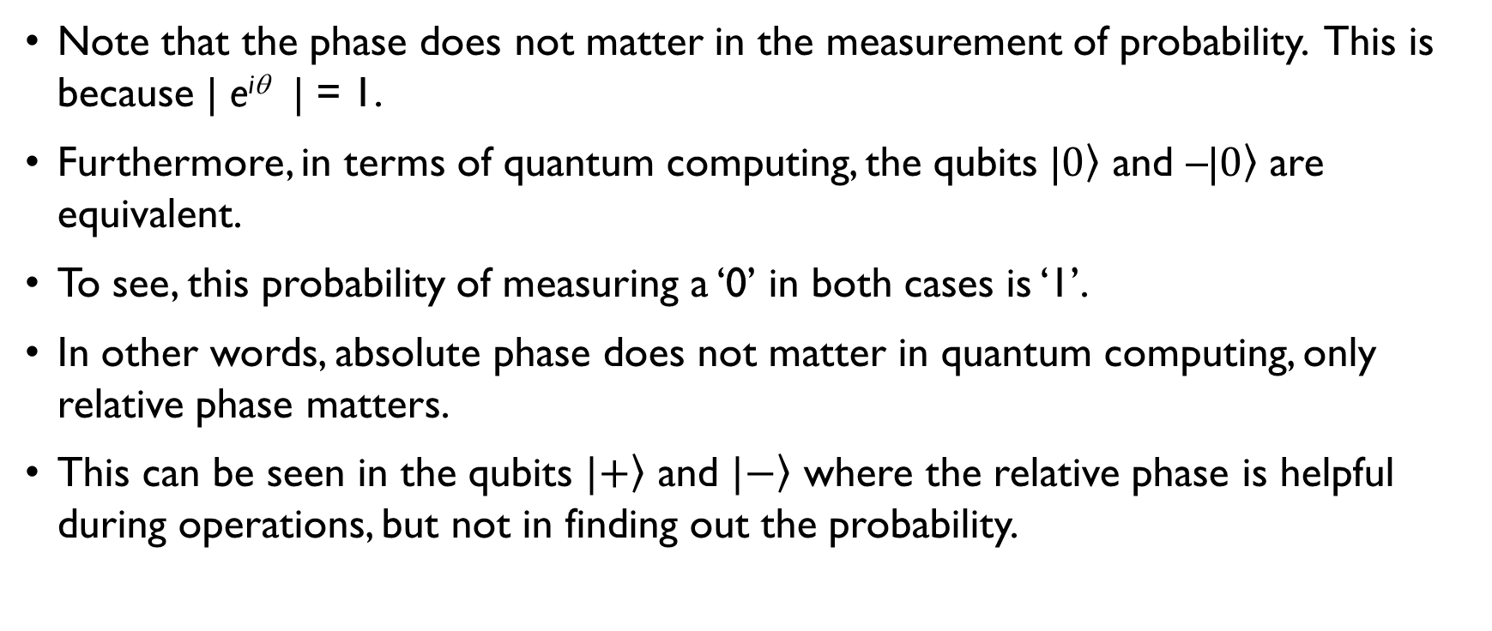
A Qubit – Phase and Amplitude
Note that the phase does not matter in the measurement of probability. This is because | e^{iθ} | = 1.
Furthermore, in terms of quantum computing, the qubits |$\left.0\right\rangle$ and –|$\left.0\right\rangle$ are equivalent.
To see, this probability of measuring a ‘0’ in both cases is ‘1’.
In other words, absolute phase does not matter in quantum computing, only relative phase matters.
This can be seen in the qubits $|\left.+\right\rangle$ and $|\left.−\right\rangle$ where the relative phase is helpful during operations, but not in finding out the probability.

Slide 21
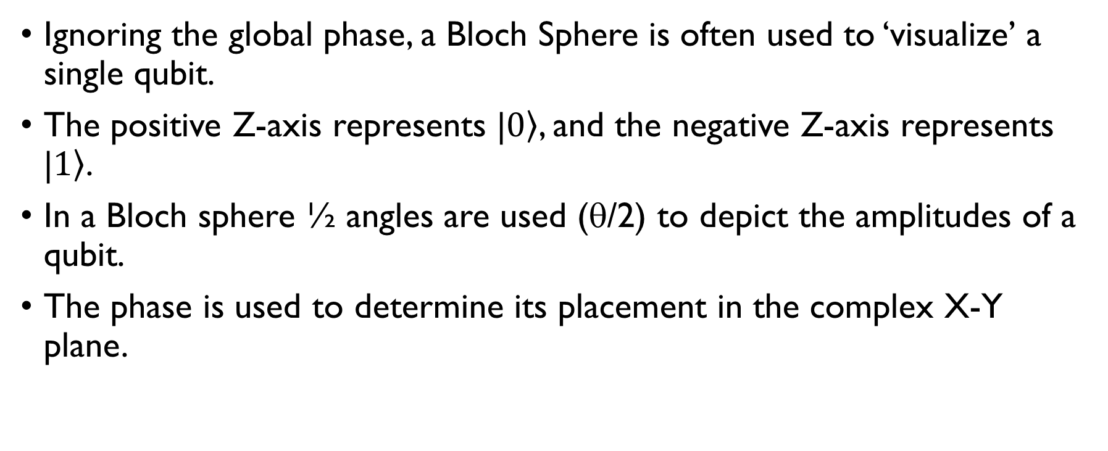
Bloch Sphere
Ignoring the global phase, a Bloch Sphere is often used to ‘visualize’ a single qubit.
The positive Z-axis represents |$\left.0\right\rangle$, and the negative Z-axis represents |$\left.1\right\rangle$.
In a Bloch sphere ½ angles are used (θ/2) to depict the amplitudes of a qubit.
The phase is used to determine its placement in the complex X-Y plane.

Slide 22
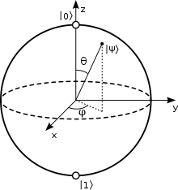


Visualization in a Bloch Sphere
For a qubit (where 0 ≤ θ ≤ π, 0 ≤ ϕ ≤ 2π)
Note that the global phase, (e ^{i γ}), is ignored.

Slide 23
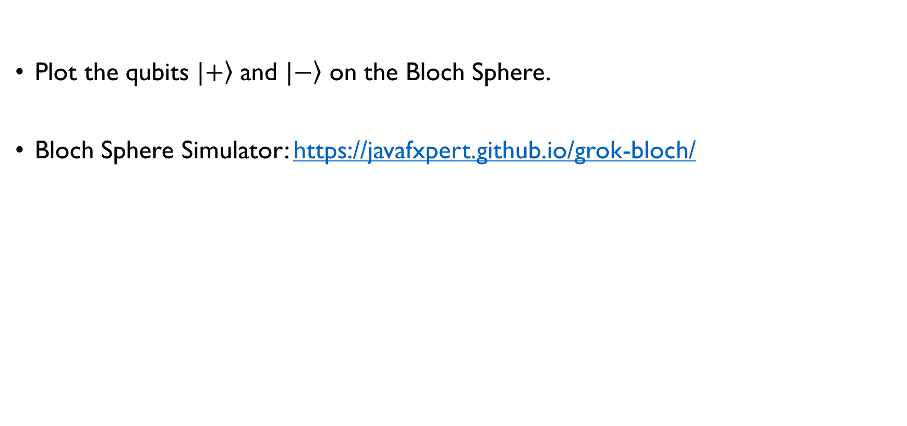
Exercise
Plot the qubits $|\left.+\right\rangle$ and $|\left.−\right\rangle$ on the Bloch Sphere.
Bloch Sphere Simulator: https://javafxpert.github.io/grok-bloch/

Slide 24
Summary
Unitary Operations preserve the norm of a qubit and therefore are a valid operation on a qubit.
The Pauli Matrices, Hadamard and the Phase Flip are some of the operations on a qubit.
R = HSH is the square root of the NOT operation.
The Bloch Sphere is used to visualize a qubit.

