Slide 1
AtliQ Mart Promotional Campaign Performance Analysis

Slide 2
Why This Report???
AtliQ Mart is a retail giant with over 50 supermarkets in the southern region of India. It ran a massive promotional campaigns on all their 50 stores during the Diwali 2023 and Sankranti 2024 only on their AtliQ branded products. Now the sales director Bruce Haryali wants to understand which promotions did well and which did not so that they can make informed decisions for their next promotional period.

Slide 3


Ad Hoc Request
Q1. Provide a list of products with a base price greater than $500 and that are featured in promo type of 'BOGOF' (Buy One Get One Free). This information will help us identify high-value products that are currently being heavily discounted, which can be useful for evaluating our pricing and promotion strategies.

Slide 4
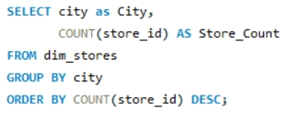
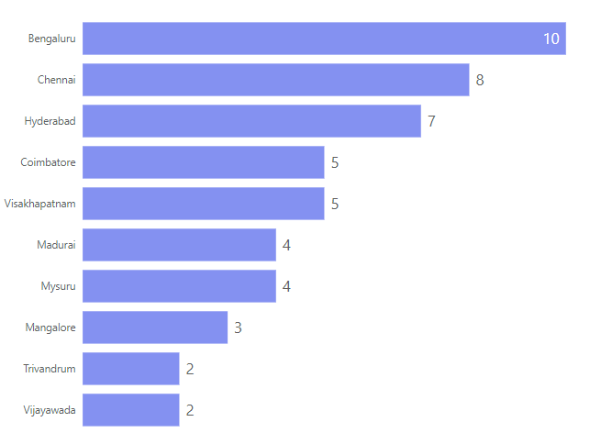
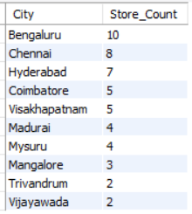
Q2. Generate a report that provides an overview of the number of stores in each city. The results will be sorted in descending order of store counts, allowing us to identify the cities with the highest store presence. The report includes two essential fields: city and store count, which will assist in optimizing our retail operations.

Slide 5
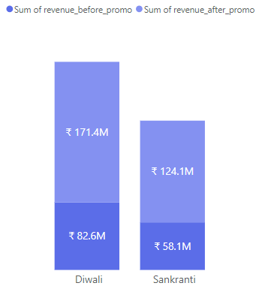
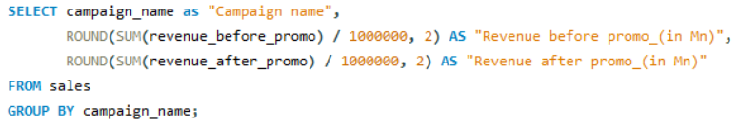

Q3. Generate a report that displays each campaign along with the total revenue generated before and after the campaign. The report should help in evaluating the financial impact of our promotional campaigns. (Display the values in millions). The report includes three key fields: campaign name, total revenue before promotion, total revenue after promotion

Slide 6
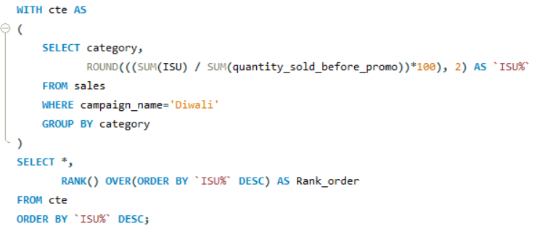
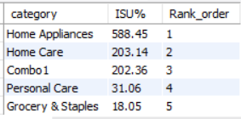
Q4. Produce a report that calculates the Incremental Sold Quantity (ISU%) for each category during the Diwali campaign. Additionally, provide rankings for the categories based on their ISU%. The report will include three key fields: Category. ISU%. rank order. This information will assist in assessing the category-wise success and impact of the Diwali campaign on incremental sales.

Slide 7
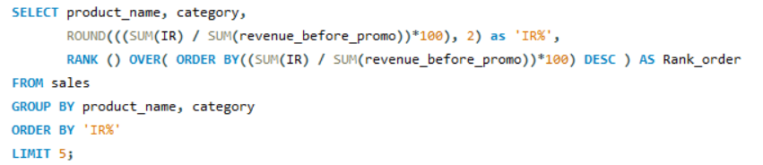
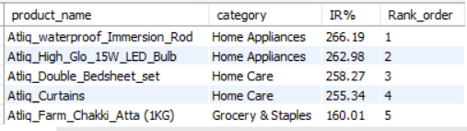
Q5. Create a report featuring the Top 5 products, ranked by Incremental Revenue Percentage (IR%), across all campaigns. The report will provide essential information including product name, category, and IR%. This analysis helps identify the most successful products in terms of incremental revenue across our campaigns, assisting in product optimization.

Slide 8
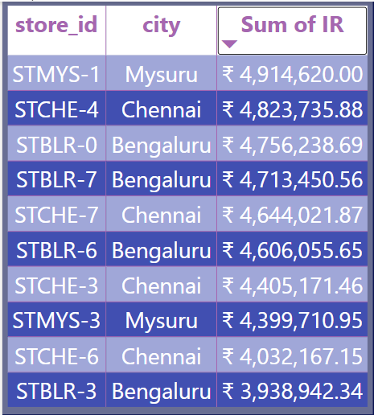

Store Performance Analysis
Top 10 Stores in terms of Incremental Revenue(IR)
Given is the list of top 10 stores that has earned the highest Incremental Revenue(IR) during the campaign
We can observe that all the 10 stores are located on Bengaluru, Chennai and Mysore

Slide 9
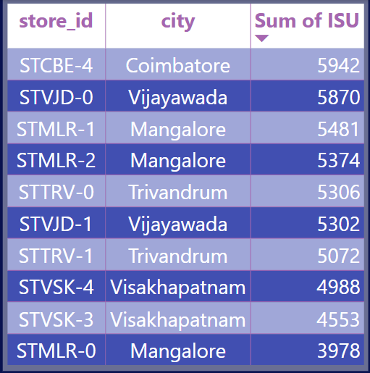
Bottom 10 Stores in terms of Incremental Sold unit(ISU)
Given is the list of bottom 10 stores that has the highest Incremental Sold Unit(ISU) during the campaign
We can observe that all the 10 stores are located on Coimbatore, Vijayawada, Visakhapatnam, Mangalore and Trivandrum

Slide 10
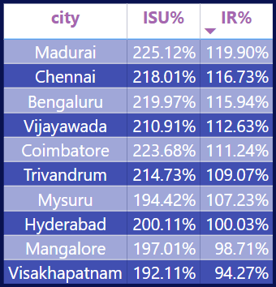
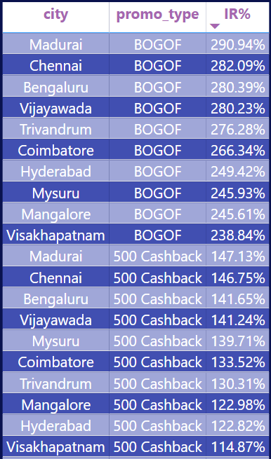
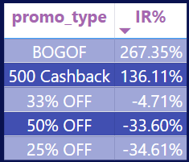
Common characteristics between top performing stores
From table1 we can see Madurai, Chennai and Bengaluru are the cities that have the top performing stores
Further from table2 we can see that BOGOF and 500 Cashback are the two promo types that performed exceptionally and from table3 we can see that non both these promo types Madurai, Chennai and Bengaluru are the top performers
And also these two of these three cities have the highest store counts.
Table1
Table3
Table2

Slide 11
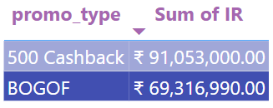
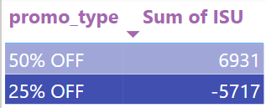
Promotion Type Analysis
Top 2 promotion types that has highest Incremental Revenue(IR)
Bottom 2 promotion types that has lowest Incremental Sold Units(ISU)

Slide 12
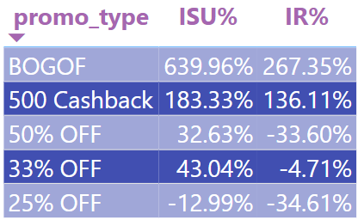
Performance of discount-based promotions versus BOGOF (Buy One Get One Free) or cashback promotions
From the above table we can infer that BOGOF and 500 cashback are actually the two promotions that is having good results while the discount based promotions are not performing well

Slide 13
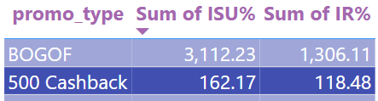
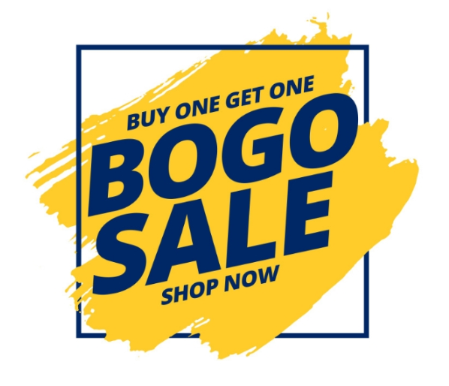
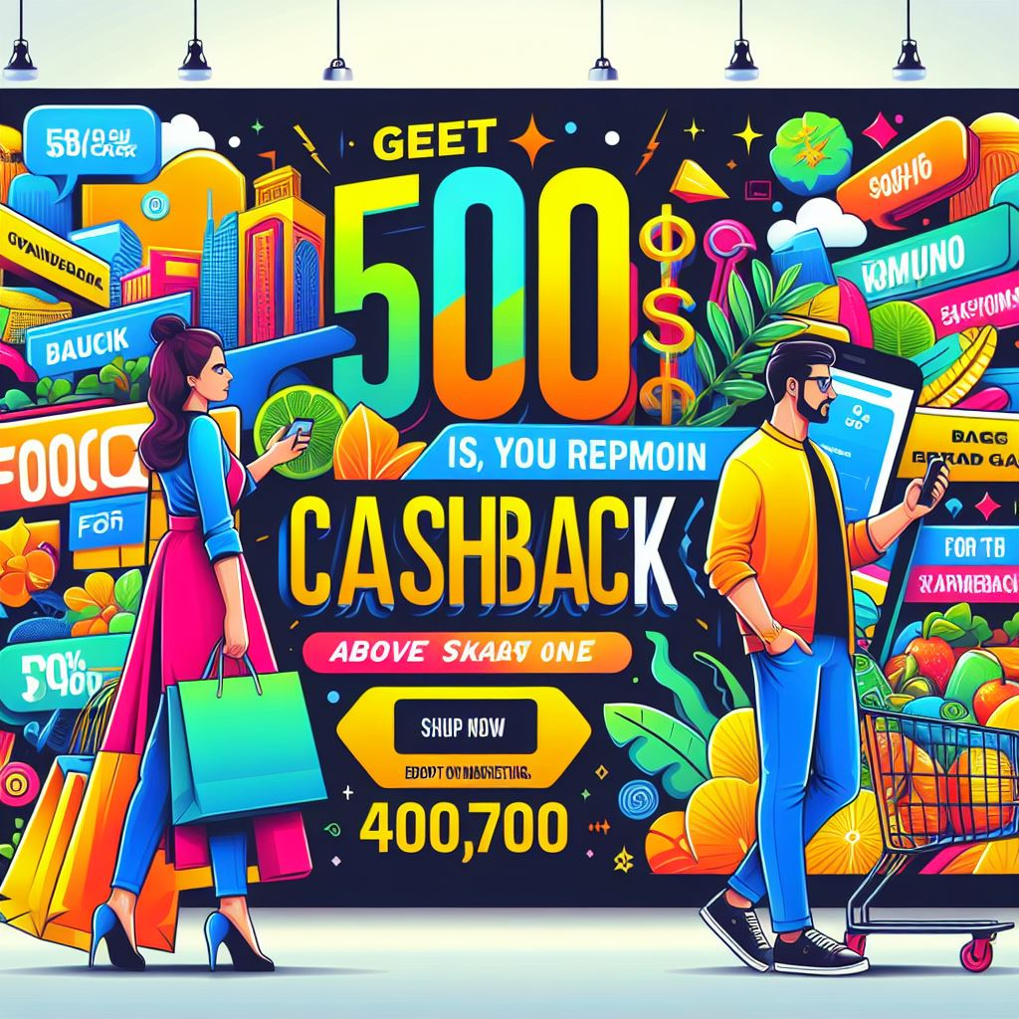
Which promotions strike the best balance between Incremental Sold Units and
maintaining healthy margins?
From the table we can infer that only BOGO Fand 500 Cashback have had Incremental units sold while also maintaining a healthy revenue margin

Slide 14
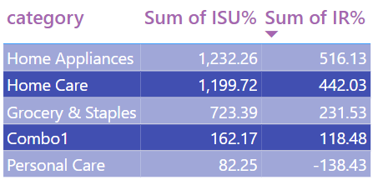
Product and Category Analysis
Product categories that have a seen lift in sales from the promotions
From the table we can see that all the product categories have seen lift in the sale except Personal care

Slide 15
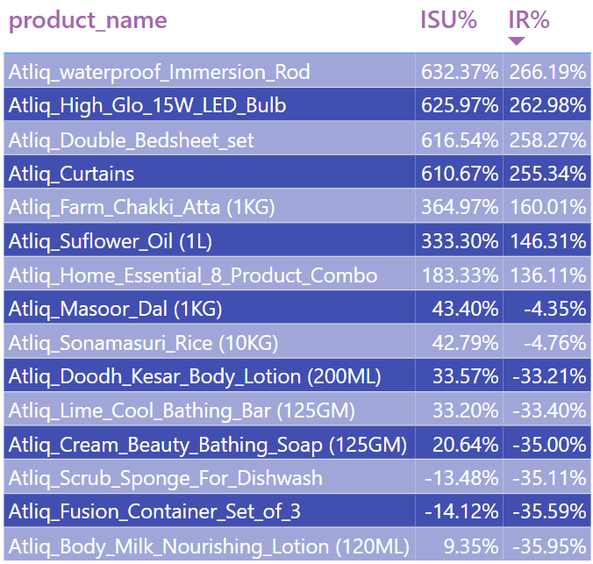
Product that responded exceptionally well and poorly to promotions
From the table we can see that top 4 products Atliq water proof immersion rod, Atliq double bedsheet set, Atliq high glo 15W LED bulb and Atliq curtains have performed well showing more that 600% increase in ISU and nearly 260% percentage increase in IR
Also Products like Atliq fusion container set of 3 , Atliq Scrub sponge for dishwash have performed poorly not having a increase in revenue after the promotion
Atliq body milk nourishing lotion and Atliq cream beauty bathing soap even though having a positive ISU because of the discounts the revenue is reduced after promotion.

Slide 16
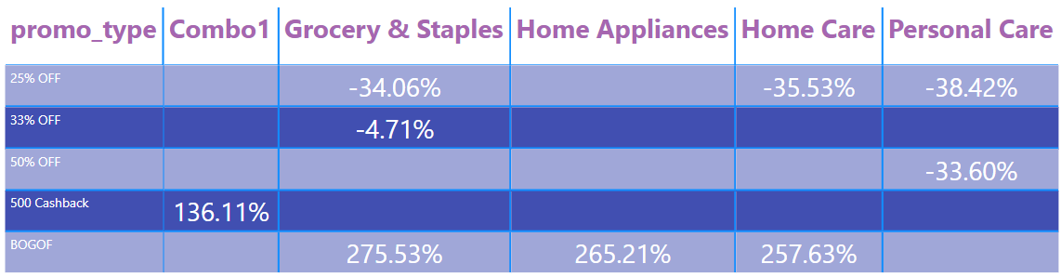
Correlation between product category and promotion type effectiveness

Slide 17
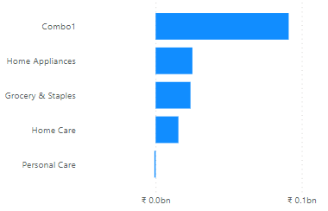
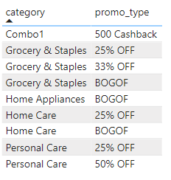
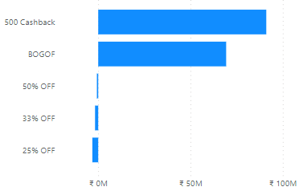
Secondary Analysis
Plot 1
Plot 3
From plot 1 we can see that category Combo 1 have performed well and from plots 2 and 3 we can see that The combo 1 have only run 500 cashback offer and that is the highest promo type in terms of IR
Of all the categories of products only the products from personal care have not had a revenue increase after running the campaigns and it has only run discount-based promotions.
Plot 2

Slide 18
Recommendations
Targeted Marketing: The customer segments are more responsive to promo-type 500 Cashback and BOGOF. Having said that we can target them with personalized marketing campaigns.
Referral Programs: Implement a referral program where existing customers get discounts for referring new customers. This can help in acquiring new customers and increasing sales.
Personal Care: Some awareness campaigns can be conducted to make customers more aware of personal hygiene thereby increasing the revenue for that category
Partnerships and Collaborations: Partner with influencers, bloggers, or other businesses for collaborations that include promoting discount-based promotions to their audience thereby increasing their revenue

Slide 19
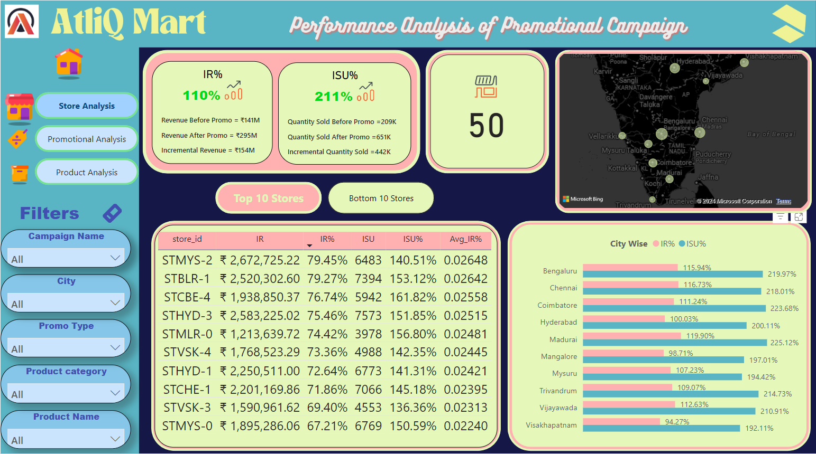
Dashboard

Slide 20
Thank You

