Slide 1

Customer Segmentation Insights
to Product Strategy Team

Slide 2
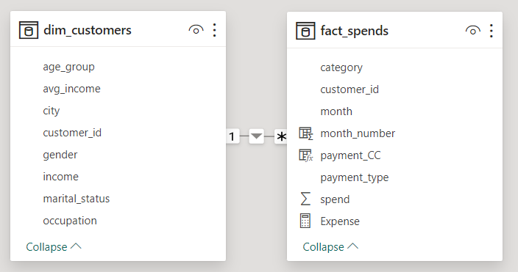
Why this report?
Mitron Bank is a legacy financial institution headquartered in Hyderabad. They want to introduce a new line of credit cards, aiming to broaden its product offerings and reach in the financial market.
AtliQ Data Services came to know about this through an internal link and approached Mitron Bank with a proposal to implement this project. However, strategy director of Mitron Bank, Mr.Bashnir Rover is skeptical and asked them to do a pilot project with the sample data before handing them the full project. They provided a sample dataset of 4000 customers across five cities on their online spend and other details.
My work as a data analyst in the AtliQ working under Tony is to take up the challenge and provide valuable insights for tailoring the credit cards based on the customer needs of the given sample dataset.
Data model:

Slide 3
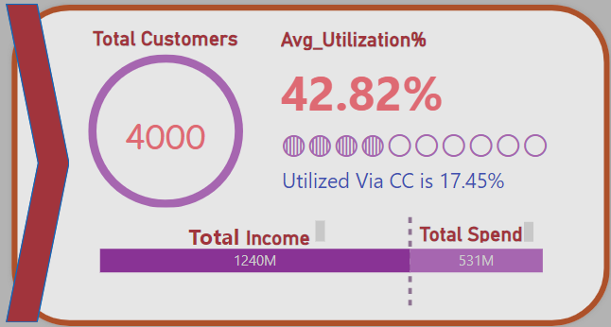
How it is done?
From the insight ideas given by Tony this report details the data based on the spending of the income across various categories using various payment methods by the customers demography
Firstly a measure the Average Utilization which is the percentage of how much money is spent from the income is calculated. This is a crucial measure as this has a positive linear relationship with the Credit card usage.
The Higher the Average Utilization higher is the likelihood of the customer to buy the Credit card.
But all the above said theory will not work without the proper segmentation of the customers and the benefits given to each segments
The following information can be inferred from the given Card visual.
Total number of customers are 4000.
The overall Average Utilization for the given population is 42.82%.
The Average utilization % of the income that is spend only through Credit card alone is 17.45%
This implies that around 40.75% of the spending is done trough Credit card.
Also the Total income for the given 6 months and the total spend for 6 months can be inferred which is 1240M and 531M respectively.

Slide 4
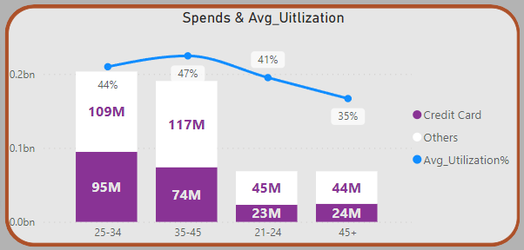
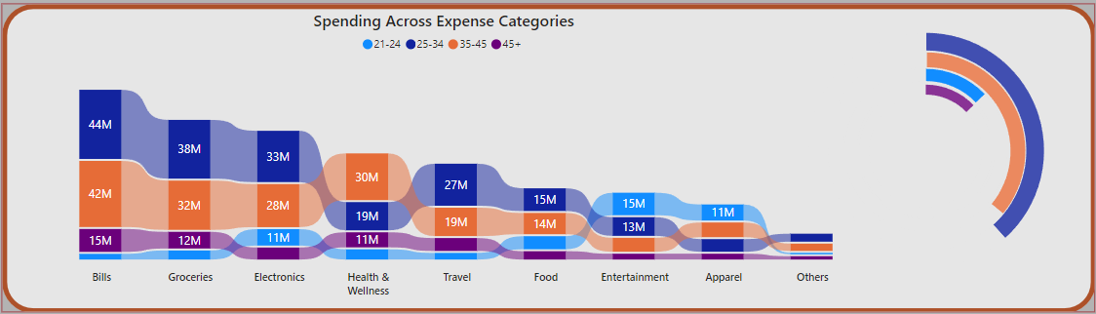
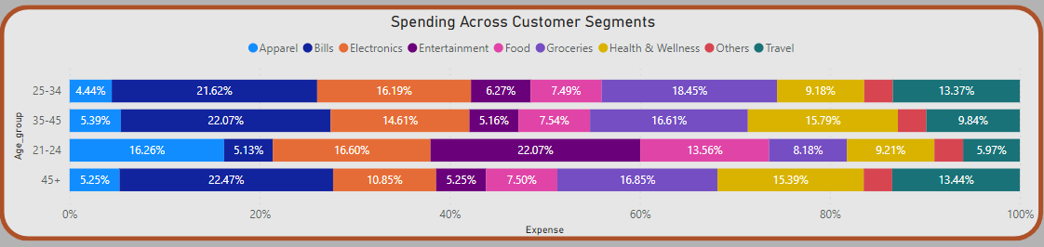
Utilization based on Age Group
Customers in the age group of 35-45 are utilizing their income more and even though they are not spending the highest.
They spend a considerable amount of money for Bills, Groceries, and Health & wellness

Slide 5
Utilization based on Age Group
Customers in the age group of 25-24 are the second highest in utilizing their income and they highest spender.
They spend a considerable amount of money for Bills, Groceries, Travel and Food

Slide 6
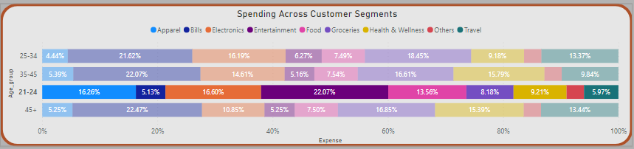
The Other group 21-24, Though this is the smallest group they are third highest income utilizers
They spend most of their income on Clothing, Entertainment and Electronics and food Which is higher than other groups respective spending

Slide 7
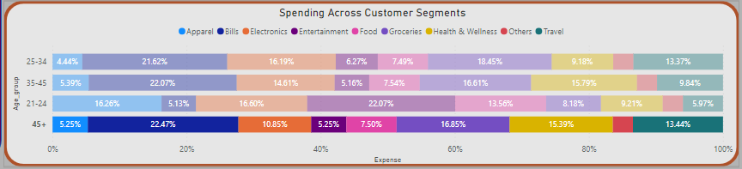
The Other group 45+, is the least spending group
They spend most of their income on Bills, Groceries and Health & Wellness Which is higher than other groups respective spending

Slide 8
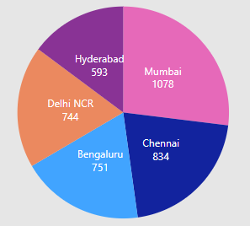
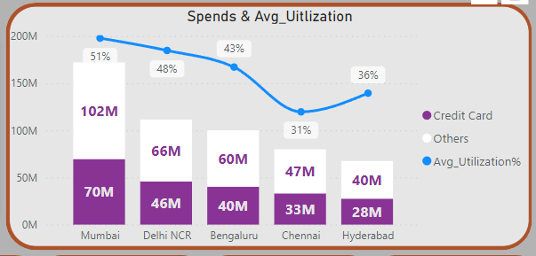
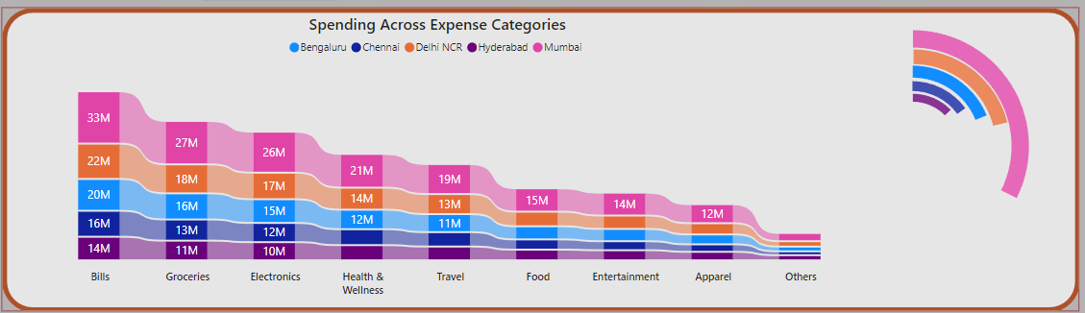
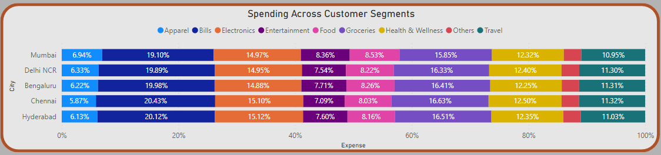
Utilization based on City
Though based on the Income Utilization% Mumbai, Delhi NCR and Bengaluru has the top three utilization and their spend is higher in the Apparel, Entertainment and Food respective to other cities
Customers from other cities Chennai and Hyderabad have lesser utilization% and though they spend their income more on Bills, Groceries and Electronics higher than the top three cities

Slide 9
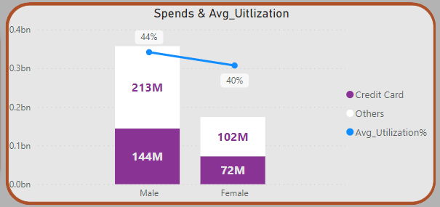
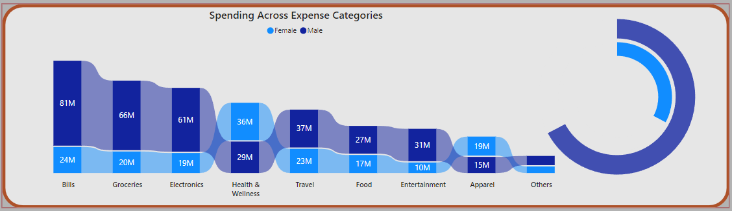
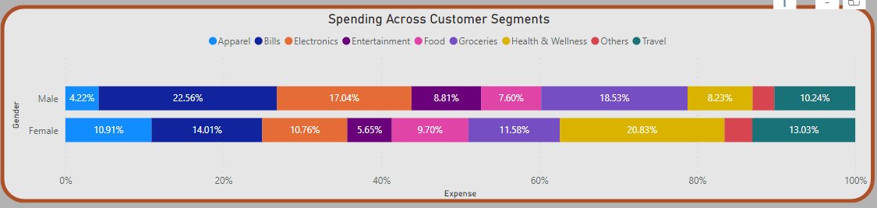
Utilization based on Gender
From the data Male tend to utilize their income more than Female.
Of the total spend male contribute 67% and female contribute 33%
Male seems to spend their income more on Bills, Groceries and Electronics
Female seems to utilize their income more on Apparel and Health & Wellness

Slide 10
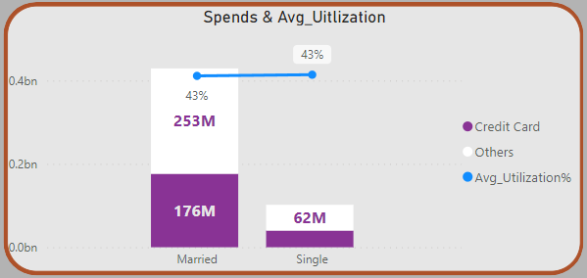
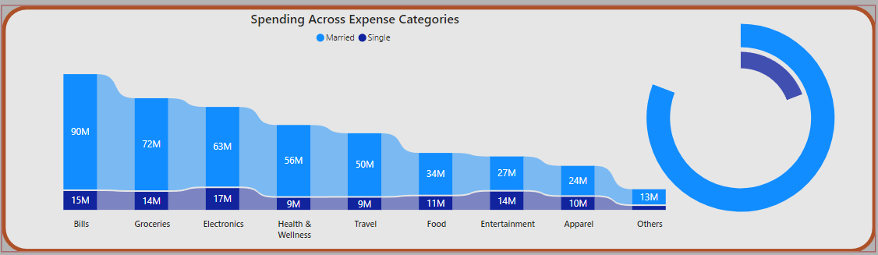
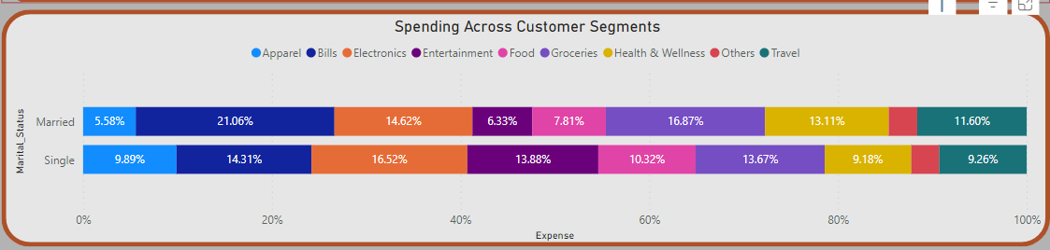
Utilization based on Marital Status
From the data Married customer tend to utilize their income more contributing 80% of the total spend than single customers whose contribution is 20%
Married seem to spend their income more on Bills, Groceries and Electronics
Single seem to utilize their income more on Apparel, Electronics and Entertainment.

Slide 11
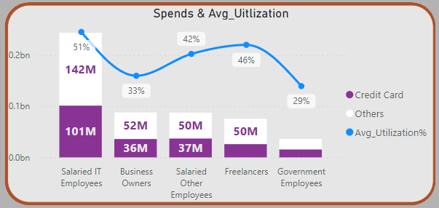
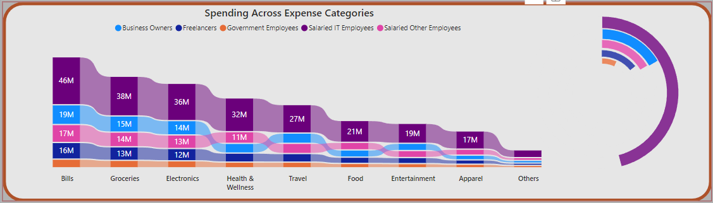
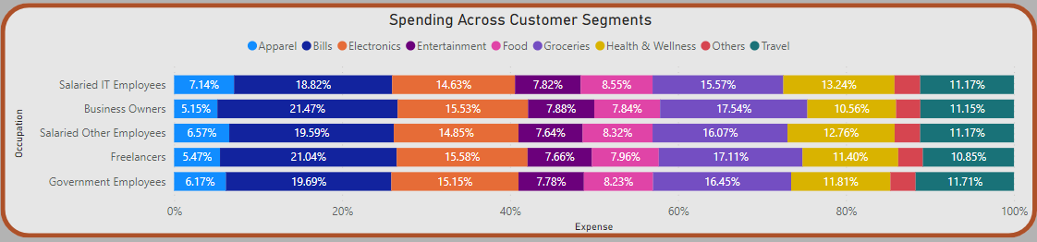
Utilization based on Occupation
Salaried IT Employees have the highest income utilization% which is higher than the overall average utilization%. Their spending being more on Bills, Apparel, Food and Health & Wellness compared to other segments.
Freelancers and Other Salaried Employees have the second and third highest utilization%. Their spending being more on Bills, Electronics and Groceries.

Slide 12
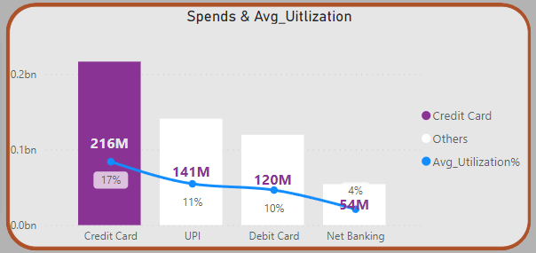
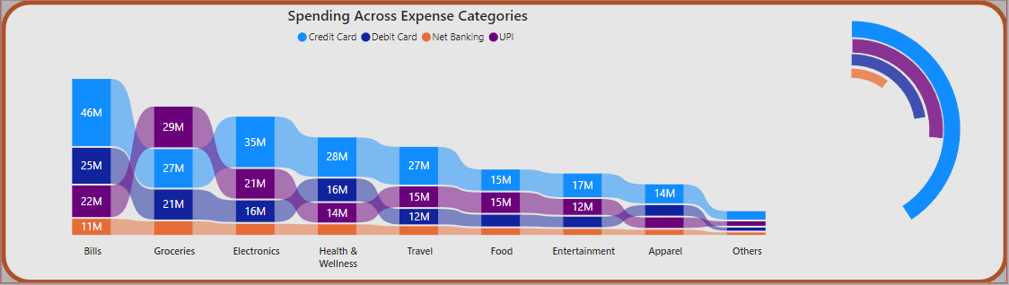
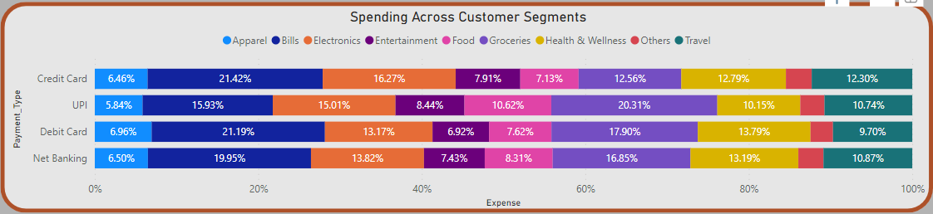
Utilization based on Payment Type
From the data it seems already Credit card users have the highest utilization%.
Customers who chose Debit Card and Net banking tend to spend their income on Bills, Electronics and Groceries
Customers who chose UPI tend to spend their income on Food and Groceries higher than other customers.

Slide 13

Key Insights and Customer Segments
Occupation
Salaried IT Employees being the highest income utilizers having utilization% higher than the overall average utilization% with most of their spend on Bills, Apparel, Groceries and Health & Wellness
Age Group The Age Groups 35-45 and 25-34 has the highest Utilization and Since they already use Credit card largely for the expenses they are considered and Key segment
Marital Status and Gender
Married Customer have the higher Utilization% than singles with most of their Spends on Bills and Groceries
Male Customer have higher utilization% than female
With most of their spend on Bills and Electronics
City
Mumbai, Delhi NCR and Bengaluru have the higher Utilization% and their spend is higher in the Apparel, Entertainment and Food

Slide 14






Credit Card Feature Recommendation.
BILLS
Groceries
Electronics
Reward Points for Utility Bills:
Reward points for paying utility bills, such as electricity, water, or gas bills.
Cashback on Recurring Payments:
Cashback for recurring bill payments, such as subscriptions or insurance premiums.
Store Discounts:
Exclusive discounts and promotions at partner retailers.
Cash Back Rewards:
Cash back rewards on grocery purchases as a standard or rotating category.
Grocery Delivery Subscription Discounts:
With the rise of online grocery shopping and delivery services, offering discounts or cash back for subscriptions to grocery delivery services.
Purchase Protection:
It covers newly purchased items against theft or accidental damage for a specific period
Extended Warranty Coverage:
Extended original manufacturer's warranty on eligible electronic purchases, providing additional coverage for repair or replacement beyond the standard warranty period.
Food
Health & Wellness
Travel
Dining Rewards: Extra points or cash back for dining-related expenses.
Restaurant Discounts: Exclusive discounts at participating restaurants.
Food Delivery Rewards: Earn rewards for ordering food through specific platforms.
Gym Memberships Discounts:
Special discounts or cash back on gym memberships or fitness-related expenses.
Telehealth Services:
Access to telehealth service in discounted or waived fees.
Reward Points for Healthy Purchases:
Earn reward points for spending on health-conscious products, such as organic groceries or fitness gear.
Airline Miles: Earn points or miles for every purchase, redeemable for flights.
Airport Lounge Access: Access to airport lounges for relaxation and amenities.
Travel Insurance: Coverage for trip cancellations, delays, and lost luggage.
No Foreign Transaction Fees: Avoid fees when making international transactions.

Slide 15


Apparel
Entertainment
Reward Points for Fashion Spending:
Rewards programs that offer bonus points or miles for spending on fashion-related purchases, including clothing, shoes, and accessories
Early Access to Sales and Collections:
provide cardholders with early access to special sales events or the launch of new fashion collections from partnered brands.
Ticket Discounts or Cash Back:
Discounts or cash back on ticket purchases for movies, concerts, theater performances, and other entertainment events.
Exclusive Access and VIP Experiences:
Premium credit cards may provide exclusive access to VIP experiences, such as early ticket sales, backstage passes, or special event invitations.

