Slide 1
System Analysis
EP-Praktikum “Secure Cloud Energy Monitoring Platform”
Retrospective for Sprint #01, 10.10.-24.10.2018
Presentation created by Benedikt Holler (Product Owner)

Slide 2
Contents
Software Requirement Specification
  Overall Description
  Specific Requirements
  DevOps and Tooling
What can we improve in future sprints?
What went well during this sprint?

Slide 3
I. Software Requirement Specification
1. Overall Description
Quick Description
Product Environment
User Characteristics
Evolution
Assumptions and Dependencies
Architecture

Slide 4
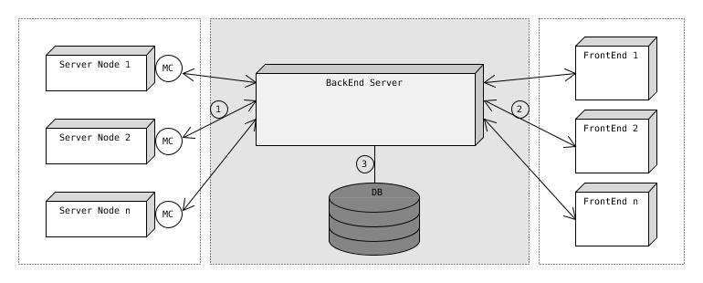
I. Software Requirement Specification
1. Overall Description

Slide 5
I. Software Requirement Specification
2. Specific Requirements
User Interface
Functions
Extended Criteria
Constraints
Performance Requirements
Software Quality Attributes
Global Scenarios and Test Cases
Security

Slide 6
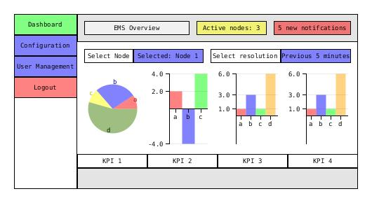
I. Software Requirement Specification
2. Specific Requirements

Slide 7
I. Software Requirement Specification
3. DevOps and Tooling
Collaboration
Version Control System
IDEs
Platform

Slide 8
II. What can we improve in further sprints?
Working with YouTrack was problematic
→ We introduced a “To Verify” task state before “Done”, which messed up our Burn Down Chart
→ Saving tasks as User Stories caused technical problems
Some tasks were not assigned clearly
We overestimated how difficult certain tasks would be

Slide 9
III. What went well during this sprint?
Good team collaboration despite differing work times
Communication between team members was open and constructive
Individual work was done quickly and effectively, so review and discussion was made possible early on

Slide 10
Thank you for your attention.
Room for discussion

