Slide 1


“Fast and Accurate ML in 3 Lines of Code”
An open-source AutoML toolkit by Amazon that automatically builds high-quality machine learning models with minimal code or tuning.
Documentation: https://auto.gluon.ai/

Slide 2
Time Series Models
NaiveModel, SeasonalNaiveModel, AverageModel, SeasonalAverageModel, ZeroModel, ETSModel, AutoARIMAModel, AutoETSModel, AutoCESModel, ThetaModel, ADIDAModel, CrostonModel, IMAPAModel, NPTSModel, DeepARModel, DLinearModel, PatchTSTModel, SimpleFeedForwardModel, TemporalFusionTransformerModel, TiDEModel, WaveNetModel, DirectTabularModel, PerStepTabularModel, RecursiveTabularModel, ChronosModel

Slide 3
AutoGluon Time Series
Forecast future values of time series:
from autogluon.timeseries import TimeSeriesDataFrame, TimeSeriesPredictor
data = TimeSeriesDataFrame('train.csv’)
predictor = TimeSeriesPredictor(target='target', prediction_length=48).fit(data)
predictions = predictor.predict(data)
Trains multiple models.
Finds the best model, features and hyperparameters – automatically.
Automatic ensembling, combining models to improve accuracy.

Slide 4
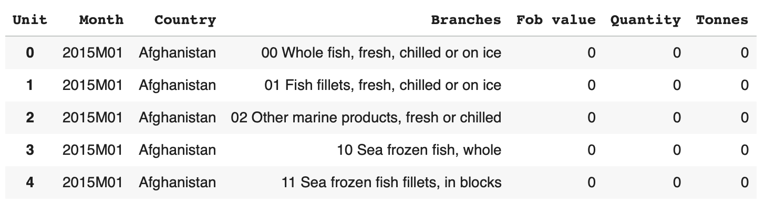
Data Preparation
df = pd.read_parquet("Exports-by-branches-of-processing-and-countries-2015-2025.parquet")
df_wide = ( pd.pivot_table( df, index=["Month", "Country", "Branches"], columns="Unit",
values="DATA", aggfunc="sum", dropna=False).reset_index()
)
df_wide.head()

Slide 5
Model Training
predictor = TimeSeriesPredictor(prediction_length=prediction_length, target="target",
freq="MS", eval_metric="WAPE",
known_covariates_names=["month_sin", "month_cos"]
)
predictor.fit(ts_train, presets="medium_quality", time_limit=600, random_seed=42)
Starting training. Start time is 2025-10-29 11:10:12
Models that will be trained: ['Naive', 'SeasonalNaive', 'RecursiveTabular', 'DirectTabular', 'ETS', 'Theta', 'Chronos[bolt_small]', 'TemporalFusionTransformer’]
…
Total runtime: 199.19 s
Best model: WeightedEnsemble
Best model score: -0.4508

Slide 6
Best Model
Best model: WeightedEnsemble
Ensemble validation WAPE: 0.450764497201321
Base models and weights:
- SeasonalNaive weight=0.0341 val_RMSE=0.611
- RecursiveTabular weight=0.1932 val_RMSE=0.518
- Theta weight=0.1250 val_RMSE=0.506
- Chronos[bolt_small] weight=0.4886 val_RMSE=0.474
- TemporalFusionTransformer weight=0.1591 val_RMSE=0.557

Slide 7
Ensemble Models
SeasonalNaive → repeats past seasonal values (simple but strong baseline).
RecursiveTabular → trains a tabular regressor on lag features, predicts one step at a time recursively.
Theta → a combination of trend + exponential smoothing components.
ChronosFineTuned[bolt_small] → small Chronos transformer, fine-tuned on the dataset.
TemporalFusionTransformer (TFT) → attention-based deep model combining static + dynamic features.

Slide 8
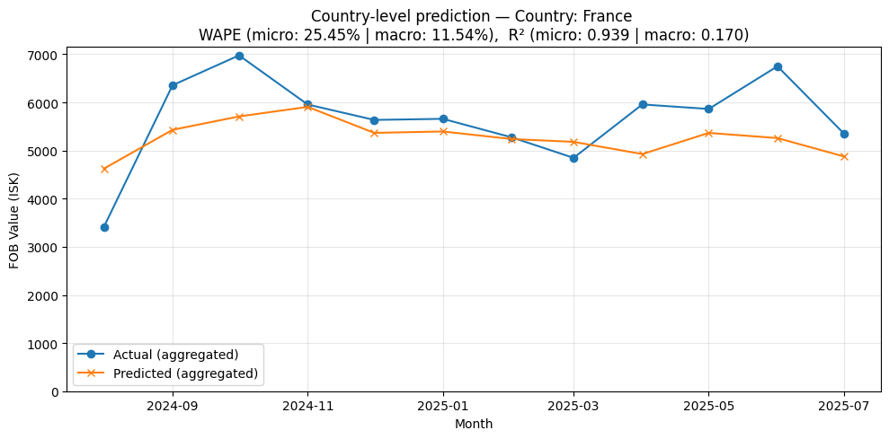
Test Set Metrics
Overall metrics:
WAPE: 40.91%
Accuracy: 59.09%
R²: 0.938

Slide 9
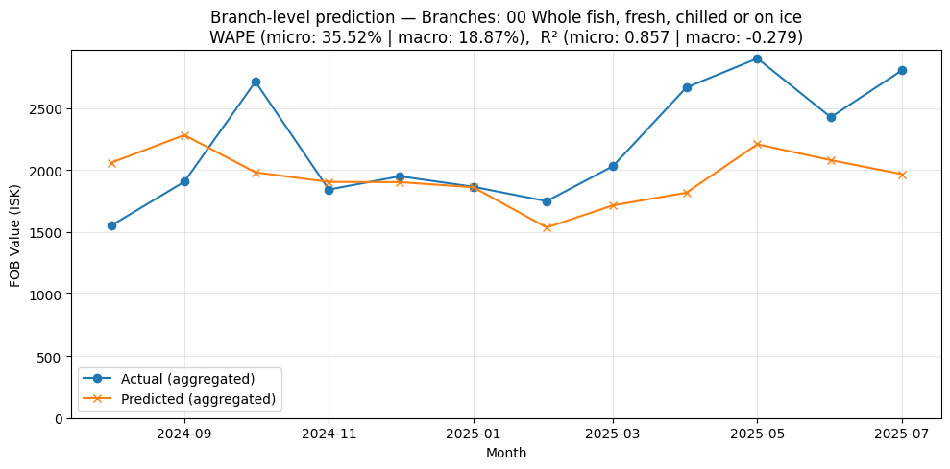
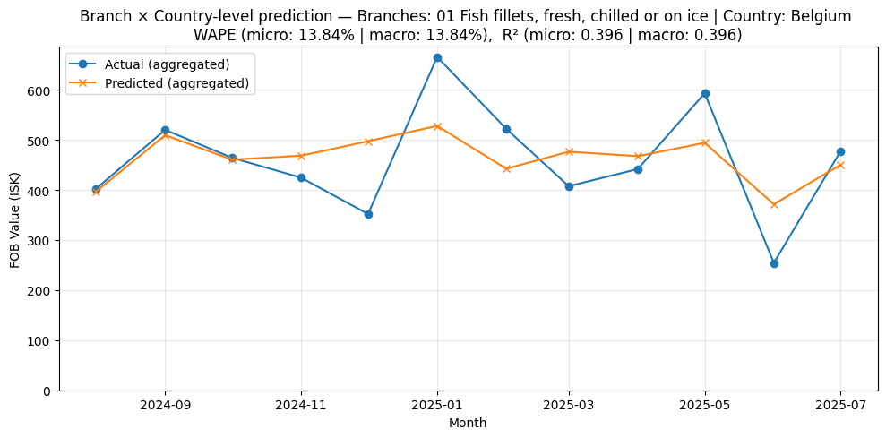

Slide 10
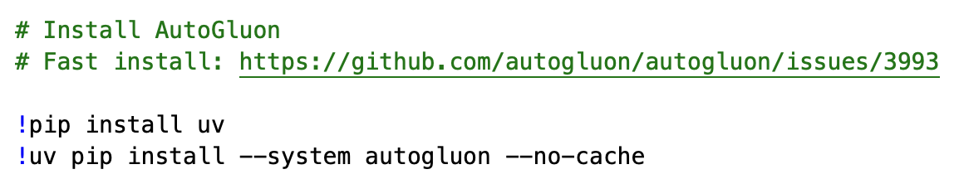
AutoGluon on Google Colab

