Slide 1
The first Icelandic train datathon
Presentation for teams
23.11.2024

Slide 2

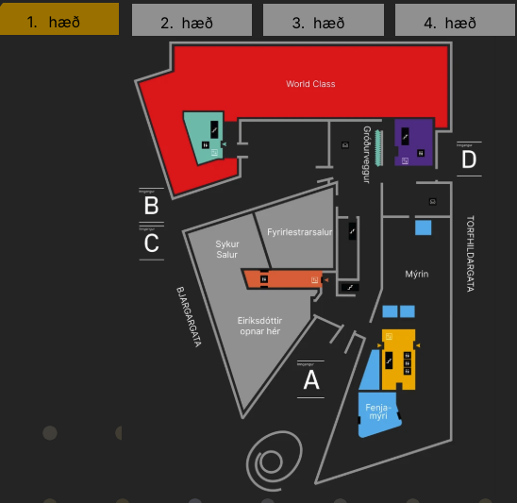
Welcome to the HVDS gagnaþon event
The first gagnaþon of this kind for High Value Dataset in Iceland
Place: Gróska- Fenjamýri
Ground floor, south entrance opposite of the Eiríksdóttir restaurant

Slide 3
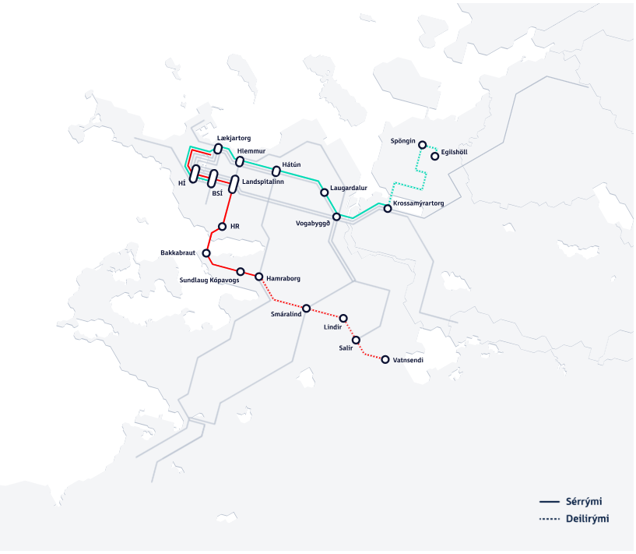
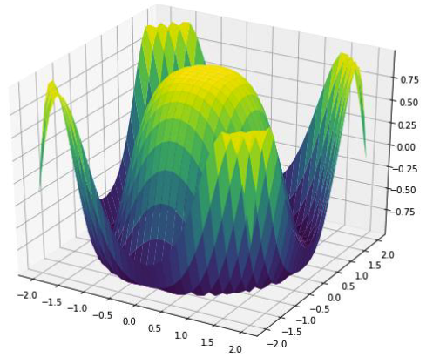
Welcome to the HVDS gagnaþon
Gagnaþon the next two days
The presentation of the gagnaþon result can be done in many ways. As example, it can be good to have a visual representation with some statistics.
The results should from the gagnþon shall focus on the High Value Dataset derived from data interpretation. Specifically aimed at determining the probability of users opting for a particular mode of transport when located within 400 meters of a designated city line stop (Borgarlína stop) shown on the map.
A compelling (not necessary) way to visualize this is by creating a 3D diagram where the x- and y-axes represent distances, with the stop positioned at the center of the coordinate system, 400 meters from the edges. The z-axis would then illustrate the probability of residents within this coordinate range using the city line based on their distance from the stop."

Slide 4
Overview
Today we will present to you
The project of the datathon
The data that can be used
The metadata
What are the criteria that will be used for judging the winners
What will happen to the winners?
A little bit of practical information
The data can be downloaded from Teams and Github
Team chat: Kynning á gagnaþoni fyrir þátttakendur
https://github.com/hIngolfur/hackathon-data
Q&A

Slide 5
The project(1): The city line

Slide 6
The project(2)
How can we use data to inform decisions on where to lay train tracks of the cityline project?
E.g. based on the current situation or a possible future scenario
What is the most suitable way to present such data?
E.g. Maps, dashboard, etc.
Present a working demo of the solution.

Slide 7
The data(1)
Small areas from the Icelandic 2021 censusS
As a GeoJSON file
Coordinates of the City-lane (Borgarlína) train system
As a GeoJSON file
The number of employed individuals
For each small areas
As a csv file
The number of individuals in each income decile
For each small area
As a csv file
The population by gender and age groups
For each small area
As a csv file

Slide 8
The data(1)
Small areas from the Icelandic 2021 census
As a GeoJSON file
Coordinates of the City-lane (Borgarlína) train system
As a GeoJSON file
The number of employed individuals
For each small areas
As a csv file
The number of individuals in each income decile
For each small area
As a csv file
The population by gender and age groups
For each small area
As a csv file

Slide 9
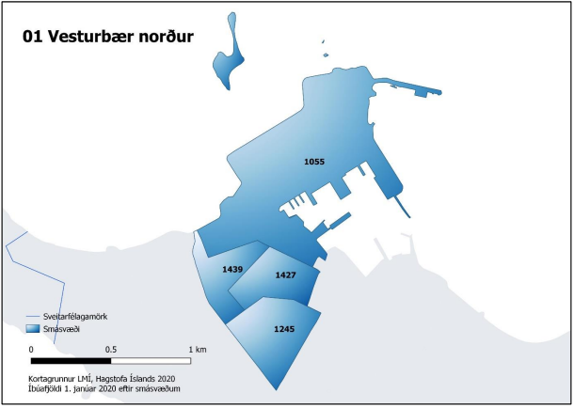
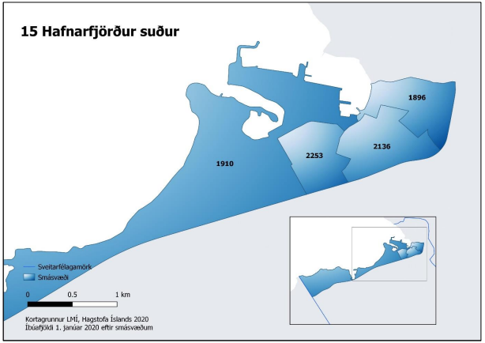
Small areas (two examples)

Slide 10
The data(2)
The number of dwellings
For each small area
As a csv file
The number of construction sites and when the plan is to build on them
For each small area
As a csv file
Any data you find useful on the site of Landmælingar Íslands
https://kort.gis.is/mapview/?app=kort&lang=en

Slide 11
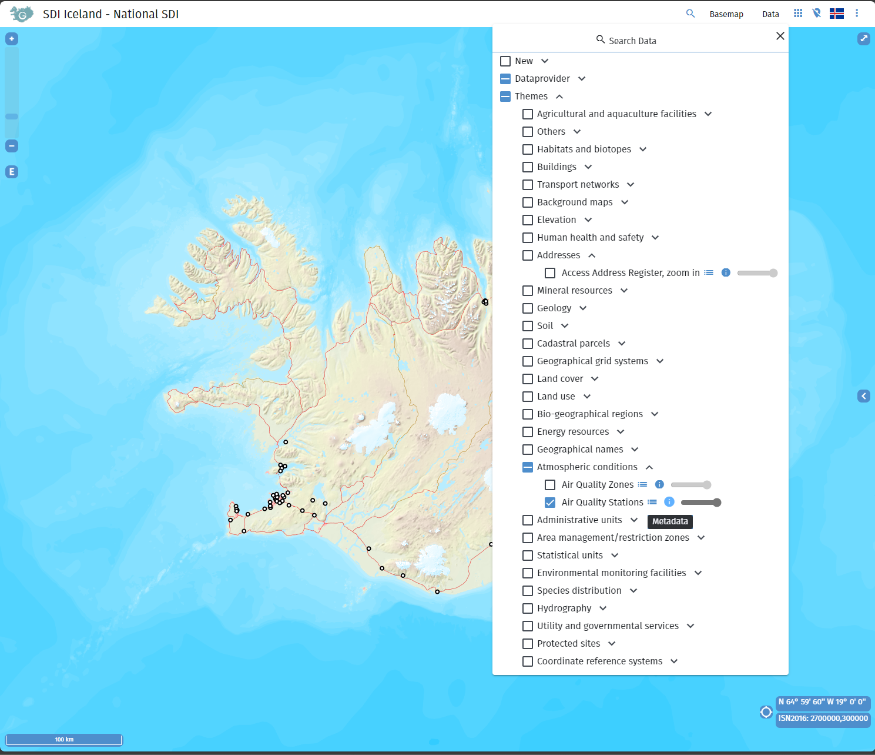
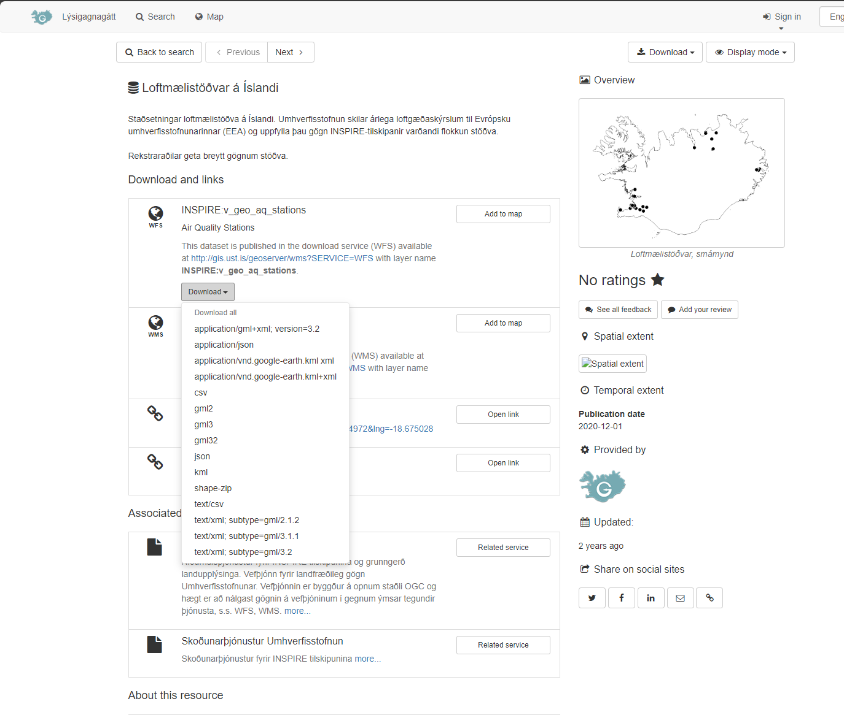
Landmælingar

Slide 12
Metadata
Metadata will be included with all data provided for the datathon
In txt files
Describing the categories of the variables
The coverage of each data file
On the site of Landmælingar, high quality metadata is provided

Slide 13
The criteria
The solutions will be judged on the following:
Functionality (1 - 5)
Look (1 - 5)
Usability (1 - 5)
Clarity (1 - 5)
Ease of putting the solution in regular production (1 - 5)
User relevance (1 - 5)
Lowest possible grade is 6
Highest possible grade is 30

Slide 14
The winning team
Is the team that scores the highest on the criteria of the datathon according to the scores of the judges
Will get a prize
Will present their solution to the Gagnvist conference

Slide 15
Practical information(1)
The datathon will take place in Gróska
The official times of the datathon
Starts on Saturday November 23rd at 9:00
Ends on Sunday November 24th at 20:00
You can spend as much or as little time you want at the site of the datathon.
Presentations for judges will start at 16:00 on Sunday November 24th:
Each team will get 15 minutes for their pitch

Slide 16

Practical information(2)
The Gagnvist conference will take place on November 27th
The winning team will make their presentation for the conference in a timeslot between 10:00 and 11:55.
We will use the teams chat for this meeting to provide further information.
You can also use that for further questions and queries.
My email is anton.o.karlsson@hagstofa.is
That can also be used for questions and clarifications.

Slide 17
Questions, comments?

