Slide 1


HVDS AI Gagnathon 2026
Presentation for teams
28.10.2026

Slide 2

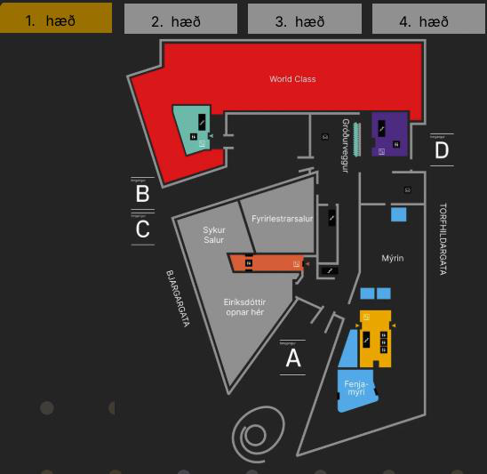





Welcome to Gagnaþon 2026
The third Statistics Iceland AI data hackathon
The challenge
Build a chatbot that makes official statistics easier to find and understand.
The teams
Students, professionals and companies working with open data and AI.
The venue
Gróska · Fenjamýri
Ground-floor south entrance, opposite Eiríksdóttir.
2

Slide 3
Welcome to the HVDS Gagnaþon
Two days to build a statistical assistant
“How has Iceland’s
population changed?”
Turn Statistics Iceland’s open data into a chatbot that people can use in everyday language.
Choose prepared RAG, direct PX-API or HPC-optimised RAG. Build a web interface and connect the backend.
YOUR CHATBOT
Web interface + AI backend
Test real questions and present a working demo with clear answers, figures, units and sources.
1 RAG
2 PX-API
3 HPC
A clear answer
with official sources
3

Slide 4

Today’s programme
1 The challenge
The user experience and three project tracks.
2 Getting started
Code, data, README instructions and computing resources.
3 Your demo
Shared deliverables, testing and draft judging criteria.
4 Practical details
Schedule, support, Gagnvist and questions.
4

Slide 5
From a question to trusted statistics
One chatbot experience. Three ways to find the data.
Population
Prices
Migration
1 Prepared RAG
Search prepared data
AI explains
the results
Ask about
Iceland
2 Direct PX-API
Query official statistics
Figures • Units
Official source
You ask
3 RAG on HPC
A question in
everyday language
Your web chatbot
Optimise data search
You understand
Built on Statistics Iceland’s open data • Every track delivers a working prototype
5

Slide 6

Three tracks, one shared outcome
Choose the route that matches your experience and interests.
TRACK 1
TRACK 2
TRACK 3
Prepared RAG
Direct PX-API
RAG on HPC
Build on a ready-made
local retrieval backend.
Develop direct access to
official statistical tables.
Use HPC for embeddings
and RAG optimisation.
Focus: interface and
integration.
Focus: data selection
and backend logic.
Focus: retrieval quality
and performance.
6

Slide 7

Track 1 · Prepared RAG
The same chatbot goal, with a different development focus.
Starting point
FastAPI, ChromaDB and SQLite, with a local LLM through Ollama.
Team work
Build a web chatbot, connect the backend and test answers. Optionally extend the data using ingest.py.
Files and setup
GitHub code + README. Unzip hagstofa_db.zip beside app.py: chroma_db/ and data.db.
Use the model and collection settings specified in the supplied README.
7

Slide 8

Track 2 · Direct PX-API
The same chatbot goal, with a different development focus.
Starting point
A lightweight FastAPI starter that queries Statistics Iceland’s PX-API directly.
Team work
Extend table selection and API queries. Build the web chatbot and integrate language-model responses.
Files and setup
GitHub code + README. Fetch data and metadata through PX-API; no local vector database is required.
Validate table dimensions, filters, units and sources before generating answers.
8

Slide 9
Track 3 · RAG on HPC
The same chatbot goal, with a different development focus.
Starting point
An additional embedding-based RAG project supplied by the collaborating track provider.
Team work
Use HPC to create or optimise embeddings and retrieval. Connect the results to a web chatbot.
Files and setup
Code, data, HPC access and launch instructions will be provided in the track-specific README.
Provider details are pending. Compare retrieval quality and performance in your demo.
9

Slide 10
Getting started · All tracks
Use the README for your track as the setup reference.
Get the materials
Code and instructions on GitHub. Larger data archives on Google Drive, linked from the README.
Prepare your runtime
Tracks 1–2: Python 3.10+, venv and requirements.txt.
Track 1 also needs its databases and Ollama / Llama 3.
Start and test
Tracks 1–2: uvicorn app:app --reload, then /docs or cURL.
Track 3: follow the provider’s HPC environment and job instructions.
Final repository links and Track 3 access instructions are still to be supplied.
10

Slide 11
Show a working solution · Every track
Use the same demonstration structure so the approaches are easy to compare.
1 Ask and answer
Show a real question in your web UI, the retrieved values and an answer with units and an official source.
2 Explain your route
Track 1: local RAG. Track 2: PX-API table selection.
Track 3: embeddings, retrieval and the role of HPC.
3 Show evidence
Check the answer against the source. Show an ambiguous query, response time and a known limitation.
11

Slide 12

Judging criteria · Draft
Proposed common criteria for all three tracks · Each scored from 1 to 5
Functionality
Correct retrieval and answers
Presentation
Clear, readable interface
Usability
Easy questions and navigation
Clarity
Understandable answers and sources
Deployment
A reproducible, workable solution
User value
A useful statistical use case
Total: 6–30 points. Assess the result and evidence, not the amount of hardware used.
12

Slide 13
Final presentations and the winning solution
Shortlisting and presentation format remain a draft.
Submit
A working prototype and 5–7 slides explaining the use case, approach, results and limitations.
Present
Proposed shortlist: five teams. Each selected team has 10 minutes to demonstrate its solution.
The winner
The highest-scoring team receives a prize and presents its solution at Gagnvist on 26 November.
13

Slide 14
Schedule · 28 October to 1 November
All times are Icelandic local time.
Wed 28 Oct · 16:00
Online introduction for registered teams.
Fri 30 Oct · 15:00
Kickoff and release of project materials and data.
Sat 31 Oct · 08:00
Gróska opens. Saturday access until 22:00.
Sun 1 Nov · 20:00
Team presentations · 10 minutes per team.
Sun 1 Nov · 22:00
Hackathon ends.
14

Slide 15
Support and Gagnvist
During the event
A team chat group will carry announcements and provide a place for questions and clarifications.
Gagnvist · 26 Nov
The winning solution will be presented at the conference. The exact presentation slot will be confirmed.
Contacts
ingolfuh@hi.is sma41@hi.is
thorarnar@hi.is seh@hi.is
Event information: vidburdir.hagstofa.is/datathon2026
15

Slide 16

Questions and next steps
Choose your track
Prepared RAG, direct PX-API or RAG on HPC.
Read and prepare
Follow the track README and check the code, data and compute access before you start.
Build and demonstrate
A usable chatbot with clear answers supported by Statistics Iceland’s official data.
16

Slide 17
Presentation of tracks and Q&A
Presetation of Track 3, Track 2 and Track 1
17

