Slide 1
Data 8, Lab 1
Hubert Luo
Spring 2020
24 January 2020

Slide 2
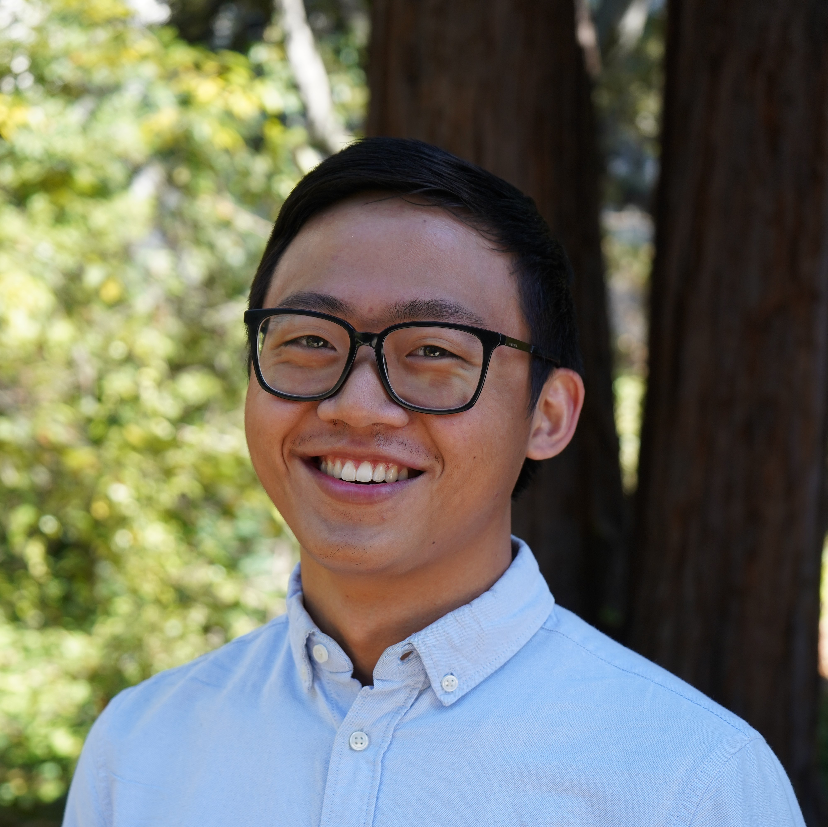
I’m a senior from Toronto, Canada studying stats and applied math. This is my fourth semester on Data 8 staff, as well as my eighth and final semester teaching at Cal.
Email: hubertluo@berkeley.edu
Lab Website: https://hluo27.github.io/data8
Lab: Friday 12-2pm in Evans 458
Office Hours: Every Weekday from 12-5pm

Slide 3
Lab Overview
Typical format of lab sections:
Worksheet
Written practice problems we will go over in lab
Useful to review problems in a written format since the exams will be written on paper as well
Lab Notebook
Review concepts by applying them to actual data
Attendance for entire lab section needed to get checked off for lab notebook
Usually we’ll have 3 lab assistants – they’ll join us next week!

Slide 4
Lab Policies
Students can only attend the lab they are enrolled in
Lab assignments released on Monday. Two ways to get credit:
1. Attend entire lab section and make substantial progress
2. Finish and pass all autograder tests by Wednesday at 8:59 AM
Waitlisted Students
Enrolled once there is an open seat in lecture + lab section
Course staff do not know what position students are at on the waitlist and have no control over it

Slide 5
Course Policies
Weekly homework and weekly labs can't be turned in late
No alternate midterm or final exam
DSP students must ask their DSP advisor to submit a letter through SCARAB for DSP accommodations
See http://data8.org/sp20/policies.html for more details

Slide 6
Grading Logistics
Each student should have Gradescope and Okpy accounts
Let me know if you don’t have an account on either yet!
Okpy
All labs, homework, and projects will be submitted to Okpy
Code is auto-graded and marks posted on Okpy
Gradescope
Written answers on homework/project assignments and exams are graded by course staff on Gradescope

Slide 7
Introductions
Form groups of 3-4 and find something all of you have in common!
Example: During a previous semester, a group of 4 all had a family relative with the same name!

Slide 8
Discussion Worksheet
Introduce yourself to the people sitting around you and work as a table
Don’t use online resources!

Slide 9
Discussion: Solutions
50 (Actual average size is 48.2)
Cog Sci (343), Applied Math (314), Sociology (313), English (282), and Integrative Biology (255)
Hawaii (81.3) and California (80.9)
America: 78, World: 72

Slide 10
Post-Discussion Review
Numerical data needed to answer the four questions earlier
Some questions can be answered without error
Example: the two Berkeley questions are based on complete information
Many questions cannot be answered without error because we have incomplete information
Example: the two LEB questions since we don’t know exactly how long everyone is going to live but we need estimates based on assumptions

Slide 11
Post-Discussion Review
There is always uncertainty around our estimates. How can we quantify it?
Example: Article about life expectancy in California only gives one number (80.9) but actual estimate is an interval (71.9 to 81.9)
Uncertainty means we need some wiggle room for the estimates
Other states could potentially have a higher estimate! Range for Connecticut is 79.7-81.8
The world is fuzzy so we have to be able to quantify our uncertainties – we have to interpret data carefully.

Slide 12
Class Survey
Please fill out this form before starting the lab notebook:
http://tinyurl.com/data8-hubert

