Slide 1
Data 8, Lab 7
A/B Testing
Hubert Luo
Spring 2020
20 March 2020

Slide 2
Why A/B Testing?
Used to test if two observed distributions (sets of values) are from the same underlying distribution
Example:
Distribution 1: Weights of babies of moms who smoke
Distribution 2: Weights of babies of moms who do not smoke
Question: Are these distributions from the same underlying distribution?
An A/B test is an example of a permutation test!

Slide 3
A/B Testing Hypothesis
Null Hypothesis: The two distributions are from the same underlying distribution, and any differences are due to chance
Example: The distribution of birth weights of babies is the same for mothers who don't smoke as for mothers who do. The difference in the sample is due to chance.
Alternative Hypothesis: The two distributions are not from the same underlying distribution, and any differences are not due to chance
Example: The babies of the mothers who smoke have a lower birth weight, on average, than the babies of the non-smokers

Slide 4
A/B Test Statistic
Main Idea: Get two representations of two distributions and find the difference between them
Example:
Difference between the average weights of smoking and non-smoking babies
Under the null hypothesis, there should be no difference between the two distributions

Slide 5
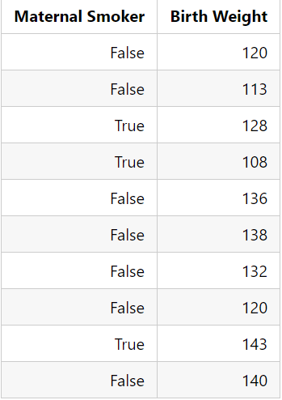
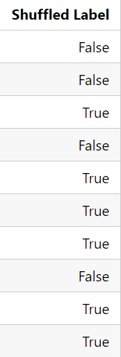
A/B Testing: Shuffle Labels
Shuffle the labels of the table: if the data are from the same distributions, rearranging the labels won’t matter!

Slide 6
A/B Testing: Shuffle Labels (Cont’d)
How do we shuffle?
Sample the original labels of the table without replacement
Example: If the table has 500 rows, sample 500 labels without replacement
Why without replacement?
This is so we keep the same proportions of labels each time!
Command: tbl.sample(n, with_replacement = False)
Need to specify without replacement!! With replacement is True by default

Slide 7
A/B Testing: Conclusions
The rest of the procedure is similar to other hypothesis tests
For a large number of iterations:
Shuffle the labels of the data (assuming the null is true)
Get the test statistic from the shuffled data
Store the test statistic
Compare the observed test statistic with all the simulated test statistic
P-value is the proportion of simulated test statistics equal to the observed test statistic or further in the direction of the alternative, assuming the null hypothesis is true

Slide 8
A/B Testing vs. TVD
A/B Testing: Test whether two samples of data come from the same/different distribution
TVD: Compute distance between two different samples from the same distribution

Slide 9
Announcements
Fill out the partner form for Project 2. Regardless of whether or not you are working alone, please fill it out by Friday March, 20th at 11:59PM so I know who you are working with
Midterm scores and mid-semester grade reports are out
Regrade requests due Tuesday, March 24 at 11:59PM
HW8 is due 4/2 (bonus point for early submission by 4/1)
Question 3.10 on Lab 7 has been updated so the tests are less strict

