Slide 1
Data 8, Lab 6
Testing Hypotheses
Hubert Luo
Fall 2019
11 October 2019

Slide 2
Agenda
Null/Alternative Hypotheses
Test Statistics
Multiple Categories
Simulations
P-Values
Decision-Making
Examples

Slide 3
Assessing a Model
Identifying a model (a set of assumptions)
Example: Jury panel selected at random from the population
Choose a statistic to measure discrepancy between model and data
Example: Number of black men selected for jury panel
Simulate statistic under the model
Compare observed statistic with the distribution of simulated statistics

Slide 4
Null Hypothesis
Goal is to prove a model does not fit the observed data
We call this model we are trying to disprove the null hypothesis
Should be clearly defined from the problem!
The null hypothesis typically says some observed value was due to random chance alone
Example: Jury panel selected at random; the observed number of black males on the panel was due to random chance alone
By disproving the null hypothesis, we demonstrate that there is something other than random chance affecting what we observe

Slide 5
Alternative Hypothesis
An alternative model for the data
Based on what you observed: was it something weird or unexpected if the null hypothesis was true?
Example: Jury panel was not selected at random
Both high and low number of Black jurors relative to the population would have supported this alternative hypothesis
Example: Jury panel was biased against Black jurors
Only low number of Black jurors relative to the population would have supported this alternative hypothesis

Slide 6
Test Statistic
Measures the discrepancy between a model and the data
Depends on the Alternative Hypothesis:
Example: (AH) Jury panel was not selected at random
| % eligible Black jurors in population - % Black jurors on panel |
Example: (AH) Jury panel was biased against Black jurors
% Black jurors on panel
Ask: What values of the statistic will support the alternative?
Ideally should be in just statistics in one direction

Slide 7
Multiple Categories
To assess models about multiple categories
Example: We want to look at the ethnic composition of jury panels for all groups instead of just one
New test statistic for multiple categories: Total Variation Distance
Find differences between theoretical and empirical proportions for each category
Take the absolute value of each difference
Sum these absolute differences and divide by 2

Slide 8
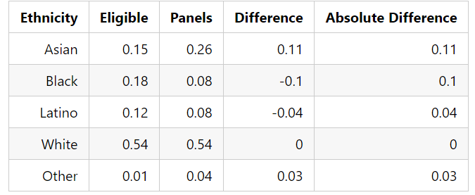
TVD (cont’d)

Slide 9
Simulation: Sample Proportions
The sample_proportions function takes in two arguments:
Sample size
Theoretical probabilities of each category
Returns array consisting of the empirical probabilities of each category
Simulates drawing a sample of specified size with replacement
Common Mistake: Don’t forget the theoretical probabilities have to sum to 1, and the empirical probabilities also have to sum to 1

Slide 10
Sample Proportions Examples
Flip a fair coin 15 times
sample_proportions(15, make_array(0.5,0.5))
Hypothetically, suppose you get 10 heads and 5 tails: the output is an array [10/15, 5/15]
Roll a fair die 30 times
sample_proportions(30, make_array(1/6,1/6,1/6,1/6,1/6,.1/6))
Hypothetically, suppose you get five 1’s, seven 2’s, four 3’s, six 5’s, and eight 6’s: the output is an array [5/30, 7/30, 4/30, 6/30, 8/30]

Slide 11
P-Value
The P-value is the chance,
under the null hypothesis,
that the test statistic is equal to the value that was observed in the data
or is even further in the direction of the alternative.
Each one of these bullet points is necessary! Without it, this would not be the p-value so the full definition is important

Slide 12
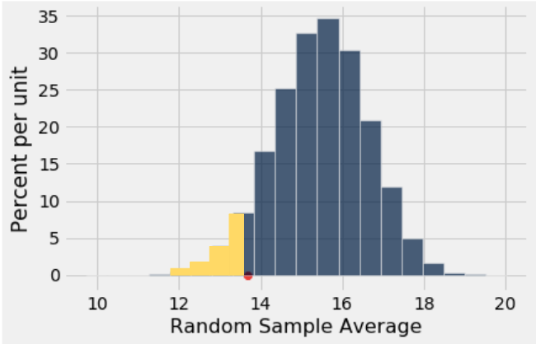
P-Value (cont’d)

Slide 13
Making a Decision
Compare the observed test statistic with the simulated test statistics to make a decision on whether or not to reject the null
Traditionally people use a p-value cutoff of 5%
Any p-value less than or equal to 5% is treated as “statistically significant”
If less than the cutoff, the null hypothesis is inconsistent with the data and we reject the null
Otherwise, we “fail to reject the null”

Slide 14
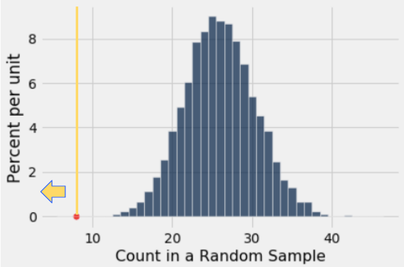
Example: Swain v. Alabama
Null: Jury panel drawn at random
Alternative: Too few Black jurors
Statistic: Number of black jurors on panel
P-Value: Area at or to the left of the observed value (yellow line)
Result: Test favours alternative

Slide 15
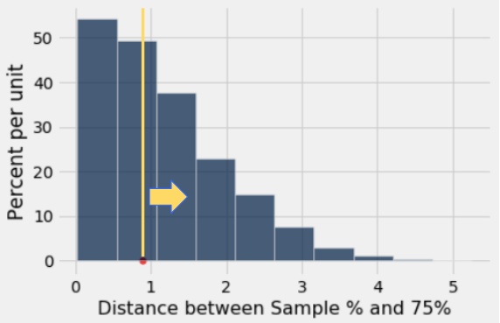
Example: Mendel’s Peas
Null: Each pea plant has 75% chance of being purple flowering
Alternative: Pea plant does not have 75% chance of being purple flowering
Statistic: | % purple flowering peas in sample – 75 |
P-Value: Area at or to the right of the observed value (yellow line)
Result: Test favours null

Slide 16
Error Probabilities
The p-value cutoff is also the probability of a Type I Error
It is the probability of rejecting the null even when the null is true
Example: Using a p-value cutoff of 5%, there is a 5% chance of rejecting the null even when the null is true

Slide 17
Announcements
Next week is midterm review! Please go to a lab on Wednesday or Thursday to work on the problems
Lab next Friday will just be Office Hours
Refer to your email for list of Resources!

